Slide 1
The Power of Preprocessing: Gems in Kernelization
Bart M. P. Jansen
Aachen-Bonn-Cologne Workshop
December 13th 2016, Bonn, Germany

Slide 2
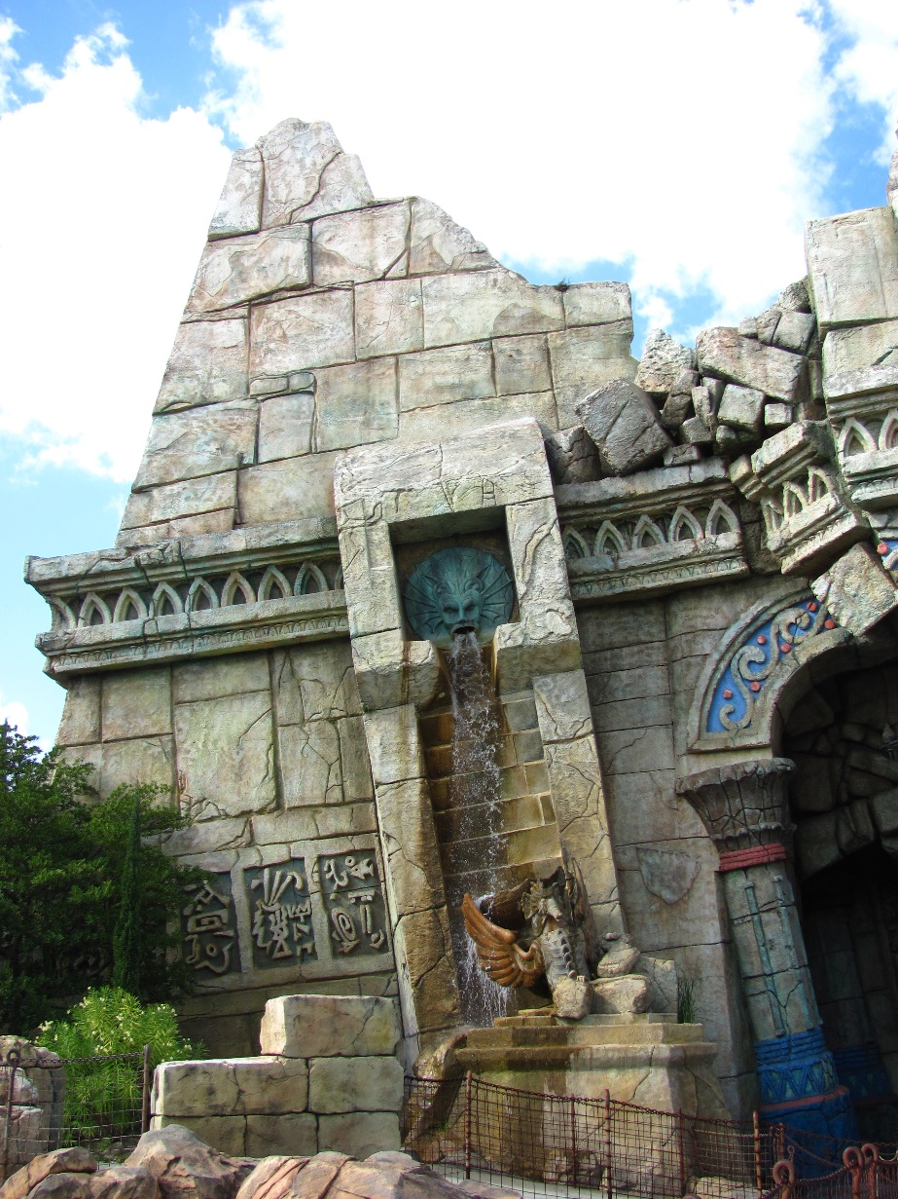
The lost continent of polynomial time

Slide 3
The lost continent of polynomial time
1970’s: Discovery of NP-completeness
Many problems (probably) cannot be solved in poly-time
1980’s: Work on theory of approximation algorithms
Output a solution that is provably not very bad
1990’s: Early results on parameterized complexity
2000’s: Discovery of the lost continent of polynomial time
Polynomial-time algorithms that attack NP-hard problems
Work to optimal solutions, but fall short of finding them
The lost continent of polynomial time contains: provably effective and efficient preprocessing algorithms
that reduce the sizes of NP-hard inputs
(without changing the answer)

Slide 4
Provable preprocessing
What does provably effective and provably efficient mean?
Efficient: preprocessing runs in polynomial time
Effective: shrinks the input without changing the answer
How to guarantee an effective preprocessing algorithm?
$n$ bits
$n−1$ bits
$$x$$
$poly(n)$ time
$$x′$$
$x′$ has same answer as $x$
$n−2$ bits
$$⋯$$
$1$ bit
$$x′′$$
$$x^{∗}$$
$n⋅poly(n)$time

Slide 5
Provable preprocessing
What does provably effective and provably efficient mean?
Efficient: preprocessing runs in polynomial time
Effective: shrinks the input without changing the answer
How to guarantee an effective preprocessing algorithm?
If $P≠NP$, no NP-hard problem has a poly-time preprocessing algorithm that shrinks the input by 1 bit
The viewpoint of parameterized complexity helps
$n$ bits
$$x$$
$$k$$

Slide 6
Parameterized problems
We focus on decision problems (yes/no questions)
optimization: “Find the shortest path from $x$ to $y$”
decision: “Is there a path from $x$ to $y$ of length at most $k$?”
Captures the key algorithmic issues in a clean theory
A parameterized problem is a decision problem where we associate an integer parameter $k$ to each instance $x$
Give preprocessing guarantee in terms of parameter $k$
Notes:
The parameter measures the difficulty of the instance in some way.

Slide 7
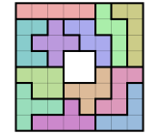
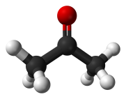
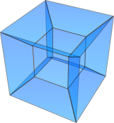
Problem parameterizations
By solution size
$k$-Vertex Cover
𝑘-Vertex Cover
$k$-Feedback Vertex Set
𝑘-Feedback Vertex Set
By instance structure
Tree-likeness of the input graph
By dimension of the input
Linear programs in $k$ dimensions
Linear programs in 𝑘 dimensions
$k$-Edge Clique Cover
𝑘-Edge Clique Cover
Vertex cover size of the input graph
Separate points in $k$ dimensions by hyperplanes
Separate points in 𝑘 dimensions by hyperplanes
Many different ways to parameterize the same problem

Slide 8
Kernelization: data reduction with a guarantee
A kernelization for a parameterized problem $𝒫$ is:
an algorithm that transforms inputs $(x,k)$ into $(x^{′},k^{′})$
in $poly(\left|x\right|,k)$ time
such that $(x,k)$ has answer yes iff $(x^{′},k^{′})$ has answer yes
and $\left|x^{′}\right|≤f(k)$ and $k^{′}≤f(k)$
The function $f:ℕ→ℕ$ is the size of the kernelization
Can be exponential or polynomial; smaller is better
A kernelization guarantees that instances that are large with respect to their complexity parameter can be shrunk
$n$ bits
$f(k)$ bits
$$x$$
$poly(\left|x\right|,k)$ time
$$x′$$
$$k$$
$$k′$$

Slide 9
Gems in kernelization
Edge Clique Cover

Slide 10
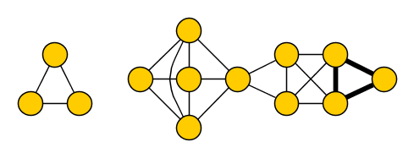
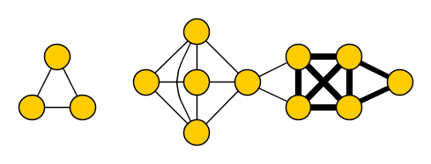
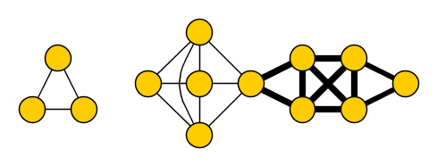
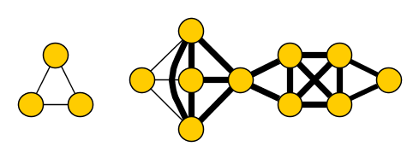
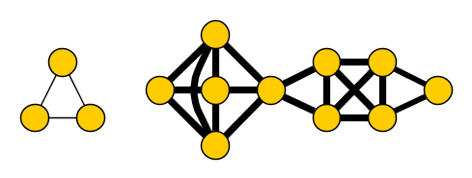
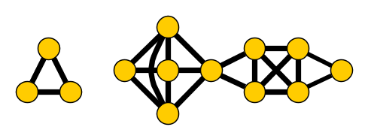
Edge Clique Cover
Input: An undirected graph $G$ and an integer $k$ Parameter: $k$ Question: Do there exist $k$ cliques $C_{1},…, C_{k}$ in $G$, such that for each $\left\{u,v\right\}∈E(G)$ there is a clique $C_{i}⊇\{u,v\}$?
Vertices are allowed to belong to more than one clique
The edge set of $G$ can be covered by $k$ cliques (is their union)
Notion of cover is different than for Vertex Cover!
yes for $k=6$
Notes:
NP-complete, has applications in finding the smallest representation of the graph as the intersection graph of a system of subsets of a size-k universe.

Slide 11
Reduction rules for Edge Clique Cover
(R1) If $v$ is an isolated vertex, then remove $v$
(R2) If $C$ is a connected component that forms a clique, then remove $C$ and decrease $k$ by one
(R3) If $N\left[u\right]=N[v]$, then remove $u$ ($k$ does not change)

Slide 12
Reduction rules for Edge Clique Cover
Claim. If $N\left[u\right]=N[v]$ and (R2) does not apply, then:
$(G,k)$ is yes $⇔$ ($G−\left\{u\right\},k)$ is yes
($⇒$) If $C_{1},…, C_{k}$ is a solution in $G$, then $C_{1}−\left\{u\right\},…, C_{k}−\{u\}$ is a solution in $G−\{u\}$
(R1) If $v$ is an isolated vertex, then remove $v$
(R2) If $C$ is a connected component that forms a clique, then remove $C$ and decrease $k$ by one
(R3) If $N\left[u\right]=N[v]$, then remove $u$ ($k$ does not change)

Slide 13
Reduction rules for Edge Clique Cover
Claim. If $N\left[u\right]=N[v]$ and (R2) does not apply, then:
$(G,k)$ is yes $⇔$ ($G−\left\{u\right\},k)$ is yes
($⇐$) If $C_{1},…, C_{k}$ is a solution in $G−\{u\}$, then $v$ appears in some clique $C_{i}$
Add $u$ to each clique $C_{i}$ in which $v$ appears (covers edge $\{u,v\}$)
$∀\left\{u,w\right\}∈E(G)$, edge $\{v,w\}$ is covered by some $C_{i}$, so $C_{i}∪\{u\}$ covers edge $\{u,w\}$
(R1) If $v$ is an isolated vertex, then remove $v$
(R2) If $C$ is a connected component that forms a clique, then remove $C$ and decrease $k$ by one
(R3) If $N\left[u\right]=N[v]$, then remove $u$ ($k$ does not change)

Slide 14
Reduction rules for Edge Clique Cover
(R1) If $v$ is an isolated vertex, then remove $v$
(R2) If $C$ is a connected component that forms a clique, then remove $C$ and decrease $k$ by one
(R3) If $N\left[u\right]=N[v]$, then remove $u$ ($k$ does not change)

Slide 15
Effectiveness of reduction rules
Lemma. If $(G,k)$ is a yes-instance that cannot be reduced by (R1)-(R3), then: $\left|V\left(G\right)\right|<2^{k}$
Proof. Fix a solution $C_{1},…, C_{k}$ and assign a bitvector to each vertex
$$vec\left(v\right)≔(v\begin{matrix}? \\ ∈ \\ \end{matrix}C_{1},v\begin{matrix}? \\ ∈ \\ \end{matrix}C_{2},…, v\begin{matrix}? \\ ∈ \\ \end{matrix}C_{k})$$
Notes:
N[u] = vertices occurring in a clique with u = vertices occurring in a clique with v = N[v]

Slide 16
Effectiveness of reduction rules
Lemma. If $(G,k)$ is a yes-instance that cannot be reduced by (R1)-(R3), then: $\left|V\left(G\right)\right|<2^{k}$
Proof. Fix a solution $C_{1},…, C_{k}$ and assign a vector to each vertex
$$vec\left(v\right)≔(0,1,1, 0,0,0)\begin{matrix} \\ \\ \end{matrix}$$
Notes:
N[u] = vertices occurring in a clique with u = vertices occurring in a clique with v = N[v]

Slide 17
Effectiveness of reduction rules
Lemma. If $(G,k)$ is a yes-instance that cannot be reduced by (R1)-(R3), then: $\left|V\left(G\right)\right|<2^{k}$
Proof. If $vec\left(v\right)=000…000$: then $v$ is isolated, (R1) applies
If $vec\left(v\right)=vec(u)$: then $N\left[u\right]=N[v]$ and (R2/3) applies
So $\left|V\left(G\right)\right|<$ $|\{$bitvectors of length $k\}|$ = $2^{k}$
Notes:
N[u] = vertices occurring in a clique with u = vertices occurring in a clique with v = N[v]

Slide 18
Complete kernelization for Edge Clique Cover
Consider input $(G,k)$
Exhaustively apply (R1)-(R3) to obtain $(G^{′},k^{′})$
if $\left|V\left(G^{′}\right)\right|≥2^{k^{′}}$
then output “$G$ has no solution of size $k$”
else output $(G^{′},k^{′})$ with less than $2^{k^{′}}$ vertices
This kernelization is essentially the best known
[Gramm, Guo, Hüffner and Niedermeier, ACM Exper. Alg. 08]
No kernel of bitsize $2^{o\left(k\right)}$ unless P=NP
[Cygan, Pilipczuk, Pilipczuk, SICOMP’16]

Slide 19
Gems in kernelization
Edge Clique Cover
Feedback Vertex Set

Slide 20
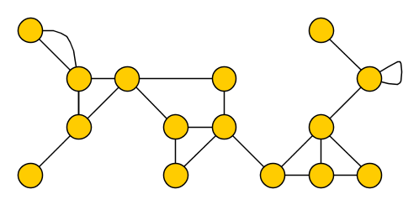
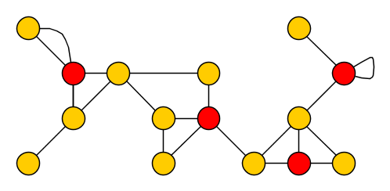
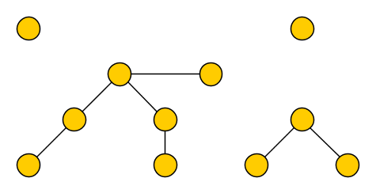
Feedback Vertex Set
Input: An undirected (multi)graph $G$ and an integer $k$ Parameter: $k$ Question: Is there a set $S$ of at most $k$ vertices in $G$, such that each cycle contains a vertex of $S$?
We allow parallel edges and self-loops
Such a set $S$ is a feedback vertex set of $G$
Removing $S$ from $G$ results in an acyclic graph, a forest

Slide 21
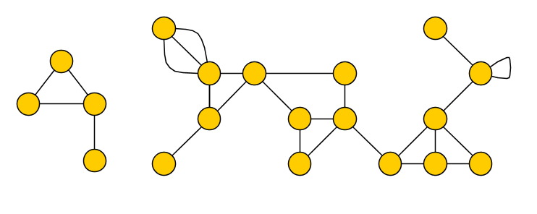
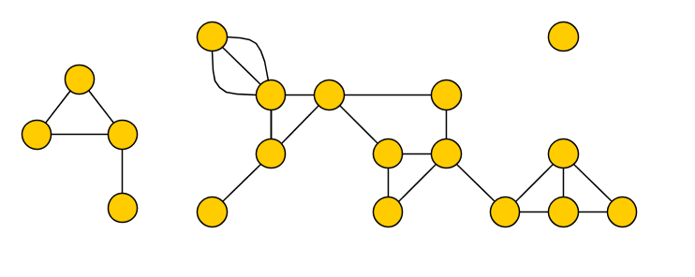
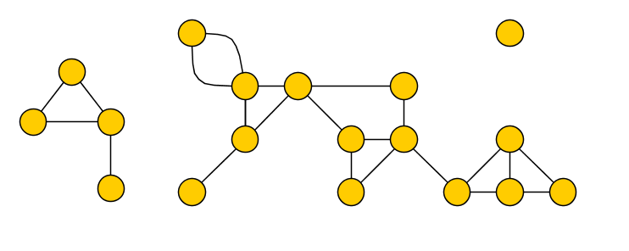
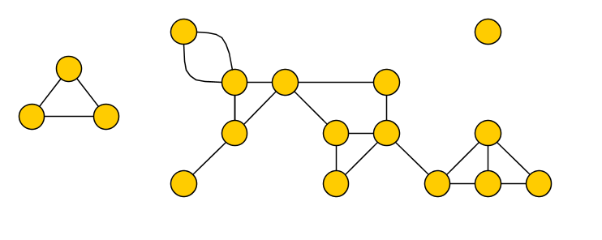
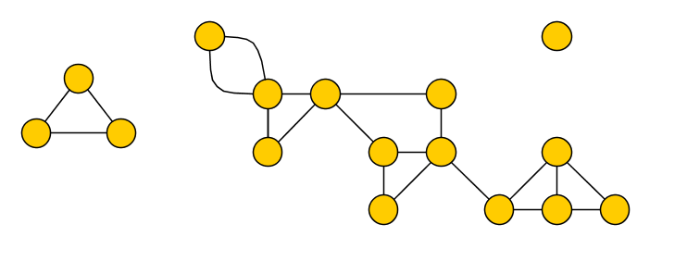
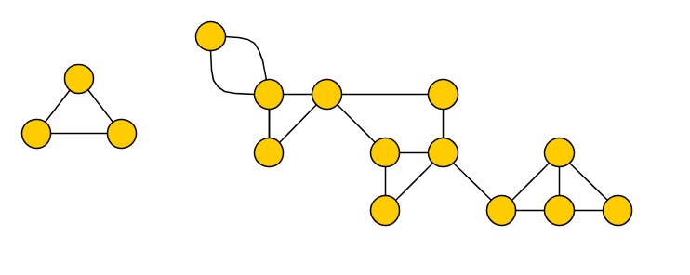
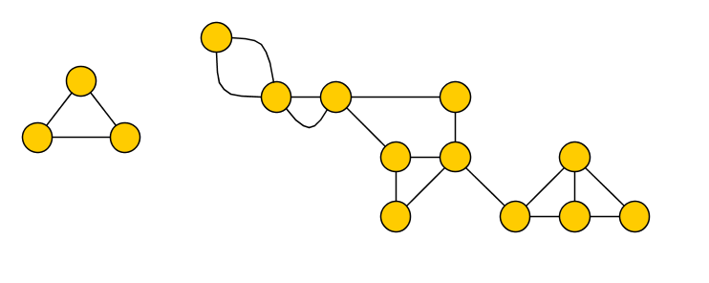
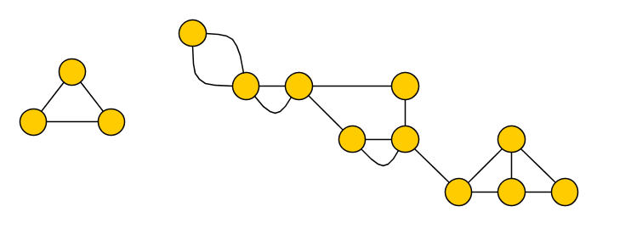
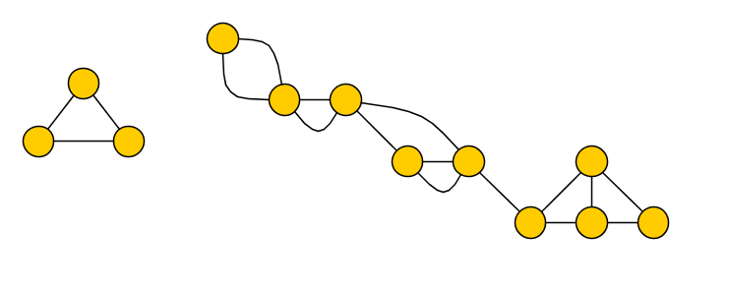
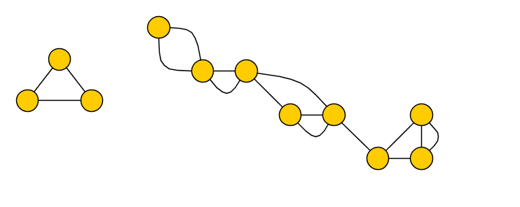
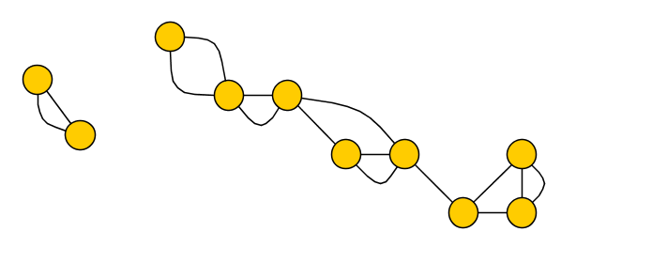
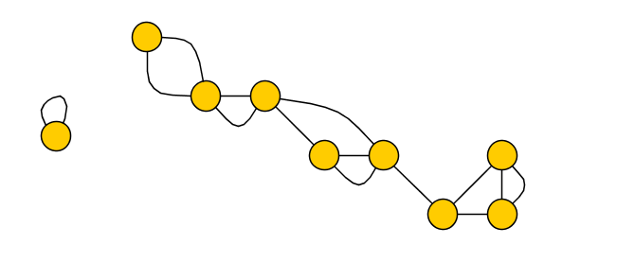
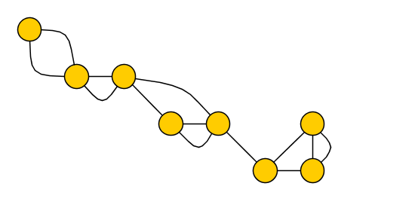
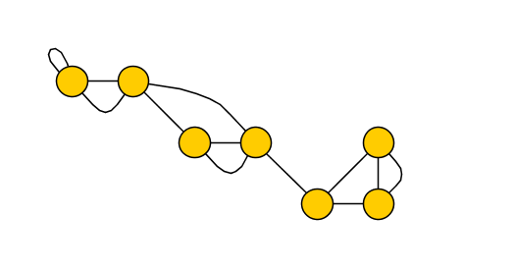
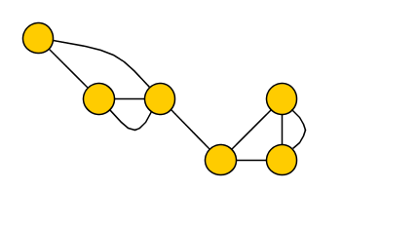
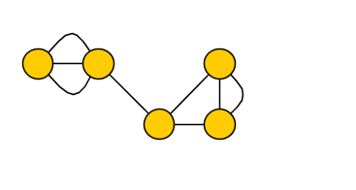
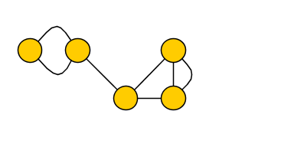
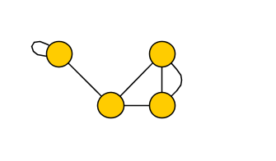
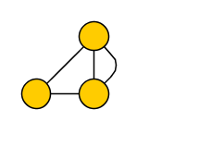
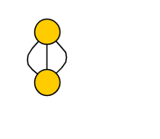
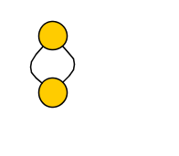
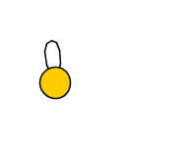
Simple reduction rules
(R1) If there is a loop at vertex $v$, then delete $v$ and decrease $k$ by one
(R2) If there is an edge of multiplicity larger than two, then reduce its multiplicity to two
(R3) If there is a vertex $v$ of degree at most one, then delete $v$
(R4) If there is a vertex $v$ of degree two, then delete $v$ and add an edge between $v$’s neighbors
If (R1-R4) cannot be applied anymore, then there are no loops and each vertex has degree at least three

Slide 22
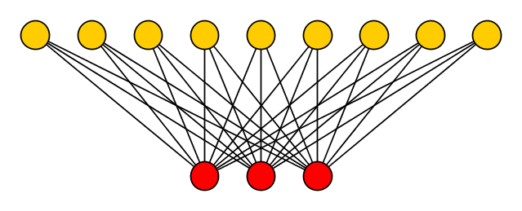
Are we done already?
Given rules are not enough to reduce input to size $f(k)$
Template for large irreducible instances:
$$⋯$$
$$⋯$$
Graph is large but feedback vertex set is small
High-degree vertices in FVS are the (only) problem

Slide 23
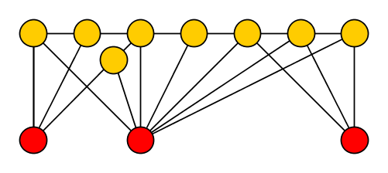
The degree-sum of feedback vertex sets
Lemma. Let $X$ be a FVS in $G$ such that $\deg_{G}{(v)}≥3$ for all $v∉X$. Then:
$$\left|V\left(G\right)\right|≤\left|X\right|+\sum_{v∈X}{\deg_{G}⁡(v)}$$
Proof. Consider forest $F≔G−X$, split vertices into $V_{≤1}, V_{2},V_{≥3}$ by $F$-degree
Notes:
Q: State the lemma when G – X has degree >= 3?

Slide 24
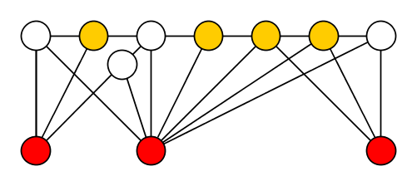
The degree-sum of feedback vertex sets
Lemma. Let $X$ be a FVS in $G$ such that $\deg_{G}{(v)}≥3$ for all $v∉X$. Then:
$$\left|V\left(G\right)\right|≤\left|X\right|+\sum_{v∈X}{\deg_{G}⁡⁡(v)}$$
Proof. Consider forest $F≔G−X$, split vertices into $V_{≤1}, V_{2},V_{≥3}$ by $F$-degree
Each ${v∈V}_{2}$ has at least one edge to $X$, since $\deg_{G}\left(v\right)≥3$
$$\sum_{v∈X}{\deg\left(v\right)≥\left|V_{2}\right|+2\left|V_{≥1}\right|≥\left|V_{2}\right|+\left|V_{≥1}\right|+\left|V_{≥3}\right|=|V\left(F\right)|}$$

Slide 25
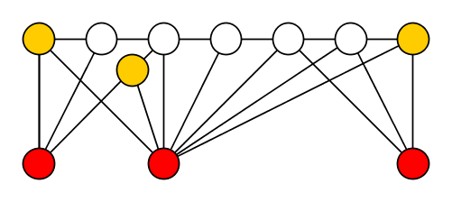
The degree-sum of feedback vertex sets
Lemma. Let $X$ be a FVS in $G$ such that $\deg_{G}{(v)}≥3$ for all $v∉X$. Then:
$$\left|V\left(G\right)\right|≤\left|X\right|+\sum_{v∈X}{\deg_{G}⁡⁡(v)}$$
Proof. Consider forest $F≔G−X$, split vertices into $V_{≤1}, V_{2},V_{≥3}$ by $F$-degree
Each ${v∈V}_{≤1}$ has at least two edges to $X$, since $\deg_{G}\left(v\right)≥3$
$$\sum_{v∈X}{\deg\left(v\right)≥\left|V_{2}\right|+2\left|V_{≥1}\right|≥\left|V_{2}\right|+\left|V_{≥1}\right|+\left|V_{≥3}\right|=|V\left(F\right)|}$$
$$\sum_{v∈X}{\deg\left(v\right)≥\left|V_{2}\right|+2\left|V_{≤1}\right|≥\left|V_{2}\right|+\left|V_{≥1}\right|+\left|V_{≥3}\right|=|V\left(F\right)|}$$

Slide 26
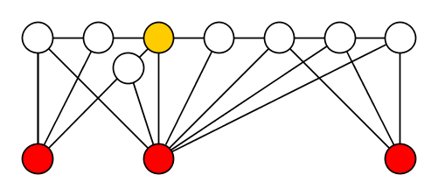
The degree-sum of feedback vertex sets
Lemma. Let $X$ be a FVS in $G$ such that $\deg_{G}{(v)}≥3$ for all $v∉X$. Then:
$$\left|V\left(G\right)\right|≤\left|X\right|+\sum_{v∈X}{\deg_{G}⁡⁡(v)}$$
Proof. Consider forest $F≔G−X$, split vertices into $V_{≤1}, V_{2},V_{≥3}$ by $F$-degree
Each ${v∈V}_{≥3}$ forces another leaf in the forest, so $\left|V_{≤1}\right|≥|V_{≥3}|$
$$\sum_{v∈X}{\deg\left(v\right)≥\left|V_{2}\right|+2\left|V_{≤1}\right|≥\left|V_{2}\right|+\left|V_{≥1}\right|+\left|V_{≥3}\right|=|V\left(F\right)|}$$
$$\sum_{v∈X}{\deg\left(v\right)≥\left|V_{2}\right|+2\left|V_{≤1}\right|≥\left|V_{2}\right|+\left|V_{≤1}\right|+\left|V_{≥3}\right|=|V\left(F\right)|}$$

Slide 27
The degree-sum of feedback vertex sets
Lemma. Let $X$ be a FVS in $G$ such that $\deg_{G}{(v)}≥3$ for all $v∉X$. Then:
$$\left|V\left(G\right)\right|≤\left|X\right|+\sum_{v∈X}{\deg_{G}⁡⁡(v)}$$
Proof. Consider forest $F≔G−X$, split vertices into $V_{≤1}, V_{2},V_{≥3}$ by $F$-degree
Since $\left|V\left(G\right)\right|=\left|X\right|+\left|V\left(F\right)\right|$, this completes the proof
$$\sum_{v∈X}{\deg\left(v\right)≥\left|V_{2}\right|+2\left|V_{≥1}\right|≥\left|V_{2}\right|+\left|V_{≥1}\right|+\left|V_{≥3}\right|=|V\left(F\right)|}$$

Slide 28
The degree-sum of feedback vertex sets
Lemma. Let $X$ be a FVS in $G$ such that $\deg_{G}{(v)}≥3$ for all $v∉X$. Then:
$$\left|V\left(G\right)\right|≤\left|X\right|+\sum_{v∈X}{\deg_{G}⁡⁡(v)}$$
Lemma with (R1)-(R4) to achieve degree $≥3$, suggest:
Shrink the instance by reducing degree-sum of a FVS to $poly(k)$
Which FVS to use for this purpose?
Finding a minimum FVS is hard
… but a 4-approximation can be found in linear time [Bar-Yehuda et al. SICOMP’02]
We target the degree-sum of a 4-approximate FVS

Slide 29
Exploiting the approximation algorithm
The 4-approximation works for a more general problem:
Find a smallest feedback vertex set without given vertex $v$
We utilize this in a win/win approach
Compute 4-approximate FVS called $X$
If $\left|X\right|>4k$, no solution of size $k$ exists, output no
For each $v∈X$, compute 4-approximate FVS $Y_{v}$ without $v$
If $\left|Y_{v}\right|>4k$: no solution of size $k$ without $v$ exists
Delete $v$, decrease $k$ by one
If $\left|Y_{v}\right|≤4k$: we use $Y_{v}$ to reduce $deg⁡(v)$

Slide 30
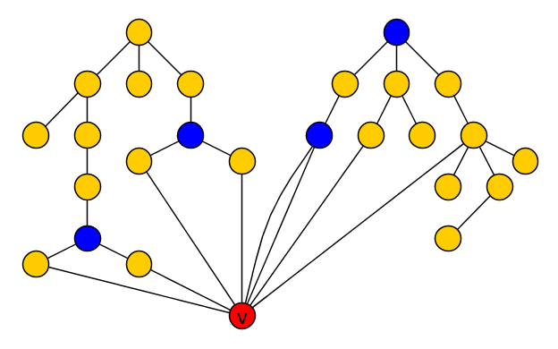
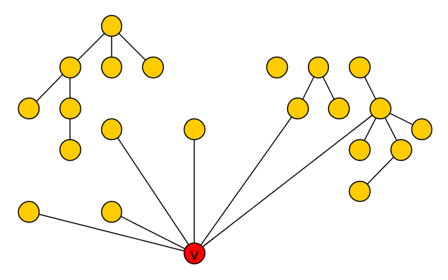
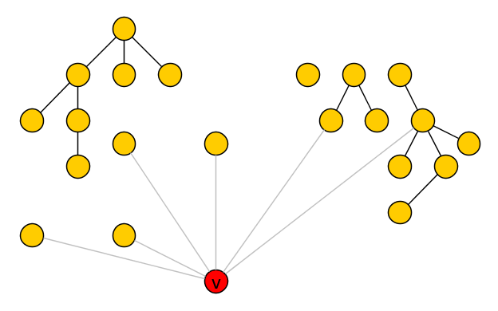
Reducing degree using a solution without $v$
Lemma. Given a feedback vertex set $Y_{v}⊆V\left(G\right)∖\{v\}$, the degree of $v$ can be reduced to $\left|Y_{v}\right|⋅(k+4)$ efficiently, without changing the answer
Consider forest $F≔G−(Y_{v}∪\{v\})$
Using (R2), each vertex in $Y_{v}$ has $≤2$ edges to $v$
Each tree of $F$ has at most one edge to $v$
Idea: reduce $deg⁡(v)$ by reducing # adjacent trees
Notes:
We will reduce deg(v) by reducing number of adjacent trees.

Slide 31
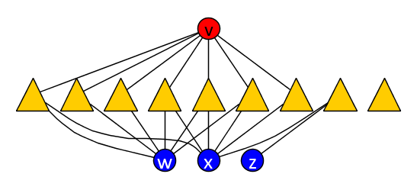
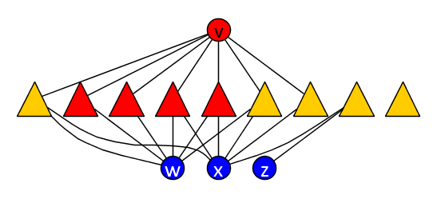
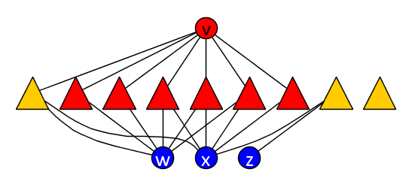
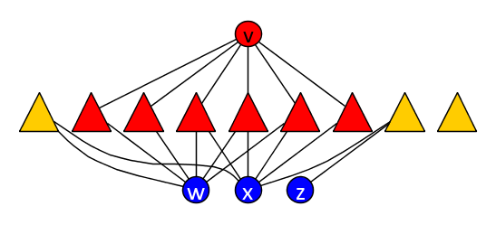
Reducing degree using a solution without $v$
Lemma. Given a feedback vertex set $Y_{v}⊆V\left(G\right)∖\{v\}$, the degree of $v$ can be reduced to $\left|Y_{v}\right|⋅(k+4)$ efficiently, without changing the answer
After reduction: $\deg\left(v\right)≤2\left|Y_{v}\right|+\left|Y_{v}\right|\left(k+2\right)$
Using (R2), each vertex in $Y_{v}$ has $≤2$ edges to $v$
Each tree of $F$ has at most one edge to $v$
$$k=2$$
Marked for $w$
Marked for $x$
$$Y_{v}$$
For each $u∈Y_{v}$, mark up to $k+2$ trees of $F$ that contain both a neighbor of $v$ and a neighbor of $u$
Remove edges from $v$ to all unmarked trees

Slide 32
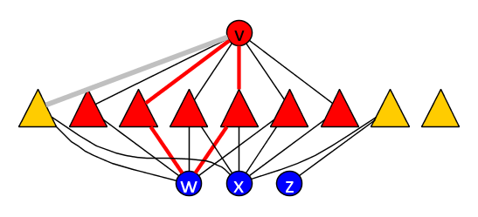
Reducing degree using a solution without $v$
Claim. If graph $G’$ is obtained from $G$ by removing an edge from $v$ to an unmarked tree $T$, then any FVS $X′$ for $G’$ of size $≤k$ is a FVS for $G$
Lemma. Given a feedback vertex set $Y_{v}⊆V\left(G\right)∖\{v\}$, the degree of $v$ can be reduced to $\left|Y_{v}\right|⋅(k+4)$ efficiently, without changing the answer
If $v∈X′$, then $G^{′}−X′=G−X′$
If $v∉X′$, then $X′$ contains all of $T$’s neighbors except $v$
So $T$ is a tree in $G−X′$ connecting to the remainder using $1$ edge
$$k=2$$
$$T$$
For all $u∈N_{G}\left(T\right)∖\{v\}$, there are $k+2$ marked trees adjacent to $u$ and $v$
At least two such trees $T_{1},T_{2}$ are disjoint from $X′$ of size $k$
If $\left\{u,v\right\}∩X^{′}=∅$, then $T_{1}∪T_{2}∪\{u,v\}$ has a cycle in $G^{′}−X$
So $X′$ contains $v$, or $X′$ contains all of $N_{G}\left(T\right)∖\{v\}$

Slide 33
Complete kernelization for Feedback Vertex Set
Compute 4-approximate FVS called $X$
If $\left|X\right|>4k$, no solution of size $k$ exists, output no
For each $v∈X$, compute 4-approximate FVS $Y_{v}$ without $v$
If $\left|Y_{v}\right|>4k$: no solution of size $k$ without $v$ exists
Delete $v$, decrease $k$ by one
If $\left|Y_{v}\right|≤4k$: we use $Y_{v}$ and marking to reduce $deg⁡(v)$
Apply (R1)-(R4) to ensure minimum degree $≥3$ for $G−X$
If $\left(G,k\right)↦(G^{′},k^{′})$, then $G^{′}$ has a FVS of degree-sum $O\left(k^{3}\right)$:
size at most $4k$
each vertex has degree $O\left(k^{2}\right)$
Graph $G′$ has $O(k^{3})$ vertices by the degree-sum lemma
Notes:
Easy to apply the reduction rules in polynomial time, approximation is also polynomial.

Slide 34
Discussion
Kernel can be improved to $O(k^{2})$ vertices and edges [Thomassé, TALG’14]
Improvement uses 2-expansion lemma (matching theory)
Kernel can be computed in $O(n⋅k^{O\left(1\right)})$ time
Bitsize $O\left(k^{2}\right)$ for the kernel is optimal [Dell & van Melkebeek, JACM’14]
No kernel of size $O(k^{2−ε})$ exists unless NP $⊆$ coNP/poly
Unknown whether there is a kernel with $O(k)$ vertices

Slide 35
Gems in kernelization
Graph Coloring
Edge Clique Cover
Feedback Vertex Set

Slide 36
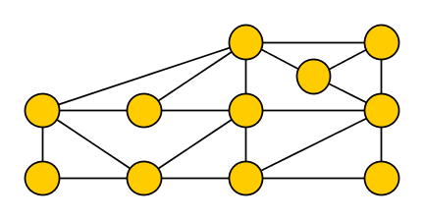
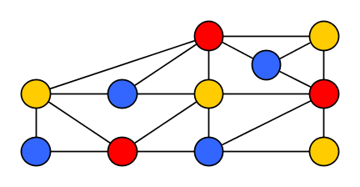
Graph $q$-Coloring
Input: An undirected graph $G$ Question: Can we assign each vertex a color $f\left(v\right)∈\left\{1,…, q\right\}$, such that $f\left(u\right)≠f(v)$ for all edges $\left\{u,v\right\}∈E(G)$ ?
Coloring where $f\left(u\right)≠f(v)$ for all edges is called proper
Which parameter to use?
yes for $q=3$
Notes:
Graph coloring is often used to model scheduling problems (assign each vertex (exam) a timeslot (color)). Exams that have overlap in the participants have an edge (can’t be simultaneous). Minimum number of colors in a proper coloring = smallest number of timeslots needed to schedule all exams.

Slide 37
Take one: parameterize by # allowed colors
Use the desired number of colors $q$ as the parameter
Can we reduce to bitsize $f(q)$, for some function $f$?
Suppose such a kernelization exists; apply it to 3-Coloring
Would solve 3-Coloring (NP-complete) in polynomial time
$n$ bits
$f(3)$ bits
$$x$$
$poly(\left|x\right|,3)$ time
$$x′$$
$$3$$
$$…$$
Notes:
Can brute-force the f(3)-size input in constant time.

Slide 38
Take two: parameterize by graph complexity
Introduce a parameter that measures graph complexity
Can Coloring inputs on large but simple graphs be reduced?
Some ways to measure graph complexity:
Treewidth [more in Peter Rossmanith’s talk]
Size of smallest edge clique cover
Size of smallest feedback vertex set
Size of smallest vertex cover

Slide 39
Vertex Covers
A vertex cover (VC) in a graph $G$ is a vertex set $S$ such that for each edge $\left\{u,v\right\}∈E(G)$ we have $u∈S$ or $v∈S$
The associated optimization problem is interesting on its own
Today: preprocess Coloring inputs on graphs with small VC’s
If a 3-Coloring input $G$ is large compared to $minVC(G)$, can we shrink it efficiently without changing the answer?
Notes:
We look at 3-coloring for simplicity, we will generalize later.

Slide 40
Reducing 3-Coloring inputs with small covers
Input: instance $G$ of 3-Coloring
Compute 2-approximate vertex cover $X$
$∀S⊆X$ of size 3:
mark a common neighbor of $S$
Delete all unmarked $v∉X$
Output resulting $G’$ on $n’$ vertices
$$n’≤\left|X\right|+{\left|X\right|}^{3}≤2k+{\left(2k\right)}^{3}$$
$$X$$

Slide 41
Correctness: $G$ is 3-colorable $⇔$ $G′$ is 3-colorable
($⇒$) Trivial
($⇐$) Take a 3-coloring of $G’⊇X$
Independently give each deleted vertex $v$ a color not used on $N_{G}(v)$
If $S=\{r,b,y\}$ uses all colors:
Marked vertex v_{S} is improper in $G’$
$$X$$

Slide 42
Provable preprocessing for 3-Coloring
Theorem. There is a polynomial-time algorithm that, given a graph $G$, outputs a subgraph $G’$ with $O(minVC{\left(G\right)}^{3})$ vertices such that $G$ is 3-colorable iff $G’$ is
A 3-coloring of $G’$ can be lifted to a 3-coloring of $G$ in polynomial time
Algorithm and correctness proof generalize to $q$-Coloring
Mark common neighbors of groups of $q$ vertices
[J & Kratsch, Inform. Comput. ‘13]
Kernel size $O\left(k^{q}\right)$ vertices, dependence on $q$ is unavoidable
[Bodlaender, J & Kratsch SIDMA’14]

Slide 43
Kernelization for $q$-Coloring
Reduction to size $poly(k)$
Vertex Cover
Distance to linear forest
Distance to Split graph components
Distance to Cograph
Feedback Vertex Set
Distance to Interval
Reduction to size $f(k)$
No $poly(k)$ unless NP $⊆$ coNP/poly
Treewidth
Distance to Chordal
Odd Cycle Transversal
No reduction to size $f(k)$
unless P=NP
Distance to Perfect
Chromatic Number

Slide 44
Conclusion
Nice preprocessing algorithms found on the lost continent
Rich theory of algorithmic techniques and lower bounds
Several tantalizing open problems remain:
Vertex Planarization? Directed Feedback Vertex Set?
Edge Clique Cover
Graph Coloring
Feedback Vertex Set
THANK YOU!

