Slide 1
New developments in Circuit Complexity From Circuit-SAT Algorithms to Circuit Lower Bounds
Insert «Academic unit» on every page: 1 Go to the menu «Insert» 2 Choose: Date and time 3 Write the name of your faculty or department in the field «Footer»
4 Choose «Apply to all"
Bart M. P. Jansen University of Bergen, Norway
March 20th 2014, UiB Algorithms Group Winter School 2014

Slide 2
Circuit complexity up to 2010
1970’s:
Boolean circuits are combinatorial objects
Possibly easier to understand than Turing machines
Analyze circuits to separate P from NP?
If P ≠ NP is there a large program that solves SAT instances of size ≤ 10⁶?
Non-uniform circuit lower bounds exclude this possibility
Early 1980’s: Parity does not have non-uniform poly-size AC⁰ circuits
What happens if we give AC⁰ the parity function for free?
Study AC⁰ with mod 2 gates of arbitrary fan-in
Late 1980’s: Majority does not have non-uniform poly-size AC⁰[2] circuits
What happens if we give an arbitrary constant mod gate for free?
1989: Barrington conjectures:
Majority does not have non-uniform poly-size AC⁰[m] circuits for fixed m
1990’s: Prove NEXP does not have non-uniform poly-size AC⁰[m] circuits?
Open until 2010

Slide 3
A solution to an embarrassing problem
STOC 2010, Ryan Williams:
“Improving exhaustive search implies superpolynomial lower bounds”
Improvements over brute force for Circuit-SAT yield superpolynomial Boolean circuit lower bounds for NEXP
CCC 2011, Ryan Williams:
“Non-uniform ACC Circuit Lower Bounds”
Improvements over brute force for ACC-Circuit-SAT yield superpolynomial nonuniform ACC circuit lower bounds for NEXP
Such improvements are possible by exploiting the structure of ACC
NEXP does not have poly-size non-uniform ACC circuits

Slide 4
Goal of this lecture
Informally:
NEXP ⊄ ACC
(More) Formally:
There is a language in NEXP that is not decided by a family of constant-depth, polynomial-size circuits using AND/OR/NOT/MOD[m] gates of unbounded fan-in
(Even more) Formally:
∃L ∈ NEXP: ¬ (
∃d,m ∈ ℕ, ∃ polynomial p, ∃ circuit family C₁, C₂, ... such that:
C_{n} is a circuit of size ≤ p(n) of depth ≤ d over gateset {AND,OR,NOT,Mod[m]} that decides all n-bit inputs of L
)

Slide 5
Outline of the proof
I. Nontrivial ACC-Circuit-SAT algorithms imply NEXP ⊄ ACC
a. NEXP-completeness of Succinct 3SAT
b. Small witness circuits for Succinct 3SAT
c. Checking an assignment by analyzing a circuit
d. ACC circuits simulate Boolean circuits
e. Verifying a guessed circuit
Testing poly(n)-size ACC circuits with n inputs for satisfiability in $2^{n −n^{ε}}$ time
II. Nontrivial ACC-Circuit-SAT algorithms exist
a. Decomposing ACC circuits using multilinear polynomials
b. Quickly evaluating a multilinear polynomial on many points
c. Reducing the number of variables
NEXP ⊄ ACC

Slide 6
Approaching the problem
We are proving size lower bounds for non-uniform circuits
You are allowed “infinite time” to design the ideal circuit to solve n-bit instances
Still, no polynomial-size circuit family will solve all instances
The lower bound is unconditional
Does not rely on P ≠ NP, ETH, Unique Games, etc.
Where to start?!
Non-deterministic time hierarchy theorem:
If $f\left(n+1\right)∈o(g(n))$, then NTIME[f(n)] $⊂$ NTIME[g(n)]
Unconditionally, strict subset
Proof by contradiction: assume both [A] NEXP ⊆ ACC and [B] nontrivial ACC-Circuit-SAT, then contradict time hierarchy theorem

Slide 7
Outline of the proof
I. Nontrivial ACC-Circuit-SAT algorithms imply NEXP ⊄ ACC
a. NEXP-completeness of Succinct 3SAT
b. Small witness circuits for Succinct 3SAT
c. Checking an assignment by analyzing a circuit
d. ACC circuits simulate Boolean circuits
e. Verifying a guessed circuit
(ACC-Circuit-SAT in time $2^{{n −n}^{ε}}$) ∧ (NEXP ⊆ ACC) ⇒ ¬ (Non-det. time hierarchy theorem) ⇒ ⊥

Slide 8
Contradicting the time hierarchy theorem
How to speed up all problems in NTIME[$2n$]?
Give an improvement for a NEXP-complete problem
Which problem to pick?
Succinct 3SAT
(It is “very very NEXP-complete”)
Let tt(C) denote the length-$2n$ bitstring you get by
evaluating an $n$-input circuit C
on all $n$-bit strings
in lexicographical order
tt(C)=C(000…000) C(000…001) C(000…010) … C(111…111)

Slide 9
Succinct 3SAT
Succinct 3SAT is the following problem:
Input: A Boolean circuit $C$
Question: Does tt($C$) encode a satisfiable 3SAT formula?
Succinct 3SAT is NEXP-complete under poly-time reductions
A $2n$-bit string encodes a formula with $2n$ variables and $2n$ clauses
A literal $l=x_{i}$ or $l=¬x_{i}$ in a clause $(l1∨l2∨l3)$ is encoded by
Sign bit for possible negation
$n$-bit binary encoding of variable index $i$
Encoding length of a clause is $3(n+1)$
In a $2n$-bit string, we can encode $\frac{2^{n}}{3\left(n+1\right)}$ clauses
Define remaining clauses to be trivially true $(x1∨¬ x1∨x1)$
Given $i$, easy to determine which $3(n+1)$ bits encode i^{th} clause

Slide 10
Ryan’s intuition
If NEXP (and therefore Succinct 3SAT) has small ACC circuits, then this shows a “weakness” of Succinct 3SAT
A poly(n)-size circuit for the n-bit instances compresses the yes/no answers to all 2^{n} n-bit instances into poly(n) bits
This weakness should also be exploitable algorithmically
If NEXP has small ACC circuits, Succinct 3SAT should be solvable better than brute force, contradicting the time hierarchy theorem
“At this point we have reached a degree of handwaving so exuberant, one may fear we are about to fly away. Surprisingly, this handwaving has a completely formal theorem behind it.” (Ryan Williams 2011, SIGACT News)

Slide 11
Efficient Cook-Levin for NEXP
For each L ∈ NTIME[$2n$], there is a polynomial-time reduction R from L to Succinct 3SAT such that:
$x∈L⇔R(x)∈$ Succinct 3SAT
($x$ is a yes-instance iff $R(x)$ is a circuit $C$ where tt(C) encodes a satisfiable 3SAT formula)
$R(x)$ is a circuit with $poly(|x|)$ gates
For long enough x, $R(x)$ has at most $|x|+4\log{|x|}$ inputs
Follows from prior work, e.g., Fortnow, Lipton, van Melkebeek, Viglas ’05

Slide 12
Time lower bound for Succinct 3SAT
Theorem. Succinct 3SAT on a circuit $C$ with $n$ inputs and size poly($n$) cannot be solved in NTIME[$2^{n −n^{ε}}$]
Proof. Suppose this is possible, let L ∈ NTIME[$2n$]
To decide an n-bit instance $x$ of L in NTIME[$o(2n)$] :
Compute equivalent Succinct 3SAT instance
A circuit $Cx :=R(x)$ of size $poly(n)$ on $n+4\log{n}$ inputs
Apply hypothetical Succinct 3SAT algorithm to $Cx$
Runtime is:
$$2^{\left(n+4\log{n}\right)−{\left(n+4\log{n}\right)}^{ε} }≤$$
$2^{n−{\left(n+4\log{n}\right)}^{ε} }poly\left(n\right)≤$ $o\left(2^{n}\right)$
Contradiction to non-det. time hierarchy theorem

Slide 13
Outline of the proof
I. Nontrivial ACC-Circuit-SAT algorithms imply NEXP ⊄ ACC
a. NEXP-completeness of Succinct 3SAT
b. Small witness circuits for Succinct 3SAT
c. Checking an assignment by analyzing a circuit
d. ACC circuits simulate Boolean circuits
e. Verifying a guessed circuit
(ACC-Circuit-SAT in time $2^{{n −n}^{ε}}$) ∧ (NEXP ⊆ ACC) ⇒ $n$-input Succinct 3SAT in NTIME[$2^{{n −n}^{ε}}$] ⇒ ¬ (Non-det. time hierarchy theorem) ⇒ ⊥

Slide 14
Outline of the proof
I. Nontrivial ACC-Circuit-SAT algorithms imply NEXP ⊄ ACC
a. NEXP-completeness of Succinct 3SAT
b. Small witness circuits for Succinct 3SAT
c. Checking an assignment by analyzing a circuit
d. ACC circuits simulate Boolean circuits
e. Verifying a guessed circuit

Slide 15
Consequences of NEXP ⊆ ACC
Exploit assumption [A]: NEXP ⊆ ACC
[A] ⇒ poly-size ACC circuits for Succinct 3SAT
For every $n$, satisfiability of the 3SAT formula encoded by a bitlength-$n$ circuit can be determined by a poly($n$)-size ACC circuit
Impagliazzo, Kabanets, Wigderson ‘02 boosts this to:
[A] ⇒ poly-size Boolean circuits encoding satisfying assignments
∀ Boolean circuits $C$: formula tt($C$) is satisfiable ⇒ ∃ poly($|C|$)-size circuit $W$ encoding satisfying assignment
Assignment setting $i$ to $W(i)$ satisfies tt(C)

Slide 16
Exploiting small witness circuits
We are building a nondeterministic algorithm using [A]
Guess the circuit W encoding the satisfying assignment?
Solve Succinct 3SAT instance $C$ as follows:
Guess a small circuit $W$
Answer yes if tt($W$) satisfies tt($C$)
Under [A] this is a correct nondeterministic algorithm
How to verify that tt($W$) satisfies tt($C$)?
If $C$ has $n$ inputs, writing down the formula of size $2n$ and manipulating it requires $2n$ time, we need $2^{{n −n}^{ε}}$
Use the ACC Circuit SAT algorithm?

Slide 17
Outline of the proof
I. Nontrivial ACC-Circuit-SAT algorithms imply NEXP ⊄ ACC
a. NEXP-completeness of Succinct 3SAT
b. Small witness circuits for Succinct 3SAT
c. Checking an assignment by analyzing a circuit
d. ACC circuits simulate Boolean circuits
e. Verifying a guessed circuit

Slide 18
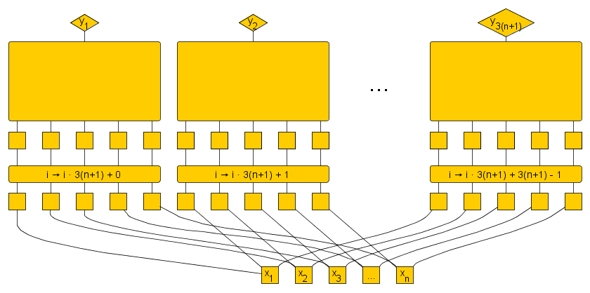
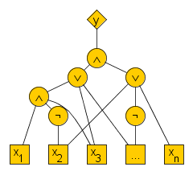
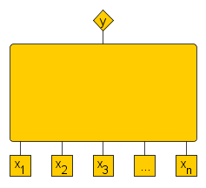
Checking a guessed assignment using Circuit SAT
tt(W) satisfies tt(C) ⬄ impossible to pick $i$ such that no literal of the $i$^{th} clause is satisfied by tt(W)
By making $O(n)$ copies of the $n$-input circuit $C$, we can get
an $n$-input, multi-output circuit $C’$ of poly($|C|$) size,
on input $i$, circuit $C’$ outputs the $3(n+1)$ bits of the $i$^{th} clause

Slide 19
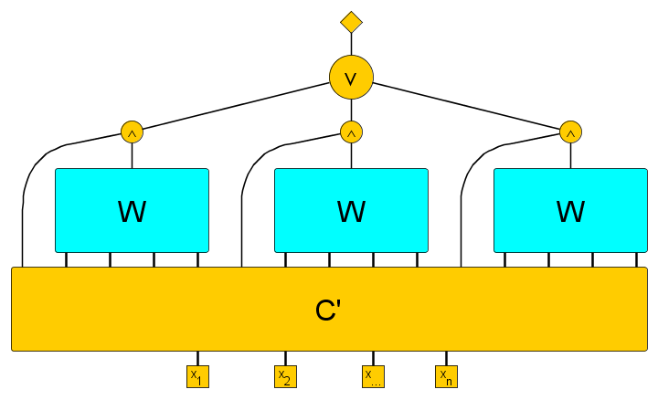
Checking a guessed assignment using Circuit SAT
tt(W) satisfies tt(C) ⬄ impossible to pick $i$ such that no literal of the $i$^{th} clause is satisfied by tt(W)
Compose $C’$ with three copies of $W$ to obtain circuit $D$
Feed the indices of the variables in clause $i$ to a copy of $W$ to find the truth value
Clause $i$ is satisfied if the sign bit of one of the literals matches the truth value under $W$

Slide 20
Checking a guessed assignment using Circuit SAT
tt(W) satisfies tt(C) ⬄ impossible to pick $i$ such that no literal of the $i$^{th} clause is satisfied by tt(W)
Assignment encoded by $W$ satisfies formula encoded by $C$ iff $D(i)=1$ for all possible clauses

Slide 21
Checking a guessed assignment using Circuit SAT
tt(W) satisfies tt(C) ⬄ ¬D is unsatisfiable
D has $n$ inputs: run a circuit SAT algorithm on ¬D to determine whether the guess was correct!
Circuit SAT in $2^{n−n^{ε}}$ time for $n$-input, poly($n$) size circuits would solve $n$-input, poly($n$)-size Succinct 3SAT instance fast enough to contradict the time hierarchy theorem
Problem:
¬D is not an ACC circuit
(depth may be large)
Solution:
Replace W and C’ by ACC circuits

Slide 22
Outline of the proof
I. Nontrivial ACC-Circuit-SAT algorithms imply NEXP ⊄ ACC
a. NEXP-completeness of Succinct 3SAT
b. Small witness circuits for Succinct 3SAT
c. Checking an assignment by analyzing a circuit
d. ACC circuits simulate Boolean circuits
e. Verifying a guessed circuit

Slide 23
Equivalent ACC circuits for every Boolean circuit
Assume [A]: NEXP ⊆ ACC
Consider the meta-algorithmic Circuit Value problem:
Input: Binary encoding $x$ of $n$-input circuit $C$, bitstring $x’∈\{0,1\}n$
Question: Does $C$ output $1$ on input $x’$?
Circuit Value is in P (given the input, simulate the circuit)
So Circuit Value ∈ P (⊆ NEXP) has poly-size ACC circuits by [A]
Constant-depth ACC circuit of size poly($n+n’$)
Value of $C(x’)$
Binary encoding of a circuit $C$
Input $x’$

Slide 24
Equivalent ACC circuits for every Boolean circuit
Consider an $n$-input poly($n$)-size Boolean circuit $C$
Hardcode $x$ into a Circuit Value Decider of size poly($n$)
Yields a poly($n$)-size ACC circuit equivalent to $C$
Assuming [A], for every Boolean circuit of polynomial size there is an equivalent ACC circuit of polynomial size
Binary encoding of a circuit C
Input x’

Slide 25
Using the existence of small ACC circuits
Recall our approach to faster Succinct 3SAT
Under [A] there are poly-size ACC circuits equivalent to $C’$ and $W$
A nondeterministic algorithm can
Guess two small ACC circuits $\hat{C}$ and $\hat{W}$
Use them instead of $C’$ and $W$
Have to ensure that branches with wrong guesses do not accidentally output yes if the answer to Succinct 3SAT is no
Wrongly guessing $\hat{W}$ is not a problem
Then $\hat{W}$ does not satisfy the formula, we output no
Wrongly guessing $\hat{C}$ is a problem
If $\hat{C}$ encodes a different formula than C’, tt($\hat{C}$) might be satisfiable even if tt(C) is not
We might incorrectly answer yes
After guessing we should verify that tt($\hat{C}$) = tt($C’$)

Slide 26
Outline of the proof
I. Nontrivial ACC-Circuit-SAT algorithms imply NEXP ⊄ ACC
a. NEXP-completeness of Succinct 3SAT
b. Small witness circuits for Succinct 3SAT
c. Checking an assignment by analyzing a circuit
d. ACC circuits simulate Boolean circuits
e. Verifying a guessed circuit

Slide 27
Checking that C’ and $\hat{C}$ are equivalent
We could make a circuit that tests whether it is possible to satisfy ¬ [ C’(x) ⇔ $\hat{C}$(x) ]
Run our Circuit SAT algorithm on it?
It would not be an ACC circuit since it contains $C’$
Solution:
Guess a circuit that gives more information than C’
Makes it easier to verify that it gives the right information

Slide 28
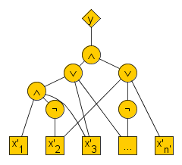
The Circuit Gate Value Problem
Input:
Binary encoding $x$ of $n’$-input circuit $C$
Bitstring $x’∈\{0,1\}n’$
Index $k$ of a gate in $C$
Question: Does gate $k$ of $C$ evaluate to $1$ on input $x’$?
Circuit Gate Value ∈ P
Assuming [A] it has polynomial-size ACC circuits
Gate k

Slide 29
The Circuit Gate Value Problem
By hardcoding a description of $C’$ into a Circuit Gate Value Decider, we get a poly-size ACC circuit $E(x’,k)$ such that:
$E(x’,k)$ = Value of gate $k$ when $C’$ evaluates $x’$
A guessed circuit $E(x’,k)$ is correct if and only if:
For all possible inputs $x’$, for all gate indices $k$ of $C’$:
If $k$ is an AND-gate with inputs $i,j$ then $E(x’,k)=E(x’,i)∧E(x’,j)$
If $k$ is an OR-gate with inputs $i,j$ then $E(x,k)=E(x,i)∨E(x,j)$
If $k$ is a NOT-gate with inputs $i$ then $E(x,k)=¬E(x,i)$
If $k$ is the $i$^{th} input gate then $E(x,k)=x[i]$
Can we set up an ACC circuit to test this?
May assume that the fan-in of $C′$ is 2

Slide 30
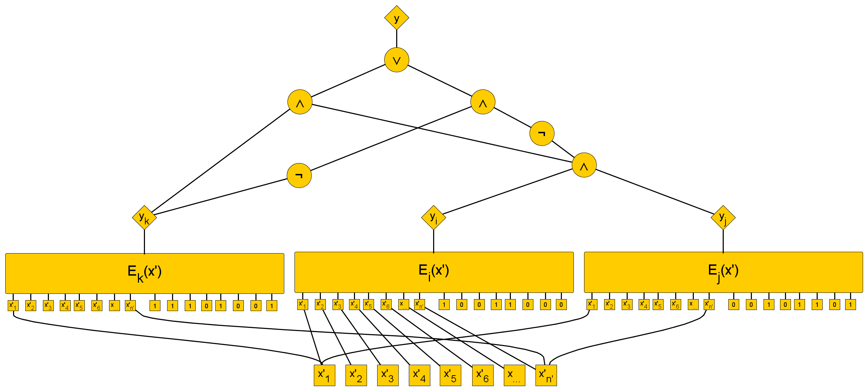
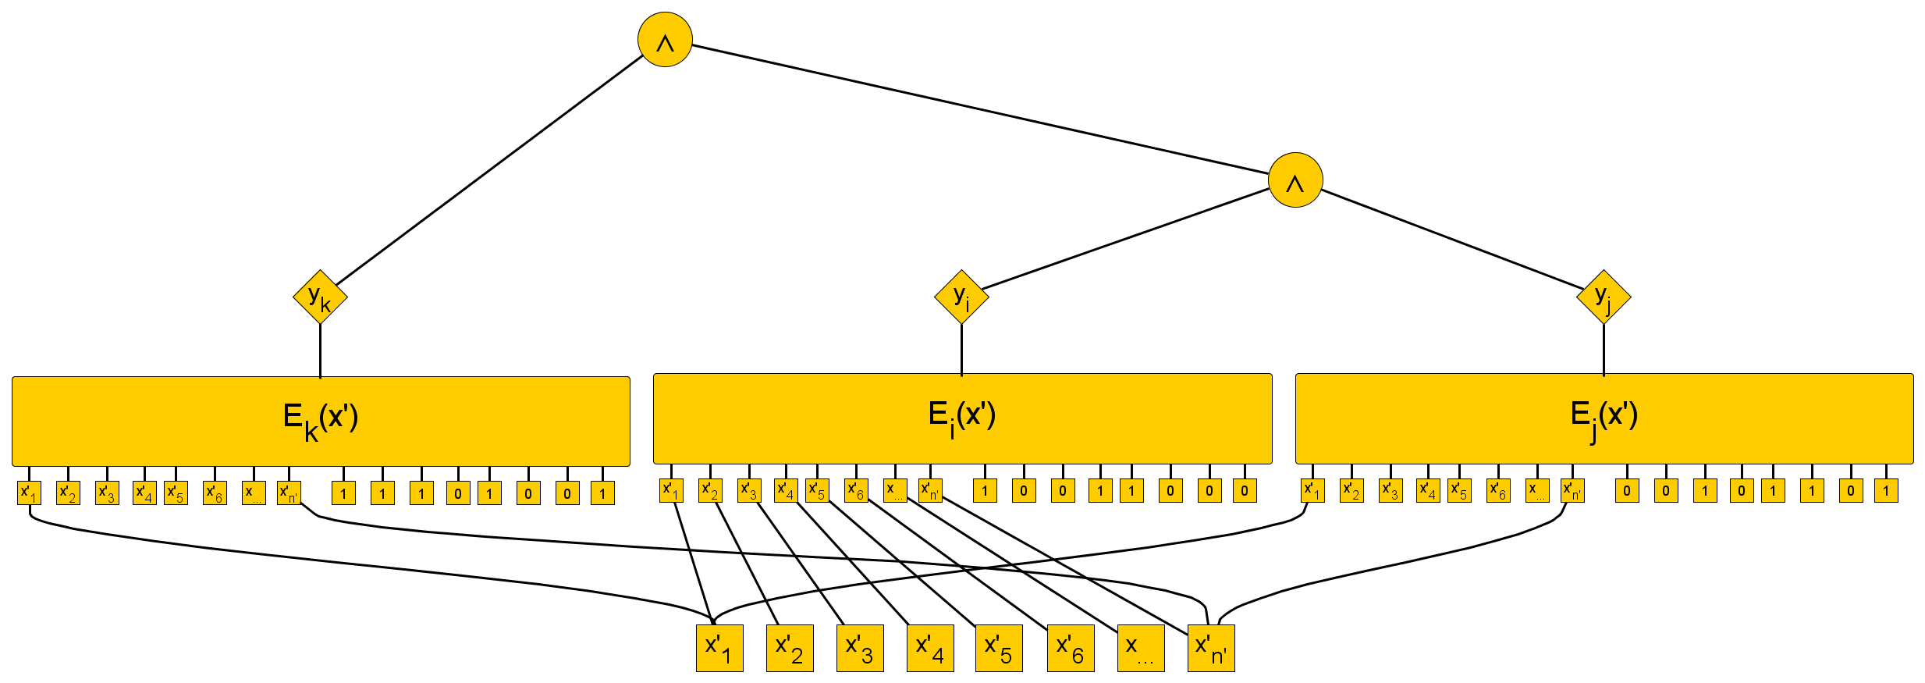
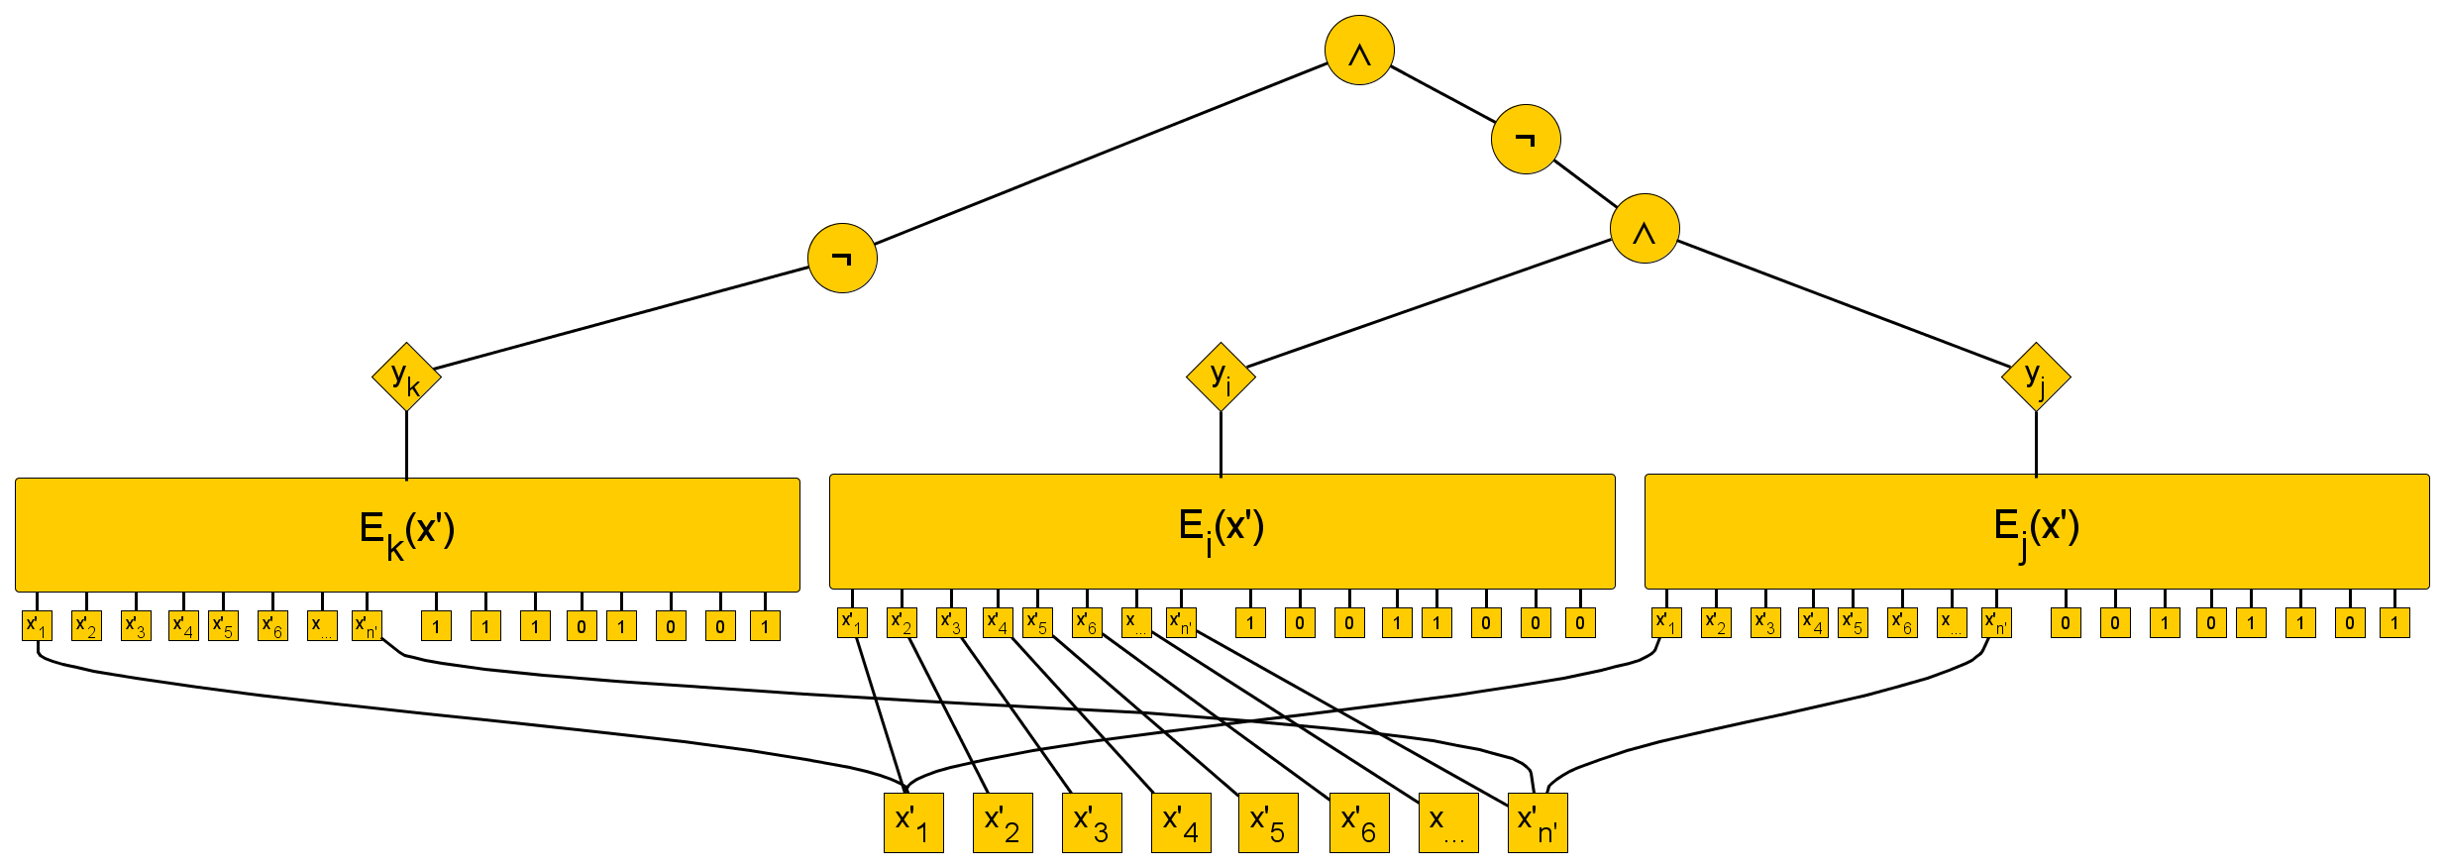
An ACC circuit to verify the behavior of a gate
To verify correctness of an AND-gate $k$ with inputs $i$ and $j$:
(for all possible inputs $x’$)

Slide 31
An ACC circuit to verify the behavior of a gate
To verify correctness of an AND-gate $k$ with inputs $i$ and $j$:
(for all possible $x’$)
Similar constructions for OR, NOT and INPUT gates
To check consistency of all gates simultaneously, for one input $x’$:
Build constant-depth checkers for each gate
Feed them into an AND gate to get circuit $E’$
$n$-input circuit $C’$ has size poly($n$), so poly($n$) gates
…

Slide 32
An ACC circuit to verify the behavior of a gate
$E$ correctly simulates $C’$ if and only if $¬E$ is unsatisfiable
Note: $¬E$ is an ACC circuit with $n$ inputs and poly($n$) size
The ACC-Circuit-SAT algorithm runs in time $2^{{n −n}^{ε}}$
…

Slide 33
$n$-input Succinct 3SAT in NTIME[$2^{{n −n}^{ε}}$]
Assume: $n$-input, poly($n$)-size ACC-Circuit-SAT in time $2^{n −n^{ε}}$
Input: string $x$ encoding an $n$-input circuit $C$ of size poly($n$)
Construct circuit $C′$ such that $C′(i)$ is the i^{th} clause of tt(C)
Guess poly($n$)-size ACC circuits $\hat{W}\left(⋅\right)$ and $E(⋅,⋅)$
Construct the ACC circuit $E′(⋅)$ testing if $E$ simulates $C’$
Call the ACC-Circuit-SAT algorithm on $¬E′$
If $¬E′$ is satisfiable: guess for $E$ is incorrect, output no
Else: E simulates gates of C’ so $E(x′,$OUT$)=C′(x^{′})$
Compose 3 copies of $\hat{W}\left(⋅\right)$ with $E(⋅,$OUT$)$ to form D
Call the ACC-Circuit-SAT algorithm on $¬D$
If $¬D$is satisfiable: output no
(W’ is not a satisfying assignment)
Else: output yes ($W’$ satisfies tt(C))
$$\hat{W}$$
$$\hat{W}$$
$$\hat{W}$$
If TT(C) is satisfiable, then $\hat{W}(⋅)$ encodes a satisfying assignment in $≥1$ branch
In some branch, $E(x’,k)$ outputs the value of the $k$^{th} gate of $C’$ on input $x’$
$E′$ has $n$ inputs and size poly(n)
Executes in $2^{n −n^{ε}}$ time
…

Slide 34
Outline of the proof
I. Nontrivial ACC-Circuit-SAT algorithms imply NEXP ⊄ ACC
a. NEXP-completeness of Succinct 3SAT
b. Small witness circuits for Succinct 3SAT
c. Checking an assignment by analyzing a circuit
d. ACC circuits simulate Boolean circuits
e. Verifying a guessed circuit
(ACC-Circuit-SAT in time $2^{{n −n}^{ε}}$) ∧ (NEXP ⊆ ACC) ⇒ $n$-input Succinct 3SAT in NTIME[$2^{{n −n}^{ε}}$] ⇒ ¬ (Non-det. time hierarchy theorem) ⇒ ⊥

Slide 35
Outline of the proof
I. Nontrivial ACC-Circuit-SAT algorithms imply NEXP ⊄ ACC
a. NEXP-completeness of Succinct 3SAT
b. Small witness circuits for Succinct 3SAT
c. Checking an assignment by analyzing a circuit
d. ACC circuits simulate Boolean circuits
e. Verifying a guessed circuit
II. Nontrivial ACC-Circuit-SAT algorithms exist
a. Decomposing ACC circuits using multilinear polynomials
b. Quickly evaluating a multilinear polynomial on many points
c. Reducing the number of variables

Slide 36
Nontrivial algorithms for ACC Circuit SAT
Three different routes
Coppersmith’s rectangular matrix multiplication algorithm
(In the conference version)
Dynamic programming using the zeta transform
(In the journal version)
Recursion
(In the informal article)
All exploit a structural decomposition of ACC developed in the 90’s
[Yao’90, Beigel&Tarui’94, Allender&Gore’94]

Slide 37
Outline of the proof
I. Nontrivial ACC-Circuit-SAT algorithms imply NEXP ⊄ ACC
a. NEXP-completeness of Succinct 3SAT
b. Small witness circuits for Succinct 3SAT
c. Checking an assignment by analyzing a circuit
d. ACC circuits simulate Boolean circuits
e. Verifying a guessed circuit
II. Nontrivial ACC-Circuit-SAT algorithms exist
a. Decomposing ACC circuits using multilinear polynomials
b. Quickly evaluating a multilinear polynomial on many points
c. Reducing the number of variables

Slide 38
Decomposing ACC circuits by polynomials
Let $C$ be an $n$-input circuit of size $s$, depth $d$, with mod[m] gates
Computation C(x₁, … , x_{n}) can be simulated by:
Evaluating a “sparse” multilinear polynomial $p(x1, … , xn)$
Looking up $A[p(x1, … , xn)]$ in a sparse 0-1 array A
The decomposition can be obtained algorithmically in $\tilde{O}(K)$ time
Reduces ACC Circuit Satisfiability to checking whether there is
some point ${x∈\left\{0,1\right\}}^{n}$ with $A[p(x)]=1$
A=
1 | 1 | 0 | 1 | 0 | 0 | 0 | 1 | 1 | 0 | 1 | 1 | 1 | 0 | 0 | 1 | 0 | 1 | 1 | 0
$K≤2^{{O(log}^{f\left(d,m\right)}{s)}}$ cells
$$p\left(x_{1},…, x_{n}\right)=81x_{1}x_{5}x_{7}+24x_{2}x_{4}x_{5}+5x_{1}x_{6}x_{8}+ … +3x_{1}x_{2}x_{3}x_{4}x_{5}x_{6}x_{7}x_{8}$$
$≤K$terms

Slide 39
Outline of the proof
I. Nontrivial ACC-Circuit-SAT algorithms imply NEXP ⊄ ACC
a. NEXP-completeness of Succinct 3SAT
b. Small witness circuits for Succinct 3SAT
c. Checking an assignment by analyzing a circuit
d. ACC circuits simulate Boolean circuits
e. Verifying a guessed circuit
II. Nontrivial ACC-Circuit-SAT algorithms exist
a. Decomposing ACC circuits using multilinear polynomials
b. Quickly evaluating a multilinear polynomial on many points
c. Reducing the number of variables

Slide 40
Quickly evaluating a polynomial
Why does a decomposition into polynomials help?
A $K$-term $n$-variate multilinear polynomial $p$ can be evaluated
on all points of ${\left\{0,1\right\}}^{n}$
in $2^{n}⋅poly\left(n\right)$ time
(assuming constant-time arithmetic)
We spend poly($n$) amortized time per point
Even though $K$ may be $≫poly(n)$
Compare to naïve $2^{n}⋅K⋅poly\left(n\right)$ algorithm

Slide 41
Quickly evaluating a polynomial
Why does a decomposition into polynomials help?
A $K$-term $n$-variate multilinear polynomial $p$ can be evaluated
on all points of ${\left\{0,1\right\}}^{n}$
in $2^{n}⋅poly\left(n\right)$ time
(assuming constant-time arithmetic)
Decompose $p$ into multilinear $q1, q2$ as follows:
$p\left(x_{1},x_{2},…, x_{n}\right)=x_{1}⋅q_{1}\left(x_{2},…, x_{n}\right)+q_{2}\left(x_{2},…,x_{n}\right)$
Then:
$p\left(0,x_{2},…, x_{n}\right)=q_{2}\left(x_{2},…, x_{n}\right)$
$p\left(1,x_{2},…, x_{n}\right)=q_{1}\left(x_{2},…, x_{n}\right)$ + $q_{2}\left(x_{2},…, x_{n}\right)$
Gives a recursive algorithm
$T\left(n\right)$ $≤2^{n}⋅poly\left(n\right)+2T\left(n−1\right)$
$≤2^{n}⋅poly(n)$

Slide 42
Exploiting fast evaluation of polynomials
Idea to check satisfiability of an $n$-input ACC circuit $C$:
Compute decomposition $C(x1, …, xn)=A[p(x1, … , xn)]$
Evaluate $p$ on all points x in ${\left\{0,1\right\}}^{n}$
Check if some $A[p(x)]=1$
To get $2^{n −n^{ε}}poly(n)$ time, $p$ should have $<n$ variables
But C has $n$ inputs!

Slide 43
Outline of the proof
I. Nontrivial ACC-Circuit-SAT algorithms imply NEXP ⊄ ACC
a. NEXP-completeness of Succinct 3SAT
b. Small witness circuits for Succinct 3SAT
c. Checking an assignment by analyzing a circuit
d. ACC circuits simulate Boolean circuits
e. Verifying a guessed circuit
II. Nontrivial ACC-Circuit-SAT algorithms exist
a. Decomposing ACC circuits using multilinear polynomials
b. Quickly evaluating a multilinear polynomial on many points
c. Reducing the number of variables

Slide 44
Reducing the number of variables
Consider an $n$-input circuit $C$ for Circuit Satisfiability of size $s$
Reduce the number of variables to $n−k$ by a $k$-blowup:
Enumerate all assignments to $x_{1},x_{2},…, x_{k}$
Hardcode each assignment into a new copy of $C$
Take the OR of the resulting circuits
Resulting circuit has size $O(2^{k}⋅s)$
Depth is increased by one
Result is still an ACC circuit
Satisfiable if and only if C is satisfiable!

Slide 45
A faster algorithm for ACC Circuit SAT
Running time:
$\tilde{O}\left(2^{{O(log}^{f\left(d,m\right)}{s′)}}\right)$ $≤$ $\tilde{O}\left(2^{{O(log}^{f\left(d,m\right)}{2^{k}s)}}\right)$ $≤$ $\tilde{O}\left(2^{{O(log}^{f\left(d,m\right)}{2^{k}+\log^{f\left(d,m\right)}{s}})}\right)$ $≤$ $\tilde{O}\left(2^{{O(k}^{f\left(d,m\right)}{+\log^{f\left(d,m\right)}{s}})}\right)$ $≤$
$\tilde{O}\left(2^{{O(n}^{ε⋅f\left(d,m\right)}{+\log^{f\left(d,m\right)}{s}})}\right)$ $≤2^{n – n^{ε′}}$
Testing satisfiability of circuit $C$
$n$ variables, size $s$, depth $d$, with mod[$m$] gates
Pick $k=n^{ε}$
($ε$ depends on $m$,$d$)
Compute the $k$-blowup $C’$ of $C$
Size $2^{k}⋅s$ and depth $d+1$
Compute a decomposition of $C’$
Sparse lookup table $A$ of a sparse multilinear polynomial $p$
Evaluate $p(x)$ for all $x∈{\left\{0,1\right\}}^{n−k}$
Output yes if and only if $A[p(x)]$ for some $x∈{\left\{0,1\right\}}^{n−k}$
Running time:
${O(2}^{n−k}poly\left(n\right))$ $≤$
${O(2}^{n−n^{ε}}poly(n))$ $≤2^{n −n^{ε^{′}}}$

Slide 46
What happened?
Where did the speed-up come from?
The algorithm to evaluate the polynomial beats brute force when the number of terms is large compared to $n$
By blowing up the circuit, we increased the size of the circuit
And therefore the number of terms in the polynomial
This allows the ACC Circuit SAT algorithm to beat brute force

Slide 47
QED
I. Nontrivial ACC-Circuit-SAT algorithms imply NEXP ⊄ ACC
a. NEXP-completeness of Succinct 3SAT
b. Small witness circuits for Succinct 3SAT
c. Checking an assignment by analyzing a circuit
d. ACC circuits simulate Boolean circuits
e. Verifying a guessed circuit
II. Nontrivial ACC-Circuit-SAT algorithms exist
a. Decomposing ACC circuits using multilinear polynomials
b. Quickly evaluating a multilinear polynomial on many points
c. Reducing the number of variables
NEXP ⊄ ACC

Slide 48
Conclusion
An algorithm for Circuit Satisfiability that is slightly faster than brute force can be turned into a circuit complexity lower bound
In 2011 this led to a proof that NEXP ⊄ ACC
Follow-up work proves size lower bounds for more general circuits
[STOC’14]: ACC with threshold gates at the bottom layer
There are many other transference theorems on how algorithmic advances imply circuit lower bounds [Oliveira’13]
Derandomization
Learning algorithms
Compression algorithms
Plenty of algorithmic challenges in circuit complexity!

Slide 49
Thank you!

