Slide 1
Preprocessing Graph Problems
When Does a Small Vertex Cover Help?
Bart M. P. Jansen
Joint work with
Fedor V. Fomin & Michał Pilipczuk
June 2012, Dagstuhl Seminar 12241

Slide 2
Motivation
Graph structure affects problem complexity
Algorithmic properties of such connections are pretty well-understood:
  Courcelle's Theorem
  Many other approaches for parameter vertex cover
What about kernelization complexity?
  Many problems admit polynomial kernels
  Many problems do not admit polynomial kernels
Which graph problems can be effectively preprocessed when the input has a small vertex cover?

Slide 3
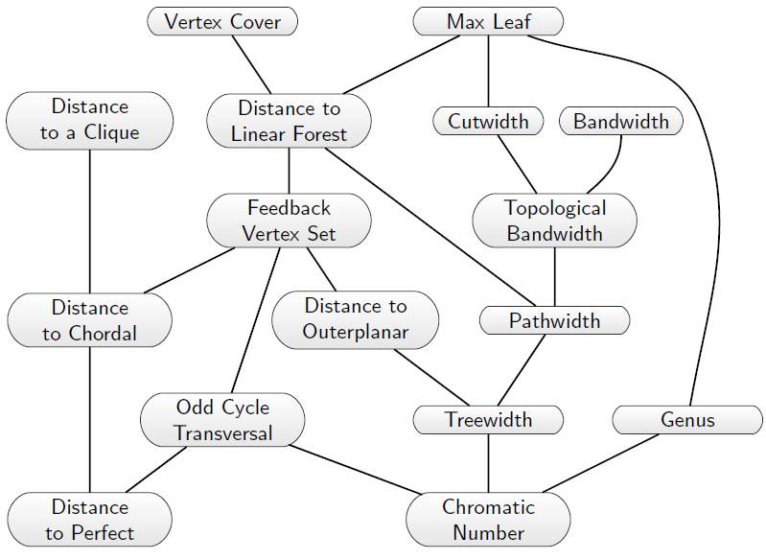
Hierarchy of parameters

Slide 4
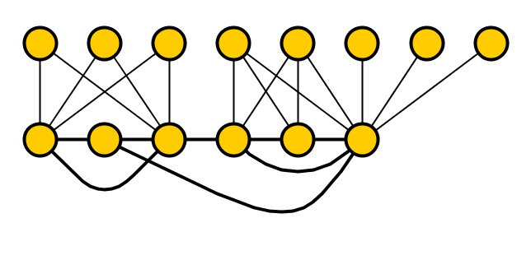
Problem setting
Clique parameterized by Vertex Cover
Input: A graph G, a vertex cover X of G, integer k
Parameter: |X|.
Question: Does G have a clique on k vertices?
Vertex Cover parameterized by Vertex Cover
Input: A graph G, a vertex cover X of G, integer k
Parameter: |X|.
Question: Does G have a vertex cover of size at most k?
A vertex cover is given in the input for technical reasons
  May compute a 2-approximate vertex cover for X
X

Slide 5

Vertex Cover
Clique
Odd Cycle Transversal
Chromatic number
q-Coloring
Longest Path
Steiner Tree
Disjoint Paths
Dominating Set
Independent Set
Disjoint Cycles
Cutwidth
Weighted Feedback Vertex Set
Treewidth
Weighted Treewidth
η-Transversal
Kernelization Complexity of Parameterizations by Vertex Cover

Slide 6
Our results
General positive results
Sufficient conditions for vertex-deletion and induced subgraph problems to admit polynomial kernels
Upper and lower bounds for
subgraph and minor tests
Testing for an H_{t} induced subgraph / minor
(Cliques, stars, bicliques, paths, cycles …)
Subgraph vs. minor tests often behave differently
Unifies many known kernels & provides new results
Longest Induced Path, Maximum Induced Matching, and Induced K_{s,t} Subgraph Test parameterized by vertex cover, have no polynomial kernel (unless NP ⊆ coNP/poly)

Slide 7
Deletion Distance to π-free
Sufficient conditions for polynomial kernels

Slide 8
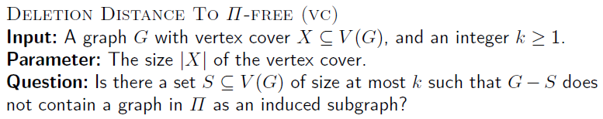
General positive results
Π | Problem
{K₂} | Vertex Cover
Cyclic graphs | Feedback Vertex Set
Graphs with an odd cycle | Odd Cycle Transversal
Graphs with a chordless cycle | Chordal Deletion
Graphs with a K_{3,3} or K₅ minor | Vertex Planarization
Not about expressibility in logic
Revolves around a closure property of graph families

Slide 9
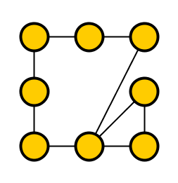
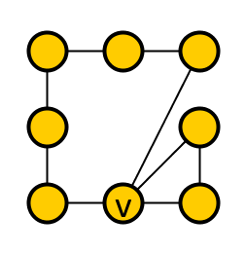
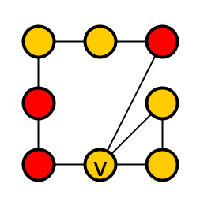
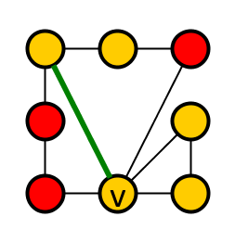
Properties characterized by few adjacencies
Graph property Π is characterized by c_{Π} adjacencies if:
  for any graph G in Π and vertex v in G,
  there is a set D ⊆ V(G) \ {v} of ≤ c_{Π} vertices,
  such that all graphs G’ made from G by changing the presence of edges between v and V(G) \ D,
  are contained in Π.
Example: property of having a chordless cycle (c_{Π}=3)
Non-example: having an odd hole

Slide 10
Some properties characterized by few adjacencies
Having a chordless cycle of length at least l [c = l - 1]
Containing H as a minor [ c = Δ(H) ]
For a Hamiltonian graph and vertex v, let D be the predecessor and successor on some Hamiltonian cycle
Let D be the neighbors of v in a minimal minor model [ deg(v) ≤ Δ(H) ]
Any finite set of graphs [ c = max_{H} |V(H)| - 1 ]
Hamiltonicity [ c = 2 ]
(Π ∪ Π’) is characterized by max(c_{Π}, c_{Π’}) adjacencies
(Π ∩ Π’) is characterized by c_{Π}+c_{Π’} adjacencies

Slide 11
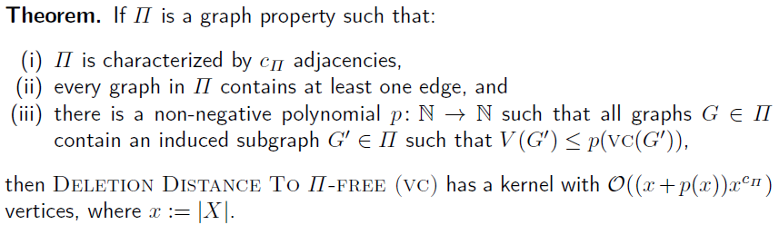
Generic kernelization scheme for
Deletion Distance to Π-Free
Set of forbidden graphs behaves “nicely”
Deletion Distance to {2 · K₁}-Free is Clique, for which a lower bound exists
All forbidden graphs contain an induced subgraph of size polynomial in their VC number
For Chordal Deletion let Π be graphs with a chordless cycle
Characterized by 3 adjacencies
All graphs with a chordless cycle have ≥ 4 edges
Satisfied for p(x) = 2x
  Vertex-minimal graphs with a chordless cycle are Hamiltonian
  For Hamiltonian graphs G it holds that |V(G)| ≤ 2 vc(G)
Chordal Deletion has a kernel with
O( (x + 2x) · x³) = O(x⁴) vertices

Slide 12
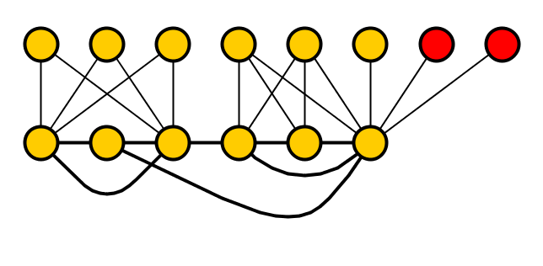
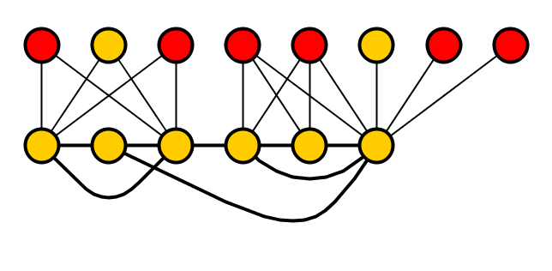
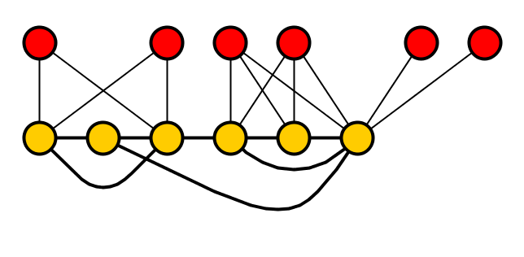
Reduction rule
Reduce(Graph G, Vertex cover X, integer l, integer c_{Π})
For each Y ⊆ X of size at most c_{Π}
  For each partition of Y into Y⁺ and Y⁻
    Let Z be the vertices in V(G) \ X adjacent to all of Y⁺ and none of Y⁻
    Mark l arbitrary vertices from Z
Delete all unmarked vertices not in X
Reduce(G, X, l, c) results in a graph on
O(|X| + l · c · 2^{c} · |X|^{c}) vertices
X
-
+
Example for c = 3 and l = 2

Slide 13
Kernelization strategy
Kernelization for input (G, X, k)
If k ≥ |X| then output yes
  Condition (ii): all forbidden graphs in Π have at least one edge, so X is a solution of size ≤ k
Return Reduce(G, X, k + p(|X|), c_{Π})
Size bound follows immediately from reduction rule

Slide 14
Correctness (I)
Suppose (G,X,k) is transformed into (G’,X,k)
G’ is an induced subgraph of G
  G-S is Π-free implies that G’-S is Π-free
Reverse direction: any solution S in G’ is a solution in G
  Proof…

Slide 15
Correctness (II)
G’-S Π-free ➔ G-S Π-free
Reduction deletes some unmarked vertices Z
Add vertices from Z back to G’-S to build G-S
If adding v creates some forbidden graph H from Π, consider the set D such that changing adjacencies between v and V(H)\D in H, preserves membership in Π
  We marked k + p(|X|) vertices that see exactly the same as v in D ∩ X
  |S| ≤ k and |V(H)| ≤ p(|X|) by Condition (iii)
  There is some marked vertex u, not in H, that sees the same as v in D ∩ X
As u and v do not belong to the vertex cover, neither sees any vertices outside X
  u and v see the same in D \ X, and hence u and v see the same in D
Replace v by u in H, to get some H’
  H’ can be made from H by changing edges between v and V(H) \ D
  So H’ is forbidden (condition (i)) – contradiction
d₁
v
u
X
d₂
d₃

Slide 16
Implications of the theorem
Polynomial kernels for the following problems parameterized by the size x of a given vertex cover
Vertex Cover | O(x²) vertices
Odd Cycle Transversal | O(x³) vertices
Feedback Vertex Set | O(x³) vertices
Chordal Vertex Deletion | O(x⁴) vertices
Vertex Planarization | O(x⁵) vertices
η-Transversal | O(x^{f(η)}) vertices
F-Minor-Free Deletion | O(x^{Δ+1})
Distance Hereditary Vertex Deletion | O(X⁶)
Chordal Bipartite Vertex Deletion | O(X⁵)
Pathwidth-t Vertex Deletion | O(x^{f(t)}) vertices

Slide 17
Largest Induced π-subgraph
Sufficient conditions for polynomial kernels

Slide 18
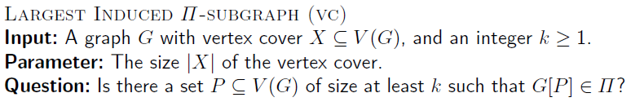
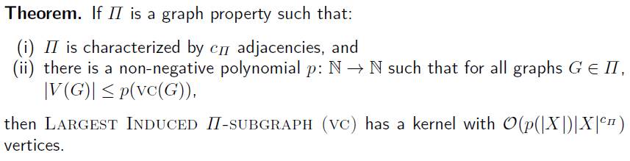
General positive results
Π | Problem
Hamiltonian graphs | Longest Cycle
Graphs with a Hamiltonian path | Longest Path
Graphs partitionable into triangles | Triangle Packing
Graphs partitionable into vertex-disjoint H | H-Packing

Slide 19
Minor testing vs. induced subgraph testing

Slide 20
Kernelization complexity overview
Graph family | Induced subgraph testing | Minor testing
Cliques K_{t} | No polynomial kernel | Polynomial kernel *
Stars K_{1,t} | Polynomial kernel * | No polynomial kernel
Bicliques K_{s,t} | No polynomial kernel * | No polynomial kernel
Paths P_{t} | No polynomial kernel * | Polynomial kernel
Matchings t · K₂ | No polynomial kernel * | P-time solvable
Problems are parameterized by the size of a given VC
Size t of the tested graph is part of the input

Slide 21
Conclusion
Generic reduction scheme yields polynomial kernels for Deletion Distance to π-free and Largest Induced π-subgraph
Gives insight into why polynomial kernels exist for these cases
  Expressibility with respect to forbidden / desired graph properties Π that are characterized by few adjacencies
Differing kernelization complexity of minor vs. induced subgraph testing
Open problems:
  Are there polynomial kernels for
    Perfect Vertex Deletion
    Bandwidth
  parameterized by Vertex Cover?
  More general theorems that also capture Treewidth, Clique Minor Test, etc.?
THANK YOU!

