Slide 1
Pleased to meet you
Bart M. P. Jansen
October 16th, Department dialogue

Slide 2
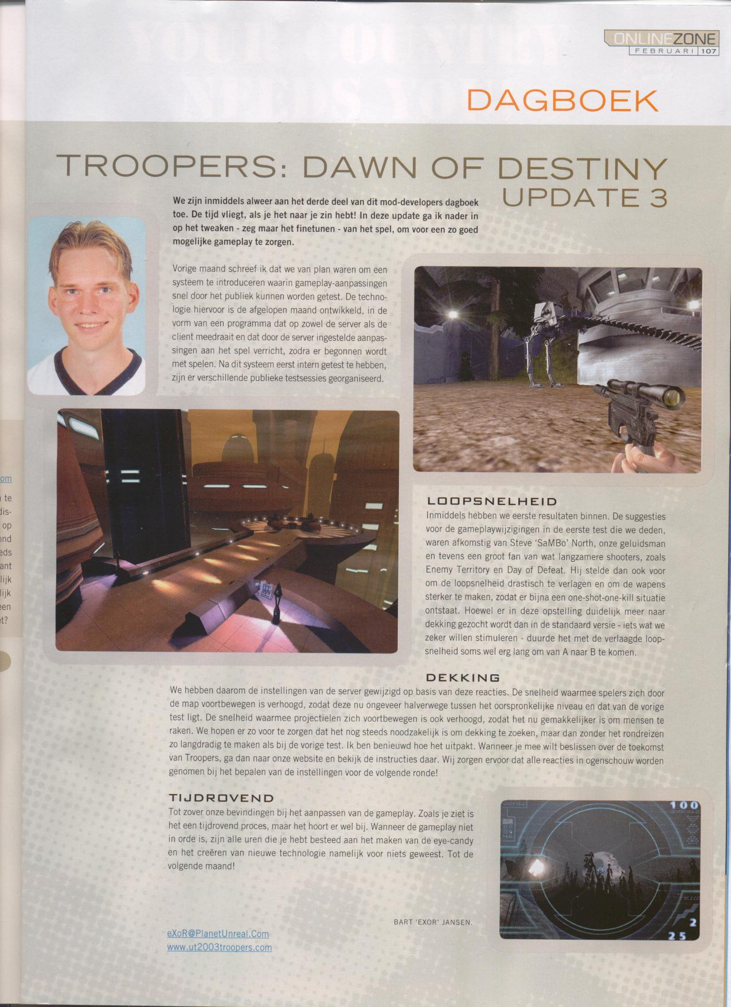
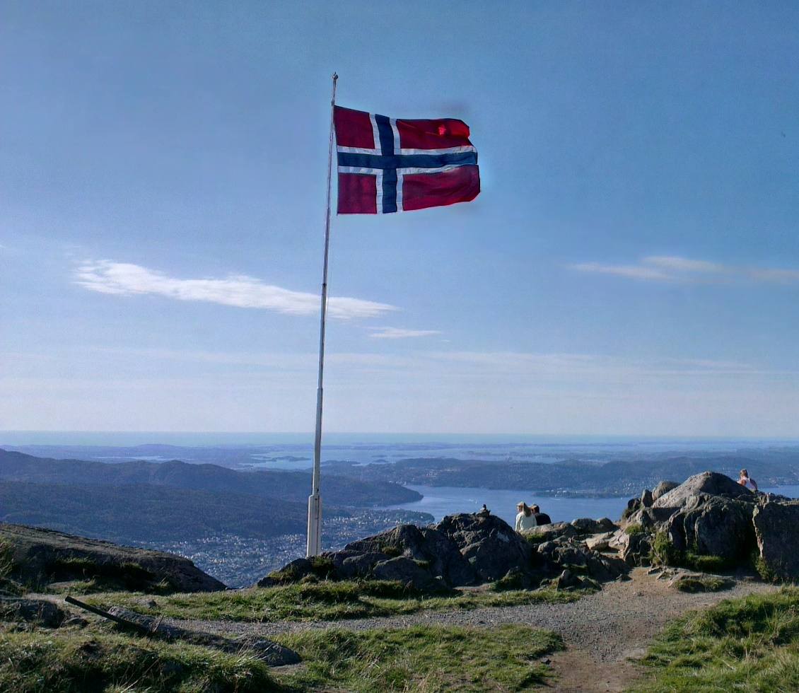
About me
1986 – 2004
Grew up around Nijmegen
Programmed extensions to computer games
2004 – 2009
Studied game design in Utrecht
Later applied computing science
2009 – 2013
Ph.D. student in Utrecht
Supervised by Hans Bodlaender & Jan van Leeuwen
The Power of Data Reduction
2013 – 2014
Postdoc at the University of Bergen, Norway

Slide 3
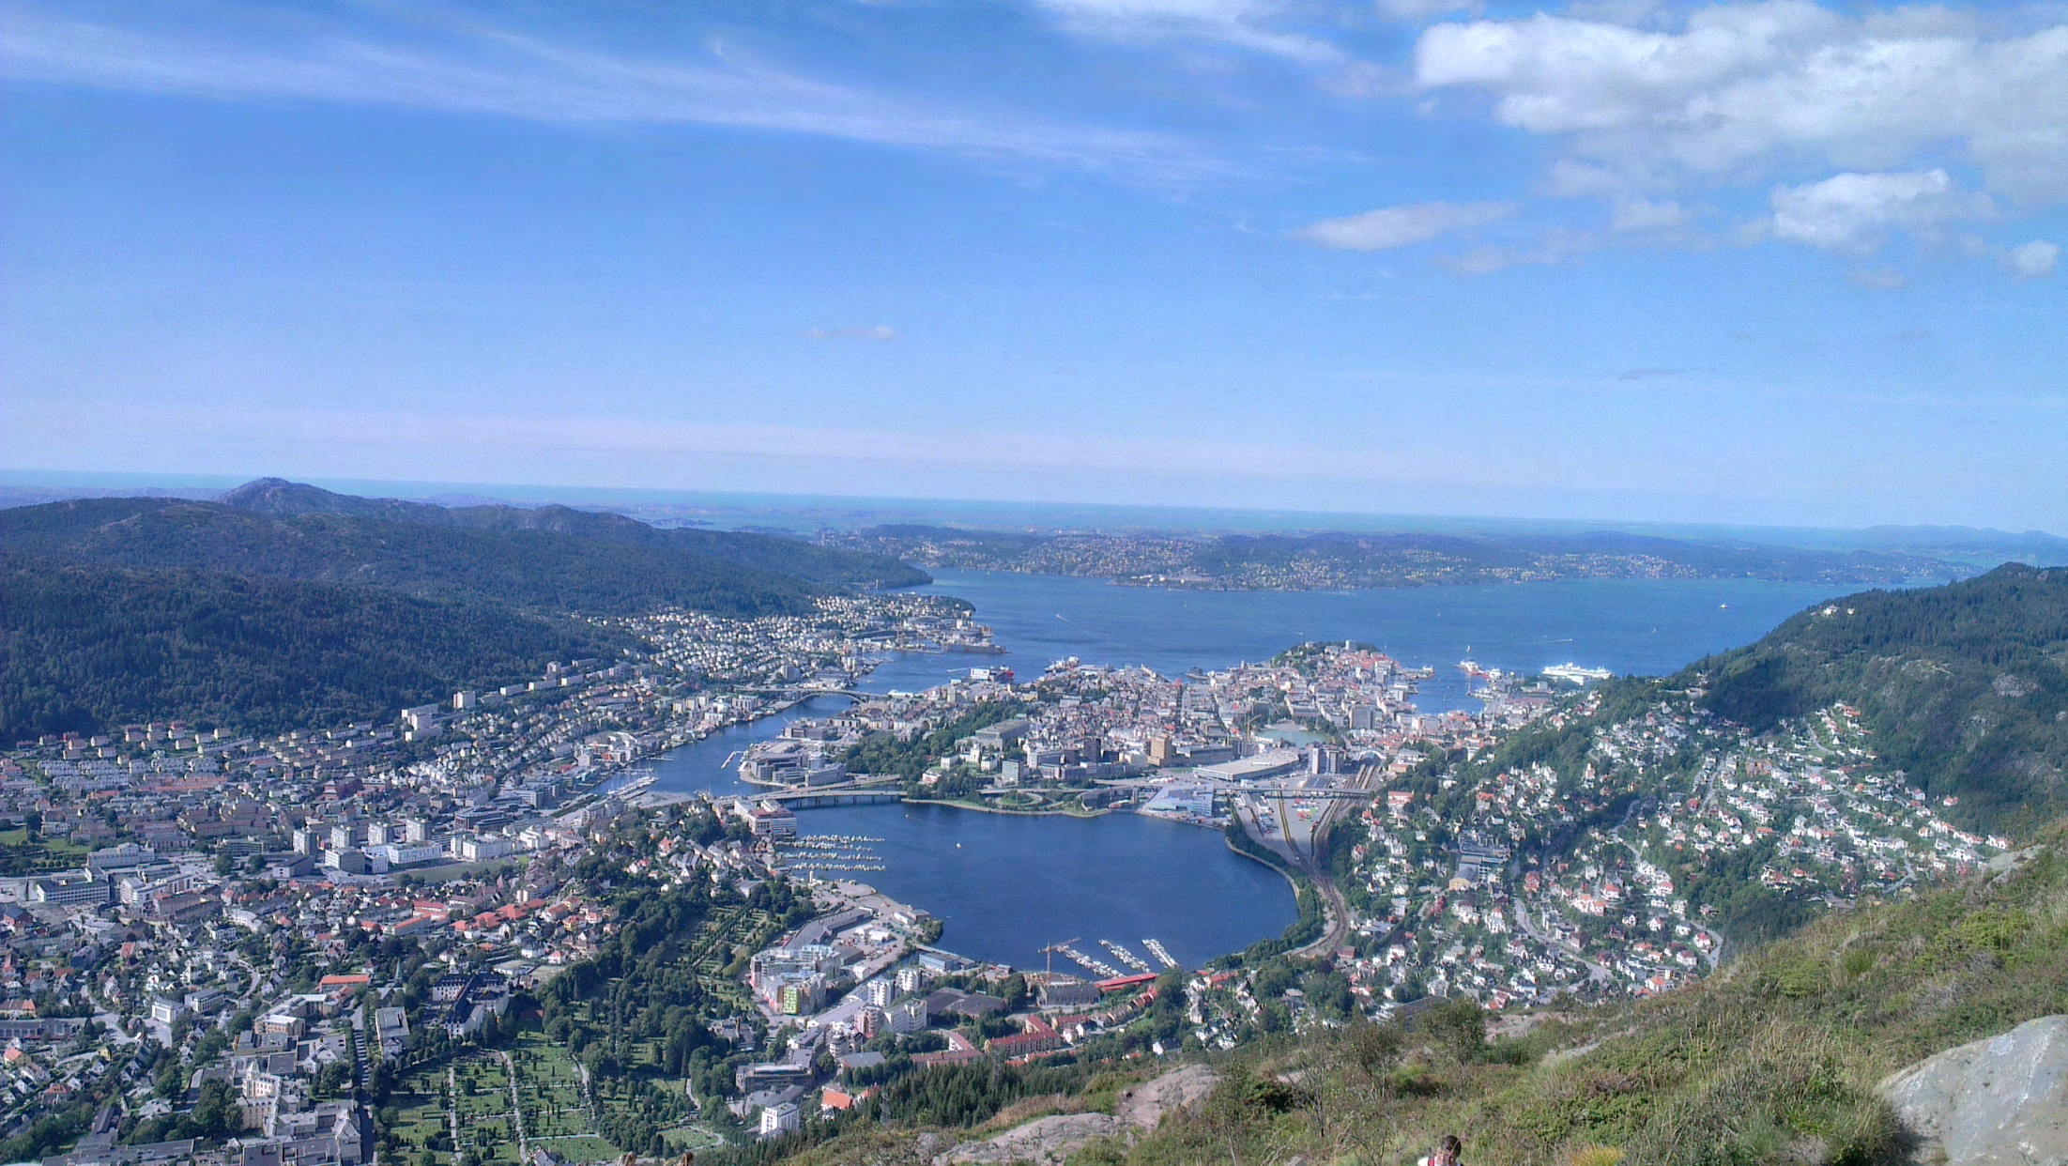
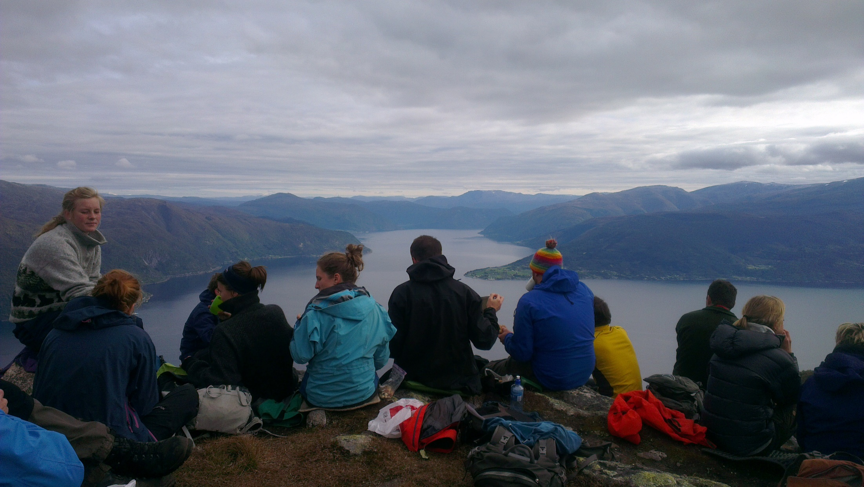
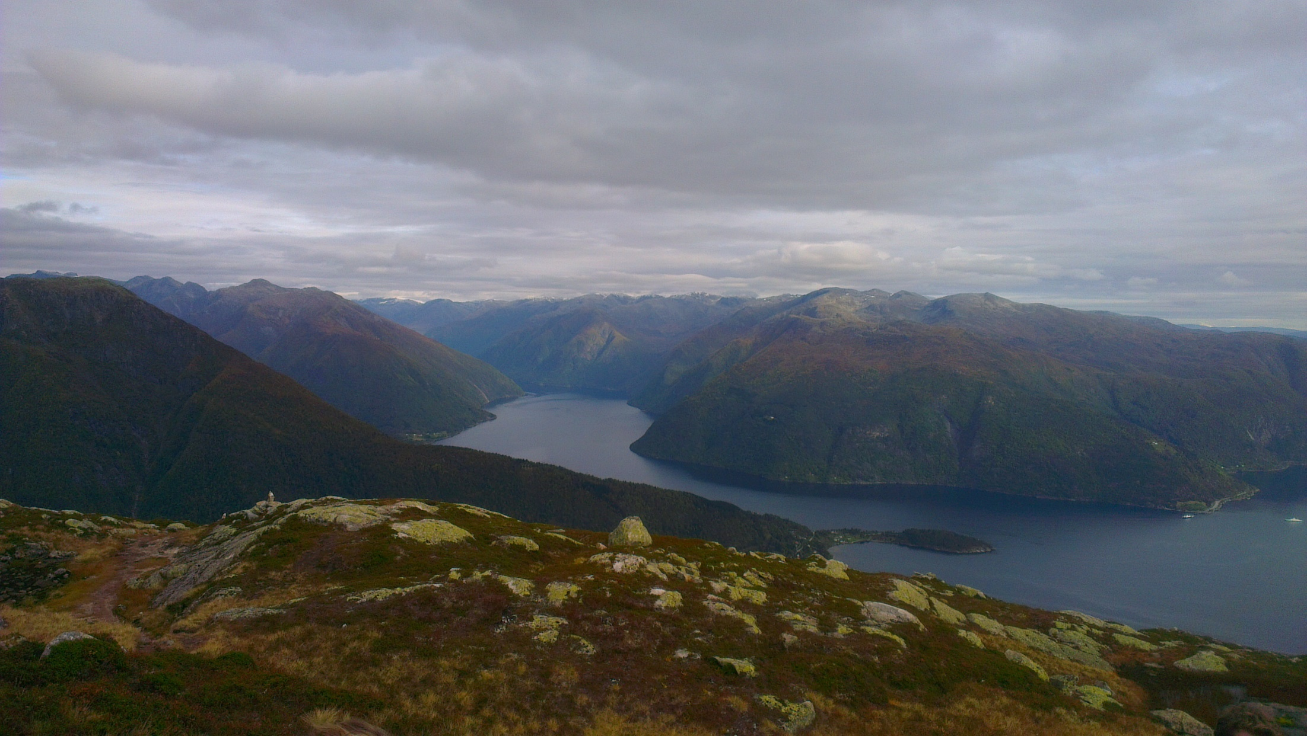
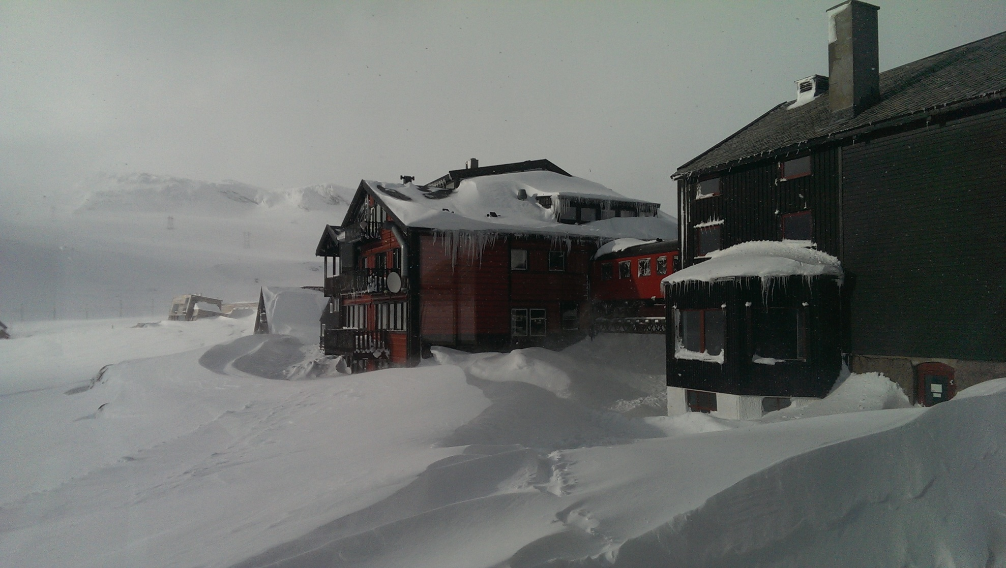
Norway

Slide 4
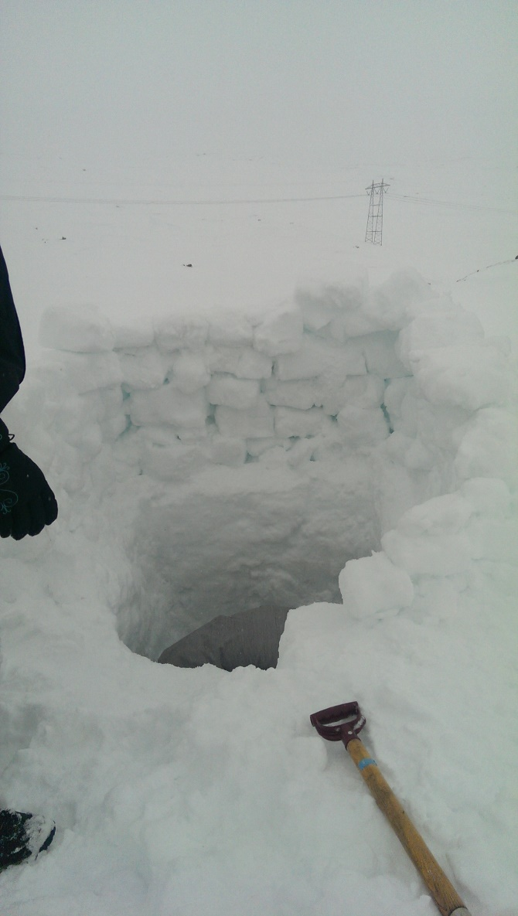
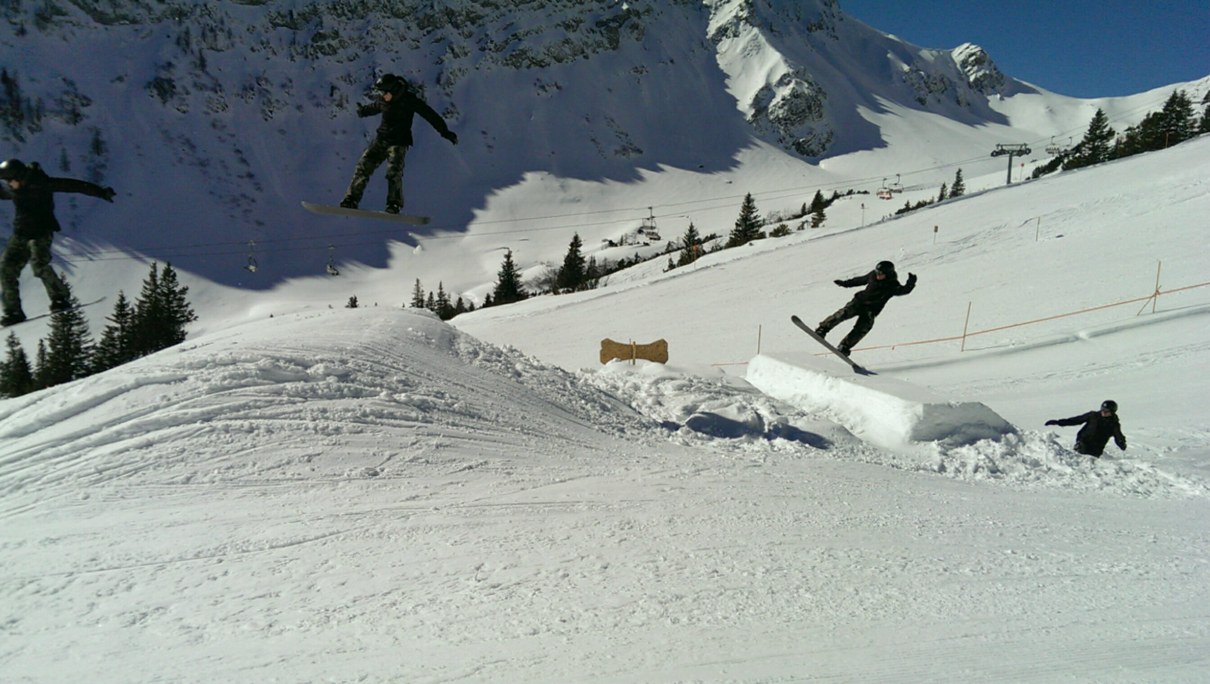
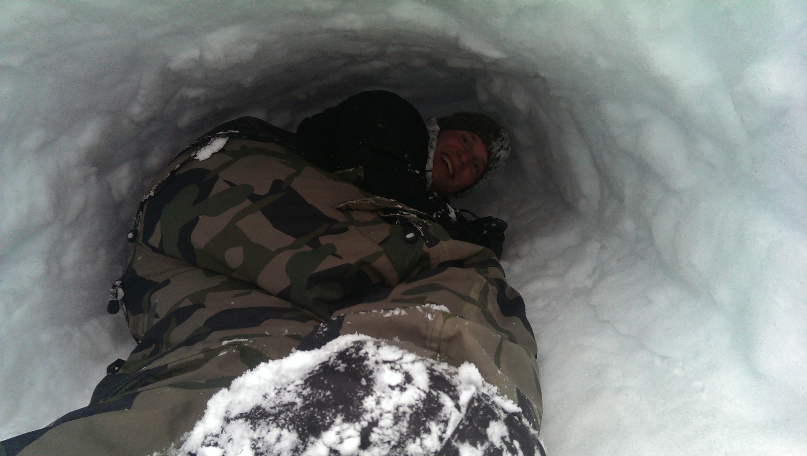
Snow hobbies

Slide 5
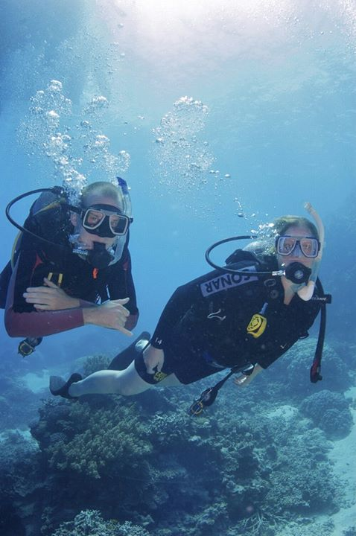
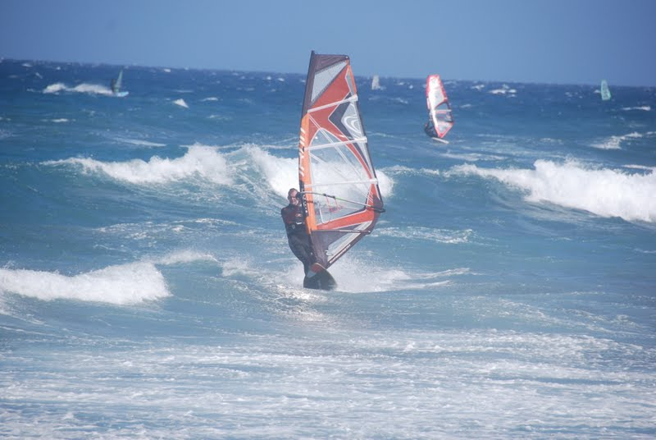
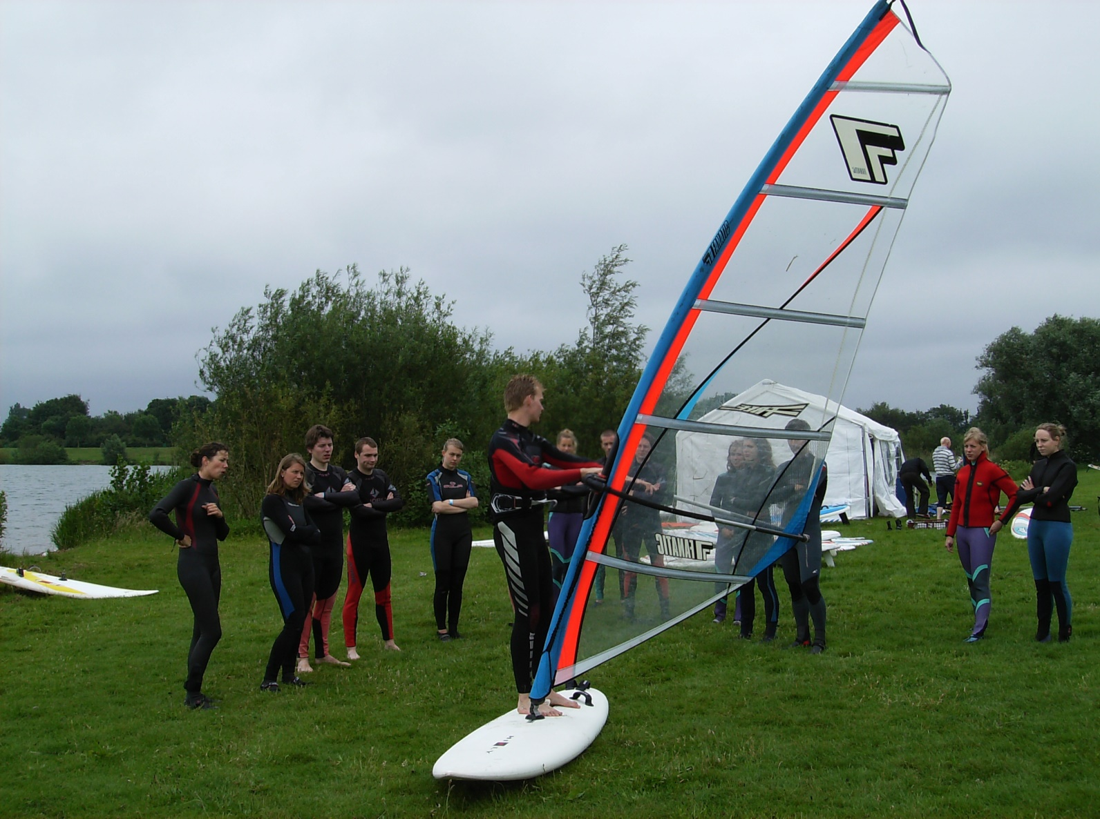
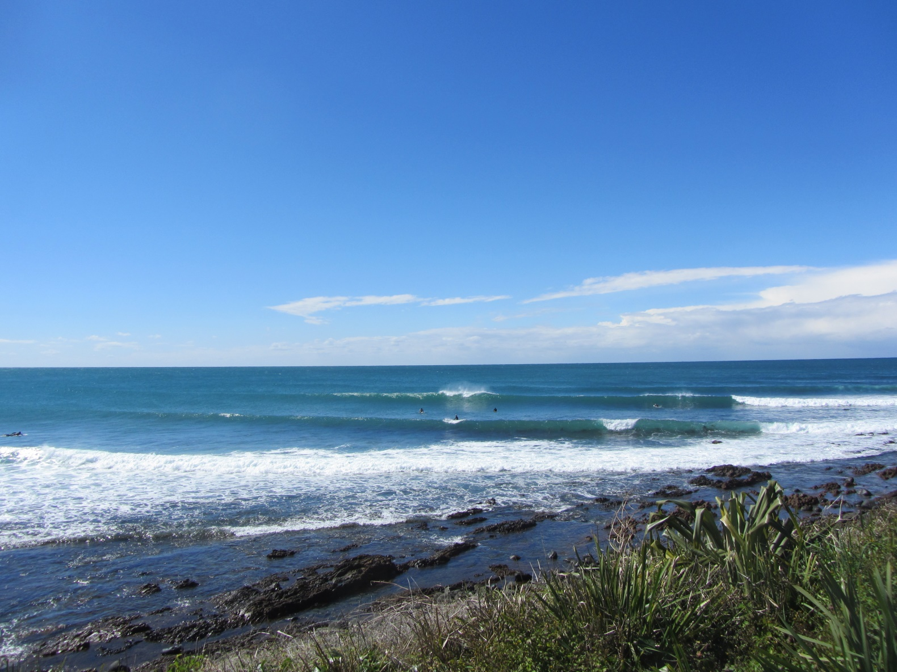
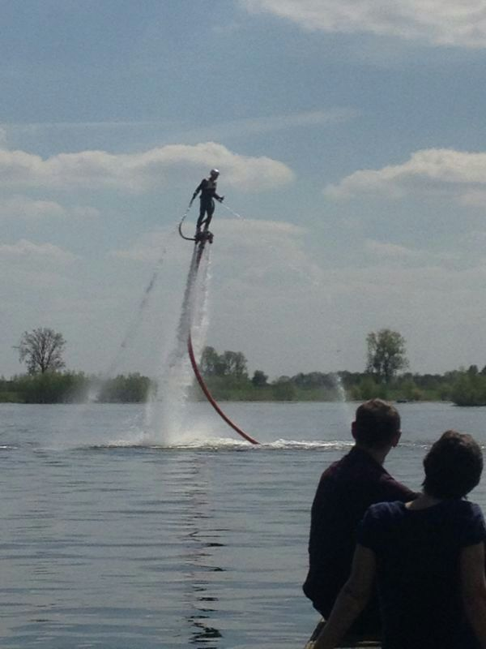
Water hobbies

Slide 6
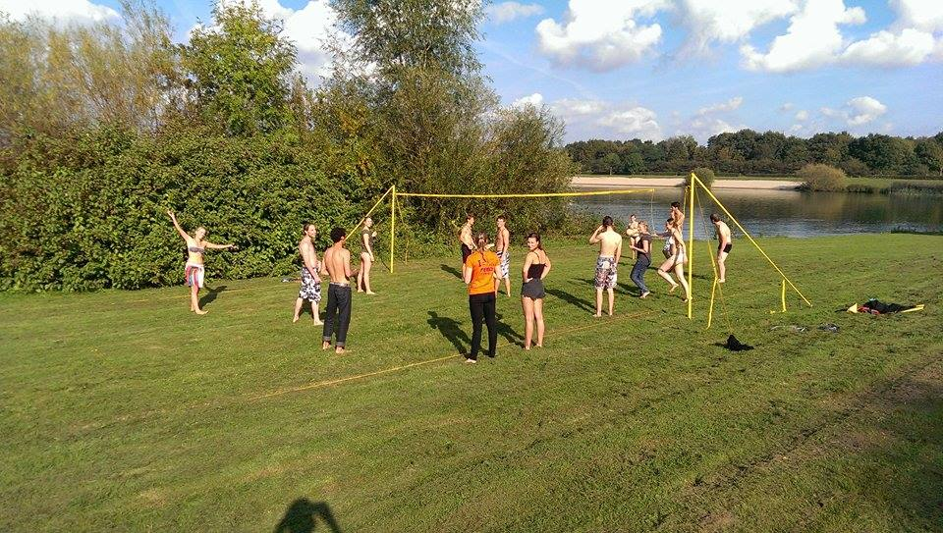
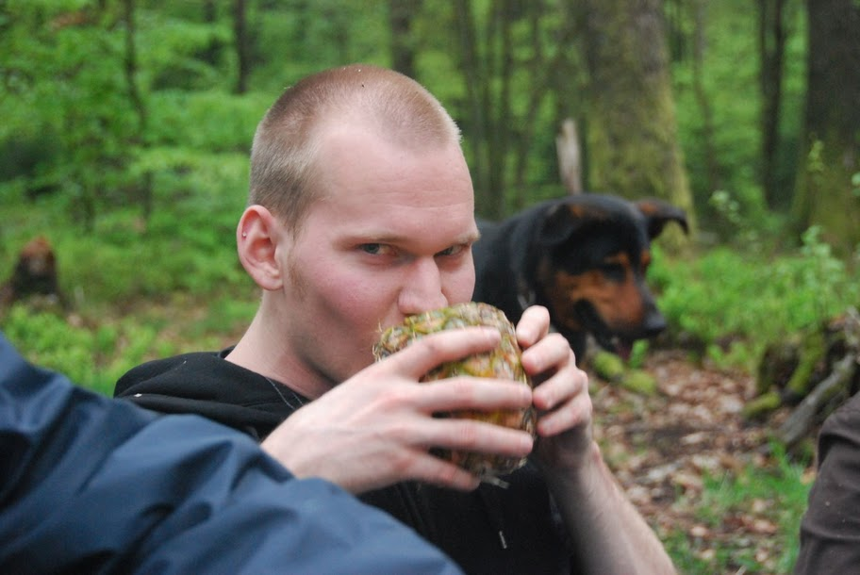
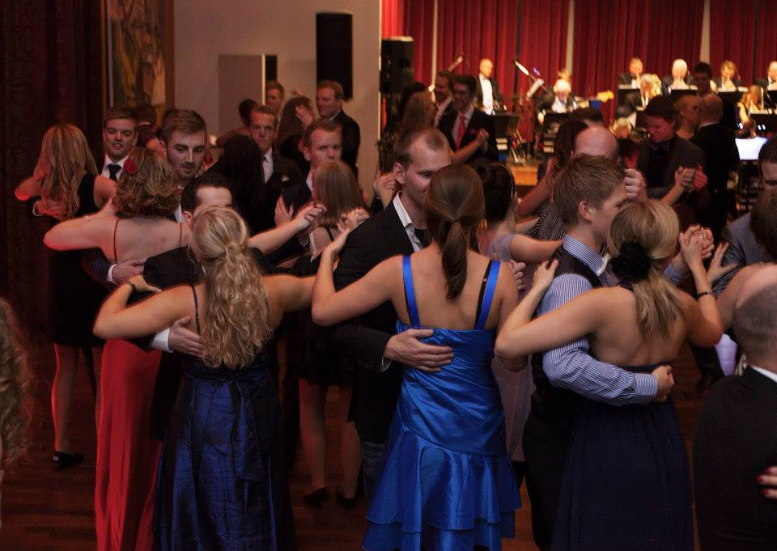
Land hobbies

Slide 7
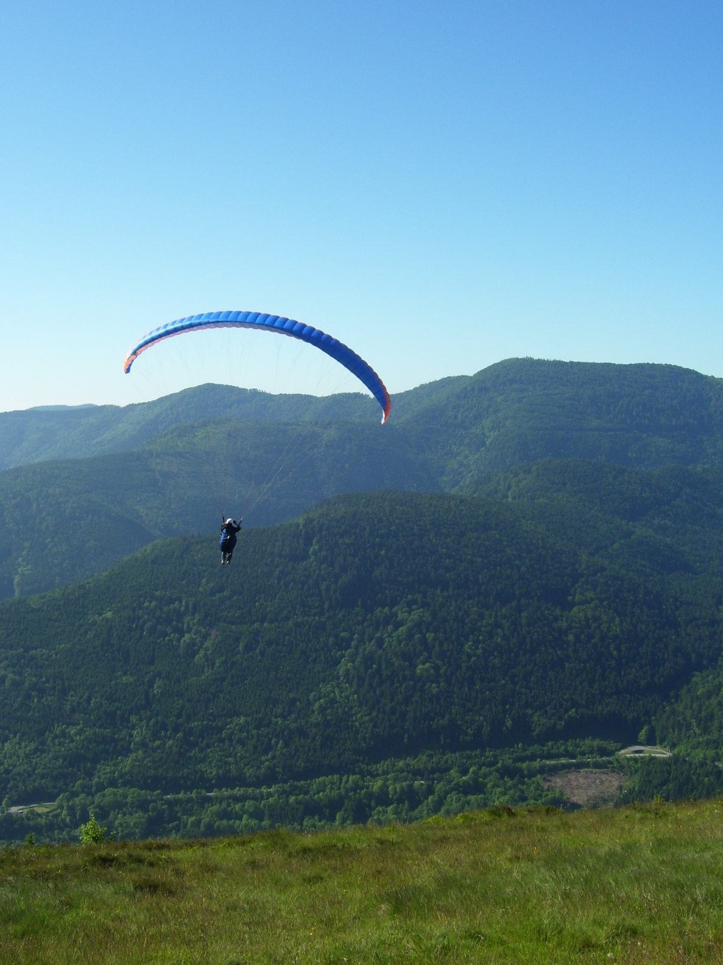
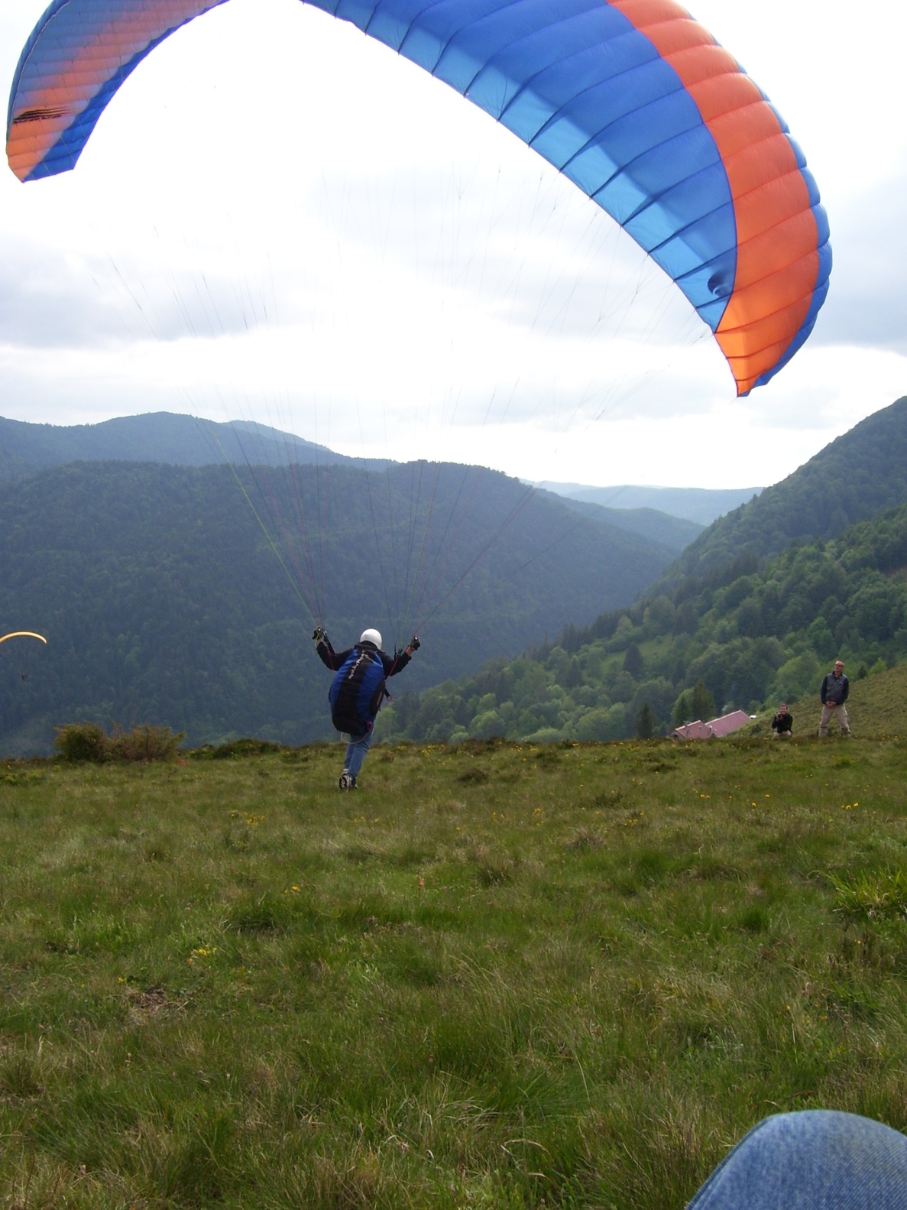
Air hobbies

Slide 8
Christiaan Huygens award
For ICT, given once every 5 years
Awarded for my PhD thesis
“
de promovendus die de meest vernieuwende en maatschappelijke relevantie resultaten heeft geboekt binnen de informatie- en communicatie-technologie in de afgelopen 5 jaar bij één van de Nederlandse universiteiten of onderzoeksscholen
”

Slide 9
Veni grant
This summer, my veni proposal was funded by NWO
Frontiers in Parameterized Preprocessing
It deals with provably good preprocessing for hard problems

Slide 10
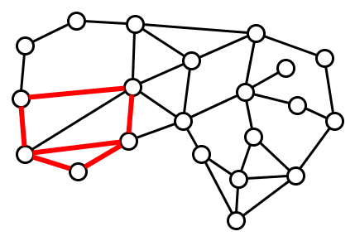
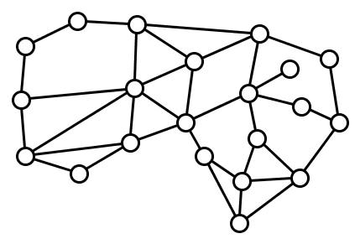
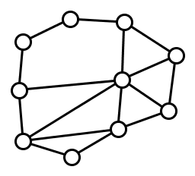
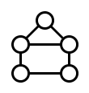
Preprocessing for finding patterns in networks
Does contain ?
Goal is to efficiently reduce to an question whose answer is the same, and whose encoding size is provably small in terms of a chosen parameter

Slide 11
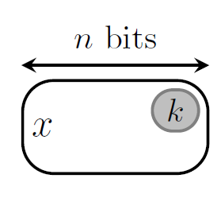
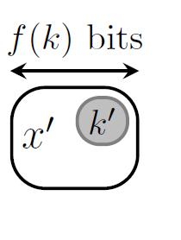
Frontiers in preprocessing
I will investigate more general models of preprocessing
?

Slide 12
Position in Eindhoven
Since September 2014, assistant professor in the Algorithms and Visualization group
Appointed on the Networks project

Slide 13
My research background
Multivariate algorithmics / parameterized complexity / fixed-parameter tractability
Classic algorithm design
Measure quality of an algorithm by the dependency on the running time on the total input length
$$O(n\log{n), O\left(n^{2}\left(n+m\right)\right),O\left(2^{n}⋅n\right), etc.}$$
Parameterized algorithmics
Not all aspects of the input contribute equally to the problem difficulty
Take a secondary measurement of the input, besides its length
This used as the parameter $k$
$$O\left(2^{k}⋅n^{3}\right),O\left(n^{k−1}\right),etc$$
$k$-Vertex Cover
𝑘-Vertex Cover
Solvable in $O(2^{k}⋅n)$
Solvable in 𝑂(2^𝑘⋅𝑛)
$k$-Clique
𝑘-Clique
Solvable in $O(n^{k})$
Solvable in 𝑂(𝑛^𝑘)

Slide 14
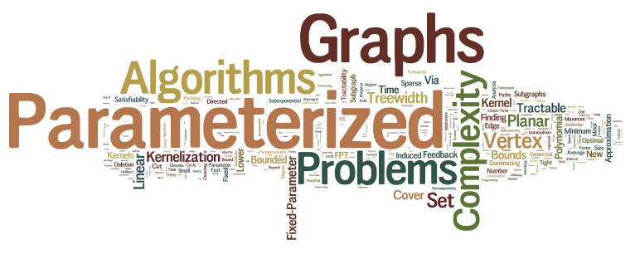
The end

