Slide 1
The Power of Preprocessing
Insert «Academic unit» on every page: 1 Go to the menu «Insert» 2 Choose: Date and time 3 Write the name of your faculty or department in the field «Footer»
4 Choose «Apply to all"
Bart M. P. Jansen
July 14th 2014, Eindhoven

Slide 2
Preprocessing for hard problems
For a large group of computational problems, no algorithm is known that always finds the answer quickly
Such NP-complete problems come from all kinds of important applications:
Train scheduling, design of network infrastructure, delivery route planning, DNA sequencing, etc.
Technique of preprocessing often reduces computation time
Simplify the input using simple reduction rules that do not change the answer
Run the (resource demanding) algorithm on the simplified problem

Slide 3
Parameterized preprocessing
Provable guarantee on amount of simplification, expressed in terms of a complexity parameter
A big problem with a small parameter can be reduced to a small problem whose answer is the same
Irrelevant information is removed to reduce to the kernel of the problem
The data reduction process is called kernelization

Slide 4
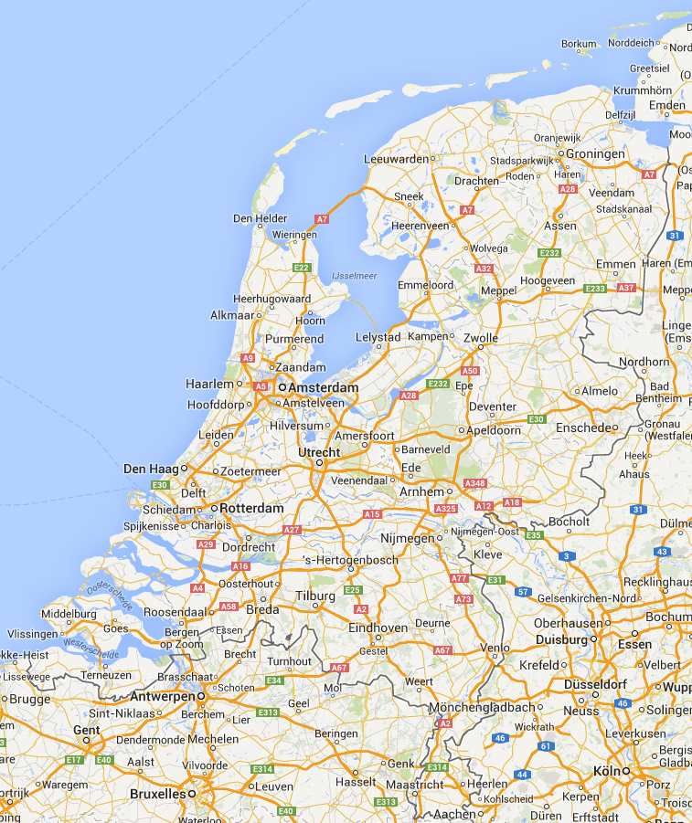

Slide 5
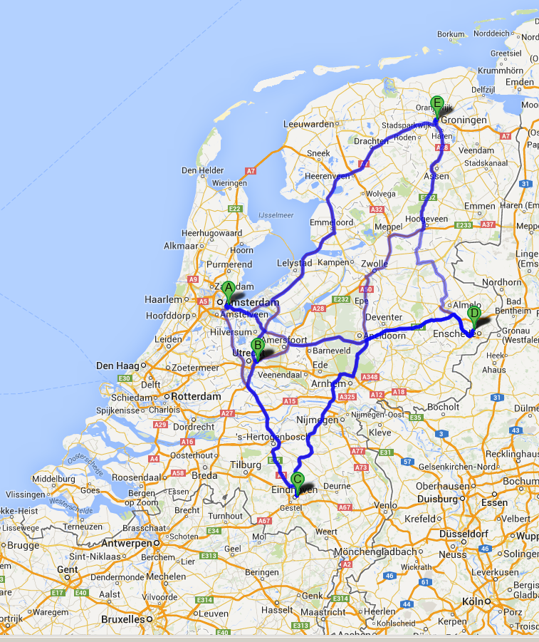

Slide 6
The core of the problem
Shortest tour: 638 km
50km
177km
187km
155km
123km
145km
90km
133km
251km
176km

Slide 7
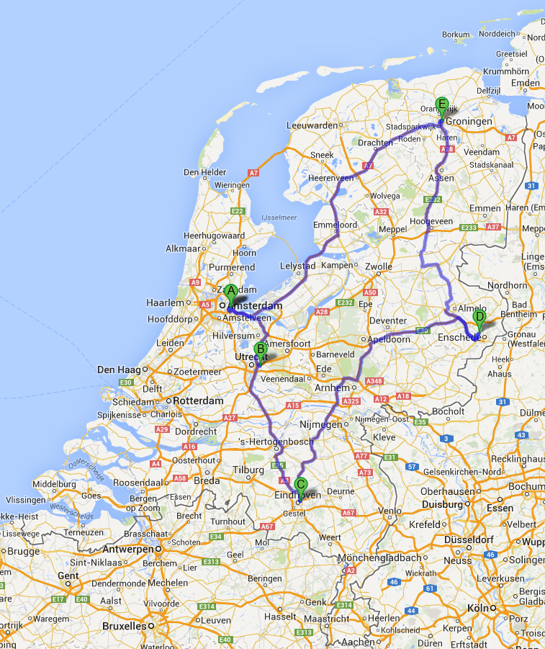

Slide 8
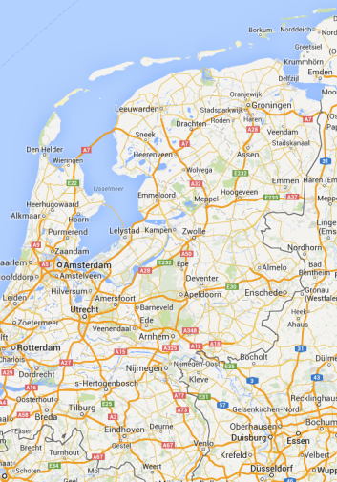
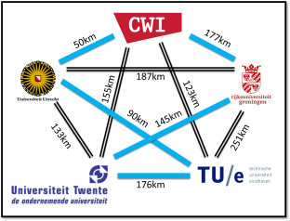
The basic model of kernelization
A kernelization is an algorithm that efficiently reduces a parameterized input to an equivalent input whose size is bounded in the parameter
5
5

Slide 9
Why investigate kernelization
Preprocessing allows solutions to be found quicker
The search for the best solution often has to be cut off due to time restrictions
Preprocessing then allows better solutions to be found in the same time
Better means: using less fuel in a delivery route, using fewer trains to run the time table, etc.
Kernelization is a widely applicable, fundamental technique with a beautiful mathematical structure

Slide 10
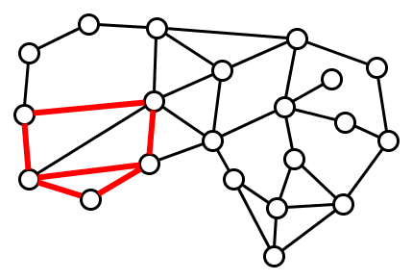
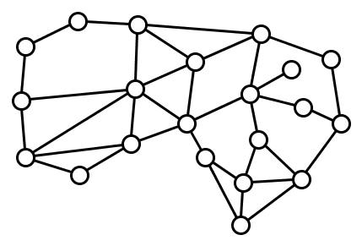
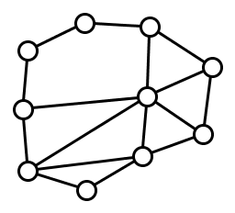
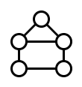
Finding patterns in networks
Does contain ?
Bart M. P. Jansen and Dániel Marx
Characterizing the easy-to-find subgraphs from the viewpoint of polynomial-time algorithms, kernels, and Turing kernels
Submitted to SODA

Slide 11
Exploring the parameter landscape
Kernelization gives provable size reduction in terms of the chosen parameter
What parameter to choose?
Number of visiting points in the tour
Size of the pattern graph
Use the complexity of the network as the parameter!
If the input has a large but simple network, can we reduce to a smaller network without changing the answer?
Michael R. Fellows, Bart M. P. Jansen, and Frances Rosamond Towards fully multivariate algorithmics: Parameter ecology and the deconstruction of computational complexity
Published in European Journal of Combinatorics (2013)

Slide 12
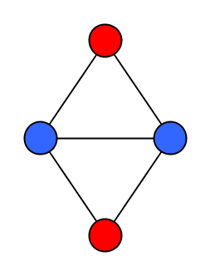
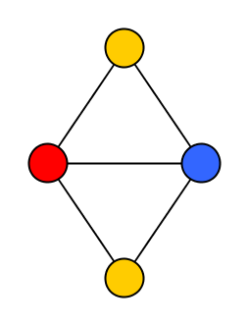
The graph coloring problem
Assign colors to nodes of a network such that adjacent nodes get different colors
Use as few colors as possible
Models scheduling and frequency assignment problems

Slide 13
The parameterized complexity of graph coloring
Bart M. P. Jansen and Stefan Kratsch
Data reduction for graph coloring problems
Published in Information and Computation (2013)

Slide 14
Multi-output kernelization
In some settings, it is provably impossible to efficiently reduce the problem to a single, small instance
Then we study preprocessing algorithms that output a list of small instances that can be solved in parallel

Slide 15
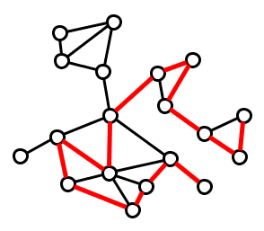
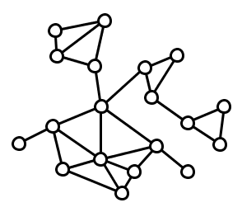
Finding long paths in planar graphs
Bart M. P. Jansen
Turing Kernelization for Finding Long Paths and Cycles in Restricted Graph Classes
To appear at ESA 2014

Slide 16
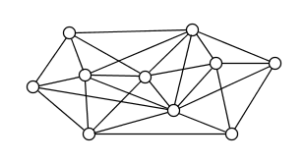
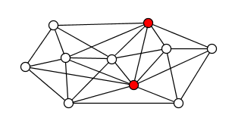
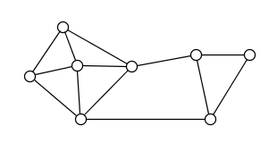
Parameterized algorithms
Algorithms that solve NP-hard problems exactly and that are efficient on large inputs if the parameter is small
Example: the Planarization problem
Algorithm with running time $2^{O(k\log{k})}∙n$
Bart M. P. Jansen, Daniel Lokshtanov, and Saket Saurabh
A near-optimal planarization algorithm
Appeared in SODA 2014

Slide 17
Future research
The power of multi-output kernelization
Find new preprocessing techniques that give multiple outputs
Analyzing the Longest Path problem in unrestricted graphs
Prove impossibility of multi-output kernelization in certain settings
Parameterized analysis of random graphs
Many NP-hard problems become easier on random graphs
Can parameterized analysis explain why?
Analyzing the Planarization problem
Is there an efficient approximation algorithm?
Is there a single-output, or multi-output, kernelization algorithm?

Slide 18
Thank you!

