Slide 1
Fine-grained complexity analysis of computational problems on networks
Bart M. P. Jansen
March 23rd 2016, BeNeLuxMC, Amsterdam, The Netherlands

Slide 2
My background
Theoretical computer scientist
Graph algorithms & complexity theory
Goal for this talk:
Share exciting recent insights into the computational complexity of some very fundamental network problems
Disclaimer:
The presented work is not my own
I have contributions in this area, which are less suitable for a 40-minute talk
I spent 3 months @ UC Berkeley in a research program devoted to this topic

Slide 3
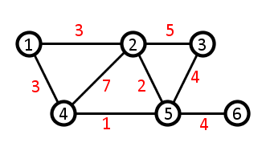
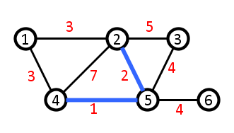
Fundamental network optimization problems
X All-Pairs Shortest Paths (apsp)
X Input: An (undirected) graph $G$ with vertices numbered $1…n$ and non-negative integer edge weights
X Output: An $n×n$ matrix $M$ such that $M_{ij}$ is the length of a shortest path from $i$ to $j$
$$j$$
$$i$$
0
 | 0 |  | 3
 |  | 0
 | 3 |  | 0
 |  |  |  | 0
 |  |  |  |  | 0
All-Pairs Shortest Paths

Slide 4
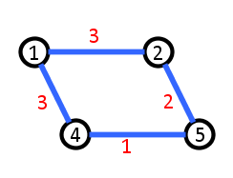
Fundamental network optimization problems
X Shortest Cycle
X Input: An edge-weighted graph
X Output: A cycle of minimum length
All-Pairs Shortest Paths
Shortest Cycle

Slide 5
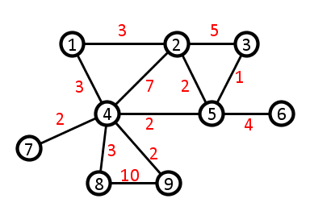
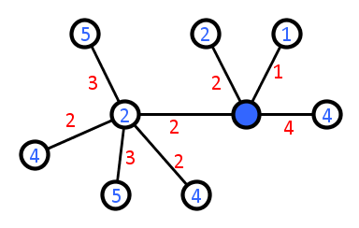
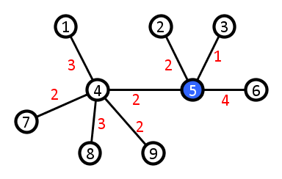
Fundamental network optimization problems
X Radius
X Input: An edge-weighted graph
X Output: A vertex $v$ minimizing $\max_{u}{δ\left(v,u\right)}$
$δ\left(v,u\right)=$ length of shortest $v−u$ path
All-Pairs Shortest Paths
Shortest Cycle
Radius

Slide 6
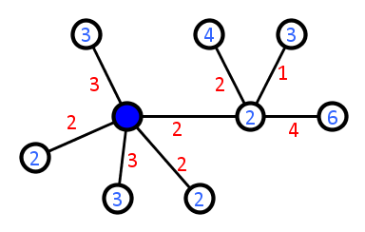
Fundamental network optimization problems
X Median
X Input: An edge-weighted graph
X Output: A vertex $v$ minimizing $\sum_{u}{δ\left(v,u\right)}$
$$\sum_{u}{δ\left(v_{5},u\right)=27}$$
$$\sum_{u}{δ\left(v_{4},u\right)=25}$$
All-Pairs Shortest Paths
Shortest Cycle
Radius
Median

Slide 7
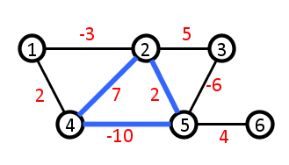
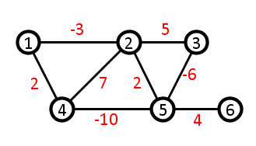
Fundamental network optimization problems
X Negative Triangle Detection
X Input: An undirected graph with integer edge weights (positive and negative!)
X Output: Yes if there is a triangle whose total weight is negative, No otherwise
“Yes”
All-Pairs Shortest Paths
Shortest Cycle
Radius
Median
Negative Triangle Detection

Slide 8
Current state of the art
These problems can be solved in $O\left(n^{3}\right)$ time on $n$-vertex graphs
For Negative Triangle Detection this is trivial, others less so
Runtime $O\left(n^{3}\right)$ is theoretically efficient (polynomial time)
Not practical on large networks (the Facebook graph)
$n^{3}$ steps take 10 years for one million vertices at $3$ Ghz
Throughout this talk, algorithm means:
Provably correct procedure
Finishes in the claimed time for all inputs
Do faster algorithms exist?
All-Pairs Shortest Paths
Shortest Cycle
Radius
Median
Negative Triangle Detection

Slide 9
Truly subcubic algorithms
Despite intensive research since the 1960’s, no algorithm with running time $O\left(n^{2.99}\right)$ known for any of these problems
Is there a truly subcubic algorithm for any of these problems?
Running time $O(n^{3−ε})$ for some $ε>0$
Conceivably not for All-Pairs Shortest Paths
Have to compute $n^{2}$ different numbers
Each number is computed from a path with up to $n$ edges
But what about Negative Triangle Detection?
Output consists of only a single bit (yes or no)
All-Pairs Shortest Paths
Shortest Cycle
Radius
Median
Negative Triangle Detection

Slide 10
Recent fine-grained complexity insights
Proving that fast algorithms do not exist is notoriously hard
Despite work since 1970’s, no proof of $P≠NP$ in sight
No proof that apsp needs $n^{3}$ time, either
But there is enormous progress in connecting problems!
$O(n^{3−ε})$ algorithm for one $⇒$ $O(n^{3−δ})$ algorithm for others
Theorem. If any of the problems below can be solved in truly subcubic time, then all of them can.
[Vassilevska Williams & Williams, ’10] [Abboud, Vassilevska Williams, Grandoni, ‘15]
All-Pairs Shortest Paths
Shortest Cycle
Radius
Median
Negative Triangle Detection

Slide 11
What does this tell us?
Optimist
Pessimist
To speed up all these problems, only have to find 1 algorithm!
These equivalent problems form a fundamental barrier that cannot be overcome

Slide 12
How can this be?
Suppose Negative Triangle Detection can be solved in $O\left(n^{2.9}\right)$
How would this help us solve apsp faster than $O(n^{3})$?
Triangle detection only outputs one bit
For apsp we need to find $n^{2}$ distance values
But $n^{2}$ calls to Negative Triangle take $O(n^{4.9})$ time?!
Theorem. If any of the problems below can be solved in truly subcubic time, then all of them can.
[Vassilevska Williams & Williams, ’10] [Abboud, Vassilevska Williams, Grandoni, ‘15]
All-Pairs Shortest Paths
Shortest Cycle
Radius
Median
Negative Triangle Detection

Slide 13
A glimpse of the proof
The proof is elementary and very elegant
Unfortunately, it is slightly too long for this talk
We present similar reductions between two other problems
Using many of the same ideas
(Unweighted) Triangle Detection
Given an unweighted graph, does it have a triangle yes or no?
Boolean Matrix Multiplication (next slide)
Output consists of $1$ bit
Theorem. If Boolean Matrix Mult. can be solved in $O\left(n^{3−ε}\right)$ time, then Triangle Detection can be solved in $O\left(n^{3−ε}\right)$ time.
Output consists of $n^{2}$ bits
[Itai & Rodeh, ’78]
Theorem. If Triangle Detection can be solved in $O\left(n^{3−ε}\right)$ time, then Boolean Matrix Mult. can be solved in $O\left(n^{3−ε/3}\right)$ time.
[Vassilevska Williams & Williams, ’10]

Slide 14
A fundamental matrix product
Boolean Matrix Multiplication Input: Two $n×n$ Boolean matrices $A$ and $B$ Output: The Boolean product $C≔A×B$, where $C_{ij}≔\bigvee_{1≤k≤n}{{(A}_{ik}∧B_{kj})}$
$$\left(\begin{matrix}1 & 1 & 0 \\ 1 & 0 & 1 \\ 0 & 0 & 1\end{matrix}\right)×\left(\begin{matrix}1 & 0 & 0 \\ 0 & 1 & 0 \\ 1 & 0 & 1\end{matrix}\right)=\left(\begin{matrix}1 & 1 & 0 \\ 1 & 0 & 1 \\ 1 & 0 & 1\end{matrix}\right)$$
$C_{ij}=1$ if and only if $i$th row of $A$ and $j$th column of $B$ have a nonzero inner product
$$A$$
$$B$$
$$C$$

Slide 15
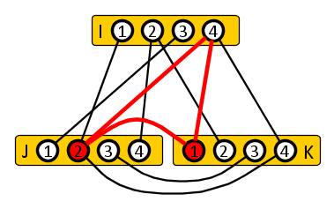
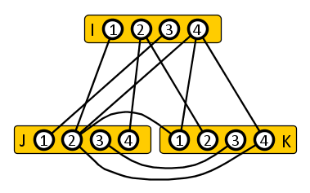
Boolean matrix products using Triangle Detection
Show that any Triangle Detection algorithm can be used to find triangles in tripartite graphs, in the same asymptotic runtime
Turn matrices $A$ and $B$ into a tripartite graph with parts $I,J,K$:
${\left(A×B\right)}_{xy}=1⇔$ there is a triangle containing $J_{x}$ and $K_{y}$
Using (1) and a hypothetical fast algorithm for Triangle Detection, we can efficiently find all pairs $x,y∈J×K$ occurring in a triangle
Theorem. If Triangle Detection can be solved in $O\left(n^{3−ε}\right)$ time, then Boolean Matrix Mult. can be solved in $O\left(n^{3−ε/3}\right)$ time.
[Vassilevska Williams & Williams, ’10]
$$\left(\begin{matrix} & & \\ & A & \\ & & \end{matrix}\right)×\left(\begin{matrix} & & \\ & B & \\ & & \end{matrix}\right)= … ?$$

Slide 16
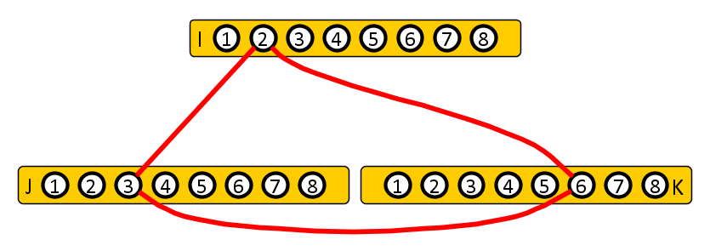
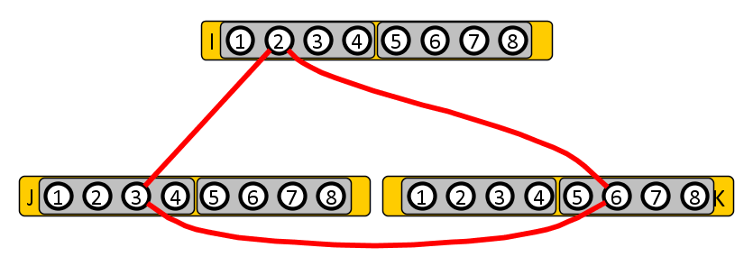
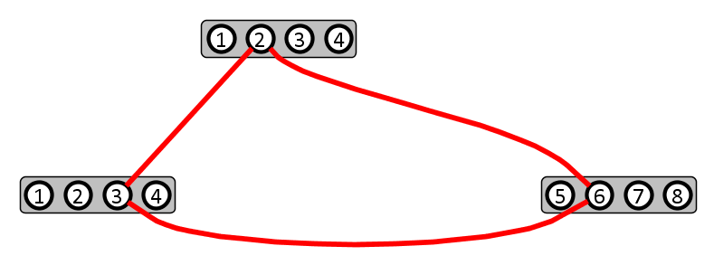
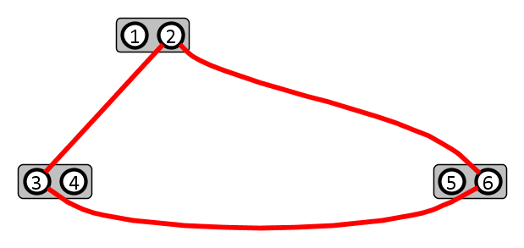
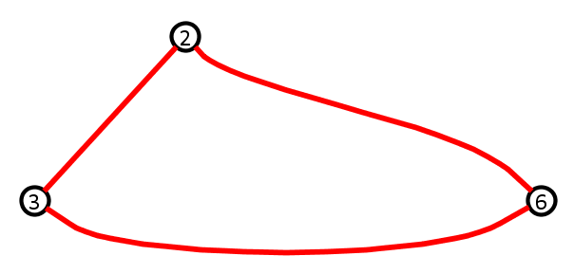
(1) Finding a triangle in a tripartite graph
… using a subroutine that detects whether a triangle exists
Split each part in two halves of equal size
For each of the 8 ways to select 1 half from each part:
Use Triangle Detection subroutine on the sub-instance
If $Δ$ exists: recursively Find $Δ$ in the sub-instance, stop
Observation. To find $Δ$ in tripartite graph with parts of size $n$:
8 calls to Triangle Detection with parts of size $n/2$
1 recursive call to Find Triangle with parts of size $n/2$

Slide 17
(1) Running time analysis
Suppose Triangle Detection takes $D(n)$ time with $n$ nodes/part
Runtime $F(n)$ to find a triangle, in an input with $n$ nodes/set:
$$F\left(n\right)≤8D\left(\frac{n}{2}\right)+F\left(\frac{n}{2}\right)$$
$$8D\left(\frac{n}{2}\right)$$
$$8D\left(\frac{n}{4}\right)$$
$$8D\left(\frac{n}{8}\right)$$
$$8D\left(\frac{n}{16}\right)$$
$$8D\left(\frac{n}{32}\right)$$

Slide 18
(1) Running time analysis
Suppose Triangle Detection takes $D(n)$ time with $n$ nodes/part
Runtime $F(n)$to find a triangle, in an input with $n$ nodes/set:
$$F\left(n\right)≤8D\left(\frac{n}{2}\right)+F\left(\frac{n}{2}\right)$$
As $D\left(n\right)≥n$, the geometric series yields $F\left(n\right)≤16D(n)$
Finding a triangle is asymptotically equally fast as detecting one
$$8D\left(\frac{n}{2}\right)$$
$$8D\left(\frac{n}{4}\right)$$
$$8D\left(\frac{n}{8}\right)$$
$$8D\left(\frac{n}{16}\right)$$
$$8D\left(\frac{n}{32}\right)$$
Lemma. For tripartite graphs, the following holds:
algorithm for Triangle Detection with runtime $O\left(n^{c}\right)$ $⇒$
algorithm for Triangle Finding with runtime $O(n^{c})$.
[Folklore]

Slide 19
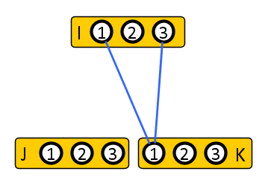
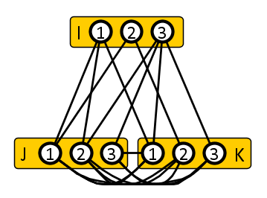
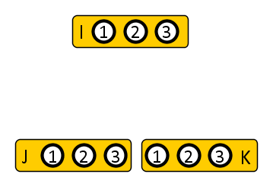
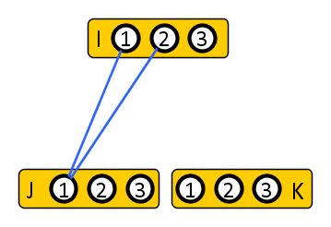
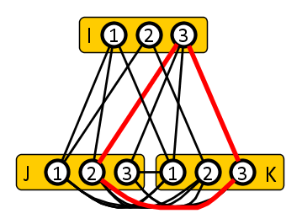
(2) Turning bmm into a graph problem
Turn matrices $A$ and $B$ into tripartite graph with parts $I,J,K$:
${\left(A×B\right)}_{xy}=1⇔$ there is a triangle containing $J_{x}$ and $K_{y}$
From $n×n$ matrices we build a graph with parts of size $n$
$$\left(\begin{matrix}1 & 1 & 0 \\ 1 & 0 & 1 \\ 0 & 0 & 1\end{matrix}\right)×\left(\begin{matrix}1 & 0 & 0 \\ 0 & 1 & 0 \\ 1 & 0 & 1\end{matrix}\right)= …?$$
$$\left(\begin{matrix}1 & 1 & 0 \\ 1 & 0 & 1 \\ 1 & 0 & 1\end{matrix}\right)$$
$$A$$
$$B$$
Edge ${\{J}_{x},I_{y}\}$ if $A_{xy}=1$
Edge $\{I_{x}, K_{y}\}$ if $B_{xy}=1$
All edges between $J$ and $K$

Slide 20
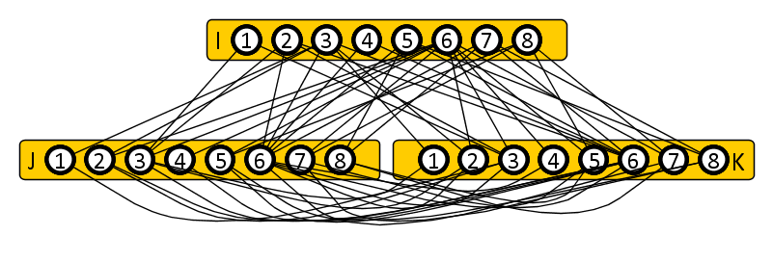
(3) Efficiently finding pairs involved in triangles
… using a subroutine that finds a triangle
Split each part into $\left(\frac{n}{s}\right)$ pieces of size $s$ each
For each of the ${\left(\frac{n}{s}\right)}^{3}$ ways to select 1 piece from each part:
Repeatedly call Triangle Finding on the sub-instance
While a triangle $\left\{J_{x},K_{y},I_{z}\right\}$ is found:
Report $(x,y)$, set $C_{xy}=1$ in the output, remove edge $\{J_{x},K_{y}\}$
Observations:
The algorithm finds all pairs $x,y∈J×K$ involved in a triangle, setting the $C_{xy}$ entry of the product matrix to 1.
Over the entire execution, at most $n^{2}$ triangles are found.

Slide 21
(3) Running time analysis
The runtime of the algorithm is dominated by the calls to the Triangle Finding subroutine
It is called only on graphs with parts of size $s$
Count two types of calls separately:
At most $n^{2}$ calls in which a triangle is found
At most ${\left(\frac{n}{s}\right)}^{3}$ calls in which no triangle is found
Once for each triple of pieces
Pick $s$ to balance number of calls versus time of each call
If $s=n$ then 1 call without triangle, but each call takes long
If $s=1$ then $n^{3}$ calls without triangle, but each call is fast

Slide 22
(3) Running time analysis
Count two types of calls separately:
At most $n^{2}$ calls in which a triangle is found
At most ${\left(\frac{n}{s}\right)}^{3}$ calls in which no triangle is found
Choose $s≔n^{\frac{1}{3}}$. If Triangle Finding takes time $O\left(n^{3−ε}\right)$:
X $BMM\left(n\right)≤n^{2}⋅s^{3−ε}+{\left(\frac{n}{s}\right)}^{3}⋅s^{3−ε}$
X $BMM\left(n\right)≤n^{2}⋅{\left(n^{\frac{1}{3}}\right)}^{3−ε}+{\left(n^{\frac{2}{3}}\right)}^{3}⋅{\left(n^{\frac{1}{3}}\right)}^{3−ε}$
X $BMM\left(n\right)≤2n^{2}⋅n^{1−ε/3}=2n^{3−ε/3}$ $=O\left(n^{3−ε/3}\right)$
Theorem. If Triangle Detection can be solved in $O\left(n^{3−ε}\right)$ time, then Boolean Matrix Mult. can be solved in $O\left(n^{3−ε/3}\right)$ time.
[Vassilevska Williams & Williams, ’10]

Slide 23
Discussion
The proof that apsp can be solved using a subroutine for Negative Triangle Detection uses much of the same ideas
Based on known equivalence of apsp with a matrix product
Distance product of matrices $A$ and $B$:
$${(A⊗B)}_{ij}≔\min_{k}{A_{ik}+B_{kj}}$$
Reduction of Matrix Distance Product to Negative Triangle Detection is a weighted version of the given proof

Slide 24
Conclusion
Fine-grained complexity analysis reveals that several fundamental problems about networks are equally difficult
Truly subcubic algorithm for all of them, or for none
The list of equivalent problems keeps growing
All-Pairs Shortest Paths
Shortest cycle
Median
Negative triangle detection
Betweenness centrality
Replacement paths
Traveling salesman 3-opt improvement
Radius
Second shortest path
THANK YOU!

Slide 25
Algorithms for All-Pairs Shortest Paths
Author | Runtime | Year
Floyd, Warshall | $$n^{3}$$ | 1962
Fredman | $$n^{3}\log{\log^{\frac{1}{3}}{n}}/\log^{\frac{1}{3}}{n}$$ | 1976
Takaoka | $$n^{3}\log{\log^{\frac{1}{2}}{n}}/\log^{\frac{1}{2}}{n}$$ | 1992
Dobosiewicz | $$n^{3}/\log^{\frac{1}{2}}{n}$$ | 1992
Han | $$n^{3}\log{\log^{\frac{5}{7}}{n}/\log^{\frac{5}{7}}{n}}$$ | 2004
Takaoka | $$n^{3}\log{\log^{2}{n}/\log{n}}$$ | 2004
Zwick | $$n^{3}\log{\log^{\frac{1}{2}}{n}/\log{n}}$$ | 2004
Chan | $$n^{3}/\log{n}$$ | 2005
Han | $$n^{3}\log{\log^{5/4}{n}/\log^{5/4}{n}}$$ | 2006
Chan | $$n^{3}\log{\log^{3}{n}/\log^{2}{n}}$$ | 2007
Han, Takaoka | $$n^{3}\log{\log{n }/\log^{2}{n}}$$ | 2012
Williams | $$n^{3}/exp⁡(\sqrt{\log{n)}}$$ | 2014

