Slide 1
Fine-Grained Complexity Analysis of Two Classic TSP Variants
Mark T. de Berg Kevin A. Buchin Bart M. P. Jansen Gerhard J. Woeginger
July 12th 2016, ICALP, Rome, Italy

Slide 2
The Traveling Salesman Problem
Find a tour among $n$ cities visiting each city exactly once while minimizing the total travel distance
Classic problem with an extensive history
The lens of fine-grained analysis uncovers new insights!
We focus on the symmetric problem on graphs, and among points in the Euclidean plane
$d\left(u,v\right)=d(v,u)$
Our research covers two settings:
Finding bitonic TSP tours in the plane
Finding $k$-opt improvements to an existing tour (used in local search)
fine-grained

Slide 3
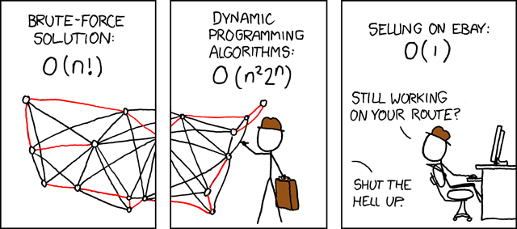
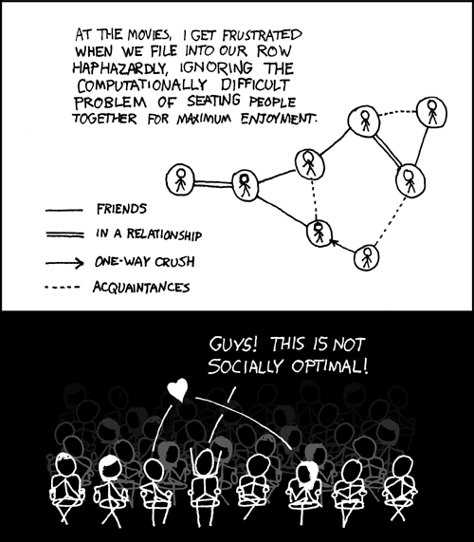
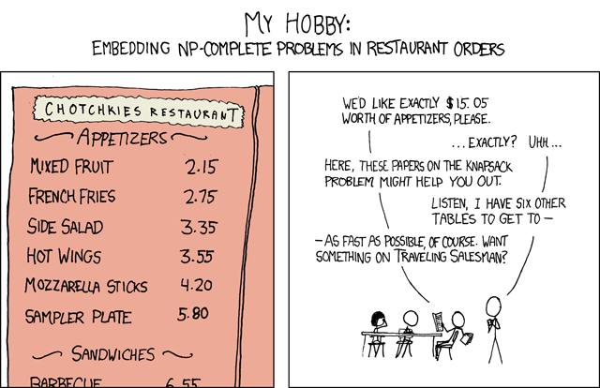
Background of TSP
© xkcd.com

Slide 4
Variant 1: bitonic tsp

Slide 5
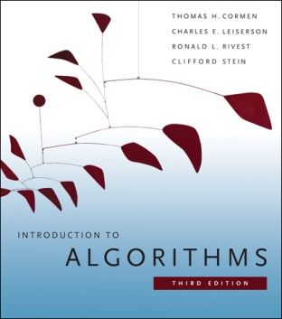
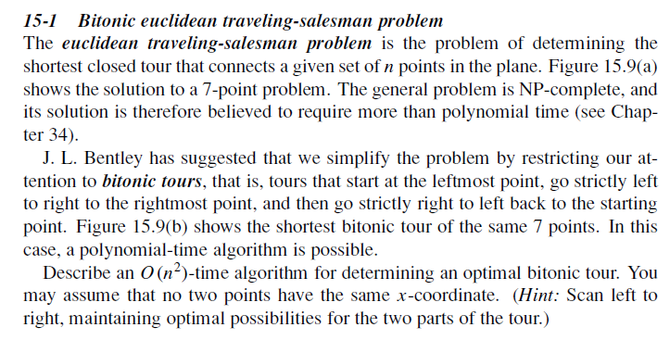
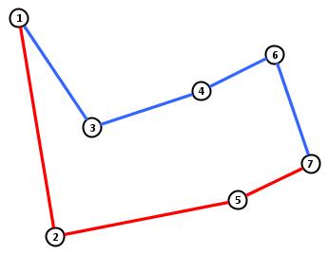
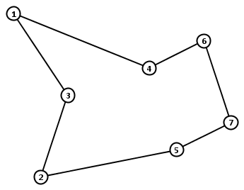
Bitonic length: $25.58$
Optimal length: $24.89$

Slide 6
Bitonic Euclidean TSP
Bentley presented detailed study of TSP heuristics in 1st SODA
(He did not actually mention bitonic tours)
Cormen & al. textbook popularized the problem in 1990
An optimal bitonic tour can be found in $O\left(n^{2}\right)$ time
Simple dynamic program
Has not been improved since the problem’s introduction

Slide 7
Is $Θ\left(n^{2}\right)$ time needed for Bitonic TSP?
Other problems from the same chapter of Cormen & al.
Edit Distance
Longest Common Subsequence
For these $2$ problems:
There are classic $O(n^{2})$-time dynamic programs
No $O(n^{2−ε})$-time algorithm exists, unless SETH is false
(SETH = Strong Exponential Time Hypothesis)
[ABV-W&BK,FOCS’15] + [BI,STOC ’15]
Motivating question:
Does Bitonic TSP require quadratic time?

Slide 8
Results on bitonic TSP
Theorem [Berg, Buchin, J, Woeginger]
Bitonic TSP can be solved in $O(n\log^{2}{n})$ time
We speed up the dynamic program by:
Computing the table implicitly, instead of explicitly
Exploiting semi-dynamic geometric data structures
Additively-weighted Voronoi diagrams
Some insights into the proof:
Analysis of the structure of the dynamic program
Connection to geometric data structures

Slide 9
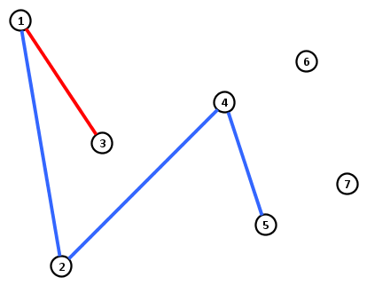
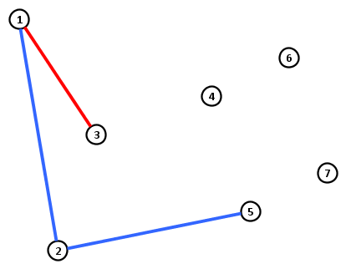
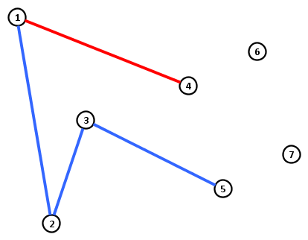
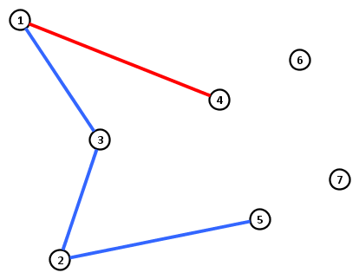
Partial bitonic tours
A partial $(i,j)$-tour for $i>j$ is a pair of $x$-monotone paths:
both starting in city 1 but not sharing any other city,
one ends in $i$ and one ends in $j$, and
visiting all cities up to and including $i$.
Let $T[i,j]$ denote length of a shortest partial $(i,j)$-tour ($i>j$)
Partial $(5,4)$-tour
Partial $(5,3)$-tour
Partial $(5,3)$-tour

Slide 10
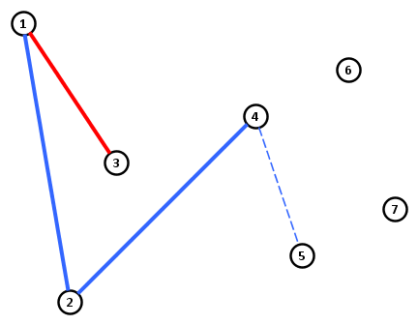
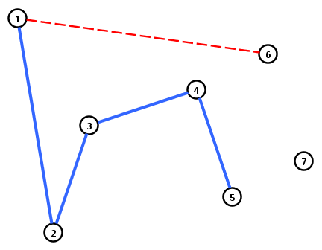
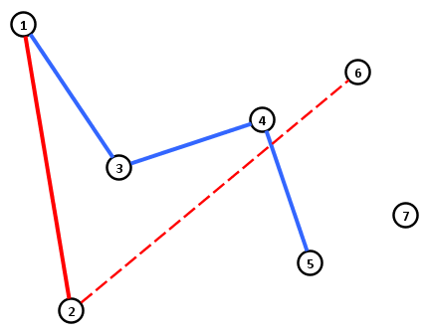
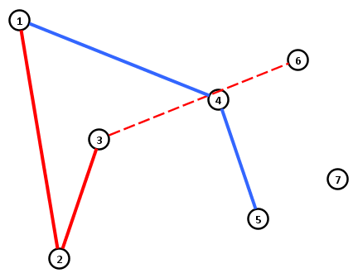
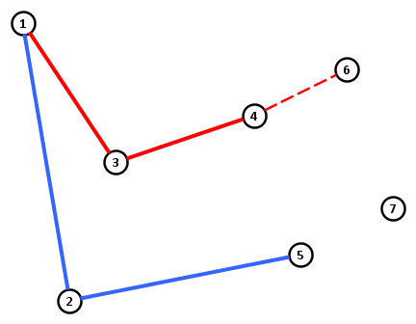
Structure of partial tours
Any partial $(i,j)$-tour for $j<i−1$ connects $i$ to $i−1$
$$T\left[i,j\right]≔T\left[i−1,j\right]+d(i,i−1)$$
Any partial $(i,j)$-tour for $j=i−1$ connects $i$ to $1≤k<i−1$
$$T\left[i,i−1\right]≔\min_{1≤k<i−1}{T\left[i−1,k\right]+d(k,i)}$$
Partial $(5,3)$-tour
Partial $(6,5)$-tour

Slide 11
Dynamic programming for Bitonic TSP
Base case:
$$T\left[2,1\right]≔d(1,2)$$
Recurrence for $i>j:$
$$T\left[i,j\right]= \left\{\begin{matrix}T\left[i−1,j\right]+d\left(i−1,i\right) & ,j<i−1 \\ & \\ \min_{1≤k<i−1}{T\left[i−1,k\right]+d(k,i)} & ,j=i−1\end{matrix}\right.$$
Cost of optimal bitonic tour:
$$\min_{1≤k<n}{T\left[n,k\right]+d(k,n)}$$
Less than $n^{2}$ entries of this type, $O(1)$ time each
Less than $n$ entries of this type, $O(n)$ time each
An optimal bitonic tour can be found in $O\left(n^{2}\right)$ time using this DP

Slide 12
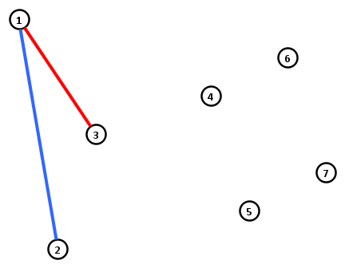
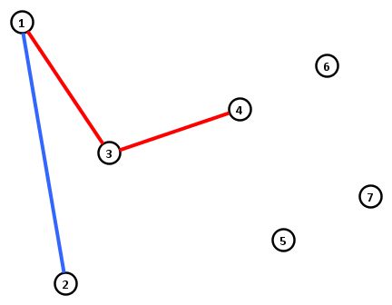
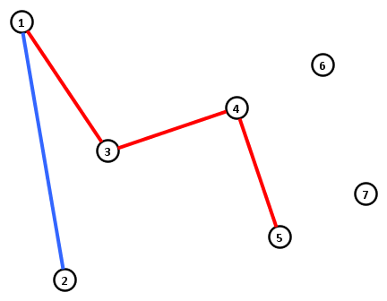
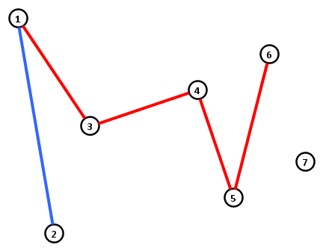
Structure of the dynamic program
$$i→$$
 | $$1$$ | $$2$$ | $$3$$ | $$4$$ | $$5$$ | $$6$$ | $$7$$
$$1$$ |  | 6.08 | 9.24 | 12.40 | 15.56 | 19.69 | 22.85
$$2$$ |  |  | 9.68 | 12.85 | 16.01 | 20.13 | 23.29
$$3$$ |  |  |  | 14.63 | 17.79 | 21.91 | 25.07
$$4$$ |  |  |  |  | 17.94 | 22.07 | 25.23
$$5$$ |  |  |  |  |  | 20.18 | 23.34
$$6$$ |  |  |  |  |  |  | 22.42
$$7$$
$$j$$
$$→$$
$$T\left[i,j\right]=\left\{\begin{matrix}T\left[i−1,j\right]+d\left(i−1,i\right) & ,j<i−1 \\ \min_{1≤k<i−1}{T\left[i−1,k\right]+d(k,i)} & ,j=i−1\end{matrix}\right.$$

Slide 13
Structure of the dynamic program
$$i→$$
 | $$1$$ | $$2$$ | $$3$$ | $$4$$ | $$5$$ | $$6$$ | $$7$$
$$1$$ |  | 6.08 | 9.24 | 12.40 | 15.56 | 19.69 | 22.85
$$2$$ |  |  | 9.68 | 12.85 | 16.01 | 20.13 | 23.29
$$3$$ |  |  |  | 14.63 | 17.79 | 21.91 | 25.07
$$4$$ |  |  |  |  | 17.94 | 22.07 | 25.23
$$5$$ |  |  |  |  |  | 20.18 | 23.34
$$6$$ |  |  |  |  |  |  | 22.42
$$7$$
$$j$$
$$→$$
$$T\left[i,j\right]=\left\{\begin{matrix}T\left[i−1,j\right]+d\left(i−1,i\right) & ,j<i−1 \\ \min_{1≤k<i−1}{T\left[i−1,k\right]+d(k,i)} & ,j=i−1\end{matrix}\right.$$

Slide 14
Modeling as a dynamic data structure problem
$$i→$$
 | $$1$$ | $$2$$ | $$3$$ | $$4$$ | $$5$$ | $$6$$ | $$7$$
$$1$$ |  | 6.08 | 9.24 | 12.40 | 15.56 | 19.69
$$2$$ |  |  | 9.68 | 12.85 | 16.01 | 20.13
$$3$$ |  |  |  | 14.63 | 17.79 | 21.91
$$4$$ |  |  |  |  | 17.94 | 22.07
$$5$$
$$6$$
$$7$$
Evaluating all entries explicitly is slow
Represent a column implicitly
Implicit representation of column $i−1$:
Store weighted points $p_{1},…, p_{i−2}$
Weight $w\left(p_{j}\right)≔T[i−1,j]$
Find representation of column $i$:
Query to find value $v$ of $T[i,i−1]$
Increase all weights by $d\left(i−1,i\right)$
Insert point $p_{i−1}$ with weight $v$
Add $d(i−1,i)$ to value in previous column
$$j$$
$$→$$
Take min. over $1≤k<i−1$
$$T\left[i,j\right]=\left\{\begin{matrix}T\left[i−1,j\right]+d\left(i−1,i\right) & ,j<i−1 \\ \min_{1≤k<i−1}{T\left[i−1,k\right]+d(k,i)} & ,j=i−1\end{matrix}\right.$$

Slide 15
Query for the value of $T[i,i−1]$
Cost $T\left[i,i−1\right]=\min_{1≤k<i−1}{T\left[i−1,k\right]+d(k,i)}$ splits into:
Euclidean distance between $p_{k}$ and $p_{i}$
Cost of optimal $\left(i−1,k\right)$-partial tour
Without term $T\left[i−1,k\right]$ it is easy to answer in $O(\log{n)}$ time
Nearest neighbor query in Voronoi diagram $\{p_{1},…,p_{i−2}\}$

Slide 16
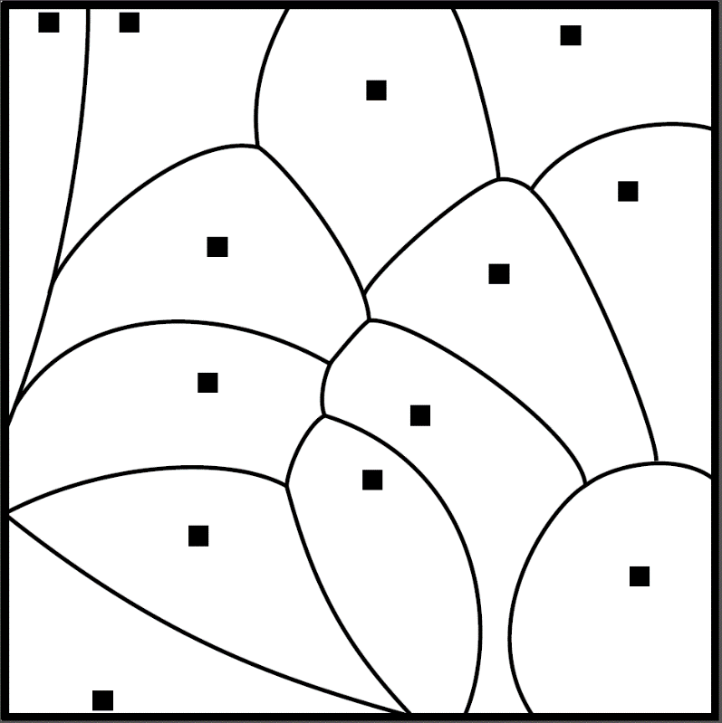
Additively weighted Voronoi diagrams
For $n$ sites $p_{1},…, p_{n}∈ℛ^{2}$ with weights $w\left(p_{1}\right),…, w\left(p_{n}\right)∈ℛ$, the additively weighted Voronoi diagram
partitions the plane into Voronoi cells $C_{1},…, C_{n}$, such that
points $q$ in $C_{i}$ are closer to $p_{i}$ than to any other site, with respect to:
$$d_{w}\left(q,p_{i}\right)≔d\left(q,p_{i}\right)+w(p_{i})$$
Geometric interpretation:
Circle around each site, larger weight means smaller circle
Point belongs to cell whose circle is closest
Using point location in the AW-Voronoi diagram, the next diagonal element of the table can be computed in $O(\log^{2}{n)}$ time
Combines Fortune [SOCG ‘86] and Bentley & Saxe [J. Alg ‘80]
Theorem [Berg, Buchin, J, Woeginger]
Bitonic TSP can be solved in $O(n\log^{2}{n})$ time

Slide 17
Variant 2: searching the $k$-opt neighborhood

Slide 18
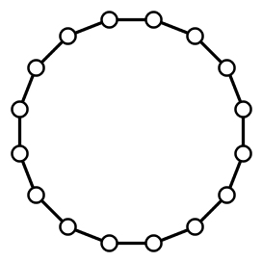
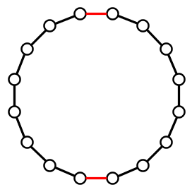
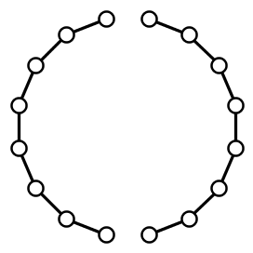
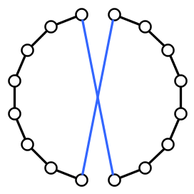
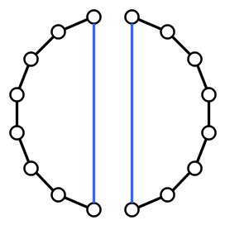
Local search heuristics for TSP
A popular way to deal with TSP in practice is using local search
Generate a starting tour by some heuristic, then repeatedly improve the tour by small changes
Explore the local neighborhood of the current tour $T$
The $2$-opt neighborhood is often used
Consists of tours obtained from $T$ by replacing 2 edges

Slide 19
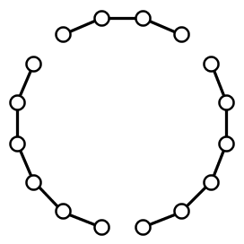
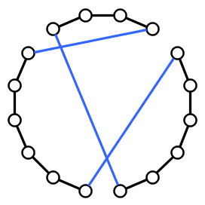
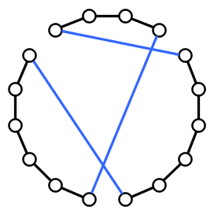
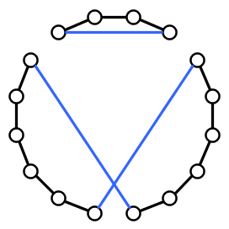
General $k$-opt neighborhood
The $k$-opt neighborhood of tour $T$ contains:
Tours obtained from $T$ by replacing at most $k$ edges
Removing $k$ edges splits a tour into $k$ paths
For $k≥3$, there are multiple ways to reconnect the tour

Slide 20
Analysis of local search for TSP
Many aspects to analyze:
How many iterations are needed to find a local optimum?
How far are local optima from global optima?
How much time is needed for a single iteration?
To check whether a tour is locally optimal for $k$-opt:
Test whether any $k$-opt move decreases the cost
To move through the landscape of solutions:
Find the best tour in the $k$-opt neighborhood

Slide 21
Two computational problems about $k$-opt
The first is a decision problem:
$k$-opt detection Input: A tour $T$ in a weighted complete graph $G$ Question: Is there a $k$-opt move that decreases the cost?
The second is an optimization problem:
$k$-opt optimization Input: A tour $T$ in a weighted complete graph $G$ Task: Find the best tour in the $k$-opt neighborhood of $T$

Slide 22
Complexity of $k$-opt detection / optimization
For fixed $k$ there is an $O(n^{k})$ algorithm for $k$-opt optimization
Try all $\left({n \atop k}\right)$ possibilities for $k$ edges $X$that leave the tour
Removing $X$ splits the tour $T$ into $k$ pieces
Try all $f(k)$ different ways to reconnect into a tour
Even for $k$-opt detection you cannot improve much:
No algorithm with runtime $f\left(k\right)⋅n^{o\left(\frac{k}{\log{k}}\right)}$ unless ETH fails
(Graph setting with symmetric weights {1,2})
[Marx ’08] & [Guo, Hartung, Niedermeier, Suchý ‘13]
Motivating question:
What is the exact complexity of detecting whether a given tour can be improved by a $k$-opt move, for small $k$?

Slide 23
Our results for $k$-opt
$2$-opt detection requires $Ω\left(n^{2}\right)$ time
Easy adversarial argument: algorithms must read the entire input
$3$-opt detection is unlikely to have a truly subcubic algorithm
Reductions to and from Negative Triangle Detection, using framework of Vassilevska-Williams & Williams [FOCS’10]
Could $Θ(n^{k})$ be the right complexity for all $k$?
Theorem. $3$-opt detection has a truly subcubic algorithm if and only if APSP has one
Terminology:
An algorithm for inputs with integer weights in $[−M…M]$ is truly subcubic if its runtime is $O(n^{3−ε}\operatorname{polylog}{M)}$ for some $ε>0$
APSP refers to All-Pairs Shortest Paths in weighted directed graphs without negative-weight cycles

Slide 24
Exhaustive search can be avoided for $k≥4$
For all $k≥4$ we can do better than ${Θ(n}^{k})$
Implies that $4$-opt optimization is in $Θ\left(n^{3}\right)$ time
Based on an analysis of the structure of $k$-opt moves
Enumerate partial solutions, use dynamic programming
Theorem. For each fixed $k$ there is an algorithm that finds the best $k$-opt move in time $O(n^{\left\lfloor \frac{2k}{3}\right\rfloor +1})$

Slide 25
Faster algorithms for repeated $2$-opt
For $2$- and $3$-opt, brute force is likely optimal to perform a single iteration
In local search, one repeatedly improves a given starting tour
Speed up repeated improvements to the same instance?
In the repeated setting, only the first iteration is expensive:
Based on ideas of Fredman et al. [J. ALG ‘95] and Chrobak et al. [TCS ‘90] to store tour in a balanced search tree
Allows quick applications of a $2$-opt move by reversals
Theorem. After $O\left(n^{2}\right)$ preprocessing time, one can repeatedly find and apply the best $2$-opt move in $O(n\log{n)}$ time per move

Slide 26
Conclusion
Bitonic TSP tours in the plane in $O(n\log^{2}{n})$ time
Variants (pyramidal tours, bottleneck TSP) also in $\tilde{O}(n)$ time
There is a truly subcubic algorithm for $3$-opt detection if and only if there is one for All-Pairs Shortest Paths
For $k≥4$, we can improve upon exhaustive search for $k$-opt
Open problems:
Is $k$-opt detection fixed-parameter tractable:
Is 𝑘-opt detection fixed-parameter tractable:
in planar graphs?
for finding tours among points in the Euclidean plane?
THANK YOU!

Slide 27
Extensions
Using different dynamic data structures, several variants can be solved in near-linear time as well
Theorem. For any ordering of $n$ given points in the plane, an optimal pyramidal tour can be found in $O(n\log^{2}{n})$ time
Theorem. For any ordering of $n$ given points in the plane, an optimal pyramidal bottleneck tour can be found in $O(n\log^{3}{n})$ time

Slide 28
$2$-opt optimization for TSP on points in the plane
We can also speed up 2-opt optimization for TSP in the plane
Based on data structures for geometric range searching
Preprocess pointset for semi-algebraic range queries
Theorem. There is an algorithm with expected runtime $O\left(n^{\frac{8}{5}+ε}\right)$ for $2$-opt detection for TSP on points in the Euclidean plane

