Slide 1
Introduction to Fixed-Parameter Tractability With Links to Computational Geometry
Bart M. P. Jansen
April 4th 2016, Lorentz Center, Leiden, The Netherlands

Slide 2
Outline
I
Introduction
II
Algorithms
III
Complexity
History
Parameters
W[1]-hard
Exp-time hypotheses
Definitions
Overview of techniques
Branching
Color coding
Kernelization lower bounds
Kernelization

Slide 3
History of parameterized complexity
Fine-grained complexity
PCP Theorem
Downey & Fellows book
NP-completeness
Kernelization lower bounds
1940 1950 1960 1970 1980 1990 2000 2010 2015
FPT&CG workshop
Matching algorithm
Parameterized(in)tractability
Graph Minors Theorem
Simplex algorithm
Planar Dominating Set kernel

Slide 4
Google Scholar Papers on FPT and Kernelization

Slide 5
Parameterized problems
As usual in complexity theory, we primarily study decision problems (yes/no questions)
optimization: “Find the shortest path from $x$ to $y$”
decision: “Is there a path from $x$ to $y$ of length at most $k$?”
Having an efficient algorithm for one typically gives an efficient algorithm for the other
A parameterized problem is a decision problem where we associate an integer parameter to each instance
The parameter measures some aspect of the instance
Formally, $𝒬⊆Σ^{∗}×ℕ$ contains the yes-instances $(x,k)$

Slide 6
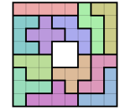
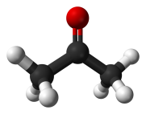
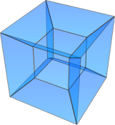
Problem parameterizations
By solution size
$k$-Vertex Cover
𝑘-Vertex Cover
$k$-Triangulation Flip Distance
𝑘-Triangulation Flip Distance
By instance structure
Closeness of input graph to a tree
By dimension of the input
Many examples in Christian Knauer’s talk
Labeling all but $k$ points on a map
Labeling all but 𝑘 points on a map
Closeness of input polygon to a simple/star/skyline polygon
Relevant parameters can be identified by:
Measuring distance from triviality
Deconstructing hardness proofs
Inspecting datasets
Many different ways to parameterize the same problem

Slide 7
Fixed-parameter tractability
A parameterized problem is fixed-parameter tractable if:
there is an algorithm that decides
inputs of size $n$,
with parameter value $k$,
in time $f\left(k\right)⋅n^{c}$ for some constant $c$ and function $f$
For each fixed $k$, there is a polynomial-time $O\left(n^{c}\right)$ algorithm
A runtime of the form $n^{k}$ is not fixed-parameter tractable
Can the problem be solved efficiently, if the parameter is small?

Slide 8
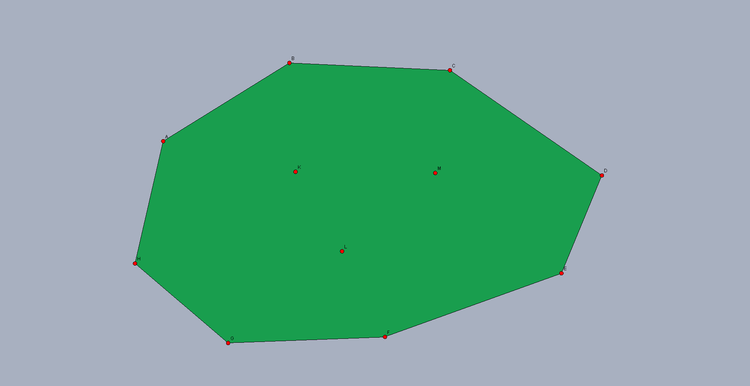
$k$-Euclidean Traveling Salesman
Input: A set of $n$ points in the plane, of which $k$ lie in the interior of the convex hull, and an integer $ℓ$ Parameter: $k$ Question: Is there a tour of length $≤ℓ$ that visits all points?
Solvable in time $O\left(2^{k}⋅k^{2}⋅n\right)$ [Deineko, Hoffmann, Okamoto, Woeginger, ’06]

Slide 9
Fixed-parameter intractability
Consider the Chromatic Number problem
Does graph $G$ have a proper vertex coloring with $k$ colors?
Suppose there is an $f\left(k\right)⋅n^{c}$ algorithm:
Then 3-Coloring can be solved in $f\left(3\right)⋅n^{c}=O\left(n^{c}\right)$ time
So Chromatic Number parameterized by the number of colors is not fixed-parameter tractable unless P = NP
Interesting fixed-parameter intractability works differently:
Consider problem solvable in $n^{f\left(k\right)}$ time
Argue that it cannot be solved in $f\left(k\right)⋅n^{c}$ time

Slide 10
$k$-Center in the Plane
Input: A set of $n$ points in the plane and an integer $k$ Parameter: $k$ Question: Is there a set $S$ of $k$ points, such that every point is within Euclidean distance $1$ of a point in $S$?
Not fixed-parameter tractable unless $k$-Clique is FPT
Probably no $f\left(k\right)⋅n^{c}$ algorithm for any $f,c$ [Marx, ’06]

Slide 11
I
Introduction
II
Algorithms
III
Complexity
History
Parameters
Color coding
W[1]-hard
Overview of techniques
Exp-time hypotheses
Definitions
Branching
Kernelization lower bounds
Kernelization

Slide 12
The FPT toolkit
There are many techniques to develop FPT algorithms
Some apply only to graph problems
We consider 3 techniques, and briefly mention others
Bounded-depth search trees
Kernelization
Color coding

Slide 13
Bounded-depth search trees
A branching algorithm that explores a search tree of bounded depth is one of the simplest types of FPT algorithms
Main idea:
Reduce problem instance $(x,k)$ to solving a bounded number of instances with parameter $<k$
If you can solve $\left(x,k\right)$ in polynomial time using the answers to two instances $\left(x_{1},k−1\right)$ and $(x_{2},k−1)$, then the problem can be solved in $2^{k}⋅n^{c}$ time
(assuming the case $k=0$ is polynomial-time solvable)
If you generate $k$ subproblems instead of 2, then the problem can be solved in $k^{k}{⋅n}^{c}=2^{O\left(k\log{k}\right)}⋅n^{c}$ time

Slide 14
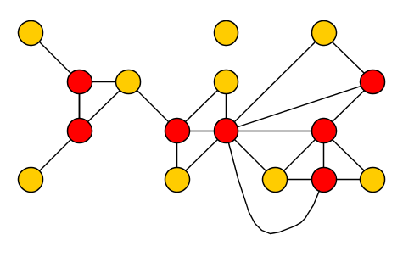
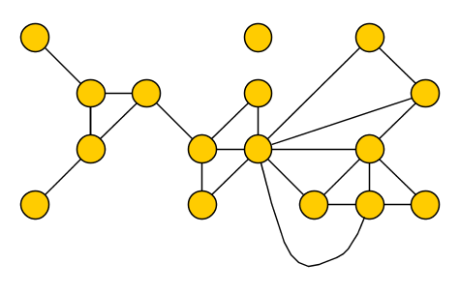
Vertex Cover
Input: A graph $G$ and an integer $k$ Parameter: $k$ Question: Is there a set $S$ of at most $k$ vertices in $G$, such that each edge has an endpoint in $S$?

Slide 15
Algorithm for Vertex Cover
Algorithm VC(Graph $G$, integer $k$)
if $k<0$ then return false
if $G$ has no edges
then return true
else pick an edge $\{u,v\}$ in $G$
return VC$(G–u, k−1)$ or VC$(G−v, k−1)$
Correct because any vertex cover must use $u$ or $v$, and:
size-$k$ cover in $G$ using $u⇔$ size-$(k−1)$ cover in $G−u$

Slide 16
Running time for Vertex Cover
Every iteration either solves the problem directly or makes two recursive calls with a decreased parameter
Tree of depth $k$ with branching factor $2$ has ${O(2}^{k})$ nodes
Running time is $2^{k}⋅n^{c}$
$$(x,k=3)$$
$$(x_{1},2)$$
$$(x_{2},2)$$
$$(x_{3},1)$$
$$(x_{4},1)$$
$$(x_{5},1)$$
$$(x_{6},1)$$
$$(x_{7},0)$$
$$(x_{8},0)$$
$$(x_{9},0)$$
$$(x_{10},0)$$
$$(x_{11},0)$$
$$(x_{12},0)$$
$$(x_{13},0)$$
$$(x_{14},0)$$

Slide 17
Kernelization: data reduction with a guarantee
Kernelization is a method for parameterized preprocessing:
Reduce $(x,k)$ to equivalent instance $(x^{′},k^{′})$ in polynomial time
Such that $\left|x^{′}\right|+k^{′}≤f(k)$ for some function $f$
Preprocessing algorithm is called a kernel, function $f(k)$ is its size
Distinction between polynomial and superpolynomial kernels
Even for exp-size kernels, runtime of preprocessing is polynomial
Kernelization is one of the simplest ways of obtaining FPT algorithms
FPT algorithm when solving shrunk instance by brute force
$n$ bits
$poly(|x|,k)$time
$f(k)$ bits
$(x,k)$ is yes $⇔$ $(x^{′},k^{′})$ is yes
Notes:
Let’s look at an example before giving the formal definition

Slide 18
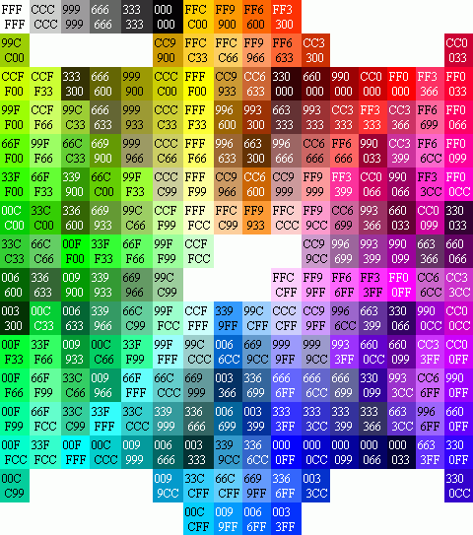
Color coding
Randomly assign colors to the input structure
If there is a solution and we are lucky with the coloring, every element of the solution has received a different color
Develop an algorithm to detect such colorful solutions
Solutions of elements with pairwise different colors
Most applications of color coding can be derandomized efficiently

Slide 19
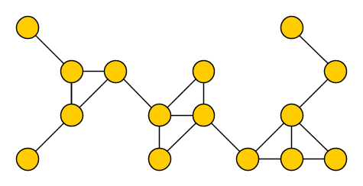
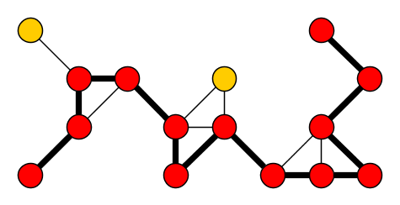
The Longest Path problem
Input: An undirected graph $G$ and an integer $k$ Parameter: $k$ Question: Is there a simple path on $k$ vertices in $G$?
A solution is a $k$-path
NP-complete (Hamiltonian Path is a special case)

Slide 20
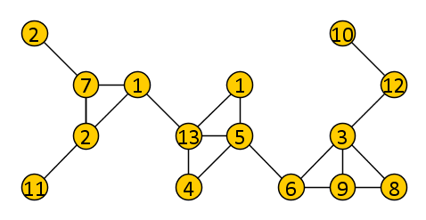
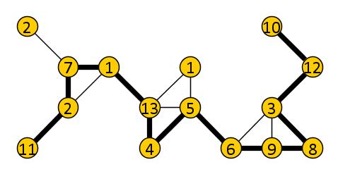
Color coding for Longest Path
Color the vertices of $G$ randomly with colors $\{1,2,…, k\}$
We want to detect a colorful $k$-path if one exists
Any $k$-vertex path with $k$ different colors is simple
If we are lucky, a $k$-path becomes colorful
Use dynamic programming over subsets

Slide 21
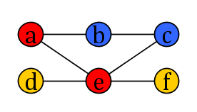
The dynamic programming table
For every subset of colors $S⊆[k]$ and vertex $v$, define:
$T[S,v]$ = true iff there is a colorful path whose colors are $S$ and that has $v$ as an endpoint
Colorful $k$-path if $T[\left[k\right],v]$ = true for some $v∈V(G)$
$T[\{■$,$■\}, b]=$ true
$T[\{■$,$■\text{,}■\}, b]=$ false
$T[\{■$,$■\text{,}■\}, f]=$ true

Slide 22
A recurrence to fill the table
If $S$ is a singleton set, containing some color $c$:
$T[\{c\},v]$ = true if and only if $f\left(v\right)=c$
If $\left|S\right|>1$:
$T\left[S,v\right]=\bigvee_{u∈N\left(v\right)}{T[S∖\{f\left(v\right)\},u]}$ if $f\left(v\right)∈S$
$T\left[S,v\right]=$ false otherwise
Fill the table in time $2^{k}n^{c}$

Slide 23
Randomized algorithm for Longest Path
Algorithm LongPath(Graph $G$, integer $k$)
repeat $e^{k}$ times:
Color the vertices of $G$ uniformly at random with $k$ colors
Fill the DP table $T$
if $∃v∈V\left(G\right)$ such that $T[[k],v]$ = true then return true
return false
Probability that a fixed $k$-path becomes colorful is at least $e^{−k}$
Independent of $n$, since only colors of $k$ vertices matter
$e^{k}$ repetitions ensure good coloring with prob. $≥1−\frac{1}{e}$
Theorem. There is a Monte Carlo algorithm for Longest Path with one-sided error that runs in time ${\left(2e\right)}^{k}⋅n^{c}$ and has constant success probability

Slide 24
Discussion of color coding
When doing dynamic programming, color coding effectively allows us to reduce the number of states from
keeping track of all vertices visited by the path, $n^{k}$, to
keeping track of all colors visited by the path, $2^{k}$
The technique extends to finding size-$k$ occurrences of other “thin” patterns in graphs
A size-$k$ pattern graph of treewidth $t$ can be found in time $2^{O\left(k\right)}⋅n^{O\left(t\right)}$, with constant probability

Slide 25
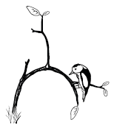
Techniques for building FPT algorithms
Branch in $f(k)$ ways
Decrease the parameter
Bounded-depth search trees
$$(x,k=3)$$
$$(x_{1},2)$$
$$(x_{2},2)$$
$$(x_{3},1)$$
$$(x_{4},1)$$
$$(x_{5},1)$$
$$(x_{6},1)$$
$$(x_{7},0)$$
$$(x_{8},0)$$
$$(x_{9},0)$$
$$(x_{10},0)$$
$$(x_{11},0)$$
$$(x_{12},0)$$
$$(x_{13},0)$$
$$(x_{14},0)$$

Slide 26
Techniques for building FPT algorithms
Reduce to equivalent instance of size $f(k)$
Solve by any means
Bounded-depth search trees
Kernelization
$n$ bits
$f(k)$ bits

Slide 27
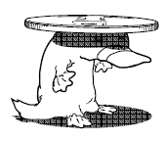
Techniques for building FPT algorithms
Randomly color the input structure
Develop an algorithm to find colorful solutions
Bounded-depth search trees
Kernelization
Color coding

Slide 28
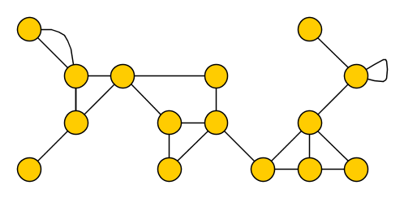
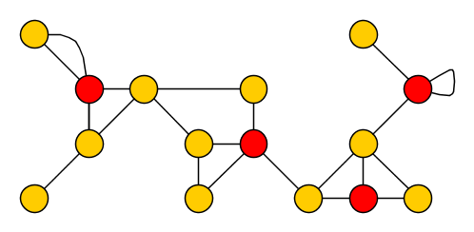
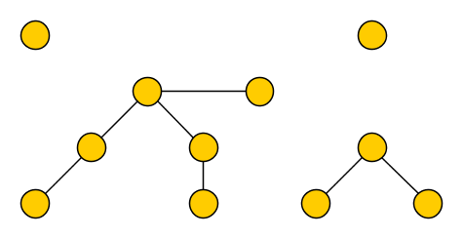
Techniques for building FPT algorithms
To get an FPT algorithm for:
Feedback Vertex Set Input: Graph $G$, integer $k$ Parameter: $k$ Question: $∃S⊆V(G)$ of size $k$: $G−S$ acyclic?
It suffices to get FPT for:
Disjoint Feedback Vertex Set Compression Input: $(G$,$k)$ and fvs $T$ of size $k+1$ Parameter: $k$ Question: $∃S⊆V\left(G\right)∖T$ of size $k$: $G−S$ acyclic?
Bounded-depth search trees
Kernelization
Color coding
Iterative compression

Slide 29
Techniques for building FPT algorithms
Use a win/win approach
Graph is not treelike?
No small FVS, output no
Remove an irrelevant vertex
Graph is treelike?
Build tree decomposition
Solve by DP
Bounded-depth search trees
Kernelization
Color coding
Iterative compression
Graph minors & treewidth
Images from “Parameterized Algorithms” by Cygan et al.

Slide 30
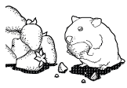
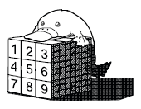
More techniques for building FPT algorithms
Graph cuts & separators
Integer linear programming
Matroids
Dynamic programming over subsets
Algebraic transformations
Bounded-depth search trees
Kernelization
Color coding
Iterative compression
Graph minors & treewidth

Slide 31
I
Introduction
II
Algorithms
III
Complexity
History
Definitions
W[1]-hard
Parameters
Exp-time hypotheses
Overview of techniques
Branching
Color coding
Kernelization lower bounds
Kernelization

Slide 32
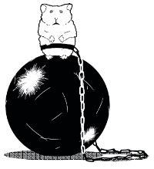
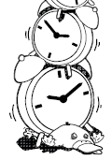
Hardness theory in parameterized complexity
Consists of two ingredients:
Hardness assumption about a fundamental problem
Notion of reduction to show other problems are hard
In classic complexity, the main hardness assumption is P $≠$ NP
Parameterized complexity uses several assumptions
FPT $≠$ W[1]
FPT ≠ W[1]
Used to rule out $f\left(k\right)⋅n^{c}$ algorithms
Used to rule out 𝑓(𝑘)⋅𝑛^𝑐 algorithms
Exponential Time Hypotheses
Used to give running time lower bounds
Applies to all runtimes: $O\left(n^{2}\right),$ $$O\left(n^{\sqrt{k}}\right), 2^{O\left(k\log{k}\right)}n^{c}$$
Applies to all runtimes: 𝑂(𝑛^2 ), 𝑂(𝑛^√𝑘 ), 2^𝑂(𝑘 log⁡𝑘 ) 𝑛^𝑐
NP ⊈ coNP/poly
Used to prove superpolynomial lower bounds on kernel sizes
More in talk by Hans Bodlaender

Slide 33
An intractable parameterized problem
$k$-Clique Input: An undirected graph $G$ and an integer $k$ Parameter: $k$ Question: Is there a set of $k$ pairwise adjacent vertices in $G$?
Testing all size-$k$ vertex sets takes $Θ(k^{2}⋅n^{k})$ time
Our starting assumption is that $k$-Clique is not fixed-parameter tractable
Practical justification
Despite major efforts, nothing close to an FPT algorithm known
Theoretical justification
Equivalent to the $k$-Step Turing Machine Acceptance for single-tape Turing machines with unbounded nondeterminism
Equivalent to the 𝑘-Step Turing Machine Acceptance for single-tape Turing machines with unbounded nondeterminism
Fastest known algorithm is $O\left(n^{0.792⋅k}\right)$ [Nešetřil and Poljak, 85]
Fastest known algorithm is 𝑂(𝑛^(0.792⋅𝑘) ) [Nešetřil and Poljak, 85]

Slide 34
Parameterized reductions
Consider two parameterized problems $A,B⊆Σ^{∗}×ℕ$
A parameterized reduction from $A$ to $B$ is an algorithm that:
reduces instance $\left(x,k\right)$ of $A$ to instance $(x^{′},k^{′})$ of $B$
$\left(x,k\right)∈A$ if and only if $\left(x^{′},k^{′}\right)∈B$
$k^{′}≤f_{1}(k)$ for some function $f_{1}$
runs in time $f_{2}\left(k\right){\left|x\right|}^{c}$ for some $c$ and function $f_{2}$
$A≤_{FPT}B$ and $B$ is FPT $⇒$ FPT-algorithm for $A$
$f_{2}\left(k\right){\left|x\right|}^{c}$ time
$$k^{′}≤f_{1}\left(k\right)$$
$$\left|x^{′}\right|≤f_{2}(k){\left|x\right|}^{c}$$
Instance of $A$
Instance of $B$

Slide 35
Parameterized reductions preserve FPT runtimes
Running $f\left(k\right){\left|x\right|}^{d}$ algorithm for $B$ on $(x^{′},k^{′})$ takes time:
A $f\left(k^{′}\right){ \left|x^{′}\right|}^{d}≤$
A $f\left(f_{1}\left(k\right)\right){ \left|x^{′}\right|}^{d}≤$
A $f\left(f_{1}\left(k\right)\right){ \left(f_{2}\left(k\right){\left|x\right|}^{c}\right)}^{d}≤$
A $f\left(f_{1}\left(k\right)\right) {\left(f_{2}\left(k\right)\right)}^{d}{\left|x\right|}^{cd}≤f^{′}\left(k\right){ \left|x\right|}^{cd}$
$A≤_{FPT}B$ and $B$ is FPT $⇒$ FPT-algorithm for $A$
$f_{2}\left(k\right){\left|x\right|}^{c}$ time
$$k^{′}≤f_{1}\left(k\right)$$
$$\left|x^{′}\right|≤f_{2}(k){\left|x\right|}^{c}$$
Instance of $A$
Instance of $B$

Slide 36
Notes on parameterized reductions
Most parameterized reductions run in polynomial time
Some (non)-examples:
Now let’s consider a more complicated example
Not a parameterized reduction; $k′$ is not bounded by $f(k)$
Not a parameterized reduction; 𝑘′ is not bounded by 𝑓(𝑘)
Cliques versus independent sets
$G$ has a $k$-clique $⇔$ $\overline{G}$ has an independent set of size $k^{′}≔k$
𝐺 has a 𝑘-clique ⇔ 𝐺 ̅ has an independent set of size 𝑘^′≔𝑘
Independent sets versus vertex covers
Size-$k$ independent set $⇔$ vertex cover of size $k^{′}≔n−k$
Size-𝑘 independent set ⇔ vertex cover of size 𝑘^′≔𝑛−𝑘
Correct parameterized reduction

Slide 37
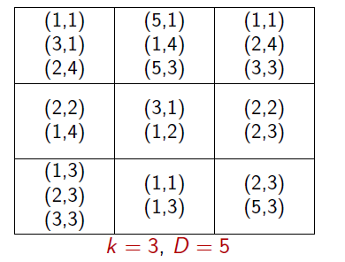
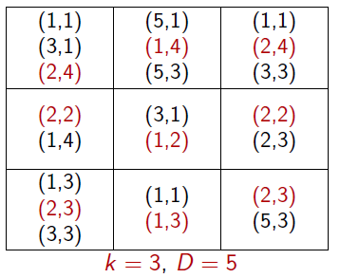
$k$-Grid Tiling
Input: A $k×k$ matrix, and for every cell $\left(i,j\right)∈{\left[k\right]}^{2}$ a set $S_{ij}⊆\left[n\right]×[n]$ of pairs Parameter: $k$
Question: Can you choose one pair $s_{ij}$ from each cell, s.t. : vertical neighbors agree in first coordinate, and horizontal neighbors agree in second coordinate?
$$k=3 \\ n=5$$
Images by Dániel Marx

Slide 38
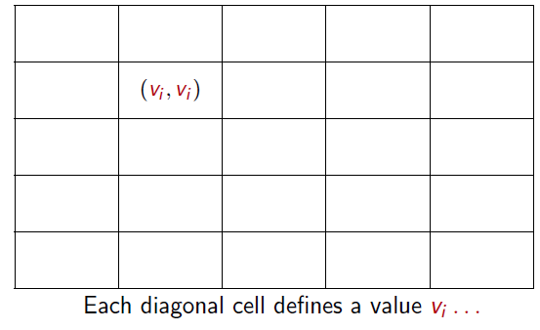
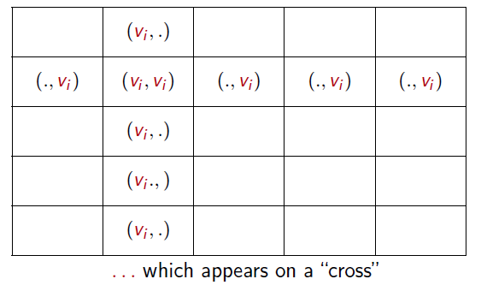
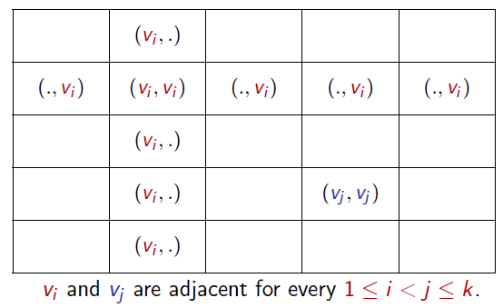
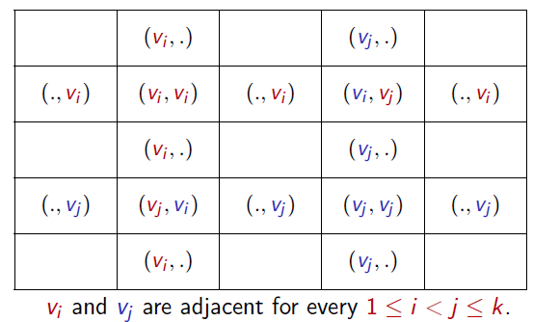
Parameterized reduction from Clique to Tiling
Given a $k$-Clique instance $(G,k)$, define the sets as follows:
For $i=j$: $\left(x,y\right)∈S_{ij}⇔x=y$
For $i≠j$: $\left(x,y\right)∈S_{ij}⇔x$ and $y$ are adjacent in $G$
Theorem. There is a parameterized reduction from $k$-Clique to $k$-Grid Tiling. So if $k$-Grid Tiling is FPT, then $k$-Clique is FPT.

Slide 39
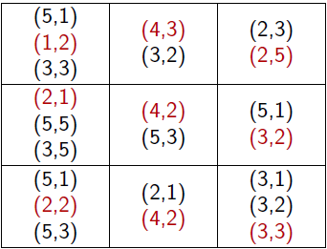
$k$-Grid Tiling with $≤$
Input: A $k×k$ matrix, and for every cell $\left(i,j\right)∈{\left[k\right]}^{2}$ a set $S_{ij}⊆\left[n\right]×[n]$ of pairs Parameter: $k$
Question: Can you choose one pair $s_{ij}$ from each cell, s.t. : 1st coordinate of $s_{ij}≤$ 1st coordinate of $s_{i+1, j}$ 2nd coordinate of $s_{ij}≤$ 2nd coordinate of $s_{i,j+1}$ ?
Theorem. There is a parameterized reduction from $k$-Grid Tiling to $k$-Grid Tiling with $≤$.
$$k=3 \\ n=5$$
Images by Dániel Marx

Slide 40
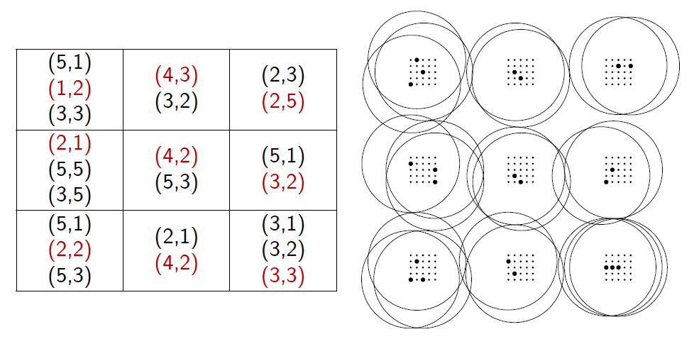
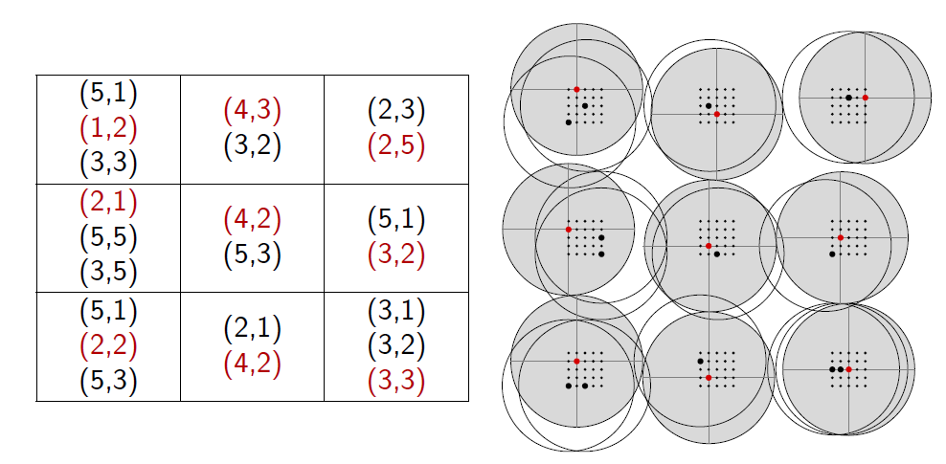
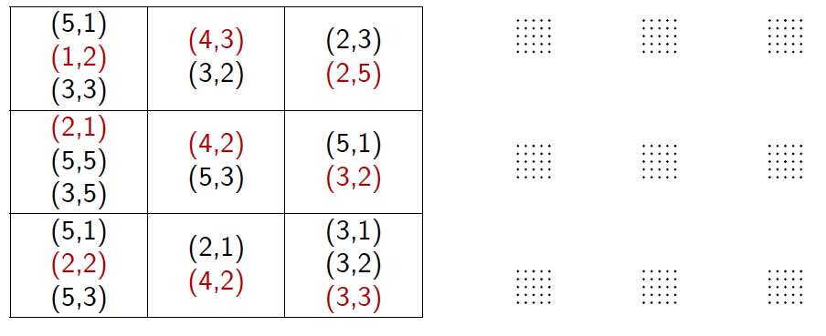
Parameterized reduction from $k$-Grid Tiling ($≤$) to$k$-Independent Set on Unit Disk Graphs
Theorem. If $k$-Independent Set on Unit Disk Graphs is FPT, then $k$-Clique is FPT.

Slide 41
Complexity class W[1]
Practically, showing that a parameterized problem is “not FPT unless $k$-Clique is FPT” is good evidence of intractability
On the theoretical side, there is a hierarchy of parameterized complexity classes defined in terms of circuits
$W\left[1\right]⊆W\left[2\right]⊆…$
The first level of the hierarchy is called W[1] (for weft-one)
The $k$-Clique problem is complete for W[1]
“not FPT unless $k$-Clique is FPT” $⇔$ W[1]-hard
“Problem $𝒬$ is contained in W[1]” $⇔$ ($Q≤_{FPT}k$-Clique)

Slide 42
Complexity class W[2]
The next level of the hierarchy can also be characterized by a natural graph problem
$k$-Dominating Set Input: An undirected graph $G$ and an integer $k$ Parameter: $k$ Question: Is there a set $S$ of $k$ vertices such that each vertex is in $S$ or has a neighbor in $S$?
$k$-Dominating Set is complete for W[2]
$∃$parameterized reduction from $k$-Clique to $k$-Dominating Set
Reduction in the other way is not believed to exist

Slide 43
(Uniform) parameterized complexity classes
W[1]
Problems that FPT-reduce to $k$-Clique
Problems that FPT-reduce to 𝑘-Clique
Polynomial kernel
Reduce $(x,k)$ to size $k^{O\left(1\right)}$ in poly-time
Reduce (𝑥,𝑘) to size 𝑘^𝑂(1) in poly-time
W[2]
…
XP
FPT
Problems solvable in time $f\left(k\right)⋅n^{c}$
Problems solvable in time 𝑓(𝑘)⋅𝑛^𝑐
Reduce $(x,k)$ to size $f(k)$ in poly-time
Reduce (𝑥,𝑘) to size 𝑓(𝑘) in poly-time
Problems that FPT-reduce to $k$-Dominating Set
Problems that FPT-reduce to 𝑘-Dominating Set
Infinite hierarchy $W[…]$ based on weft
Infinite hierarchy 𝑊[…] based on weft
Problems solvable in time $n^{f\left(k\right)}$
Problems solvable in time 𝑛^𝑓(𝑘)

Slide 44
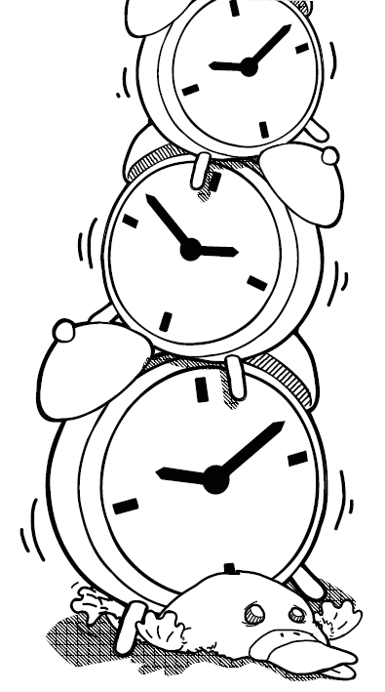
And now, for something different …

Slide 45
(Strong) Exponential Time Hypothesis
Hypotheses about the time needed to solve Cnf-Satisfiability
Much stronger hypotheses than $P≠NP$
Introduced in work of Impagliazzo, Paturi & Zane
Derive strong lower bounds based on these hypotheses
Denote #variables by $n$ and #clauses by $m$
Exponential time hypothesis (roughly)
3-sat cannot be solved in $2^{o\left(n\right)}⋅poly(n,m)$ time
3-sat cannot be solved in 2^𝑜(𝑛) ⋅𝑝𝑜𝑙𝑦(𝑛,𝑚) time
Strong Exponential Time hypothesis (roughly)
Cnf-Sat cannot be solved in ${\left(2−ε\right)}^{n}⋅poly(n,m)$ for any $ε>0$
Cnf-Sat cannot be solved in (2−𝜖)^𝑛⋅𝑝𝑜𝑙𝑦(𝑛,𝑚) for any 𝜖>0
Exponential time hypothesis (formally)
$∃ε>0:$ $3$-sat $∉$ time$[2^{εn}⋅poly\left(n,m\right)]$
∃𝜖>0: 3-sat ∉ time[2^𝜖𝑛⋅𝑝𝑜𝑙𝑦(𝑛,𝑚)]
Strong Exponential Time hypothesis (formally)
$∀ε>0, ∃k:$ $k$-sat $∉$ time$[{\left(2−ε\right)}^{n}⋅poly\left(n,m\right)]$
∀𝜖>0, ∃𝑘: 𝑘-sat ∉ time[(2−𝜖)^𝑛⋅𝑝𝑜𝑙𝑦(𝑛,𝑚)]

Slide 46
Discussion of (S)ETH
Formal statements are even stronger assumptions
ETH is widely believed, SETH is under constant scrutiny
Relevant even if you do not believe in their validity:
Relate potential speed-ups for your favorite problem to potential breakthroughs for solving Satisfiability
Many algorithms are provably “optimal” under (S)ETH

Slide 47
Implications of the Exponential Time Hypothesis
P $≠$ NP
$k$-Clique cannot be solved in $f\left(k\right)⋅n^{o\left(k\right)}$ time
Hence implies that FPT $≠$ W[1]
Unit Disk $k$-Independent Set is not in time ${f\left(k\right)⋅n}^{o\left(\sqrt{k}\right)}$
Algorithm with runtime $n^{O\left(\sqrt{k}\right)}$ is known
For graph problems such as Vertex Cover, Dominating Set, and 3-Coloring with $n$ vertices and $m$ edges:
Cannot be solved in $2^{o\left(n+m\right)}$ time
On planar graphs, cannot be solved in time $2^{o\left(\sqrt{n+m}\right)}$
Algorithms with runtime $2^{O\left(\sqrt{n}\right)}$ are known

Slide 48
Implications of the Strong ETH
Strong ETH implies ETH
$k$-Dominating Set in $n$-vertex graphs cannot be solved in $n^{k−ε}$ time for any constant $k≥3$ and $ε>0$
Several algorithms parameterized by treewidth are optimal:
$2^{tw}⋅poly(n)$ for Vertex Cover, no ${\left(2−ε\right)}^{tw}⋅poly(n)$
$3^{tw}⋅poly(n)$ for Dominating Set, no ${\left(3−ε\right)}^{tw}⋅poly(n)$
$q^{tw}⋅poly(n)$ for $q$-Coloring, no ${\left(q−ε\right)}^{tw}⋅poly(n)$
Several $O\left(n^{2}\right)$ algorithms cannot be improved to $O(n^{2−ε})$
Discrete Fréchet Distance (Karl Bringmann’s talk)

Slide 49
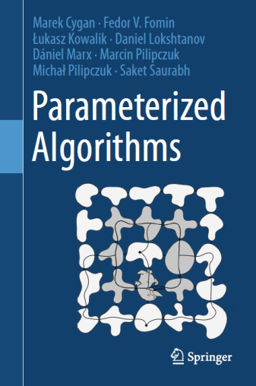
Conclusion
FPT is a vibrant field of algorithm design and complexity theory that deals with NP-hard problems
Opportunities for application to computational geometry:
Find FPT algorithms for geometric problems
Can geometric instances be solved faster than general instances, with respect to known (S)ETH lower bounds?
Do geometric instances allow smaller kernels than general?
Examples in the open problem session tonight
THANK YOU!

