Slide 1
New frontiers for graph drawing Lossy (structural) kernelization and hybrid parameterizations
Bart M. P. Jansen Eindhoven University of Technology
Dagstuhl Seminar 23162: “New Frontiers of Parameterized Complexity in Graph Drawing”
April 17th 2023
Notes:
Figure: the lost continent of polynomial time.
Goal of the talk: survey some non-standard algorithmic paradigms in FPT with pointers to recent work and invitation to apply them in graph drawing. The talk will probably contain some well-known things for both halves of the audience (graph drawing vs. FPT), but hopefully also some new things for both halves.

Slide 2
Three frontiers
Kernelization for structural parameterizations
Lossy kernelization
Hybrid parameterizations
Notes:
Let’s start by introducing kernelization, which will take us along to each of the three frontiers. Along each frontier I will try to present some open problems related to graph drawing, and survey some recent related work I was involved in.

Slide 3
Three frontiers
Kernelization for structural parameterizations
Lossy kernelization
Hybrid parameterizations
Notes:
Let’s start by introducing kernelization, which will take us along to each of the three frontiers. Along each frontier I will try to present some open problems related to graph drawing, and survey some recent related work I was involved in.

Slide 4
Data reduction with a guarantee
Kernelization is a method for parameterized preprocessing
Efficiently reduce an instance $(x,k)$ to an equivalent instance of size bounded by some $f(k)$
One of the simplest ways of obtaining FPT algorithms
Apply a brute force algorithm on the shrunk instance
Kernelization also facilitates a rigorous analysis of efficient data compression
$n$ bits
$f(k)$ bits
$$x$$
$poly(\left|x\right|,k)$ time
$$x′$$
$$k$$
$$k′$$

Slide 5
Data reduction with a guarantee
A kernelization for a parameterized decision problem $L$ is:
an algorithm that transforms inputs $(x,k)$ into $(x^{′},k^{′})$
in $poly(\left|x\right|,k)$ time
such that $(x,k)$ has answer yes iff $(x^{′},k^{′})$ has answer yes
and $\left|x^{′}\right|≤f(k)$ and $k^{′}≤f(k)$
The function $f:ℕ→ℕ$ is the size of the kernelization If the size bound $f$ is a polynomial, it is a polynomial kernelization
A kernelization guarantees that instances that are large with respect to their complexity parameter can be shrunk
$n$ bits
$f(k)$ bits
$$x$$
$poly(\left|x\right|,k)$ time
$$x′$$
$$k$$
$$k′$$

Slide 6
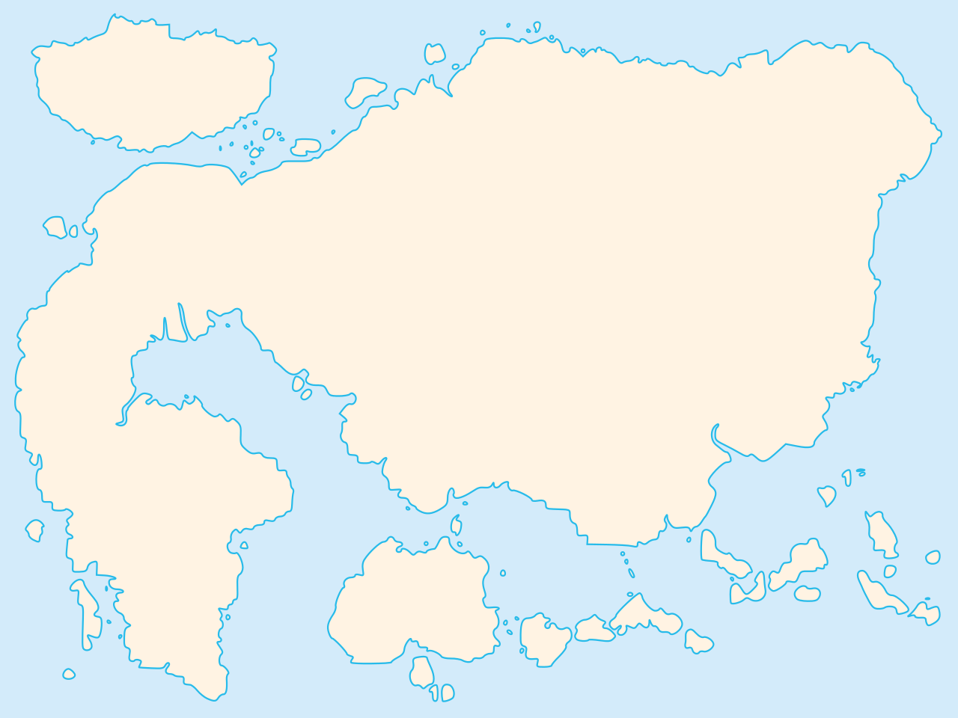
Map of polynomial-time computation
Kernelization
Primality
testing
Network flows
The lost continent of polynomial time
Sorting
Parsing context-free grammars
Fast Fourier transform
The lost continent of polynomial time contains: provably effective and efficient preprocessing algorithms
that reduce the sizes of NP-hard inputs
(without changing the answer)
Shortest paths
Longest common subsequence
Approximation
Islands of minor-testing
Notes:
Survey talk by Mike during the same IWPEC where the first polynomial kernel for FVS was presented. The striking realization that there are polynomial-time algorithms that hold provable power over NP-hard problems, without actually solving them.

Slide 7
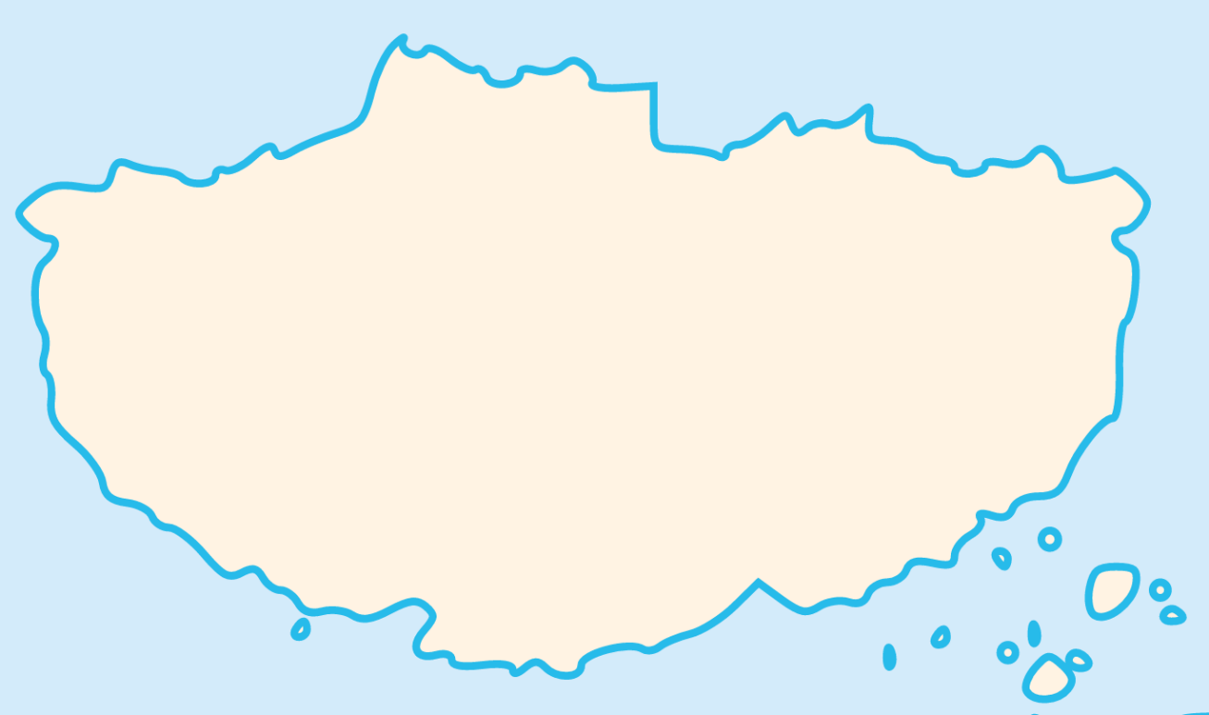
Map of the lost continent
Lower bounds
Linear algebra
Crown reduction
2-layer planarization
Representative sets
...
Expansion lemma
Protrusion replacement
Sunflower lemma
Rainbow matching
Well-quasi ordering
Notes:
Put some survey items here? $k$-Vertex Cover has a kernel with $2k$ vertices. $k$-Feedback Vertex Set has a kernel with $O(k^{2})$ vertices and edges. $k$-Odd Cycle Transversal has a randomized kernel with $poly(k)$ vertices. $P_{3}$-packing kernel with $O(k)$ vertices [SODA ‘23]. Kernel lower bounds for graph genus from SOCG 2016.
Are there interesting kernelization results to be obtained for problems in graph drawing?

Slide 8
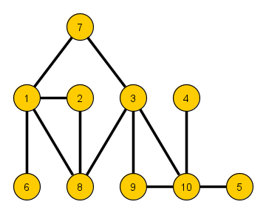
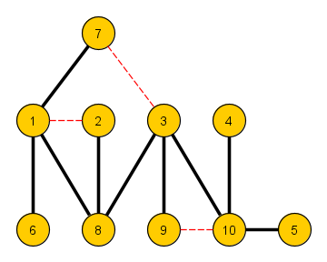
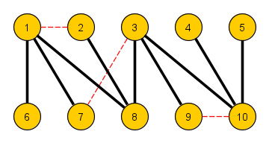
A fruitfly for parameterized graph drawing
2-layer planarization Input: A graph $G$ and an integer $k$ Question: Is there a set $S$ of at most $k$ edges, such that $G−S$ has a straight-line planar drawing with the vertices on 2 horizontal layers?
NP-complete, even on bipartite graphs where one side has maximum degree two [Eades & Whitesides, TCS’94]
Notes:
Let’s not do vertex cover again.

Slide 9
A fruitfly for parameterized graph drawing
2-layer planarization (Natural parameterization) Input: A graph $G$ and an integer $k$ Parameter: $k$ Question: Is there a set $S$ of at most $k$ edges, such that $G−S$ has a straight-line planar drawing with the vertices on 2 horizontal layers?
Kernel with $O(k)$ vertices and edges [DFHKMNRRW, Algorithmica’06]
Fixed-parameter tractable, solvable in time $O(k⋅{3.562}^{k}+n+m)$ [Suderman, PhD thesis‘05]
Notes:
Dujmović
Let’s not do vertex cover again. Known: a graph has such a straight-line drawing if and only if it is a forest of caterpillars, that is, each tree in the forest consists of a path plus leaves attached to the path. This shows that the solution size is at least as large as feedback edge set. Note: the problem is equivalent to ‘reduce the pathwidth to 1 by edge deletions’. But then: it’s even FPT in the feedback vertex number, and even in the treewidth, since you can define the forbidden minors in MSO and quantify over the edge set?

Slide 10
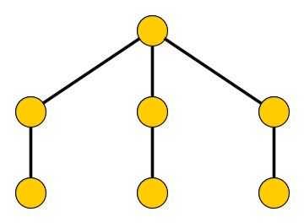
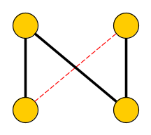
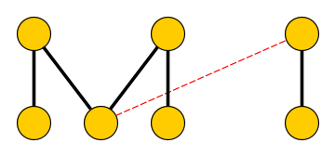
Frontier 1: Kernelization for structural parameterizations
2-layer planarization (Refined parameterization) Input: A graph $G$ and an integer $k$ Parameter: The size $f$ of a minimum feedback edge set, i.e., $f=n−m+\#cc(G)$ Question: Is there a set $S$ of at most $k$ edges, such that $G−S$ has a straight-line planar drawing with the vertices on 2 horizontal layers?
This is a refined parameterization:
if there is a solution of size $k$, then $k≥f$ since a solution breaks all cycles
... but $f$ can be arbitrarily much smaller than an optimal solution
Notes:
So here: we want to explain a little bit about our recent result. So the storyline can be: start by kernel for $k$, then kernel for FES, then ask problem about kernel for FVS (which is an even smaller parameterization), which was already asked as an open problem, and then: what is the smallest parameterization that allows for a polynomial kernel? We can sometimes answer this, give example for Feedback Vertex Set.

Slide 11
Frontier 1: Kernelization for structural parameterizations
2-layer planarization (Refined parameterization) Input: A graph $G$ and an integer $k$ Parameter: The size $f$ of a minimum feedback edge set, i.e., $f=n−m+\#cc(G)$ Question: Is there a set $S$ of at most $k$ edges, such that $G−S$ has a straight-line planar drawing with the vertices on 2 horizontal layers?
The good algorithmic behavior extends to this parameterization: [Uhlmann & Weller, TCS’13]
There is a kernel with $O(f)$ vertices and edges
The problem can be solved in time $O(6^{f}⋅f^{2}+(f+1)·(n+m))$
What is the smallest structural parameterization, for which the problem has a polynomial-size kernel?
Notes:
Other structural parameterizations of graph drawing problems that have been considered in the past include the number of triconnected components, number of cut vertices, etc.

Slide 12
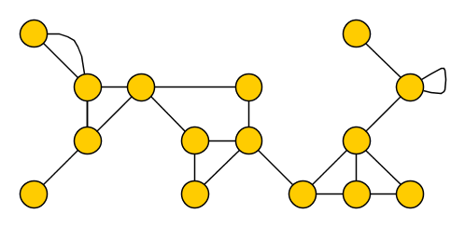
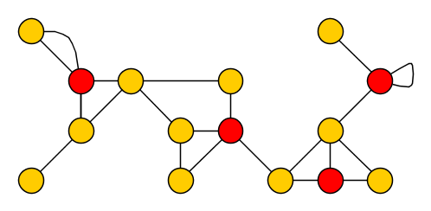
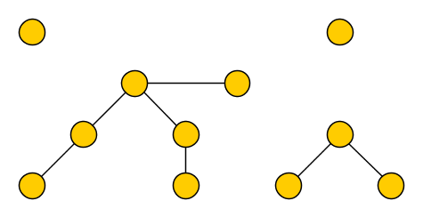
The undirected Feedback Vertex Set problem
Feedback Vertex Set (Natural parameterization) Input: An undirected (multi)graph $G$ and an integer $k$ Parameter: $k$ Question: Is there a set $X$ of at most $k$ vertices that intersects each cycle?

Slide 13
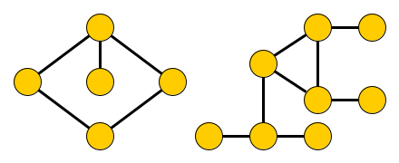
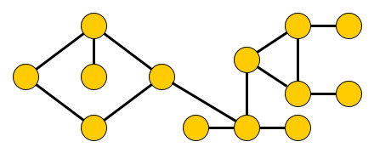
The undirected Feedback Vertex Set problem
Feedback Vertex Set (Natural parameterization) Input: An undirected (multi)graph $G$ and an integer $k$ Parameter: $k$ Question: Is there a set $X$ of at most $k$ vertices that intersects each cycle?
There is a kernel with $O(k^{2})$ vertices and edges [Iwata, ICALP’17] [Thomassé, TALG’10]
Natural parameterization coincides with vertex-deletion distance to a forest
Refined parameterizations: vertex-deletion distance to a superclass of forests
Pseudo forest [J, Raman & Vatshelle, TST’14] Each component has $≤$ 1 cycle
Mock-$d$-forest [Majumdar & Raman, Algorithmica ‘18] Each component has $≤d$ cycles, each vertex in $≤1$ cycle
$$d=2$$

Slide 14
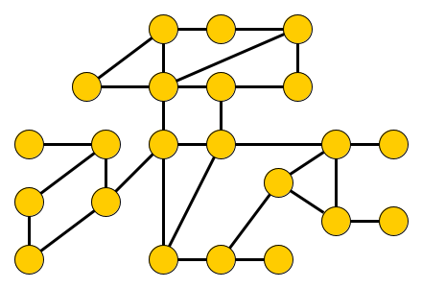
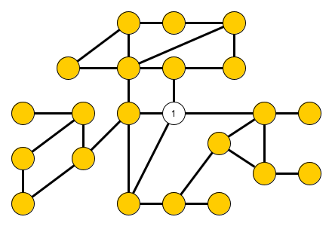
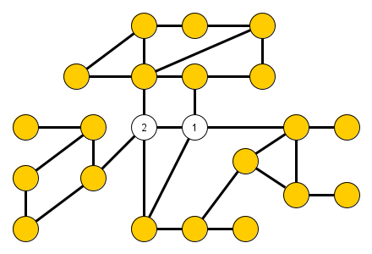
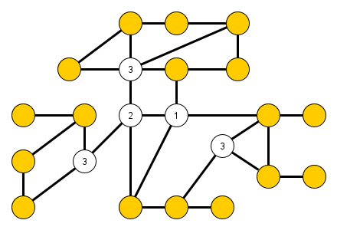
The smallest FVS parameterizations with polynomial kernels
For a graph $G$, its elimination distance to a forest is:
the minimum number of rounds needed to turn $G$ into a forest,
when removing 1 vertex from each connected component in each round

Slide 15
The smallest FVS parameterizations with polynomial kernels
For a graph $G$, its elimination distance to a forest is:
the minimum number of rounds needed to turn $G$ into a forest,
when removing 1 vertex from each connected component in each round
Let $𝒢$ be a minor-closed class of graphs and assume NP ⊈ coNP/poly
The degree of the polynomial depends on the bound on the elimination distance
Feedback Vertex Set parameterized by vertex-deletion distance to $𝒢$ has a polynomial kernel
$⇔$
$𝒢$ has bounded elimination distance to a forest
[Dekker & J, WG’22]
Notes:
So the concept of elimination distance shows, at least with respect to parameterizations defined in terms of vertex-deletion distance to a minor-closed graph class, which ones have a polynomial kernel.

Slide 16
Research directions on the frontier of structural kernelization
For some problems, it is within reach to find the strongest tractable parameterizations
Does 2-layer edge planarization admit a polynomial kernel parameterized by:
The size of a feedback vertex set? (also asked by [Uhlmann & Weller, TCS’13]; FPT by Courcelle’s theorem)
Edge-elimination distance to a 2-layer planar graph?
Edge-elimination distance to a forest?
2&3 are FPT as edge-elimination dist. is bounded exponentially in edge-deletion dist.
What is the largest (well-behaved) graph class $𝒢$ such that 2-layer edge planarization has a polynomial kernel parameterized by edge-deletion distance to $𝒢$?
Can this frontier be explored for graph drawing?

Slide 17
Three frontiers
Kernelization for structural parameterizations
Lossy kernelization
Hybrid parameterizations
Notes:
Let’s start by introducing kernelization, which will take us along to each of the three frontiers. Along each frontier I will try to present some open problems related to graph drawing, and survey some recent related work I was involved in.

Slide 18
Frontier 2: Lossy kernelization
The standard definition of kernelization targets exact answers to decision problems
For highly complex problems, a polynomial-size kernelization may seem out of reach ... or simply be impossible, under established complexity assumptions
The framework of lossy kernelization relaxes the strict requirements of kernelization, to capture preprocessing with a small factor-$α$loss of accuracy [Lokshtanov, Panolan, Ramanujan & Saurabh, STOC’17]
$n$ bits
Reduction algo.
$poly(k)$ bits
$$x$$
$$x′$$
$$k≈opt$$
$poly(\left|x\right|,k)$ time
$$s$$
$$s′$$
$(c⋅α)$-approximate solution for $x$
$c$-approximate solution for $x′$
Lifting algo.

Slide 19
Frontier 2: Lossy kernelization
The standard definition of kernelization targets exact answers to decision problems
For highly complex problems, a polynomial-size kernelization may seem out of reach ... or simply be impossible, under established complexity assumptions
The framework of lossy kernelization relaxes the strict requirements of kernelization, to capture preprocessing with a small factor-$α$loss of accuracy [Lokshtanov, Panolan, Ramanujan & Saurabh, STOC’17]
Polynomial-size $α$-approximate kernelization for $α∈O(1)$is interesting when:
No $O(1)$-approximation is known for the problem (it may not exist)
No polynomial-size exact kernelization is known for the problem (it may not exist)

Slide 20
Intuition behind lossy kernelization
If problem $X$ admits a polynomial-size kernel, it roughly speaking means:
The task of optimally solving $X$ on large inputs with small parameter values, can efficiently be reduced to solving $X$ on small inputs
If problem $X$ admits a polynomial-size $O(1)$-approximate kernel, it roughly means:
The task of approximating $X$ on large inputs with small optimal solutions, can efficiently be reduced to approximating $X$ on small inputs
Which tough-to-approximate problems in graph drawing admit polynomial-size $O(1)$-approximate lossy kernels?
Notes:
Will give a concrete question after a sample of results of this type.

Slide 21
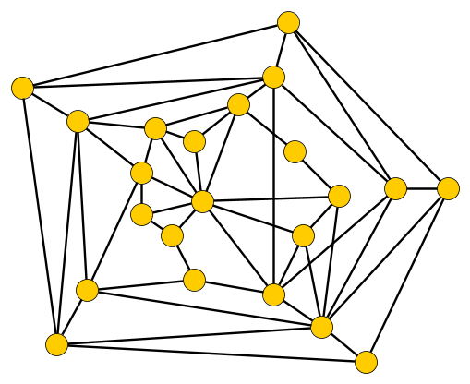
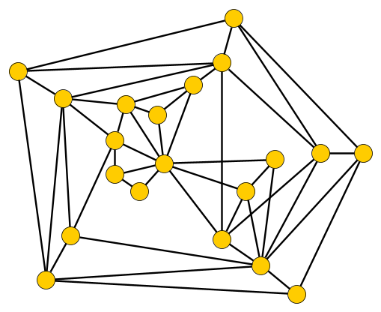
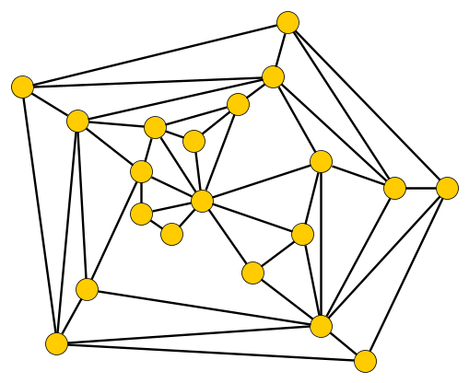
Lossy kernelization for a problem related to graph drawing
Vertex Planarization (Natural parameterization) Input: An undirected graph $G$ and an integer $k$ Parameter: $k$ Question: Is there a set $X$ of at most $k$ vertices such that $G−X$ is planar?

Slide 22
Lossy kernelization for a problem related to graph drawing
Vertex Planarization (Natural parameterization) Input: An undirected graph $G$ and an integer $k$ Parameter: $k$ Question: Is there a set $X$ of at most $k$ vertices such that $G−X$ is planar?
Big mystery from the kernelization & approximation perspective:
No polynomial-size exact kernel is known
No constant-factor approximation algorithm is known
... but neither have been proven to be impossible under plausible conjectures
$O(n^{ε})$-approximation in time $O(n^{\frac{1}{ε}})$ for all $ε>0$ and quasi-poly. $\log^{O\left(1\right)}{(n)}$-approx. [Kawarabayashi & Sidiropoulos, FOCS ’17]

Slide 23
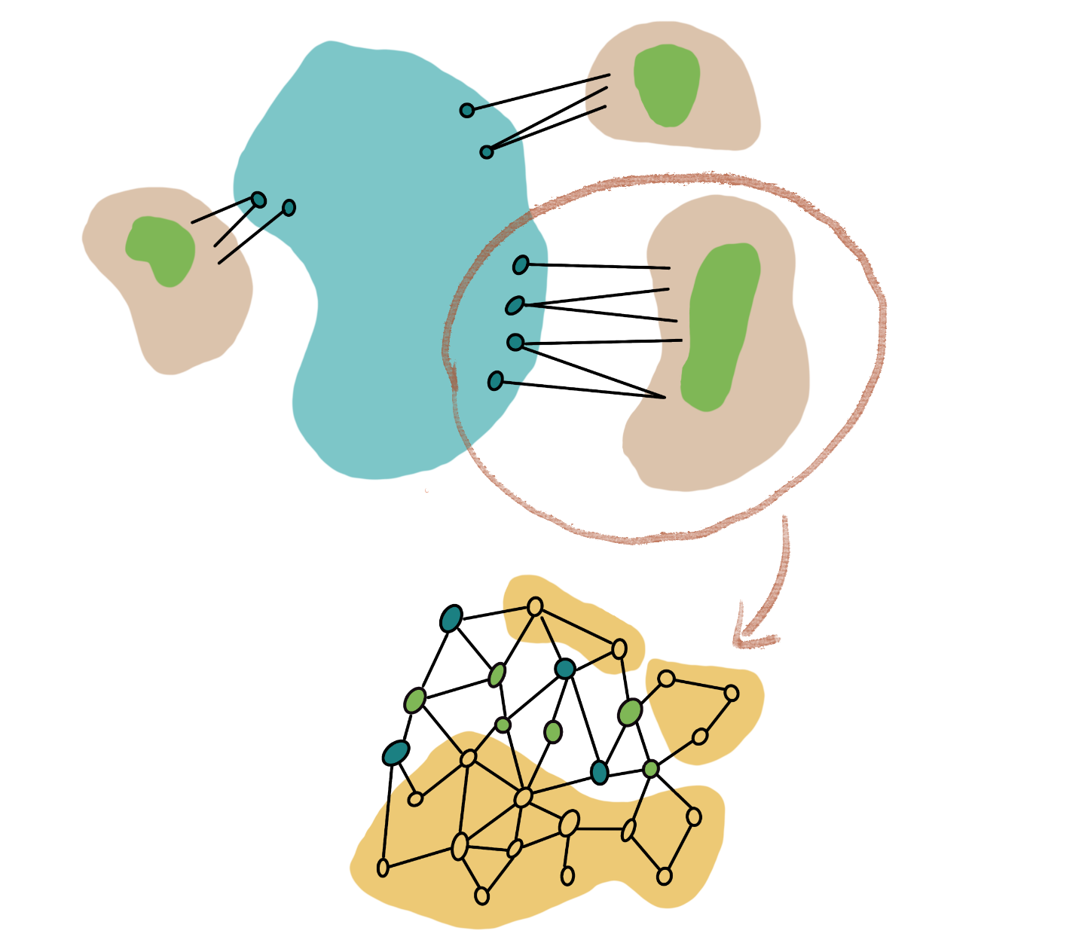
Planarization has an $O(1)$-approximate lossy kernel
Vertex Planarization has a $O(1)$-approximate lossy kernelization of polynomial-size
[J & Wlodarzcyk, STOC’22]
Find $X⊆V(G)$ of size $k^{O\left(1\right)}$ such that for each component $C$ of $G−X:$
Find 𝑋⊆𝑉(𝐺) of size 𝑘^𝑂(1) such that for each component 𝐶 of 𝐺−𝑋:
Embed each component $C$ with its neighborhood $N_{G}(C)$ considered as terminals
Embed each component 𝐶 with its neighborhood 𝑁_𝐺 (𝐶) considered as terminals
Within each component $C$, mark $k^{O\left(1\right)}$ vertices such that an $O(1)$-approximation exists among the marked vertices
Within each component 𝐶, mark 𝑘^𝑂(1) vertices such that an 𝑂(1)-approximation exists among the marked vertices
Compress the set of unmarked vertices
$N_{G}[C]$ induces a planar subgraph, and
𝑁_𝐺 [𝐶] induces a planar subgraph, and
the number of such components is $k^{O\left(1\right)}$
the number of such components is 𝑘^𝑂(1)
Reduce treewidth to $k^{O\left(1\right)}$ by removing irrelevant vertices
Reduce treewidth to 𝑘^𝑂(1) by removing irrelevant vertices
$$X$$
Notes:
Image due to Michal Wlodarzcyk. The hard work of making the lossy kernel for planarization is to analyze planar subgraphs with terminals on the outer face. The task is to understand how deleting vertices from the interior of such planar subgraphs can help planarize a graph obtained by gluing a subgraph to the terminals.

Slide 24
Planarization has an $O(1)$-approximate lossy kernel
The core work in making the lossy kernel is:
Analyzing planar subgraphs interacting through terminals on outer face
Have to understand how deleting vertices from their interior, can help planarize the graph obtained by gluing a subgraph onto the terminals
Vertex Planarization has a $O(1)$-approximate lossy kernelization of polynomial-size
[J & Wlodarzcyk, STOC’22]
Notes:
Image due to Michal Wlodarzcyk. The hard work of making the lossy kernel for planarization is to analyze planar subgraphs with terminals on the outer face. The task is to understand how deleting vertices from the interior of such planar subgraphs can help planarize a graph obtained by gluing a subgraph to the terminals.

Slide 25
Research directions on the frontier of lossy kernelization
Crossing number Input: A graph $G$ and integer $k$ Parameter: $k$ Question: Does $G$ have a drawing with at most $k$ crossings?
Fixed-parameter tractable via treewidth reduction [Grohe, STOC’01] [Kawarabayashi & Reed, STOC’07]
No polynomial-size exact kernel assuming NP ⊈ coNP/poly [Hliněný & Derňár, SOCG’16]
No $O(1)$-approximation known, but its existence is not ruled out
Kawarabayashi & Sidiropoulos
Chuzhoy, Mahabadi, and Tan
Chuzhoy & Tan
$\tilde{O}\left(n^{0.5−ε}⋅Δ^{O\left(1\right)}\right)$ approximation for $ε>0$
𝑂 ̃(𝑛^(0.5−𝜖)⋅Δ^𝑂(1) ) approximation for 𝜖>0
FOCS’20
$2^{O\left({\left(\log{n}\right)}^{\frac{7}{8}}\log{\log{n}}\right)}⋅Δ^{O\left(1\right)}$ approximation
2^𝑂((log⁡𝑛 )^(7/8) log⁡log⁡𝑛 ) ⋅Δ^𝑂(1) approximation
STOC’22
$\tilde{O}(\sqrt{n}⋅Δ^{O\left(1\right)})$ approximation
𝑂 ̃(√𝑛⋅Δ^𝑂(1) ) approximation
STOC’19
Notes:
Already APX hard on subcubic graphs.

Slide 26
Research directions on the frontier of lossy kernelization
Crossing number Input: A graph $G$ and integer $k$ Parameter: $k$ Question: Does $G$ have a drawing with at most $k$ crossings?
Fixed-parameter tractable via treewidth reduction [Grohe, STOC’01] [Kawarabayashi & Reed, STOC’07]
No polynomial-size exact kernel assuming NP ⊈ coNP/poly [Hliněný & Derňár, SOCG’16]
No $O(1)$-approximation known, but its existence is not ruled out
Does Crossing number have an $O(1)$-approximate lossy kernel of polynomial size?
Even a result for subcubic graphs could be interesting
Notes:
Already APX hard on subcubic graphs.

Slide 27
Three frontiers
Kernelization for structural parameterizations
Lossy kernelization
Hybrid parameterizations
Notes:
Let’s start by introducing kernelization, which will take us along to each of the three frontiers. Along each frontier I will try to present some open problems related to graph drawing, and survey some recent related work I was involved in.

Slide 28
Frontier 3: Hybrid parameterizations
Elimination processes also give rise to hybrid parameterizations
They can lead to parameterizations which can simultaneously be much smaller than:
the size of the solution,
measures of graph complexity like treedepth or treewidth
This added generality can come for free in several applications!
Results of this type greatly generalize the class of tractable inputs
Which positive algorithmic results for solution-size or width parameterizations, can be generalized to hybrid parameterizations?
Notes:
These concepts have been worked on extensively by people in the room, e.g. Rober
For one-sided crossing minimization (given a bipartition and an ordering of one layer, find an ordering of the other layer such that you get at most $k$ crossings from straight-line drawings) has a PTAS and subexponential-time algorithm of runtime $2^{O\left(\sqrt{k}\log{k}\right)}$ by Chromatic Coding and relation to Feedback Arc Set on semi-complete digraphs.

Slide 29
A hybrid parameterization for planarization
Vertex Planarization (Hybrid parameterization) Input: An undirected graph $G$ and an integer $k$ Parameter: The vertex-elimination distance $d$ of $G$ to a planar graph Question: Is there a set $X$ of at most $k$ vertices such that $G−X$ is planar?
Notes:
Parameter dependence for given decomposition matches best-known running time for both treewidth and solution size!

Slide 30
A hybrid parameterization for planarization
Vertex Planarization (Hybrid parameterization) Input: An undirected graph $G$ and an integer $k$ Parameter: The vertex-elimination distance $d$ of $G$ to a planar graph Question: Is there a set $X$ of at most $k$ vertices such that $G−X$ is planar?
This hybrid parameterization dominates solution size and treedepth
Result even extends to the more general notion of $ℋ$-treewidth, for $ℋ$ = planar graphs
Vertex Planarization can be solved in time $2^{d^{O\left(1\right)}}⋅n^{O\left(1\right)}$. If an elimination forest of depth $d$ is given, the time improves to $2^{O\left(d\log{d}\right)}⋅n^{O\left(1\right)}$.
[J, de Kroon & Wlodarzcyk, STOC’21]
Notes:
Parameter dependence for given decomposition matches best-known running time for both treewidth and solution size! Treedepth = elimination distance to empty graph.

Slide 31
Solving Vertex Planarization using a elimination distance
The elimination process provides a decomposition of the graph by small separators
We can use dynamic programming over this decomposition, but need to solve the subproblems corresponding to planar subgraphs remaining after elimination
If $G$ can be made planar by $d$ rounds of eliminating a vertex from each component, an optimal planarization set contains at most $d$vertices from a leftover component
Notes:
In many cases, this allows us to employ algorithms for the solution-size parameterization to compute the information for the leaves of the decomposition. The remaining process of computing a solution is similar as for treewidth.

Slide 32
Solving Vertex Planarization using a elimination distance
FPT algorithms for the parameterization by $k$ can be used to bootstrap the DP
We can use dynamic programming over this decomposition, but need to solve the subproblems corresponding to planar subgraphs remaining after elimination
If $G$ can be made planar by $d$ rounds of eliminating a vertex from each component, an optimal planarization set contains at most $d$vertices from a leftover component
Notes:
In many cases, this allows us to employ algorithms for the solution-size parameterization to compute the information for the leaves of the decomposition. The remaining process of computing a solution is similar as for treewidth.

Slide 33
Research directions on the frontier of hybrid parameterizations
Is 2-layer edge planarization single-exponential FPT parameterized by:
The edge-elimination distance to a 2-planar drawing? This parameters can be exponentially much smaller than solution size, but not more
The edge-elimination distance to a forest? (Can this quantity be computed in polynomial time?)
The vertex-deletion distance to a graph having a planar 2-layer drawing?
The vertex-elimination distance to a graph having a planar 2-layer drawing?
The $ℋ$-treewidth of the input, for $ℋ$ the class of graphs of pathwidth 1?
Does your favorite FPT algorithm generalize from ‘size of a solution’ to ‘minimum number of rounds to build a solution’?
Notes:
For one-sided crossing minimization (given a bipartition and an ordering of one layer, find an ordering of the other layer such that you get at most $k$ crossings from straight-line drawings) has a PTAS and subexponential-time algorithm of runtime $2^{O\left(\sqrt{k}\log{k}\right)}$ by Chromatic Coding and relation to Feedback Arc Set on semi-complete digraphs.

Slide 34
Conclusion
Many frontiers to be explored in the parameterized complexity of graph drawing ... even for well-studied problems like 2-layer planarization
Kernelization for structural parameterizations
Lossy kernelization
Hybrid parameterizations
Detecting essential elements
Does your favorite graph drawing problem lie on one of these frontiers?
Notes:
For essential elements: open problem for edge planarization.

