Slide 1
Data Reduction for Graph Coloring Problems
Bart M. P. Jansen
Joint work with Stefan Kratsch
August 22nd 2011, Oslo

Slide 2
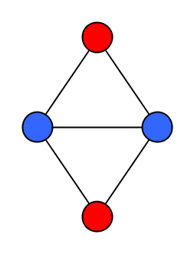
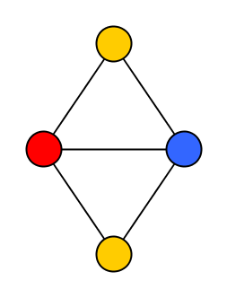
Vertex Coloring of Graphs
Given an undirected graph G and integer q, can we assign each vertex a color from {1, 2, …, q} such that adjacent vertices have different colors?
If q is part of the input: Chromatic Number
If q is constant: q-Coloring
3-Coloring is NP-complete

Slide 3
Data reduction by preprocessing
First line of attack for hard graph coloring problems
Desired: polynomial-time preprocessing algorithm
Input: instance x of a coloring problem
Parameter: value k which measures some property of x
Output: instance y such that x is yes iff y is yes |y| is bounded by f(k)
This is a kernelization or kernel
If |y| is polynomial in k: polynomial kernel
We study how small y can be

Slide 4
Data reduction for graph coloring
How small can we make an instance of a coloring problem in polynomial time, without changing the answer?
Express the output size in terms of a parameter of the input
Which parameter should we use?
Not clear a priori
We study a spectrum of parameters and find the limits of what is possible
Next: examples of three different parameters

Slide 5
Parameter 1: # allowed colors
Use the desired number of colors q as the parameter
Can we reduce to bitsize f(q), for some function f?
Not unless P=NP since 3-Coloring is NP-complete
On input x, compute instance y in polynomial time
|y| = f(q) = f(3) = O(1)
Solve the constant-size instance in constant time
Polynomial-time procedure for an NP-complete problem

Slide 6
Parameter 2: Treewidth
Well-known structural graph measure
Behavior of Chromatic Number parameterized by treewidth:
Preprocess to size f(tw) in polynomial time
Exponential function f [Implied by FPT status]
Cannot preprocess to size poly(tw) unless the polynomial hierarchy collapses
Not even for 3-Coloring [BDFH’09,JK’11]

Slide 7
Parameter 3: Vertex Cover Nr
A vertex cover of a graph G is a set of vertices which contains an endpoint of every edge
The vertex cover number is the size of a smallest vertex cover
tw(G) ≤ vc(G) [Folklore]
Cannot preprocess Chromatic Number to bitsize poly(vc(G)), unless the polynomial hierarchy collapses [BJK’11]
Difficulty of an instance depends on q
Size of a processed instance needs to depend on q
Sample of our results:
An instance of q-Coloring on graph G be reduced in polynomial time to an equivalent instance on O(vc(G)^{q}) vertices

Slide 8
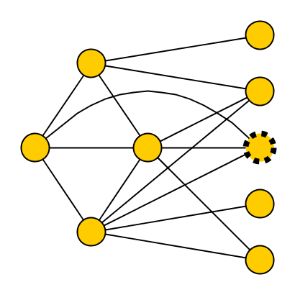
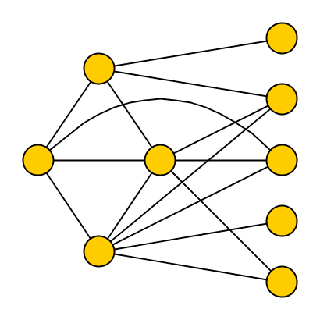
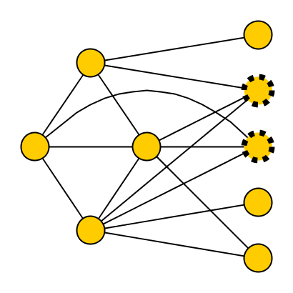
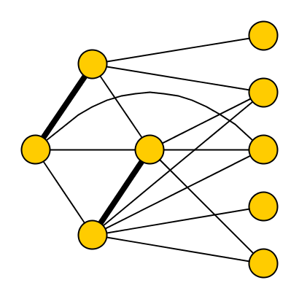
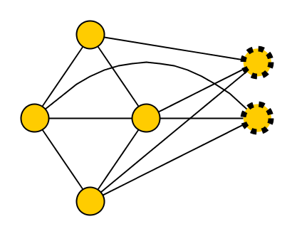
Preprocessing algorithm parameterized by Vertex Cover Nr
Input: instance G of q-Coloring
Compute a 2-approximate vertex cover X of G
For each set S of q vertices in X, mark a vertex v_{S} which is adjacent to all vertices of S (if one exists)
Delete all vertices which are not in X, and not marked
Output the resulting graph G’ on n’ vertices
n’ ≤ |X| + |X|^{q}
≤ 2k + (2k)^{q}
X
q=3
Claim: Algorithm runs in
polynomial time
Claim: n’ is O(k^{q}),
with k = vc(G)

Slide 9
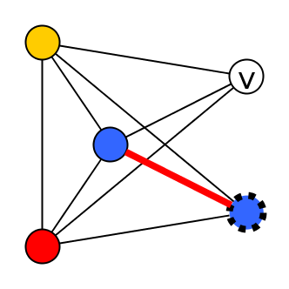
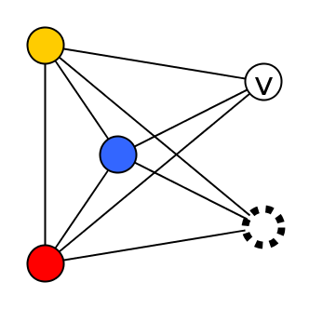
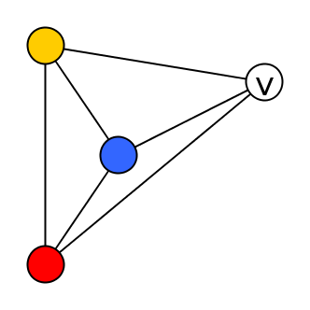
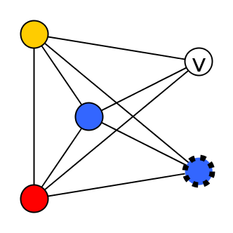
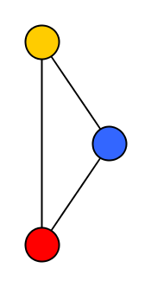
Correctness: χ(G)≤q ⬄ χ(G’)≤q
(➔) Trivial since G’ is a subgraph of G
(⬅) Take a q-coloring of G’
For each deleted vertex v:
If there is a color in {1, …, q} which does not appear on a neighbor of v, give v that color
Proof by contradiction: we cannot fail
when failing: q neighbors of v each have a different color
let S⊆X be a set of these neighbors
look at v_{S} we marked for set S
all colors occur on S → v_{S} has neighbor with same color
X

Slide 10
Result
The reduction procedure gives the following:
What we know about q-Coloring so far:
parameter treewidth does not allow a polynomial kernel
parameter vertex cover does allow one
Now consider parameters which are “sandwiched” in between
q-Coloring parameterized by vertex cover number has a kernel with O(k^{q}) vertices

Slide 11
a hierarchy of parameters

Slide 12
Structural graph parameters
Let F be a class of graphs
For a graph G, the deletion distance to F is the minimum number of vertex deletions needed to transform G into a graph in F
Parameterize by this deletion distance for various F
Using a hierarchy of graph classes F, we obtain a hierarchy of parameters
Guides the search for the boundary of good preprocessing

Slide 13
Hierarchy of structural parameters
Vertex Cover
Distance to an independent set
Distance to linear forest
Linear forest: union of paths
Distance to Split graph components
Distance to Cograph
Feedback Vertex Set
Distance to Interval
Distance to a forest
Treewidth
Distance to Chordal
Odd Cycle Transversal
Distance to bipartite
Distance to Perfect
Chromatic Number

Slide 14
Hierarchy of structural parameters
Vertex Cover
Distance to linear forest
Let G be a graph with feedback vertex set of size k. Can we reduce G in polynomial time to G’ such that:
|G’| ∈ poly(k)
χ(G)≤q ⬄ χ(G’)≤q
Distance to Cograph
Let G be a graph with a vertex cover of size k. Can we reduce G in polynomial time to G’ such that:
|G’| ∈ poly(k)
χ(G)≤q ⬄ χ(G’)≤q
Let G be a graph of treewidth at most k. Can we reduce G in polynomial time to G’ such that:
|G’| ∈ poly(k)
χ(G)≤q ⬄ χ(G’)≤q
Distance to Split graph components
Feedback Vertex Set
Distance to Interval
Treewidth
Distance to Chordal
Odd Cycle Transversal
Distance to Perfect
Chromatic Number

Slide 15
What can we say about these parameters?
Situation for Chromatic Number is simple: no polynomial kernel for any parameter ≤ vertex cover, unless the polynomial hierarchy collapses [BJK’11]
More interesting situation for q-Coloring
Related earlier work:
FPT algorithms parameterized by edge and vertex deletion distance to several graph classes [Cai’03,Marx’06]
FPT algorithm parameterized by Max Leaf Number [FellowsLMMRS’09]

Slide 16
Data reduction for q-Coloring
Vertex Cover
Distance to linear forest
Distance to Split graph components
Distance to Cograph
Feedback Vertex Set
Distance to Interval
Treewidth
Distance to Chordal
Odd Cycle Transversal
Distance to Perfect
Chromatic Number

Slide 17
Data reduction for q-Coloring
Vertex Cover
Distance to linear forest
Distance to Split graph components
Distance to Cograph
Feedback Vertex Set
NP-complete for k=2 [Cai’03]
No kernel unless P=NP
Distance to Interval
Treewidth
Distance to Chordal
Odd Cycle Transversal
Distance to Perfect
Chromatic Number

Slide 18
Data reduction for q-Coloring
Vertex Cover
Distance to linear forest
Distance to Split graph components
Distance to Cograph
Feedback Vertex Set
Distance to Interval
Treewidth
Distance to Chordal
Odd Cycle Transversal
Distance to Perfect
Chromatic Number

Slide 19
Data reduction for q-Coloring
Vertex Cover
Distance to linear forest
Distance to Split graph components
Distance to Cograph
Feedback Vertex Set
Distance to Interval
Fixed-Parameter Tractable parameterized by treewidth
Polynomial-time reduction to size f(k) possible, for exponential f
Treewidth
Distance to Chordal
Odd Cycle Transversal
Distance to Perfect
Chromatic Number

Slide 20
Data reduction for q-Coloring
Vertex Cover
Distance to linear forest
Distance to Split graph components
Distance to Cograph
Feedback Vertex Set
Distance to Interval
Treewidth
Distance to Chordal
Odd Cycle Transversal
Distance to Perfect
Chromatic Number

Slide 21
Data reduction for q-Coloring
Vertex Cover
Distance to linear forest
Distance to Split graph components
Distance to Cograph
Fixed-Parameter Tractable, for fixed q
Using bounded treewidth
Feedback Vertex Set
Distance to Interval
Treewidth
Distance to Chordal
Odd Cycle Transversal
Distance to Perfect
Chromatic Number

Slide 22
Data reduction for q-Coloring
Vertex Cover
Distance to linear forest
Distance to Split graph components
Distance to Cograph
Feedback Vertex Set
Distance to Interval
Treewidth
Distance to Chordal
Odd Cycle Transversal
Distance to Perfect
Chromatic Number

Slide 23
Data reduction for q-Coloring
Vertex Cover
Distance to linear forest
Polynomial kernel:
Reduction to G’ on O(k^{q}) vertices [JansenK’11]
Distance to Split graph components
Distance to Cograph
Feedback Vertex Set
Distance to Interval
Treewidth
Distance to Chordal
Odd Cycle Transversal
Distance to Perfect
Chromatic Number

Slide 24
Data reduction for q-Coloring
Vertex Cover
Distance to linear forest
Distance to Split graph components
Distance to Cograph
Feedback Vertex Set
Distance to Interval
Treewidth
Distance to Chordal
Odd Cycle Transversal
Distance to Perfect
Chromatic Number

Slide 25
Data reduction for q-Coloring
Polynomial kernels through classification theorem (next) [JansenK’11]
Polynomial kernel:
Reduction to G’ with k+k^{q} vertices [JansenK’11]
Vertex Cover
Distance to linear forest
Distance to Split graph components
Distance to Cograph
Feedback Vertex Set
Distance to Interval
Treewidth
Distance to Chordal
Odd Cycle Transversal
Distance to Perfect
Chromatic Number

Slide 26
Data reduction for q-Coloring
Vertex Cover
Distance to linear forest
Distance to Split graph components
Distance to Cograph
Feedback Vertex Set
Distance to Interval
Treewidth
Distance to Chordal
Odd Cycle Transversal
Distance to Perfect
Chromatic Number

Slide 27
Data reduction for q-Coloring
Vertex Cover
Distance to linear forest
Distance to Split graph components
Distance to Cograph
No polynomial kernel unless the polynomial hierarchy collapses [JansenK’11]
Feedback Vertex Set
Distance to Interval
Treewidth
Distance to Chordal
Odd Cycle Transversal
Distance to Perfect
Chromatic Number

Slide 28
Data reduction for q-Coloring
Reduction to size poly(k)
Vertex Cover
Distance to linear forest
Distance to Split graph components
Distance to Cograph
Feedback Vertex Set
Distance to Interval
Reduction to size f(k)
No poly(k) unless
Treewidth
Distance to Chordal
Odd Cycle Transversal
No reduction to size f(k)
unless P=NP
Distance to Perfect
Chromatic Number

Slide 29
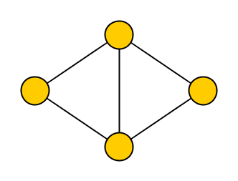
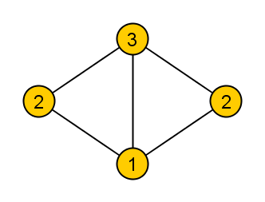
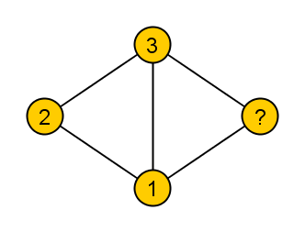
Classification theorem
All positive results are implied by a general theorem
Gives a sufficient condition for existence of polynomial kernels for q-Coloring parameterized by distance to F
Expressed using q-List Coloring:
Given an undirected graph G and a list of allowed colors L(v) ⊆ {1,…,q} for each vertex v, can we assign each vertex v a color in L(v) such that adjacent vertices have different colors?
{2,3}
{1,2}
{1,2,3}
{1,3}
{1}

Slide 30
General classification theorem
Let F be a hereditary class of graphs for which there is a function g:N→N such that:
for any no-instance (G,L) of q-List Coloring on a graph G in F,
there is a no-subinstance (G’,L’) on at most g(q) vertices.
q-Coloring parameterized by distance to F admits a polynomial kernel with O(k^{q·g(q)}) vertices for every fixed q
F that work
Independent sets
Cographs
F that fail
Paths
Graphs where each component is a split graph
3-coloring by distance to a path does not admit a poly kernel
(unless the polynomial hierarchy collapses)

Slide 31
Summary of results
q-Coloring by Vertex Cover
Polynomial kernel of bitsize O(k^{q}) ⬄ O(k^{q-1-ε}) lower bound
(assuming PH does not collapse)
Classification theorem for q-Coloring
Polynomial kernels for deletion distance to:
Cographs
Unions of split graphs
3-Coloring by distance to a path
no polynomial kernel unless PH collapses
Parameters relating to domination-structure
3-coloring parameterized by a Dominating Set:
in FPT, no polynomial kernel unless PH collapses

Slide 32
Conclusion
Study the potential of preprocessing by considering a hierarchy of structural parameters
For q-Coloring we located the threshold of polynomial kernelizability in the considered hierarchy
Open problems:
Use edge deletions as a parameter
Complexity parameterized by distance to P₅-free graphs?
Thank you!

