Slide 1
Hamiltonicity below Dirac’s condition
László Kozma Bart M. P. Jansen Jesper Nederlof
Networks Training Week Spring 2019 May 6th 2019, Kaap Doorn, Netherlands
Notes:
Advertisement for this talk: (1) it deals with a game that someone actually introduced for fun, not just a ‘game-theory’ game which are generally not fun. (2) It shows you some elegant ideas in graph theory. (3) It showcases a way to turn mathematical statements about existence of certain types of objects, into interesting algorithmic research questions. Perspective projection of a dodecahedron with a Hamiltion cycle through its vertices by CMG Lee based on http://commons.wikimedia.org/wiki/File:Dodecahedron_light_blue.svg (cc-by-sa).

Slide 2
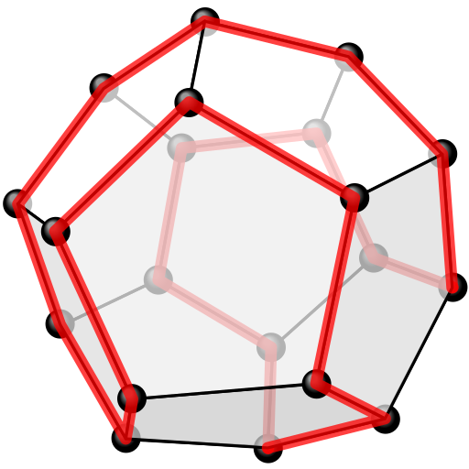
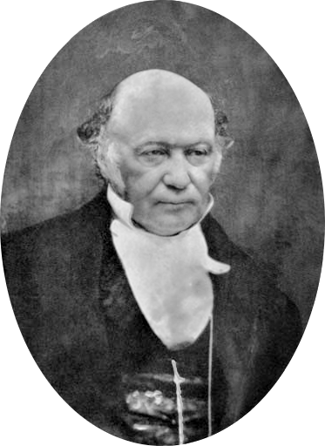
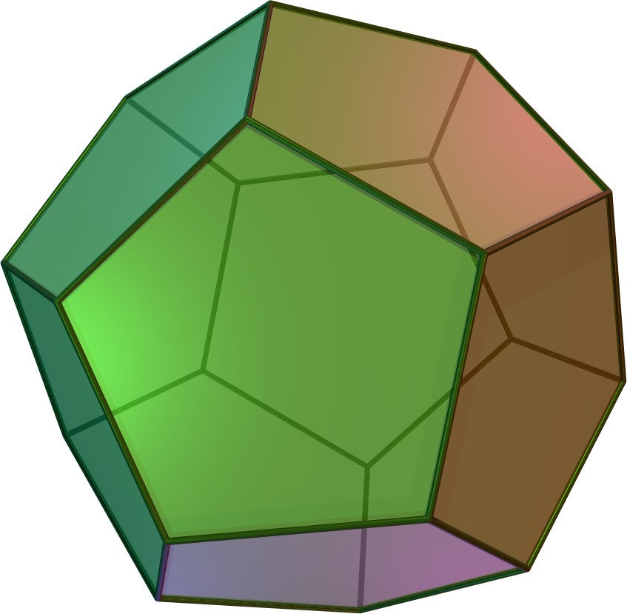
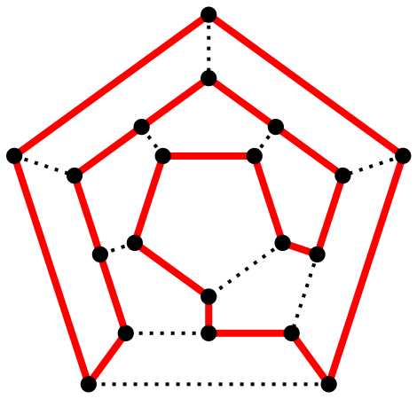
William Rowan Hamilton (1805-1865)
A Hamiltonian cycle visits every vertex exactly once
Notes:
If, like me, you programmed computer games at age 15, you might have come across his notion of quaternions to describe rotations. Game introduced by William Rowan Hamilton (Irish Mathematician, died in 1865). He invented icosian calculus and the icosian game. The related algorithmic problem is: given a graph, determine whether or not it has a Hamiltonian cycle. It is NP-hard and explains the intractability of the Traveling Salesman problem. Perspective projection of a dodecahedron with a Hamiltion cycle through its vertices by CMG Lee based on http://commons.wikimedia.org/wiki/File:Dodecahedron_light_blue.svg (cc-by-sa). Also, https://en.wikipedia.org/wiki/File:Hamiltonian_path.svg by Christoph Sommer (cc-by-sa). By Created by en:User:Cyp and copied from the English Wikipedia. - not stated, CC BY-SA 3.0, https://commons.wikimedia.org/w/index.php?curid=38668

Slide 3
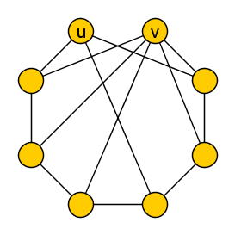
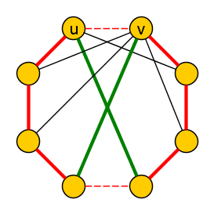
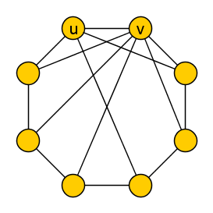
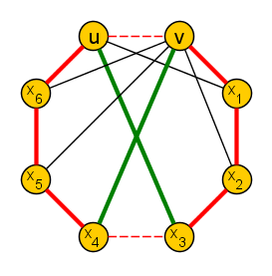
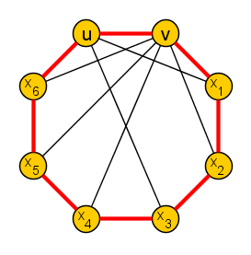
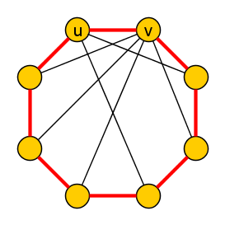
Let $G$ be an undirected $n$-vertex graph having non-adjacent vertices $u,v$ with $\deg\left(u\right)+\deg\left(v\right)≥n$.
Let $G′$ be obtained from $G$ by adding edge $\{u,v\}$. Then:
$G$ has a Hamiltonian cycle $⇔$ $G′$ has a Hamiltonian cycle
[Bondy & Chvátal ‘76]
If $(u,v,x_{1},…, x_{n−2},u)$ is a Hamiltonian cycle in $G′$, there exists $1≤i<n−2$ such that $\left\{u,x_{i}\right\},\left\{v,x_{i+1}\right\}∈E(G)$
Graph $G$ $n=8$ vertices
Graph $G′$
Notes:
Bondy–Chvátal. Now, the order of this talk is unconvential. Usually, one first gives motivation, then defines the problem, and ends with some proofs. Here we go the other way around: I start by showing you a proof, which will motivate our problem. (Also, it has the side-effect that if you dose off after the first couple of minutes, at least you will have seen this proof.)

Slide 4
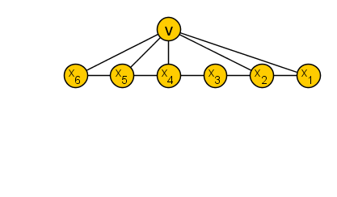
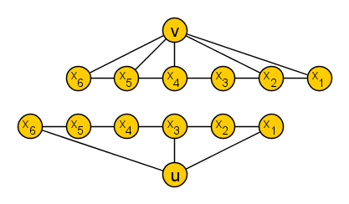
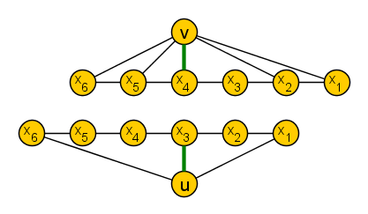
Let $G$ be an undirected $n$-vertex graph having non-adjacent vertices $u,v$ with $\deg\left(u\right)+\deg\left(v\right)≥n$. Let $G′$ be obtained from $G$ by adding edge $\{u,v\}$. Then:
$G$ has a Hamiltonian cycle $⇔$ $G′$ has a Hamiltonian cycle
[Bondy & Chvátal ‘76]
If $(u,v,x_{1},…, x_{n−2},u)$ is a Hamiltonian cycle in $G′$, there exists $1≤i<n−2$ such that $\left\{u,x_{i}\right\},\left\{v,x_{i+1}\right\}∈E(G)$
Together, $u$ and $v$ have $≥n$ edges into these $n+1$ bins
$$B_{n−1}$$
$$…$$
$$B_{2}$$
$$B_{1}$$
Notes:
Now, the order of this talk is unconvential. Usually, one first gives motivation, then defines the problem, and ends with some proofs. Here we go the other way around: I start by showing you a proof, which will motivate our problem. (Also, it has the side-effect that if you dose off after the first couple of minutes, at least you will have seen this proof.)

Slide 5
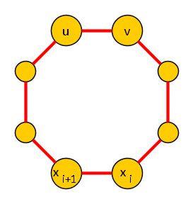
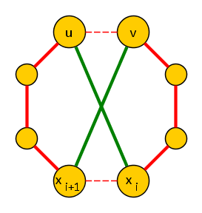
Let $G$ be an undirected $n$-vertex graph having non-adjacent vertices $u,v$ with $\deg\left(u\right)+\deg\left(v\right)≥n$. Let $G′$ be obtained from $G$ by adding edge $\{u,v\}$. Then:
$G$ has a Hamiltonian cycle $⇔$ $G′$ has a Hamiltonian cycle
[Bondy & Chvátal ‘76]
If $(u,v,x_{1},…, x_{n−2},u)$ is a Hamiltonian cycle in $G′$, there exists $1≤i<n−2$ such that $\left\{u,x_{i}\right\},\left\{v,x_{i+1}\right\}∈E(G)$
Replace edges $\{u,v\}$ and $\{x_{i},x_{i+1}\}$ with $\left\{u,x_{i}\right\}$ and $\left\{v,x_{i+1}\right\}$ to obtain a Hamiltonian cycle in $G$
Notes:
Now, the order of this talk is unconvential. Usually, one first gives motivation, then defines the problem, and ends with some proofs. Here we go the other way around: I start by showing you a proof, which will motivate our problem. (Also, it has the side-effect that if you dose off after the first couple of minutes, at least you will have seen this proof.)

Slide 6
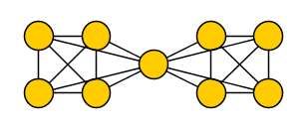
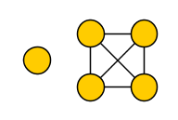
Let $G$ be an undirected $n$-vertex graph having non-adjacent vertices $u,v$ with $\deg\left(u\right)+\deg\left(v\right)≥n$. Let $G′$ be obtained from $G$ by adding edge $\{u,v\}$. Then:
$G$ has a Hamiltonian cycle $⇔$ $G′$ has a Hamiltonian cycle
[Bondy & Chvátal ‘76]
Implies Dirac’s theorem:
Best-possible; there are infinitely many non-Hamiltonian graphs:
with minimum degree $\left\lfloor \frac{n}{2}\right\rfloor$, or
in which all but 1 vertex has degree $≥n/2$
If $G$ is an $n$-vertex graph of minimum degree $≥n/2$, then $G$ has a Hamiltonian cycle
What is the complexity of Hamiltonian cycle when Dirac’s condition is almost satisfied?
Notes:
Why does it imply Dirac’s theorem? Note that Hamiltonian Cycle is a famous NP-complete problem.

Slide 7
Results
Fixed-parameter tractable algorithms to test Hamiltonicity, with parameterizations measuring the violation of Dirac’s condition
Assuming the Exponential Time Hypothesis, the running times cannot be improved to $2^{o\left(k\right)}⋅n^{O\left(1\right)}$
If all vertices of an $n$-vertex graph $G$ have degree at least $n/2−k$,
then Hamiltonian Cycle on $G$ can be solved in time $O(2^{34k}⋅n3)$.
If all but $k$ vertices of an $n$-vertex graph $G$ have degree at least $n/2$, then Hamiltonian Cycle on $G$ can be solved in $O(8^{k}⋅k^{2}+n^{3})$ time.
Let $G$ be an $n$-vertex graph such that $n−k$ vertices of $G$ have degree $≥n/2$. There is an algorithm that, given $G$, constructs a graph $G′$ on $≤3k$ vertices in $O(n^{3})$ time, such that $G$ is Hamiltonian if and only if $G^{′}$ is Hamiltonian.
Notes:
Second theorem follows from the kernelization result by running the standard Held-Karp DP on the equivalent input on $3k$ vertices. Running time of this form f(k) * poly(n) is called fixed-parameter tractable.

Slide 8
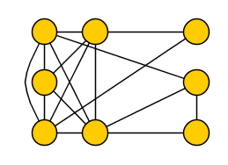
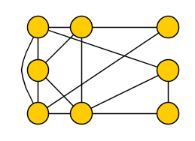
Let $G$ be an $n$-vertex graph such that $n−k$ vertices of $G$ have degree $≥n/2$. There is an algorithm that, given $G$, constructs a graph $G′$ on $≤3k$ vertices in $O(n^{3})$ time, such that $G$ is Hamiltonian if and only if $G^{′}$ is Hamiltonian.
Let $S$ be the vertices of degree less than $n/2$, with $\left|S\right|=k$
All vertex pairs in $C≔V\left(G\right)∖S$ have degree-sum $≥n$:
inserting edges to make $C$ a clique preserves Hamiltonicity
Statement is trivial if $\left|C\right|≤2|S|$, so goal is to shrink the clique
$$C$$
$$S$$
Graph $G$ $n=8$ vertices

Slide 9
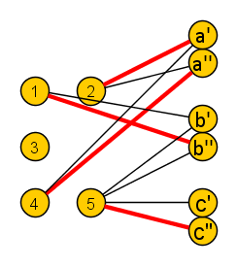
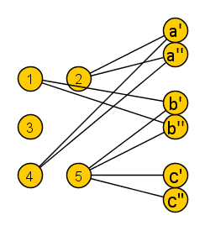
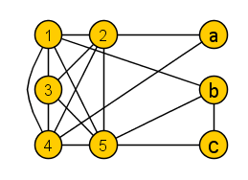
Let $G$ be an $n$-vertex graph such that $n−k$ vertices of $G$ have degree $≥n/2$. There is an algorithm that, given $G$, constructs a graph $G′$ on $≤3k$ vertices in $O(n^{3})$ time, such that $G$ is Hamiltonian if and only if $G^{′}$ is Hamiltonian.
Build a bipartite graph $H$ consisting of two partite sets:
the vertices from the clique $C$ on one side
two copies $s′,s′′$ for every low-degree vertex $s∈S$
Find a maximum matching $M$ in graph $H$
Obtain $G′$from $G$ by removing unmatched $C$-vertices
$$S^{′} \\ S^{′′}$$
$$C$$
$$S$$
$$C$$
Graph $G$ $n=8$ vertices
Graph $H$ (bipartite)

Slide 10
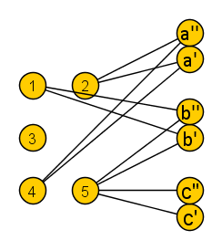
Let $G$ be an $n$-vertex graph such that $n−k$ vertices of $G$ have degree $≥n/2$. There is an algorithm that, given $G$, constructs a graph $G′$ on $≤3k$ vertices in $O(n^{3})$ time, such that $G$ is Hamiltonian if and only if $G^{′}$ is Hamiltonian.
Matching $M$ has at most $\left|S^{′}∪S^{′′}\right|=2\left|S\right|=2k$ edges
Resulting graph $G′$ has at most $2k+k=3k$ vertices
To prove: $G$ is Hamiltonian if and only if $G′$ is
Find a maximum matching $M$ in graph $H$
Obtain $G′$from $G$ by removing unmatched $C$-vertices
$$S^{′} \\ S^{′′}$$
$$C$$
$$S$$
$$C$$
Graph $G$ $n=8$ vertices
Graph $H$ (bipartite)

Slide 11
Let $G$ be an $n$-vertex graph such that $n−k$ vertices of $G$ have degree $≥n/2$. There is an algorithm that, given $G$, constructs a graph $G′$ on $≤3k$ vertices in $O(n^{3})$ time, such that $G$ is Hamiltonian if and only if $G^{′}$ is Hamiltonian.
To prove: $G$ is Hamiltonian if and only if $G′$ is

Slide 12
Let $G$ be an $n$-vertex graph such that $n−k$ vertices of $G$ have degree $≥n/2$. There is an algorithm that, given $G$, constructs a graph $G′$ on $≤3k$ vertices in $O(n^{3})$ time, such that $G$ is Hamiltonian if and only if $G^{′}$ is Hamiltonian.
$\left(⇐\right)$ Insert omitted vertices between two consecutive $C$-vertices
Clique $C$
Set $S$ of $k$ low-degree vertices

Slide 13
Let $G$ be an $n$-vertex graph such that $n−k$ vertices of $G$ have degree $≥n/2$. There is an algorithm that, given $G$, constructs a graph $G′$ on $≤3k$ vertices in $O(n^{3})$ time, such that $G$ is Hamiltonian if and only if $G^{′}$ is Hamiltonian.
$\left(⇒\right)$ Re-route cycle to jump between $C$ and $S$ via matching
Clique $C$
Set $S$ of $k$ low-degree vertices

Slide 14
Above/below guarantee parameterizations
Graph $q$-colorability
Graph 𝑞-colorability
Maximum Satisfiability
Maximum Cut
Brooks’ theorem: a graph of maximum degree $q$ is $q$-colorable (unless it is a clique or an odd cycle)
Brooks’ theorem: a graph of maximum degree 𝑞 is 𝑞-colorable (unless it is a clique or an odd cycle)
In a CNF-formula where all of the $m$ clauses have size $r$, there exists an assignment satisfying $m\left(1−\frac{1}{2^{r}}\right)$ clauses
In a CNF-formula where all of the 𝑚 clauses have size 𝑟, there exists an assignment satisfying 𝑚(1−1/2^𝑟 ) clauses
Exists FPT algorithm to test if you can satisfy $k+m\left(1−\frac{1}{2^{r}}\right)$ clauses
Exists FPT algorithm to test if you can satisfy 𝑘+𝑚(1−1/2^𝑟 ) clauses
Any $m$-edge graph has a cut of $m/2$ edges
Any 𝑚-edge graph has a cut of 𝑚/2 edges
Exists FPT algorithm to test if you can cut $k+\frac{m}{2}$ edges
Exists FPT algorithm to test if you can cut 𝑘+𝑚/2 edges
Exists FPT algorithm for coloring parameterized by #vertices of degree $>q$
Exists FPT algorithm for coloring parameterized by #vertices of degree >𝑞
[J & Nederlof]
[Alon et al. Algorithmica ‘11]
[Mahajan & Raman J. Algorithms ‘99]
Notes:
There are FPT algorithms above better bounds for max cut.

Slide 15
Conclusion
Fixed-parameter tractable algorithms for two parameterizations by how far the input graph is from satisfying Dirac’s condition
All but $k$ vertices have degree at least $n/2$
All vertices have degree at least $n/2−k$
Open problem:
What if all but $k$ vertices have degree at least $n/2−k$?
Direction for future research:
Parameterize other problems by how much the conditions that guarantee existence of a solution, are violated
THANK YOU!

