Slide 1

Polynomial Kernels for
Hitting Forbidden Minors
under Structural Parameterizations
Bart M. P. Jansen
Astrid Pieterse
ESA 2018
August 21st 2018, Helsinki, Finland

Slide 2

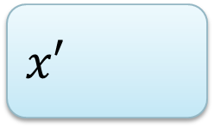
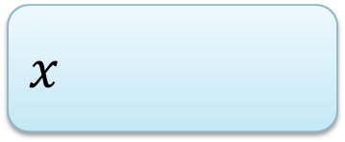
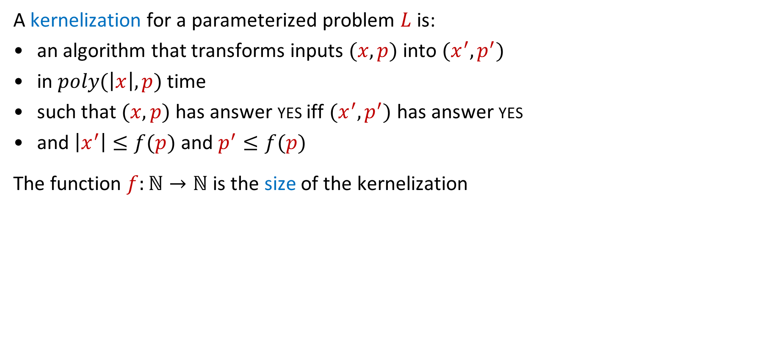
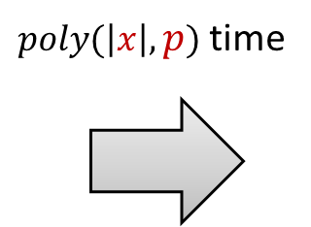




Data reduction with a guarantee for NP-hard problems
A kernelization for a parameterized problem $L$ is:
an algorithm that transforms inputs $(x,p)$ into $(x^{′},p^{′})$
in $poly(\left|x\right|,p)$ time
such that $(x,p)$ has answer yes iff $(x^{′},p^{′})$ has answer yes
and $\left|x^{′}\right|≤f(p)$ and $p^{′}≤f(p)$
The function $f:ℕ→ℕ$ is the size of the kernelization
A kernelization guarantees that instances that are large
with respect to their complexity parameter can be shrunk
$n$ bits
$f(p)$ bits
$$x$$
$poly(\left|x\right|,p)$ time
$$x′$$
$$p$$
$$p′$$

Slide 3
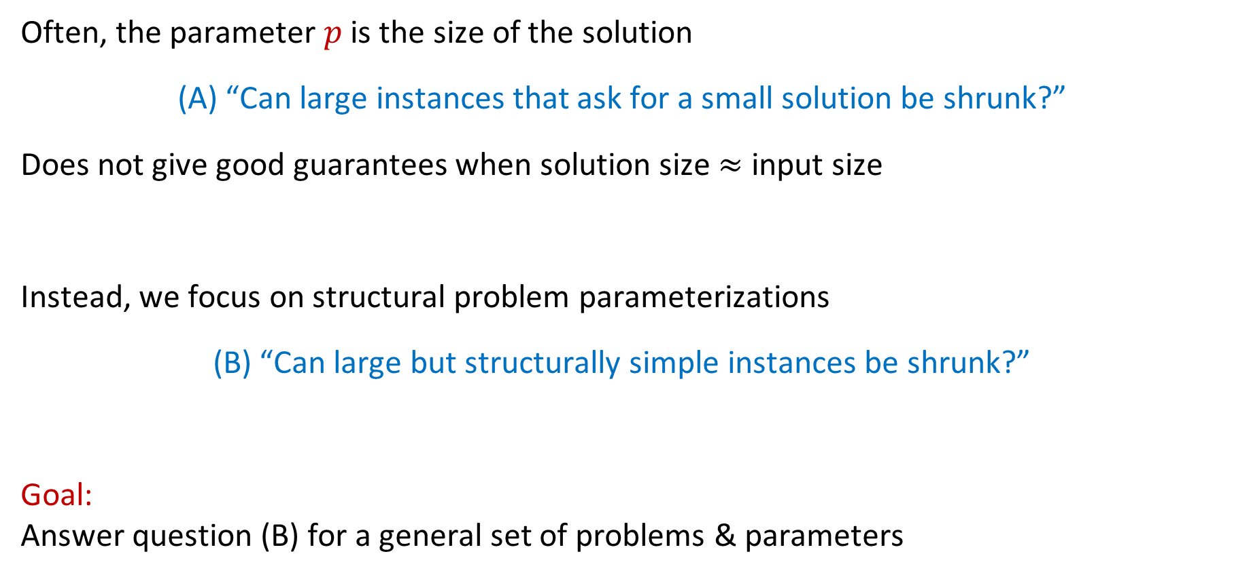
Problem parameterizations
Often, the parameter $p$ is the size of the solution
(A) “Can large instances that ask for a small solution be shrunk?”
Does not give good guarantees when solution size $≈$ input size
Instead, we focus on structural problem parameterizations
(B) “Can large but structurally simple instances be shrunk?”
Goal:
Answer question (B) for a general set of problems & parameters

Slide 4
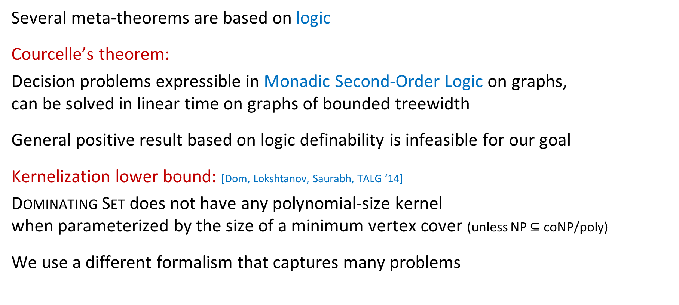
Capturing a general class of problems
Several meta-theorems are based on logic
Courcelle’s theorem:
Decision problems expressible in Monadic Second-Order Logic on graphs,
can be solved in linear time on graphs of bounded treewidth
General positive result based on logic definability is infeasible for our goal
Kernelization lower bound: [Dom, Lokshtanov, Saurabh, TALG ‘14]
Dominating Set does not have any polynomial-size kernel
when parameterized by the size of a minimum vertex cover (unless NP $⊆$ coNP/poly)
We use a different formalism that captures many problems
Notes:
Dominating Set can simply by expressed even in first-order logic, and the size of a minimum vertex cover is one of the largest graph-complexity measures. If even this simple-to-express problem does not have a poly kernel for this large graph parameter, no hope to describe a large class of problems admitting poly kernels for structural parameters using logic expressibility.

Slide 5
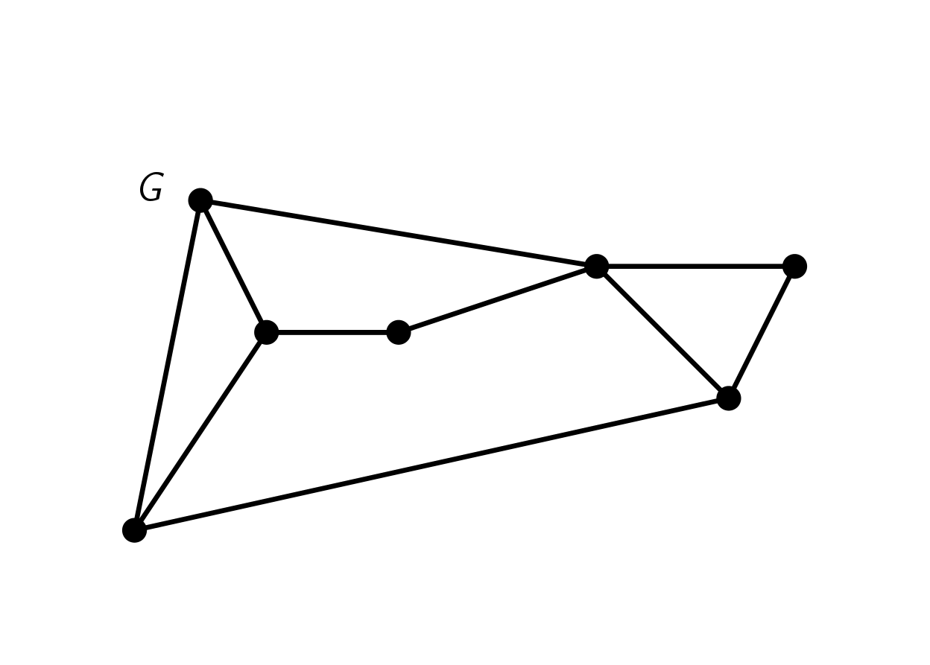
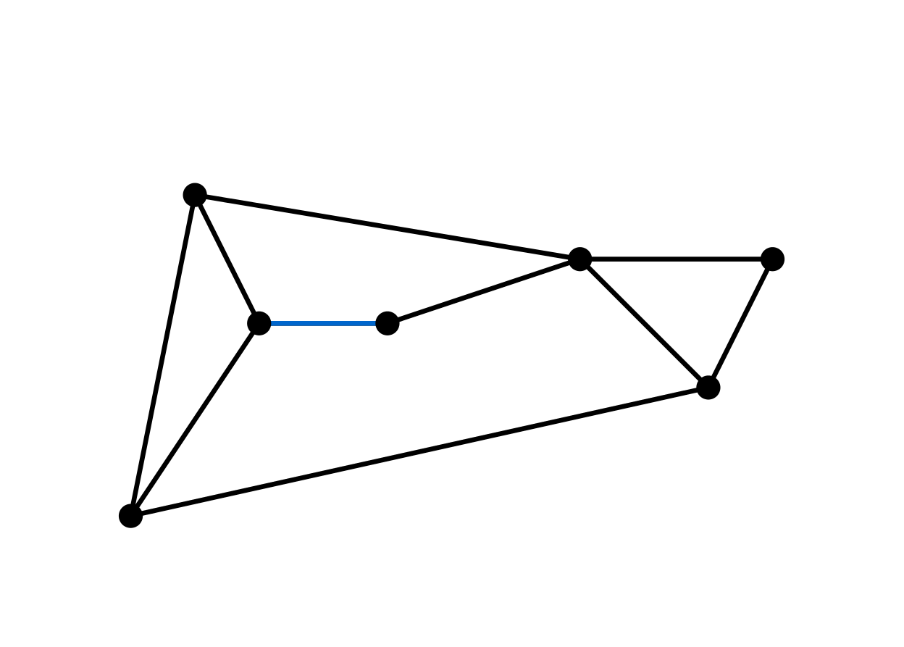
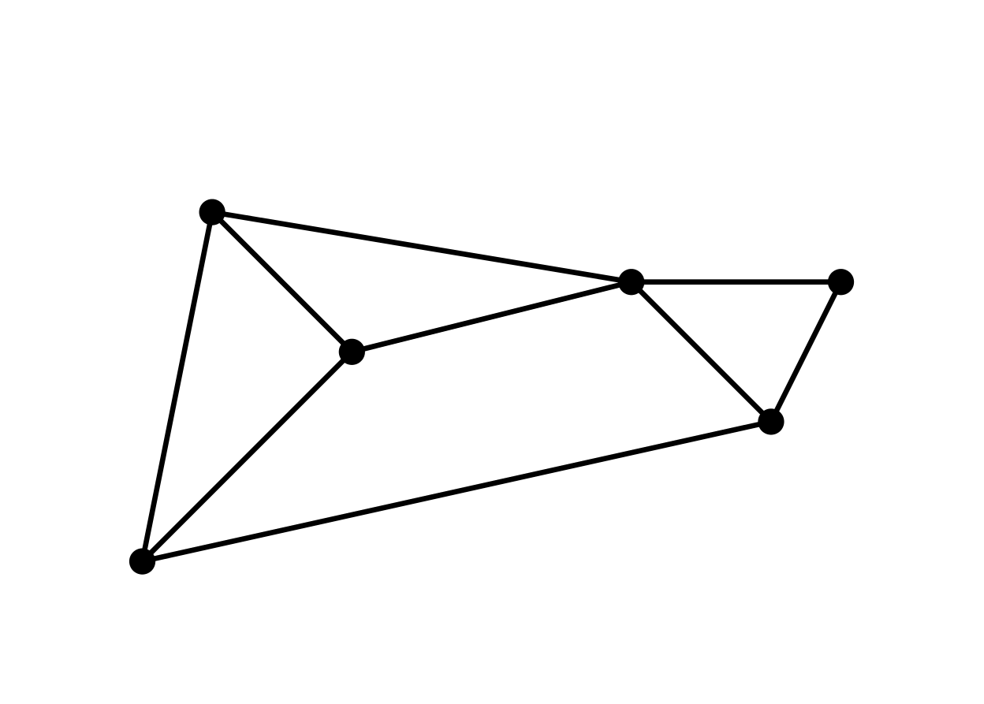
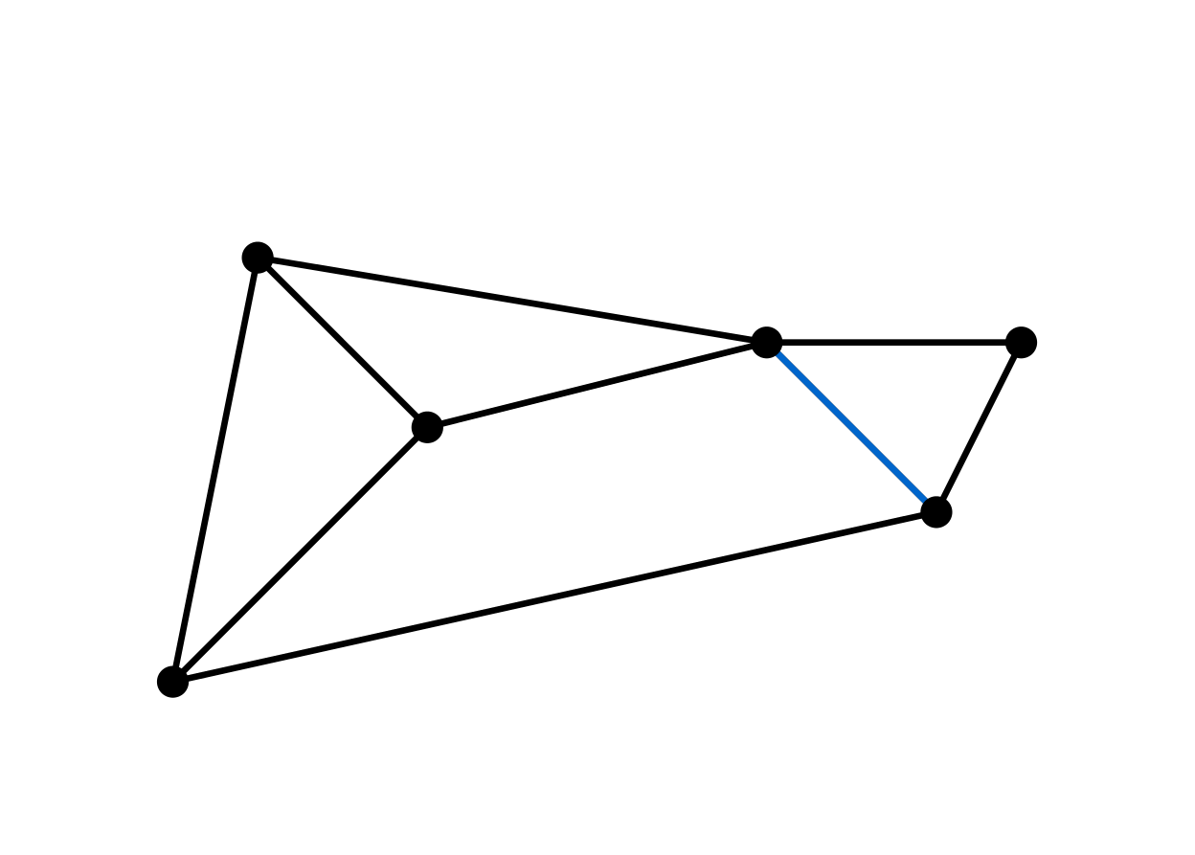
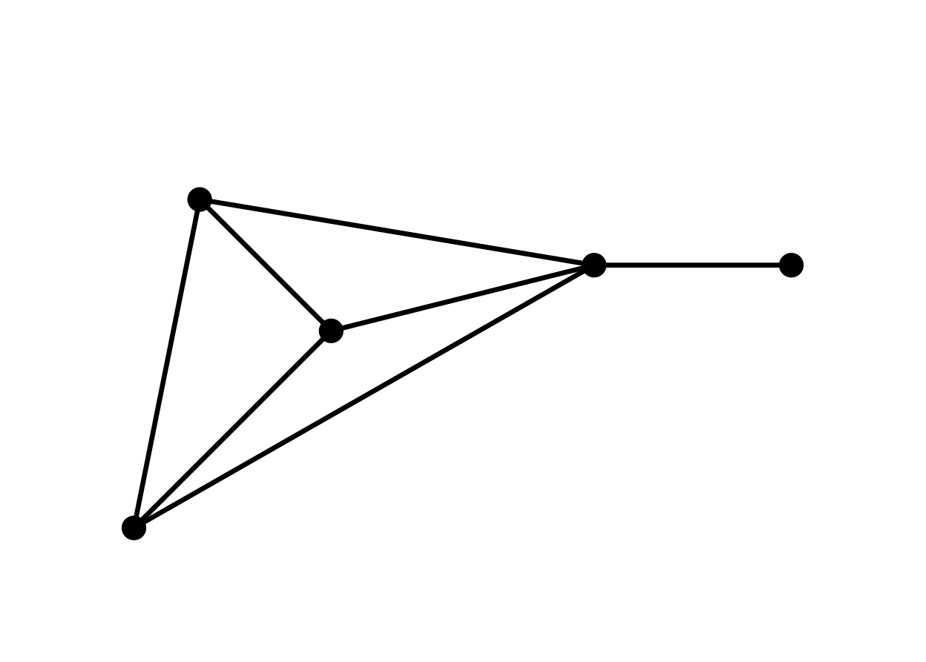
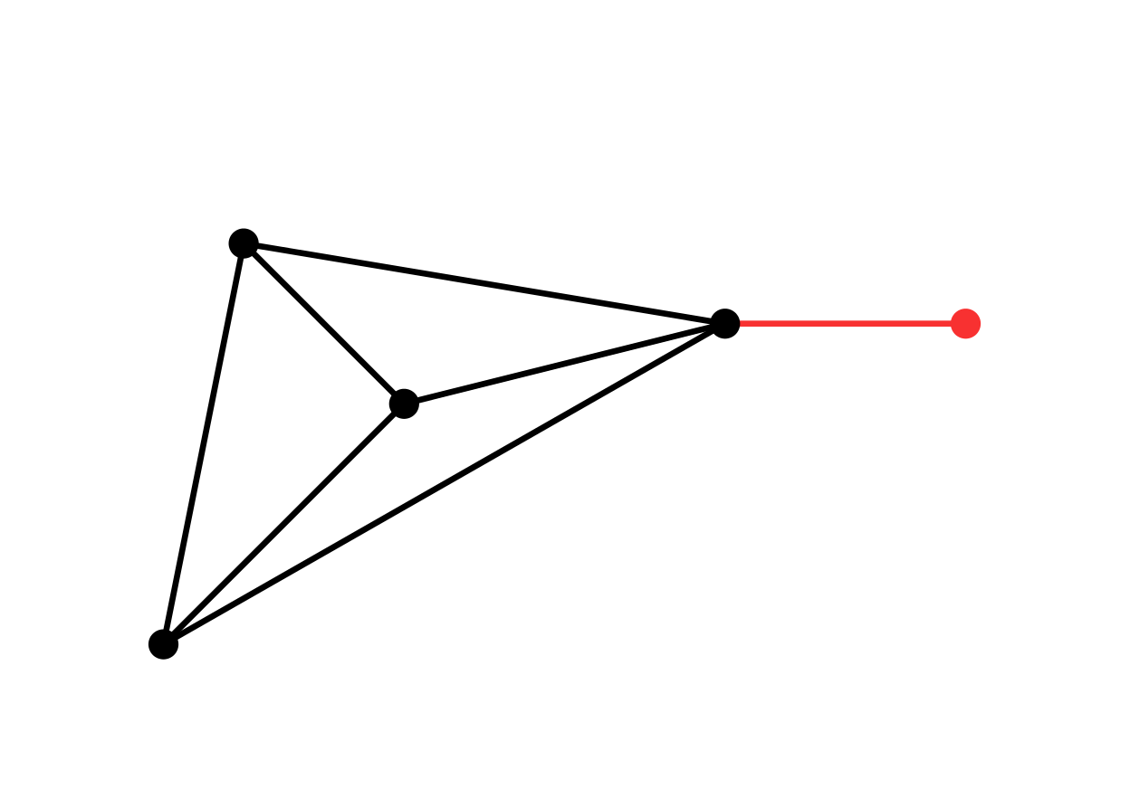
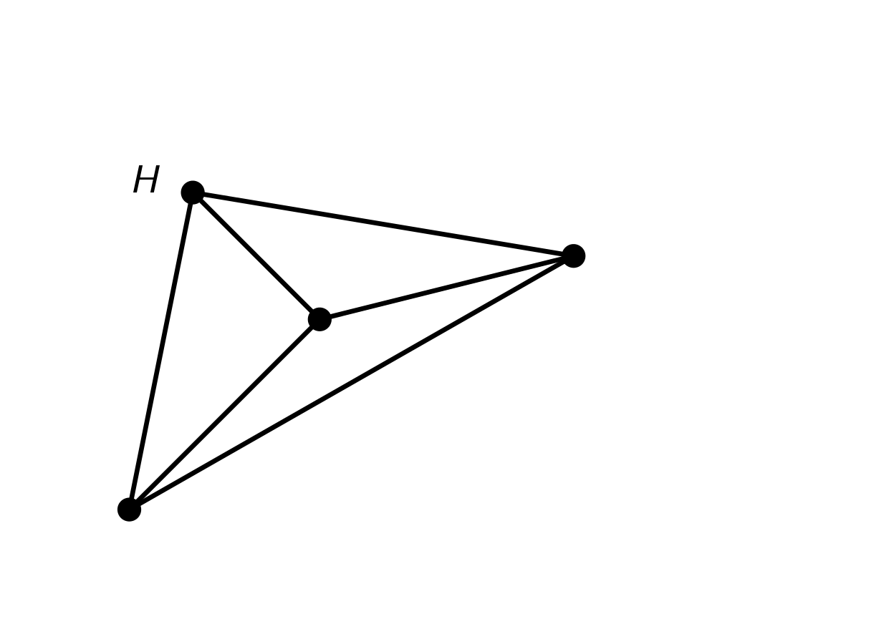

Hitting forbidden minors
Graph $H$ is a minor of graph $G$ if we can transform $G$ into $H$ by:
vertex deletions, edge deletions, and contractions

Slide 6
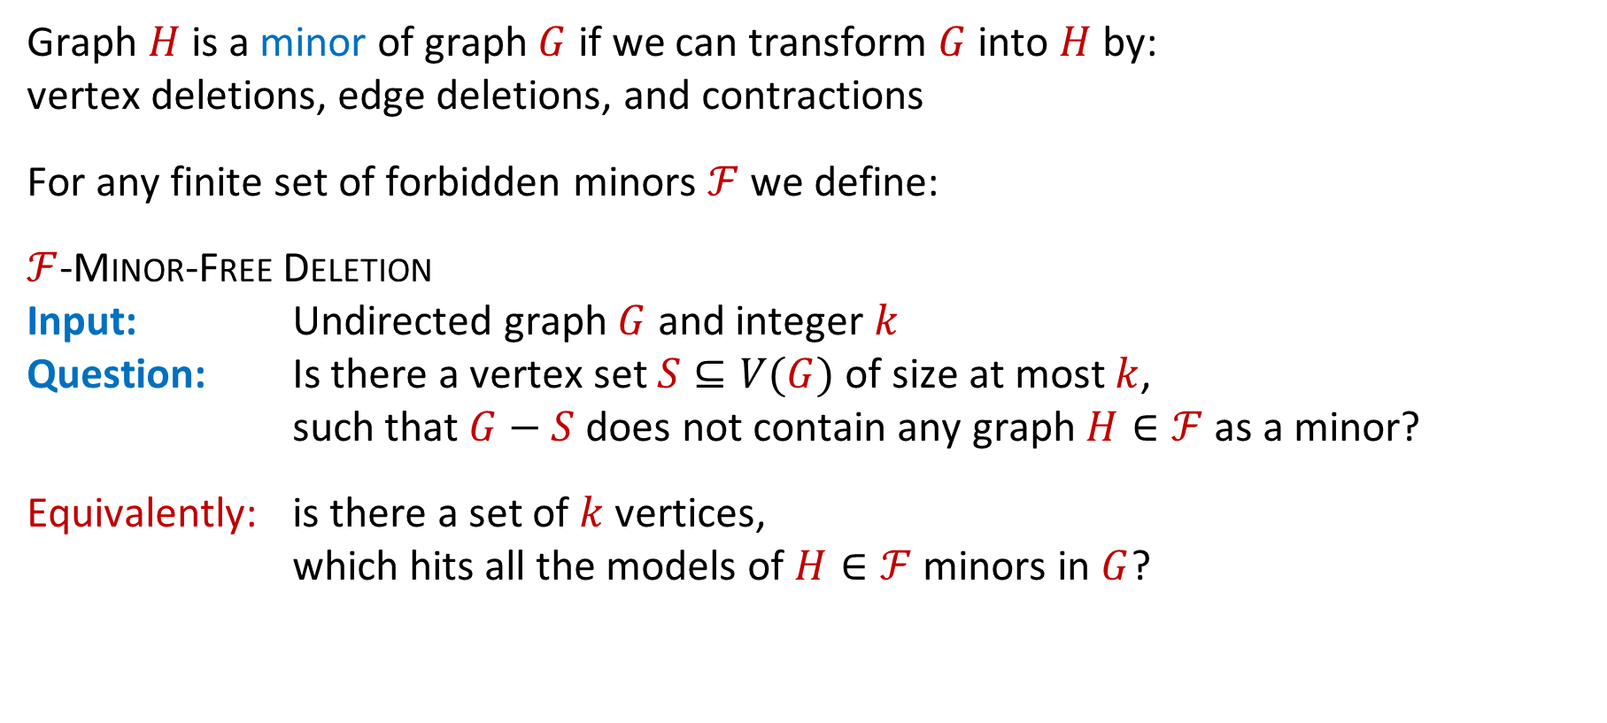
Hitting forbidden minors
Graph $H$ is a minor of graph $G$ if we can transform $G$ into $H$ by:
vertex deletions, edge deletions, and contractions
For any finite set of forbidden minors $ℱ$ we define:
$ℱ$-Minor-Free Deletion
Input: Undirected graph $G$ and integer $k$
Question: Is there a vertex set $S⊆V(G)$ of size at most $k$,
such that $G−S$ does not contain any graph $H∈ℱ$ as a minor?
Equivalently: is there a set of $k$ vertices,
which hits all the models of $H∈ℱ$ minors in $G$?

Slide 7

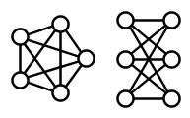

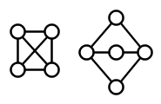
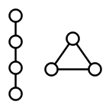
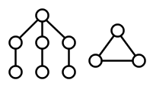





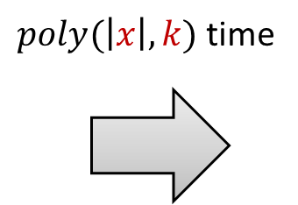




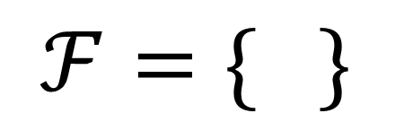


Classic $ℱ$-Minor-Free Deletion problems
Vertex Cover
Feedback
Vertex Set
Planarization
Outerplanar vertex deletion
Pathwidth-1 vertex deletion
Treedepth-2 vertex deletion
$ℱ=$ $\{ \}$
$$\{$$
$$,$$
$$\}$$
$$ℱ=\{ \}$$
$$\{$$
$$,$$
$$\}$$
$$\{$$
$$,$$
$$\}$$
$$\{$$
$$,$$
$$\}$$
Notes:
So I hope this convinces you that using the minor-free deletion formalism, we can capture a large number of graph problems. Let’s turn to the class of problem parameterizations.

Slide 8
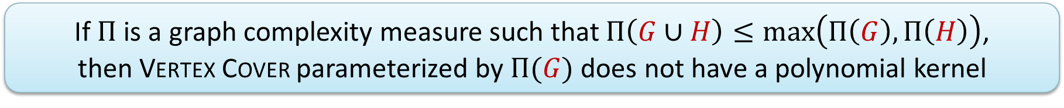
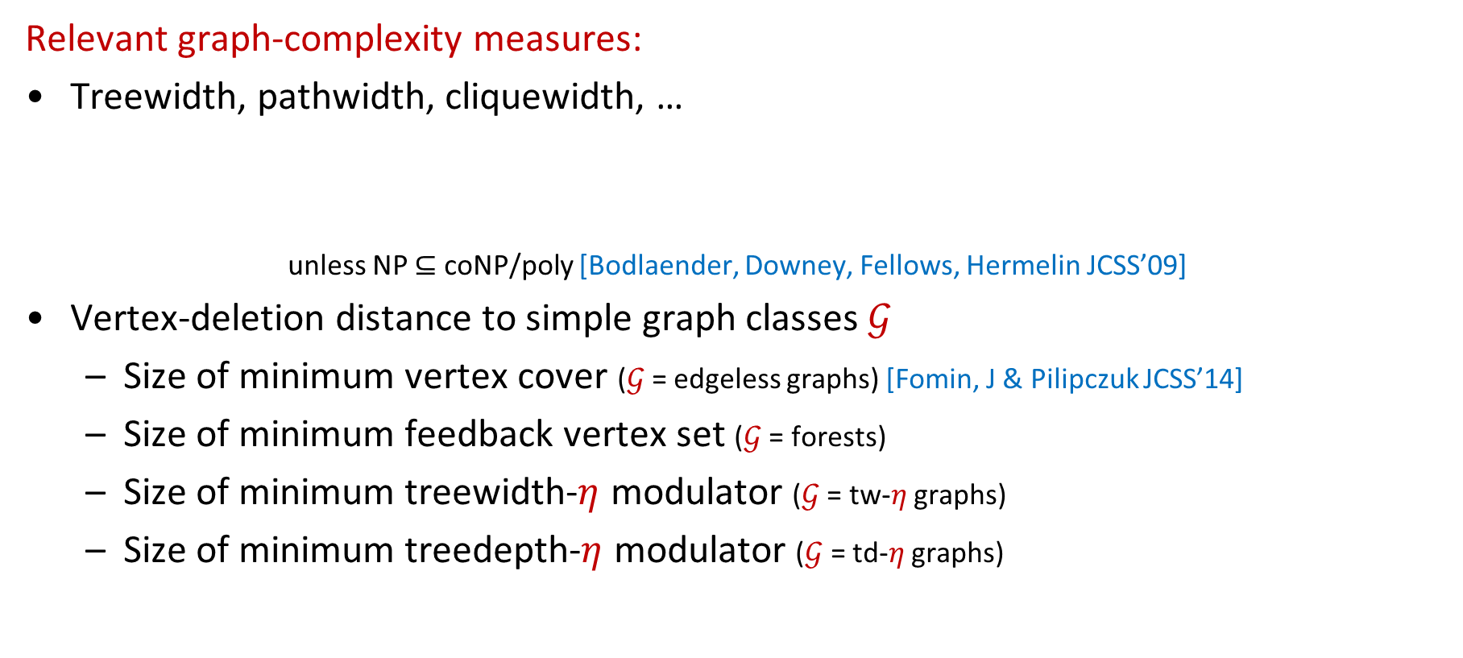
Structural parameterizations for hitting minors
Relevant graph-complexity measures:
Treewidth, pathwidth, cliquewidth, …
unless NP $⊆$ coNP/poly [Bodlaender, Downey, Fellows, Hermelin JCSS’09]
Vertex-deletion distance to simple graph classes $𝒢$
  Size of minimum vertex cover ($𝒢$ = edgeless graphs) [Fomin, J & Pilipczuk JCSS’14]
  Size of minimum feedback vertex set ($𝒢$ = forests)
  Size of minimum treewidth-$η$ modulator ($𝒢$ = tw-$η$ graphs)
  Size of minimum treedepth-$η$ modulator ($𝒢$ = td-$η$ graphs)
If $Π$ is a graph complexity measure such that $Π\left(G∪H\right)≤\max\left(Π\left(G\right),Π\left(H\right)\right)$,
then Vertex Cover parameterized by $Π(G)$ does not have a polynomial kernel

Slide 9
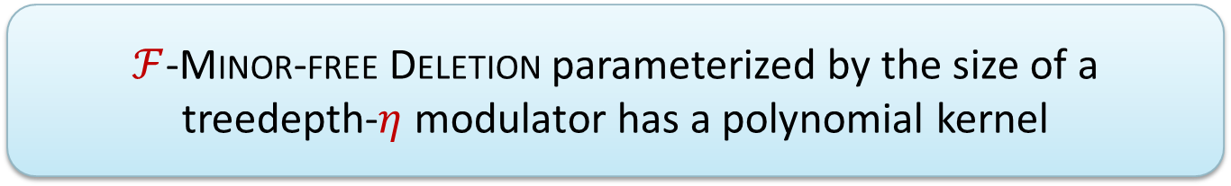
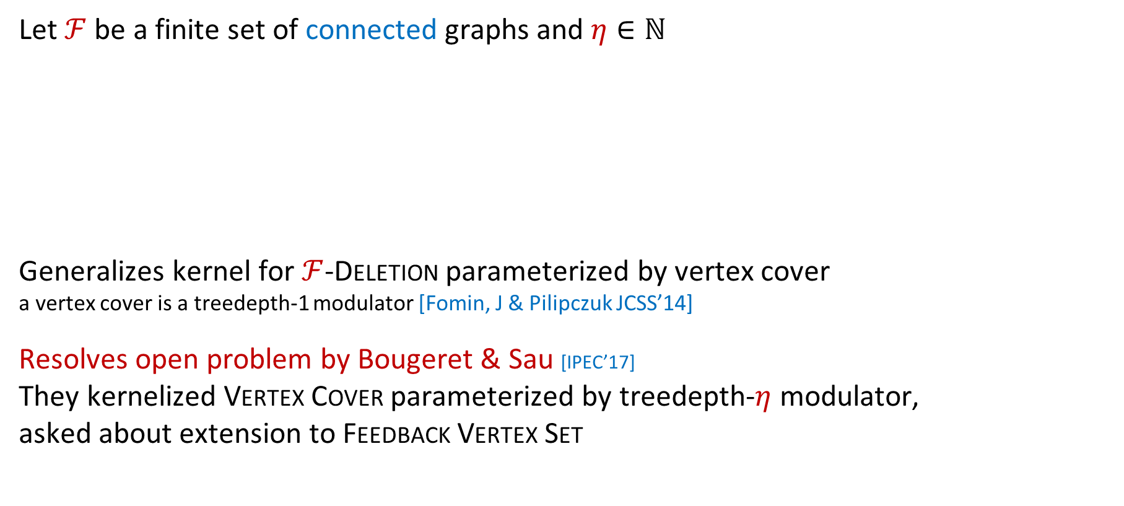
Results
Let $ℱ$ be a finite set of connected graphs and $η∈ℕ$
Generalizes kernel for $ℱ$-Deletion parameterized by vertex cover
a vertex cover is a treedepth-1 modulator [Fomin, J & Pilipczuk JCSS’14]
Resolves open problem by Bougeret & Sau [IPEC’17]
They kernelized Vertex Cover parameterized by treedepth-$η$ modulator,
asked about extension to Feedback Vertex Set
$ℱ$-Minor-free Deletion parameterized by the size of a treedepth-$η$ modulator has a polynomial kernel

Slide 10
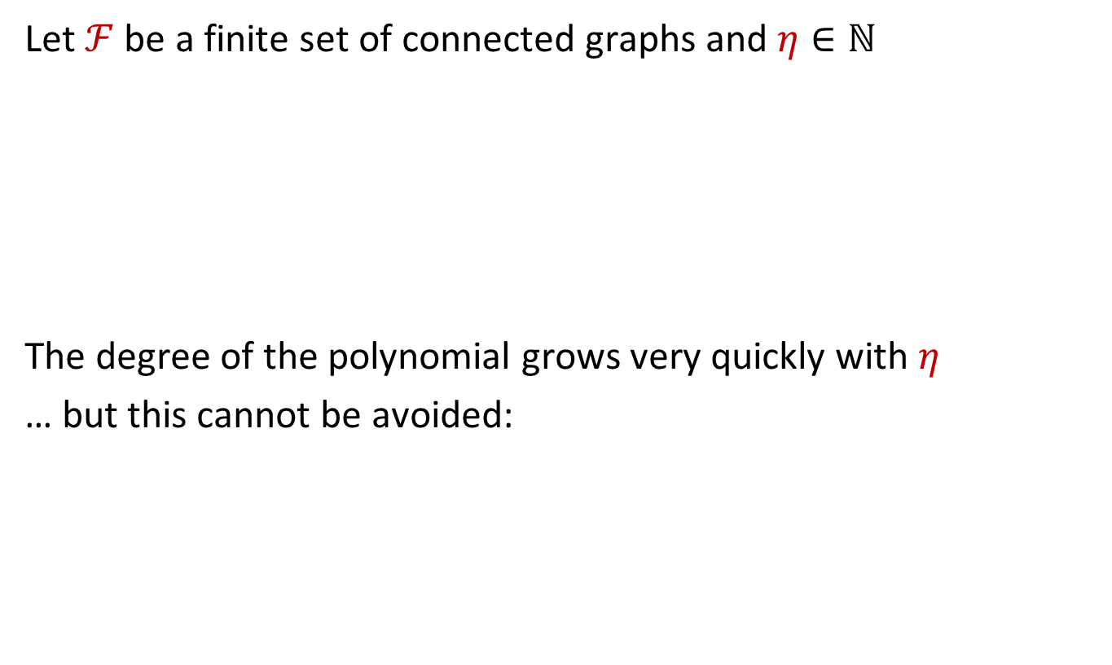
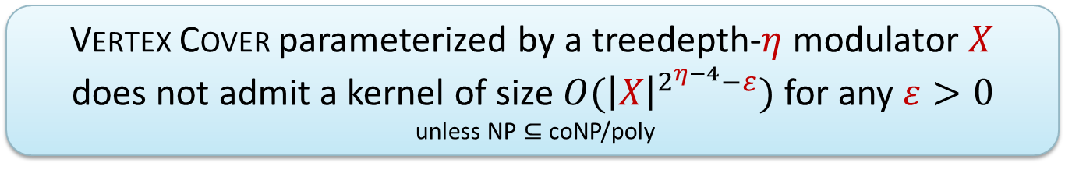
Results
Let $ℱ$ be a finite set of connected graphs and $η∈ℕ$
The degree of the polynomial grows very quickly with $η$
… but this cannot be avoided:
$ℱ$-Minor-free Deletion parameterized by the size of a treedepth-$η$ modulator has a polynomial kernel
Vertex Cover parameterized by a treedepth-$η$ modulator $X$
does not admit a kernel of size $O({\left|X\right|}^{2^{η−4}−ε})$ for any $ε>0$
unless NP $⊆$ coNP/poly

Slide 11
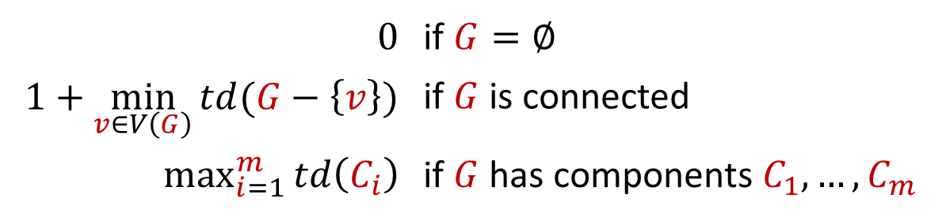
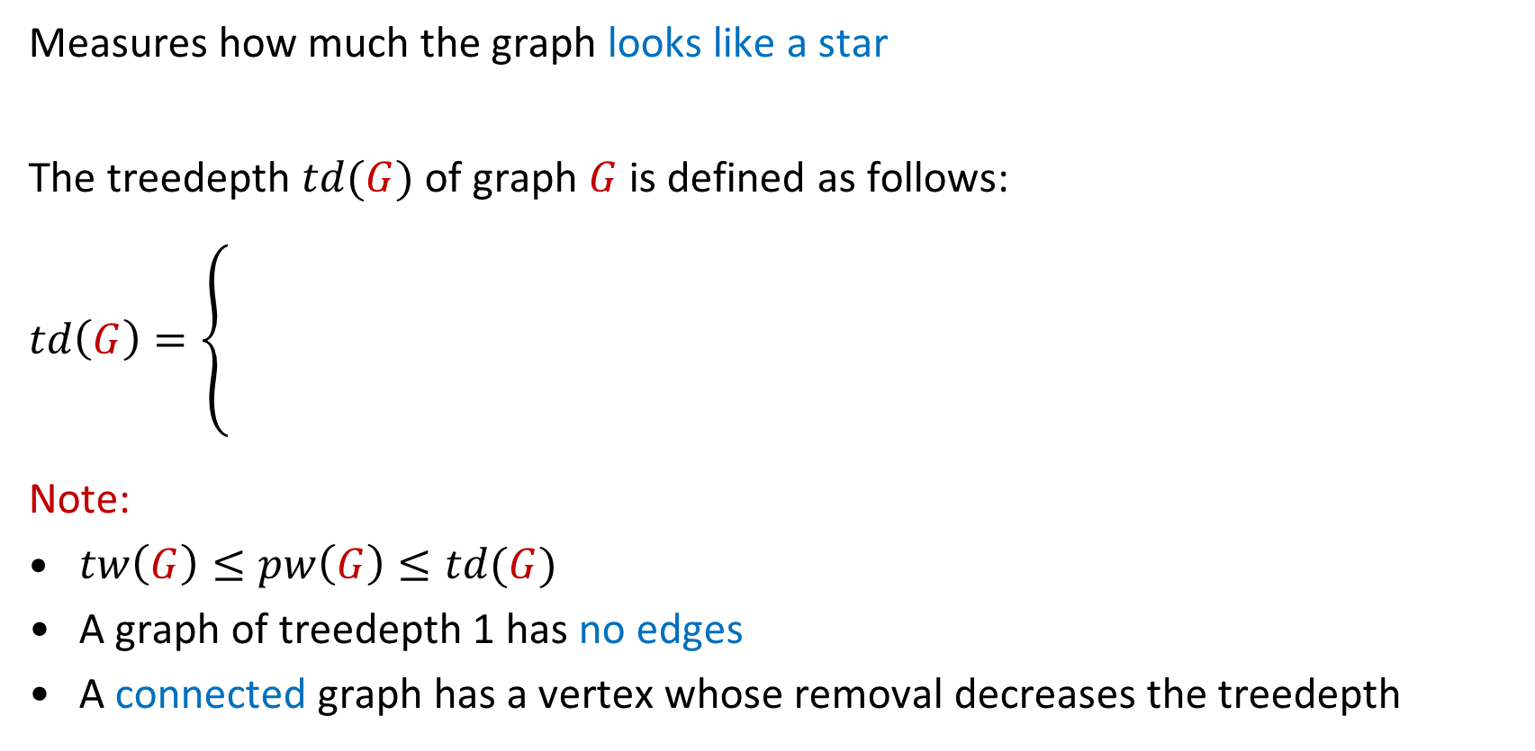
The treedepth of a graph
Measures how much the graph looks like a star
The treedepth $td(G)$ of graph $G$ is defined as follows:
$td\left(G\right)=\left\{ \begin{matrix} \\ \begin{matrix} \\ \\ \end{matrix} \\ \end{matrix}\right.$
Note:
$tw\left(G\right)≤pw\left(G\right)≤td(G)$
A graph of treedepth 1 has no edges
A connected graph has a vertex whose removal decreases the treedepth
$0$ | if $G=∅$
$1+\min_{v∈V\left(G\right)}{td(G−\left\{v\right\})}$ | if $G$ is connected
$\max_{i=1}^{m}{td\left(C_{i}\right)}$ | if $G$ has components $C_{1},…, C_{m}$

Slide 12
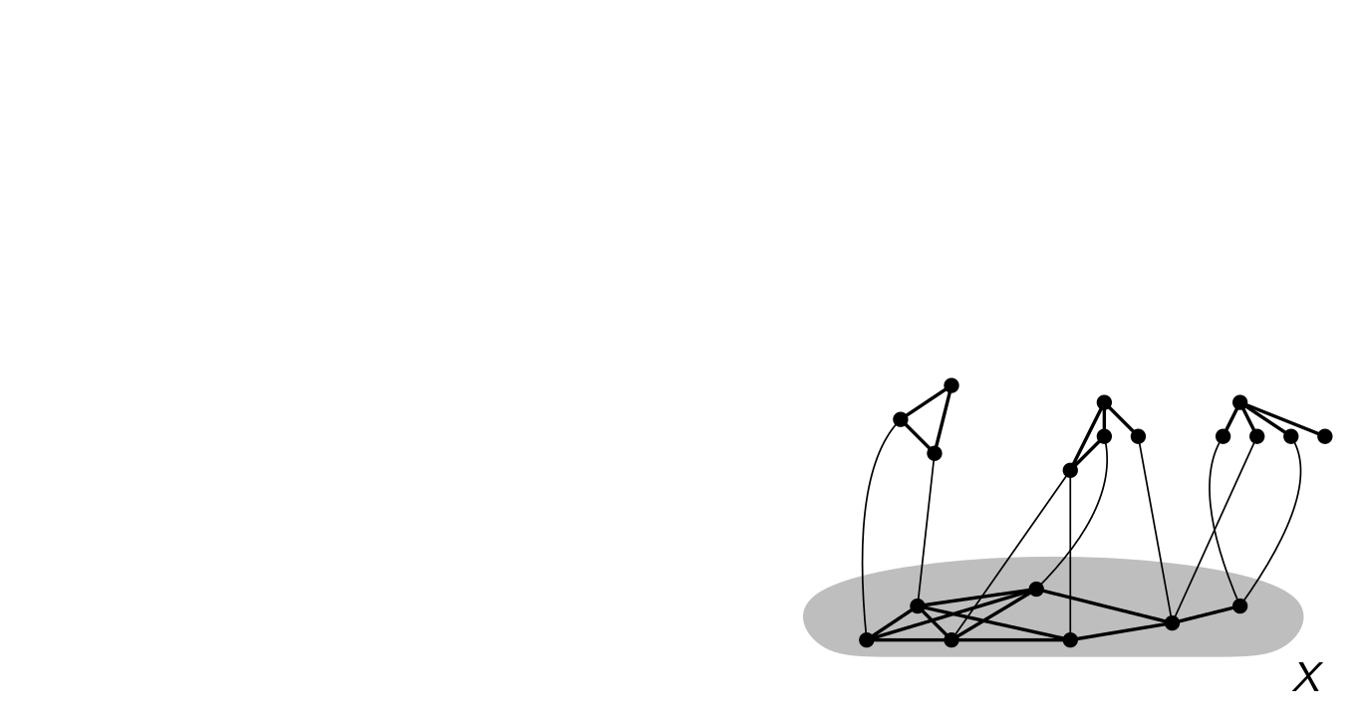
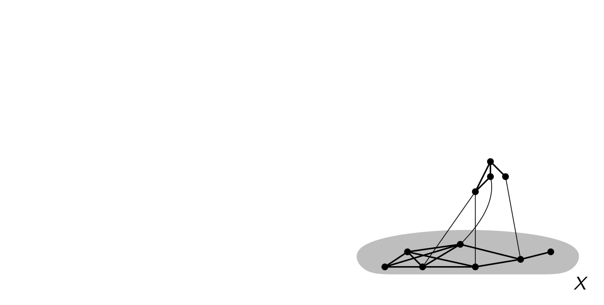

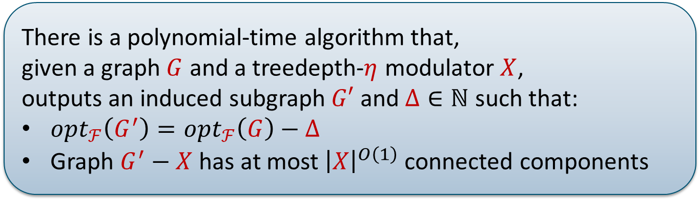
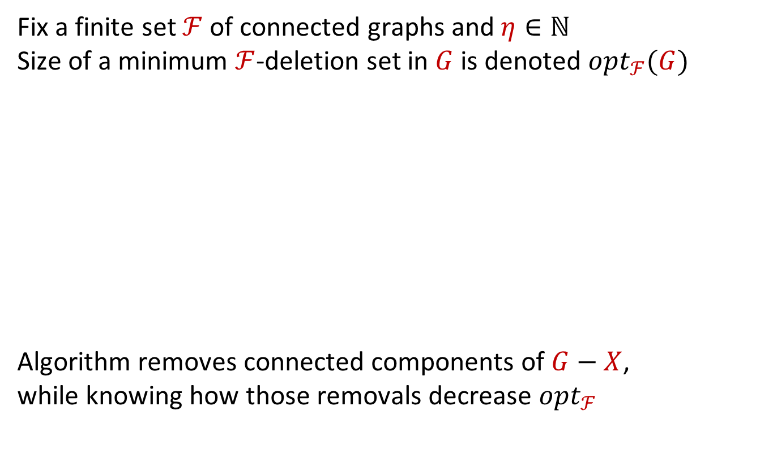
Algorithmic workhorse
Fix a finite set $ℱ$ of connected graphs and $η∈ℕ$
Size of a minimum $ℱ$-deletion set in $G$ is denoted $opt_{ℱ}(G)$
Algorithm removes connected components of $G−X$,
while knowing how those removals decrease $opt_{ℱ}$
There is a polynomial-time algorithm that,
given a graph $G$ and a treedepth-$η$ modulator $X$,
outputs an induced subgraph $G′$ and $Δ∈ℕ$ such that:
$opt_{ℱ}\left(G^{′}\right)=opt_{ℱ}\left(G\right)−Δ$
Graph $G^{′}−X$ has at most ${\left|X\right|}^{O\left(1\right)}$ connected components
$$Δ=2$$

Slide 13
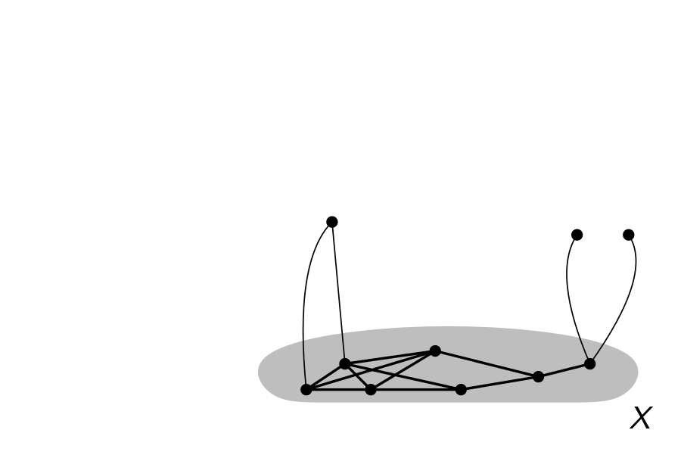
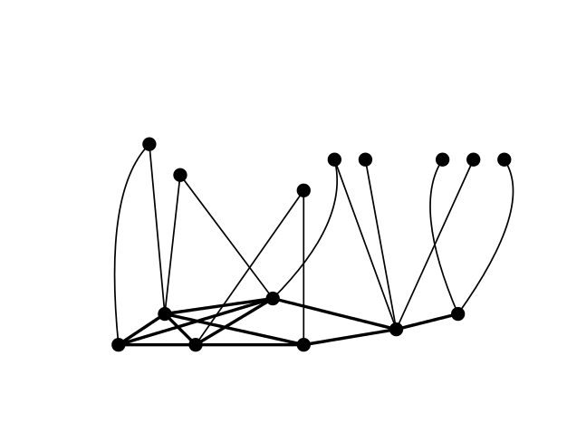
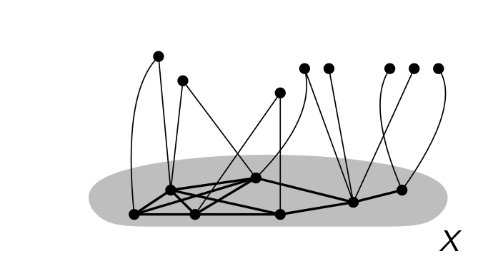

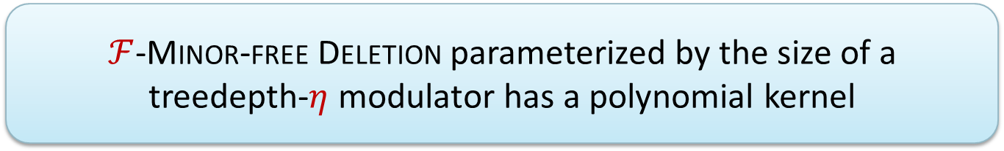
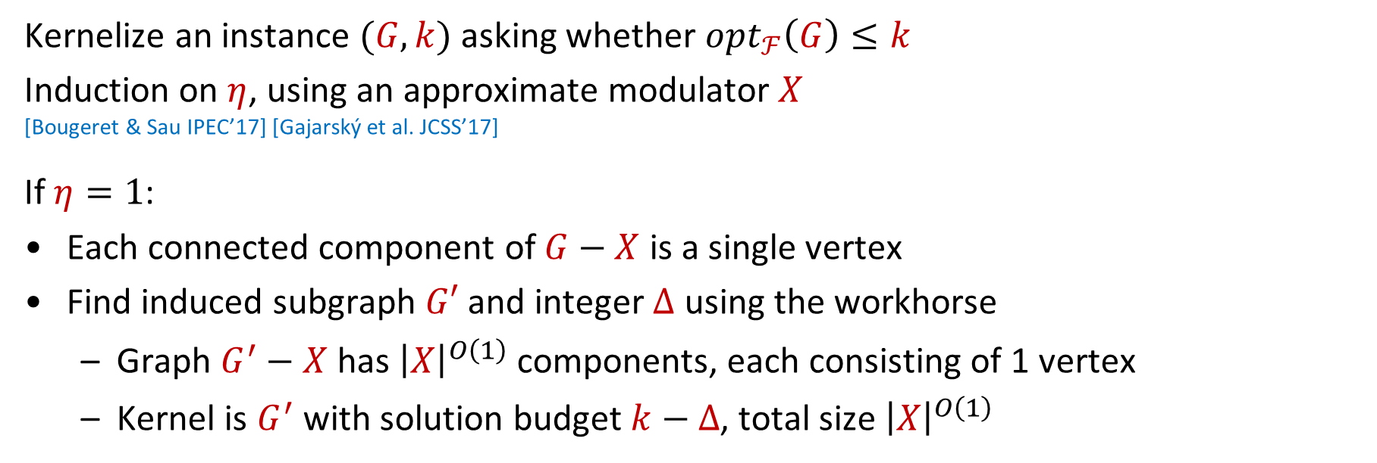
Workhorse implies polynomial kernelization
$ℱ$-Minor-free Deletion parameterized by the size of a treedepth-$η$ modulator has a polynomial kernel
Kernelize an instance $(G,k)$ asking whether $opt_{ℱ}\left(G\right)≤k$
Induction on $η$, using an approximate modulator $X$
[Bougeret & Sau IPEC’17] [Gajarský et al. JCSS’17]
If $η=1$:
Each connected component of $G−X$ is a single vertex
Find induced subgraph $G′$ and integer $Δ$ using the workhorse
  Graph $G^{′}−X$ has ${\left|X\right|}^{O\left(1\right)}$ components, each consisting of 1 vertex
  Kernel is $G^{′}$ with solution budget $k−Δ$, total size ${\left|X\right|}^{O\left(1\right)}$
$$Δ=4$$

Slide 14
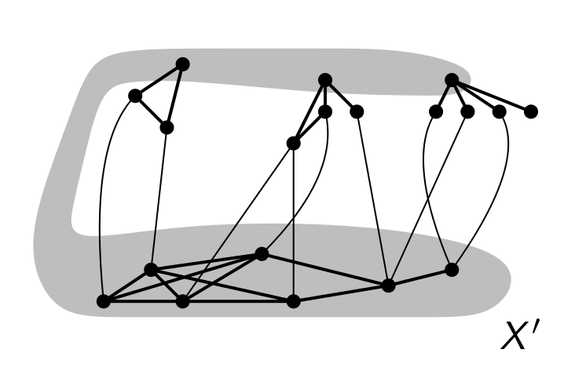
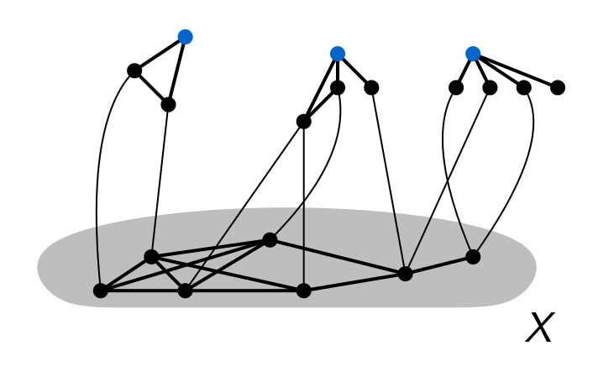

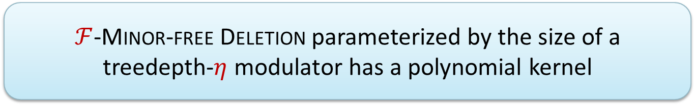
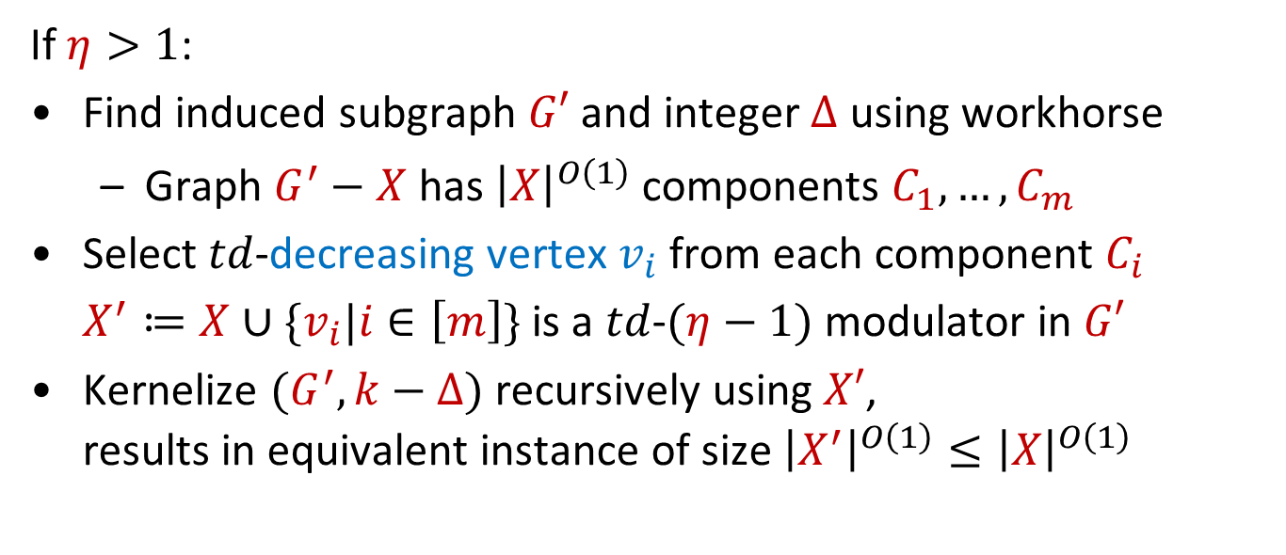
Workhorse implies polynomial kernelization
$ℱ$-Minor-free Deletion parameterized by the size of a treedepth-$η$ modulator has a polynomial kernel
If $η>1$:
Find induced subgraph $G′$ and integer $Δ$ using workhorse
  Graph $G^{′}−X$ has ${\left|X\right|}^{O\left(1\right)}$ components $C_{1},…, C_{m}$
Select $td$-decreasing vertex $v_{i}$ from each component $C_{i}$
$X^{′}≔X∪\{v_{i}|i∈\left[m\right]\}$ is a $td$-$(η−1)$ modulator in $G′$
Kernelize $(G^{′},k−Δ)$ recursively using $X′$,
results in equivalent instance of size ${\left|X^{′}\right|}^{O\left(1\right)}≤{\left|X\right|}^{O\left(1\right)}$

Slide 15
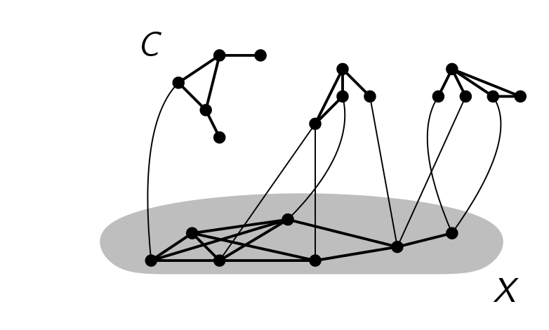
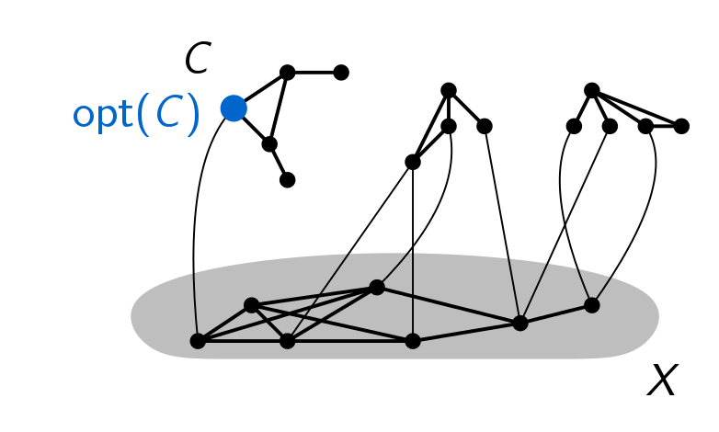
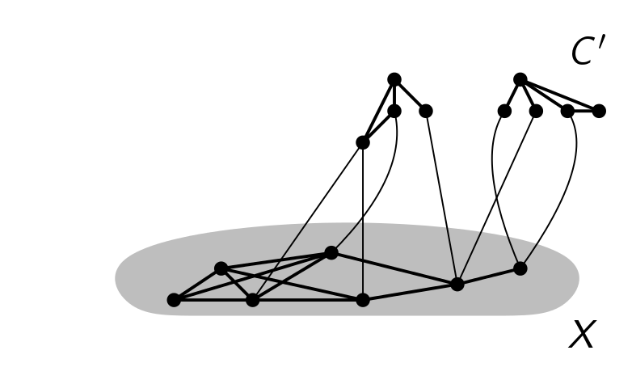
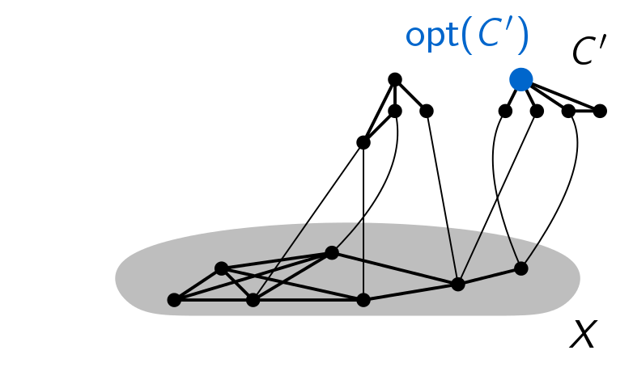
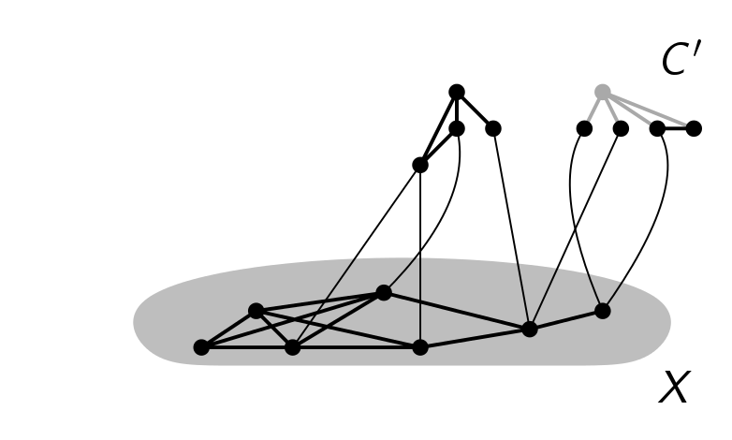
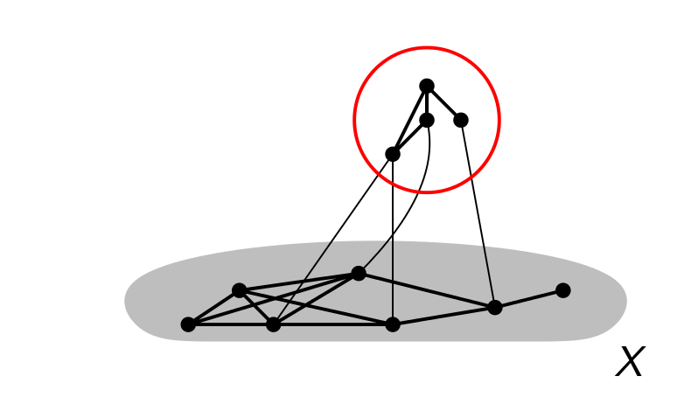


Feeding the workhorse
Goal:
Find components $C$ of $G−X$ which can safely be forgotten
remove $C$, increase $Δ$ by $opt_{ℱ}(C)$
Example for Feedback Vertex Set:
(Hit all cycles)
There is a polynomial-time algorithm that,
given a graph $G$ and a treedepth-$η$ modulator $X$,
outputs an induced subgraph $G′$ and $Δ∈ℕ$ such that:
$opt_{ℱ}\left(G^{′}\right)=opt_{ℱ}\left(G\right)−Δ$
Graph $G^{′}−X$ has at most ${\left|X\right|}^{O\left(1\right)}$ connected components

Slide 16
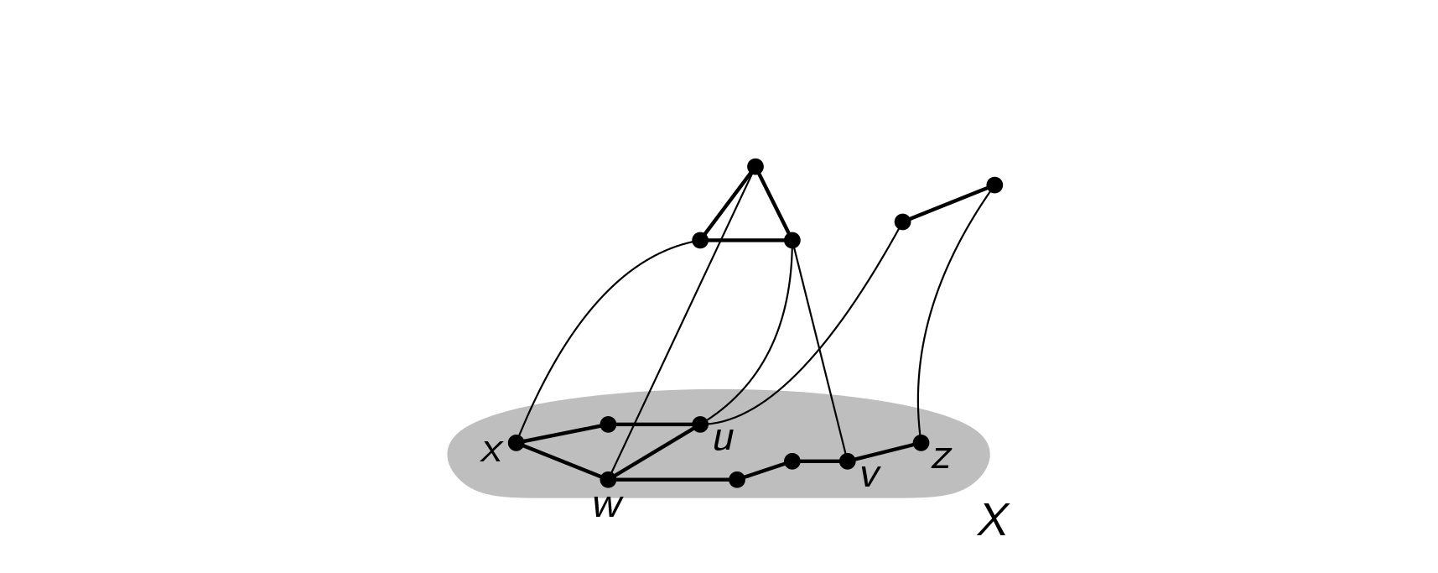








Finding irrelevant components
Difficulty:
There can be many different optimal solutions $S_{C}$ in $C$
Remainder $C−S_{C}$ may form forbidden minors with $\left(G−C\right)−S$
Solution:
Analyze collection of remainders $C−S_{C}$ of optimal $ℱ$-deletion sets
Keep track of minors made in $C−S_{C}$ and its connections to $X$
Requires extensive framework for $X$-labeled graphs
Each vertex $v$ has labelset $L\left(v\right)⊆X$
v

Slide 17



The main lemma for $ℱ=\{H\}$
Let $X$ be a label set, let $C$ be an $X$-labeled graph
Vertex $v∈C$ is labeled by the subset of its neighbors in $X$, $C$ is a component of $G−X$
Let $𝒬$ be a set of connected $X$-labeled graphs such that:
each $Q∈𝒬$ has at most $\left|E\left(H\right)\right|+1$ vertices, and
for each $X^{′}⊆X$ of size at most $|V\left(H\right)|$,
the graph consisting of 1 vertex with labelset $X′$ belongs to $𝒬$
Best-possible in several ways:
Fails without $(1)$ or $(2)$ or when replacing $td(C)$ by $tw(C)$
If all optimal solutions to $ℱ$-Deletion on $C$ leave a $𝒬$-minor,
then $∃𝒬^{∗}⊆𝒬$ whose size depends only on $(ℱ,td\left(C\right))$ such that
all optimal solutions to $ℱ$-Deletion on $C$ leave a $𝒬^{∗}$-minor.
Notes:
Intuitively: if a component C is ‘interesting’ because there is some set of to-be-destroyed fragments that it cannot break by a locally optimal solution, then there is a constant-size set of to-be-destroyed fragments that witnesses the ‘interestingness’ of C.
Condition 1 corresponds to: the fragments of $ℱ$-minors that we must break in $C$ to break $ℱ$ globally, are not much larger than the graphs in $ℱ$ themselves.
Condition 2 corresponds to: the list of to-be-broken fragments must contain a fragment that corresponds to a connected subgraph of $C$ seeing $V(H)$ different vertices of $X$ for some $H∈ℱ$; having $|V\left(H\right)|$ of such pieces would yield an $H$-minor (contract each piece onto a different neighbor in $X$’ to turn $X′$ into a clique of size $V(H)$, which contains an $H$-minor). So this condition turns out to be satisfied in our application, and is necessary for the proof; without it, the statement is false.
Proof is long and painful.

Slide 18



Summary of the proof
$ℱ$-Minor-free Deletion parameterized by the size of a
treedepth-$η$ modulator has a polynomial kernel
Simple argument (2 slides)
There is a polynomial-time algorithm that,
given a graph $G$ and a treedepth-$η$ modulator $X$,
outputs an induced subgraph $G′$ and $Δ∈ℕ$ such that:
$opt_{ℱ}\left(G^{′}\right)=opt_{ℱ}\left(G\right)−Δ$
Graph $G^{′}−X$ has at most ${\left|X\right|}^{O\left(1\right)}$ connected components
Nontrivial argument (main text)
If all optimal solutions to $ℱ$-Deletion on $C$ leave a $𝒬$-minor,
then $∃𝒬^{∗}⊆𝒬$ whose size depends only on $(ℱ,td\left(C\right))$ such that
all optimal solutions to $ℱ$-Deletion on $C$ leave a $𝒬^{∗}$-minor.
Complicated argument (30 pages appendix)

Slide 19

Conclusion
For each set of connected graphs $ℱ$ and constant $η$,
there is a polynomial kernel for $ℱ$-Minor-free Deletion [td-$η$ modulator]
Kernel uses a single reduction rule and is fully explicit
Degree of the polynomial grows exponentially with $η$,
which is unavoidable (unless NP $⊆$ coNP/poly)
Open problems:
Disconnected forbidden minors
Simpler proof of the main lemma
Generalization to topological subgraphs & parity constraints
THANK YOU!

