Slide 1
Gems in (the vocabulary of) multivariate algorithmics
A tribute to Mike Fellows
Bart M. P. Jansen
Celebrating Michael R. Fellows' 65th Birthday
June 16th 2017, Bergen, Norway
Notes:
In celebration of Mike’s 65th birthday, I give a personal view on my history with parameterized complexity and Mike. The story is structured around the gems in the vocabulary of multivariate algorithmics, to which Mike made great contributions. Disclaimer: nothing very technical. Nice to be back in Bergen; good memories around every corner.

Slide 2
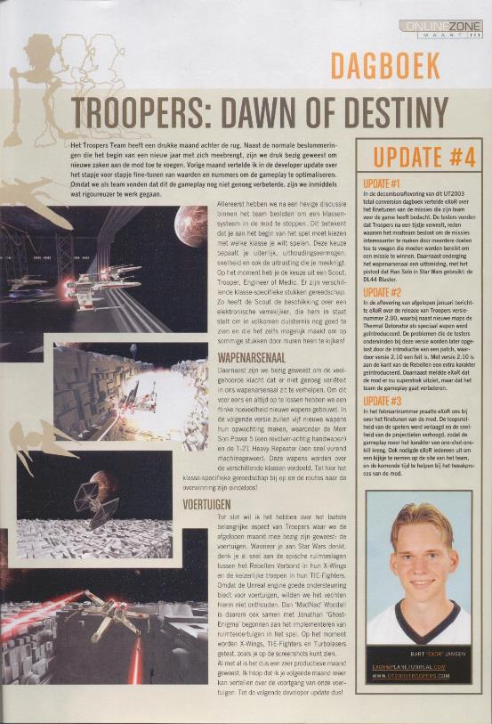
My first contact with parameterized complexity
Studied computer science @ Utrecht University, for 2 reasons
  Hands-off teaching
  Master ‘Game & media tech’
Last-minute switch to
Applied Computing Science
Master & PhD with Hans Bodlaender
  First topic: Dodgson score
Notes:
Switch based on network algorithms course by Hans.

Slide 3
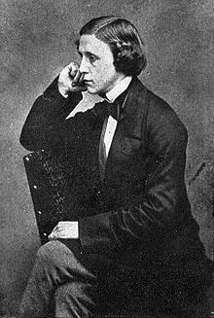
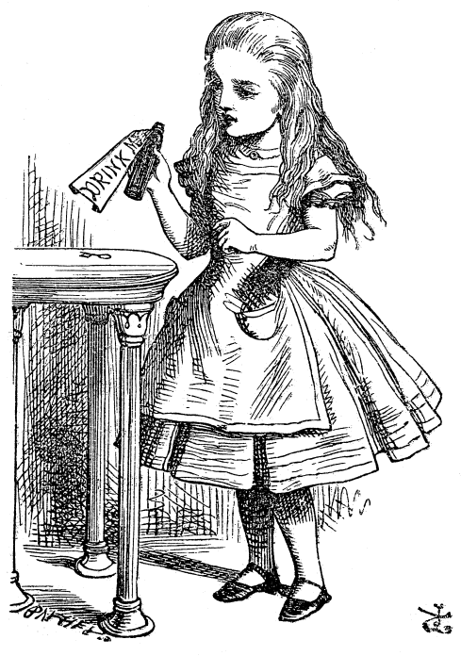
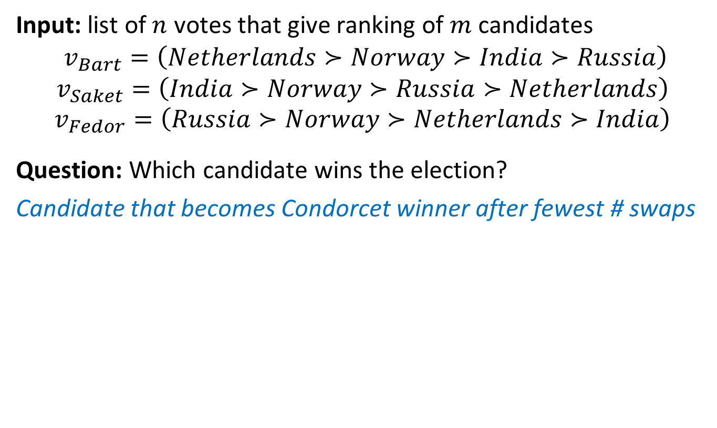
Determine who won the election
Input: list of $n$ votes that give ranking of $m$ candidates
$$v_{Bart}=\left(Netherlands≻Norway≻India≻Russia\right)$$
$$v_{Saket}=\left(India≻Norway≻Russia≻Netherlands\right)$$
$$v_{Fedor}=\left(Russia≻Norway≻Netherlands≻India\right)$$
Question: Which candidate wins the election?
Candidate that becomes Condorcet winner after fewest # swaps
Charles Dodgson
Lewis
Carroll
Notes:
To determine: where to have next workshop on kernelization? Came up with a way to determine who won, but unfortunately NP-complete to compute. If it is not clear who won: score everyone based on how much the outcome would have to be altered to make someone a clear winner.

Slide 4
My first contact with Mike’s vocabulary
Hans Bodlaender suggested that I investigate the kernelization complexity of Dodgson score
  “On Problems Without Polynomial Kernels” just appeared
First exposure to Mike’s colorful vocabulary:
This talk: tribute to Mike based on our history,
guided by his contributions & vocabulary
Notes:
Following open problem in paper by Nadia Betzler et al.

Slide 5
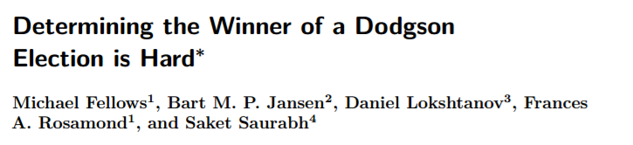

My first paper with Mike
Failed to settle the kernelization complexity of Dodgson Score
  Switched to leafy spanning trees for my master thesis
Later met Daniel Lokshtanov in Copenhagen at ALGO’09
  Kernelization lower bounds using colors & IDs
  W[1]-hardness proof, independently found by Mike
Notes:
First contact with Mike. In closing of his first email: ‘By the way, do you also surf?’

Slide 6
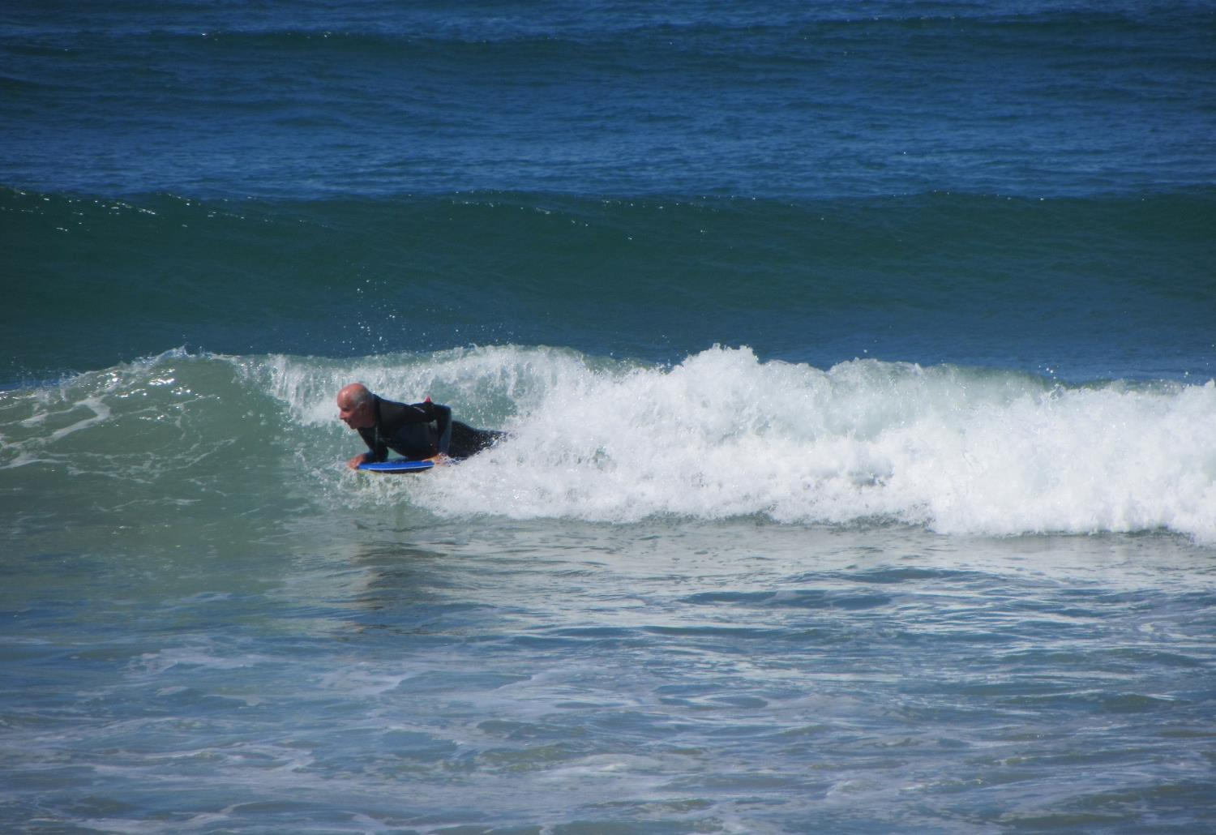
Sensing God’s
will is FPT

Slide 7
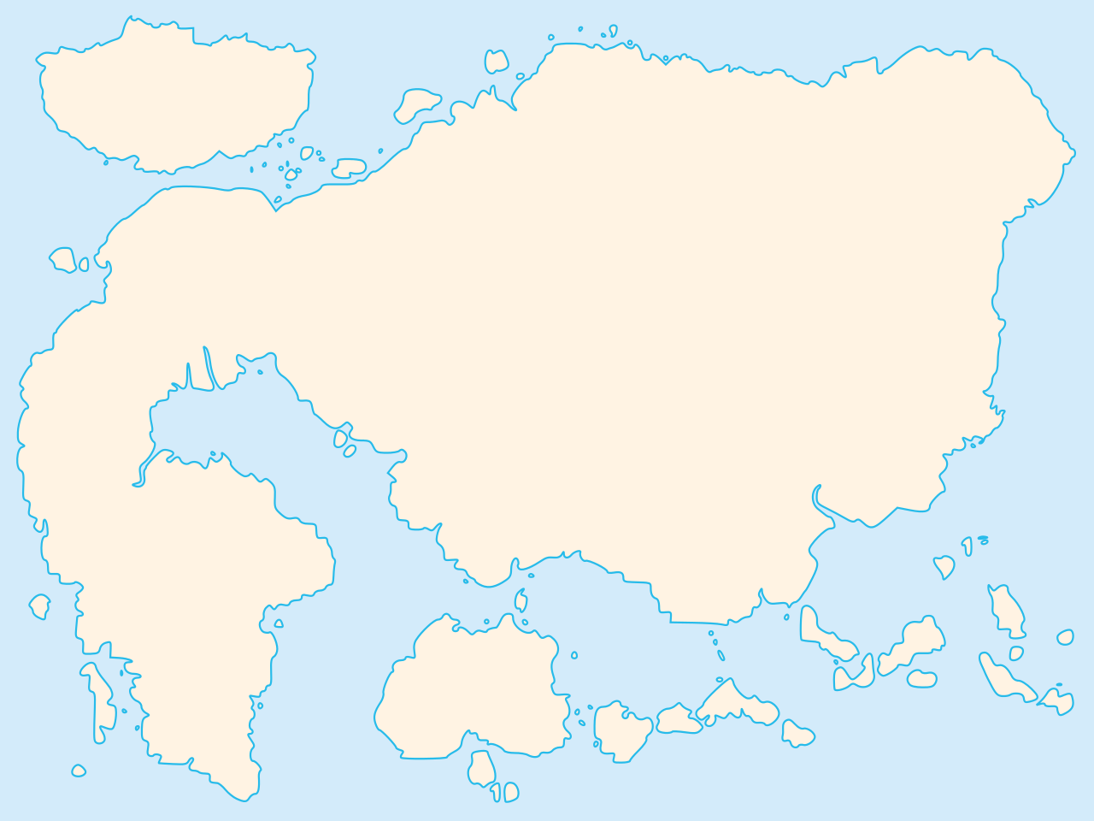
Map of polynomial-time computation
Kernelization
Primality
testing
The lost continent of polynomial time
Network flows
Sorting
Parsing
context-free grammars
Fast Fourier transform
Shortest paths
Longest common
subsequence
Approximation
Islands of
minor-testing
Notes:
The striking realization that there are polynomial-time algorithms that hold provable power over NP-hard problems, without actually solving them.

Slide 8

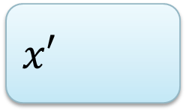
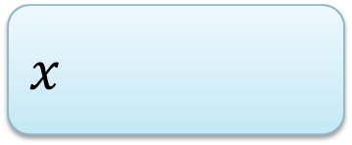
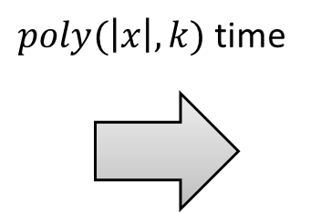




The lost continent of polynomial time
Described by Mike in a survey talk at IWPEC 2006
there are polynomial-time algorithms that hold provable power over NP-hard problems, without actually solving them
$n$ bits
$f(k)$ bits
$$x$$
$poly(\left|x\right|,k)$ time
$$x′$$
$$k$$
$$k′$$

Slide 9
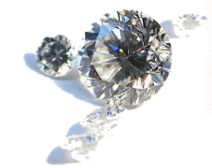
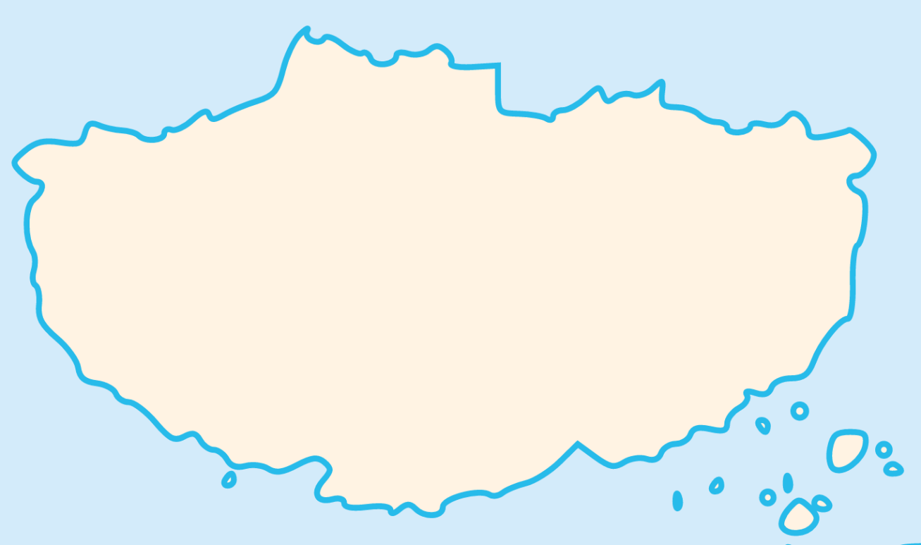
Map of the lost continent
Linear algebra
Crown reduction
Protrusion
reduction
Representative sets
Concentration
bounds
Expansion lemma
Sunflower lemma
Well-quasi ordering
Notes:
There is a wide variety of species of algorithms, that can successfully attack many different types of problems. Pointing research into this direction is one of Mike’s great achievements, and one that influenced my career the most.

Slide 10
Sensing God’s
will is FPT
The lost continent of polynomial time

Slide 11

reductions
WG ‘04
Can be used to kernelize a wide variety of problems
Vertex Cover
Saving $k$ Colors
Saving 𝑘 Colors
Max CNF-SAT
Longest Cycle/Path
$P_{2}$-Packing
𝑃_2-Packing
Hitting Set
$k$-Internal spanning tree
𝑘-Internal spanning tree
Treewidth
Set Packing
Star packing
Triangle packing
Disjoint Cycles
Notes:
Batman-mask reduction?

Slide 12

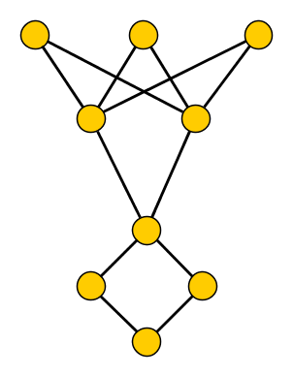
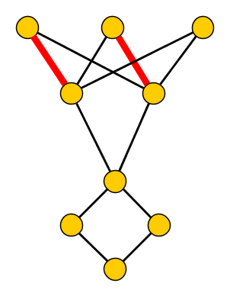

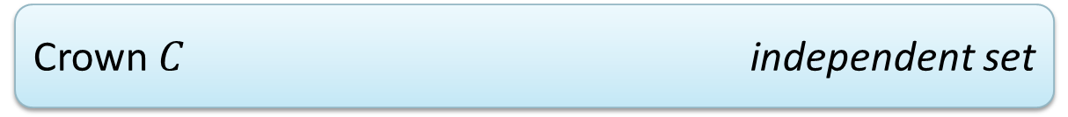
The definition
A crown decomposition of graph $G$ is a partition of $V(G)$ into
Crown $C$
independent set
Head $H$
matched into $C$
Remainder $R$
not adjacent to $C$

Slide 13
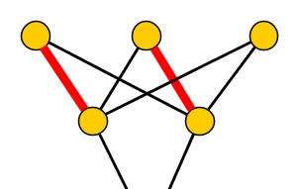
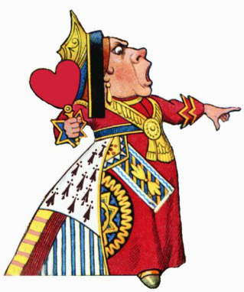

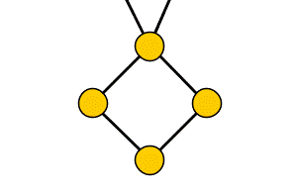
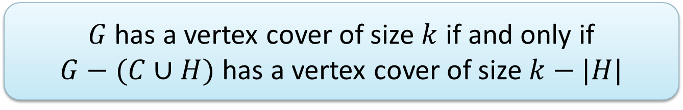
Crown reduction for Vertex Cover
$G$ has a vertex cover of size $k$ if and only if
$G−(C∪H)$ has a vertex cover of size $k−|H|$
Off with his head!
Notes:
The name of the concept is so colorful that you cannot help but remember. Combined with the generality and wide applicability of the technique, this led to many applications.

Slide 14
‘Crown reductions' in Google Scholar papers*
Notes:
Not so easy to determine – you have to filter out ‘crown reductions’ from forestry that are done to trees to help their growth, and that have to do with dentistry.

Slide 15
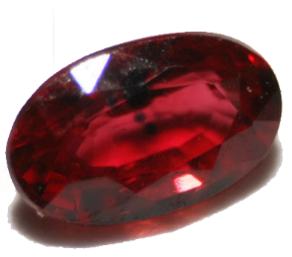
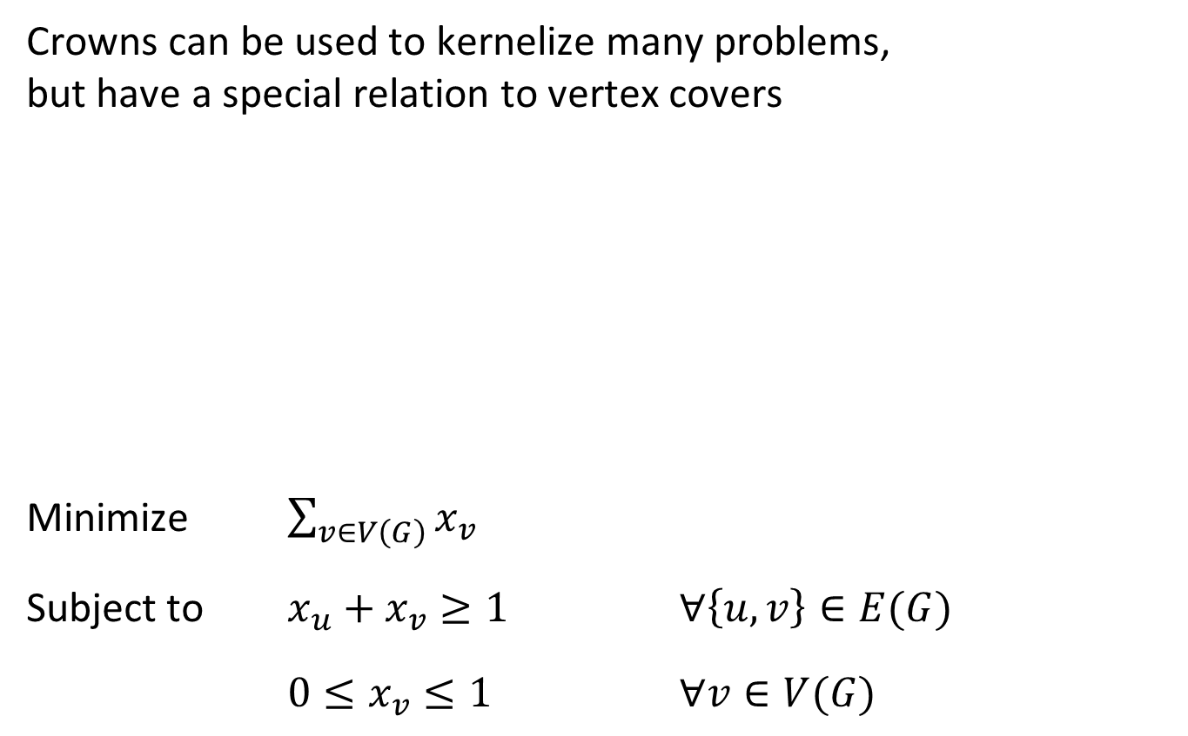
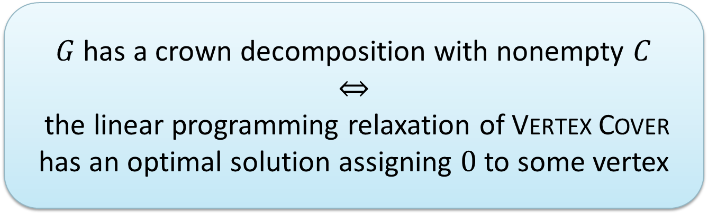
Crown reductions and linear programming
Crowns can be used to kernelize many problems,
but have a special relation to vertex covers
Minimize $\sum_{v∈V\left(G\right)}{x_{v}}$
Subject to $x_{u}+x_{v}≥1$ $∀\left\{u,v\right\}∈E(G)$
$0≤x_{v}≤1$ $∀v∈V(G)$
$G$ has a crown decomposition with nonempty $C$
$$⇔$$
the linear programming relaxation of Vertex Cover has an optimal solution assigning $0$ to some vertex
[Abu-Khzam, Fellows, Langston, Suters ‘07] & [Chlebík, Chlebíková ‘08]

Slide 16
Sensing God’s
will is FPT
Crown
reductions
The lost continent of polynomial time

Slide 17
Win/win’s
WG ‘03
cycle length $≥k$
/
treewidth $≤$ k
cycle length ≥𝑘
/
treewidth ≤ k
vertex cover $≤k$
/
$k$-internal spanning tree
vertex cover ≤𝑘
/
𝑘-internal spanning tree
vertex cover $≤k$
/
nonblocker $≤$ k
vertex cover ≤𝑘
/
nonblocker ≤ k
treewidth $≤O(2^{k}k^{\frac{3}{2}})$
/
Irrelevant vertex for Disjoint Paths
treewidth ≤𝑂(2^𝑘 𝑘^(3/2))
/
Irrelevant vertex for Disjoint Paths
cycle length $≥$ k
/
Irrelevant vertex for
$k$-Cycle
cycle length ≥ k
/
Irrelevant vertex for
𝑘-Cycle
Planar graphs:

Slide 18
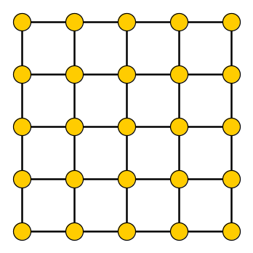
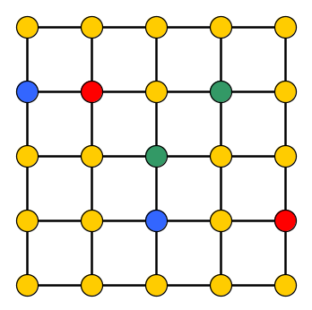
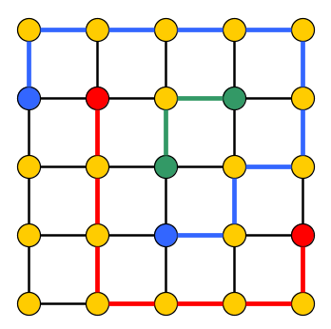


The Planar Disjoint Paths problem
Input: Planar undirected graph $G$ and $k$ terminal pairs
$\left(s_{1},t_{1}\right),…, \left(s_{k}, t_{k}\right)∈V\left(G\right)×V(G)$
Task: Find $k$ paths in $G$ such that each $P_{i}$ connects $s_{i}$ to $t_{i}$
and is vertex-disjoint from other paths $P_{j}$
NP-complete, solvable in time $2^{2^{O\left(k\right)}}⋅n^{2}$

Slide 19

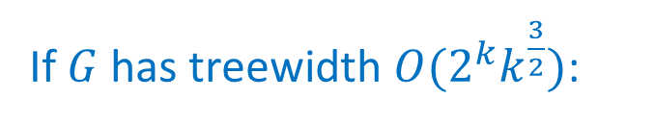
A two-sided approach
If $G$ has treewidth $O(2^{k}k^{\frac{3}{2}})$:
If the treewidth is larger:
Dynamic programming to find a solution if one exists
Courcelle’s theorem applies
$G$ has a grid minor with side length $Θ(2^{k}k^{\frac{3}{2}})$
Find&delete irrelevant vertex
win
win

Slide 20
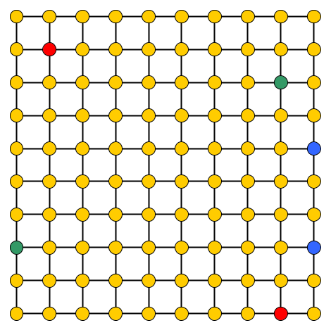
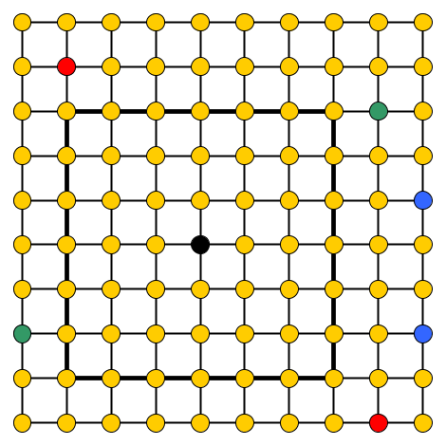
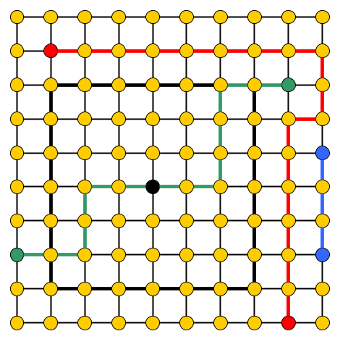

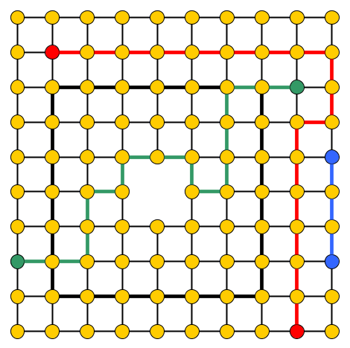
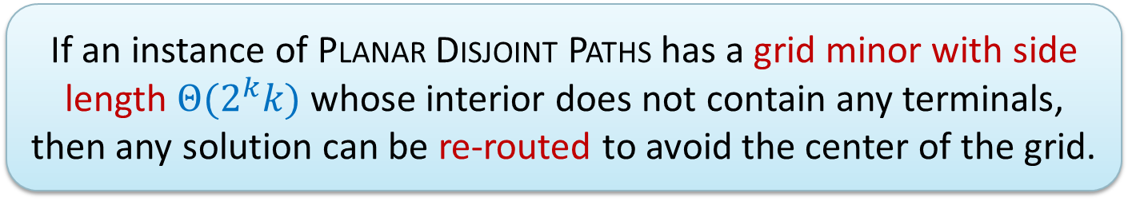
Irrelevant vertices for Planar Disjoint Paths
  If an instance of Planar Disjoint Paths has a grid minor with side length $Θ(2^{k}k)$ whose interior does not contain any terminals, then any solution can be re-routed to avoid the center of the grid.
[Adler, Kolliopoulos, Krause, Lokshtanov, Saurabh, Thilikos, JCT B‘12]

Slide 21


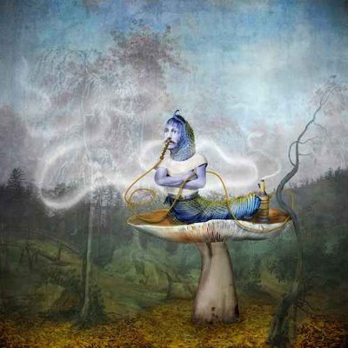


A recent win/win based on Turing kernelization
Turing kernelization is more than just cheating kernelization
(a way to circumvent lower bounds for many-one kernels)
Poses fundamental questions about computing interactively
???
?
!
!

Slide 22
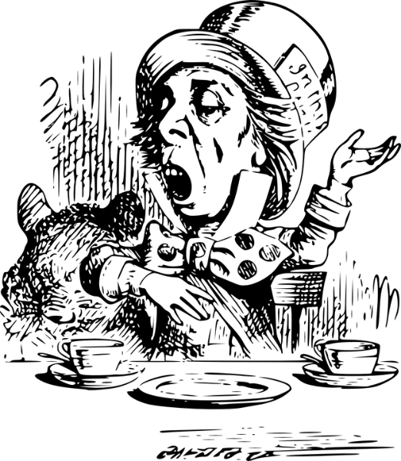

A recent win/win based on Turing kernelization
Turing kernelization is more than just
a way to circumvent lower bounds for many-one kernels
Poses fundamental questions about computing interactively
?
!
  How large should Alice’s questions be, to allow her to
  solve her problem by querying different oracles?
!
Notes:
Setting is useful if you don’t want to reveal the entire input. If the questions can be formulated in parallel, then also potentially interesting for speed-ups.

Slide 23
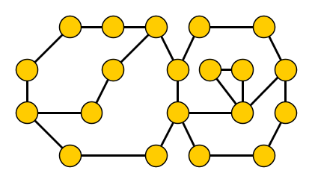
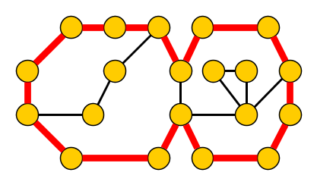

A Turing kernel win/win for Longest Cycle
Planar $k$-Cycle
Input: Undirected planar graph $G$ and integer $k$.
Parameter: $k$.
Question: Does $G$ have a simple cycle of length at least $k$?

Slide 24
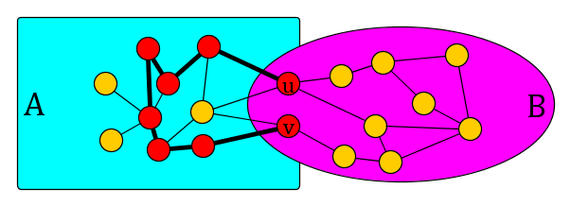
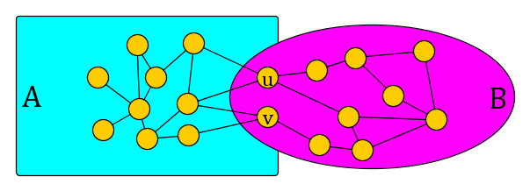
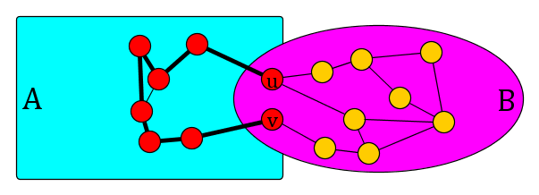

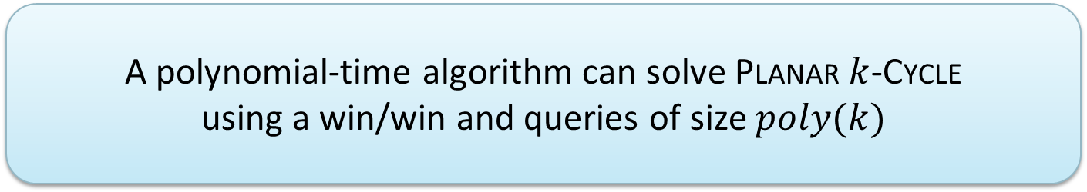
The win/win
For biconnected planar $G$ and integer $k$, in poly-time we find
  a cycle of length $≥k$ in $G$, or
  a 2-separation $(A,B)$ of $V(G)$ with $k<\left|A\right|<poly(k)$
Ask oracle for $k$-cycle and longest $uv$-path in $G[A]$
  Remove remaining vertices of $A∖B$
  A polynomial-time algorithm can solve Planar $k$-Cycle
  using a win/win and queries of size $poly(k)$
[J, ESA’14]

Slide 25
Sensing God’s
will is FPT
Crown
reductions
Win/win’s
The lost continent of polynomial time
Notes:
Which Alice-in-wonderland related FPT term is next?

Slide 26
Miniaturization

Slide 27
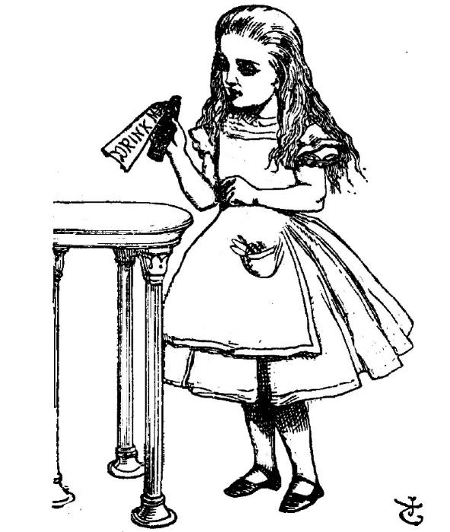

Miniaturization
3-SAT
Input: A 3-CNF formula $φ$.
Question: Is $φ$ satisfiable?

Slide 28



Miniaturization
Mini-3-SAT
Input: Integers $k$ and $n$ in unary, and
a 3-CNF formula $φ$ of size $k\log{n}$.
Parameter: $k$.
Question: Is $φ$ satisfiable?
  Mini-3-SAT is complete for the class $M[1]$, with
  $$FPT⊆M\left[1\right]⊆W[1]$$
Downey Fellows et al. + Cai & Juedes + Flum & Grohe
Notes:
Exponential time hypothesis is equivalent to saying FPT != M[1].

Slide 29
Sensing God’s
will is FPT
Crown
reductions
Win/win’s
Miniaturization
The lost continent of polynomial time

Slide 30
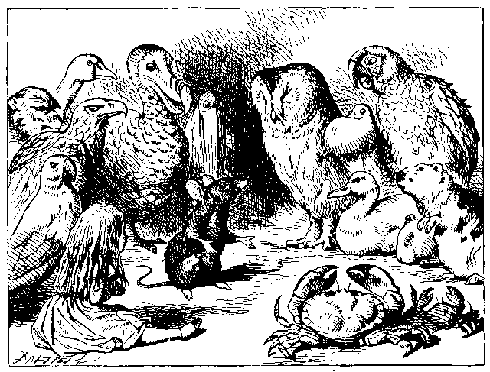
The parameter ecology program
CiE’07
  Inputs to real-world computational problems are often generated by processes that are themselves computationally bounded
Notes:
Consider the interaction between a computational problem and all possible species of parameterizations.

Slide 31


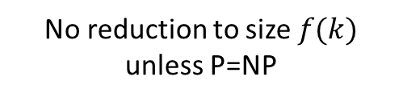
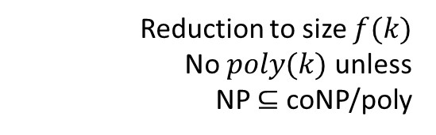
Parameter ecology: kernelization for $q$-Coloring
Reduction to size $poly(k)$
Vertex Cover
Distance to linear forest
Distance to Split graph components
Distance to Cograph
Feedback Vertex Set
Distance to Interval
Reduction to size $f(k)$
No $poly(k)$ unless
NP $⊆$ coNP/poly
Treewidth
Distance to Chordal
Odd Cycle Transversal
No reduction to size $f(k)$
unless P=NP
Distance to Perfect
Chromatic Number
[J & Kratsch ’11,’13]

Slide 32
Sensing God’s
will is FPT
Crown
reductions
Win/win’s
Miniaturization
The lost continent of polynomial time
Parameter ecology

Slide 33
A mathematical monster machine
ACiD’05
When correctly formulated from the right perspective:
  Mathematical project unfolds as small steps on a trajectory
Notes:
In the sense of Grothendieck; about methodology. Theory-builder project, as described by Peter yesterday. For kernelization: in surprisingly many occasions, the best data reduction we can do in polynomial time matches the best existential bounds: best kernel size matches upper bound on sizes of minimal obstructions. For example, for Vertex Cover and other minor-free deletion problems, for 3NAE-SAT, for sparsification for 3-Coloring, and so on. Paper with Mike @ WG.

Slide 34
Greedy localization
Fidelity preserving transformations
Sensing God’s
will is FPT
Crown
reductions
The rock of intractability
P-time extremal structure
Kernelization
Win/win’s
Catalytic reductions
Miniaturization
The lost continent of polynomial time
Parameter ecology
Weft
Tractability: The view from Mars

Slide 35
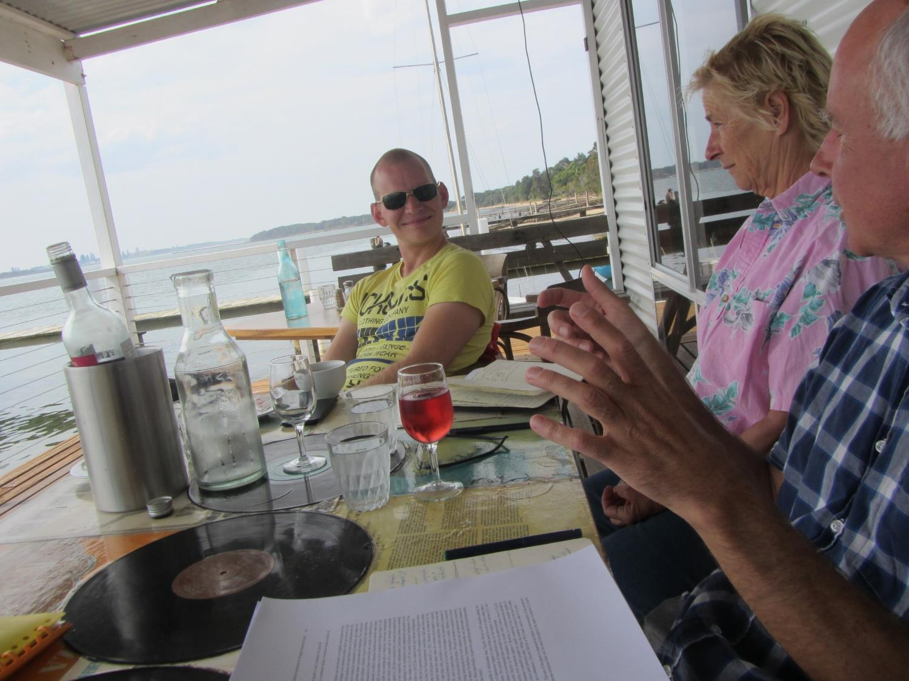










Slide 36
Conclusion
Mike introduced poetic terms into multivariate algorithmics
  Popularized many others through his invited talks & surveys
His pioneering work is felt as much in the vocabulary of our field, as in the techniques and research programs
Storytelling is a force that should be exploited,
even in mathematical research papers
  Open problem. What meaningful and colorful vocabulary
  can you use in your next paper?
Notes:
In your next paper: see if there is something more appropriate than ‘interesting components’ and ‘boring components’ when you are attacking a graph problem.

Slide 37

Happy 65th anniversary Mike
&
THANK YOU!

