Slide 1
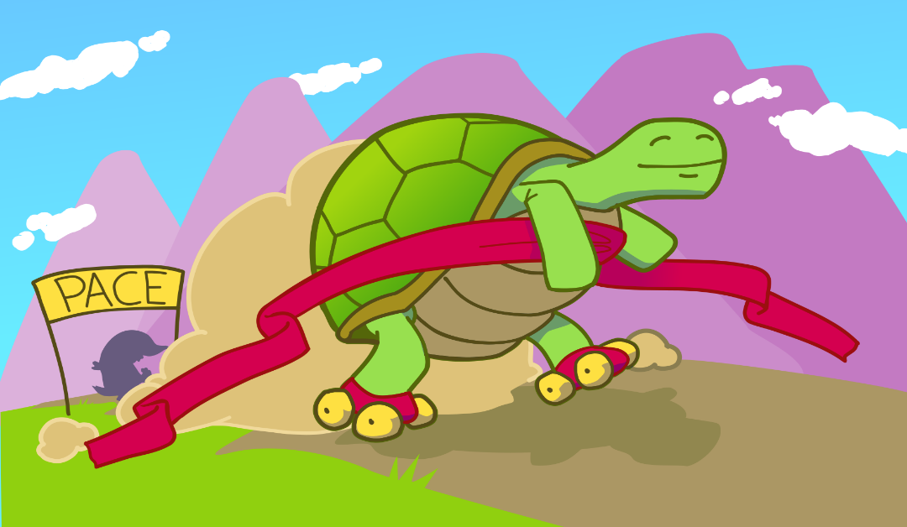
Parameterized Algorithms & Computational Experiments Challenge
www.pacechallenge.org
December 17th, IPEC 2020, Hong Kong

Slide 2
Goals
Investigate the applicability of algorithmic ideas from parameterized algorithmics
provide bridge between algorithm theory and algorithm engineering practice
inspire new theoretical developments
investigate the competitiveness of analytical and design frameworks
produce universally accessible libraries of implementations & benchmark inputs
encourage dissemination of the findings in scientific papers

Slide 3
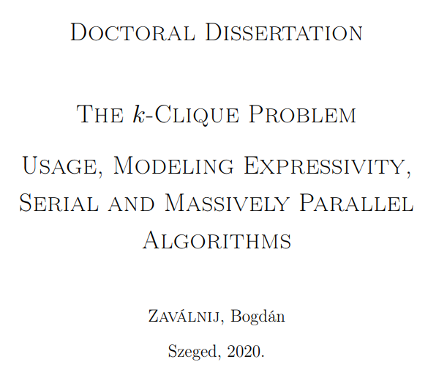
Impact of PACE
Notes:
> 90 citations of PACE competition reports of past 5 years.

Slide 4
The history of PACE
[Johannes Fichte & Markus Hecher]
Idea for PACE born @ Simons Institute meeting
“parameterized algorithmics should have a greater impact on practice”
Vertex Cover
Hypertree width
Poster session
[Holger Dell & Christian Komusiewicz]
Treewidth
Minimum Fill-in
2015 2016 2017 2018 2019 2020 2021 2022
Treewidth
Feedback Vertex Set
First PACE challenge
Steiner Tree
Treedepth
Implementation reports in proceedings
Cluster Editing
[Édouard Bonnet & Florian Sikora]
[‪André Nichterlein]
[Holger Dell & Christian Komusiewicz]
[Lukasz Kowalik]

Slide 5
PACE 2021: Cluster Editing
Challenge tracks:
Exact algorithms
Heuristic algorithms
Kernelization algorithms
https://pacechallenge.org/2021/tracks/
Program Committee:
Leon Kellerhals Tomohiro Koana André Nichterlein*
Philipp Zschoche Technical University of Berlin
Public instances released today!
Notes:
Public instances released today!

Slide 6
PACE 2022: We need your help!
Wanted: researcher with experience in theory & practice of parameterized algorithms, to be the program chair of PACE 2022
Set up challenge tracks in discussion with the steering committee
Assemble a program committee to help with selection of instances, setting up the evaluation platform, handling submissions, evaluating implementation reports
Publish an article summarizing the challenge in the IPEC proceedings
Potentially interested? Contact the steering committee!
Notes:
This year’s chair Lukasz thanked me for talking him into doing the job, as it provided a nontrivial amount of fun.

Slide 7
Steering committee
Édouard Bonnet LIP, ENS Lyon Holger Dell Goethe University Frankfurt and IT University of Copenhagen Johannes Fichte Technische Universität Dresden Markus Hecher Technische Universität Wien Bart M. P. Jansen* Eindhoven University of Technology Łukasz Kowalik University of Warsaw Marcin Pilipczuk University of Warsaw Manuel Sorge Technische Universität Wien
Former members
Thore Husfeldt (2016-2019) Petteri Kaski (2016-2020) Christian Komusiewicz (2016-2020) Frances Rosamond (2016-2019) Florian Sikora (2017-2020)

