Slide 1
Kernel Bounds for Structural Parameterizations of Pathwidth
Bart M. P. Jansen
Joint work with
Hans L. Bodlaender & Stefan Kratsch
July 6th 2012, SWAT 2012, Helsinki

Slide 2
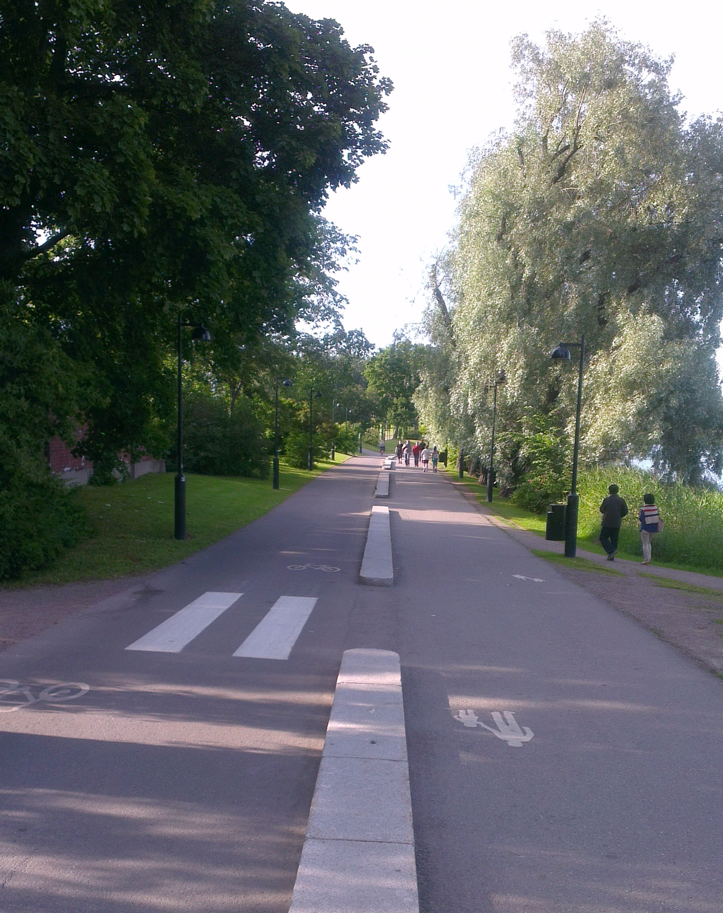
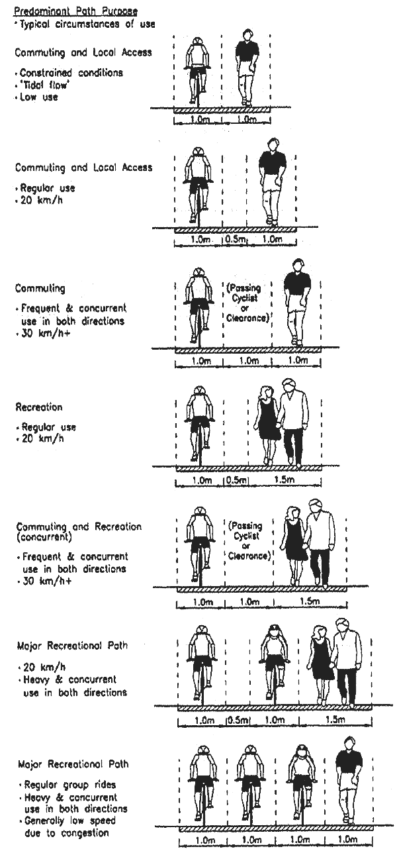
What is pathwidth?

Slide 3
What is pathwidth?
Measure of how “path-like” a graph is
  Related to treewidth (“tree-like”)
Gives the quality of a path decomposition, a decomposition of a graph into pieces arranged on a path
Both pathwidth and treewidth have been introduced many times under different names
  (vertex separation number, node search number, partial k-tree, etc …)
Play crucial roles in Robertson & Seymour’s proof of the Graph Minor Theorem

Slide 4
Why is it important?
Many graph problems can be solved efficiently (in linear time) if a path or tree decomposition of small width is known
When comparing pathwidth to treewidth:
  Path decompositions have larger width
  Dynamic programming algorithms for path decompositions are simpler and use less memory
Important to find low-width path and tree decompositions efficiently

Slide 5
Finding good decompositions is hard
Computing pathwidth or treewidth of a graph is NP-complete
  Pathwidth is even NP-complete on planar graphs
  Treewidth of planar graphs is open
No constant-factor approximation algorithms known
  Use heuristics, or exponential-time algorithms
There are 2^{poly(k)} n algorithms that either:
  Compute a decomposition of width k
  Determine that no such decomposition exists
Runtime ☹(n) for every fixed k

Slide 6
Preprocessing
Preprocess G to find a smaller graph G’, such that:
  Path decomposition of G’ can be lifted efficiently to decomposition of G
  Lifting does not increase the width
After preprocessing, find a decomposition for G’ by an exponential-time algorithm or heuristics
We want to give a guarantee on the size of the output
  Kernelization
Cannot guarantee output is smaller than input (else P=NP)
So given a graph G of “difficulty” k, shrink G to poly(k)
  Afterwards we can shrink no more

Slide 7
Setting realistic goals
Cannot preprocess G to size poly(pw(G)) without changing the pathwidth
  Unless NP ⊆ coNP/poly [BDFH’08,D’12]
  k-Pathwidth is AND-compositional
Pick a measure for graph difficulty that is larger than pw(G)
Can we shrink to size polynomial in the larger measure?
  For example: size of a minimum vertex cover
  (Vertex set that covers all edges)

Slide 8
The preprocessing story so far …
Lots of work on preprocessing for treewidth
Heuristic reduction rules with experimental evaluations
Rules were found to work well in practice
  No theoretical justification
BJK ‘11:
  Existing reduction rules give size reduction to O(VC³)
  With some more rules, size reduction to O(FVS⁴)
  Heuristic rules have provable effect!
No prior work on preprocessing for pathwidth
This work: reduction rules, analysis & lower bounds

Slide 9
Path decomposition
A path decomposition of a graph G=(V,E) is a sequence
(X₁, …, X_{r}) of subsets of V, called bags, such that:
  For all v, there is a bag that contains v
  For all {v,w} ∈ E, there is a bag that contains v and w
  For all v, the bags that contain v are consecutive
a
a
g
a
g
h
c
f
a
g
h
a
b
b
c
f
c
b
d
e
f
c
f
g
h

Slide 10
Path decomposition
The width of a path decomposition (X₁, …, X_{r}) is the size of its largest bag minus one: max_{1≤i ≤ r} |X_{i}|-1
The pathwidth of a graph G is the minimum width of a path decomposition of G
a
a
g
a
g
h
c
f
a
g
h
a
b
b
c
f
c
b
d
e
f
c
f
Width 3-1=2
g
h

Slide 11
Path decomposition
Path/treewidth does not increase when deleting or contracting edges / vertices
Treewidth ≤ pathwidth
Paths have pathwidth = treewidth = 1
Trees have treewidth 1, but may have pathwidth Θ(log n)
a
a
g
a
g
h
c
f
a
g
h
a
b
b
c
f
c
b
d
e
f
c
f
Width 3-1=2
g
h

Slide 12
Problem setting
Decision problem associated to pathwidth
  Instance: Graph G, integer k.
  Question: Does G have pathwidth ≤ k?
A reduction from G to G’ is safe for pathwidth k if it preserves whether the graph has pathwidth ≤ k
  (G has pathwidth ≤ k) iff (G’ has pathwidth ≤ k)
Easy to lift decompositions of G’ to G
In practical settings:
  Guess k, or work with upper- and lower bounds

Slide 13
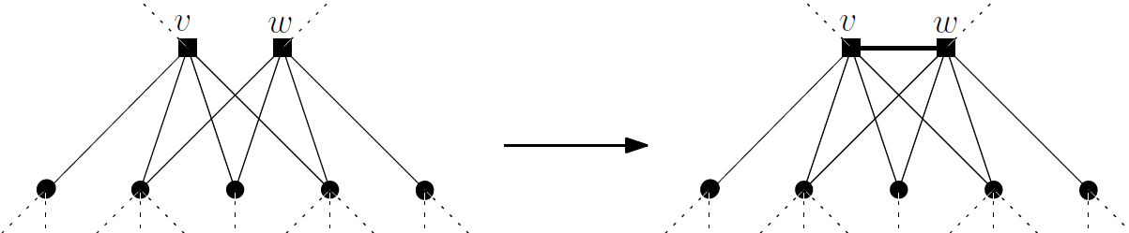
Common neighbors
Rule originates from Bodlaender’s linear-time algorithm for Treewidth
Any width-k tree decomposition has a bag with v and w
  Hence any width-k path decomposition has a {v,w} bag
Pathwidth Edge Improvement Rule
If v and w have ≥ k+1 common neighbors in G, then
adding edge {v,w} does not change whether pw(G) ≤ k
Treewidth Edge Improvement Rule
If v and w have ≥ k+1 common neighbors in G, then
adding edge {v,w} does not change whether tw(G) ≤ k

Slide 14
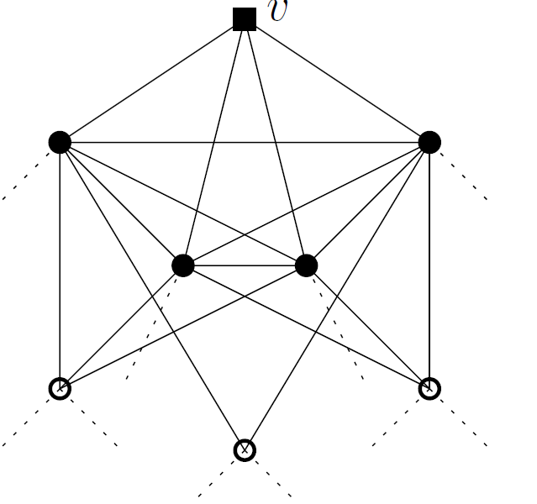
Simplicial Vertices
x
y
A vertex v is simplicial if N(v) is a clique
x
y
..
N(v)
..
..
v
k+1 vertices
N(v)
Closed neighborhood of v is a k+2 clique
Treewidth Simplicial Vertex Rule
Let v be a simplicial vertex in G.
If deg(v) ≥ k+1 then tw(G) > k
If deg(v) ≤ k then deleting v is safe for treewidth k
Pathwidth Simplicial Vertex Rule?
Let v be a simplicial vertex in G.
If deg(v) ≥ k+1 then pw(G) > k
If deg(v) ≤ k then deleting v is safe for pathwidth k
Helly property for trees ensures that there is a bag containing N(v)
Repeated application would eat up a tree

Slide 15
Degree-one vertices
v
w
x
X₃
X₄
X₁
Z
w
x
x
x
X₃
X₄
X₁
Z
w
Z
v
Pathwidth Degree-1 Vertex Rule
If vertex v is only adjacent to x, and
there is another degree-1 vertex w adjacent to x, then
then deleting v is safe for pathwidth k

Slide 16
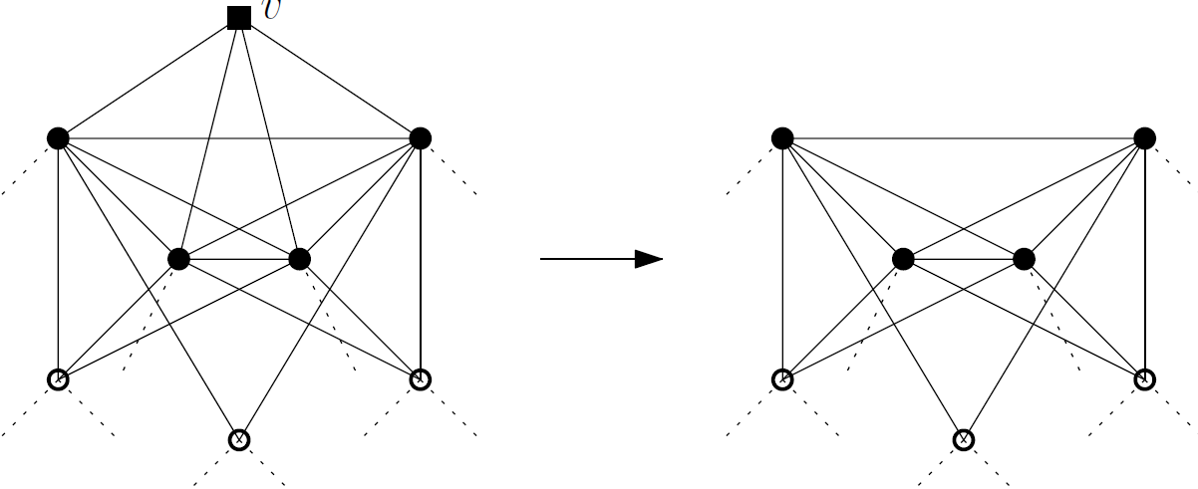
Pathwidth Simplicial Vertex Rule
Pathwidth Simplicial Vertex Rule
If v is simplicial with 2 ≤ deg(v) ≤ k, and
∀ {x,y} in N(v), ∃ simplicial vtx ∉ N[v] seeing x and y,
then deleting v is safe for pathwidth k

Slide 17
Effects of the reduction rules
If G has a vertex cover X of size l, and you work relative to the structure of X:
  Easy counting arguments prove O(l³) vertices
  (After some trivial rules)
Polynomial kernels (sizes in # vertices)
O(l³) when l is the vertex cover number
O(cl³ + c²l²) when l is the size of a vertex set whose removal gives components of at most c vertices each
O(l⁴) when l is the size of a vertex set whose removal results in disjoint stars

Slide 18
A kernelization lower bound
Pathwidth of a clique K_{t} is t-1
Pathwidth is easy for graphs that are “almost” a clique?
  That become a clique after deleting k vertices
Builds on the NP-completeness proof for Treewidth and Pathwidth by Arnborg, Corneil & Proskurowski ‘87
  They reduce Minimum Cut Linear Arrangement to computing Tree/path width on cobipartite graphs
We build a cross-composition of MinCut on cubic graphs into tree/pathwidth on a cobipartite graph where one partite set is small
  Deleting the small set yields a clique
Pathwidth and Treewidth do not admit polynomial kernels parameterized by vertex-deletion distance to a clique
(unless NP ⊆ coNP/poly)

Slide 19
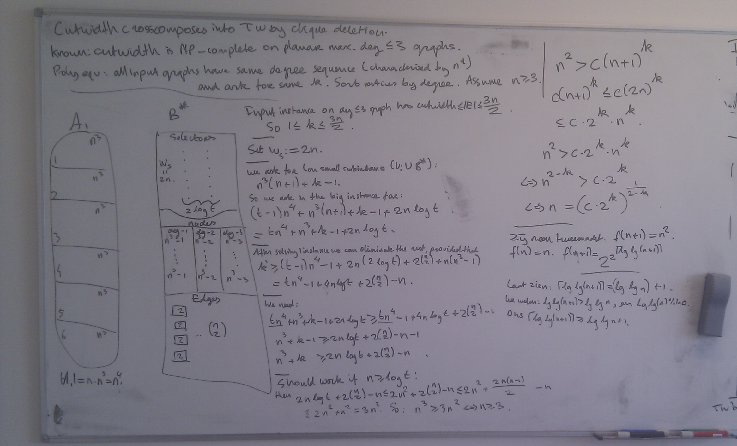
Details of the construction …

Slide 20
Conclusion
Reduction rules for pathwidth are more complicated than for treewidth, because the structure is more restricted
Analysis proves effect of the rules with respect to several parameters
Pathwidth and treewidth do not admit polynomial kernels by deletion distance to a clique

Slide 21
Future directions
Experimental evaluation of the reduction rules
Lower bounds on kernel sizes
Pathwidth parameterized by feedback vertex set
Polynomial kernel for treewidth by FVS
Kernel with O(k^{3-ε}) bits for parameterization by vertex cover?
Trees have constant treewidth but potentially large pathwidth
THANK YOU!

