Slide 1


Lower Bounds for Dynamic Programming
on Planar Graphs of Bounded Cutwidth
Bas A.M. van Geffen
Bart M.P. Jansen
Arnoud A.W.M. de Kroon
Rolf Morel
NWO-JSPS joint seminar: Computations on Networks with a Tree-Structure
September 14th 2018, Eindhoven, Netherlands

Slide 2


Lower bounds for treewidth-based algorithms
Lokshtanov, Marx & Saurabh proved several lower bounds based on the
Strong Exponential Time Hypothesis
[SODA 2011, TALG 2018]
Assuming SETH, there is no $ε>0$ for which an algorithm,
given an $n$-vertex graph $G$ and a tree decomposition of width $k$, can solve
Vertex Cover/Independent Set in time ${\left(2−ε\right)}^{k}⋅n^{O\left(1\right)}$
Dominating Set in time ${\left(3−ε\right)}^{k}⋅n^{O\left(1\right)}$
Max Cut in time ${\left(2−ε\right)}^{k}⋅n^{O\left(1\right)}$
Odd Cycle Transversal in time ${\left(3−ε\right)}^{k}⋅n^{O\left(1\right)}$
$q$-Coloring ($q≥3$ constant) in time ${\left(q−ε\right)}^{k}⋅n^{O\left(1\right)}$
Partition into Triangles in time ${\left(2−ε\right)}^{k}⋅n^{O\left(1\right)}$
Lokshtanov, Marx & Saurabh proved several lower bounds for parameterized algorithms
[SODA 2011, TALG 2018]
Assuming SETH, there is no $ε>0$ for which an algorithm,
given an $n$-vertex graph $G$ and a tree decomposition of width $k$, can solve
but $2^{k}⋅n^{O\left(1\right)}$ is possible
but $3^{k}⋅n^{O\left(1\right)}$ is possible
but $2^{k}⋅n^{O\left(1\right)}$ is possible
but $3^{k}⋅n^{O\left(1\right)}$ is possible
but $q^{k}⋅n^{O\left(1\right)}$ is possible
but $2^{k}⋅n^{O\left(1\right)}$ is possible
Notes:
These lower bounds match the running times of the best-known algorithms for these problems.

Slide 3
Motivating questions
Do faster algorithms exist …
when the bounded-width graph is also planar?
[open problem from Lokshtanov, Marx & Saurabh]
when parameterizing by more restrictive width measures?
Width measures considered earlier:
Kelly width
Path width
Rank width
Tree width
Clique width
Modular width
DAG width
MIM width
Boolean width
NLC width

Slide 4
Motivating questions
Do faster algorithms exist …
when the bounded-width graph is also planar?
[open problem from Lokshtanov, Marx & Saurabh]
when parameterizing by more restrictive width measures?
More restrictive width measures considered earlier:
Pathwidth
Feedback vertex number
Vertex cover number

Slide 5
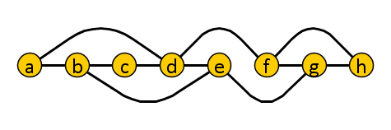


Decomposing graphs by small edge-cuts
The cutwidth of a linear ordering of $V(G)$ is:
maximum number of edges intersected by a vertical line between vertices
The cutwidth of a graph is the minimum cutwidth of any ordering of $V(G)$
  For any graph $G$:
  $$treewidth\left(G\right)≤pathwidth\left(G\right)≤cutwidth(G)$$
cutwidth 3

Slide 6
Motivating questions
Do faster algorithms exist …
when the bounded-width graph is also planar?
[open problem from Lokshtanov, Marx & Saurabh]
when parameterizing by more restrictive width measures
such as cutwidth?
The answers to these questions are related!
Lower bounds against cutwidth parameterizations,
transfer to planar graphs by suitable crossover gadgets

Slide 7
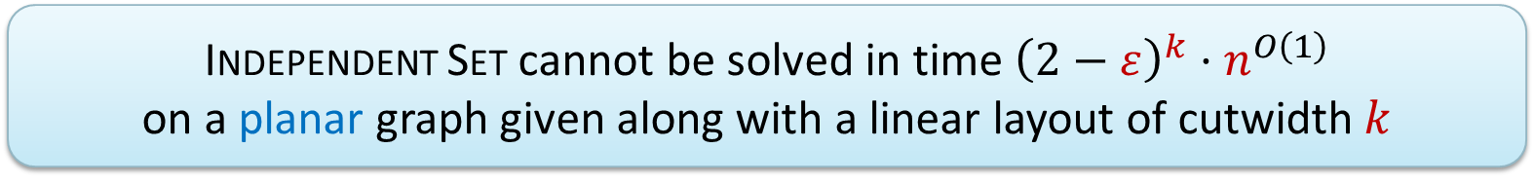

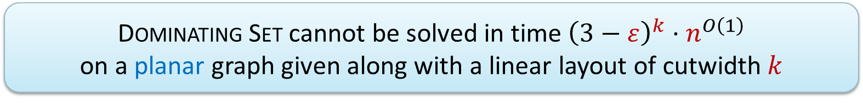
Main results
Assuming the Strong Exponential Time Hypothesis:
for any $ε>0$
Lower (& upper) bounds match those for parameterization by treewidth
Planarity does not help for treewidth-based DP!
  Independent Set cannot be solved in time ${\left(2−ε\right)}^{k}⋅n^{O\left(1\right)}$
  on a planar graph given along with a linear layout of cutwidth $k$
  Dominating Set cannot be solved in time ${\left(3−ε\right)}^{k}⋅n^{O\left(1\right)}$
  on a planar graph given along with a linear layout of cutwidth $k$

Slide 8
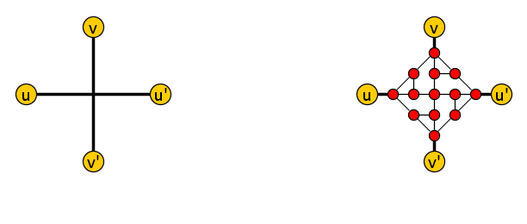
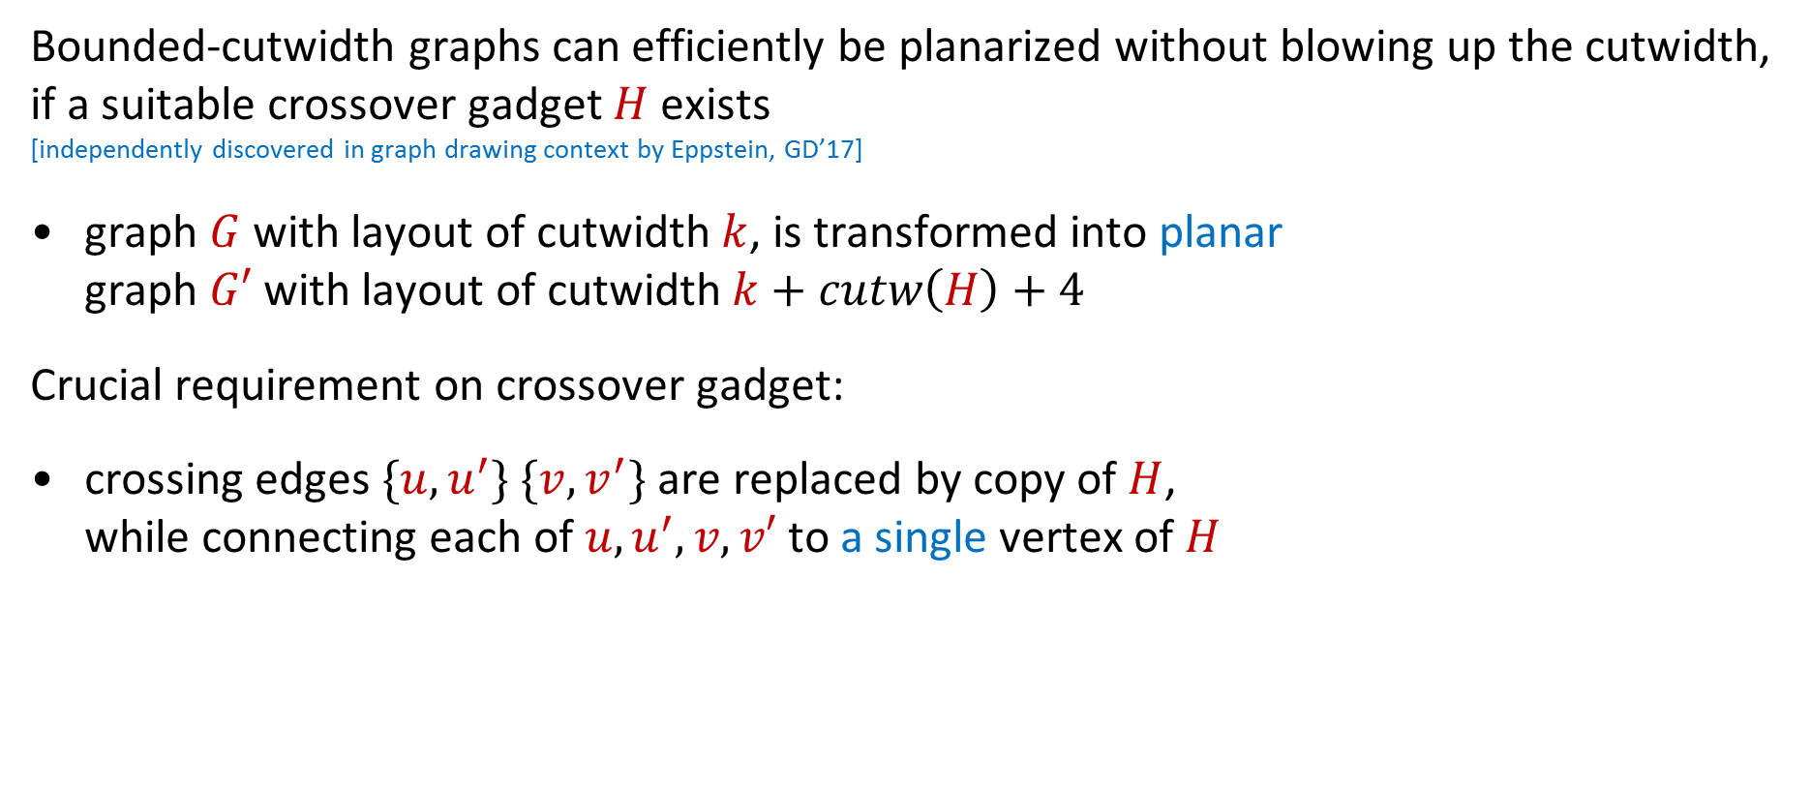
Conceptual contribution
Bounded-cutwidth graphs can efficiently be planarized without blowing up the cutwidth, if a suitable crossover gadget $H$ exists
[independently discovered in graph drawing context by Eppstein, GD’17]
graph $G$ with layout of cutwidth $k$, is transformed into planar
graph $G′$ with layout of cutwidth $k+cutw\left(H\right)+4$
Crucial requirement on crossover gadget:
crossing edges $\{u,u^{′}\}$ $\{v,v^{′}\}$ are replaced by copy of $H$,
while connecting each of $u,u^{′},v,v′$ to a single vertex of $H$

Slide 9
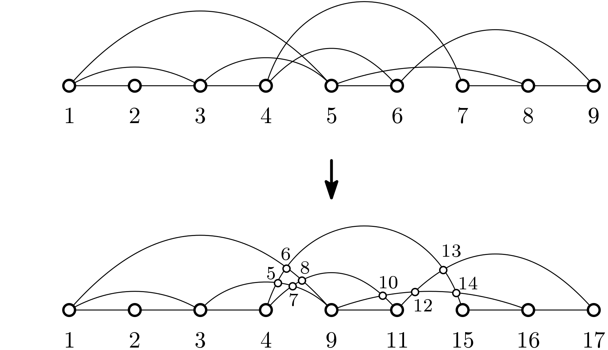
Planarization by vertices preserves cutwidth
Replacing crossings by degree-4 vertices preserves cutwidth

Slide 10
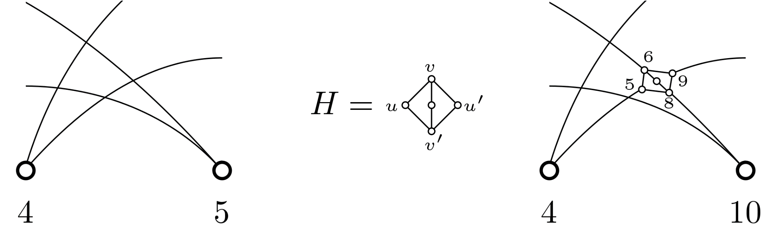

Gadget planarization does not blow up cutwidth
Replacing all crossings by gadget $H$ satisfying the requirement,
increases cutwidth by at most $cutw\left(H\right)+4$

Slide 11
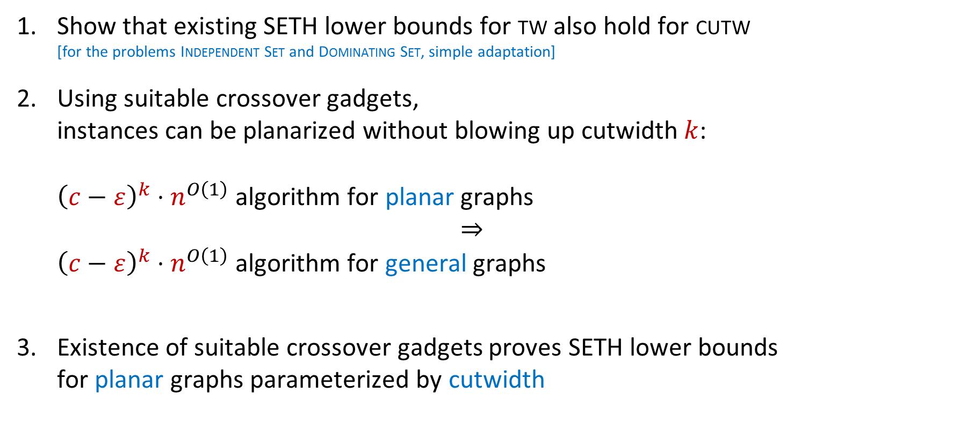
Proof strategy for lower bounds
Show that existing SETH lower bounds for tw also hold for cutw
[for the problems Independent Set and Dominating Set, simple adaptation]
Using suitable crossover gadgets,
instances can be planarized without blowing up cutwidth $k$:
${\left(c−ε\right)}^{k}⋅n^{O\left(1\right)}$ algorithm for planar graphs
$⇒$
${\left(c−ε\right)}^{k}⋅n^{O\left(1\right)}$ algorithm for general graphs
Existence of suitable crossover gadgets proves SETH lower bounds
for planar graphs parameterized by cutwidth

Slide 12
Technical contribution
Following NP-completeness, several crossover gadgets were developed
[Garey, Johnson & Stockmeyer, TCS ‘76] [Lichtenstein, SICOMP ‘82]
Existing Independent Set gadget directly gives first lower bound
We design a novel crossover gadget for Dominating Set
Vertex Cover
Independent Set
3-Colorability
Satisfiability

Slide 13
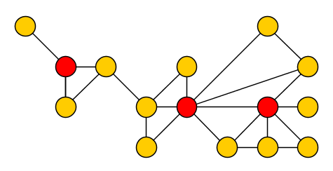
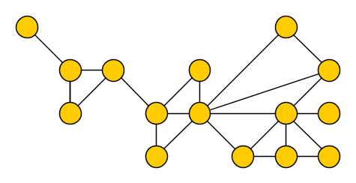

The Dominating Set problem
Input: An undirected graph $G$
Output: A minimum-size vertex set $S⊆V(G)$ such that each vertex $v∈V\left(G\right)$ belongs to $S$, or has a neighbor in $S$
Such a set $S$ is called a dominating set of $G$
Vertex $v$ is said to dominate itself and its neighbors

Slide 14
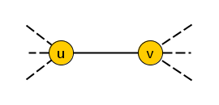
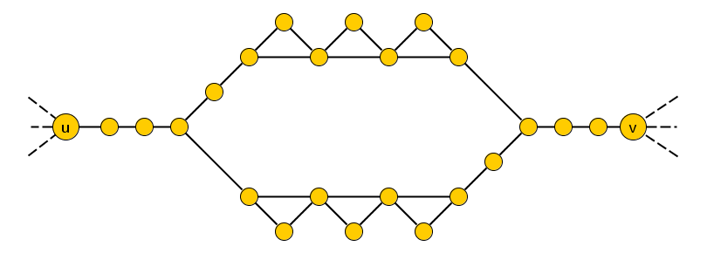
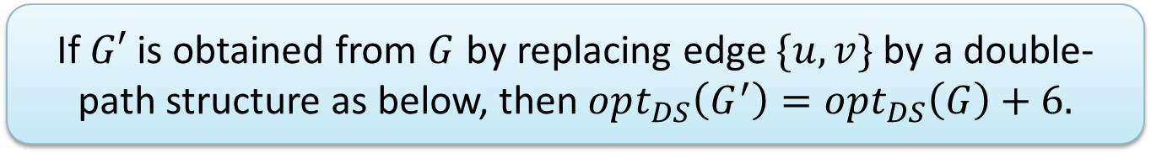
Replacing single edges
  If $G′$ is obtained from $G$ by replacing edge $\{u,v\}$ by a double-path structure as below, then $opt_{DS}\left(G^{′}\right)=opt_{DS}\left(G\right)+6.$

Slide 15
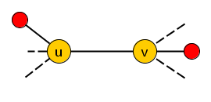
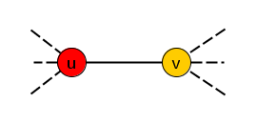
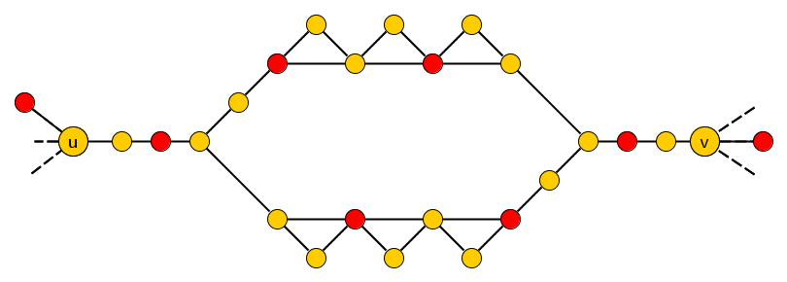
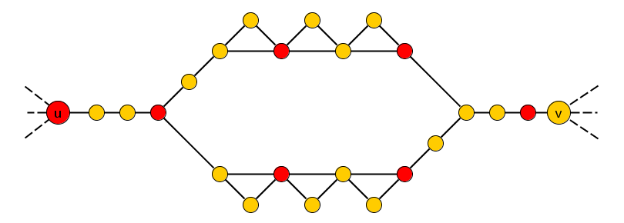

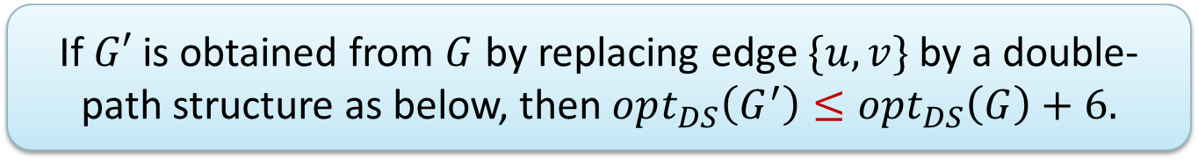
Replacing single edges $(≤)$
  If $G′$ is obtained from $G$ by replacing edge $\{u,v\}$ by a double-path structure as below, then $opt_{DS}\left(G^{′}\right)≤opt_{DS}\left(G\right)+6.$

Slide 16
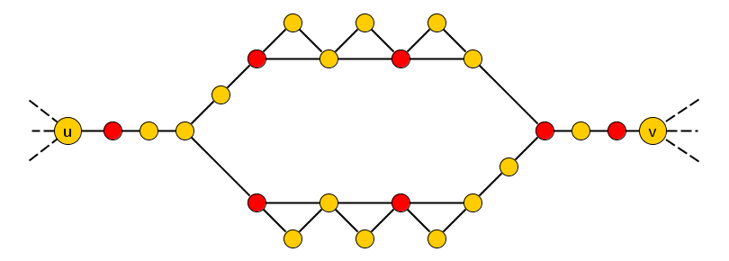
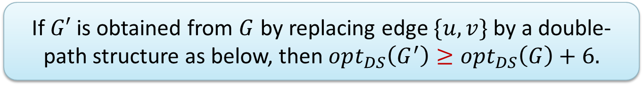

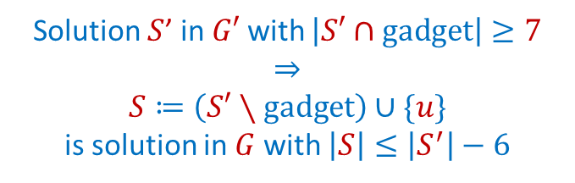
Replacing single edges $(≥)$
  If $G′$ is obtained from $G$ by replacing edge $\{u,v\}$ by a double-path structure as below, then $opt_{DS}\left(G^{′}\right)≥opt_{DS}\left(G\right)+6.$
Solution $S$’ in $G′$ with $\left|S′∩gadget\right|≥7$
$$⇒$$
$$S≔\left(S′∖gadget\right)∪\{u\}$$
is solution in $G$ with $\left|S\right|≤\left|S^{′}\right|−6$

Slide 17
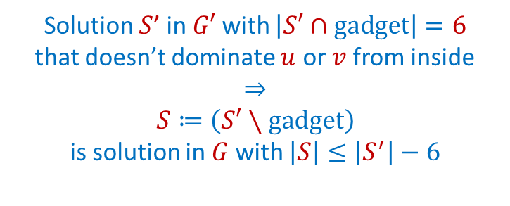
Replacing single edges $(≥)$
  If $G′$ is obtained from $G$ by replacing edge $\{u,v\}$ by a double-path structure as below, then $opt_{DS}\left(G^{′}\right)≥opt_{DS}\left(G\right)+6.$
Solution $S$’ in $G′$ with $\left|S′∩gadget\right|=6$
that doesn’t dominate $u$ or $v$ from inside
$$⇒$$
$$S≔\left(S′∖gadget\right)$$
is solution in $G$ with $\left|S\right|≤\left|S^{′}\right|−6$
Notes:
If you use more than 6 vertices from interior: remove those 7, add u instead (dominates v by the edge uv in G). If you use exactly 6 from interior but don’t use neighbors of u or v: then remove those 6 vertices to get a domset in G. If you use exactly 6 and use the neighbor of u: then show v must be in the domset.

Slide 18
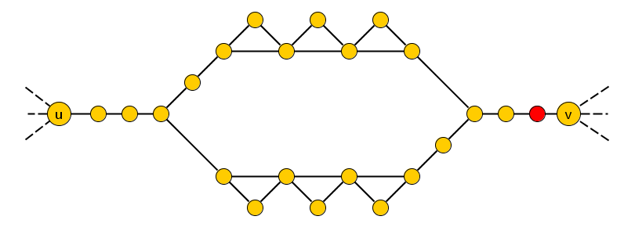
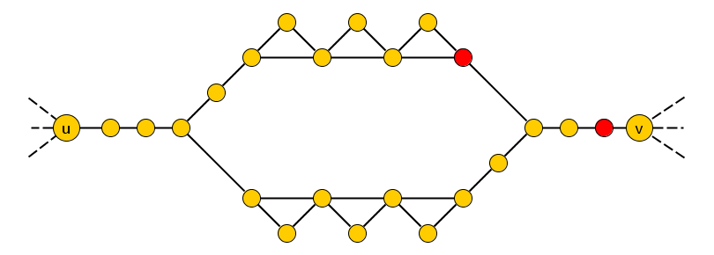
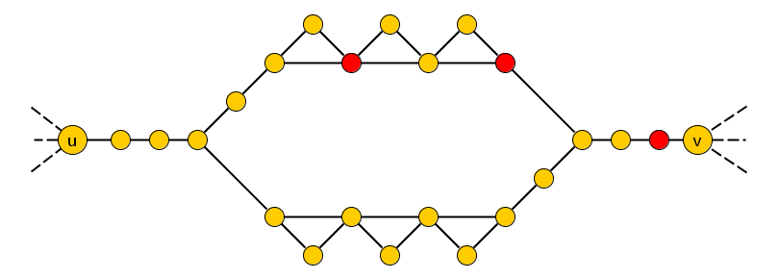
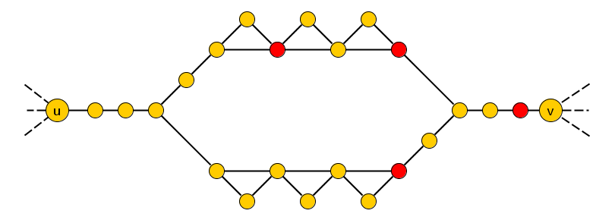
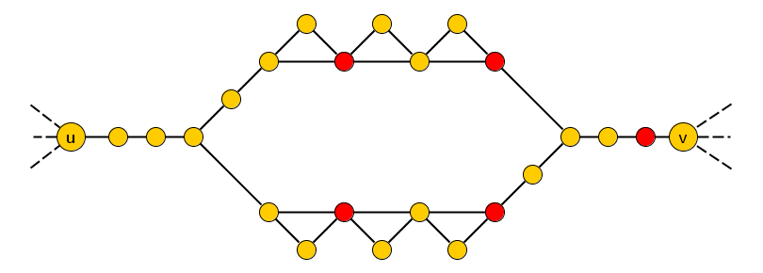
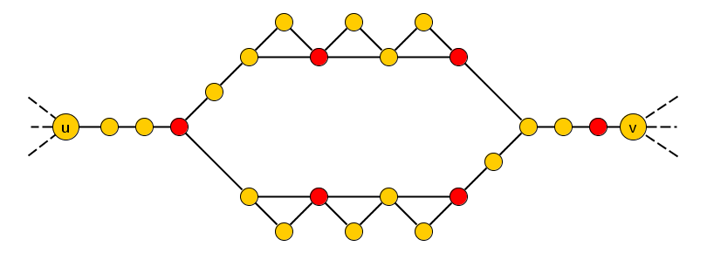
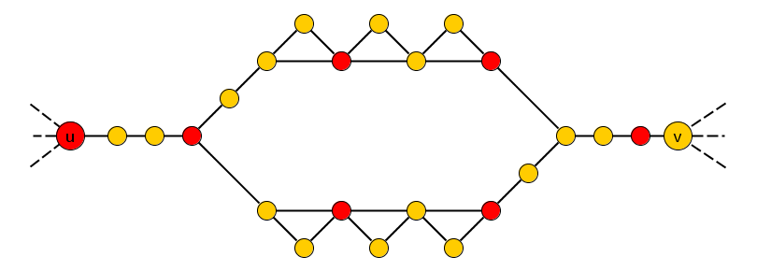

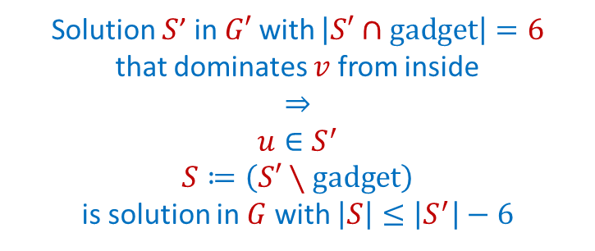
Replacing single edges $(≥)$
  If $G′$ is obtained from $G$ by replacing edge $\{u,v\}$ by a double-path structure as below, then $opt_{DS}\left(G^{′}\right)≥opt_{DS}\left(G\right)+6.$
Solution $S$’ in $G′$ with $\left|S′∩gadget\right|=6$
that dominates $v$ from inside
$$⇒$$
$$u∈S^{′}$$
$S≔\left(S′∖gadget\right)$
is solution in $G$ with $\left|S\right|≤\left|S^{′}\right|−6$
Each solution $S′$ in $G′$ satisfies
$$\left|S^{′}∩gadget\right|≥6$$
Notes:
If you use more than 6 vertices from interior: remove those 7, add u instead (dominates v by the edge uv in G). If you use exactly 6 from interior but don’t use neighbors of u or v: then remove those 6 vertices to get a domset in G. If you use exactly 6 and use the neighbor of u: then show v must be in the domset.

Slide 19
Replacing single edges
  If $G′$ is obtained from $G$ by replacing edge $\{u,v\}$ by a double-path structure as below, then $opt_{DS}\left(G^{′}\right)=opt_{DS}\left(G\right)+6.$

Slide 20
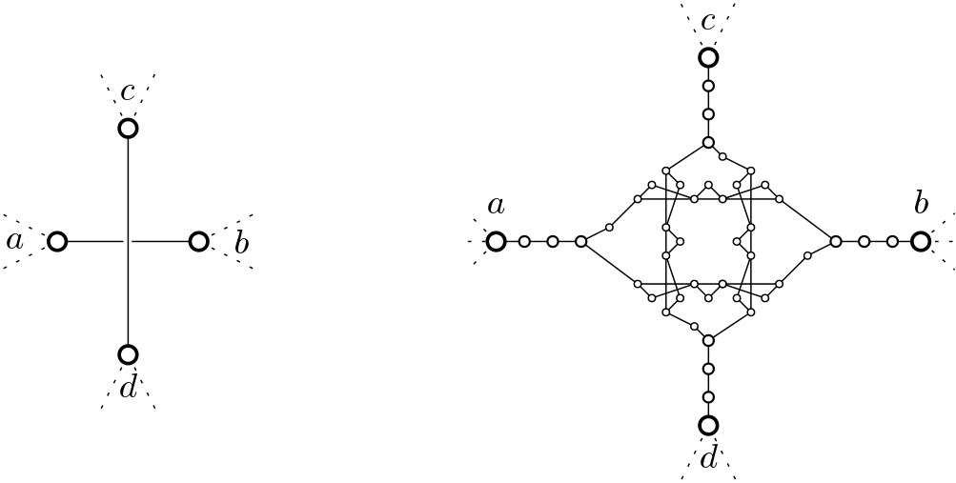

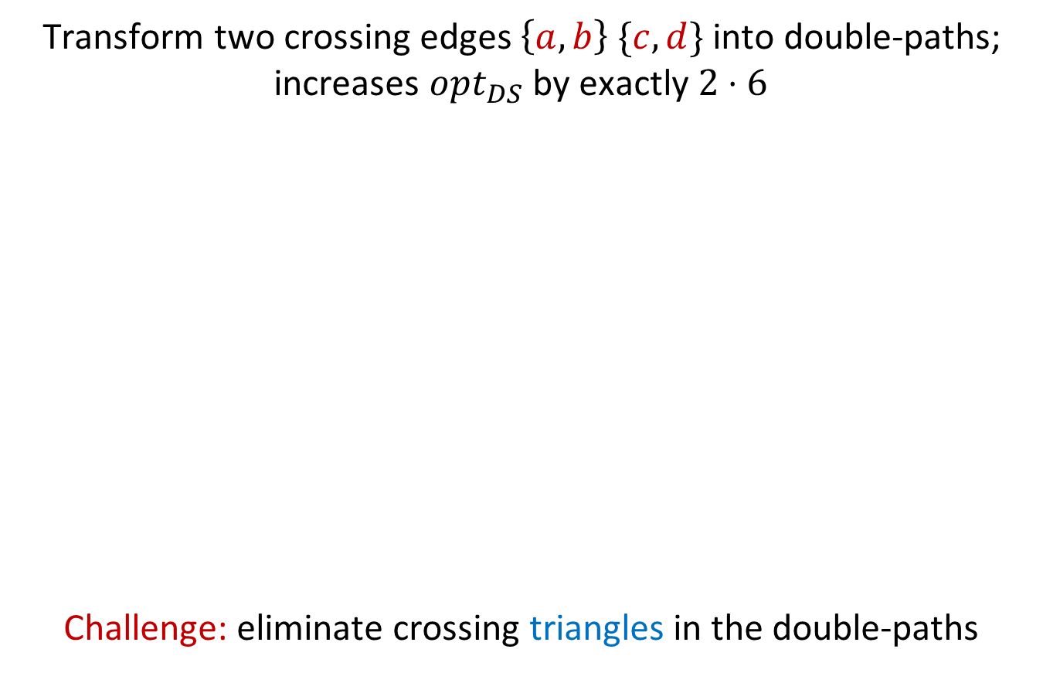
2 crossing edges $⇒$ 4 crossing triangles
Transform two crossing edges $\left\{a,b\right\} \{c,d\}$ into double-paths;
increases $opt_{DS}$ by exactly $2⋅6$
Challenge: eliminate crossing triangles in the double-paths

Slide 21
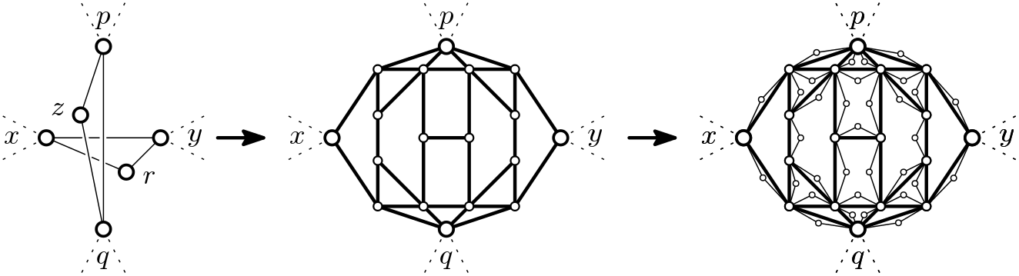
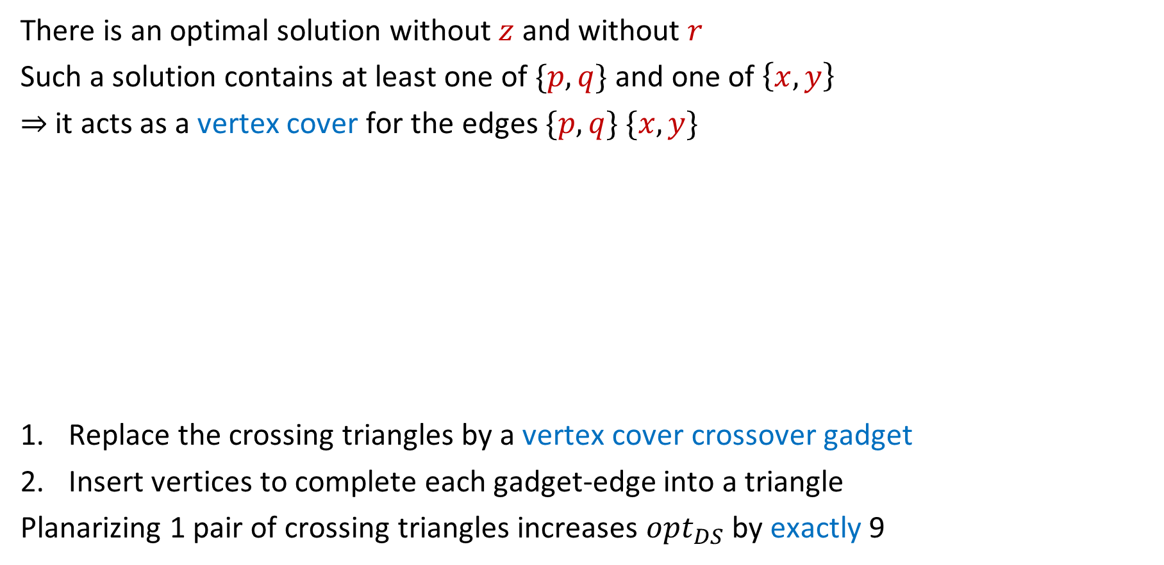
Eliminating crossing triangles
There is an optimal solution without $z$ and without $r$
Such a solution contains at least one of $\{p,q\}$ and one of $\left\{x,y\right\}$
$⇒$ it acts as a vertex cover for the edges $\{p,q\}$ $\{x,y\}$
Replace the crossing triangles by a vertex cover crossover gadget
Insert vertices to complete each gadget-edge into a triangle
Planarizing 1 pair of crossing triangles increases $opt_{DS}$ by exactly 9

Slide 22
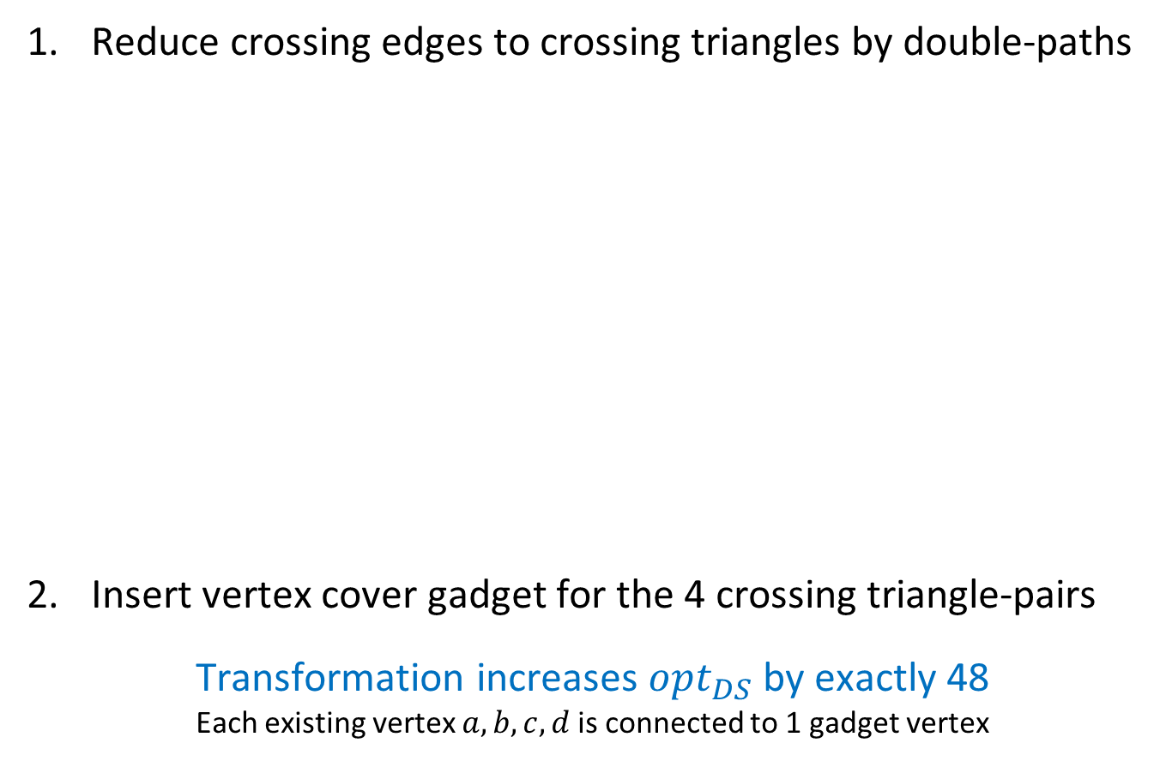
Complete planarization operation
Reduce crossing edges to crossing triangles by double-paths
Insert vertex cover gadget for the 4 crossing triangle-pairs
Transformation increases $opt_{DS}$ by exactly 48
Each existing vertex $a,b,c,d$ is connected to 1 gadget vertex
Notes:
Existence of crossover gadget proves SETH lowerbound for Dominating Set by route sketched earlier.

Slide 23
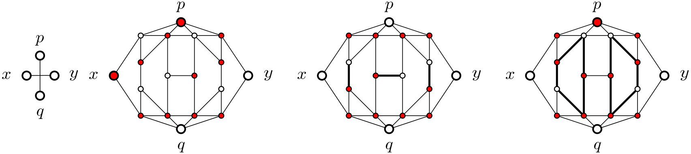
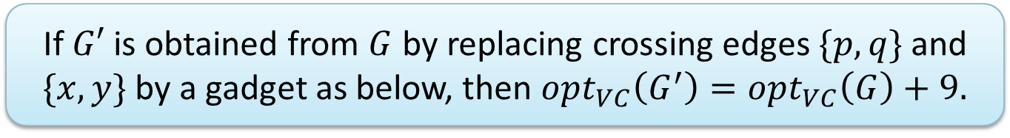
Behavior of the Vertex Cover gadget
  If $G′$ is obtained from $G$ by replacing crossing edges $\{p,q\}$ and $\{x,y\}$ by a gadget as below, then $opt_{VC}\left(G^{′}\right)=opt_{VC}\left(G\right)+9.$

Slide 24
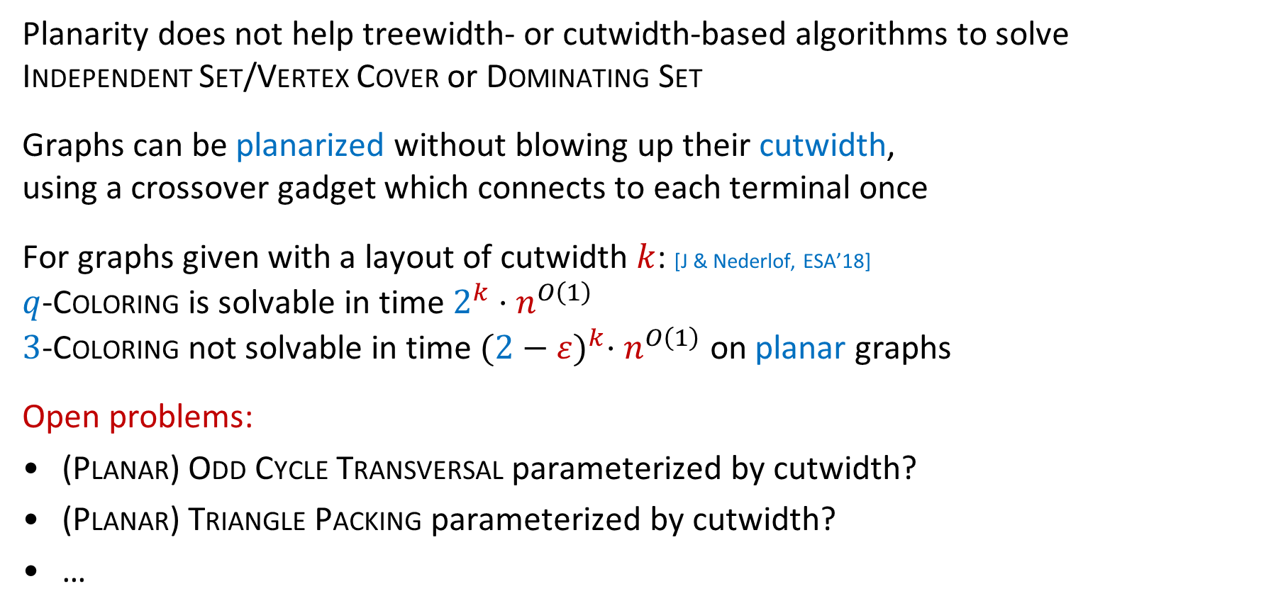
Conclusion
Planarity does not help treewidth- or cutwidth-based algorithms to solve
Independent Set/Vertex Cover or Dominating Set
Graphs can be planarized without blowing up their cutwidth,
using a crossover gadget which connects to each terminal once
For graphs given with a layout of cutwidth $k$: [J & Nederlof, ESA’18]
$q$-Coloring is solvable in time $2^{k}⋅n^{O\left(1\right)}$
$3$-Coloring not solvable in time ${(2−ε)}^{k}⋅n^{O\left(1\right)}$ on planar graphs
Open problems:
(Planar) Odd Cycle Transversal parameterized by cutwidth?
(Planar) Triangle Packing parameterized by cutwidth?
…
THANK YOU!

