Slide 1
The Power of Preprocessing
Bart M. P. Jansen
September 29th, Algorithms & Visualization seminar, TU Eindhoven

Slide 2
Preprocessing for hard problems
For a large group of computational problems, no algorithm is known that always finds the answer quickly
Such NP-complete problems come from all kinds of important applications
Technique of preprocessing often reduces computation time
  Simplify the input using simple reduction rules that do not change the answer
  Run the (resource demanding) algorithm on the simplified problem

Slide 3
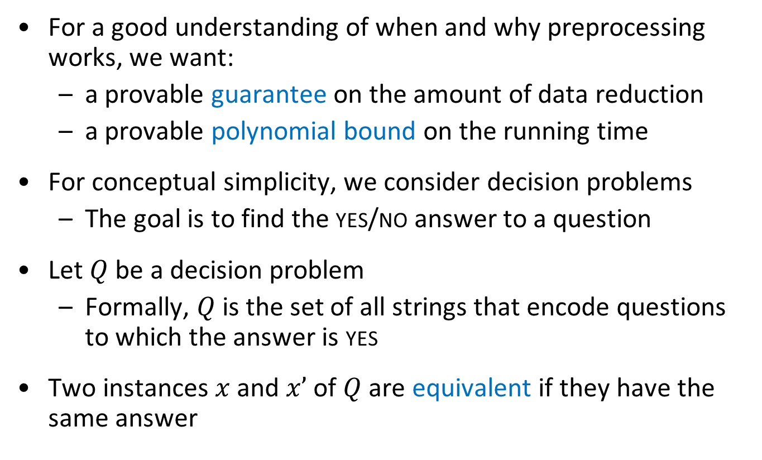
Preprocessing with a guarantee
For a good understanding of when and why preprocessing works, we want:
  a provable guarantee on the amount of data reduction
  a provable polynomial bound on the running time
For conceptual simplicity, we consider decision problems
  The goal is to find the yes/no answer to a question
Let $Q$ be a decision problem
  Formally, $Q$is the set of all strings that encode questions to which the answer is yes
Two instances $x$ and $x’$ of $Q$ are equivalent if they have the same answer

Slide 4
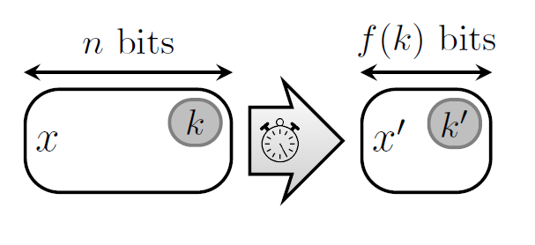

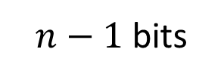

Great preprocessing algorithms
A great preprocessing algorithm for a decision problem $Q$:
  takes an instance $x$ of $Q$ as input,
  runs in time polynomial in $|x|$, and
  outputs an equivalent instance $x′$ such that $\left|x^{′}\right|<|x|$
$n$ bits
$n−1$ bits

Slide 5
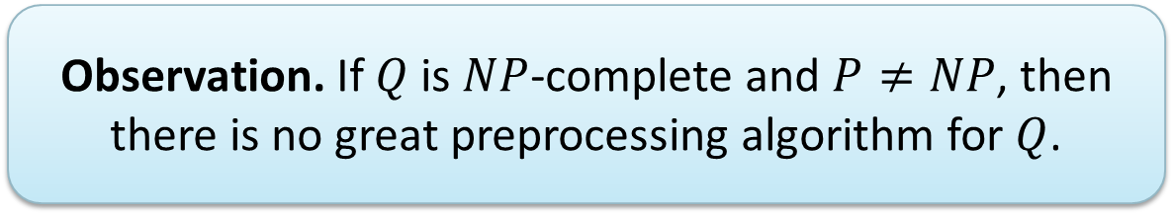
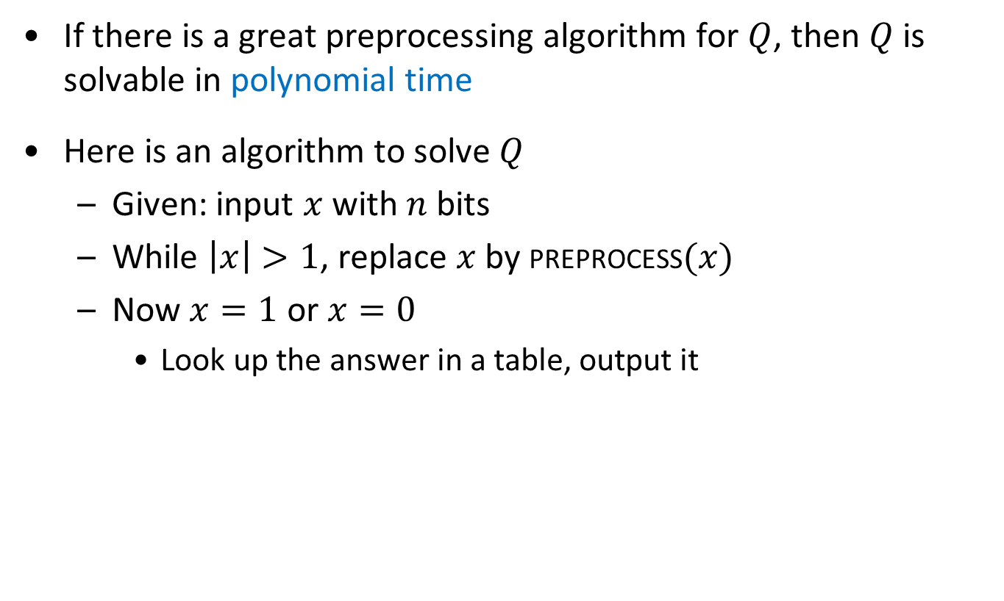
Great preprocessing algorithms – the downside
If there is a great preprocessing algorithm for $Q$, then $Q$ is solvable in polynomial time
Here is an algorithm to solve $Q$
  Given: input $x$ with $n$ bits
  While $\left|x\right|>1$, replace $x$ by preprocess$(x)$
  Now $x=1$ or $x=0$
    Look up the answer in a table, output it
  Observation. If $Q$ is $NP$-complete and $P≠NP$, then there is no great preprocessing algorithm for $Q$.

Slide 6
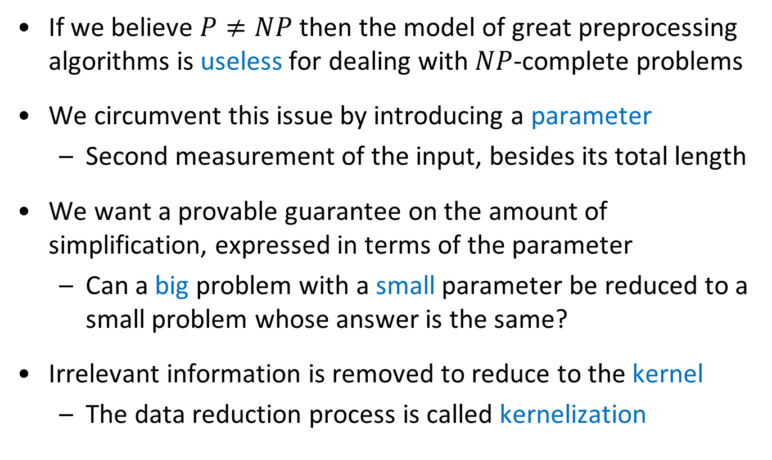
Parameterized preprocessing
If we believe $P≠NP$ then the model of great preprocessing algorithms is useless for dealing with $NP$-complete problems
We circumvent this issue by introducing a parameter
  Second measurement of the input, besides its total length
We want a provable guarantee on the amount of simplification, expressed in terms of the parameter
  Can a big problem with a small parameter be reduced to a small problem whose answer is the same?
Irrelevant information is removed to reduce to the kernel
  The data reduction process is called kernelization

Slide 7
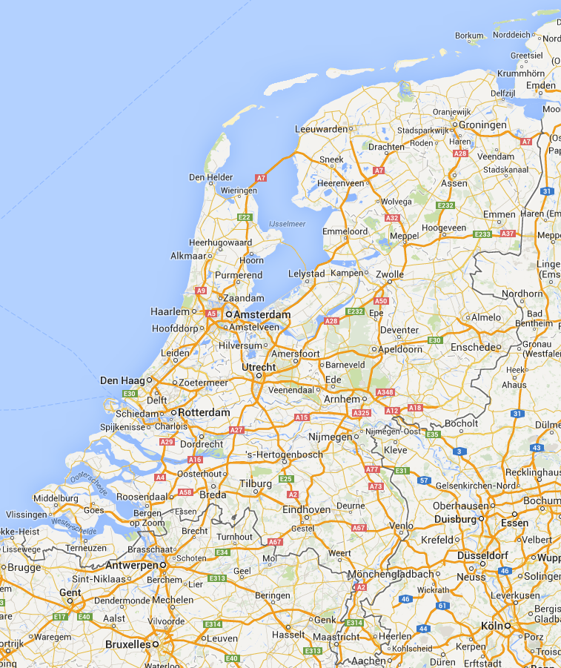






Slide 8
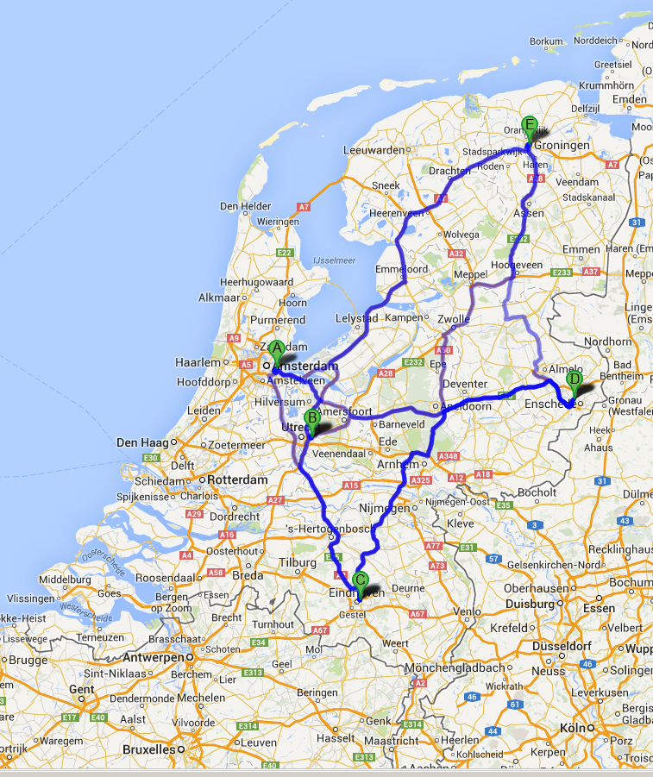

Slide 9




The core of the problem
Shortest tour: 638 km
50km
177km
187km
155km
123km
145km
90km
133km
251km
176km

Slide 10
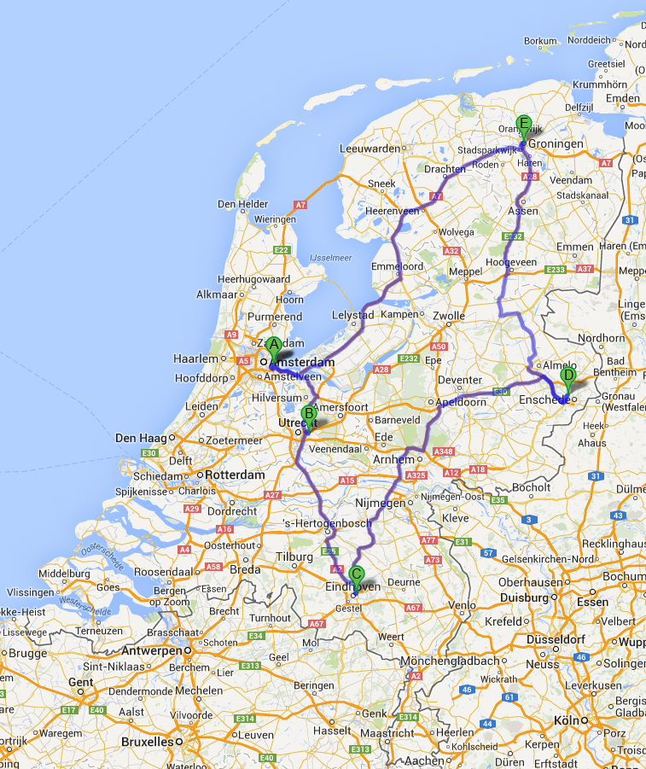

Slide 11
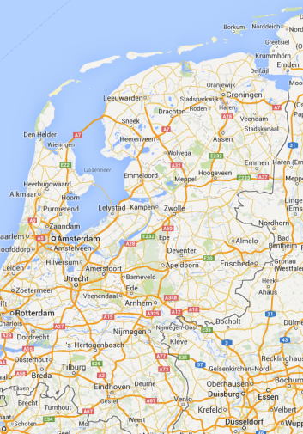

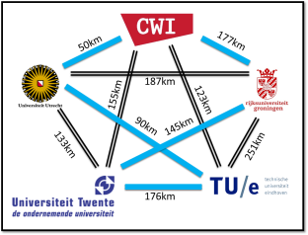


The basic model of kernelization
A kernelization is an algorithm that efficiently reduces a parameterized input to an equivalent input whose size is bounded in the parameter
5
5

Slide 12
Why investigate kernelization
Preprocessing allows solutions to be found quicker
  Can also be combined with approximation algorithms, heuristics, or branch & bound
The search for the best solution often has to be cut off due to time restrictions
  Preprocessing then allows better solutions to be found in the same time
Kernelization is a widely applicable, fundamental technique with a beautiful mathematical structure

Slide 13
My work on kernelization

Slide 14
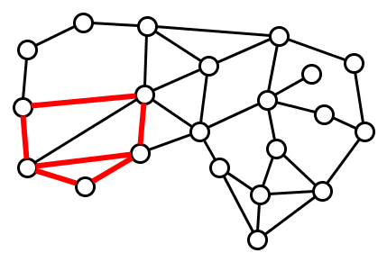
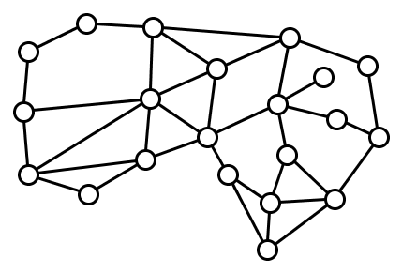
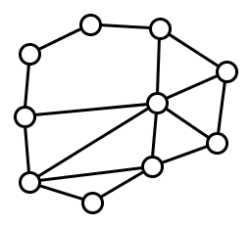
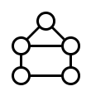
Finding patterns in networks
Does contain ?
  Bart M. P. Jansen and Dániel Marx
  Characterizing the easy-to-find subgraphs from the viewpoint of polynomial-time algorithms, kernels, and Turing kernels
  To appear in SODA 2015

Slide 15
Exploring the parameter landscape
Kernelization analyzes provable size reduction in terms of the chosen parameter
What parameter to choose?
  Number of visiting points in the tour
  Size of the pattern graph
Use the complexity of the network as the parameter!
  If the input has a large but simple network, can we reduce to a smaller network without changing the answer?
  Michael R. Fellows, Bart M. P. Jansen, and Frances Rosamond Towards fully multivariate algorithmics: Parameter ecology and the deconstruction of computational complexity
  Published in European Journal of Combinatorics (2013)

Slide 16
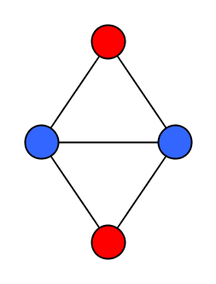
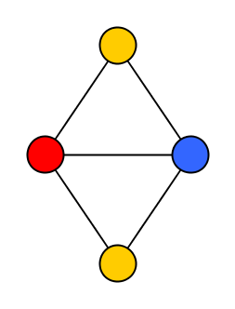
The graph coloring problem
Assign colors to nodes of a network such that adjacent nodes get different colors
  Use as few colors as possible
Models scheduling and frequency assignment problems

Slide 17
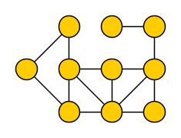
Some well-known parameters
Vertex Cover number
  Size of the smallest set intersecting each edge

Slide 18
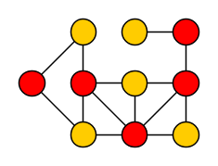
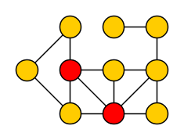
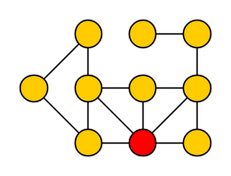
Some well-known parameters
Vertex Cover number
  Size of the smallest set intersecting each edge
≥
Feedback Vertex number
  Size of the smallest set intersecting each cycle
≥
Odd Cycle Transversal number
  Size of the smallest set intersecting all odd cycles

Slide 19
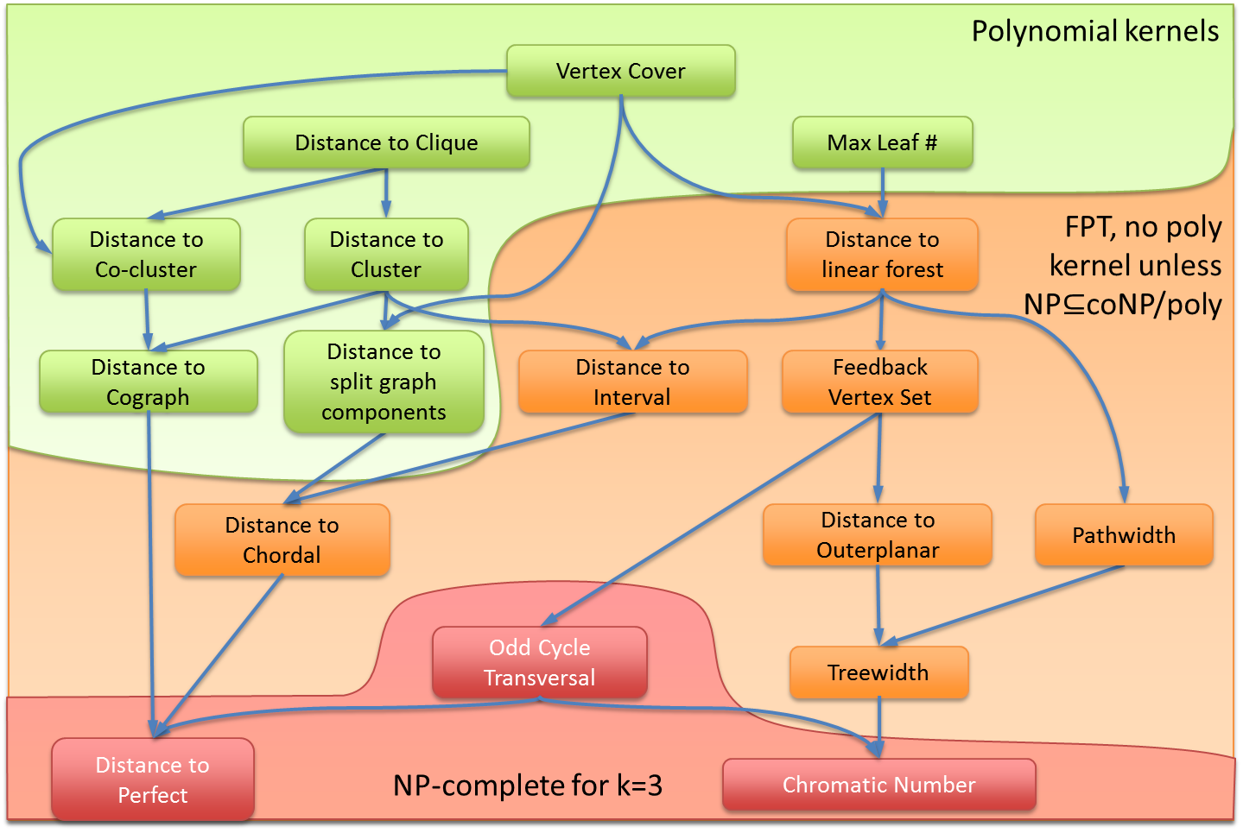

Preprocessing for Graph $q$-Coloring
  Bart M. P. Jansen and Stefan Kratsch
  Data reduction for graph coloring problems
  Published in Information and Computation (2013)

Slide 20
Other models of preprocessing
In some settings, we have to consider slightly different models of preprocessing to obtain positive answers
We illustrate the ideas by looking at long path problems
  Bart M. P. Jansen
  Turing Kernelization for Finding Long Paths and Cycles
  in Restricted Graph Classes
  Appeared in ESA 2014

Slide 21
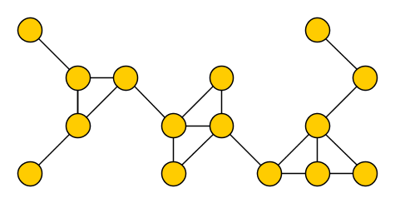
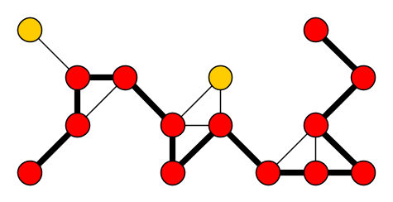

Finding long paths and cycles
$k$-Path ($k$-Cycle)
Input: An undirected graph $G$ and an integer $k$
Parameter: $k$
Question: Is there a simple path (cycle) of length at least $k$?
Such a path (cycle) is called a $k$-path ($k$-cycle)
Generalizes Hamiltonian Path (Cycle), so $NP$-complete
  Even on planar graphs of degree at most three
$k$-Path and $k$-Cycle are fixed-parameter tractable
  Solvable in $f\left(k\right)⋅n^{O(1)}$ time

Slide 22
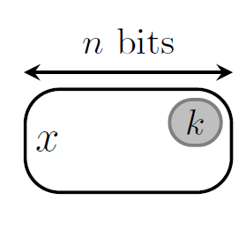

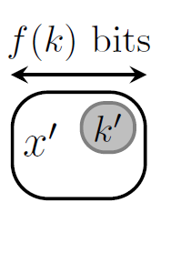

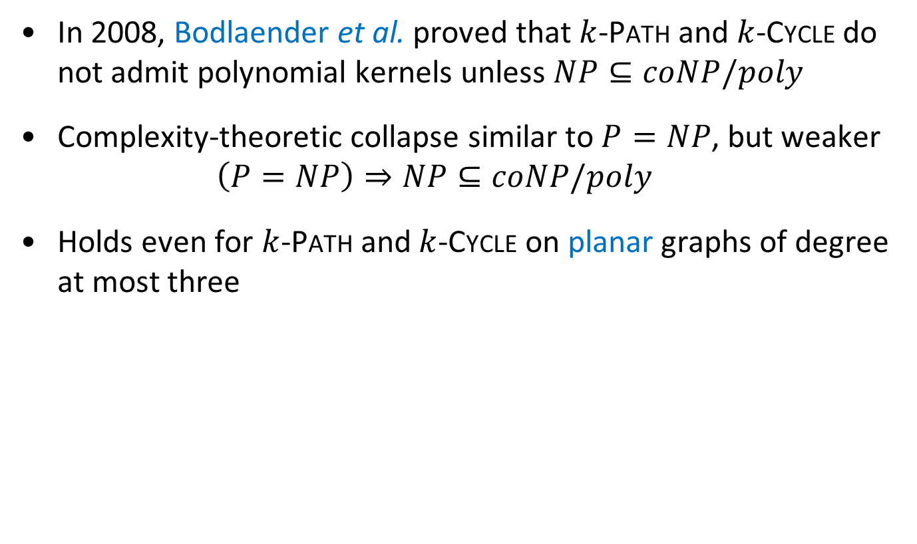
Preprocessing for path and cycle problems
In 2008, Bodlaender et al. proved that $k$-Path and $k$-Cycle do not admit polynomial kernels unless $NP⊆coNP/poly$
Complexity-theoretic collapse similar to $P=NP$, but weaker
  $$\left(P=NP\right)⇒NP⊆coNP/poly$$
Holds even for $k$-Path and $k$-Cycle on planar graphs of degree at most three

Slide 23
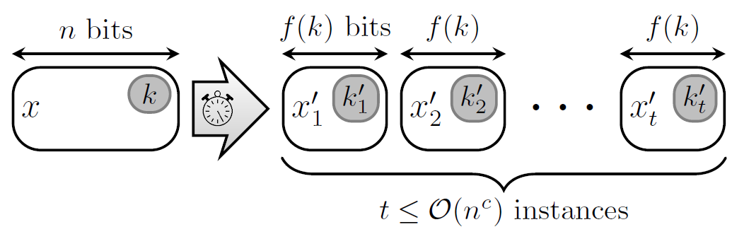

Relaxed notions of preprocessing
For other parameterized problems that do not admit polynomial kernels, researchers found provably effective preprocessing schemes in a slightly different model
  A reduction to a list of $poly(k)$-size instances
Are there provably effective preprocessing schemes for
$k$-Path and $k$-Cycle in such relaxed models?
?

Slide 24
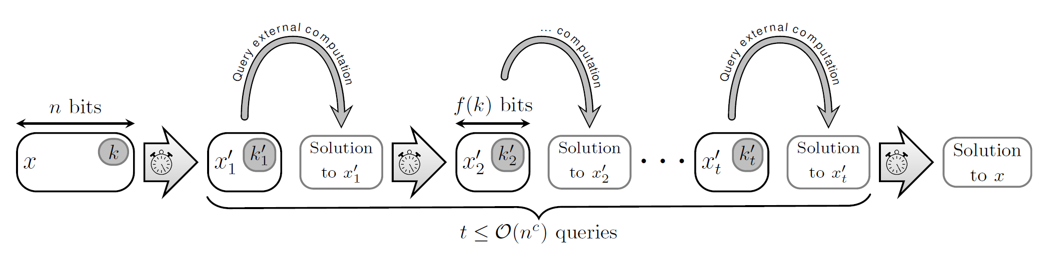

Turing kernelization
Let $Q⊆Σ^{∗}×ℕ$ be a parameterized problem and let $f:ℕ→ℕ$
A Turing kernelization for $Q$ of size $f$ is an algorithm that
  decides whether a given instance $\left(x,k\right)∈Σ^{∗}×ℕ$ is in $Q$
  in time polynomial in $\left|x\right|+k$
  when given access to an oracle that
    for any instance $\left(x^{′},k^{′}\right)$ with $\left|x^{′}\right|,k^{′}≤f\left(k\right)$,
    decides whether $\left(x^{′},k^{′}\right)∈Q$ in a single step

Slide 25
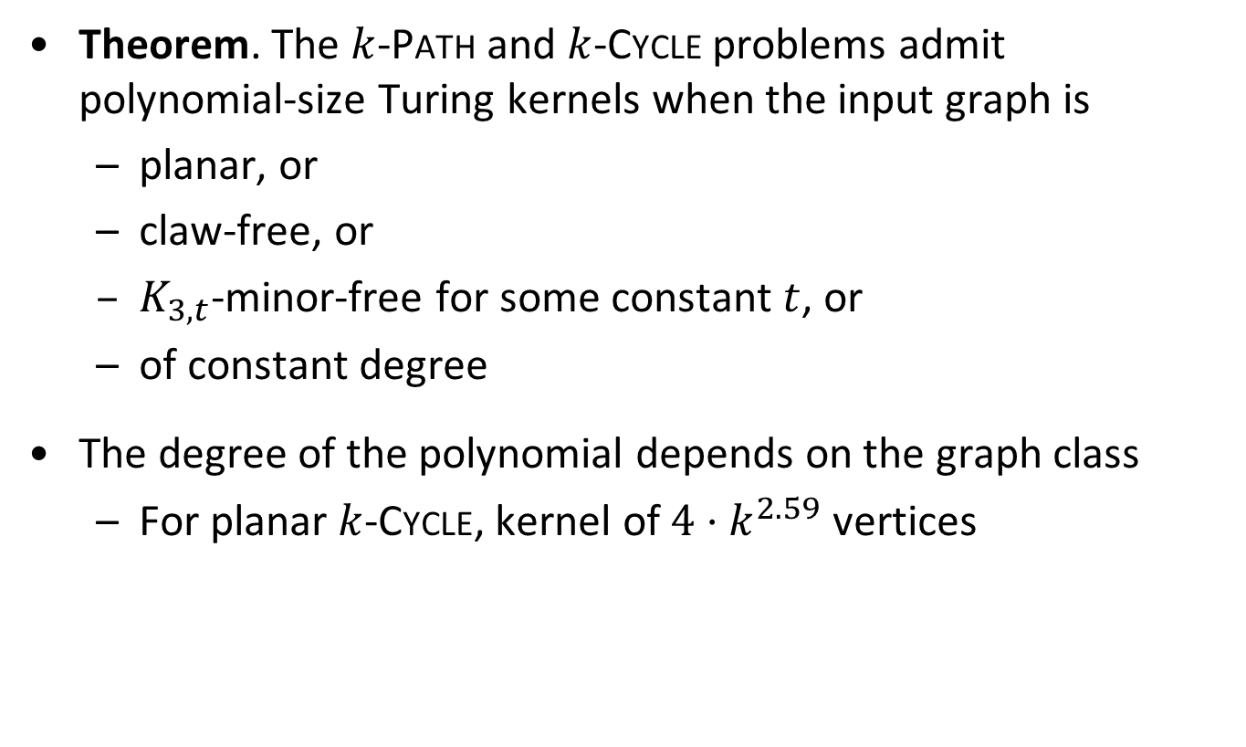
Our results
Theorem. The $k$-Path and $k$-Cycle problems admit polynomial-size Turing kernels when the input graph is
  planar, or
  claw-free, or
  $K_{3,t}$-minor-free for some constant $t$, or
  of constant degree
The degree of the polynomial depends on the graph class
  For planar $k$-Cycle, kernel of $4⋅k^{2.59}$ vertices
The difficult part of finding long paths and cycles in these graph classes can be confined to small subtasks

Slide 26
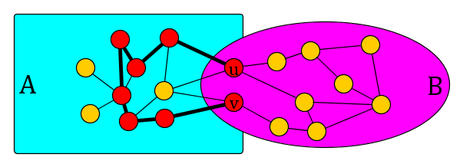
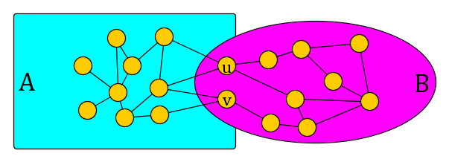


Long cycles through $2$-separators
Claim.
  Let $A,B⊆V(G)$ such that $A∪B=V(G)$, $A∩B=\{u,v\}$, and there are no edges between $A∖B$ and $B∖A$
  Let $S⊆V(G)$ be the vertices on a longest $uv$ path in $G[A]$
  If $G$ has a cycle of length $≥k$, then:
    The graph $G[A]$ has a cycle of length $≥k$, or
    The graph $G[S∪B]$ has a cycle of length $≥k$

Slide 27
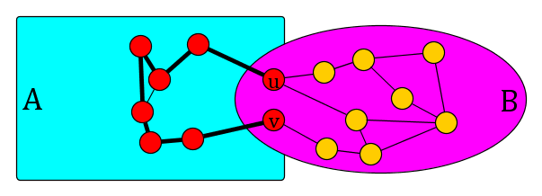
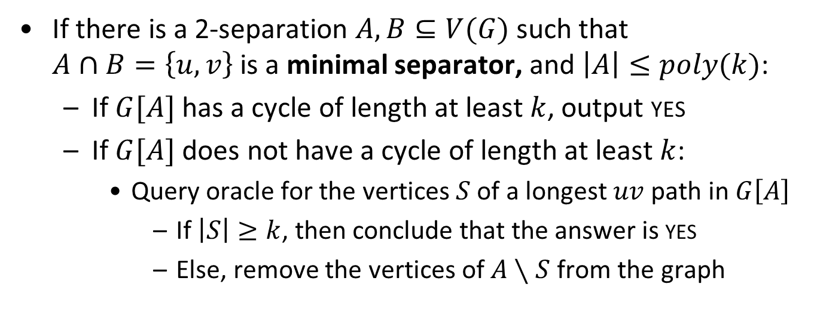


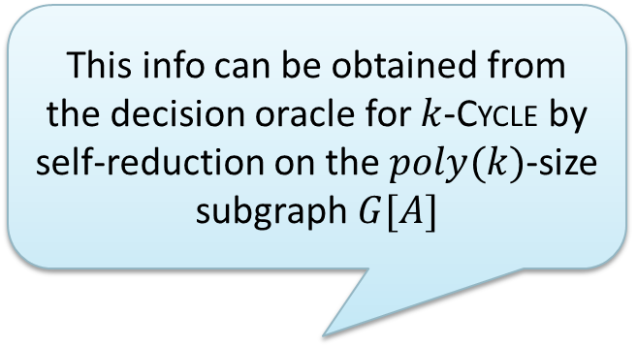
Turing reduction rule for $k$-Longest Cycle
This info can be obtained from the decision oracle for $k$-Cycle by self-reduction on the $poly(k)$-size subgraph $G[A]$
If there is a 2-separation $A,B⊆V(G)$ such that
$A∩B=\left\{u,v\right\}$ is a minimal separator, and $\left|A\right|≤poly(k)$:
  If $G[A]$ has a cycle of length at least $k$, output yes
  If $G[A]$ does not have a cycle of length at least $k$:
    Query oracle for the vertices $S$ of a longest $uv$ path in $G\left[A\right]$
      If $\left|S\right|≥k$, then conclude that the answer is yes
      Else, remove the vertices of $A∖S$ from the graph
Query the oracle for the instance $(G\left[A\right],k)$ with $poly\left(k\right)$ vertices

Slide 28
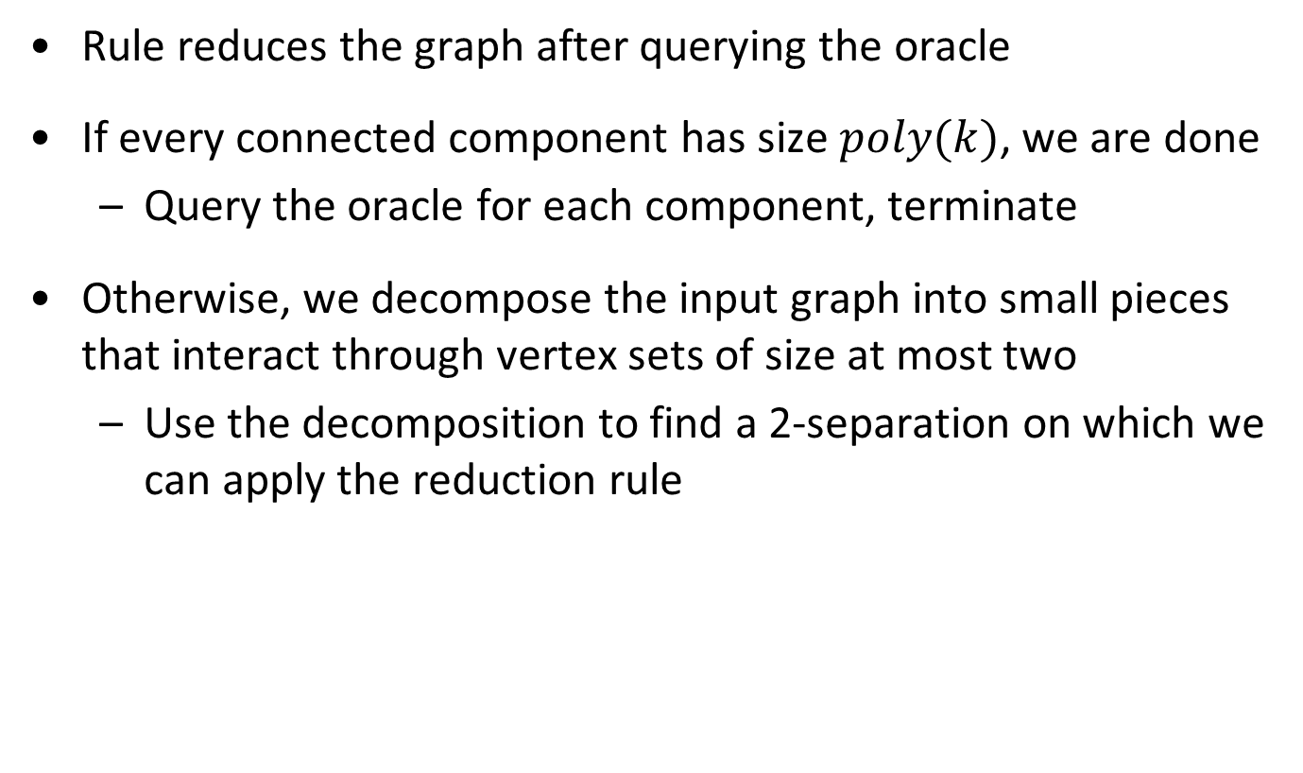
Decompose-Query-Reduce
Rule reduces the graph after querying the oracle
If every connected component has size $poly(k)$, we are done
  Query the oracle for each component, terminate
Otherwise, we decompose the input graph into small pieces that interact through vertex sets of size at most two
  Use the decomposition to find a 2-separation on which we can apply the reduction rule

Slide 29
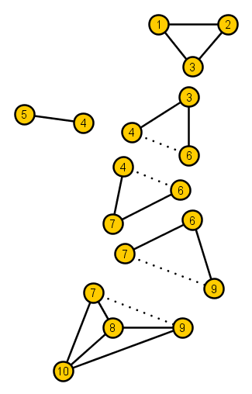
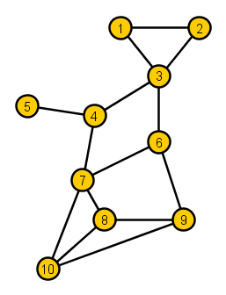
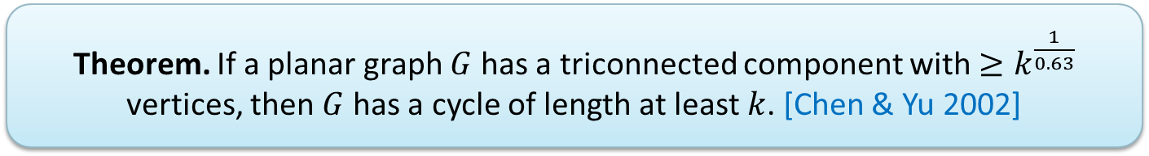
Decomposition into triconnected components
Every graph can be decomposed into triconnected components [Tutte 1966]
  Theorem. If a planar graph $G$ has a triconnected component with $≥k^{\frac{1}{0.63}}$ vertices, then $G$ has a cycle of length at least $k$. [Chen & Yu 2002]

Slide 30
Conclusion
My research deals with various models of provably effective and efficient preprocessing
  Phrased in the language of parameterized complexity
Most of my work concerns graph problems
  Recent submission: preprocessing Integer Linear Programs
Questions I hope to answer in the future:
Is there a polynomial Turing kernel for $k$-Path in general graphs?
Is there a polynomial Turing kernel for 𝑘-Path in general graphs?
Can we relate the non-existence of Turing kernels for specific problems to a complexity-theoretic collapse like $NP⊆coNP/poly$?
Can we relate the non-existence of Turing kernels for specific problems to a complexity-theoretic collapse like 𝑁𝑃⊆𝑐𝑜𝑁𝑃/𝑝𝑜𝑙𝑦?
Can adaptive Turing kernels be transformed into non-adaptive ones?
THANK YOU!

Slide 31
History of parameterized complexity
PCP Theorem
Downey & Fellows book
NP-completeness
Kernelization lower bounds
1940 1950 1960 1970 1980 1990 2000 2010 …
Noon seminar
Matching algorithm
Parameterized(in)tractability
Graph Minors Theorem
Simplex algorithm
Planar Dominating Set kernel

