Slide 1
Heuristics for Road Network Augmentation
Bart Jansen, University of Utrecht

Slide 2
Outline
Problem background
Geometrical problem statement
Research
Experimental evaluation of heuristics
Heuristics
Results
Conclusion

Slide 3
Problem background
Several types of analysis require accessibility information
Study the relationship between deaths by heart attacks in an area, and the distance to the nearest hospital
Accessibility information also required for various optimization problems
Facility location problem
What to do if the road network is not fully known?

Slide 4
Incomplete road networks
Map data from developing countries
Known information:
Locations of settlements
Major roads
Some settlements are not connected to the road network
Google Maps view of area around Lusaka, Zambia

Slide 5
Road network augmentation
People “get around”, so some roads must exist
Try to compute roads that seem reasonable, and add them to the network
Added roads are “feed links”
Metric to compute the quality of feed links
Added one feed-link

Slide 6
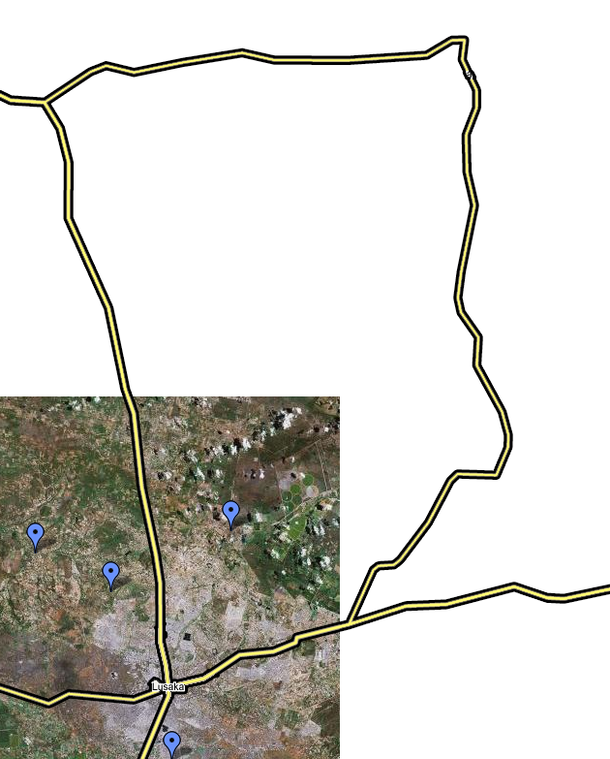
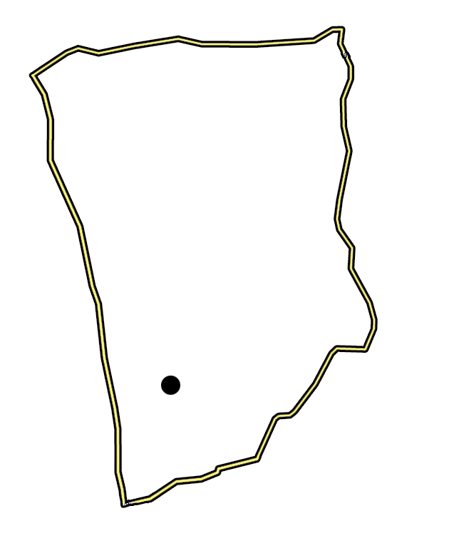
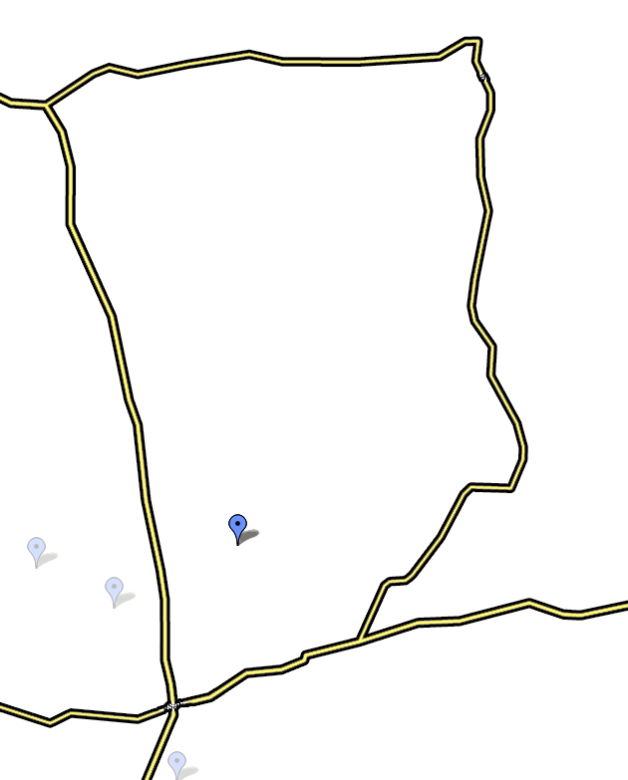
Geometric problem
Add feed links to connect a village to the road network
Connect point inside polygon to boundary, avoiding obstacles
Find best feed link(s), based on a quality metric

Slide 7
Metric for network induced detour
Based on the detour you take when traveling over the road network
Network distance between A and B:
Length of shortest path over the road network
Crow-flight distance between A and B:
Length of shortest path cross-country that avoids obstacles
Crow-flight conversion factor (CFCF) for A⬄B

Slide 8
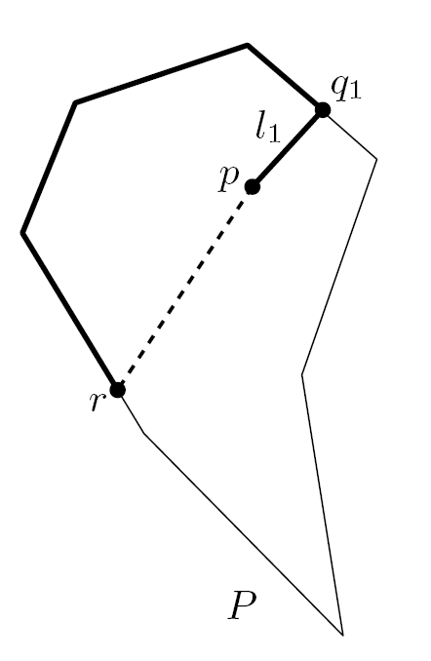
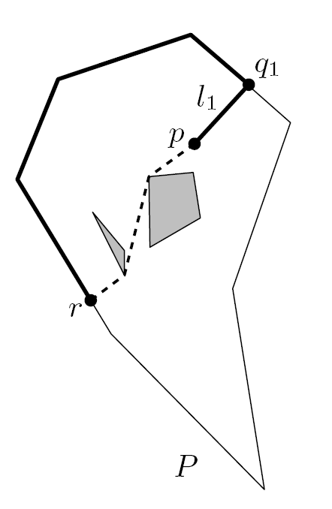
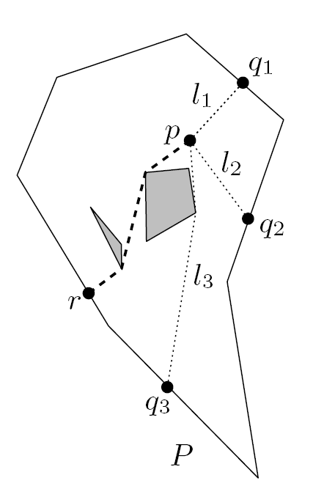
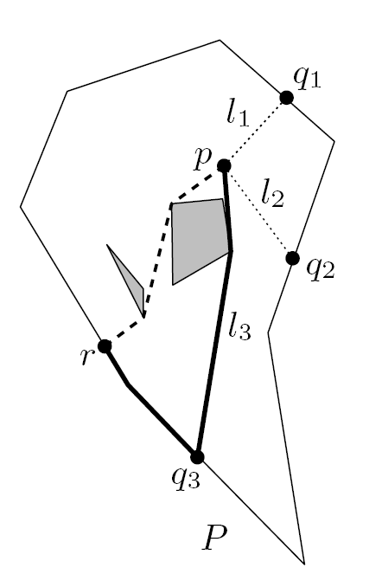
Examples of CFCF
Crow flight conversion factor between p and r
With obstacles
Feed links avoid obstacles
Multiple feed links
Use link that yields shortest path
Polygon with feed links

Slide 9
Metric for network quality
Dilation induced by a set of feed links:
Maximum CFCF between source point and a point on the boundary
Intuitively:
Maximum “detour” forced by the road network
Leads to various geometric problems
Minimize the dilation using exactly k feed links
Minimize the number of feed links to achieve an dilation of at most d

Slide 10
Research on feed links
Various theoretical and experimental results
My contribution: experimental evaluation of heuristics

Slide 11
Experimental analysis
Goal: minimize the dilation using a fixed number of feed links
Hard to solve exactly, for arbitrary numbers of feed links
Three heuristics were experimentally evaluated
Experimentation project for Game and Media Technology
Applied heuristics to 100 randomly generated problem instances, using Java

Slide 12
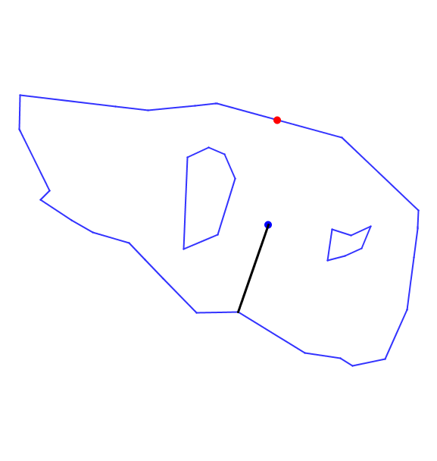
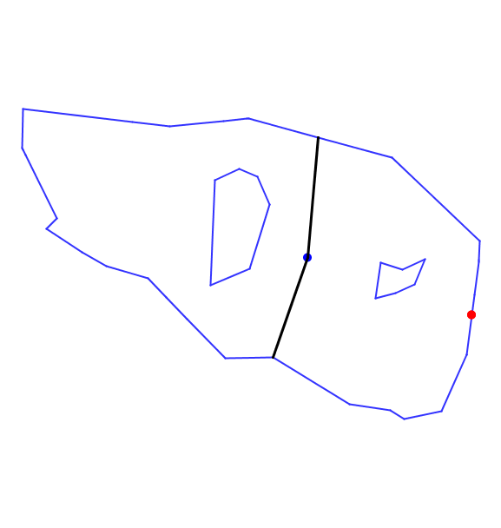
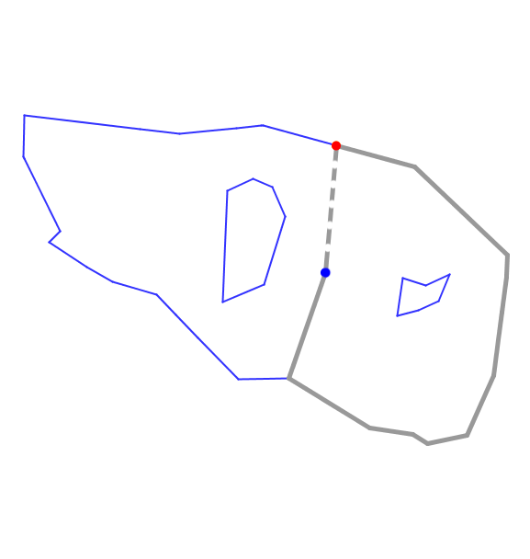
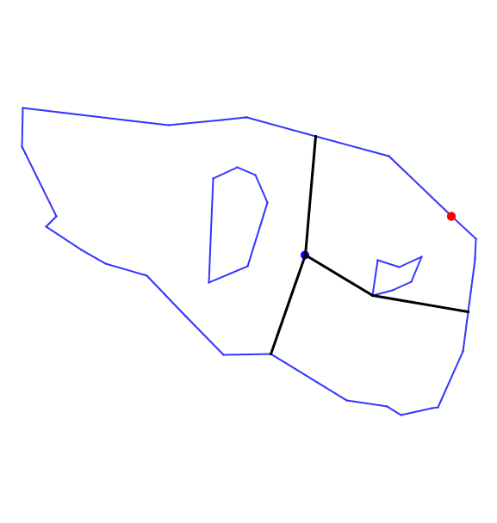
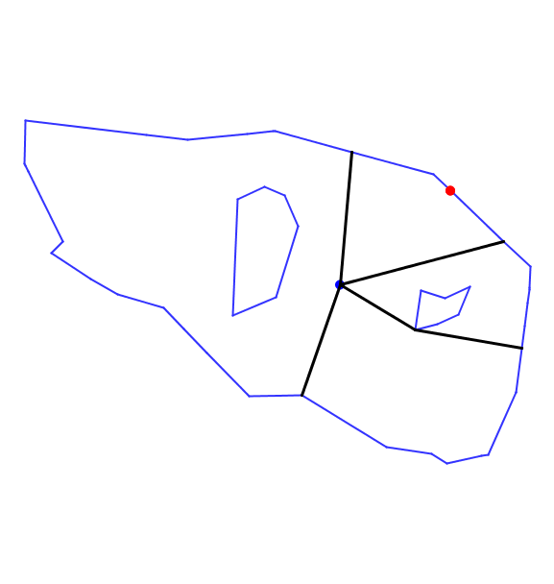
Maximum Dilation Heuristic
To place first feed link
Connect p to closest point on boundary
To place i+1’th feed link
Connect p to point that has largest CFCF using feed links 1, 2, .. , i

Slide 13
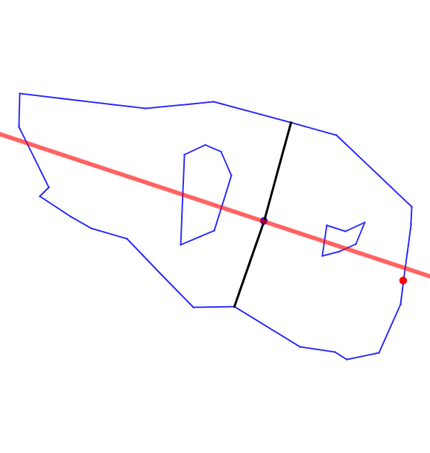
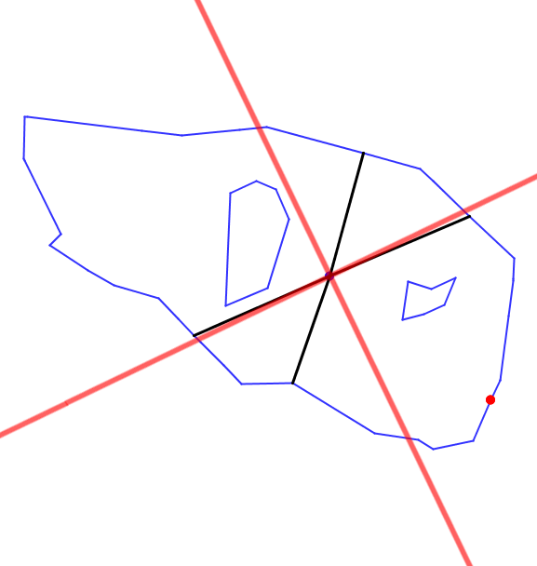
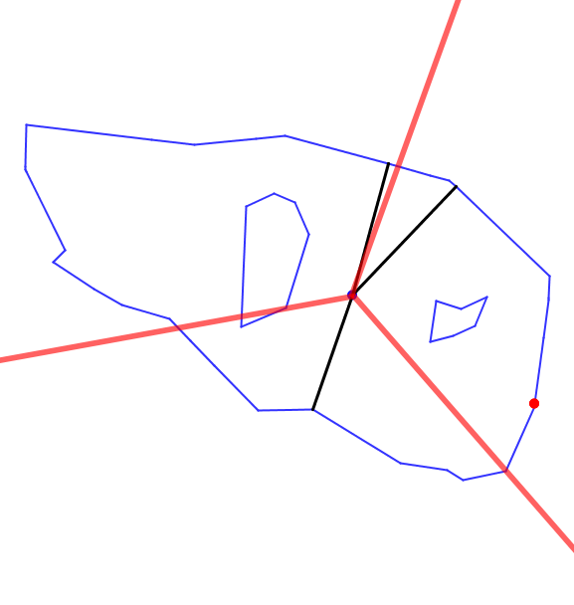
Sector Heuristic
To place k feed links
Divide the polygon into k sectors around p
In each sector, connect a feed link to the closest boundary point
Two strategies for sector orientation
Greedy
Random

Slide 14
Experimental results
Maximum Dilation Heuristic performs best in general
Average dilation of 4.2 for 1 feed link
Observed average approximation ratio of best heuristic close to 1.1
Relative performance of sector heuristics depends on number of feed links
For 2 feed links, greedy is better
For 3 feed links, random is better

Slide 15
Results: average dilation

Slide 16
Sector heuristic for 2 feed links
Greedy orientation
Dilation value 2.1
Random orientation
Dilation value 2.6

Slide 17
Sector heuristic for 2 feed links
Greedy orientation
Dilation value 2.1
Random orientation
Dilation value 2.6

Slide 18
Conclusion
Road network augmentation has practical use for accessibility analysis using incomplete data
The problem offers interesting scientific challenges
Simple heuristics often perform well

Slide 19
Sector heuristic for 3 feed links
Greedy orientation
Dilation value 2.4
Random orientation
Dilation value 1.9

Slide 20
Sector heuristic for 3 feed links
Greedy orientation
Dilation value 2.4
Random orientation
Dilation value 1.9

