Slide 1

Exact algorithms
for NP-hard problems
Search-space reduction for Odd Cycle Transversal
Bart M. P. Jansen
Joint work with Jari de Kroon and Benjamin Bumpus @ ESA 2022
Department Dialogue
October 13th 2022, Eindhoven
Notes:
Painting credit due to Midjourney AI. The talk will be about odd flowers and we are ‘in’ the city of light (bulbs). Warning: I attempt to give you an insight into one of the things I recently worked on, which includes a proof.

Slide 2
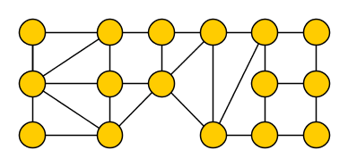
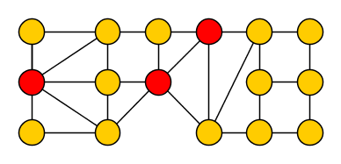
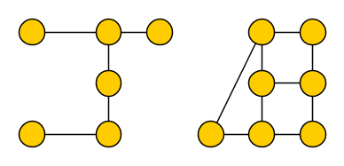
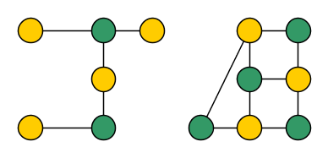

NP-hard problems on graphs
I investigate simple to state NP-hard combinatorial problems, such as:
Odd Cycle Transversal (oct)
Input: An undirected graph $G$
Output: A minimum-size vertex set $X⊆V(G)$ intersecting all odd cycles
Removal of $X$ results in a bipartite graph
Notes:
Karp in ’72. OCT is an example of combinatorial optimization:
Easy to solve: try all options
Difficult to solve efficiently: exponential number of options

Slide 3
When can we guarantee to find an optimal OCT quickly?
1970’s [Era of NP-completeness]
2000’s [Era of Fixed-Parameter Tractability]
2020’s [Era of Search Space Reduction]
Problem can be solved by brute force in time $2^{n}⋅O(n+m)$
Problem can be solved by brute force in time 2^𝑛⋅𝑂(𝑛+𝑚)
Fast when the graph is small, say $n≤20$ vertices
Fast when the graph is small, say 𝑛≤20 vertices
If an optimal transversal has size at most $k$, one can be found in time $3^{k}⋅k⋅O(n+m)$
If an optimal transversal has size at most 𝑘, one can be found in time 3^𝑘⋅𝑘⋅𝑂(𝑛+𝑚)
If an optimal transversal has size $k$, of which all but $ℓ≪k$ vertices are essential for making
2-approximate solutions, then an optimal solution can be found in time $3^{ℓ}⋅n^{O\left(1\right)}$
If an optimal transversal has size 𝑘, of which all but ℓ≪𝑘 vertices are essential for making
2-approximate solutions, then an optimal solution can be found in time 3^ℓ⋅𝑛^𝑂(1)
Fast for large graphs when the solution is small, say $k≤15$
Fast for large graphs when the solution is small, say 𝑘≤15
Fast for graphs with large solutions when OPT contains few non-essential vertices, say $ℓ≤15$
Fast for graphs with large solutions when OPT contains few non-essential vertices, say ℓ≤15
Notes:
The second one is what students learn in 2IMA25. This is the most important slide of the talk. Captures the idea that when the solution is large, but a large part of it ‘stands out’ in a certain formal sense, it can still be found efficiently.

Slide 4


Essential vertices for Odd Cycle Transversal
Say a vertex $v∈V(G)$ is $2$-essential for Odd Cycle Transversal on $G$ if:
Yes we can!
Provides guarantees on when the combinatorial explosion can be avoided
each transversal of size at most $2⋅opt(G)$ contains $v$
Can we detect the 2-essential vertices in a solution in polynomial time?

Slide 5
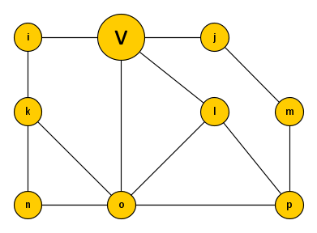
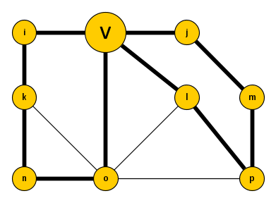
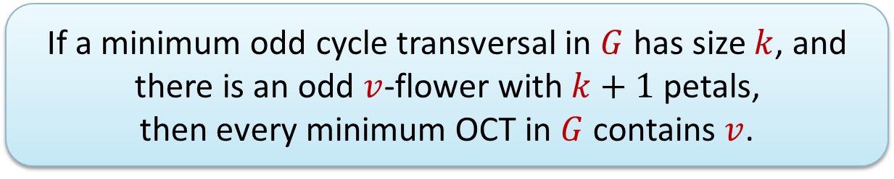

Odd flowers for detecting 2-essential vertices for OCT
For an undirected graph $G$ and vertex $v$, an odd $v$-flower is a set of odd cycles $C_{1},…, C_{p}$ containing $v$ such that $V\left(C_{i}\right)∩V\left(C_{j}\right)=\{v\}$ for $1≤i<j≤p$
The odd cycles $C_{1},…, C_{p}$ are the petals of the odd $v$-flower
A maximum odd $v$-flower can be computed in polynomial time,
by reduction to matching [Geelen, Gerards, Reed, Seymour & Vetta @ JCTB ’02]
If a minimum odd cycle transversal in $G$ has size $k$, and
there is an odd $v$-flower with $k+1$ petals,
then every minimum OCT in $G$ contains $v$.

Slide 6
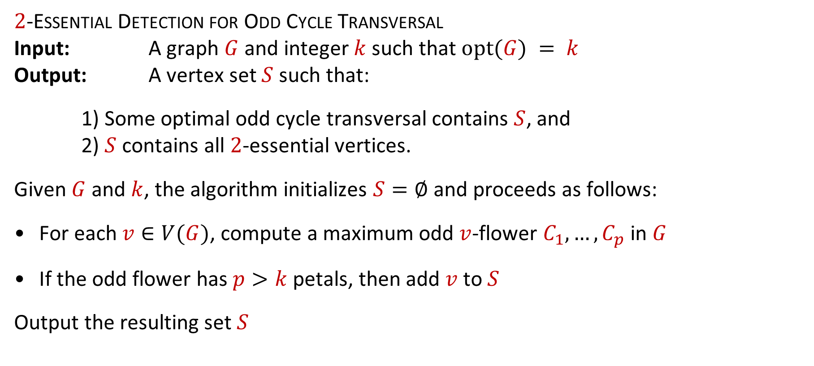

Search space reduction for Odd Cycle Transversal
$2$-Essential Detection for Odd Cycle Transversal
Input: A graph $G$ and integer $k$ such that $opt(G) = k$
Output: A vertex set $S$ such that:
1) Some optimal odd cycle transversal contains $S$, and
2) $S$ contains all $2$-essential vertices.
Given $G$ and $k$, the algorithm initializes $S=∅$ and proceeds as follows:
For each $v∈V(G)$, compute a maximum odd $v$-flower $C_{1},…, C_{p}$ in $G$
If the odd flower has $p>k$ petals, then add $v$ to $S$
Output the resulting set $S$
Notes:
Recall that 2-essential = contained in all 2-approximations. Easy to see that (1) holds. Why does (2) hold?

Slide 7
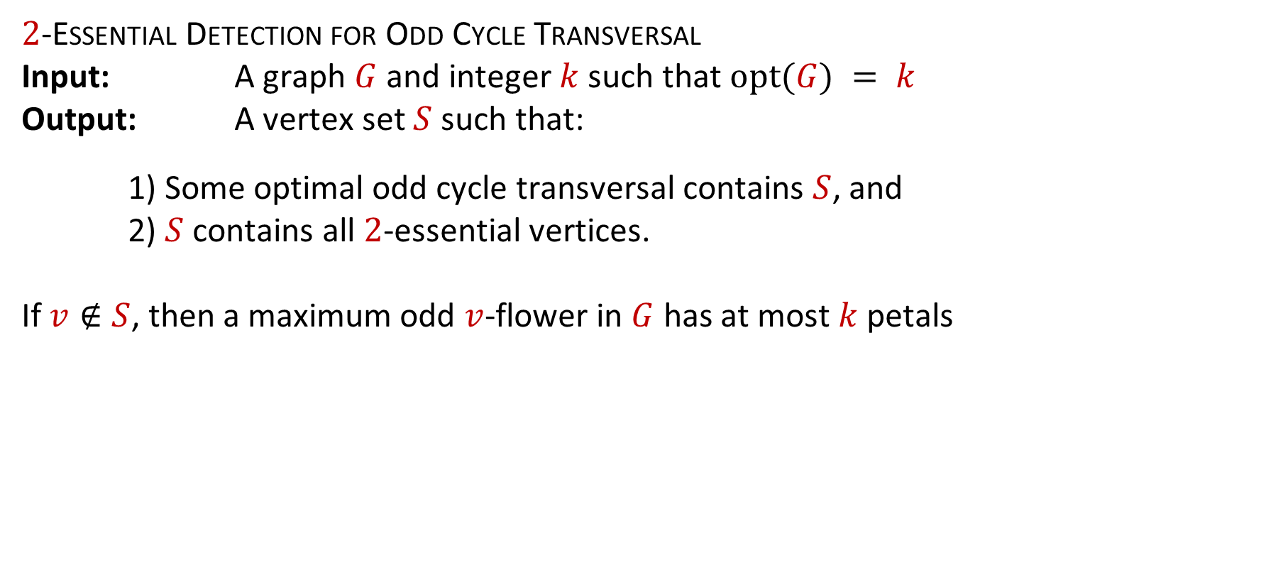
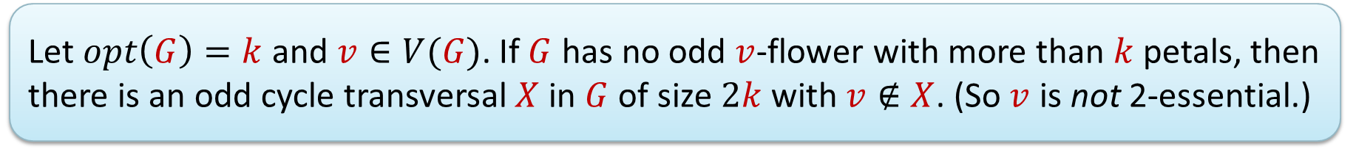
Search space reduction for Odd Cycle Transversal
$2$-Essential Detection for Odd Cycle Transversal
Input: A graph $G$ and integer $k$ such that $opt(G) = k$
Output: A vertex set $S$ such that:
1) Some optimal odd cycle transversal contains $S$, and
2) $S$ contains all $2$-essential vertices.
If $v∉S$, then a maximum odd $v$-flower in $G$ has at most $k$ petals
Let $opt\left(G\right)=k$ and $v∈V(G)$. If $G$ has no odd $v$-flower with more than $k$ petals, then there is an odd cycle transversal $X$ in $G$ of size $2k$ with $v∉X$. (So $v$ is not 2-essential.)
Notes:
This concludes the discussion of essential vertices for search space reduction.

Slide 8
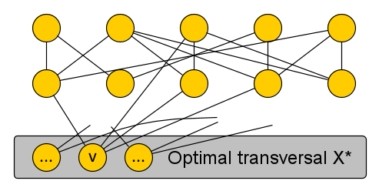
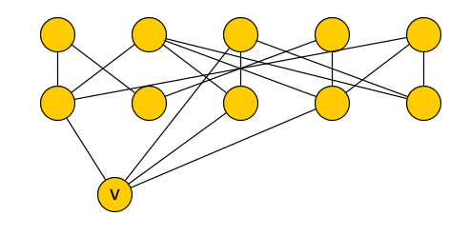
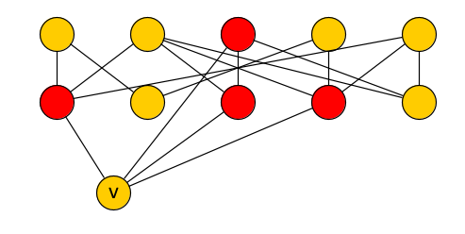
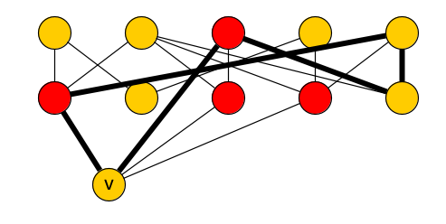
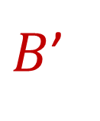
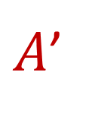



Constructing a $2$-approximation avoiding $v$
Let $H≔G−(X^{∗}∖\{v\})$, so $H−v$ is bipartite with bipartition $\left(A,B\right)$
Let $A^{′}, B′$ be the neighbors of $v$ in the respective sides
Each odd cycle in $H$ consists of $v$ together with a path connecting $A′$ to $B′$
$A$’
$$A$$
$B$’
$$B$$
Let $opt\left(G\right)=k$ and $v∈V(G)$. If $G$ has no odd $v$-flower with more than $k$ petals, then there is an odd cycle transversal $X$ in $G$ of size $2k$ with $v∉X$. (So $v$ is not 2-essential.)
Notes:
Any path starting and ending in the same side of the bipartition of $H−v$ is even! Any path ending in different sides is odd!

Slide 9


Constructing a $2$-approximation avoiding $v$
Since $G$ has no odd $v$-flower with $k$ petals, $H−v$ has no $k$ vertex-disjoint $A^{′}$-$B′$ paths
By Menger’s theorem, there is a vertex set $Y$ of size $≤k$ intersecting all $A′$-$B′$ paths
Each odd cycle in $H$ consists of $v$ together with a path connecting $A′$ to $B′$
$A$’
$B$’
Let $opt\left(G\right)=k$ and $v∈V(G)$. If $G$ has no odd $v$-flower with more than $k$ petals, then there is an odd cycle transversal $X$ in $G$ of size $2k$ with $v∉X$. (So $v$ is not 2-essential.)
Notes:
This concludes the discussion of essential vertices for search space reduction.

Slide 10


Constructing a $2$-approximation avoiding $v$
A minimum Odd Cycle Transversal can be computed in time $3^{ℓ}⋅n^{O\left(1\right)}$,
where $ℓ$ is the number of vertices in an optimal solution which are not 2-essential.
Since $G$ has no odd $v$-flower with $k$ petals, $H−v$ has no $k$ vertex-disjoint $A^{′}$-$B′$ paths
By Menger’s theorem, there is a vertex set $Y$ of size $≤k$ intersecting all $A′$-$B′$ paths
The set $\left(X^{∗}∖\{v\}\right)∪Y$ has size $≤2k$ and hits all odd cycles without using $v$
$A$’
$B$’
Let $opt\left(G\right)=k$ and $v∈V(G)$. If $G$ has no odd $v$-flower with more than $k$ petals, then there is an odd cycle transversal $X$ in $G$ of size $2k$ with $v∉X$. (So $v$ is not 2-essential.)
Notes:
This concludes the discussion of essential vertices for search space reduction.

Slide 11

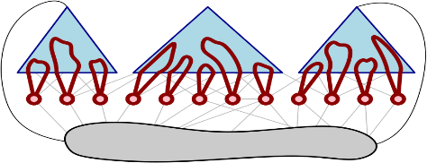









Conclusion
I investigate:
how efficient preprocessing,
can reduce the search space
of algorithms solving NP-hard problems on graphs
Recent work on rigorous search-space reduction:
Which theoretical questions should we ask to find practical preprocessing algorithms?
kernelization
$n$ bits
$f(k)$ bits
$$x$$
$$x′$$
$$k$$
essential vertices
simple certificates
Notes:
Can we extend the scope of these first two case studies? Apply the notion of essential elements beyond vertex-subset minimization problems? Apply ideas on finding parts of solutions for which there are simple certificates, beyond FVS? Experiment with these ideas in practice! Other ways to formulate rigorous search-space reduction, based on the stability of optimal solutions?

