Slide 1
A faster parameterized algorithm to find $k$-secluded trees
Huib Donkers Bart M. P. Jansen Jari J. H. de Kroon
Networks Training Week October 24th 2023, Asperen, The Netherlands
Notes:
Motivation: nice combinatorial problem, easy to state, non-trivial solution that does not require any heavy machinery to understand.
Goals of the talk:
Expose you to some interesting graph-theoretic concepts
Expose you to the design of fixed-parameter tractable algorithms
Expose you to multivariate complexity analysis of algorithms

Slide 2
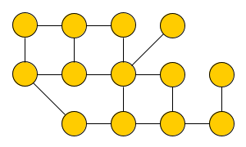
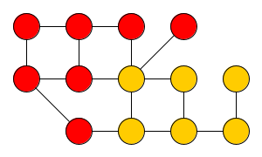
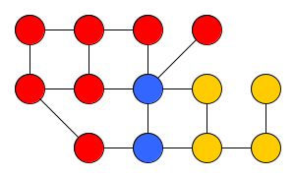
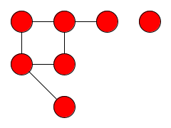
Secluded vertex sets
An undirected graph $G$ consists of a set of vertices $V(G)$ and edges $E\left(G\right)$
The open neighborhood $N_{G}\left(S\right)$of a vertex set $S⊆V(G)$ contains:
those vertices outside $S$ which have an edge to a vertex inside $S$
$G[S]$ denotes the subgraph of $G$ induced by the vertices in $S$ and edges between them
Definition. A vertex set $S$ is $k$-secluded in a graph $G$ if $\left|N_{G}\left(S\right)\right|≤k$
Notes:
For an NP-hardness proof, we can mimic the reduction from independent set: reduce from 3CNF-SAT. Each clause becomes a 3-clique. Add an edge between conflicting literals. Add a universal vertex of large weight (or a path of $n+2$ degree-2 vertices) to simulate the root.

Slide 3
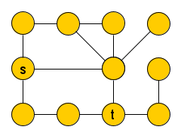
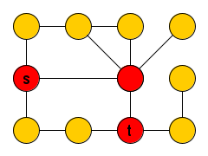
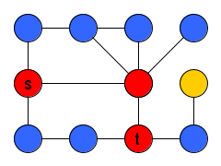
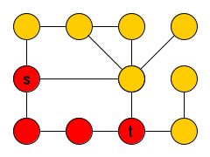
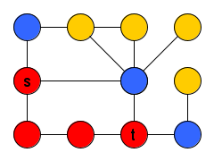
Secluded optimization problems
Recent work deals with finding secluded solutions to classic graph problems Motivated by tasks in network analysis
Find a $k$-secluded path from $s$ to $t$
Find a $k$-secluded $(s,t)$-separator
Find a $k$-secluded clique
Find a $k$-secluded induced subgraph with a prescribed property
Secluded variant is often NP-complete, even when the standard variant is not
Parameterized complexity investigates how the parameter $k$ affects the complexity
Solvable in time $2^{O\left(k\right)}⋅n$- solvable in time $n^{O\left(k\right)}$ - NP-complete for constant $k$
A parameterized problem is fixed-parameter tractable if there is an algorithm solving inputs of size $n$ with parameter $k$ in time $f\left(k\right)⋅n^{c}$ for some function $f$ and constant $c$
Notes:
‘For each fixed value of $k$ the problem is tractable because there is an $n^{O\left(1\right)}$ algorithm.’ Add: often easy to find an algorithm with running time $n^{O\left(k\right)}$? For $k$-secluded path problem: this remains hard for constant $k$ (since a 0-secluded solution exists iff there is a Hamiltonian path). For $k$-secluded $(s,t)$-separator: we are guessing the neighborhood of the separator; then all the vertices adjacent to the neighborhood can go into the separator; then we test whether or not that choice is really a separator.

Slide 4
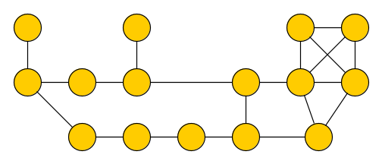
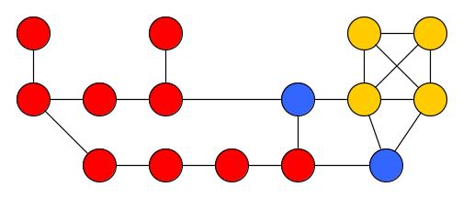
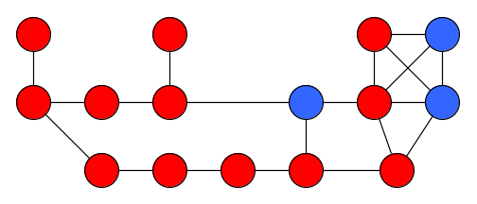
Finding $k$-secluded trees
Interesting special case of finding a secluded subgraph of a specific form (still NP-complete)
$k$-Secluded Tree Input: Undirected graph $G$ and integer $k$ Output: A maximum-size $k$-secluded vertex set $S$ for which $G[S]$ is a tree
This problem can be solved in time $2^{2^{O\left(k\right)}}⋅n^{O\left(1\right)}$ using heavy machinery [Golovach, Heggernes, Lima, Montealegre@JCSS’20]
We obtained a much faster algorithm using elementary means:
To facilitate recursion, we study a more general problem
$$k=2$$
$$k=3$$
$k$-Secluded Tree can be solved in time $2^{O\left(k\log{k}\right)}⋅n^{4}$
[Donkers, J, de Kroon@JCSS’23]

Slide 5
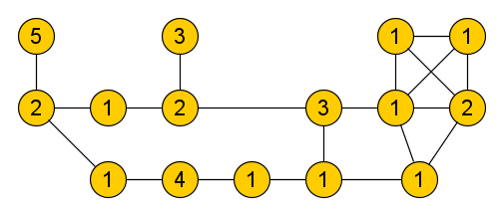
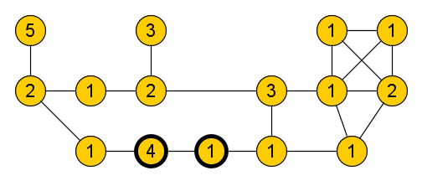
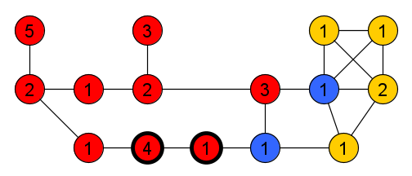
A weighted generalization of finding secluded trees
$k$-Secluded Supertree Input: Undirected graph $G$ and integer $k$,
weight function $w:V\left(G\right)→ℕ_{+}$,
and a non-empty vertex set $T⊆V\left(G\right)$ such that $G[T]$ is connected
Output: A maximum-weight $k$-secluded set $T^{′}⊇T$ for which $G[T^{′}]$ is a tree ... or the conclusion that such a set does not exist
Can be used to solve $k$-Secluded Tree by trying every singleton set $T=\{v_{i}\}$

Slide 6
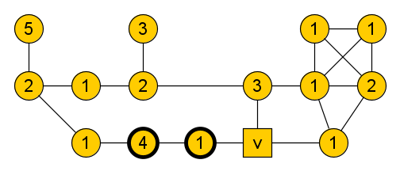
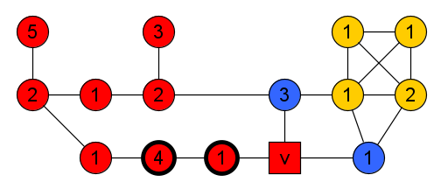
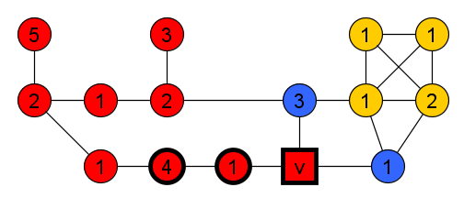
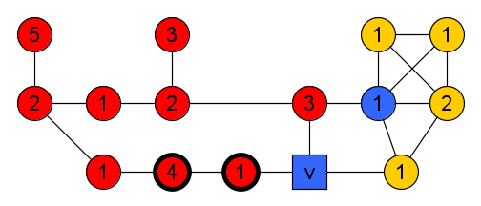
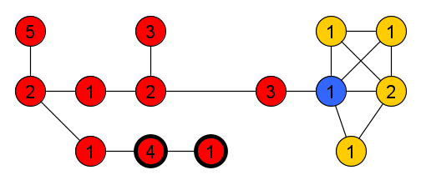
A recursive approach to finding $k$-secluded supertrees
Consider a graph $G$, with weight function $w$, integer $k$, and vertex set $T⊆V(G)$ Let $v∈N_{G}(T)$ be an arbitrary vertex in the open neighborhood of $T$
Suppose $T^{′}⊇T$ is a maximum-weight $k$-secluded supertree of $T$ in graph $G$
If $v∈T′$, then $T′$ is a maximum-weight $k$-secluded supertree of $T∪\{v\}$ in graph $G$
If $v∉T′$, then $T′$ is a maximum-weight $(k−1)$-secluded supertree of $T$ in $G−v$
Solving the problem on $G$ can be reduced to solving two subproblems: 1) same graph but $v$ is forced in the solution; 2) graph $G−v$ with threshold $k−1$
Notes:
Since $v$ is in the open neighborhood of $v$: if $v$ does not belong to $T′$, then it belongs to $N_{G}(T′)$.

Slide 7
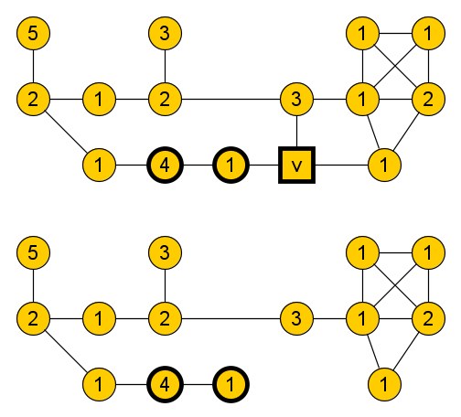
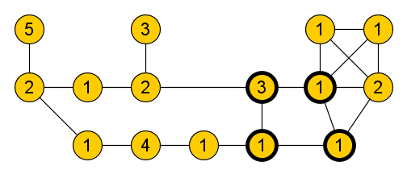
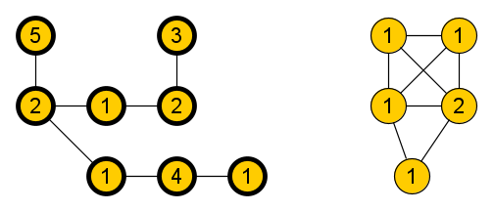
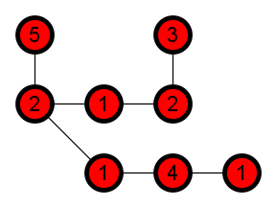
Algorithm for $k$-Secluded Supertree, version 1
If $k<0$ or $G[T]$ contains a cycle: output “No solution exists”
If $N_{G}\left(T\right)=∅$: output $T$ as the unique optimal solution
Otherwise, choose an arbitrary neighbor $v∈N_{G}(T)$ of the vertices in $T$
Recurse to find a maximum-weight $k$-secluded supertree of $T∪\{v\}$ in $G$
Recurse to find a maximum-weight $(k−1)$-secluded supertree of $T$ in $G−v$
Output the best solution found by these recursive calls
$$k=2$$
$$k=2$$
No solution exists
$$k=1$$
Notes:
Algorithm is correct since the search is exhaustive: a solution contains $v$ or not

Slide 8
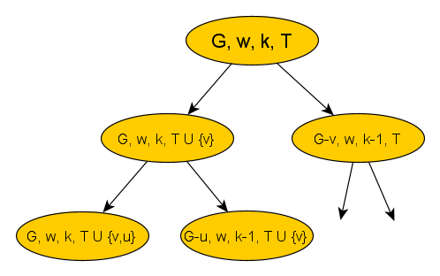
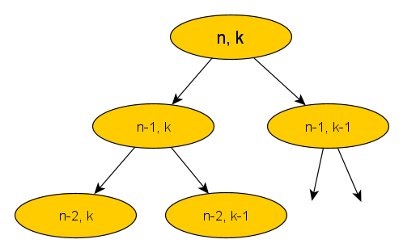
Analysis of version 1 of the algorithm
Analysis in terms of the number $n$ of undecided vertices $V\left(G\right)∖T$
Running time depends on the size of the recursion tree generated by the algorithm
The root represents the first call to the algorithm
For each recursive call that is performed, there is a corresponding child in the tree
Let $T(n,k)$ denote the maximum number of leaves in the recursion tree generated for an input with $n$ undecided vertices and parameter value $k$
$$T\left(n,k\right)≤T\left(n−1,k\right)+T\left(n−1,k−1\right)$$
$$T\left(0,k\right)=T\left(n,0\right)=1.$$
This solves to $T\left(n,k\right)≈\left({n \atop k}\right)≈n^{k}$, which is not fixed-parameter tractable
Notes:
In the first recursive call: $v$ is added to $T$ (so is no longer ‘undecided’), $k$ stays unchanged. In the second call: $v$ is deleted from the graph (so is no longer ‘undecided’), $k$ decreases by 1.

Slide 9
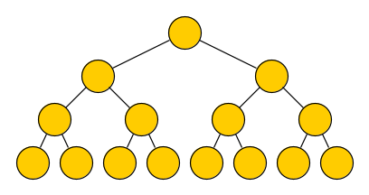
Speeding up the algorithm
The recursion tree would be much smaller if $k$ decreases in every recursive call:
It would be a tree of depth $O(k)$ in which each node has $O(1)$ children
At most $2^{O\left(k\right)}$ nodes in total, which is fixed-parameter tractable
Not clear how to achieve this while ensuring the algorithm finds an optimal solution
More realistic target: Ensure that on each path of $k^{O\left(1\right)}$ consecutive recursive calls, the parameter decreases
Under this condition, the recursion tree has depth ${k⋅k}^{O\left(1\right)}$, so at most $2^{k^{O\left(1\right)}}$ nodes
depth $k$
Notes:
Note: in a succession of choices that do NOT decrease the parameter, the parameter actually decreases in all branches except one. So we can localize this sequence of branches that do not drop the parameter. If we contract it into a single vertex, we effectively get a node with $O(k^{2})$ children, each of which decreases the parameter. So: the number of leaves in the recursion tree becomes $O{\left(k^{2}\right)}^{k}$. This we can re-write as ${\left({\left(2^{\log{k}}\right)}^{2}\right)}^{k}=2^{2⋅k⋅\log{k}}=2^{O\left(k\log{k}\right)}$.

Slide 10
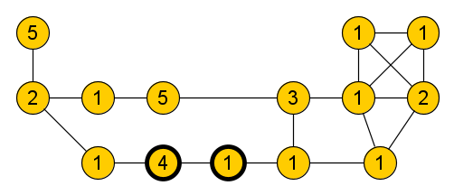
Improvement 1: Simplification step for degree-1 vertices
Consider a graph $G$, with weight function $w$, integer $k$, and vertex set $T⊆V(G)$
Suppose there is a degree-1 vertex $v∉T$ with unique neighbor $u$
Any maximum-weight $k$-secluded supertree of $T$ that contains $u$, also contains $v$
$$v$$
merge $v$ into $u$
$$u$$
$$u$$
sum their weights
After exhaustively applying this step, all vertices outside $T$ have degree two or more
Notes:
Effectively:
We can remove $v$ and add its weight to that of vertex $u$
Whenever a solution is found that contains $u$, we add $v$ to it

Slide 11
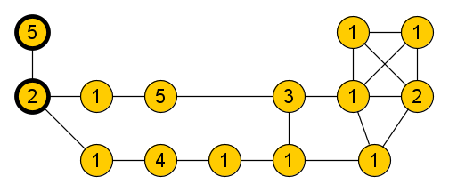
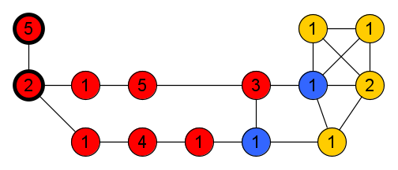
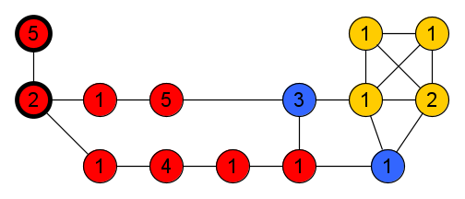
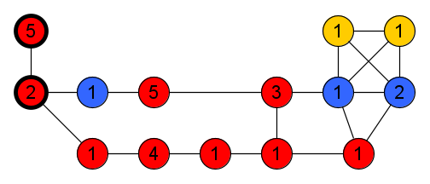
Improvement 2: Deciding the fate of degree-2 paths in one step
Consider a graph $G$, with weight function $w$, integer $k$, and vertex set $T⊆V\left(G\right)$ Let $P=(v_{1},…, v_{ℓ})$ be an inclusion-maximal path in $G$ such that:
vertex $v_{1}$ is a neighbor of $T$, so $v_{1}∈N_{G}(T)$
all vertices $v_{i}$ for $i<ℓ$ have degree exactly 2 in $G$, and
the internal vertices $v_{i}$ for $1<i<ℓ$ are not adjacent to any vertex of $T$
There is a maximum-weight $k$-secluded supertree of $T^{′}⊇T$ such that:
all vertices of $P$ belong to the supertree $T′$, or
all vertices of $P$ except $v_{ℓ}$ belong to the supertree $T′$, or
supertree $T′$ contains all vertices of $P$ except one of smallest weight
$v_{3}$ $$=v_{ℓ}$$
$$v_{1}$$
$$v_{2}$$
Notes:
Why would you not include all vertices of $P$?
If you do not include $v_{ℓ}$, then all internal vertices can go in without making cycles and without increasing the seclusion.
If you do include $v_{ℓ}$, and you do not include the entire path, then it is optimal to avoid a minimum-weight vertex.

Slide 12
Algorithm for $k$-Secluded Supertree: version 2
If $k<0$ or $G[T]$ contains a cycle: output “No solution exists”
[Simplification step] While there is a degree-1 vertex $v∉T$ with unique neighbor $u$:
Remove $v$, increase the weight of $u$ by $w(v)$
If $N_{G}\left(T\right)=∅$: output $T$ as the unique optimal solution
Choose an arbitrary $v_{1}∈N_{G}(T)$ and construct its extending path $P$
Initialize $P$ as the 1-vertex path containing $v_{1}$
While the last vertex $v_{i}$ of $P$ has degree 2, with one neighbor inside $T∪V(P)$ and one neighbor $v_{i+1}$ outside $T∪V(P)$: append $v_{i+1}$ to the path $P$
Let $v_{ℓ}$ be the last vertex of $P$
Recurse to find a maximum-weight $k$-secluded supertree of $T∪V(P)$ in $G$
Recurse to find a maximum-weight $(k−1)$-secluded supertree of $T$ in $G−v_{ℓ}$
Recurse to find a maximum-weight $(k−1)$-secluded supertree of $T$ in $G−\underset{v_{i}∈\{v_{1},…, v_{ℓ−1}\}}{arg min}{w(v_{i})}$
Output the best solution found by these recursive calls
$$v_{1}$$
$$v_{2}$$
$$v_{3}$$
$$v_{4}$$
Notes:
Correctness follows from the arguments

Slide 13
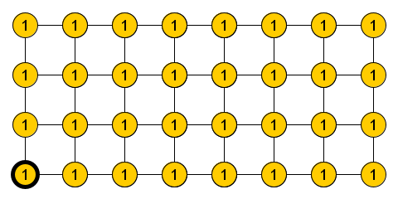
Analysis of version 2 of the algorithm
The algorithm considers $\left({n \atop k}\right)$ options that do not lead to any $k$-secluded tree
There are many situations in which version 2 is much more efficient than version 1 ... but is it fixed-parameter tractable?
Can the size of the recursion tree be bounded by a function of $k$ alone?
No.
$$k$$
$$n$$
Notes:
Intuitively: a search is hopeless if the open neighborhood of $T$ is very large.

Slide 14
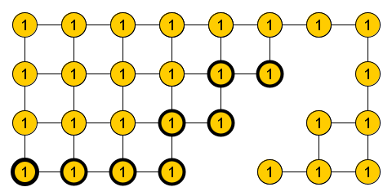
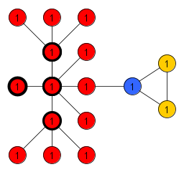
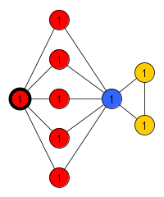
Improvement 3: Stopping the search when it turns hopeless
We want to stop searching a branch when it cannot lead to an optimal solution ... thereby effectively pruning branches of the recursion tree
If $|N_{G}\left(T\right)|$ is much larger than $k$, it seems unlikely there is a $k$-secluded supertree of $T$
However, there are two scenarios in which a $k$-secluded supertree $T′$ can still exist:
Many vertices of $N_{G}(T)$ lead to degree-1 vertices of $V\left(G\right)∖T$
$$v$$
$$k$$
A single vertex $v∉T′$ is a neighbor of many leaves of the supertree $T′$
Dealt with by degree-1 simplification
$$n$$
Can be detected and handled
Notes:
Scenario on the left: cannot occur since we get rid of degree-1 vertices in $V\left(G\right)∖T$ by simplification.
Scenario on the right: we can try to detect it in the algorithm and deal with it upfront.

Slide 15
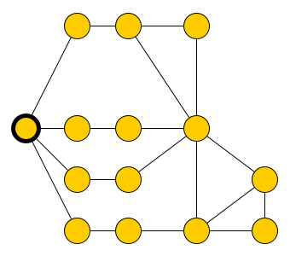
Vertices in the neighborhood of any $k$-secluded supertree
Consider a graph $G$, integer $k$, and vertex set $S$ such that $G[T]$ is connected
Lemma. If $v∈V\left(G\right)∖T$ and there is a sequence of $k+2$ paths $P_{1},…, P_{k+2}$ that:
start in a vertex of $T$,
end in $v$, and
which are internally vertex-disjoint,
then any $k$-secluded supertree $T^{′}⊇T$ has $v$ in its open neighborhood
Proof.
Consider a $k$-secluded supertree $T^{′}⊇T$
$N_{G}(T^{′})$ avoids interiors of two paths $P_{i}, P_{j}$
Their interiors are fully contained in $T′$
If $v∈T^{′}$, these form a cycle using $G[T]$
... which is impossible since $G[T^{′}]$ is acyclic
$$v$$
$$k=2$$

Slide 16
Vertices in the neighborhood of any $k$-secluded supertree
Lemma. If $v∈V\left(G\right)∖T$ and there is a sequence of $k+2$ paths $P_{1},…, P_{k+2}$ that:
start in a vertex of $T$,
end in $v$, and
which are internally vertex-disjoint,
then any $k$-secluded supertree $T^{′}⊇T$ has $v$ in its open neighborhood
Lemma. Consider a graph $G$, vertex set $T$, and integer $k$. If all of the following hold:
$\left|N_{G}\left(T\right)\right|≥k(k+2)$,
all vertices of $V\left(G\right)∖T$ have degree two or more, and
there is a $k$-secluded supertree of $T$,
then there is a vertex $v∈V\left(G\right)∖T$ reached by $k+2$ internally vertex-disjoint paths from $T$

Slide 17
Algorithm for $k$-Secluded Supertree: version 3
If $k<0$ or $G[T]$ contains a cycle: output “No solution exists”
[Simplification step] While there is a degree-1 vertex $v∉T$ with unique neighbor $u$:
Remove $v$, increase the weight of $u$ by $w(v)$
If $N_{G}\left(T\right)=∅$: output $T$ as the unique optimal solution
[Pruning step] If $\left|N_{G}\left(T\right)\right|≥k(k+2)$:
If some $v∈V\left(G\right)∖T$ is reachable by $k+2$ internally vertex-disjoint paths from $T$: Recurse to find a maximum-weight $(k−1)$-secluded supertree of $T$ in $G−v$
Otherwise: output “No solution exists”
Choose an arbitrary $v_{1}∈N_{G}(T)$ and construct its extending path $P=(v_{1},…, v_{ℓ})$
Recurse to find a maximum-weight $k$-secluded supertree of $T∪V(P)$ in $G$
Recurse to find a maximum-weight $(k−1)$-secluded supertree of $T$ in $G−v_{ℓ}$
Recurse to find a maximum-weight $(k−1)$-secluded supertree of $T$ in $G−\underset{v_{i}∈\{v_{1},…, v_{ℓ−1}\}}{arg min}{w(v_{i})}$
Output the best solution found by these recursive calls
This is the only recursive call in which we search for a $k$-secluded supertree (all others recurse for $k−1$)
Notes:
Add: If we reach the problematic branch, then the size of the open neighborhood of $T∪\{v\}$ is larger than that of $T$!

Slide 18
Analysis of version 3 of the algorithm
Consider the recursive call where $k$ is not decreased: find a $k$-secluded supertree of $T∪V(P)$, where $P$ is the extending path
By definition of the extending path $P=(v_{1},…, v_{ℓ})$, we know:
the last vertex $v_{ℓ}$ has degree $≥3$, or
the last vertex $v_{ℓ}$ has two neighbors in $T∪V(P)$
For the updated set $T^{∗}≔T∪V(P)$ for which we search for a supertree:
$\left|N_{G}\left(T^{∗}\right)\right|>|N_{G}\left(T\right)|$, or
the graph $G[T^{∗}]$ has a cycle (so the recursive call immediately halts)
$$v_{1}$$
$$v_{2}$$
$$v_{3}$$
$$v_{4}$$

Slide 19
Analysis of version 3 of the algorithm
In recursive calls where $k$ does not decrease, the size of the open neighborhood grows
When $\left|N_{G}\left(T\right)\right|$ reaches $k(k+2)$, the algorithm either recurses for $k−1$ or halts
On each path of $k(k+2)$ consecutive calls in the recursion tree, the parameter drops
The recursion tree has branching factor 3 and depth $O(k^{3})$, so size $2^{O\left(k^{3}\right)}$
The total running time is $2^{O\left(k^{3}\right)}⋅{\left|V\left(G\right)\right|}^{O\left(1\right)}$
Refined analysis gives $2^{O\left(k\log{k}\right)}⋅{\left|V\left(G\right)\right|}^{O(1)}$
$k$-Secluded Tree can be solved in time $2^{O\left(k\log{k}\right)}⋅n^{4}$
For the updated set $T^{∗}≔T∪V(P)$ for which we search for a supertree:
$\left|N_{G}\left(T^{∗}\right)\right|>|N_{G}\left(T\right)|$, or
the graph $G[T^{∗}]$ has a cycle (so the recursive call immediately halts)

Slide 20
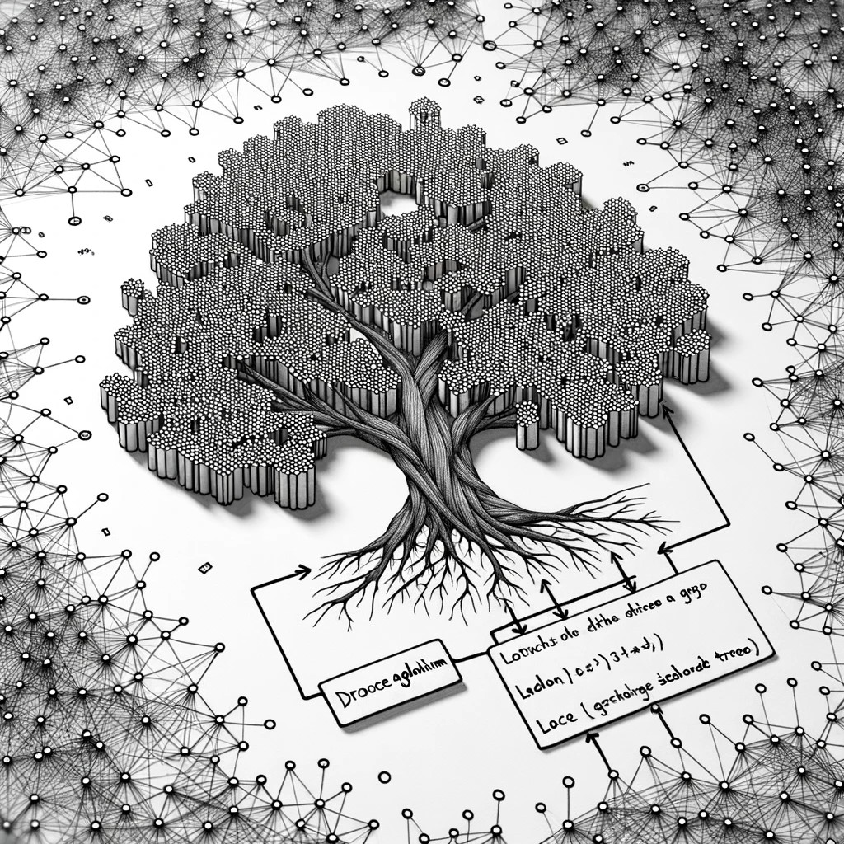
Conclusion
Fixed-parameter tractable algorithm to find a maximum-weight $k$-secluded tree
Can be extended to count the number of maximum-weight $k$-secluded trees
Can be extended to output a compact representation of all solutions
Open: Can this approach be extended to find a maximum-weight $k$-secluded ...
connected induced bipartite subgraph?
connected induced outerplanar subgraph?
Open: Can the running time be improved to $2^{O\left(k\right)}⋅n^{O\left(1\right)}$?

