Slide 1
Structural graph parameters Part 1: Treewidth
Bart M. P. Jansen
Networks Training Week 2017
January 31st – February 2nd 2017, Doorn, Netherlands

Slide 2
The goal for this micro-course
Introduce & motivate structural parameters of graphs
Different ways of measuring the complexity of a graph
Relate these parameters to each other
Use this hierarchy of parameters as a methodology for
generating & answering meaningful research problems

Slide 3
The plan for this micro-course
Tuesday:
Introduction to graph parameters & exploring treewidth
Wednesday:
More parameters & relations between them
Thursday:
Applications to combinatorics & algorithmics

Slide 4
To get all noses in the same direction
All my graphs are finite
… simple
… and undirected (edge $uv$ = edge $vu$)
I use connected component for what Tim calls cluster I use cycle for what Tim calls loop
Interrupt me any time!
Notes:
Tried to make this engaging and interactive; there will be exercises in the middle.

Slide 5
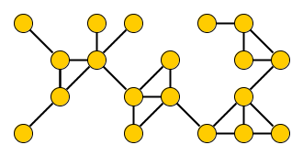
A beauty contest for graphs
Contestant number 3
complexity

Slide 6
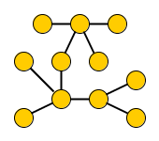
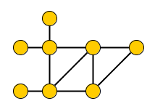
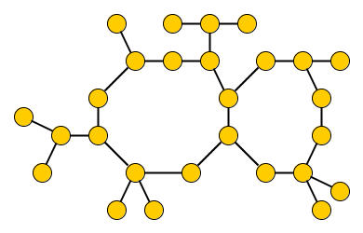
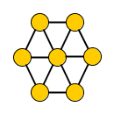
A complexity contest for graphs – Judge #1
Number of cycles
0
8
?
6
31
3
Notes:
Number of cycles. For question graph: 3 triangles, 2 cycles of length 4, 1 cycle of length 5.

Slide 7
A complexity contest for graphs – Judge #2
Vertex-deletion distance to acyclic
0
4
?
1
2
1
Notes:
Size of FVS

Slide 8
A complexity contest for graphs – Judge #3
Length of longest cycle
0
4
?
5
7
15
Notes:
Circumference

Slide 9
Measuring graph complexity
Number of cycles
Vertex-deletion distance to acyclic
Length of longest cycle
Feedback vertex number
Circumference
These are graph parameters: functions assigning integers to abstract graphs
These 3 parameters give value 0 to all trees
Which parameter captures graph complexity in a useful way?
Notes:
Independent of drawing, or labeling of vertices. (Assign integers to isomorphism classes of graphs.)

Slide 10
Complexity of a ladder graph
Number of cycles
Vertex-deletion distance to acyclic
Length of longest cycle
None of these, really: ladder graphs score arbitrarily high
Which parameter captures graph complexity in a useful way?
Notes:
.. but ladders are sparse, have a linear structure, small separators, and so on.

Slide 11
treewidth

Slide 12
History
The treewidth of a graph is a useful graph complexity parameter Intuitively: measures how treelike the graph is
Discovered by Bertelé & Brioschi (1972)
Rediscovered by Robertson & Seymour (1984)
1970 1975 1980 1985 1990
… became so popular it never has to be rediscovered again
Rediscovered by Halin (1976)
Notes:
Fact that 3 research teams arrived at it independently shows how fundamental the notion is. Will talk about the context later.

Slide 13
Definition of treewidth
Many cryptomorphic equivalent definitions of treewidth:
Minimum width of a tree decomposition
Minimum clique number of a chordal supergraph
Minimum cost of an elimination order
Minimum $k$ for which the graph is a partial $k$-tree
Minimum number of cops needed to catch a visible robber

Slide 14
Cops and robbers on graphs
Fast robber is running along the edges of a graph
Cops in a helicopter try to catch him by landing and blocking vertices
Helicopters are slow: robber sees helicopter coming and runs away
© Emoji One
Notes:
Helicopter takes off, moves to a vertex, and starts landing. Robber has time to run away while helicopter is landing. Cops catch the robber by landing on him; he cannot run through cop-vertices. 3 cops can catch any robber on this graph.

Slide 15
Graph parameter from cops and robbers
What is the smallest number of cops needed to catch any robber on $G$?
© Emoji One

Slide 16
Robbers can hide on cycles
Fact. For any graph with a cycle, you need at least 3 cops.
© Emoji One
Notes:
If you are on a cycle and a cop is in the air trying to land on you, at least 1 direction on the cycle is unobstructed and you can flee there.

Slide 17
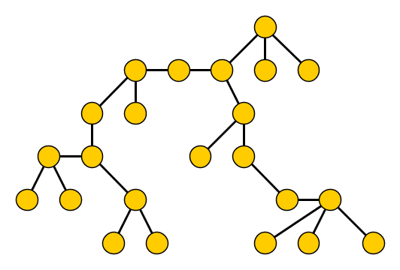
Robbers cannot hide on trees
Fact. In a tree, 2 cops can catch any robber.
© Emoji One

Slide 18
Catching robbers on the contest graphs
2
3
3
3
4

Slide 19
Catching robbers on ladder graphs
Number of cycles
Vertex-deletion distance to acyclic
Length of longest cycle
3
In a ladder graph, 3 cops can catch any robber
Notes:
.. but ladders are sparse, have a linear structure, small separators, and so on.

Slide 20
Cop number versus other parameters
Number of cycles
Vertex-deletion distance to acyclic
Length of longest cycle
CopNumber$\left(G\right)≤$ NumberOfCycles$\left(G\right)+2$
CopNumber$\left(G\right)≤$ DistanceToAcyclic$\left(G\right)+2$
CopNumber$\left(G\right)≤$ LongestCycle$\left(G\right)$
The cop number is small on a larger class of graphs … yet graphs with small cop number still have useful structure
Notes:
.. but ladders are sparse, have a linear structure, small separators, and so on.

Slide 21
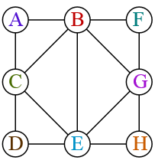
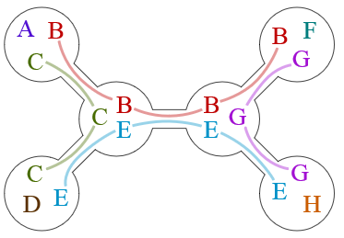
Representing search strategies
Graph $G$
Tree $T$ encoding strategy for 3 cops
Each node $v∈V(T)$ gives cop-occupied positions in state $v$
Start with cops in locations specified by start node (arbitrary)
Consider $x∈V(G)$ that robber runs to, find $x$ in $T$
Change cop state as indicated by tree-neighbor towards $x$

Slide 22
Which trees represent valid strategies?
To be able to catch a robber hiding along edge $uv$:
$∀uv∈E(G)$, some state has simultaneous cops on $u$ and $v$
To ensure next cop move is well-defined:
$∀v∈V(G)$, states with $v$-cop form connected subtree of $T$
ABC
BD
AF
CD
Notes:
If not: when in a state between 2 occurrences of $v$, don’t know how to respond when robber runs to $v$.

Slide 23
Representing search strategies
Graph $G$
Tree $T$ encoding strategy for 3 cops
$∀uv∈E(G)$, some state has simultaneous cops on $u$ and $v$
$∀v∈V(G)$, states with $v$-cop form connected subtree of $T$
Necessary conditions (A),(B) are sufficient to ensure validity. There is always an optimal strategy of this form.

Slide 24
Tree decompositions
Graph $G$
Tree decomposition $(T,X)$
A tree decomposition of $G$ is a pair $(T,X)$ where T is a tree and $X$ assigns a bag $X\left(w\right)⊆V(G)$ to each $w∈V(T)$, such that:
$∀uv∈E(G)$, some bag $X(w)$ contains both $u$ and $v$
$∀v∈V(G)$, bags containing $v$ form connected subtree of $T$

Slide 25
Treewidth
The width of a tree decomposition is the maximum bag size – 1
The treewidth of $G$ is the min. width of its tree decompositions
Theorem. Graph $G$ has a tree decomposition with bags of size $k$
$$⇔$$
$k$ cops are sufficient to catch any robber on $G$.
Theorem. Graph $G$ has treewidth at most $k−1$
$$⇔$$
$k$ cops are sufficient to catch any robber on $G$.
A tree decomposition of $G$ is a pair $(T,X)$ where T is a tree and $X$ assigns a bag $X\left(w\right)⊆V(G)$ to each $w∈V(T)$, such that:
$∀uv∈E(G)$, some bag $X(w)$ contains both $u$ and $v$
$∀v∈V(G)$, bags containing $v$ form connected subtree of $T$

Slide 26
Robbers cannot hide on trees
Fact. A tree has treewidth 1.
© Emoji One

Slide 27
Connected subgraphs yield connected subtrees
For $v∈V(G)$ let $X^{−1}(v)$ be the nodes of $T$ whose bag contains $v$
For $S⊆V(G)$ let $X^{−1}(S)$ be the nodes of $T$ whose bag intersects $S$
Lemma 1. If $H$ is a connected subgraph of $G$, then $X^{−1}(V\left(H\right))$ is a connected subtree of $T$.
A tree decomposition of $G$ is a pair $(T,X)$ where T is a tree and $X$ assigns a bag $X\left(w\right)⊆V(G)$ to each $w∈V(T)$, such that:
$∀uv∈E(G)$, some bag $X(w)$ contains both $u$ and $v$
$∀v∈V(G)$, bags containing $v$ form connected subtree of $T$

Slide 28
properties of treewidth

Slide 29
Bags of the decomposition form separators
Lemma 1. If $H$ is a connected subgraph of $G$, then $X^{−1}(V\left(H\right))$ is a connected subtree of $T$.
Let $(T,X)$ be a tree decomposition of $G$. Let $p,q∈V(G)$.
Let $w∈V(T)$ such that all paths from $X^{−1}(p)$ to $X^{−1}(q)$ in $T$ go through node $w$. Then all paths from $p$ to $q$ in $G$ intersect $X(w)$.
b,c
c,p
b,f
b,q
a,p
d,p
c,e
Implies robber will be caught
Notes:
Exercise: use this fact to prove the robber will be caught when following the suggested strategy on a tree decomposition.

Slide 30
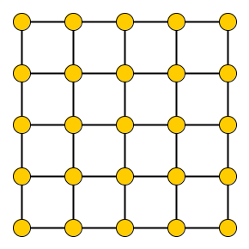
The treewidth of a grid
How many cops are needed to catch a robber on the $k×k$ grid?
Robber can hide from $k$ cops on the following subgraphs:
bottom row, remainder of last column,
and all “crosses” in the top-left $\left(k−1\right)×\left(k−1\right)$ grid
including off-diagonal ones
Lemma. The treewidth of a $k×k$ grid is exactly $k$.
Notes:
How many suffice? How could we argue that we need so many? Create a set of touching subgraphs that needs k+1 vertices to be hit. Using only k cops: always manage to stay on a cop-free subgraph.

Slide 31
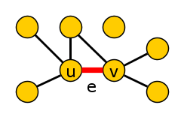
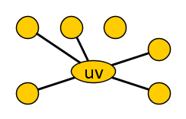
Contracting edges does not increase treewidth
Lemma. If graph $H$ can be obtained from $G$ by a sequence of edge deletions, vertex deletions, and edge contractions, then $H$ is a minor of $G$ and $treewidth\left(H\right)≤treewidth(G)$.
contract edge e
Corollary. If you can obtain a $k×k$ grid from $G$ by deleting edges, deleting vertices, and contracting edges,
then $treewidth\left(G\right)≥treewidth\left(⊞_{k×k}\right)=k$.
Notes:
Q: How to obtain a tree decomposition of G’ when you have a tree decomposition of G, and the list of operations?

Slide 32
The excluded grid theorem
Corollary. If contains a $k×k$ grid as a minor, then $treewidth\left(G\right)≥k$.
In some sense, large grid minors are the only reason for large tw
Excluded grid theorem. [RS’86, RST’94, KK’12, LS’14, CC’14, Chuzhoy’16] If $treewidth\left(G\right)=k$, then $G$ contains a $k^{′}×k′$ grid as a minor, where $k^{′}∈Ω\left(k^{\frac{1}{20}}\right)$.
Notes:
It has been conjectured that treewidth $k^{2}\log{k}$already gives a $k×k$ grid minor.

Slide 33
Balanced separators from tree decompositions
Lemma. If the $n$-vertex graph $G$ has treewidth $k$, then there is a separator $S⊆V(G)$ of size $k+1$ such that
each connected component of $G−S$ has at most $\frac{n}{2}$ vertices.
Proof.
Consider tree decomposition $(T,X)$ of $G$
Pick a root node $r$ for $T$. Then for each node $v∈V(T)$:
Let $T_{v}$ be the subtree of $T$ rooted at $v$
Let $X\left(T_{v}\right)≔\bigcup_{u∈{V(T}_{v})}{X(u)}$ be vertices of $G$ in bags of $T_{v}$
Pick deepest $v∈V\left(T\right)$ such that $\left|X\left(T_{v}\right)\right|>\frac{n}{2}$, use $S≔X(v)$

Slide 34
exercises on treewidth

Slide 35
Small-treewidth graphs have a low-degree vertex
Lemma. If $G$ has treewidth $k$,
then $G$ has a vertex of degree at most $k$.
Proof strategies:
If $k+1$ cops can catch any robber on $G$, it has a deg-$k$ vertex
Find a degree-$k$ vertex by inspecting leaves of decomposition
Corollary.
An $n$-vertex graph of treewidth $k$ has at most $nk$ edges.

Slide 36
Cliques are represented in tree decompositions
Lemma. If $S⊆V(G)$ forms a clique in $G$, then any tree decomposition for $G$ has a bag containing all vertices of $S$.
Helly property. If $T$ is a tree and $T_{1},…,T_{k}$ are connected subgraphs of $T$ such that $V\left(T_{i}\right)∩V\left(T_{j}\right)≠∅$ for all $1≤i,j≤k$, then $V\left(T_{1}\right)∩V\left(T_{2}\right)∩…∩V\left(T_{k}\right)≠∅$.
Corollary.
If $G$ has a clique of size $k$, then $treewidth\left(G\right)≥k−1$.

Slide 37
Treewidth of random graphs
Notes:
Has been studied, but is mostly large.

Slide 38
Random geometric graphs
Drop $n$ points onto the square ${\left[0,\sqrt{n}\right]}^{2}$
Connect pairs by an edge when their distance is $≤r=r(n)$
Theorem. With probability going to $1$ as $n→∞$, the random geometric graph has treewidth $Θ(r\sqrt{n})$ when $lim inf{r>r_{c}}$, the threshold for appearance of a giant component.
Theorem. With probability going to 1 as $k→∞$, the treewidth of the graph obtained from a $k×k$ grid by retaining each edge with probability $p$ is $Θ(k)$ if $p>\frac{1}{2}$ and $Θ(\sqrt{\log{k}})$ if $p<\frac{1}{2}$.
[Li & Müller, ‘15]

Slide 39
Random Erdös-Rényi graphs
Random graph $G(n,p)$
Each edge is independently present with probability $p=p(n)$
Theorem. Let $c$ be a constant and let $G=G(n,p)$ with $p=c/n$. Then the following holds almost surely:
If $c>1$ then the treewidth of $G$ is at least $c^{′}n$ for some $c′$ depending only on $c$.
If $c<1$ then the treewidth of $G$ is at most 2.
[Lee, Lee, Oum, ‘12]
Notes:
There are also results for preferential attachment model. (As soon as >= 12 neighbors, treewidth is linear.)

Slide 40
Closing remarks

Slide 41
An arboretum of graphs of bounded treewidth
series-parallel graphs
$k$-outerplanar graphs
𝑘-outerplanar graphs
$k$ vertex-deletions away from acyclic
𝑘 vertex-deletions away from acyclic

Slide 42
Summary
Treewidth is a graph parameter measuring treelike-ness
Definition in terms of tree decompositions
Definition in terms of cops catching a fast robber
Concept of treewidth gives a research methodology
Generalize results on trees to bounded-treewidth graphs
Graphs of treewidth $k$ are more general than:
Graphs with $k$ cycles
Graphs that are $k$ vertex-deletions away from acyclic
More parameters Wednesday, applications on Thursday
THANK YOU!

