Slide 1


Structural graph parameters
Part 2: A hierarchy of parameters
Bart M. P. Jansen
Networks Training Week 2017
January 31st – February 2nd 2017, Doorn, Netherlands

Slide 2


Recap
Yesterday we explored treewidth and 3 other graph parameters:
Number of cycles
Vertex-deletion distance to an acyclic graph
Length of the longest cycle
Treewidth = number of cops to catch a fast robber – 1

Slide 3
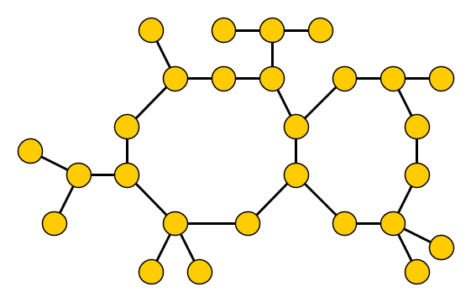
Cops and robbers on graphs
Fast robber is running along the edges of a graph
Cops in a helicopter try to catch him by landing and blocking vertices
Helicopters are slow: robber sees helicopter coming and runs away
© Emoji One

Slide 4
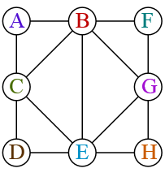
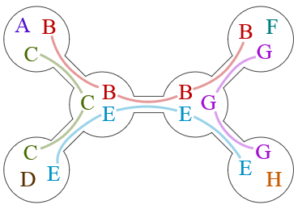


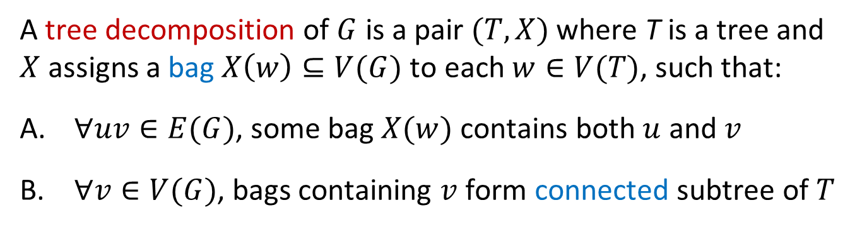
Tree decompositions
Graph $G$
Tree decomposition $(T,X)$
A tree decomposition of $G$ is a pair $(T,X)$ where T is a tree and $X$ assigns a bag $X\left(w\right)⊆V(G)$ to each $w∈V(T)$, such that:
$∀uv∈E(G)$, some bag $X(w)$ contains both $u$ and $v$
$∀v∈V(G)$, bags containing $v$ form connected subtree of $T$

Slide 5
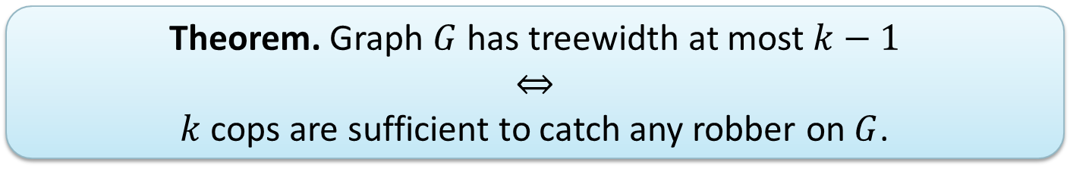
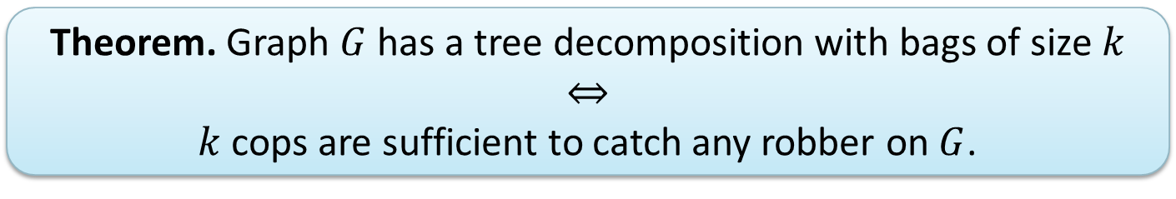
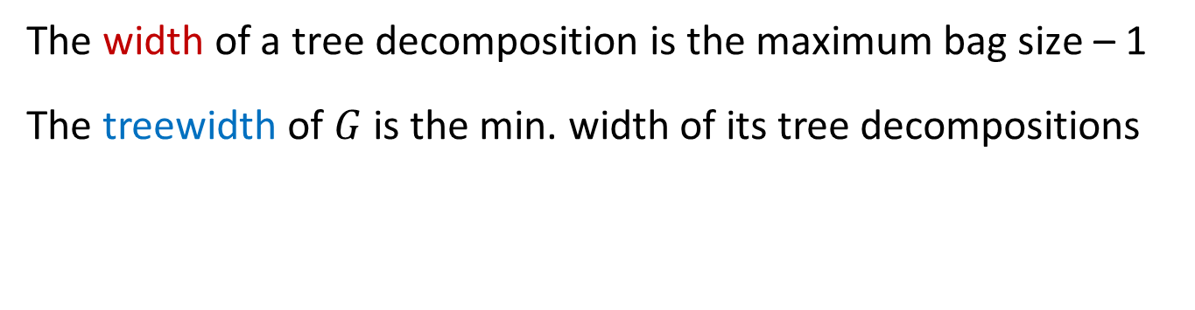
Treewidth
The width of a tree decomposition is the maximum bag size – 1
The treewidth of $G$ is the min. width of its tree decompositions
  Theorem. Graph $G$ has a tree decomposition with bags of size $k$
  $$⇔$$
  $k$ cops are sufficient to catch any robber on $G$.
  Theorem. Graph $G$ has treewidth at most $k−1$
  $$⇔$$
  $k$ cops are sufficient to catch any robber on $G$.
A tree decomposition of $G$ is a pair $(T,X)$ where T is a tree and $X$ assigns a bag $X\left(w\right)⊆V(G)$ to each $w∈V(T)$, such that:
$∀uv∈E(G)$, some bag $X(w)$ contains both $u$ and $v$
$∀v∈V(G)$, bags containing $v$ form connected subtree of $T$

Slide 6




Plan for today
More graph parameters and relations between them
Methodology for generating graph problems & solving them
Vertex-deletion distance to edgeless
$$Cutwidth$$
Vertex-deletion distance to paths
Length of longest cycle
$$Pathwidth$$
Vertex-deletion distance to acyclic
$$Treewidth$$
Degeneracy
$$Cliquewidth$$

Slide 7

a new parameter

Slide 8
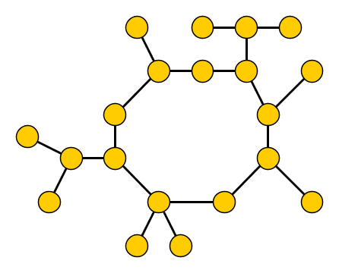

Catching a special robber
In the game defining treewidth, cops are slow but can see the fast robber
For the next parameter, we change the rules of the game:
What if the robber is a fast invisible man?
How many cops are needed to catch this invisible robber?

Slide 9
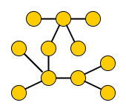
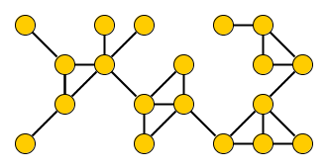
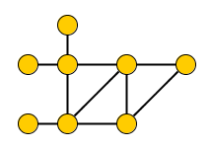

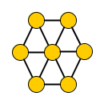
Catching invisible robbers on the contest graphs
Number of cops to catch invisible robber
2
3
?
3
  Observation. To catch an invisible robber,
  you need a fixed strategy for searching the graph.
4
4

Slide 10


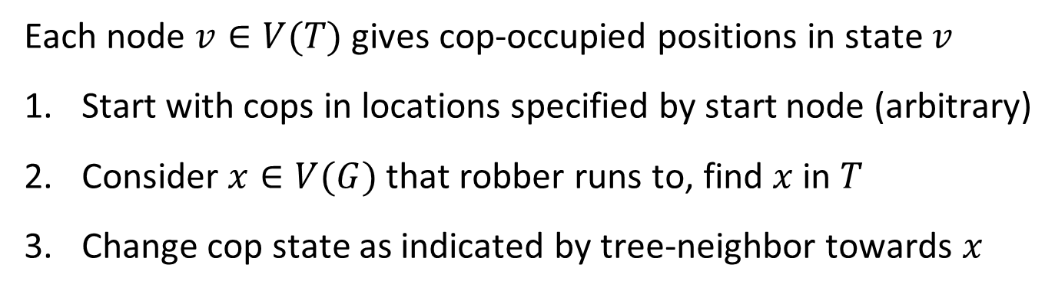
Representing search strategies
Graph $G$
Tree $T$ encoding strategy for 3 cops
Each node $v∈V(T)$ gives cop-occupied positions in state $v$
Start with cops in locations specified by start node (arbitrary)
Consider $x∈V(G)$ that robber runs to, find $x$ in $T$
Change cop state as indicated by tree-neighbor towards $x$
  Observation. Search strategy to catch an invisible robber is linear.

Slide 11
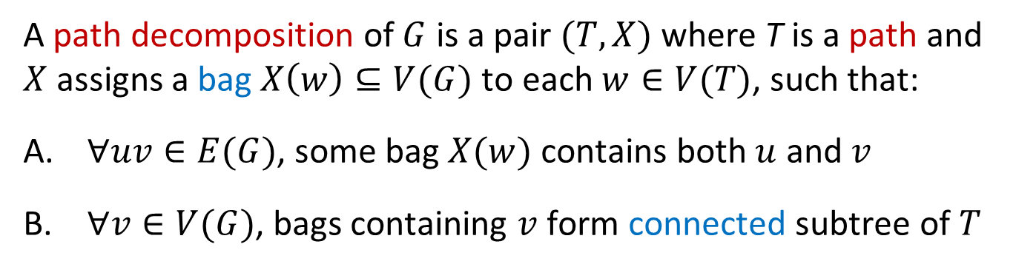

Path decompositions
Graph $G$
Path decomposition $(T,X)$
bce
beg
egh
cde
begF
abce
A path decomposition of $G$ is a pair $(T,X)$ where T is a path and $X$ assigns a bag $X\left(w\right)⊆V(G)$ to each $w∈V(T)$, such that:
$∀uv∈E(G)$, some bag $X(w)$ contains both $u$ and $v$
$∀v∈V(G)$, bags containing $v$ form connected subtree of $T$

Slide 12
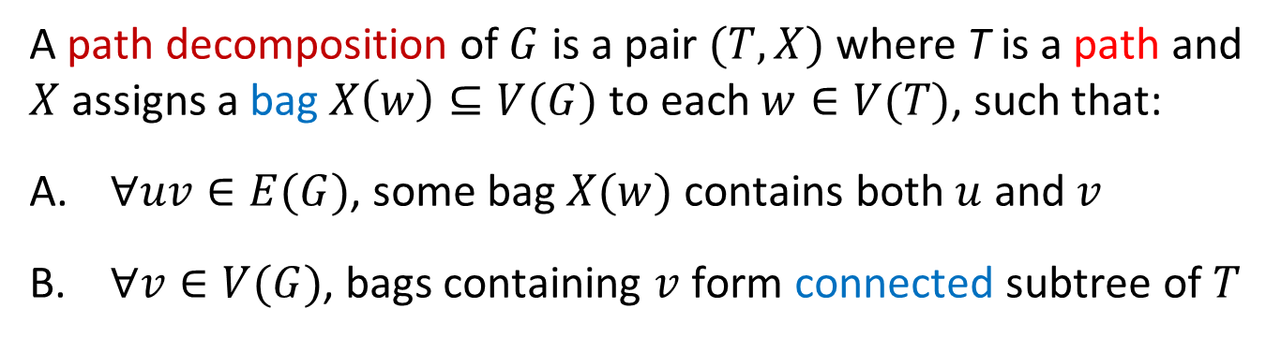
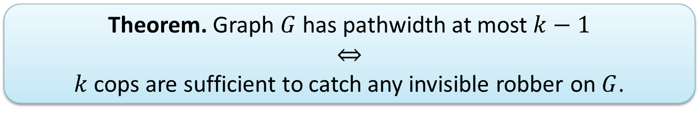
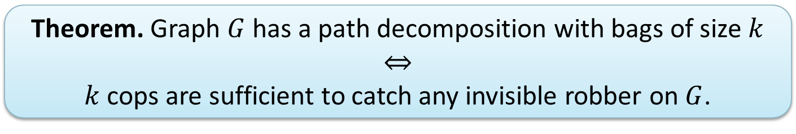

Pathwidth
The width of a path decomposition is the maximum bag size – 1
The pathwidth of $G$ is the min. width of its path decompositions
  Theorem. Graph $G$ has a path decomposition with bags of size $k$
  $$⇔$$
  $k$ cops are sufficient to catch any invisible robber on $G$.
  Theorem. Graph $G$ has pathwidth at most $k−1$
  $$⇔$$
  $k$ cops are sufficient to catch any invisible robber on $G$.
A path decomposition of $G$ is a pair $(T,X)$ where T is a path and $X$ assigns a bag $X\left(w\right)⊆V(G)$ to each $w∈V(T)$, such that:
$∀uv∈E(G)$, some bag $X(w)$ contains both $u$ and $v$
$∀v∈V(G)$, bags containing $v$ form connected subtree of $T$

Slide 13
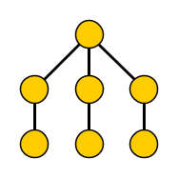
Catching robbers on trees
On a tree, a visible robber can be always caught by 2 cops
What about invisible robbers?
Invisible robber knowing the 2-cop strategy remains uncaught!
Simple lower bound for bag size of a path decomposition
Notes:
Move to root node whenever possible. When helicopter will and on root node: run to component where no cop is currently, and which is not the first one in the future where there will be 2 cops. As soon as 2 cops are there: run back to root.

Slide 14
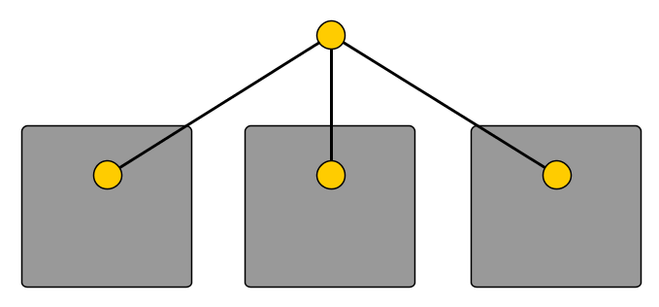
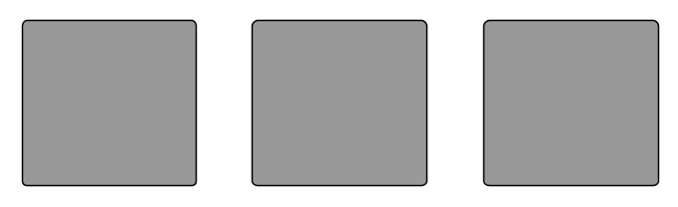





Hiding places for invisible robbers
If $pathwidth\left(C_{i}\right)=k$ for $i∈\{1,2,3\}$
… then $pathwidth\left(C_{1}∪C_{2}∪C_{3}∪\left\{v\right\}\right)=k+1$
when $v$ is connected to $1$ vertex in each $C_{i}$
$$v$$
$$C_{1}$$
$$C_{2}$$
$$C_{3}$$
Analogous lower bound for bag size of a path decomposition
Notes:
The Ci’s are connected graphs. Every time k cops gather on the same component: move to a component that will not be the next one having k cops.

Slide 15
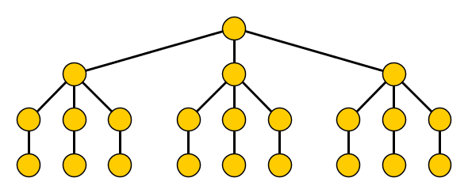
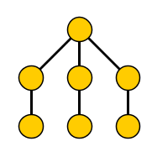

Acyclic hiding places for invisible robbers
  Fact. A complete $n$-vertex ternary tree has pathwidth $Ω(\log{n})$.

Slide 16
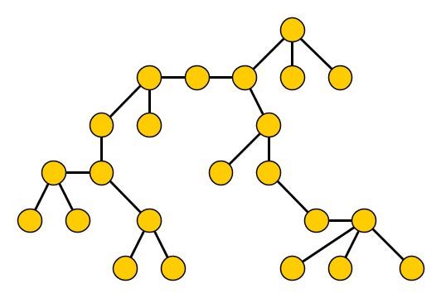
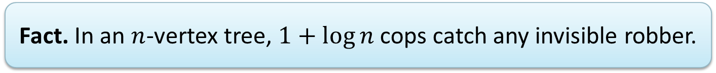
Hunting invisible robbers on trees
  Fact. In an $n$-vertex tree, $1+log{n}$ cops catch any invisible robber.
© Emoji One

Slide 17

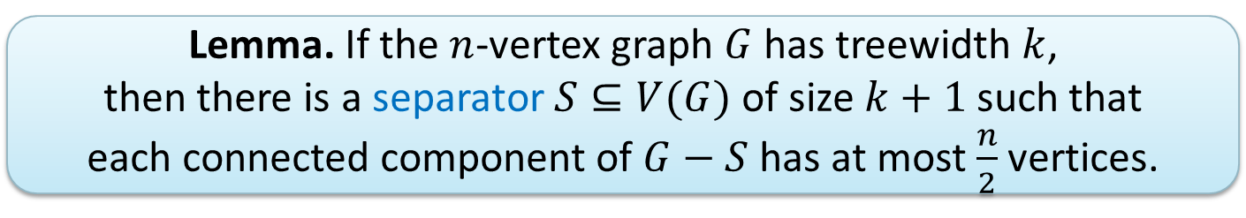
Relation between pathwidth and treewidth
  Theorem. For any graph $G$ with $n$ vertices:
  $pathwidth\left(G\right)∈O(treewidth\left(G\right)⋅\log{n})$.
  Lemma. If the $n$-vertex graph $G$ has treewidth $k$,
  then there is a separator $S⊆V(G)$ of size $k+1$ such that
  each connected component of $G−S$ has at most $\frac{n}{2}$ vertices.

Slide 18







A hierarchy of graph parameters
$A$
$$B\left(G\right)≤A\left(G\right)+1$$
$B$
Vertex-deletion distance to edgeless
$$Cutwidth$$
Vertex-deletion distance to paths
Length of longest cycle
$$Pathwidth$$
Vertex-deletion distance to acyclic
$$Treewidth$$
Degeneracy
$$Cliquewidth$$
Notes:
Nontrivial facts: Treewidth <= circumference, pathwidth <= cutwidth.

Slide 19
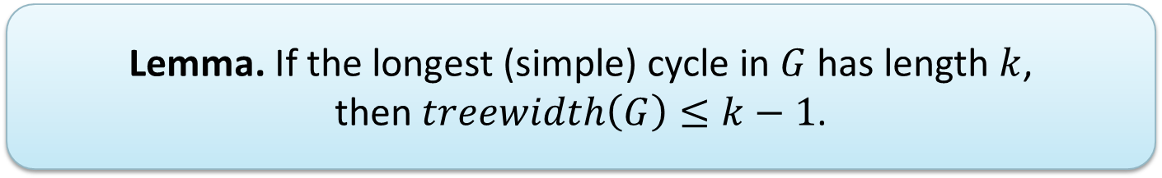
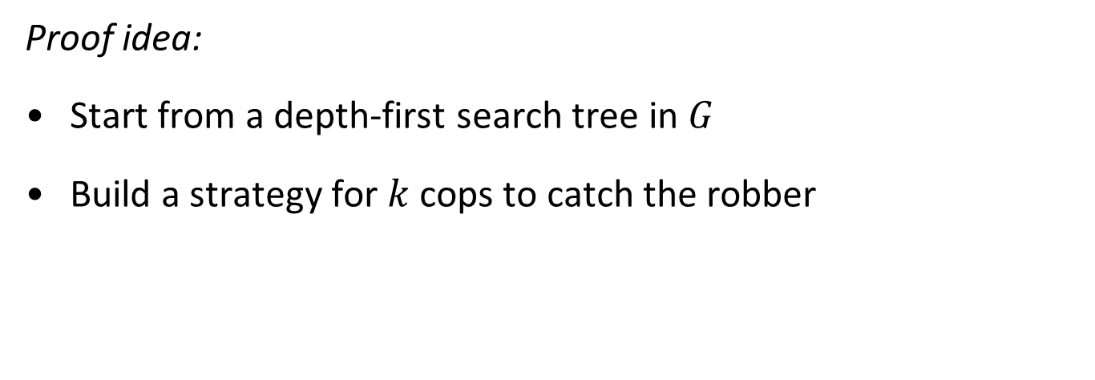
Treewidth is bounded by circumference
  Lemma. If the longest (simple) cycle in $G$ has length $k$,
  then $treewidth\left(G\right)≤k−1$.
Proof idea:
Start from a depth-first search tree in $G$
Build a strategy for $k$ cops to catch the robber

Slide 20
Intermezzo
The graph minors project

Slide 21
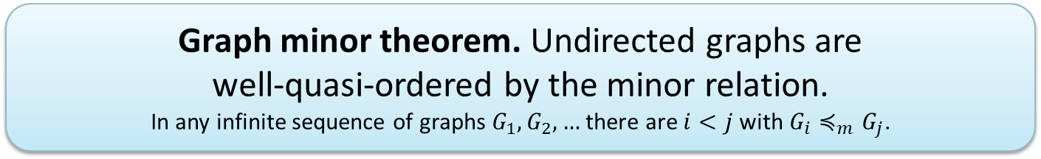
The Graph Minors project
Series of 20 papers spanning 500+ pages
Developed from 1983 – 2000
Resulted in concepts of treewidth, pathwidth, brambles, etc.
  Graph minor theorem. Undirected graphs are
  well-quasi-ordered by the minor relation.
  In any infinite sequence of graphs $G_{1},G_{2},…$ there are $i<j$ with $G_{i}≼_{m}G_{j}$.
Notes:
Started from WQO trees by the minor relation (Kruskal’s tree theorem). Then WQO bounded-pathwidth graphs and WQO bounded-treewidth graphs. Note: induced subgraph relation is NOT a well-quasi-order on undirected graphs. Consequence: every minor-closed family of graphs is characterized by a *finite* set of forbidden minors. Compare: K5, K3,3 for planar graphs.

Slide 22
Parameters based on linear structure

Slide 23
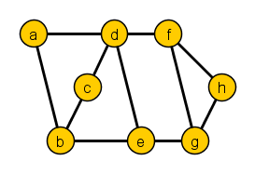
Graphs with a linear structure
Pathwidth is a measure of the linear structure of a graph
Several other graph parameters are based on linear structure
Cutwidth, bandwidth, topological bandwidth …

Slide 24
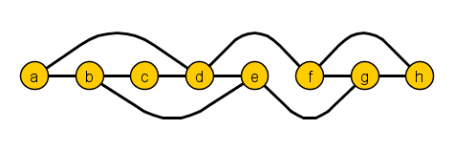

Graphs with a linear structure: cutwidth
The cutwidth of a linear ordering of $V(G)$ is:
max. # edges intersected by a vertical line between vertices
The cutwidth of a graph is min. cutwidth of any ordering of $V(G)$
cutwidth 3
Notes:
Cutwidth of K_1,n is ceil(n/2).

Slide 25
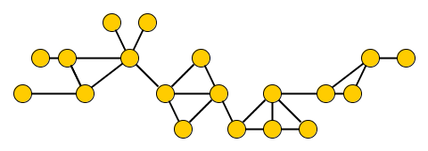

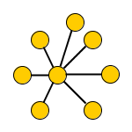
Cutwidth of some simple graphs
Cutwidth
2
3
4

Slide 26
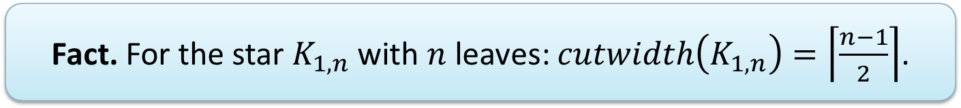
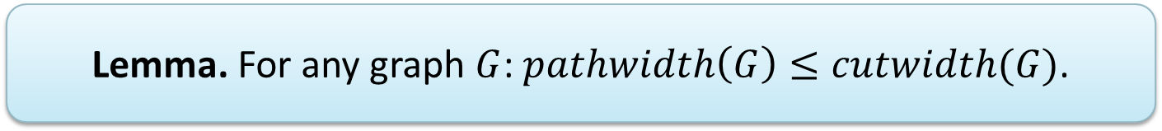
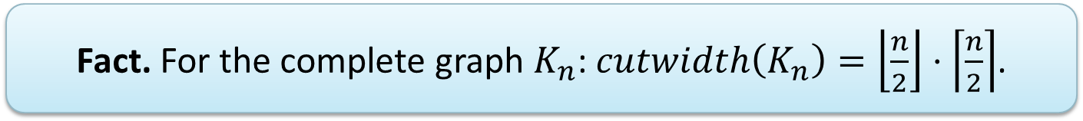
Properties of cutwidth
  Lemma. For any graph $G$: $pathwidth\left(G\right)≤cutwidth(G)$.
  Fact. For the star $K_{1,n}$ with $n$ leaves: $cutwidth\left(K_{1,n}\right)=\left\lceil \frac{n−1}{2}\right\rceil$.
  Fact. For the complete graph $K_{n}$: $cutwidth\left(K_{n}\right)=\left\lfloor \frac{n}{2}\right\rfloor ⋅\left\lceil \frac{n}{2}\right\rceil$.

Slide 27

mentimeter
And now, by popular request …

Slide 28
Beyond treewidth

Slide 29
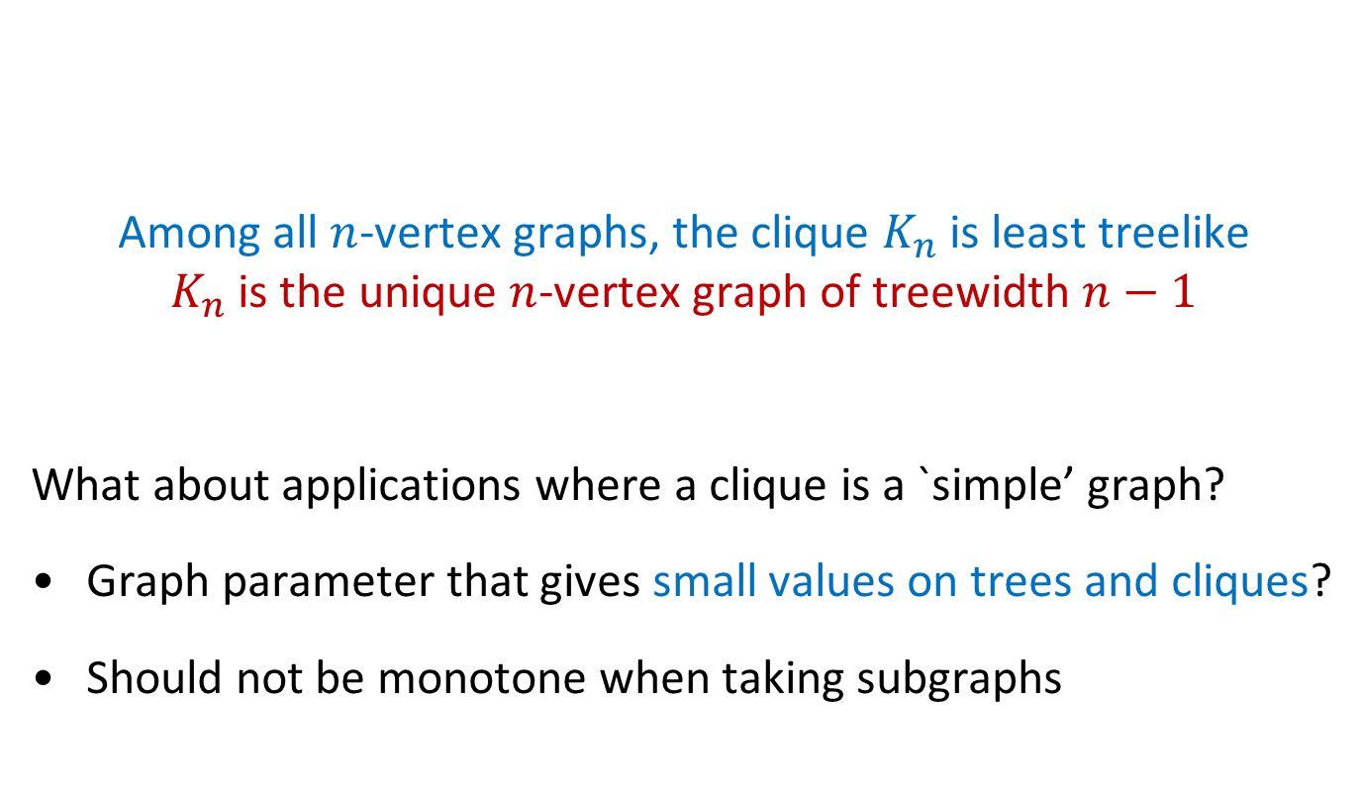
What if treewidth is too large?
Among all $n$-vertex graphs, the clique $K_{n}$ is least treelike
$K_{n}$ is the unique $n$-vertex graph of treewidth $n−1$
What about applications where a clique is a `simple’ graph?
Graph parameter that gives small values on trees and cliques?
Should not be monotone when taking subgraphs
Notes:
To show on board: if G has a non-edge uv, then treewidth(G) <= n-2.

Slide 30
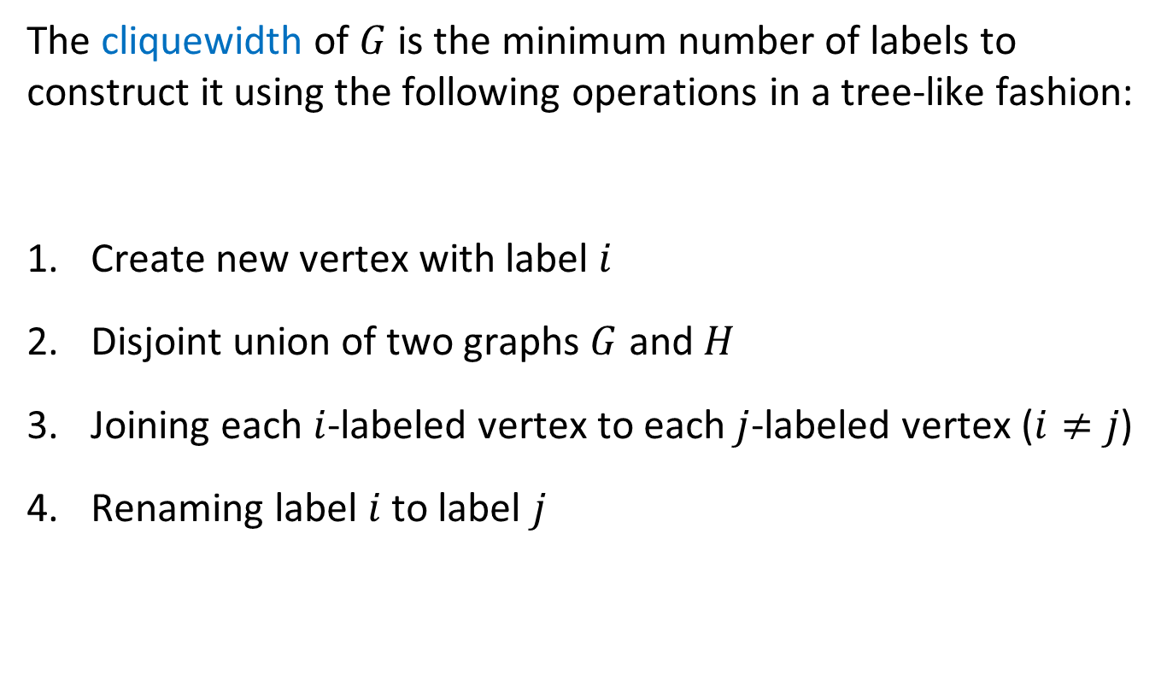
Cliquewidth
The cliquewidth of $G$ is the minimum number of labels to construct it using the following operations in a tree-like fashion:
Create new vertex with label $i$
Disjoint union of two graphs $G$ and $H$
Joining each $i$-labeled vertex to each $j$-labeled vertex ($i≠j$)
Renaming label $i$ to label $j$
Notes:
Hard to work with algorithmically; not known if computing cliquewidth is NP-complete.

Slide 31
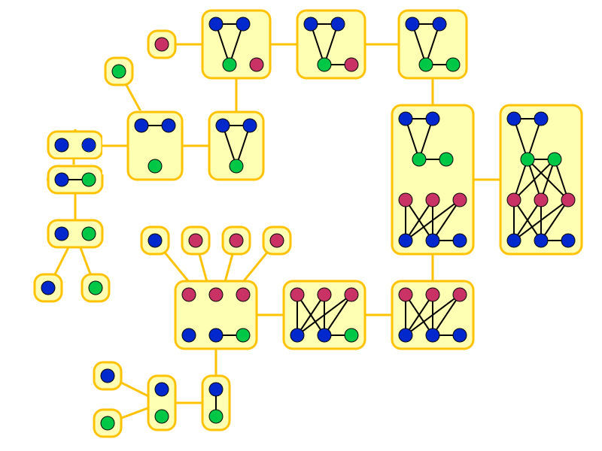
Constructing a graph of cliquewidth 3
Figure by David Eppstein

Slide 32
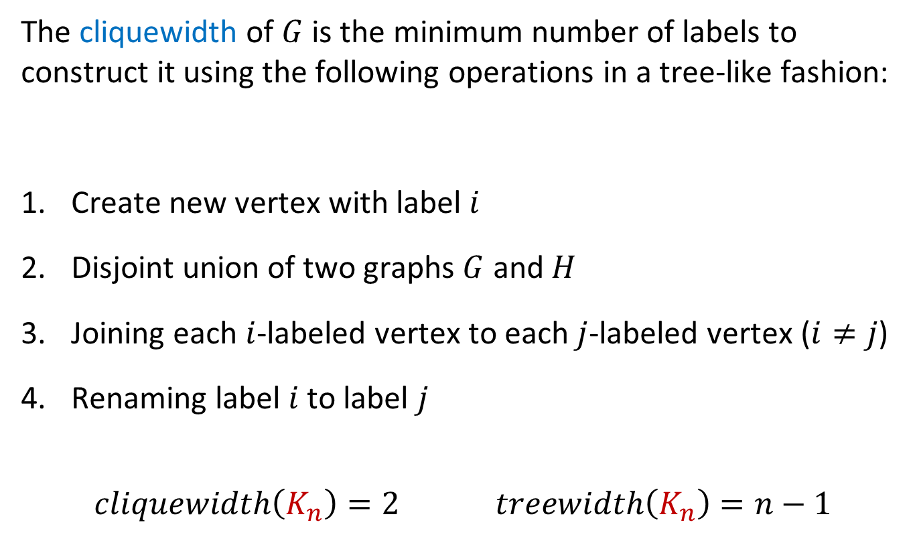
Cliquewidth
The cliquewidth of $G$ is the minimum number of labels to construct it using the following operations in a tree-like fashion:
Create new vertex with label $i$
Disjoint union of two graphs $G$ and $H$
Joining each $i$-labeled vertex to each $j$-labeled vertex ($i≠j$)
Renaming label $i$ to label $j$
$$cliquewidth\left(K_{n}\right)=2 treewidth\left(K_{n}\right)=n−1$$
Notes:
Hard to work with algorithmically; not known if computing cliquewidth is NP-complete.

Slide 33

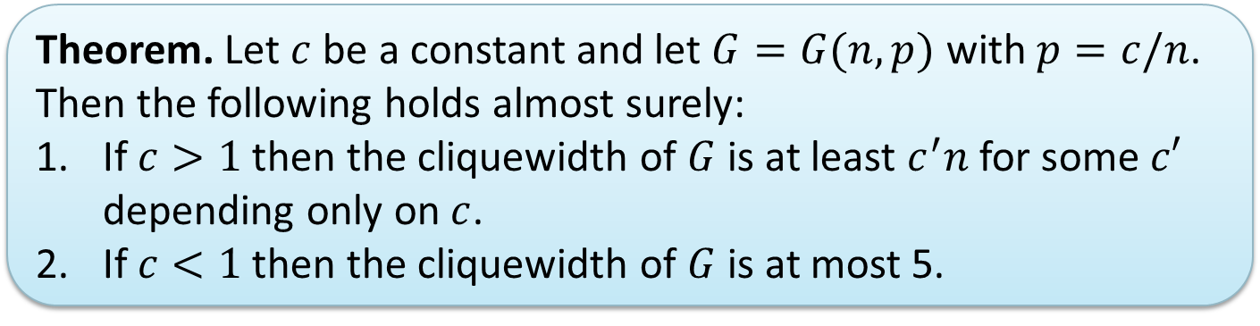
Cliquewidth of random Erdös-Rényi graphs
Random graph $G(n,p)$
Each edge is independently present with probability $p=p(n)$
  Theorem. Let $c$ be a constant and let $G=G(n,p)$ with $p=c/n$. Then the following holds almost surely:
  If $c>1$ then the cliquewidth of $G$ is at least $c^{′}n$ for some $c′$ depending only on $c$.
  If $c<1$ then the cliquewidth of $G$ is at most 5.
[Lee, Lee, Oum, ‘12]
Notes:
There are also results for preferential attachment model. (As soon as >= 12 neighbors, treewidth is linear.)

Slide 34
exercises on treewidth

Slide 35

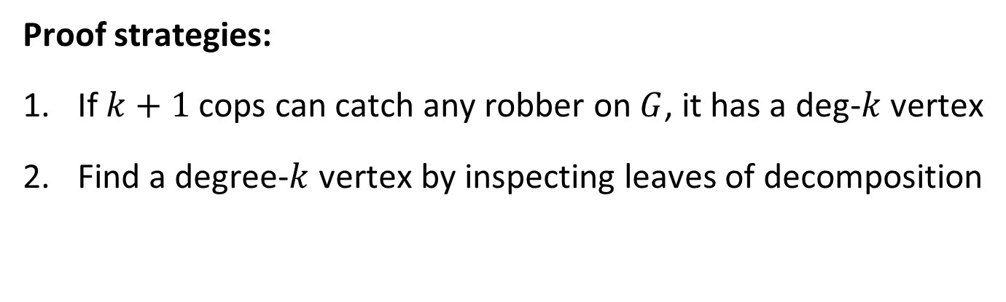
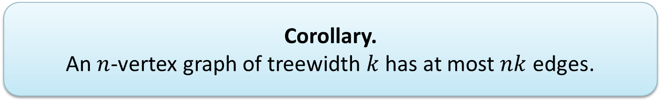
Small-treewidth graphs have a low-degree vertex
  Lemma. If $G$ has treewidth $k$,
  then $G$ has a vertex of degree at most $k$.
Proof strategies:
If $k+1$ cops can catch any robber on $G$, it has a deg-$k$ vertex
Find a degree-$k$ vertex by inspecting leaves of decomposition
  Corollary.
  An $n$-vertex graph of treewidth $k$ has at most $nk$ edges.

Slide 36
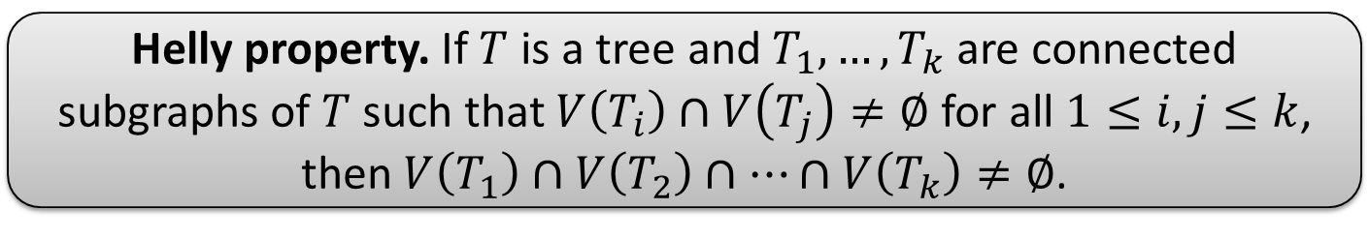
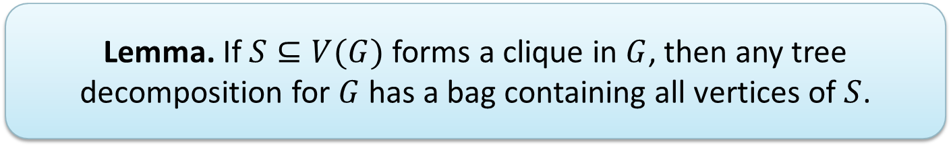

Cliques are represented in tree decompositions
  Lemma. If $S⊆V(G)$ forms a clique in $G$, then any tree decomposition for $G$ has a bag containing all vertices of $S$.
  Helly property. If $T$ is a tree and $T_{1},…,T_{k}$ are connected subgraphs of $T$ such that $V\left(T_{i}\right)∩V\left(T_{j}\right)≠∅$ for all $1≤i,j≤k$,
  then $V\left(T_{1}\right)∩V\left(T_{2}\right)∩…∩V\left(T_{k}\right)≠∅$.
  Corollary.
  If $G$ has a clique of size $k$, then $treewidth\left(G\right)≥k−1$.

Slide 37
Closing remarks

Slide 38
A hierarchy of graph parameters
$A$
$$B\left(G\right)≤A\left(G\right)+1$$
$B$
Vertex-deletion distance to edgeless
$$Cutwidth$$
Vertex-deletion distance to paths
Length of longest cycle
$$Pathwidth$$
Vertex-deletion distance to acyclic
$$Treewidth$$
Degeneracy
$$Cliquewidth$$
Notes:
Nontrivial facts: Treewidth <= circumference, pathwidth <= cutwidth.

Slide 39
Summary
Various sets of rules for cops-and-robber games yield:
  Different graph parameters
  Associated graph decompositions representing strategies
Hierarchy of parameters suggests a research methodology
  Tackle problem for small values of restrictive parameter
  Then generalize to more robust parameters
Applications on Thursday
THANK YOU!

Slide 40




