Slide 1


Structural graph parameters
Part 3: Applications
Bart M. P. Jansen
Networks Training Week 2017
January 31st – February 2nd 2017, Doorn, Netherlands

Slide 2
Plan for today
Algorithms on tree decompositions
Independent Set reconfiguration
Tackling a party planning problem
The Planar Disjoint Paths problem
Provably effective preprocessing

Slide 3
Algorithms exploiting graph structure

Slide 4
Algorithms using tree structure
Many problems that are NP-complete in general,
can be solved efficiently on graphs of bounded treewidth
  Independent Set, Dominating Set, 3-Coloring,
  Hamiltonian Cycle, Clique, Feedback Vertex Set,
  Disjoint Paths, Partition into Triangles, …
Tree-like structure can be exploited by dynamic programming
Two-step presentation:
  Dynamic programming on trees
  Dynamic programming on tree decompositions

Slide 5









The party problem
We are planning a party in a hierarchical company
Each employee has a fun factor that they would contribute
Goal: invite people that maximize the total fun factor
Constraint: a party is no fun when your direct boss is present

Slide 6

The party crowd forms an independent set
Input: A tree $T$ with a weight $w(v)$ for each $v∈V\left(T\right)$
Task: Find independent set $S⊆V(T)$ maximizing $\sum_{v∈S}{w\left(v\right)}$
Easy if all weights are equal – weights make it interesting
Focus on computing the value of an optimal solution

Slide 7


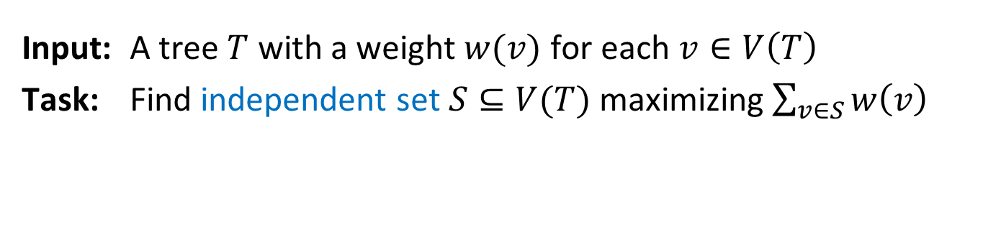
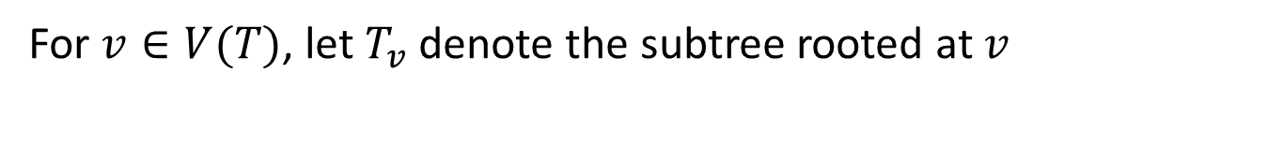
Solving the party problem
Input: A tree $T$ with a weight $w(v)$ for each $v∈V\left(T\right)$
Task: Find independent set $S⊆V(T)$ maximizing $\sum_{v∈S}{w\left(v\right)}$
For $v∈V(T)$, let $T_{v}$ denote the subtree rooted at $v$
$$v$$
$$T_{v}$$

Slide 8
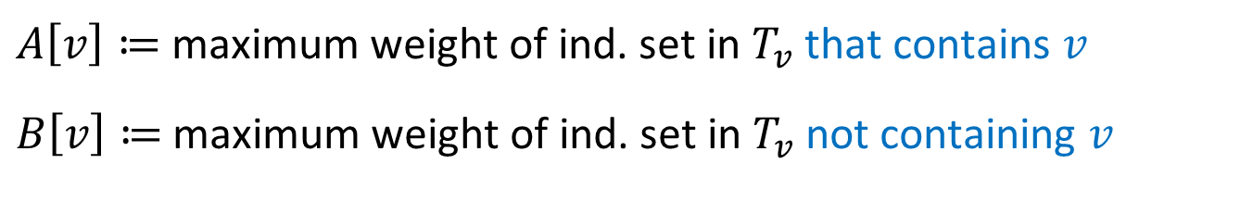
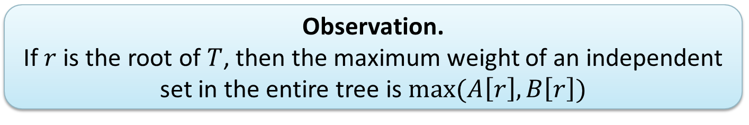
Subproblems for subtrees
$A\left[v\right]≔$maximum weight of ind. set in $T_{v}$ that contains $v$
$B\left[v\right]≔$maximum weight of ind. set in $T_{v}$ not containing $v$
For $v∈V(T)$, let $T_{v}$ denote the subtree rooted at $v$
  Observation.
  If $r$ is the root of $T$, then the maximum weight of an independent set in the entire tree is $max⁡(A\left[r\right],B\left[r\right])$
$$v$$
$$T_{v}$$
Notes:
To solve the party problem it suffices to compute A[r] and B[r].

Slide 9
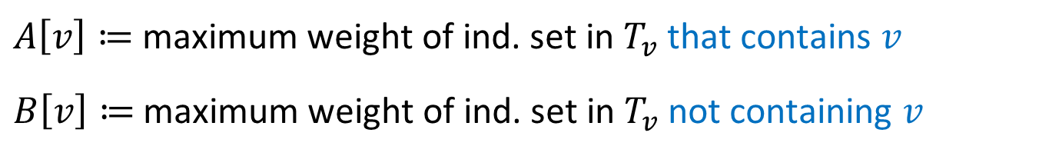

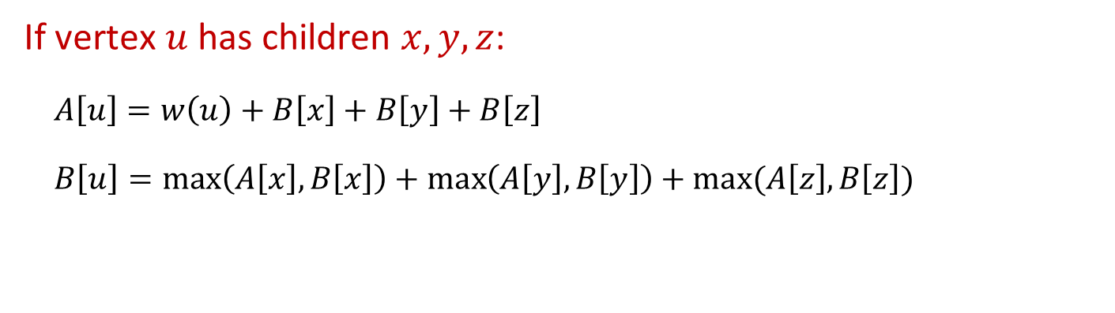



An expression using child values
$A\left[v\right]≔$maximum weight of ind. set in $T_{v}$ that contains $v$
$B\left[v\right]≔$maximum weight of ind. set in $T_{v}$ not containing $v$
If vertex $u$ has children $x,y,z$:
$A\left[u\right]=w\left(u\right)+B\left[x\right]+B\left[y\right]+B\left[z\right]$
$B\left[u\right]=\max\left(A\left[x\right],B\left[x\right]\right)+\max\left(A\left[y\right],B\left[y\right]\right)+max⁡(A\left[z\right],B\left[z\right])$
$u$
$x$
$y$
$z$

Slide 10

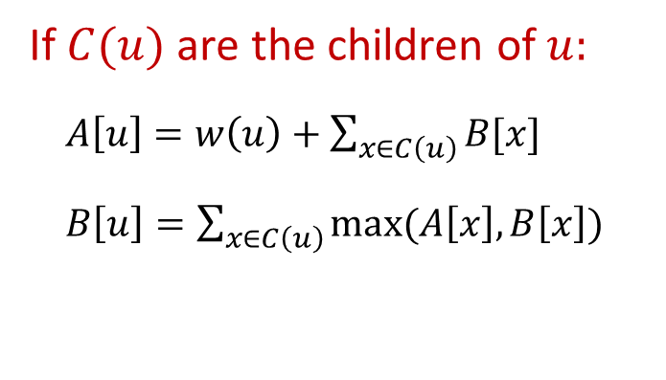
General recurrence
$A\left[v\right]≔$maximum weight of ind. set in $T_{v}$ that contains $v$
$B\left[v\right]≔$maximum weight of ind. set in $T_{v}$ not containing $v$
If $C(u)$ are the children of $u:$
$A\left[u\right]=w\left(u\right)+\sum_{x∈C\left(u\right)}{B[x]}$
$B\left[u\right]=\sum_{x∈C\left(u\right)}{max⁡(A\left[x\right],B\left[x\right])}$
If $u$ is a leaf$:$
$A\left[u\right]=w\left(u\right)$
$B\left[u\right]=0$
$u$
$x$
$y$
$z$

Slide 11

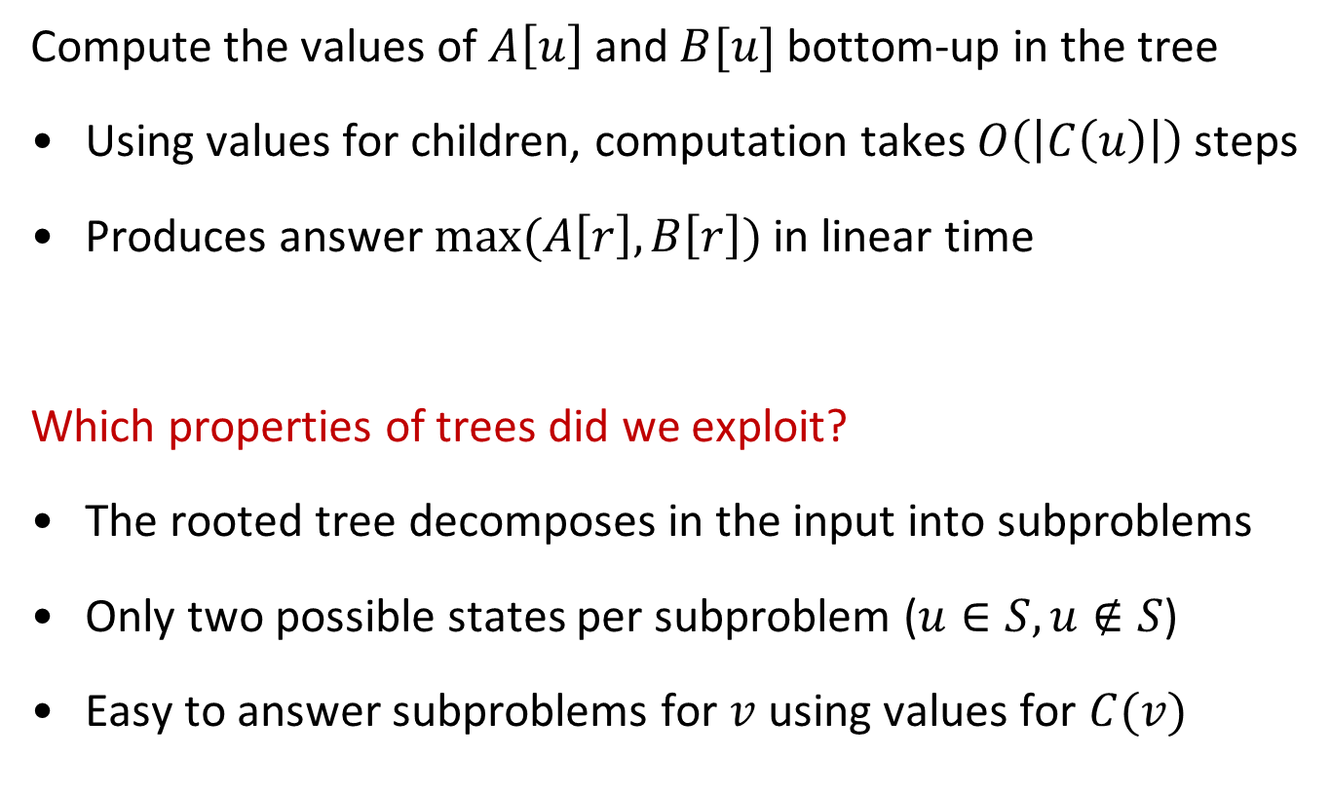
Solving the party problem using the recurrence
Compute the values of $A\left[u\right]$ and $B[u]$ bottom-up in the tree
Using values for children, computation takes $O\left(\left|C\left(u\right)\right|\right)$ steps
Produces answer $max⁡(A\left[r\right],B\left[r\right])$ in linear time
Which properties of trees did we exploit?
The rooted tree decomposes in the input into subproblems
Only two possible states per subproblem ($u∈S, u∉S$)
Easy to answer subproblems for $v$ using values for $C(v)$
  Theorem. An independent set of maximum weight
  in an $n$-vertex tree can be found in $O(n)$ time.

Slide 12
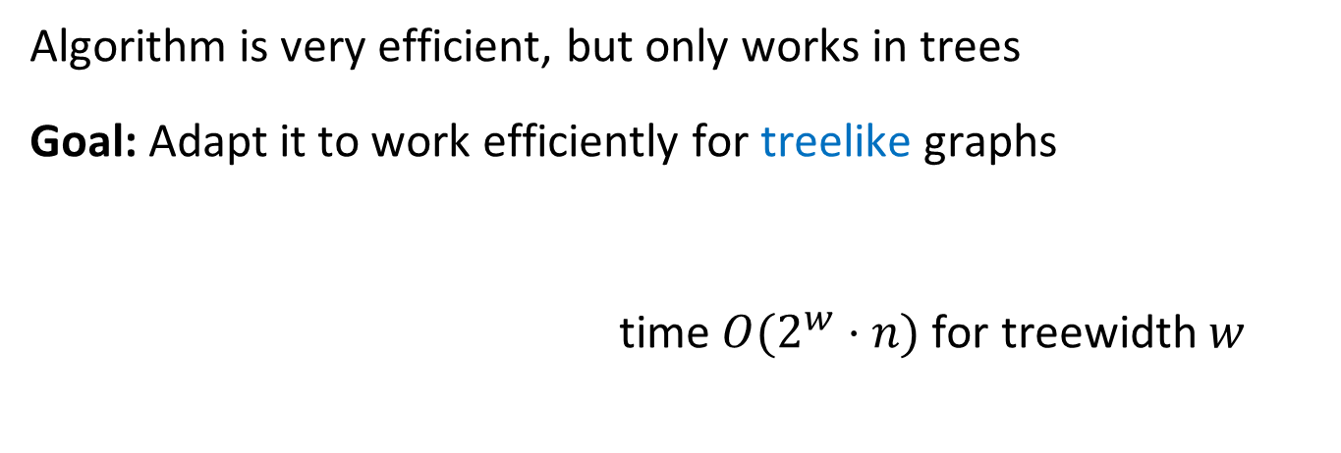
General algorithm for Independent Set
  Theorem. An independent set of maximum weight
  in an $n$-vertex tree can be found in $O(n)$ time.
Algorithm is very efficient, but only works in trees
Goal: Adapt it to work efficiently for treelike graphs
time ${O(2}^{w}⋅n)$ for treewidth $w$

Slide 13
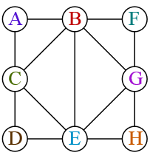
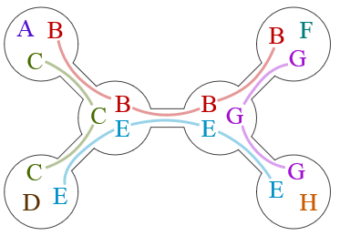


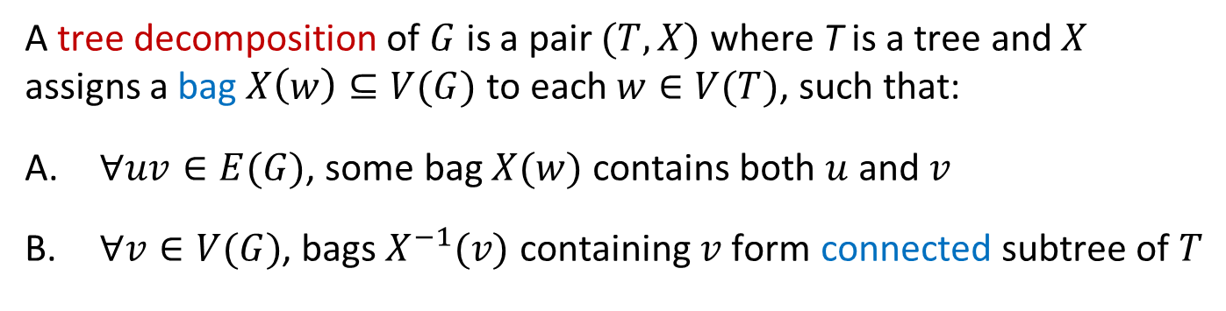
Tree decompositions
Graph $G$
Tree decomposition $(T,X)$
A tree decomposition of $G$ is a pair $(T,X)$ where T is a tree and $X$ assigns a bag $X\left(w\right)⊆V(G)$ to each $w∈V(T)$, such that:
$∀uv∈E(G)$, some bag $X(w)$ contains both $u$ and $v$
$∀v∈V(G)$, bags $X^{−1}(v)$ containing $v$ form connected subtree of $T$

Slide 14


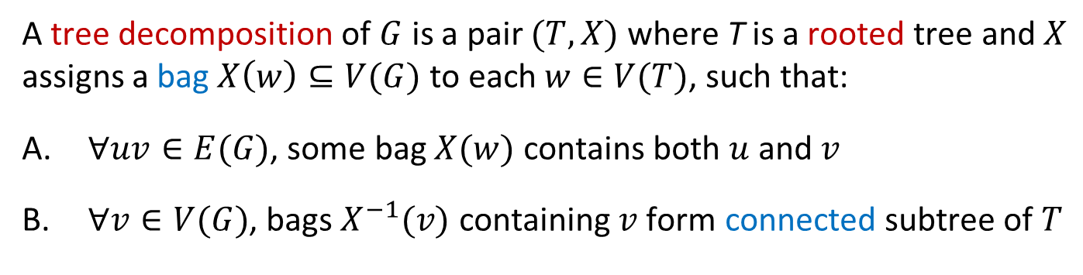





Rooted tree decompositions
Graph $G$
Rooted tree decomposition $(T,X)$
bce
$r$
beg
cde
abc
$x$
$z$
$y$
bfg
egh
$u$
$v$
A tree decomposition of $G$ is a pair $(T,X)$ where T is a rooted tree and $X$ assigns a bag $X\left(w\right)⊆V(G)$ to each $w∈V(T)$, such that:
$∀uv∈E(G)$, some bag $X(w)$ contains both $u$ and $v$
$∀v∈V(G)$, bags $X^{−1}(v)$ containing $v$ form connected subtree of $T$

Slide 15
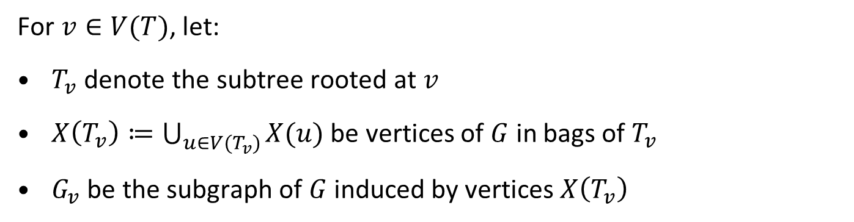



The tree decomposes the graph
Graph $G$
Rooted tree decomposition $(T,X)$
bce
$r$
$$G_{z}$$
$$T_{x}$$
beg
cde
abc
$x$
$z$
$y$
bfg
egh
$u$
$v$
$$G_{x}$$
For $v∈V(T)$, let:
$T_{v}$ denote the subtree rooted at $v$
$X\left(T_{v}\right)≔\bigcup_{u∈{V(T}_{v})}{X(u)}$ be vertices of $G$ in bags of $T_{v}$
$G_{v}$ be the subgraph of $G$ induced by vertices $X\left(T_{v}\right)$

Slide 16
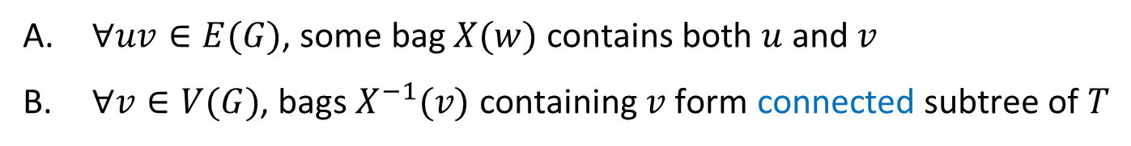

The tree decomposes the graph
Graph $G$
Rooted tree decomposition $(T,X)$
bce
$r$
$$G_{z}$$
$$T_{x}$$
beg
cde
abc
$x$
$z$
$y$
bfg
egh
$u$
$v$
$$G_{x}$$
  Claim. For any node $x∈V(T)$, each vertex of $G_{x}$ that has a neighbor outside $G_{x}$, belongs to the bag $X(x)$.
$∀uv∈E(G)$, some bag $X(w)$ contains both $u$ and $v$
$∀v∈V(G)$, bags $X^{−1}(v)$ containing $v$ form connected subtree of $T$
Vertices in $X(T_{v})$ only communicate with the outside through $X(v)$

Slide 17
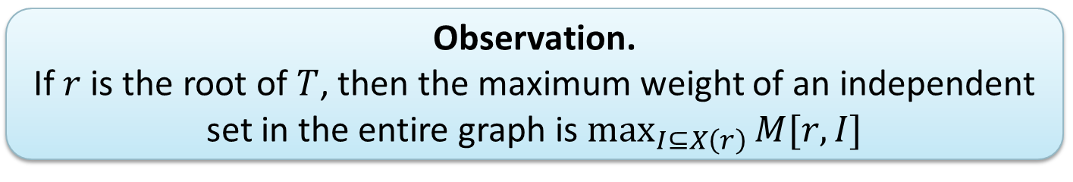
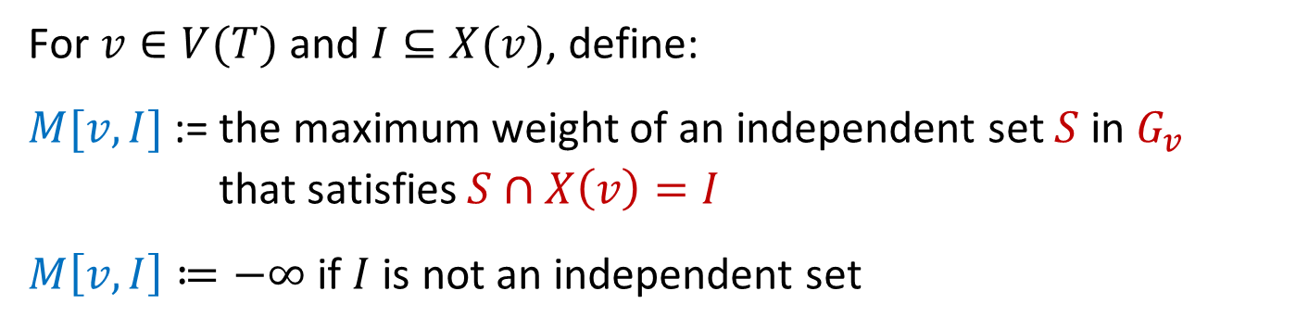
Subproblems for nodes of the decomposition
Graph $G$
Rooted tree decomposition $(T,X)$
bce
$r$
$$G_{z}$$
$$T_{x}$$
  Observation.
  If $r$ is the root of $T$, then the maximum weight of an independent set in the entire graph is $\max_{I⊆X\left(r\right)}{M[r,I]}$
beg
cde
abc
$x$
$z$
$y$
bfg
egh
$u$
$v$
$$G_{x}$$
For $v∈V(T)$ and $I⊆X(v)$, define:
$M[v,I]$:= the maximum weight of an independent set $S$ in $G_{v}$
  that satisfies $S∩X\left(v\right)=I$
$M\left[v,I\right]≔−∞$ if $I$ is not an independent set
Notes:
Compare to the tree setting where we had A[v] and T[v] depending on whether v is in the independent set.

Slide 18
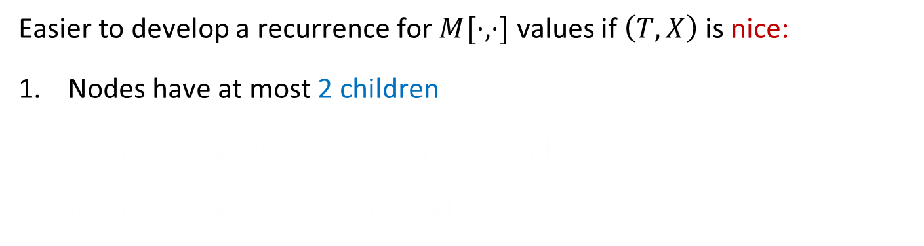
Nice tree decompositions
Graph $G$
Rooted tree decomposition $(T,X)$
bce
$r$
beg
cde
abc
$x$
$z$
$y$
bfg
egh
$u$
$v$
Easier to develop a recurrence for $M[⋅, ⋅]$ values if $\left(T,X\right)$ is nice:
Nodes have at most 2 children
If a node $p$ has 1 child $u$, then $X(p)$ and $X(u)$ differ by $≤1$ vertex
If a node $p$ has 2 children $u$ and $v$, then $X\left(p\right)=X\left(u\right)=X(v)$

Slide 19
Making a tree decomposition nice
Graph $G$
bce
beg
cde
abc
bfg
egh
Easier to develop a recurrence for $M[⋅, ⋅]$ values if $\left(T,X\right)$ is nice:
Nodes have at most 2 children
If a node $p$ has 1 child $u$, then $X(p)$ and $X(u)$ differ by $≤1$ vertex
If a node $p$ has 2 children $u$ and $v$, then $X\left(p\right)=X\left(u\right)=X(v)$

Slide 20
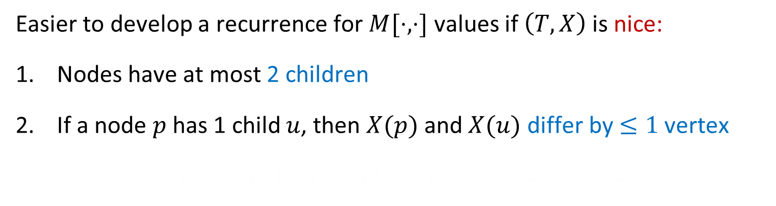
Making a tree decomposition nice
bce
Graph $G$
bce
abc
beg
cde
bfg
egh
Easier to develop a recurrence for $M[⋅, ⋅]$ values if $\left(T,X\right)$ is nice:
Nodes have at most 2 children
If a node $p$ has 1 child $u$, then $X(p)$ and $X(u)$ differ by $≤1$ vertex
If a node $p$ has 2 children $u$ and $v$, then $X\left(p\right)=X\left(u\right)=X(v)$

Slide 21
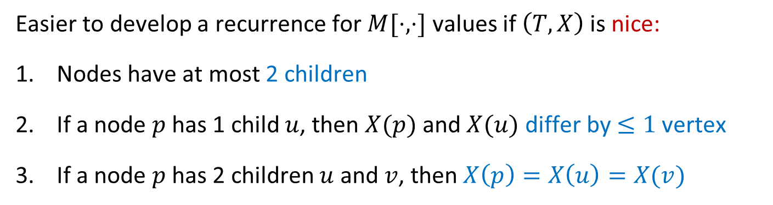
Making a tree decomposition nice
bce
Graph $G$
bce
bc
beg
cde
abc
bfg
egh
Easier to develop a recurrence for $M[⋅, ⋅]$ values if $\left(T,X\right)$ is nice:
Nodes have at most 2 children
If a node $p$ has 1 child $u$, then $X(p)$ and $X(u)$ differ by $≤1$ vertex
If a node $p$ has 2 children $u$ and $v$, then $X\left(p\right)=X\left(u\right)=X(v)$

Slide 22
Making a tree decomposition nice
bce
Graph $G$
bce
bc
bce
bce
abc
beg
cde
bfg
egh
Easier to develop a recurrence for $M[⋅, ⋅]$ values if $\left(T,X\right)$ is nice:
Nodes have at most 2 children
If a node $p$ has 1 child $u$, then $X(p)$ and $X(u)$ differ by $≤1$ vertex
If a node $p$ has 2 children $u$ and $v$, then $X\left(p\right)=X\left(u\right)=X(v)$

Slide 23


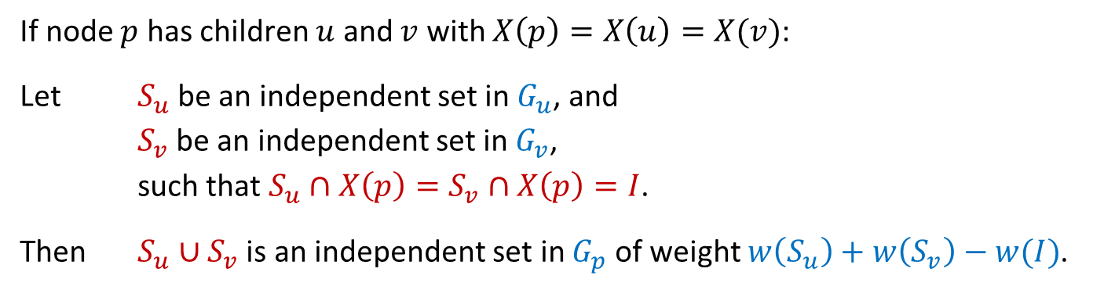






Structure of nice decompositions
bce
$$T_{p}$$
bce
Graph $G$
$p$
bc
$$T_{u}$$
bce
bce
$u$
$v$
$$T_{v}$$
abc
$$G_{u}$$
beg
cde
$$G_{v}$$
bfg
egh
If node $p$ has children $u$ and $v$ with $X\left(p\right)=X\left(u\right)=X(v)$:
Let $S_{u}$ be an independent set in $G_{u}$, and
$S_{v}$ be an independent set in $G_{v}$,
such that $S_{u}∩X\left(p\right)=S_{v}∩X\left(p\right)=I$.
Then $S_{u}∪S_{v}$ is an independent set in $G_{p}$ of weight $w\left(S_{u}\right)+w\left(S_{v}\right)−w(I)$.

Slide 24
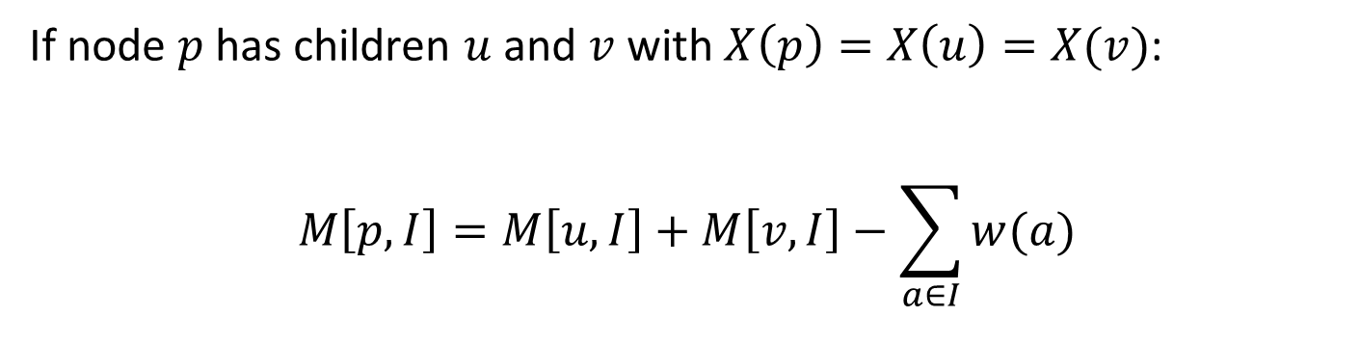

A recurrence for $M$
bce
bce
Graph $G$
$p$
bc
bce
bce
$u$
$v$
abc
beg
cde
bfg
egh
If node $p$ has children $u$ and $v$ with $X\left(p\right)=X\left(u\right)=X(v)$:
$$M\left[p,I\right]=M\left[u,I\right]+M\left[v,I\right]−\sum_{a∈I}{w(a)}$$

Slide 25

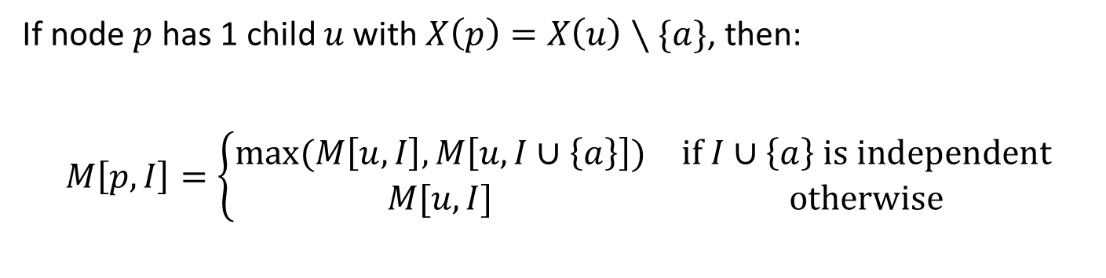

A recurrence for $M$
bce
Graph $G$
bce
bc
$p$
bce
bce
abc
$u$
beg
cde
bfg
egh
If node $p$ has 1 child $u$ with $X\left(p\right)=X\left(u\right)∖\{a\}$, then:
$$M\left[p,I\right]=\left\{\begin{matrix}max⁡(M\left[u,I\right],M\left[u,I∪\left\{a\right\}\right]) & if I∪\left\{a\right\} is independent \\ M[u,I] & otherwise\end{matrix}\right.$$

Slide 26

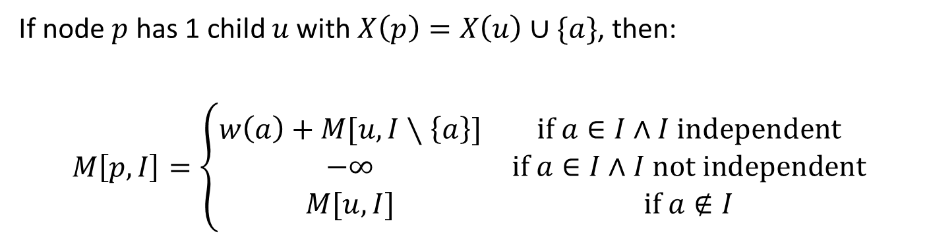

A recurrence for $M$
bce
$p$
Graph $G$
bce
bc
$u$
bce
bce
abc
beg
cde
bfg
egh
If node $p$ has 1 child $u$ with $X\left(p\right)=X\left(u\right)∪\{a\}$, then:
$$M\left[p,I\right]=\left\{\begin{matrix}w\left(a\right)+M[u,I∖\left\{a\right\}] & if a∈I∧I independent \\ −∞ & if a∈I∧I not independent \\ M[u,I] & if a∉I\end{matrix}\right.$$

Slide 27
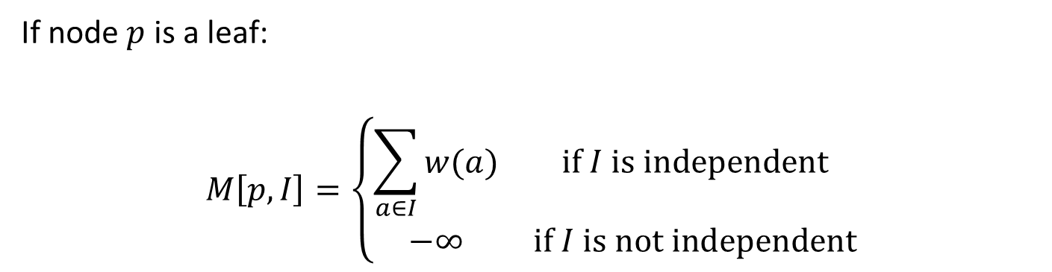

A recurrence for $M$
bce
Graph $G$
bce
bc
bce
bce
abc
$p$
beg
cde
bfg
egh
If node $p$ is a leaf:
$$M\left[p,I\right]=\left\{\begin{matrix}\sum_{a∈I}{w(a)} & if I is independent \\ −∞ & if I is not independent\end{matrix}\right.$$

Slide 28
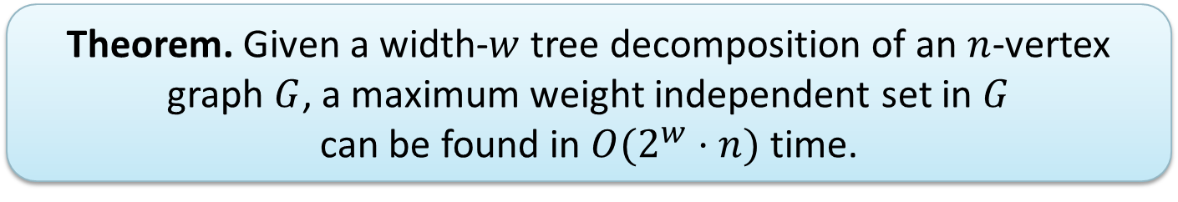
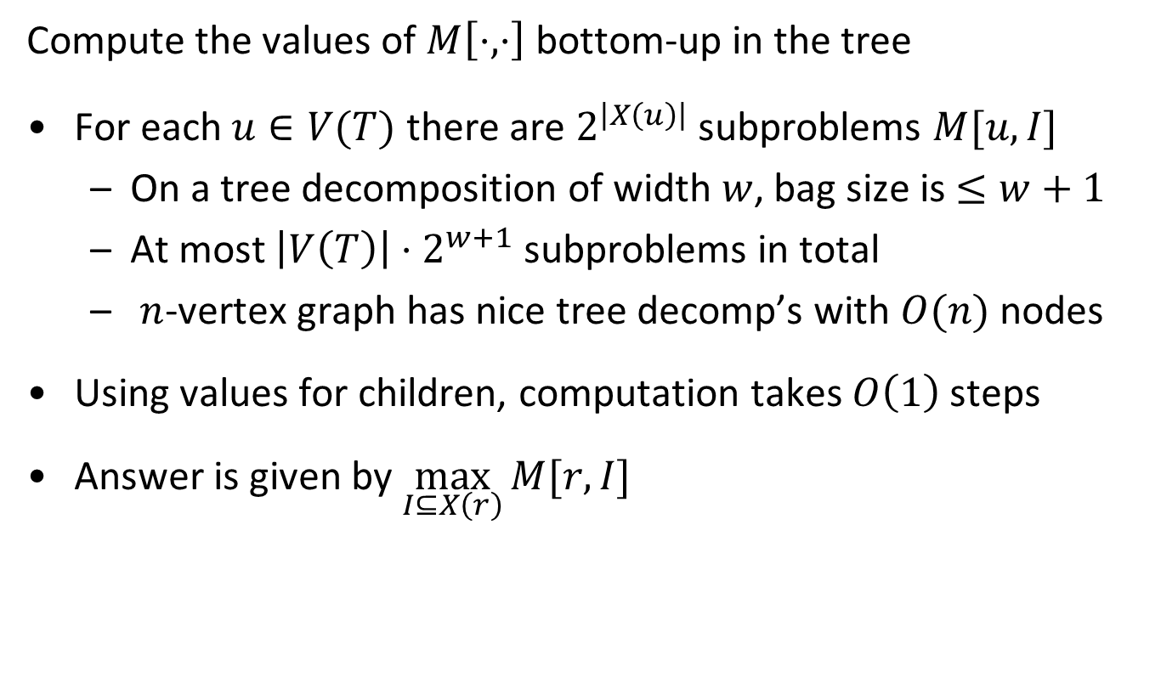
Solving Independent Set using the recurrence
Compute the values of $M\left[⋅,⋅\right]$ bottom-up in the tree
For each $u∈V(T)$ there are $2^{\left|X\left(u\right)\right|}$ subproblems $M[u,I]$
  On a tree decomposition of width $w$, bag size is $≤w+1$
  At most $\left|V\left(T\right)\right|⋅2^{w+1}$ subproblems in total
  $n$-vertex graph has nice tree decomp’s with $O(n)$ nodes
Using values for children, computation takes $O\left(1\right)$ steps
Answer is given by $\max_{I⊆X\left(r\right)}{M[r,I]}$
  Theorem. Given a width-$w$ tree decomposition of an $n$-vertex graph $G$, a maximum weight independent set in $G$
  can be found in $O(2^{w}⋅n)$ time.

Slide 29
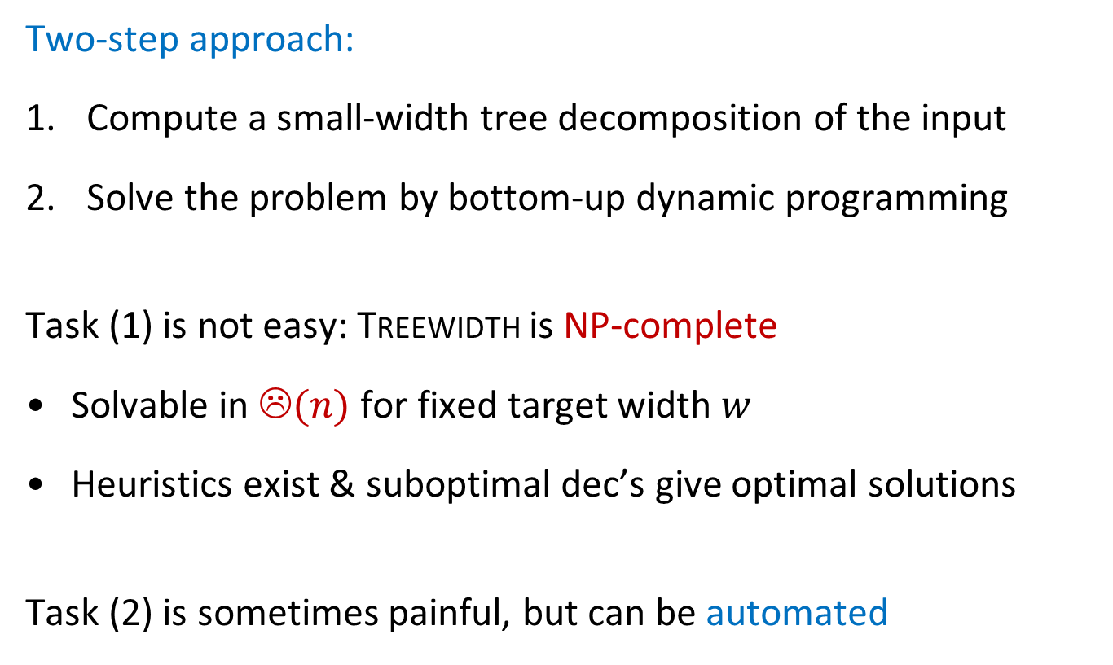
Algorithms on bounded-treewidth graphs
Two-step approach:
Compute a small-width tree decomposition of the input
Solve the problem by bottom-up dynamic programming
Task (1) is not easy: Treewidth is NP-complete
Solvable in ☹$(n)$ for fixed target width $w$
Heuristics exist & suboptimal dec’s give optimal solutions
Task (2) is sometimes painful, but can be automated

Slide 30
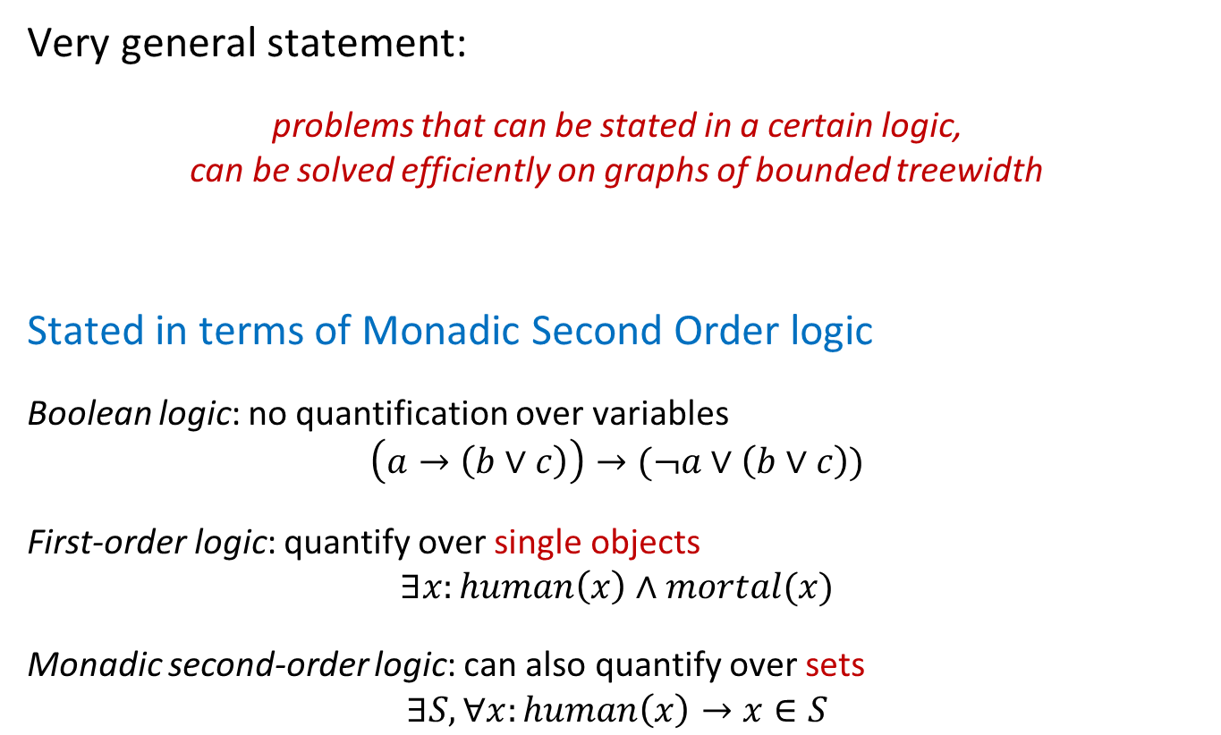
A meta-theorem
Very general statement:
problems that can be stated in a certain logic,
can be solved efficiently on graphs of bounded treewidth
Stated in terms of Monadic Second Order logic
Boolean logic: no quantification over variables
$$\left(a→\left(b∨c\right)\right)→(¬a∨\left(b∨c\right))$$
First-order logic: quantify over single objects
$$∃x:human\left(x\right)∧mortal(x)$$
Monadic second-order logic: can also quantify over sets
$$∃S,∀x:human\left(x\right)→x∈S$$

Slide 31
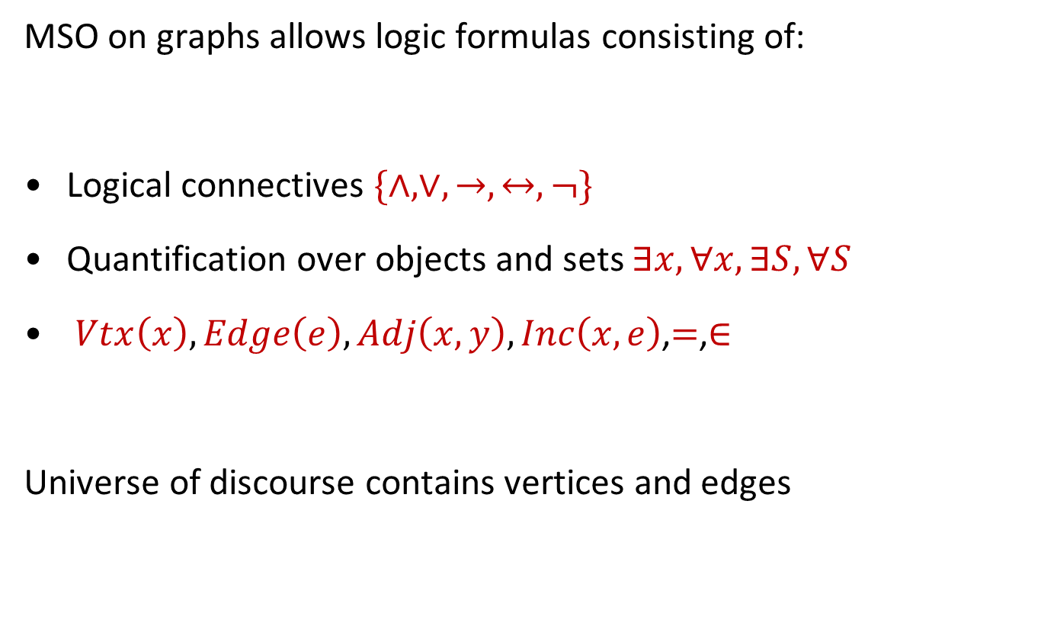
Monadic second-order logic on graphs
MSO on graphs allows logic formulas consisting of:
Logical connectives $\{∧, ∨, →,↔, ¬\}$
Quantification over objects and sets $∃x,∀x,∃S,∀S$
$Vtx\left(x\right), Edge\left(e\right),Adj\left(x,y\right),Inc\left(x,e\right)$,$=$,$∈$
Universe of discourse contains vertices and edges

Slide 32
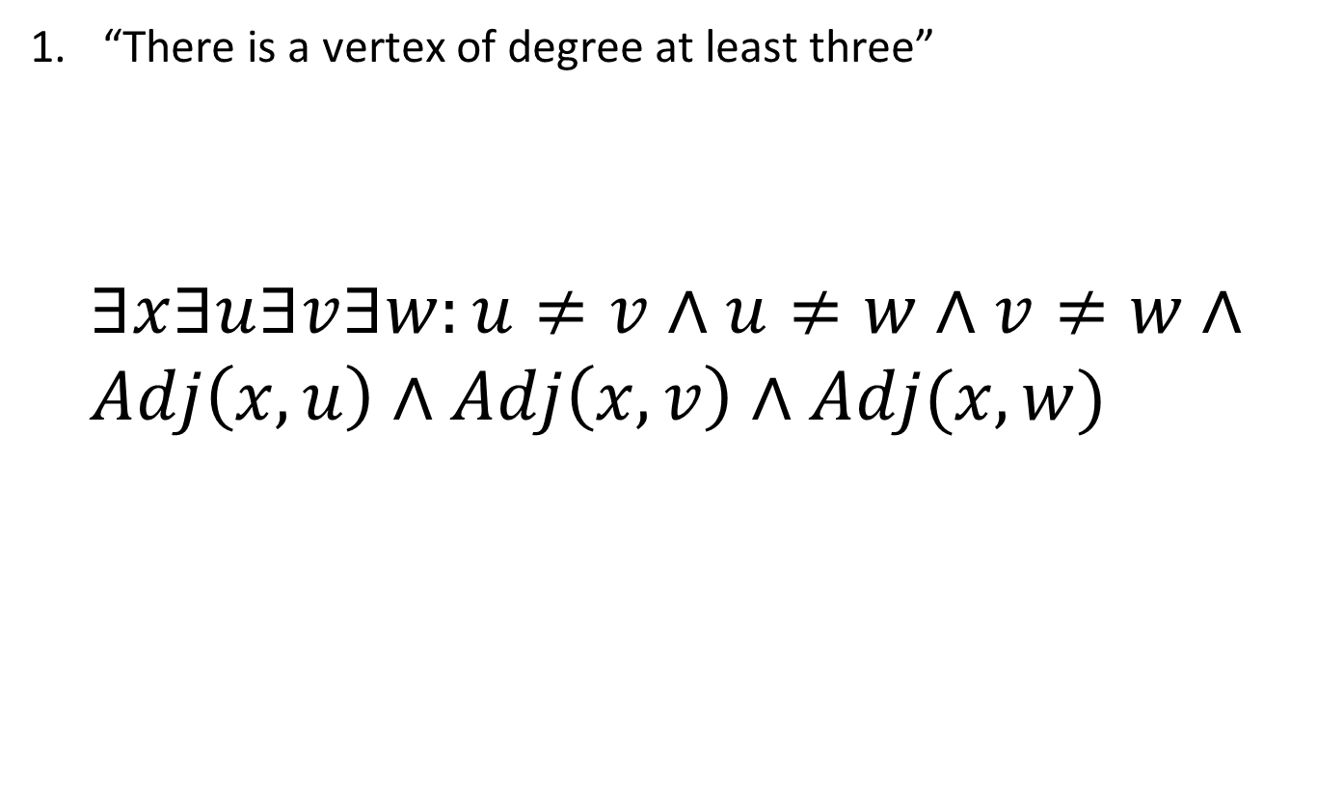
Examples of MSO expressions for graphs
“There is a vertex of degree at least three”
$$∃x∃u∃v∃w:u≠v∧u≠w∧v≠w∧ \\ Adj\left(x,u\right)∧Adj\left(x,v\right)∧Adj(x,w)$$

Slide 33
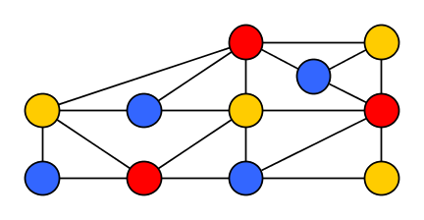
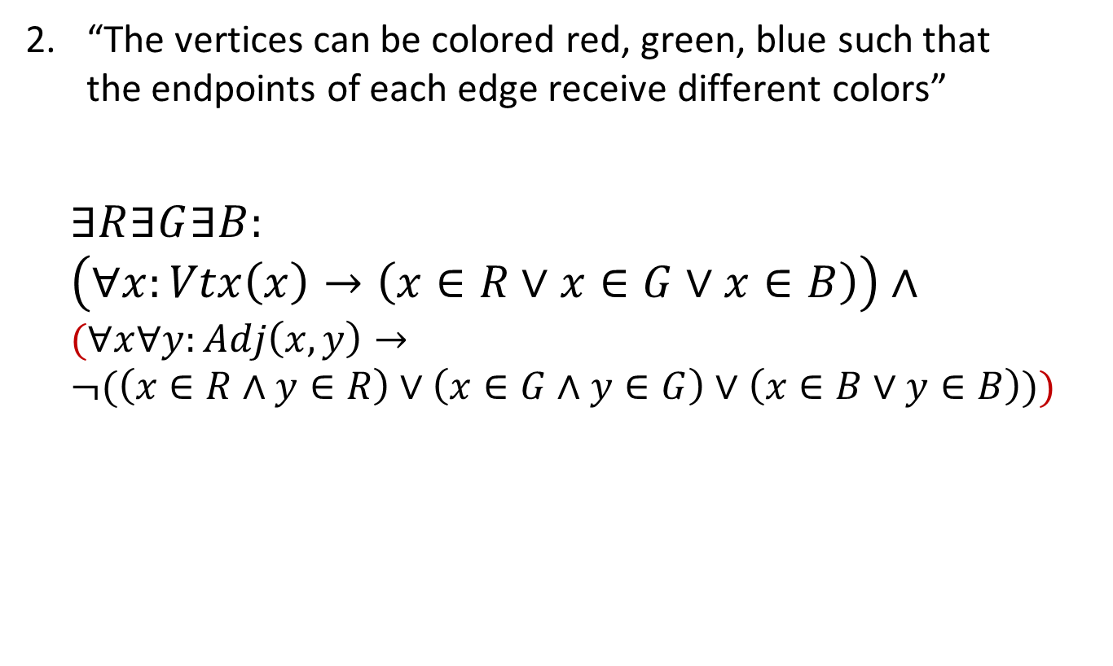
Examples of MSO expressions for graphs
“The vertices can be colored red, green, blue such that
the endpoints of each edge receive different colors”
$$∃R∃G∃B: \\ \left(∀x:Vtx\left(x\right)→\left(x∈R∨x∈G∨x∈B\right)\right)∧ \\ (∀x∀y:Adj\left(x,y\right)→ \\ ¬(\left(x∈R∧y∈R\right)∨\left(x∈G∧y∈G\right)∨\left(x∈B∨y∈B\right)))$$

Slide 34

Examples of MSO expressions for graphs
“There is an independent set of 4 vertices”
$$∃x_{1}…x_{4}:\bigwedge_{i=1}^{4}{Vtx\left(x_{i}\right)∧\bigwedge_{1≤i<j≤4}{(x_{i}≠x_{j}}}∧¬Adj(x_{i},x_{j}))$$

Slide 35

Exercise: Formulating properties in MSO
Which formula $φ$ expresses “the graph is connected”?
(Hint: negate “$G$ has 2 different connected components”)

Slide 36
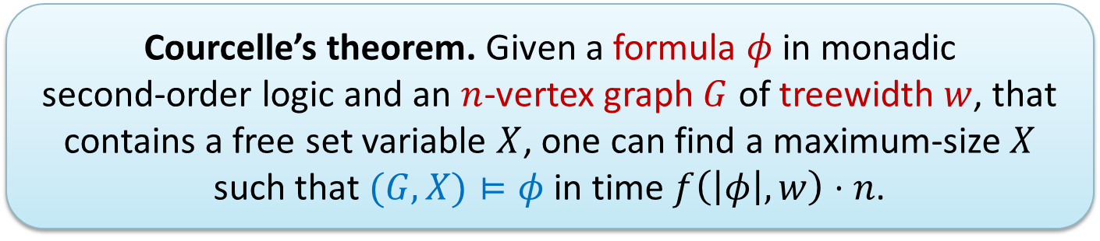
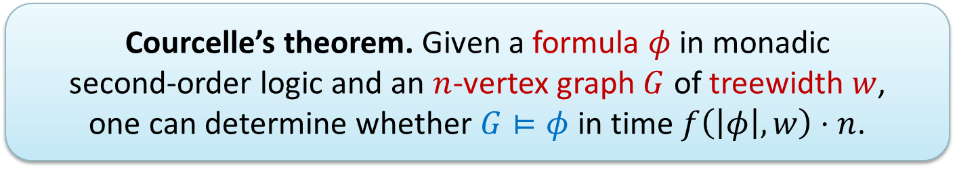
Courcelle’s theorem
  Courcelle’s theorem. Given a formula $φ$ in monadic
  second-order logic and an $n$-vertex graph $G$ of treewidth $w$,
  one can determine whether $G⊨φ$ in time $f\left(\left|φ\right|,w\right)⋅n$.
Extension to optimization problems:
  Courcelle’s theorem. Given a formula $φ$ in monadic
  second-order logic and an $n$-vertex graph $G$ of treewidth $w$, that contains a free set variable $X$, one can find a maximum-size $X$ such that $(G,X)⊨φ$ in time $f\left(\left|φ\right|,w\right)⋅n$.
Same holds for cliquewidth if $φ$ does not quantify over edge sets

Slide 37
Reconfiguring independent sets
A combinatorial application

Slide 38
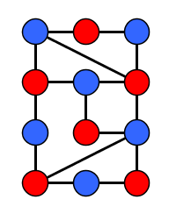

Reconfiguring between independent sets
Given: Two independent sets $I,J⊆V(G)$ of equal size in $G$
Task: Move tokens from $I$ onto $J$ one token at a time,
such that intermediate token configurations are independent sets, and buffer capacity is minimized
Buffer
1
2

Slide 39

Token addition/removal reconfiguration
Minimum buffer capacity to transform $I$ into $J$
transition time from $I$ to $J$ in Glauber dynamics
(hard-core interaction)
  Question: How does the required buffer capacity
  depend on the structure of the graph?

Slide 40
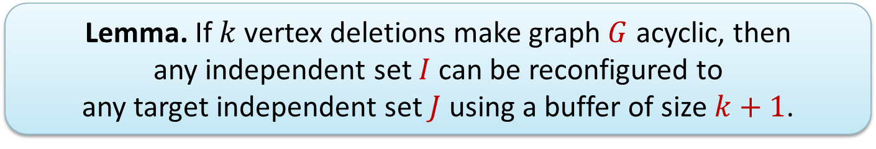
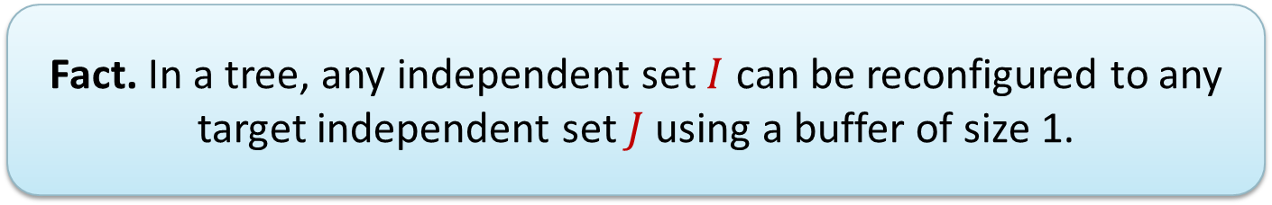
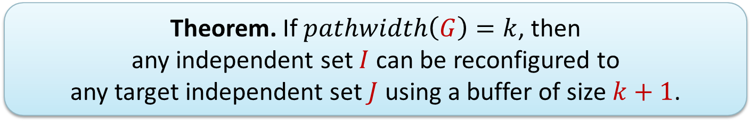
Results on buffer capacity
  Fact. In a tree, any independent set $I$ can be reconfigured to any target independent set $J$ using a buffer of size 1.
  Lemma. If $k$ vertex deletions make graph $G$ acyclic, then
  any independent set $I$ can be reconfigured to
  any target independent set $J$ using a buffer of size $k+1$.
  Theorem. If $pathwidth\left(G\right)=k$, then
  any independent set $I$ can be reconfigured to
  any target independent set $J$ using a buffer of size $k+1$.
[de Berg, J, Mukherjee, FSTTCS ‘16]

Slide 41







A hierarchy of graph parameters
$A$
$$B\left(G\right)≤A\left(G\right)+1$$
$B$
Vertex-deletion distance to edgeless
$$Cutwidth$$
Vertex-deletion distance to paths
Length of longest cycle
$$Pathwidth$$
Vertex-deletion distance to acyclic
$$Treewidth$$
Degeneracy
$$Cliquewidth$$
Notes:
Nontrivial facts: Treewidth <= circumference, pathwidth <= cutwidth.

Slide 42
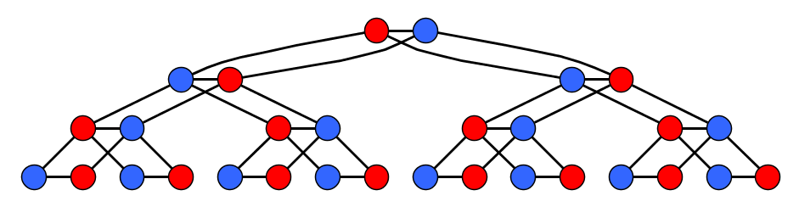

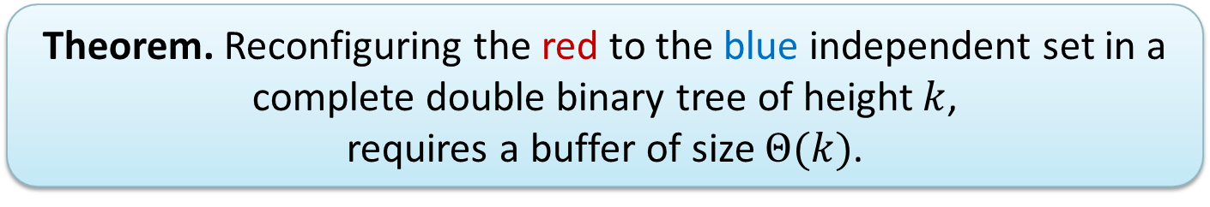
Relation between buffer capacity & treewidth?
the ``complete double binary tree’’:
  Theorem. Reconfiguring the red to the blue independent set in a complete double binary tree of height $k$,
  requires a buffer of size $Θ(k)$.
Simplest graphs with large treewidth & deletion-distance to acyclic?
treewidth:
2
pathwidth:
$$Θ(\log{n)}$$
[de Berg, J, Mukherjee, FSTTCS ‘16]

Slide 43
Structural parameters for provable preprocessing

Slide 44

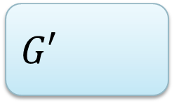
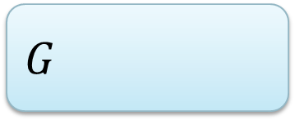






Kernelization: data reduction with a guarantee
Try to shrink the input to a hard computational problem,
without taking much time and without changing the answer
Size guarantee of shrunk instance is expressed wrt. parameter
  Function $f:ℕ→ℕ$ is the size of the kernelization
  Can be exponential or polynomial; smaller is better
$n$ vertices
$f(k)$ vertices
$$G$$
$poly(\left|G\right|,k)$ time
$$G′$$
$$k$$
$$k′$$
  A kernelization guarantees that instances that are large with respect to their complexity parameter can be shrunk

Slide 45




Kernelization for $3$-Coloring
Reduction to size $poly(k)$
Dist. to edgeless
Distance to linear forest
Distance to Split graph components
Distance to Cograph
Feedback Vertex Set
Distance to Interval
Reduction to size $f(k)$
No $poly(k)$ unless
NP $⊆$ coNP/poly
Treewidth
Distance to Chordal
Odd Cycle Transversal
No reduction to size $f(k)$
unless P=NP
Distance to Perfect
Chromatic Number

Slide 46
A win/win approach for planar disjoint paths

Slide 47





The Planar Disjoint Paths problem
Input: Planar undirected graph $G$ and $k$ terminal pairs
$\left(s_{1},t_{1}\right),…, \left(s_{k}, t_{k}\right)∈V\left(G\right)×V(G)$
Task: Find $k$ paths in $G$ such that each $P_{i}$ connects $s_{i}$ to $t_{i}$
and is vertex-disjoint from other paths $P_{j}$
NP-complete, solvable in time $2^{2^{O\left(k\right)}}⋅n^{2}$

Slide 48


A win/win approach
If $G$ has treewidth $O(2^{k}k^{\frac{3}{2}})$:
If the treewidth is larger:
Dynamic programming to find a solution if one exists
Courcelle’s theorem applies
$G$ has a huge grid minor
Find&delete irrelevant vertex
win
win

Slide 49






Irrelevant vertices for Planar Disjoint Paths
  If an instance of Planar Disjoint Paths has a grid minor with side length $Θ(2^{k}k^{\frac{3}{2}})$ whose interior does not contain any terminals, then any solution can be re-routed to avoid the center of the grid.
[Adler, Kolliopoulos, Krause, Lokshtanov, Saurabh, Thilikos, JCT B‘12]

Slide 50

  There are instances of Planar Disjoint Paths with $k$ terminal pairs containing a $2^{k}×2^{k}$ grid whose unique solution uses all vertices.
[Adler, Kolliopoulos, Krause, Lokshtanov, Saurabh, Thilikos, ICALP ‘11]

Slide 51
Closing remarks

Slide 52
Structural aspects of random graphs: last words
arxiv.org/abs/1406.2587
http://tcs.rwth-aachen.de/~reidl/slides/Bergen2015.pdf

Slide 53

  Theorem. With high probability, graphs sampled from:
  the Molloy-Reed configuration model,
  the Chung-Lu model with prescribed sparse degree sequence,
  the Erdös-Réyni model with $p=c/n$,
  perturbed bounded-degree graphs, or
  stochastic block models with small probabilities,
  have bounded expansion.
  This gives faster algorithms for counting, for fixed $H$, the number of induced $H$-subgraphs and $H$-homomorphisms.
[Demaine, Reidl, Rossmanith, Sanchez Villaamil, Sikdar, Sullivan ‘15]
Figure by Felix Reidl

Slide 54

Summary
Graph parameters have algorithmic & combinatorial applications
Solve problems on treelike graphs by dynamic programming
Courcelle’s theorem links this to monadic second-order logic
Treewidth shows up in problems where you don’t expect it
Use the parameter hierarchy to guide the attack on a problem!
THANK YOU!

