Slide 1
Fine-grained complexity analysis of two classic TSP variants
Mark T. de Berg Kevin A. Buchin Bart M. P. Jansen Gerhard Woeginger
October 27th 2015, Simons Institute, Berkeley, USA

Slide 2
The Traveling Salesman Problem
Find a tour among $n$ cities visiting each city exactly once while minimizing the total travel distance
Classic problem with an extensive history
The lens of fine-grained analysis uncovers new insights!
We focus on the symmetric problem on graphs, and among points in the Euclidean plane
$d\left(u,v\right)=d(v,u)$
Our research covers two settings:
Finding bitonic TSP tours in the plane
Finding $k$-opt improvements to an existing tour (used in local search)
fine-grained

Slide 3
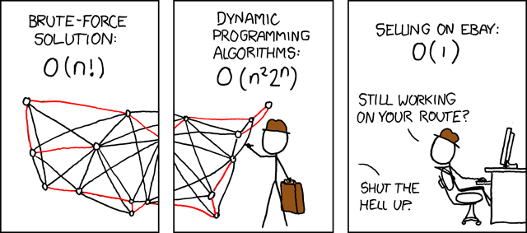
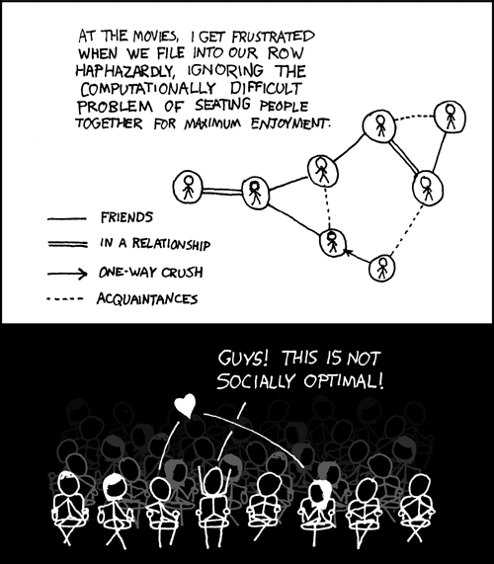
Background of TSP
© xkcd.com

Slide 4
Variant 1: bitonic tsp

Slide 5
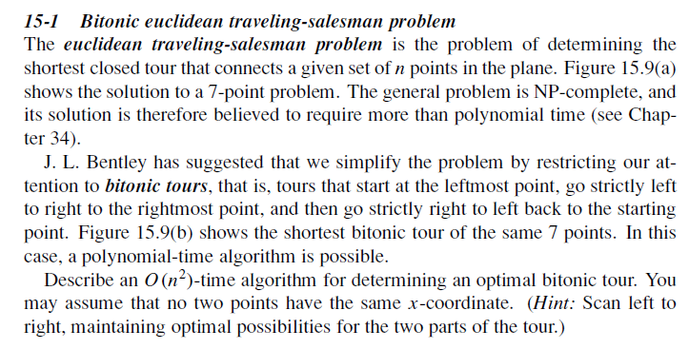
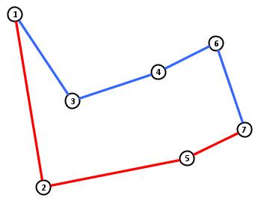
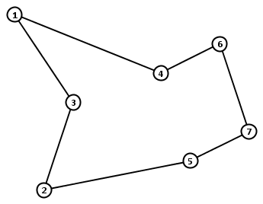
Bitonic length: $25.58$
Optimal length: $24.89$

Slide 6
Bitonic Euclidean TSP
Bentley presented detailed study of TSP heuristics in 1st SODA
Did not actually mention bitonic tours
Cormen & al. textbook popularized the problem in 1990
Bitonic tours are special cases of pyramidal tours for general TSP that are important in the literature (more later)
Exponential-size subset of permutations over which we can optimize efficiently
An optimal bitonic tour can be found in $O\left(n^{2}\right)$ time
Simple dynamic program
Has not been improved since the problem’s introduction

Slide 7
Is $Θ\left(n^{2}\right)$ time needed for Bitonic TSP?
Other problems from the same chapter of Cormen & al.
Edit Distance
Longest Common Subsequence
For these $2$ problems:
There are classic $O(n^{2})$-time dynamic programs
No $O(n^{2−ε})$-time algorithm exists, unless SETH is false
(SETH = Strong Exponential Time Hypothesis)
[ABV-W&BK,FOCS’15] + [BI,STOC ’15]
Motivating question:
Does Bitonic TSP require quadratic time?

Slide 8
Results on bitonic TSP
Theorem [Berg, Buchin, J, Woeginger]
Bitonic TSP can be solved in $O(n\log^{2}{n})$ time
We speed up the dynamic program by:
Computing the table implicitly, instead of explicitly
Exploiting semi-dynamic geometric data structures
Additively-weighted Voronoi diagrams
Presentation in three steps:
Analysis of the structure of the dynamic program
Reduction to a dynamic data structure problem
Realization of the data structure

Slide 9
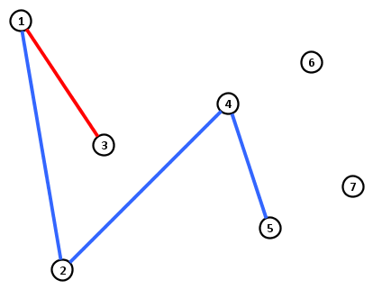
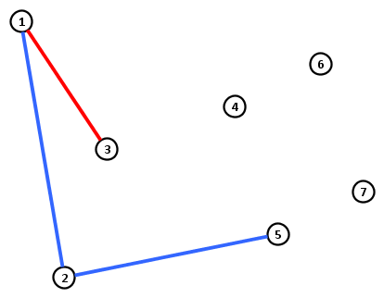
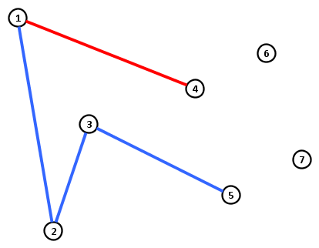
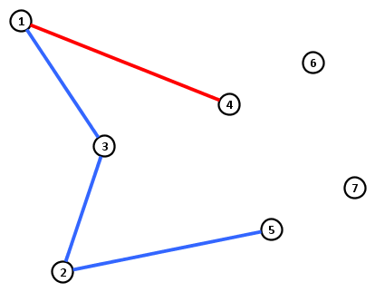
Partial bitonic tours
A partial $(i,j)$-tour for $i>j$ is a pair of $x$-monotone paths:
both starting in city 1 but not sharing any other city,
one ends in $i$ and one ends in $j$, and
visiting all cities up to and including $i$.
For $i>j$let $T[i,j]$ denote length of shortest partial $(i,j)$-tour
Partial $(5,4)$-tour
Partial $(5,3)$-tour
Partial $(5,3)$-tour

Slide 10
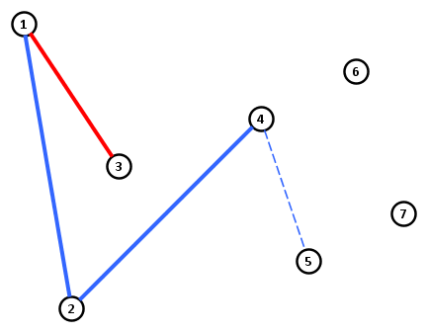
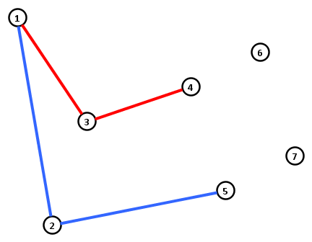
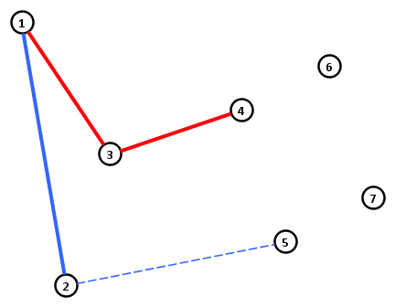
Structure of partial tours
Any partial $(i,j)$-tour for $j<i−1$ connects $i$ to $i−1$
$$T\left[i,j\right]≔T\left[i−1,j\right]+d(i,i−1)$$
Any partial $(i,j)$-tour for $j=i−1$ connects $i$ to $1≤k<i−1$
$$T\left[i,i−1\right]≔\min_{1≤k<i−1}{T\left[i−1,k\right]+d(k,i)}$$
Partial $(5,3)$-tour
Partial $(5,4)$-tour

Slide 11
Dynamic programming for Bitonic TSP
Base case:
$$T\left[2,1\right]≔d(1,2)$$
Recurrence for $i>j:$
$$T\left[i,j\right]= \left\{\begin{matrix}T\left[i−1,j\right]+d\left(i−1,i\right) & ,j<i−1 \\ & \\ \min_{1≤k<i−1}{T\left[i−1,k\right]+d(k,i)} & ,j=i−1\end{matrix}\right.$$
Cost of optimal bitonic tour:
$$\min_{1≤k<n}{T\left[n,k\right]+d(k,n)}$$
Computes an optimal bitonic tour in $O\left(n^{2}\right)$ time
Less than $n^{2}$ entries of this type, $O(1)$ time each
Less than $n$ entries of this type, $O(n)$ time each

Slide 12
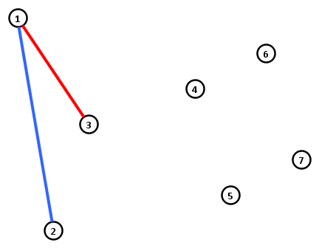
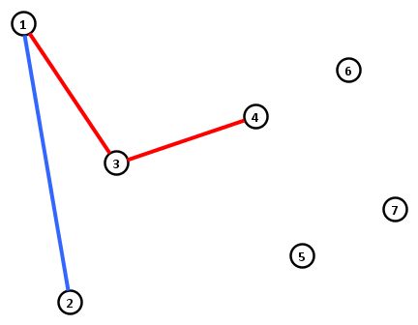
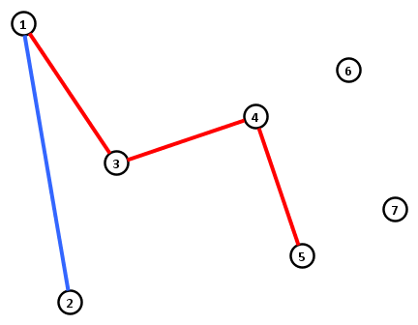
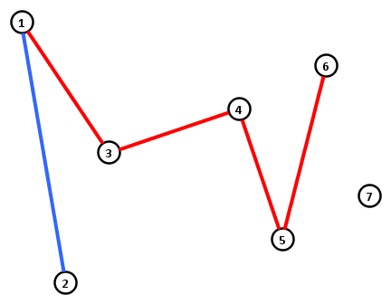
Structure of the dynamic program
$$i→$$
 | $$1$$ | $$2$$ | $$3$$ | $$4$$ | $$5$$ | $$6$$ | $$7$$
$$1$$ |  | 6.08 | 9.24 | 12.40 | 15.56 | 19.69 | 22.85
$$2$$ |  |  | 9.68 | 12.85 | 16.01 | 20.13 | 23.29
$$3$$ |  |  |  | 14.63 | 17.79 | 21.91 | 25.07
$$4$$ |  |  |  |  | 17.94 | 22.07 | 25.23
$$5$$ |  |  |  |  |  | 20.18 | 23.34
$$6$$ |  |  |  |  |  |  | 22.42
$$7$$
$$j$$
$$→$$
$$T\left[i,j\right]=\left\{\begin{matrix}T\left[i−1,j\right]+d\left(i−1,i\right) & ,j<i−1 \\ \min_{1≤k<i−1}{T\left[i−1,k\right]+d(k,i)} & ,j=i−1\end{matrix}\right.$$

Slide 13
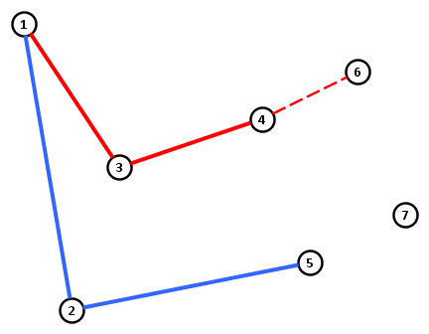
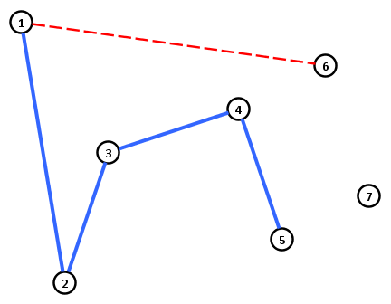
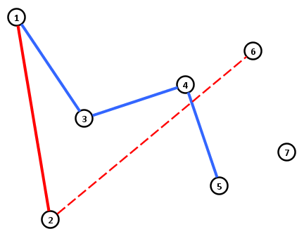
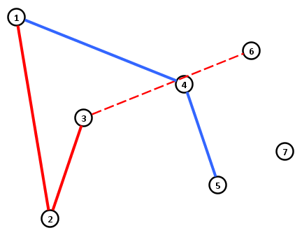
Structure of the dynamic program
$$i→$$
 | $$1$$ | $$2$$ | $$3$$ | $$4$$ | $$5$$ | $$6$$ | $$7$$
$$1$$ |  | 6.08 | 9.24 | 12.40 | 15.56 | 19.69 | 22.85
$$2$$ |  |  | 9.68 | 12.85 | 16.01 | 20.13 | 23.29
$$3$$ |  |  |  | 14.63 | 17.79 | 21.91 | 25.07
$$4$$ |  |  |  |  | 17.94 | 22.07 | 25.23
$$5$$ |  |  |  |  |  | 20.18 | 23.34
$$6$$ |  |  |  |  |  |  | 22.42
$$7$$
$$j$$
$$→$$
$$T\left[i,j\right]=\left\{\begin{matrix}T\left[i−1,j\right]+d\left(i−1,i\right) & ,j<i−1 \\ \min_{1≤k<i−1}{T\left[i−1,k\right]+d(k,i)} & ,j=i−1\end{matrix}\right.$$

Slide 14
Modeling as a dynamic data structure problem
$$i→$$
 | $$1$$ | $$2$$ | $$3$$ | $$4$$ | $$5$$ | $$6$$ | $$7$$
$$1$$ |  | 6.08 | 9.24 | 12.40 | 15.56 | 19.69
$$2$$ |  |  | 9.68 | 12.85 | 16.01 | 20.13
$$3$$ |  |  |  | 14.63 | 17.79 | 21.91
$$4$$ |  |  |  |  | 17.94 | 22.07
$$5$$
$$6$$
$$7$$
Data structure $S$ storing points in $ℛ^{2}$
Each $p_{i}$ has a weight $w\left(p_{i}\right)$
Bulk update $(r)$:
Increase all weights by $r$
Insert $\left(p_{i},w_{i}\right)$:
Insert new weighted point
Query $(q)$:
Return $p∈S$ that minimizes $w\left(p\right)+d(p,q)$
Add $d(i−1,i)$ to value in previous column
$$j$$
$$→$$
Take min. over $1≤k<i−1$
$$T\left[i,j\right]=\left\{\begin{matrix}T\left[i−1,j\right]+d\left(i−1,i\right) & ,j<i−1 \\ \min_{1≤k<i−1}{T\left[i−1,k\right]+d(k,i)} & ,j=i−1\end{matrix}\right.$$

Slide 15
Evaluating the DP using the data structure
$$i→$$
 | $$1$$ | $$2$$ | $$3$$ | $$4$$ | $$5$$ | $$6$$ | $$7$$
$$1$$ |  | 6.08 | 9.24 | 12.40 | 15.56 | 19.69
$$2$$ |  |  | 9.68 | 12.85 | 16.01 | 20.13
$$3$$ |  |  |  | 14.63 | 17.79 | 21.91
$$4$$ |  |  |  |  | 17.94 | 22.07
$$5$$
$$6$$
$$7$$
Implicit representation of column $i−1$ in data structure:
Store points $p_{1},…, p_{i−2}$
Weight $w\left(p_{j}\right)≔T[i−1,j]$
Compute representation of column $i$:
Let $p_{k}≔$ Query $\left(p_{i}\right)$
Set $w_{i−1}≔$ $w(p_{k})+d(k,i)$
Bulk update $(d\left(i−1, i\right))$
Insert $\left(p_{i−1},w_{i−1}\right)$
Find opt using contents of last col.
$$j$$
$$→$$
Implicit representation of column $2$ stores point $p_{1}$ with weight $d(1,2)$
To solve Bitonic TSP in $O(n\log^{2}{n)}$ time:
Implement each operation in $O(\log^{2}{n)}$ amortized time.
$$T\left[i,j\right]=\left\{\begin{matrix}T\left[i−1,j\right]+d\left(i−1,i\right) & ,j<i−1 \\ \min_{1≤k<i−1}{T\left[i−1,k\right]+d(k,i)} & ,j=i−1\end{matrix}\right.$$

Slide 16
Implementing the data structure
Supporting queries is the difficult part
Query $(q)$:
Return $p∈S$ that minimizes $w\left(p\right)+d(p,q)$
Looks like a nearest-neighbor query for points in the plane
Find $p∈S$ minimizing $d(p,q)$
Can be answered efficiently using a Voronoi diagram
The additive term makes it more complicated
Answer using additively-weighted Voronoi diagram

Slide 17
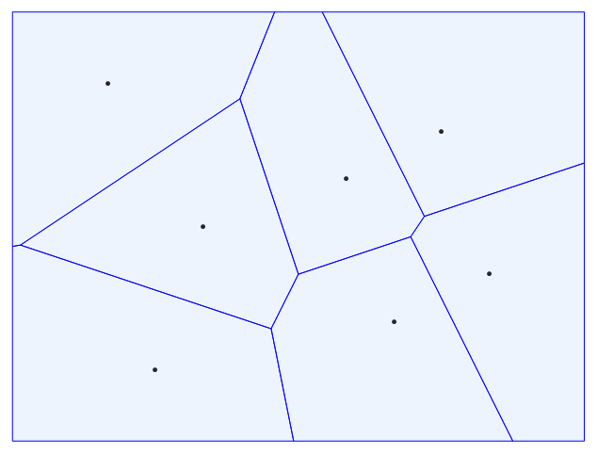
Voronoi diagrams
The Voronoi diagram of $n$ sites $p_{1},…, p_{n}$ in $ℛ^{2}$:
Partitions the plane into Voronoi cells $C_{1},…, C_{n}$
All points $q$ in $C_{i}$ are closer to $p_{i}$ than to any other site
The Voronoi diagram of $n$ sites has complexity $O(n)$
Cell boundaries are straight-line segments
To find nearest neighbor of point $q$: find cell containing $q$

Slide 18
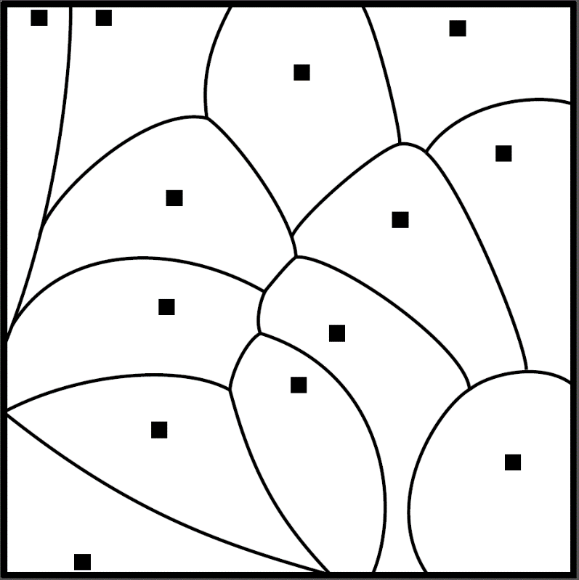
Additively weighted Voronoi diagrams
Each of the $n$ sites $p_{1},…, p_{n}$ in $ℛ^{2}$ has a weight $w\left(p_{i}\right)$
Distance between a point $q$ and a site $p_{i}$:
$$d_{w}\left(q,p_{i}\right)≔d\left(q,p_{i}\right)+w(p_{i})$$
Additively weighted Voronoi diagram of $n$ weighted sites:
Partitions the plane into weighted Voronoi cells $C_{1},…, C_{n}$
All points $q$ in $C_{i}$ are closer to $p_{i}$ than to any other site, with respect to the distance function $d_{w}$
Additively weighted Voronoi diagram has complexity $O(n)$
Boundaries are straight-line segments & hyperbolic arcs
Geometric interpretation:
Circle around each site, larger weight means smaller circle
Point belongs to cell whose circle is closest
Query$(q)$ is determined by weighted cell containing $q$

Slide 19
Data structures for Voronoi diagrams
The additively weighted Voronoi diagram of $n$ weighted sites can be constructed in $O(n\log{n)}$ time
Classic sweep-line algorithm by Fortune [SOCG ‘86]
A point location data structure for a partition of the plane:
Supports Query$(q)$, which outputs the region containing $q$
Queries can be answered in $O(\log{n)}$ time
Can build point location structure for AW-VD in $O(n\log{n)}$
Have to make these structures dynamic to speed up the DP
Standard trick to transform static into semi-dynamic
The logarithmic method by Bentley & Saxe [J. Alg ‘80]

Slide 20
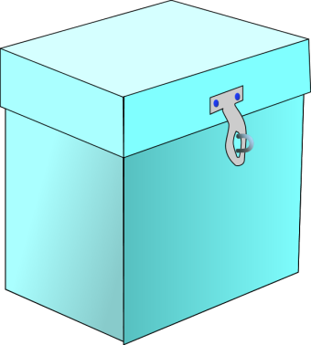
Logarithmic method – outline
$$2^{5}=32$$
$$2^{4}=16$$
$$2^{3}=8$$
$$2^{2}=4$$
$$2^{1}=2$$
$$2^{0}=1$$
$$∅$$
$$∅$$
Divide the $n$ points over $⌊log{n⌋}$ partial data structures
# of points in each partial structure is a power of 2
Partial structure for each $1$ in the binary expansion of $n$
$n=011011$
$n=2^{4}+2^{3}+2^{1}+2^{0}$

Slide 21
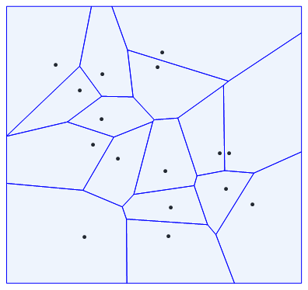
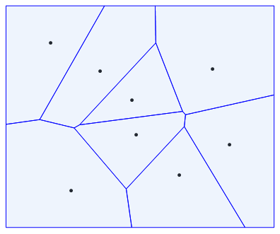
Logarithmic method – partial structures
$$2^{5}=32$$
$$2^{4}=16$$
$$2^{3}=8$$
$$2^{2}=4$$
$$2^{1}=2$$
$$2^{0}=1$$
$$∅$$
$$∅$$
$$m_{1}=8$$
$$m_{0}=15$$
$$m_{3}=11$$
$$m_{4}=7$$
A partial structure for $2^{i}$ points $P_{i}$ consists of:
Static weighted Voronoi diagram on $P_{i}$ with point location
Weight modifier $m_{i}$
Interpret total weight of $p_{j}$ stored in $P_{i}$ as:
$m_{i}$ plus weight of $p_{j}$ in the Voronoi diagram

Slide 22
Logarithmic method – bulk updates
$$2^{5}=32$$
$$2^{4}=16$$
$$2^{3}=8$$
$$2^{2}=4$$
$$2^{1}=2$$
$$2^{0}=1$$
$$∅$$
$$∅$$
$$m_{0}=15$$
$$m_{1}=8$$
$$+ r$$
$$+ r$$
$$m_{3}=11$$
$$+ r$$
Bulk update takes $O(\log{n)}$ worst-case time
$$m_{4}=7$$
$$+ r$$
To handle Bulk update $(r)$:
Increase all weight modifiers $m_{i}$ by $r$
Preserves structure of weighted Voronoi diagram:
Measures $w\left(p_{i}\right)+d(p_{i},q)$ and $w\left(p_{i}\right)+r+d(p_{i},q)$ result in the same closest neighbor $p_{i}$ for $q$

Slide 23
Logarithmic method – queries
$$2^{5}=32$$
$$2^{4}=16$$
$$2^{3}=8$$
$$2^{2}=4$$
$$2^{1}=2$$
$$2^{0}=1$$
$$∅$$
$$∅$$
$$m_{0}=15$$
$$m_{1}=8$$
$$+ r$$
$$+ r$$
Query takes $O(\log^{2}{n)}$ worst-case time
$$m_{3}=11$$
$$+ r$$
$$m_{4}=7$$
$$+ r$$
Query$(q)$ asks for point $p_{j}$ minimizing $w\left(p_{j}\right)+d(p_{j}, q)$
Here $w(p_{j})$ is the sum of weight in VD + weight modifier
To answer the query:
Find a candidate weighted-closest point in partial structure
Query for weighted-nearest neighbor, add modifier
Gives $O(\log{n)}$ candidate answers, output best one

Slide 24
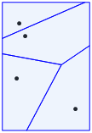
Logarithmic method – insertions
$$2^{5}=32$$
$$2^{4}=16$$
$$2^{3}=8$$
$$2^{2}=4$$
$$2^{1}=2$$
$$2^{0}=1$$
$$∅$$
$$∅$$
$$∅$$
$$∅$$
$$m_{0}=15$$
$$m_{1}=8$$
$$+ r$$
$$+ r$$
$$m_{2}=0$$
$$m_{3}=11$$
$$+ r$$
Claim: Insert takes $O(\log^{2}{n)}$ amortized time
$$m_{4}=7$$
$$+ r$$
Insert $\left(p^{∗},w^{∗}\right)$:
Let $2^{k}$ be the smallest empty structure
Collect the $\sum_{i=0}^{k−1}{2^{i}}=2^{k}−1$ points $P$ in all structures < $2^{k}$
For each collected point, set its weight to its weight in the VD containing it, plus its modifier
Build AW-VD on weighted $P∪\left\{p^{∗}\right\}$ of size $2^{k}$, set $m_{k}≔0$

Slide 25
Amortized analysis of insertions
Building a partial structure of size $n$ costs time $O(n\log{n)}$
One in every $2^{k+1}$ insertions builds a structure of size $2^{k}$:
First time is on the $2^{k}$-th insertion (bit flips to $1$)
Following $2^{k}−1$ insertions only affect lower order bits
Destroy it $2^{k}$ insertions after creation (bit flips to $0$)
After another $2^{k}$ insertions, rebuild (bit flips back to $1$)
Total time spent for $n$ insertions, up to constant factors:
$$\sum_{k=0}^{\left\lfloor \log{n}\right\rfloor }{\frac{n}{2^{k+1}}⋅2^{k}\log{2^{k}}}=\frac{n}{2}⋅\sum_{k=0}^{\left\lfloor \log{n}\right\rfloor }{k}=θ(n⋅\log^{2}{n)}$$
Amortized $O(\log^{2}{n})$ time per insertion

Slide 26
Summary of algorithm for Bitonic TSP
$$i→$$
 | $$1$$ | $$2$$ | $$3$$ | $$4$$ | $$5$$ | $$6$$ | $$7$$
$$1$$ |  | 6.08 | 9.24 | 12.40 | 15.56 | 19.69
$$2$$ |  |  | 9.68 | 12.85 | 16.01 | 20.13
$$3$$ |  |  |  | 14.63 | 17.79 | 21.91
$$4$$ |  |  |  |  | 17.94 | 22.07
$$5$$
$$6$$
$$7$$
Implicit representation of column $i−1$ in data structure:
Store points $p_{1},…, p_{i−2}$
Weight $w\left(p_{j}\right)≔T[i−1,j]$
Compute representation of column $i$:
Let $p_{k}≔$ Query $\left(p_{i}\right)$
Set $w_{i−1}≔$ $w(p_{k})+d(k,i)$
Bulk update $(d\left(i−1, i\right))$
Insert $\left(p_{i−1},w_{i−1}\right)$
Find opt using contents of last col.
$$j$$
$$→$$
Theorem [Berg, Buchin, J, Woeginger]
Bitonic TSP can be solved in $O(n\log^{2}{n})$ time

Slide 27
Beyond bitonic tours
A bitonic tour consists of a sequence of cities in increasing order, followed by a sequence in decreasing order
Order is with respect to the $x$-coordinates of the cities
The notion of pyramidal tours generalizes this:
Fix an arbitrary ordering of the cities as $1, …, n$
Pyramidal tours wrt. this ordering have the form:
$$1,i_{1},i_{2},i_{3},…, i_{k},n,j_{1},…j_{n−2−k},1$$
where $i_{1}<i_{2}<…<i_{k}$ and $j_{1}>j_{2}>…>j_{n−2−k}$
Our algorithm for bitonic tours in the plane also works to find optimal pyramidal tours among points in the plane with respect to an arbitrary ordering of the cities
Theorem. For any ordering of $n$ given points in the plane, an optimal pyramidal tour can be found in $O(n\log^{2}{n})$ time

Slide 28
Bottleneck tours
In the Bottleneck TSP we optimize the maximum of the edge lengths, instead of the sum
Euclidean Bottleneck TSP in the plane is still NP-complete
Using similar ideas, but different semi-dynamic data structures, we can prove:
Theorem. For any ordering of $n$ given points in the plane, an optimal pyramidal bottleneck tour can be found in $O(n\log^{3}{n})$ time

Slide 29
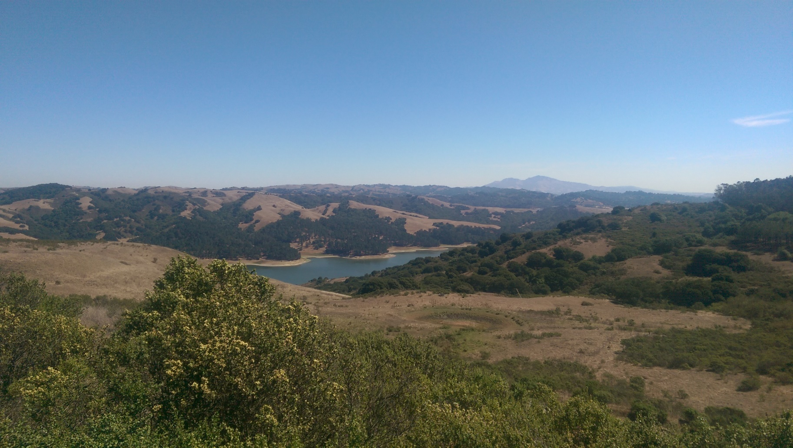
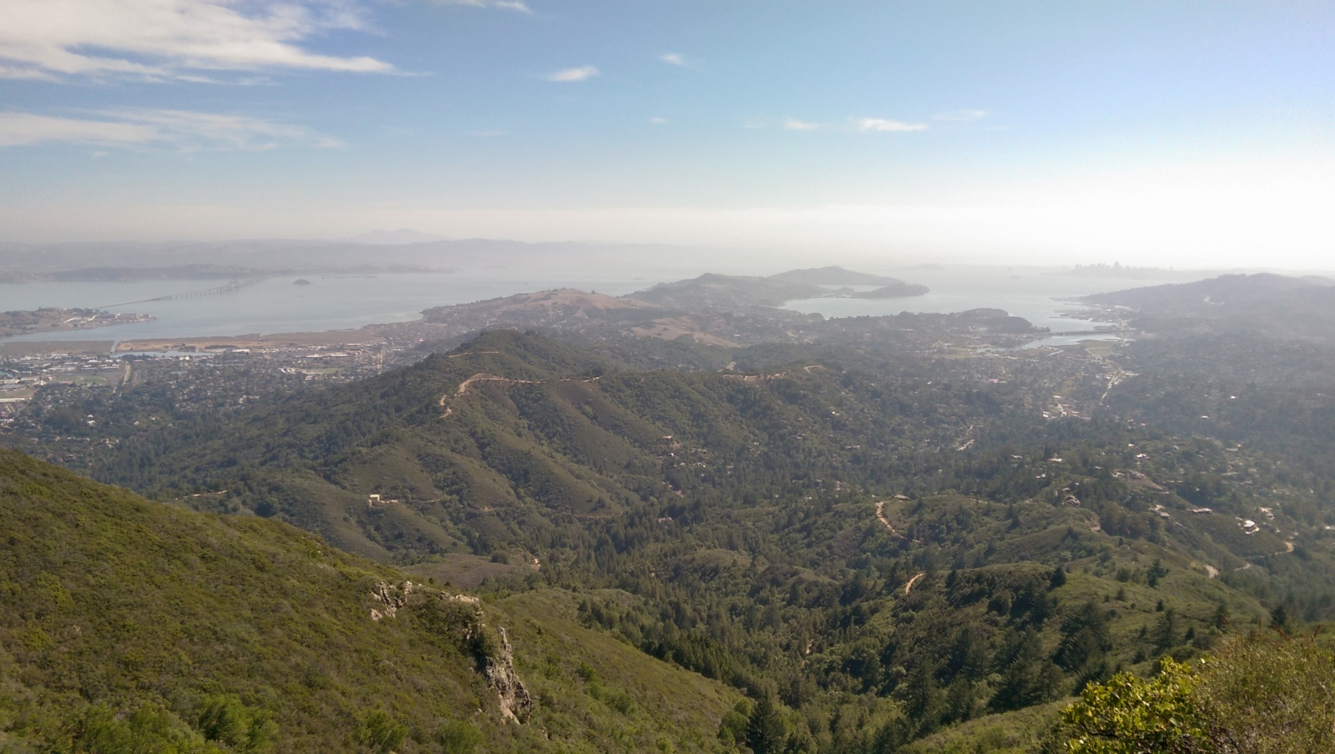
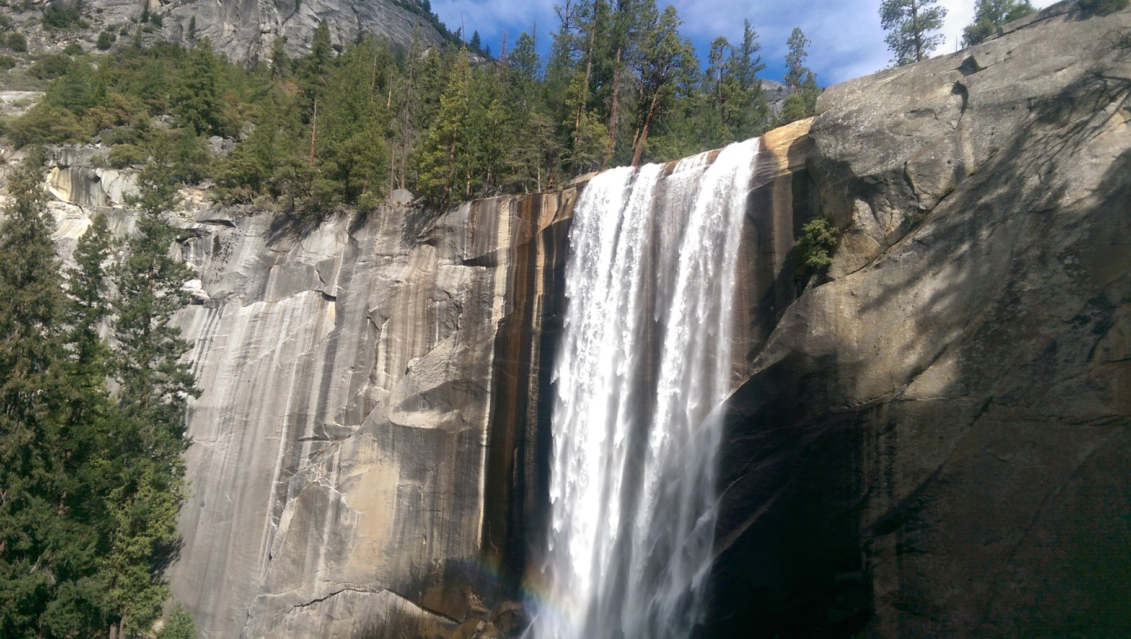
Variant 2: $k$-opt
Angel Island
Tilden Park
Mt. Tamalpais
Yosemite

Slide 30
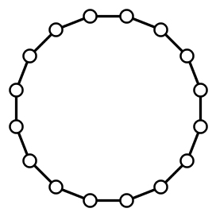
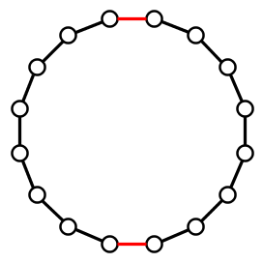
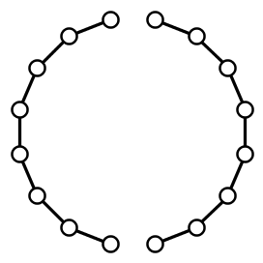
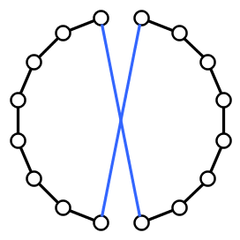
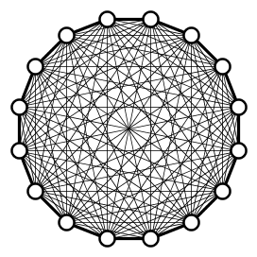
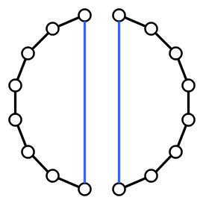
Local search heuristics for TSP
A popular way to deal with TSP in practice is using local search
Generate a starting tour by some heuristic, then repeatedly improve the tour by small changes
Explore the local neighborhood of the current tour $T$
The $2$-opt neighborhood is often used
Consists of tours obtained from $T$ by replacing 2 edges

Slide 31
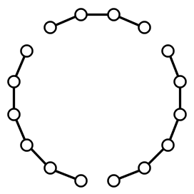
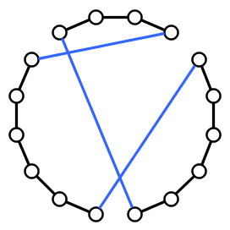
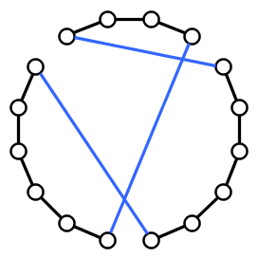
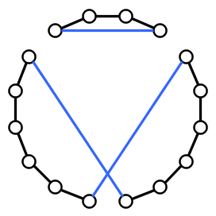
General $k$-opt neighborhood
The $k$-opt neighborhood of tour $T$ contains:
Tours obtained from $T$ by replacing at most $k$ edges
Removing $k$ edges splits a tour into $k$ paths
For $k≥3$, there are multiple ways to reconnect the tour

Slide 32
Analysis of local search for TSP
Many aspects to analyze:
How many iterations are needed to find a local optimum?
How far are local optima from global optima?
How much time is needed for a single iteration?
To check whether a tour is locally optimal for $k$-opt:
Test whether any $k$-opt move decreases the cost
To move through the landscape of solutions:
Find the best tour in the $k$-opt neighborhood

Slide 33
Two computational problems about $k$-opt
The first is a decision problem:
$k$-opt detection Input: A tour $T$ in a weighted complete graph $G$ Question: Is there a $k$-opt move that decreases the cost?
The second is an optimization problem:
$k$-opt optimization Input: A tour $T$ in a weighted complete graph $G$ Task: Find the best tour in the $k$-opt neighborhood of $T$
We only consider symmetric TSP
The graph and weight function are undirected

Slide 34
Complexity of $k$-opt detection / optimization
For fixed $k$ there is an $O(n^{k})$ algorithm for $k$-opt optimization
Try all $\left({n \atop k}\right)$ possibilities for $k$ edges $X$that leave the tour
Removing $X$ splits the tour $T$ into $k$ pieces
Try all $f(k)$ different ways to reconnect into a tour
Even for $k$-opt detection you cannot improve much:
No algorithm with runtime $f\left(k\right)⋅n^{o\left(\frac{k}{\log{k}}\right)}$ unless ETH fails
(Graph setting with symmetric weights {1,2})
[Marx ’08] & [Guo, Hartung, Niedermeier, Suchý ‘13]
Motivating question:
What is the exact complexity of detecting whether a given tour can be improved by a $k$-opt move, for small $k$?

Slide 35
Our results for $k$-opt
An algorithm for inputs with integer weights in $[−M…M]$ is truly subcubic if its runtime is $O(n^{3−ε}\operatorname{polylog}{M)}$ for some $ε>0$
APSP refers to All-Pairs Shortest Paths in weighted directed graphs without negative-weight cycles
$2$-opt detection requires $Ω\left(n^{2}\right)$ time
Easy adversarial argument
$3$-opt detection is unlikely to have a truly subcubic algorithm
Could $Θ(n^{k})$ be the right complexity for all $k$?
Theorem. $3$-opt detection has a truly subcubic algorithm if and only if APSP has one

Slide 36
Exhaustive search can be avoided for $k≥4$
For all $k≥4$ we can do better than ${Θ(n}^{k})$
Implies that $4$-opt optimization is in $Θ\left(n^{3}\right)$ time
Based on an analysis of the structure of $k$-opt moves
Enumerate partial solutions, use dynamic programming
Theorem. For each fixed $k$ there is an algorithm that finds the best $k$-opt move in time $O(n^{\left\lfloor \frac{2k}{3}\right\rfloor +1})$

Slide 37
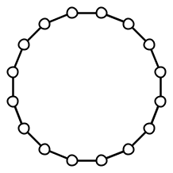
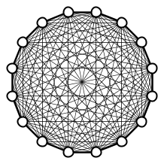
A faster algorithm for $k$-opt optimization
To give the main ideas, we show $O\left(n^{3}\right)$ algorithm for $4$-opt
Based on the structure of $4$-opt moves
Assume that the best $4$-opt move deletes a matching from $T$
General case (2 deleted edges share a vertex) reduces to it
Notation is cleaner
Fix a starting point and orientation of the input tour $T$
Starting point

Slide 38
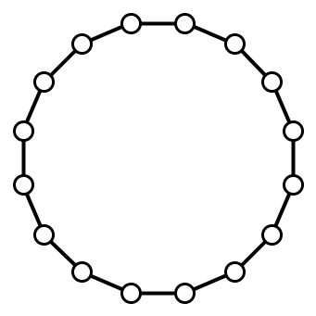
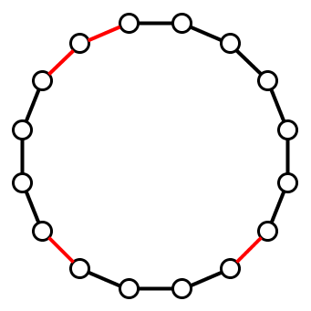
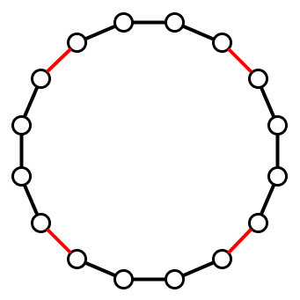
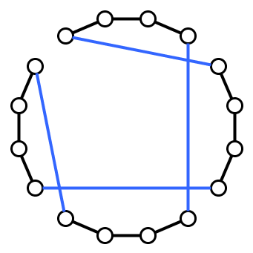
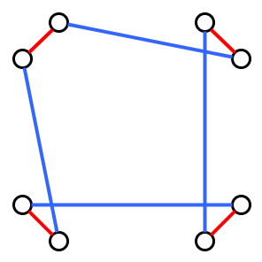
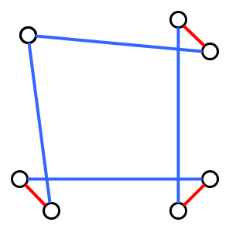
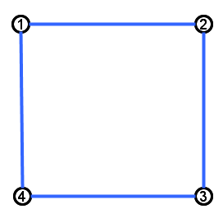
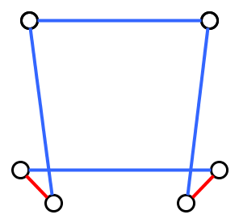
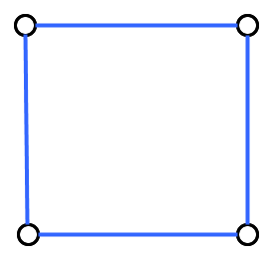
The signature of a $k$-opt move
Consider $k$-opt move where deleted edges X form a matching
Assume replacement edges Y are distinct from deletions
The signature of the $k$-opt move is defined as follows:
Take the symmetric difference 𝑋Δ𝑌, contract all edges of 𝑋
For each endpoint of each replacement edge $y$, store whether it attaches to first or second endpoint of $x$ in this orientation
2nd
2nd
1st
1st
1st
2nd
2nd
1st

Slide 39
Signatures of $4$-opt moves

Slide 40
Signatures of $4$-opt moves

Slide 41
Signatures of $4$-opt moves

Slide 42
Signatures of $k$-opt moves
Signature graph has $k$ vertices and $k$ edges
Vertices of signature: edges of $G$ leaving the tour
Edges of signature: edges of $G$ entering the tour
Each signature is a collection of cycles with $k$ vertices in total
Signatures have vertex covers of size $⌊\frac{2k}{3}⌋$
Worst case is when signature consists of disjoint triangles
For a fixed orientation, the signature and leaving edges together determine which edges enter the tour
For fixed signature, the leaving edges determine the cost

Slide 43
Faster algorithm for simple signature
2
2
Consider the example signature
To find the best $4$-opt with this signature:
Try all realizations for leaving edges $1\&3$
For each of the $Θ\left(n^{2}\right)$ options:
Find best realization for $2$ and $4$
Yields 2 independent $O(n)$-time problems
1
1
1
2
2
1

Slide 44
Faster algorithm for complicated signature
1
1
Consider a more complicated signature
To find the best $4$-opt with this signature:
Try all realizations for leaving edges $1\&4$
For each of the $Θ\left(n^{2}\right)$ options:
Find best realization for $2$ and $3$ respecting the ordering along tour
Can be solved in $O(n)$ time by dynamic program
Let $c(i,j)$ denote cost for realizing $j$-th unknown leaving edge at place $i$
$T[i,j]$ = “min. cost to realize the first $j$ unknowns among places $[1..i]$”
$T[i,0] = 0$
$T[i,j] = min⁡(T\left[i−1,j\right],T\left[i−1,j−1\right]+c\left(i,j\right))$
Generalizes to optimizing placement of any number of unknown edges, when the realization of their neighbors in the signature graph is known!
2
2
2
2
1
1
Observation:
Once a realization has been chosen for a vertex cover of the signature, the best extending $k$-move can be found in $O(n)$ time

Slide 45
General algorithm for $k$-opt optimization
Signatures have vertex covers of size $⌊\frac{2k}{3}⌋$
For each signature, fix a minimum vertex cover and try all $n^{\left\lfloor \frac{2k}{3}\right\rfloor }$ different realizations of corresponding leaving edges
Remaining problem is an $O(n)$-time dynamic program
Runtime is ${O(n}^{\left\lfloor \frac{2k}{3}\right\rfloor +1})$ for fixed $k$
Number of $k$-signatures is constant depending on $k$
Theorem. For each fixed $k$ there is an algorithm that finds the best $k$-opt move in time $O(n^{\left\lfloor \frac{2k}{3}\right\rfloor +1})$

Slide 46
Equivalence between $3$-opt and APSP
We use an intermediate problem, equivalent to APSP with respect to having truly subcubic algorithms:
Negative Triangle Detection Input: An edge-weighted complete 3-partite graph $G$ with partite sets $A,B,C$ of $n$ vertices each Question: Does $G$ have a triangle total edge weight $<0$?
[Vassilevska-Williams & Williams, FOCS’10]
There are simple many-one reductions between this problem and $3$-opt detection, in both directions
Maximum weight is increased by only a constant factor

Slide 47
Negative Triangle Detection $≤_{3}$ 3-opt detection
Given: instance $(G,A,B,C,w)$ of Negative Triangle Detection
Let $M$ be the largest absolute value of an edge weight
Build $G′$ with a perfect matching of $3n$ edges $a_{1},…,a_{n}, …, c_{1},…,c_{n}$
Denote endpoints of $a_{i}$ by $l\left(a_{i}\right)$ and $r\left(a_{i}\right)$, similar for $b_{j}^{′}s$ and $c_{k}^{′}s$
Set the edge costs in the TSP instance as follows:
Red edges have cost $−3M$, no other edge has cost $<−M$
Black edges in the perfect matching have cost $0$
Edge $\{l\left(a_{i}\right),r(b_{j})\}$ has weight $w\left(a_{i},b_{j}\right)$
Edge $\{r\left(a_{i}\right),l\left(c_{k}\right)\}$ has weight $w(a_{i},c_{k})$
Edge $\{l\left(b_{j}\right),r\left(c_{k}\right)\}$ has weight $w\left(b_{j}, c_{k}\right)$
All other edges have weight $3M$
The starting tour in the instance visits $a_{1},…, a_{n}, …, c_{1},…$ consecutively

Slide 48
Negative triangle $⇒$ improving 3-opt
If $G$ contains a negative-weight triangle $\{a_{i},b_{j},c_{k}\}$:
Remove edges $a_{i},b_{j}, c_{k}$ from the tour and reconnect:
Cost of the tour changes as follows:
We remove 3 edges of weight 0 from the tour
We add 3 edges of negative total weight to the tour
Hence the 3-opt move decreases the cost of the tour

Slide 49
Improving 3-opt $⇒$ negative triangle
If the tour in $G′$ can be improved by a $3$-opt move:
No red edge (which has weight $−3M$) can leave the tour
Replacing it by an edge of weight $≥−M$ increases the cost
All edges of weight $−3M$ are used in the starting tour, so cannot compensate loss of a $−3M$ edge elsewhere

Slide 50
Improving 3-opt $⇒$ negative triangle
If the tour in $G′$ can be improved by a $3$-opt move:
No two edges $a_{i},a_{i^{′}}$ of the same partite set can leave the tour
Edge between two $a$-endpoints is needed to reconnect
These edges have weight $3M$ so do not decrease the cost

Slide 51
Improving 3-opt $⇒$ negative triangle
If the tour in $G′$ can be improved by a $3$-opt move:
Edges in a good $3$-opt select one vertex in each partite set
Only way weight change is $<0$, is when reconnection edges follow the desired pattern
Weight of the selected triangle equals the net change in tour cost, which is negative
Theorem. If $3$-opt detection has a truly subcubic algorithm, then APSP has one

Slide 52
Faster algorithms for repeated $2$-opt
We showed that for $2$- and $3$-opt, brute force is likely optimal to perform a single iteration
In local search, one repeatedly improves a given starting tour
Speed up repeated improvements to the same instance?
In the repeated setting, only the first iteration is expensive:
Based on ideas of Fredman et al. [J. ALG ‘95] and Chrobak et al. [TCS ‘90] to store tour in a balanced search tree
Allows quick applications of a $2$-opt move by reversals
Theorem. After $O\left(n^{2}\right)$ preprocessing time, one can repeatedly find and apply the best $2$-opt move in $O(n\log{n)}$ time per move

Slide 53
$2$-opt optimization for TSP on points in the plane
We can also speed up 2-opt optimization for TSP in the plane
Based on data structures for geometric range searching
Preprocess pointset for semi-algebraic range queries
Theorem. There is an algorithm with expected runtime $O\left(n^{\frac{8}{5}+ε}\right)$ for $2$-opt detection for TSP on points in the Euclidean plane

Slide 54
Conclusion
Bitonic/pyramidal TSP tours in the plane in $O(n\log^{2}{n})$ time
There is a truly subcubic algorithm for $3$-opt detection if and only if there is one for All-Pairs Shortest Paths
For $k≥4$, we can improve upon exhaustive search for $k$-opt
Open problems:
Is the runtime ${O(n}^{\left\lfloor \frac{2k}{3}\right\rfloor +1})$ optimal for $k$-opt detection in graphs?
Is the runtime 〖𝑂(𝑛〗^(⌊2𝑘/3⌋+1)) optimal for 𝑘-opt detection in graphs?
Is $k$-opt detection fixed-parameter tractable:
Is 𝑘-opt detection fixed-parameter tractable:
in planar graphs?
for finding tours among points in the Euclidean plane?
Solve $4$-opt optimization with weights $[−M,…,M]$ in time $O(M⋅n^{ω})$?
Solve 4-opt optimization with weights [−𝑀,…,𝑀] in time 𝑂(𝑀⋅𝑛^𝜔)?
THANK YOU!

