Slide 1
On Sparsification for Computing Treewidth
Bart M. P. Jansen
March 16th 2015, TACO meeting, Eindhoven

Slide 2
Treewidth
Measure of how “tree-like” a graph is
Decompose a graph into a tree decomposition of small width to reveal its internal structure
Dynamic programming solves many optimization problems when a tree decomposition is known
First step: find good tree decomposition
Treewidth Input: A graph $G$, an integer $k$ Question: Is the treewidth of $G$ at most $k$?
NP-complete [Arnborg et al.’87]

Slide 3
Sparsification
The task of making a problem instance less dense, without changing its answer
Density
.. of a CNF formula: ratio of clauses to variables
.. of a graph: ratio of edges to vertices
Work on sparsification
Eppstein et al. @ J.ACM’97: Sparsification to speed up dynamic graph algorithms
Impagliazzo et al. @ JCSS’01: Subexponential-time Sparsification Lemma for Satisfiability
Dell & van Melkebeek @ STOC’10: No nontrivial polynomial-time sparsification for d-cnf-sat

Slide 4
Sparsification for Computing Treewidth
Given a graph $G$, we want to make it easier to find a good tree decomposition of $G$
Main idea:
quickly compute $G’$ which is “simpler” than $G$,
such that minimum-width decomposition of $G’$ easily leads to minimum-width decomposition of $G$
Possible ways to make $G’$ provably simpler than $G$:
Upper bound on the size of $G’$, in terms of structural measures of $G$
Upper bound on the density of $G’$
Notes:
Say that simpler can mean less edges.

Slide 5
Parameterized Complexity and Kernelization
A parameterized problem is a subset $Q⊆Σ^{∗}×ℕ$
For an instance $\left(x,k\right)∈Σ^{∗}×ℕ$, we call $k$ the parameter
Let $Q, Q^{′}$ be parameterized problems and $f:\text{ℕ}→\text{ℕ}$
A generalized kernelization of $Q$ into $Q’$ with size $f$ is
an algorithm that takes $(x,k)$ as input,
runs in $poly(|x|+k)$ time,
outputs $(x’,k’)$ such that:
$\left(x,k\right)∈Q ⇔ \left(x’,k’\right)∈Q’$
$\left|x^{′}\right|,k^{′}≤f(k)$
It is a kernelization (or kernel) if $Q=Q^{′}$
Poly-time mapping from $Q$ to $Q′$
preserves the answer
$f(k)$-size output bound

Slide 6
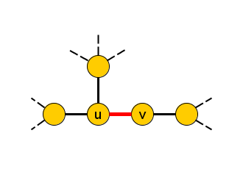
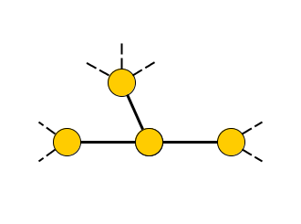
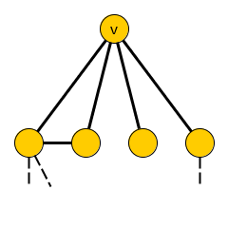
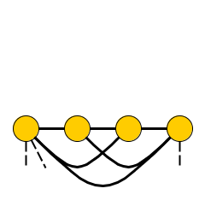
Preliminaries
To eliminate a vertex 𝑣 from a graph 𝐺 means:
Remove 𝑣 and its incident edges, turn $N_{G}\left(v\right)$ into a clique
A graph $H$ is a minor of a graph $G$ if:
$G$ can be turned into $H$ by a series of
Vertex deletions
Edge deletions
Edge contractions
If $H$ is a minor of $G$ then $tw\left(H\right)≤tw\left(G\right)$
If $𝒯$ is a tree decomposition of $G$ and $S⊆V(G)$ is a clique, then $𝒯$ has a bag containing all vertices of $S$
So its treewidth is at least $\left|S\right|−1$

Slide 7
Kernelization for treewidth

Slide 8
Treewidth Parameterized by Vertex Cover
Treewidth [vc] Input: A graph $G$, vertex cover $X$ of $G$, and an integer $k$ Parameter: $|X|$ Question: Is the treewidth of $G$ at most $k$?
Known: a kernel with $O({\left|X\right|}^{3})$ vertices
Bodlaender, J, Kratsch [ICALP’11]
We improve this to ${\left|X\right|}^{2}$ vertices
Can be encoded in $O({\left|X\right|}^{3})$ bits
Lower bound (second half of the talk) implies:
No kernel with bitsize $O({\left|X\right|}^{2−ε})$ unless NP ⊆ coNP/poly

Slide 9
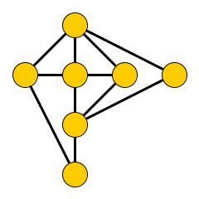
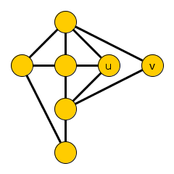
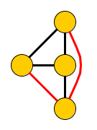
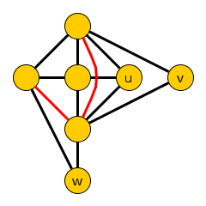
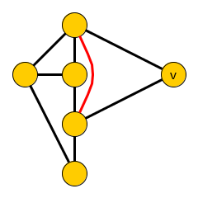
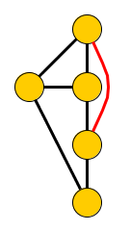
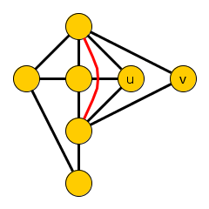
Treewidth-Invariant Sets
Kernel is based on treewidth-invariant sets
Vertex sets whose elimination has a predictable effect on treewidth
Consider a graph $G$ with an independent set $T$
Let $ĜT$ be the result of eliminating $T$ from $G$, one vertex at a time (order does not matter)
If $ĜT$ is a minor of $G – \{z\}$ for every $z∈T$, then $T$ is a treewidth-invariant set in $G$
Simplest case: $T=\{z\}$ is a simplicial vertex
$NG(z)$ is a clique, so $Ĝ_{\left\{z\right\}}=G −\{z\}$
Ĝ_{{u,v}}
Ĝ_{{u,v,w}}

Slide 10
Invariance Property
Let $Δ\left(T\right)≔\max_{v∈T} deg⁡(v)$
Lemma. If $T$ is a treewidth-invariant set in $G$,
then $tw\left(G\right)=\max{(tw\left(ĜT\right),Δ\left(T\right))}$
Proof.
(≥) $G$ contains $ĜT$ and a $(Δ(T)+1)$-clique as a minor
(≤) Consider a tree decomposition $𝒯$of $ĜT$
For every $v∈T$, $NG(v)$ exists in $ĜT$ and forms a clique there
So $𝒯$ has a bag containing $NG(v)$
Append a new bag with $N_{G}(v)∪\{v\}$, of size ≤ $Δ(T)+1$
Update independently for each $v∈T$

Slide 11
Reduction Based on Treewidth-Invariant Sets
Consider an instance $(G,k)$ of Treewidth with a treewidth-invariant set $T$:
If $Δ(T)≥k+1$: output no
Else reduce to $ĜT$
Invariance lemma shows that $tw\left(G\right)≤k⇔tw(ĜT)≤k$
Reduction is safe
Remaining issue: how to find treewidth-invariant sets?
Seems hard in general
NP-complete to test if a given set is treewidth-invariant!
q-Expansion
Lemma

Slide 12
$q$-Expansion Lemma
Let $H$ be a bipartite graph with partite sets $A$ and $B$, $q∈ℕ$
Subset $A’ ⊆ A$ is saturated by $q$-stars into $B’$ if we can assign to each $v∈A’$ a set of $q$ private neighbors from $B’$
$$NH(T)$$
$$A$$
$$A’$$
$$T$$
$$B$$
$$B’$$
$q$-Expansion Lemma [Fomin et al.@STACS’11]
Let $m$ be the size of a maximum matching in $H$. If $|B|>m·q$, then there is a nonempty set $T ⊆ B$ such that $NH(T)$ is saturated by $q$-stars into $T$. It can be found in polynomial time.

Slide 13
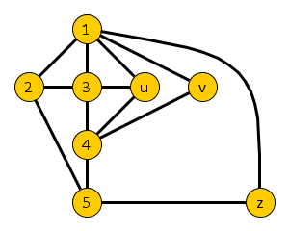
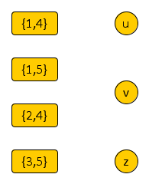
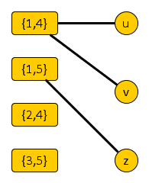
Finding Treewidth-Invariant Sets (I)
Given a graph $G$ with vertex cover $X$, form a bipartite non-edge connection graph $H_{G,X}$
One side corresponds to non-edges in $G[X]$
One side consists of the independent set $\overline{X}$
$H_{G,X}$ has an edge between non-edge $\{p,q\}$ and $v∈\overline{X}$, if $v$ is adjacent to both $p$ and $q$ in $G$
Contracting $v$ into $p$ or $q$ creates the edge $\{p,q\}$
$$G$$
$$H_{G,X}$$
X

Slide 14
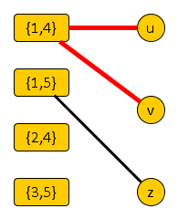
Finding Treewidth-Invariant Sets (II)
Lemma. If $H_{G,X}$ contains a set $T⊆\overline{X}$ such that $NH(T)$ can be saturated by 2-stars into $T$, then $T$ is a treewidth-invariant set
To prove: for all $x∈T$, $ĜT$ is a minor of $G–\{x\}$
Consider a non-edge $\{p,q\}$ in $NG(y)$ for $y∈T$
Since $y$ is adjacent to $p$ and $q$, we have $\{p,q\}$ in $NH(T)$
In $H$ there is a 2-star into $T$, centered at $\{p,q\}$
Pick a leaf of the star $≠x$, contract it into $p$ to create $\{p,q\}$
Can be done independently for all non-edges, as each star center is assigned private neighbors in $T$
We realize all non-edges; delete remainder of $T$ to get $ĜT$ -minor
Recall: $ĜT$ is $G–T$ with each $NG(v)$
turned into a clique for $v∈T$

Slide 15
Kernel Size Bound
Maximum matching in $H_{G,X}$ has size at most $\left({|X| \atop 2}\right)$
Non-edge side has at most this many vertices
$q$-Expansion Lemma [Fomin et al.@STACS’11]
Let $m$ be the size of a maximum matching $H$. If $|B| >m·q$, then there is a nonempty set $T ⊆ B$ such that $NH(T)$ is saturated by $q$-stars into $T$. It can be found in polynomial time.
If |$\overline{X}$| > 2 $\left({|X| \atop 2}\right)$, find a 2-expansion in poly-time and reduce
Reduced instances have ≤ $\left|X\right|+2\left({\left|X\right| \atop 2}\right)={\left|X\right|}^{2}$ vertices
Encoding into $O({\left|X\right|}^{3})$ bits
Theorem. Treewidth [vc] has a kernel with ${\left|X\right|}^{2}$ vertices that can be encoded in $O({\left|X\right|}^{3})$ bits

Slide 16
Refined analysis & implementation
Based on the number $mX$ of non-edges in $G[X]$
Size of a matching in $H_{G,X}$ is at most $mx$
If $\left|\overline{X}\right|>2m_{x}$ the algorithm finds a treewidth-invariant set
Reduced instances have at most $\left|X\right|+2m_{x}$ vertices
Exhaustive reduction by computing a single maximum matching in $H’_{G,X}$ (duplicate the non-edge side)
Time bound for the reduction algorithm:
$$O(n+m+{\left|X\right|}^{2}+\min\left(\sqrt{|\overline{X}|},m_{x}\right)⋅\left|\overline{X}\right|⋅m_{x})$$

Slide 17
Challenges
Stated version of reduction rule finds special types of treewidth invariant sets relative to some vertex cover
Treewidth invariant sets $T$ where each non-edge is covered by two unique vertices from $T$
Questions:
Can we find such sets in polynomial time without choosing a particular vertex cover?
Can we find more general treewidth-invariant sets?
How to find a vertex cover inducing few non-edges?
Lots of possibilities for algorithmic engineering!

Slide 18
No nontrivial sparsification

Slide 19
Sparsification Analysis using Kernelization
Based on the parameterization by vertex count:
$n$-Treewidth Input: $n∈ℕ$, an $n$-vertex graph $G$, an integer $k$ Parameter: $n$ Question: Is the treewidth of $G$ at most $k$?
An instance $(G,k,n)$ can be encoded in $O(n2)$ bits
Most relaxed form of polynomial-time sparsification:
Generalized kernel of size $O\left(n^{2−ε}\right)$ for some $ε>0$
Theorem. $n$-Treewidth does not have a generalized kernel of bitsize $O\left(n^{2−ε}\right)$, for any $ε>0$, unless NP ⊆ coNP/poly

Slide 20
Proof Technique
Corollary of Bodlaender et al.’12:
If there is a polynomial-time algorithm that:
composes the or of $t2$ similar $s$-vertex instances of an NP-hard problem,
into an instance $(G^{∗},n^{∗},k^{∗})$ of $n$-Treewidth with $n∈O(t⋅s)$,
then $n$-Treewidth does not have a generalized kernel of bitsize $O\left(n^{2−ε}\right)$, for any $ε>0$, unless NP ⊆ coNP/poly
Proof using cross-composition of bounded cost
Introduced in the journal version of the paper on cross-composition [Bodlaender, J, Kratsch ’12]
Easier front-end to the complementary witness lemma of Dell & van Melkebeek [STOC’10]
x_{1,1}
x_{1,2}
x…
x_{1,t}
NP-hard inputs
x_{2,1}
x_{2,2}
x…
x_{2,t}
x…
x …
x…
x …
x_{t,1}
x_{t,2}
x…
x_{t,t}
$poly(s·t)$-time
$n$-Treewidth
instance
$$(G^{∗},k^{∗},n^{∗})$$
$$n^{∗}∈O(t⋅s)$$

Slide 21
Ingredients
Proof Strategy
Elimination orderings
Cobipartite Graph Elimination
Embedding into a t × 2 table
Gadgets enforce an or-gate through the cobipartite graph
Elimination order:
Permutation $π$ of the vertices
Eliminate first vertex from $G$ to obtain $G1$, eliminate second vertex from $G1$ to obtain $G2$, ... eliminate last vertex from $G_{n−1}$ to obtain ∅
Cost of $π$ on $G$ is the maximum, over all $v∈V(G)$, of $deg⁡(v)+1$ when v is eliminated
Fact. The treewidth of a graph is the cost of its cheapest elimination order (minus one)

Slide 22
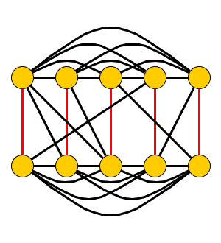
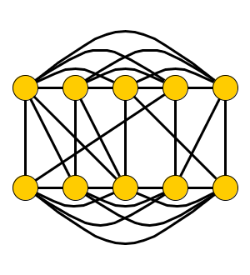
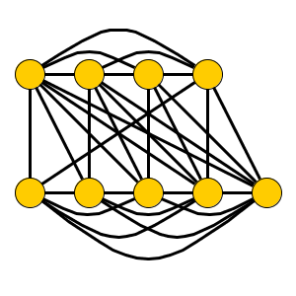
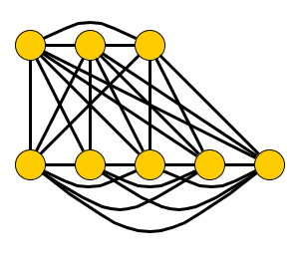
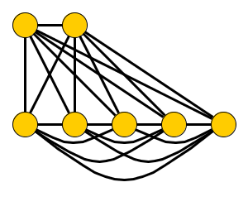
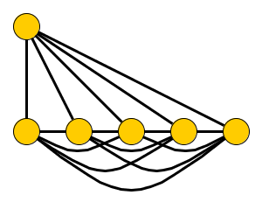
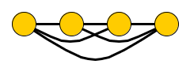
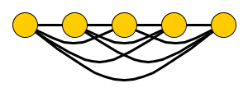
Ingredients
Proof Strategy
Elimination orderings
Cobipartite Graph Elimination
Embedding into a t × 2 table
Gadgets enforce an or-gate through the cobipartite graph
Cobipartite Graph Elimination Input: A cobipartite graph $G$ with partite sets $A,B$ of size $n$, such that $G$ has a perfect matching between $A$ and $B$. An integer $k$. Question: Does $G$ have an elimination order of cost at most $n+k$?
A
$$(n=5, k=2)$$
B
Notes:
Q: Should we incorporate k < n/4 to match the paper?

Slide 23
Ingredients
Proof Strategy
Elimination orderings
Cobipartite Graph Elimination
Embedding into a t × 2 table
Gadgets enforce an or-gate through the cobipartite graph
Embedding into a table-like structure
Inspired by Dell & Marx [SODA’12]
Compose the or of $t2$ different $n$-vertex instances of Cobipartite Graph Elimination into $t×2$ table
To compose 16 instances: 4 × 2 table
$O(t⋅n)$ vertices
Turn each row into a clique
Inputs are induced subgraphs of the composed instance
A1 | A2 | A3 | A4
B1 | B2 | B3 | B4

Slide 24
Ingredients
Proof Strategy
Elimination orderings
Cobipartite Graph Elimination
Embedding into a t × 2 table
Gadgets enforce an or-gate through the cobipartite graph
How to enforce or-behavior?
Add a group of blankers for each bottom cell
Eliminating a blanker $Xi$ “blanks out” the adjacency of the remainder of the bottom clique to $Ai$
If all blankers except $X_{i^{∗}}$ are eliminated before eliminating $B_{j^{∗}}$, then behavior matches $A_{i^{∗}}−B_{j^{∗}}$
10 pages of proof makes this work
A1 | A2 | A3 | A4
B1 | B2 | B3 | B4

Slide 25
Complete construction

Slide 26
Consequences of the Lower Bound
Corollary 1. For every $ε>0$ and every parameter $Π$ that does not exceed the vertex count, Treewidth [Π] does not have a kernel of bitsize $O(k^{2−ε}$), unless NP ⊆ coNP/poly
Applies to parameterizations by Vertex Cover, Feedback Vertex Set, Vertex-Deletion Distance to …
The constructed graph is cobipartite
For cobipartite graphs, treewidth equals pathwidth
Corollary 2. $n$-Pathwidth does not have a generalized kernel of bitsize $O(n^{2−ε})$, for any $ε>0$, unless NP ⊆ coNP/poly

Slide 27
Conclusion
Main contributions
1. No nontrivial polynomial-time sparsification for Treewidth and Pathwidth, unless NP ⊆ coNP/poly
2. Treewidth [vc] has a kernel with ${\left|X\right|}^{2}$ vertices
2. Treewidth [vc] has a kernel with |𝑋|^2 vertices
Open problems
1. Are there dense, minor-minimal treewidth obstructions that do not have a treewidth-invariant set?
2. Are there problems admitting nontrivial polynomial-time sparsification?
3. Does Treewidth [vc] have a kernel of bitsize $O(k^{2})$?
3. Does Treewidth [vc] have a kernel of bitsize 𝑂(𝑘^2)?
4. Does Pathwidth [vc] have a kernel with $O\left(k^{2}\right)$ vertices?
4. Does Pathwidth [vc] have a kernel with 𝑂(𝑘^2 ) vertices?

Slide 28
THANK YOU!

