Slide 1
Uniform kernelization complexity of hitting forbidding minors
Archontia C. Giannopoulou (Warsaw) Bart M. P. Jansen (Eindhoven) Daniel Lokshtanov (Bergen) Saket Saurabh (Chennai)
July 8th, ICALP 2015, Kyoto, Japan

Slide 2
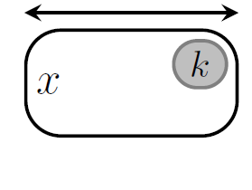
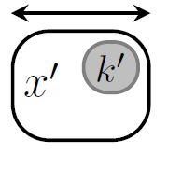
A rigorous analysis of preprocessing
The notion of kernelization analyzes how much the size of an input can be reduced in poly-time, without changing its answer
Size guarantee is expressed in terms of a parameter
Parameter expresses how complex the input is
Classic example: Vertex Cover
Input $(G,k)$ asks: does $G$ have a vertex cover of size $k$?
Has a kernel with $2k$ vertices [Nemhauser&Trotter,1975]
$n$ vertices
P-time
$≤2k$ vertices
$$G$$
$$G′$$

Slide 3
Three questions about kernel sizes
1. Can inputs be reduced to size $f(k)$ in polynomial time?
Answered by the theory of parameterized tractability
Possible if the problem is fixed-parameter tractable
Answered using compositionality and kernel lower bounds
Asks if the family has uniformly polynomial kernels
Partial answer in this talk
2. Can inputs be reduced to size $poly\left(k\right)$ in polynomial time?
3. Let $Π_{1},Π_{2},…$be a family of problems. Can inputs to problem $Π_{i}$ be reduced to size $f\left(i\right)⋅k^{c}$ in polynomial time?

Slide 4
Towards a meta-theorem
To gain a good understanding of the power of preprocessing, we search a theorem characterizing optimal kernel sizes
Several algorithmic meta-theorems such as Courcelle’s theorem characterize problems by their definability in logic
Successful for characterizing linear-size kernels for problems on sparse graphs (planar and beyond)
Unsuitable for characterizing parameterized graph problems with small kernels on unrestricted graphs
First-order expressible problems like $k$-Dominating Set are not believed to have a kernel of any size $f(k)$
We use a different formalism that captures many problems

Slide 5
Hitting forbidden minors
Graph $H$ is a minor of graph $G$ if we can transform $G$ into $H$ by vertex deletions, edge deletions, and contractions
For any finite set of forbidden minors $ℱ$ we define:
$ℱ$-Minor-Free Deletion Input: Graph $G$ and integer $k$ Parameter: $k$ Question: $∃S⊆V(G)$ of size $≤k$ such that $G−S$ does not contain any graph $H∈ℱ$ as a minor?
Equivalently: is there a set of $k$ vertices that hits all the models of $H∈ℱ$ minors in $G$?

Slide 6
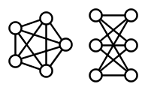
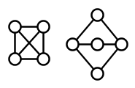
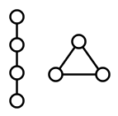
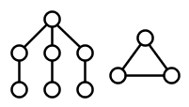
Classic $ℱ$-Minor-Free Deletion problems
Kernel: $O\left(k\right)$ vertices
$$O\left(k^{2}\right)$$
$$2^{O\left(k\log{k}\right)}$$
Vertex Cover
Feedback Vertex Set
Planarization
Outerplanar vertex deletion
Pathwidth-1 vertex deletion
Treedepth-2 vertex deletion
$ℱ=$ $\{ \}$
$$\{$$
$$,$$
$$\}$$
$$ℱ=\{ \}$$
$$k^{O\left(1\right)}$$
$$k^{O(1)}$$
$$O\left(k^{2}\right)$$
$$\{$$
$$,$$
$$\}$$
$$\{$$
$$,$$
$$\}$$
$$\{$$
$$,$$
$$\}$$

Slide 7
Kernels for $ℱ$-Minor-Free Deletion
If $ℱ$ contains a planar graph $H$, any $ℱ$-minor-free graph has treewidth at most $c_{H}$
For each such $ℱ$, reduction to size $poly(k)$ is possible
The best-known bound $g$ grows very rapidly
Not even known to be computable
We focus on the following question:
Theorem. [Fomin et al., FOCS’12] For any fixed set $ℱ$ that contains a planar graph, $ℱ$-Minor-Free Deletion has a kernel with $f\left(ℱ\right)⋅k^{g\left(ℱ\right)}$ vertices
Does Planar $ℱ$-Minor-Free Deletion have kernels of size $f\left(ℱ\right)⋅k^{c}?$

Slide 8
Our negative results
Planar $ℱ$-Minor-Free Deletion does not have uniformly poly kernels
The same lower bounds hold for the parameterization by the vertex cover number of the graph (a larger parameter)
No uniformly poly kernels for restriction to $ℱ$ containing a path
Theorem. Let $d≥3$ be a fixed integer and $ε>0$. If the parameterization by solution size $k$ of one of the problems:
$\{K_{d+1}\}$-Minor-Free Deletion,
$\{K_{d+1},P_{4d}\}$-Minor-free- Deletion, and
Treewidth-($d−1$) Deletion,
has a kernel with $O(k^{d/4−ε})$ vertices, then NP $⊆$ coNP/poly

Slide 9
Our positive results
Are there natural subfamilies of Planar $ℱ$-Minor-Free Deletion problems that do admit uniformly poly kernels?
Since treewidth does not increase when taking minors, Treewidth-$d$ Deletion gives a natural subfamily
We proved that it does not have uniformly poly kernels
Treedepth is another minor-closed graph parameter that has better algorithmic properties in some applications
Theorem. The Treedepth-$d$ Deletion problem admits a kernel with $2^{O\left(d^{2}\right)}⋅k^{6}$ vertices

Slide 10
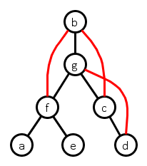
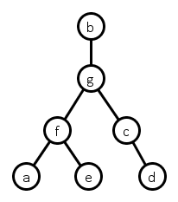
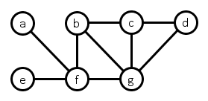
The treedepth of a graph
Measures how much the graph looks like a star
Can be defined in many different ways
Vertex Ranking number, Ordered Chromatic Number, …
A treedepth decomposition of a graph $G$ is:
a rooted forest $F$ on vertex set $V(G)$, such that
for all $\left\{u,v\right\}∈E\left(G\right):$ $u$ is an ancestor of $v$ or vice versa

Slide 11
The treedepth of a graph
The height of a treedepth decomposition is:
the number of vertices on a longest root-to-leaf path
The treedepth of $G$ is the minimum height of a treedepth dec.
A treedepth decomposition of a graph $G$ is:
a rooted forest $F$ on vertex set $V(G)$, such that
for all $\left\{u,v\right\}∈E\left(G\right):$ $u$ is an ancestor of $v$ or vice versa
Height 4

Slide 12
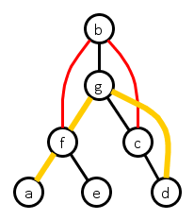
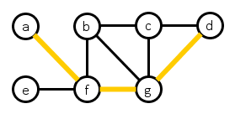
Properties of treedepth decompositions
Any path in $G$ can be emulated in the decomposition forest
Successive vertices are in ancestor-descendant relation
If $u$ and $v$ are not in ancestor-descendant relation in $F$:
All $uv$-paths contain a common ancestor of $u$ and $v$
Their common ancestors form a $uv$-separator in $G$

Slide 13
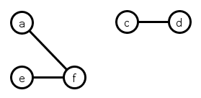
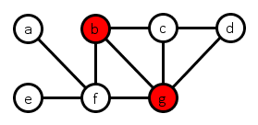
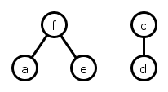
Treedepth-$d$ Deletion
Input: Graph $G$ and integer $k$ Parameter: $k$ Question: $∃S⊆V(G)$ of size $≤k$ with $td\left(G−S\right)≤d?$
“Can treedepth be reduced to $≤d$ by $≤k$ vertex deletions?”
A solution $S$ is a treedepth-$d$ modulator
NP-complete for every fixed $d≥1$
Vertex-deletion to a nontrivial hereditary class of graphs
[Lewis&Yannakakis, 1980]
$$k=d=2$$

Slide 14
Overview of the kernelization algorithm
For every $d$ there is a poly-time algorithm that reduces any input $(G,k)$ of Treedepth-$d$ Deletion to $2^{O\left(d^{2}\right)}⋅k^{6}$ vertices
Kernelization algorithm consists of two phases
Find a vertex set $Z$ of size $O\left(k^{3}\right)$ that decomposes the input:
Graph $G−Z$ has $O\left(k^{5}\right)$ components
$∃$opt that deletes $O(d)$ vertices from each component
Reduce the size of each component to $2^{O\left(d^{2}\right)}⋅O(k)$
Solution size inside component does not depend on budget $k$
Deleting optimal solution does not change component’s structure much

Slide 15
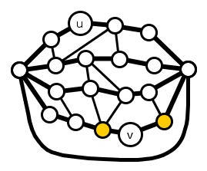
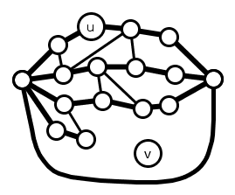
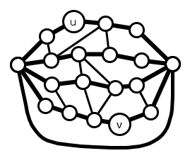
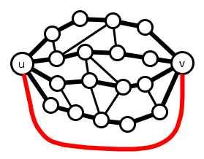
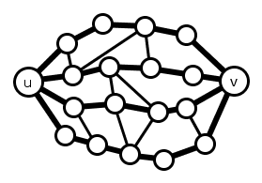
Enriching the graph
$λ_{G}(u,v)$ is the max. # of internally vertex-disjoint $uv$-paths
While there is a pair $\left\{u,v\right\}∉E(G)$ and $λ_{G}\left(u,v\right)≥d+k$:
Add the edge $\left\{u,v\right\}$
Preserves solution sets for Treedepth-$d$ Deletion
Similar argument is used in Bodlaender’s algorithm for tw
Afterwards, all non-adjacent pairs have $λ_{G}\left(u,v\right)<d+k$
Menger’s theorem: $∃uv$-vertex separator of size $<d+k$

Slide 16
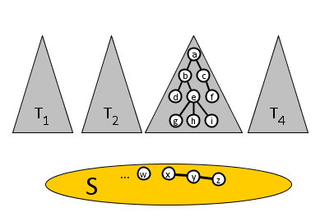
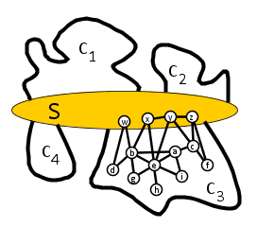
Approximate treedepth-$d$ modulator
We continue decomposing the enriched graph
Compute an approximate treedepth-$d$ modulator $S$:
If $\left|S\right|>2^{d}⋅k$: no solution of size $k$ exists, output no
Otherwise we exploit the structure of $G−S$
Lemma. [Gajarský et al., ESA’13]
Fix $d∈ℕ$. Given a graph $G$, one can in polynomial time compute $S⊆V\left(G\right)$ such that $td\left(G−S\right)≤d$ and $|S|$ is at most $2^{d}$ times the size of a minimum treedepth-$d$ modulator of $G$
$$G$$
$$F$$

Slide 17
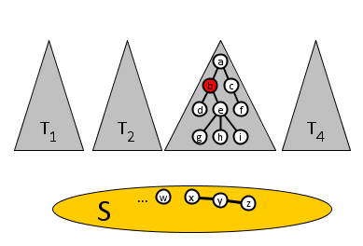
Combining separators
Create a vertex set $Y$ by combining small separators
For each pair $\left\{u,v\right\}$ of vertices from $S$, with $\left\{u,v\right\}∉E(G)$:
Compute a minimum $uv$ vertex-separator $Y_{uv}$
Add $Y_{uv}∖S$ to $Y$
$\left|Y_{uv}\right|<k+d$ by enrichment step
Results in $\left|Y\right|≤{\left|S\right|}^{2}⋅\left(k+d\right)∈O\left(k^{3}\right)$ ($O$-notation hides exponential factor in $d$)
$$G$$
$$F$$

Slide 18
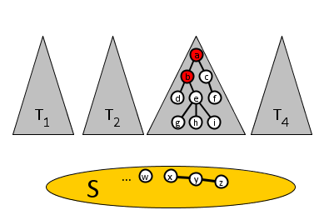
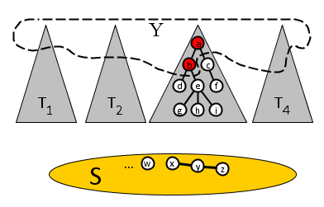
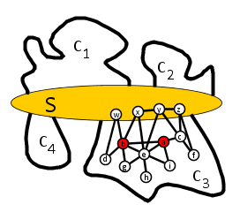
Combining separators
Create a vertex set $Y$ by combining small separators
For each vertex in Y, add all its ancestors to $Y$
Size of $Y$ increases by factor at most $d$
Result: $\left|Y\right|∈O\left(k^{3}\right)$
Observation.
For every connected component $C$ of $G−(S∪Y)$, the neighbors in $S$ form a clique and there are less than $d$ neighbors in $Y$
$$G$$
$$F$$

Slide 19
Consequences of the decomposition
If a solution deletes more than $2d$ vertices from $C$:
Solution deletes all but $≤d$ vertices of $N_{G}\left(C\right)∩S$
Find a better solution as follows:
Undo deletions in $C$, delete $N_{G}\left(C\right)∩(S∪Y)$ instead
$$F$$
$$N_{G}\left(C\right)∩Y$$
Lemma.
There is an optimal solution that deletes at most $2d$ vertices from each component $C$ of $G−(S∪Y)$
C
$$N_{G}\left(C\right)∩S$$

Slide 20
Remainder of the kernelization
Easy to reduce the number of components to $O\left(k^{5}\right)$
Main work lies in shrinking each component to size $2^{O\left(d^{2}\right)}⋅k$
We introduce several structural lemmata on treedepth to analyze what structure any treedepth-$d$ decomposition of $C$ must have, even after deleting $O(d)$ vertices from $C$
Algorithm using these lemmata is elementary
No protrusion reduction
Analysis is complicated

Slide 21
Conclusion
$ℱ$-Minor-Free Deletion does not have uniformly poly kernels
Not even when restricted to $ℱ$ containing a path
Treewidth-$d$ Deletion does not have uniformly poly kernels
But Treedepth-$d$ Deletion has kernels of size $2^{O\left(d^{2}\right)}⋅k^{6}$
Open problems
Uniformly poly kernels for Pathwidth-$d$ Deletion?
Polynomial kernel for Vertex Planarization?
Characterize the families for which $ℱ$-Minor-Free Deletion has a uniformly poly kernel
THANK YOU!

