Slide 1

Is your biometric data safe?
Alex Kot
School of Electrical & Electronic Engineering
Nanyang Technological University
Singapore

Slide 2
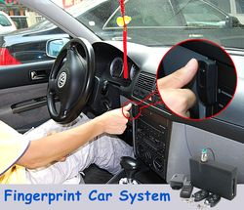
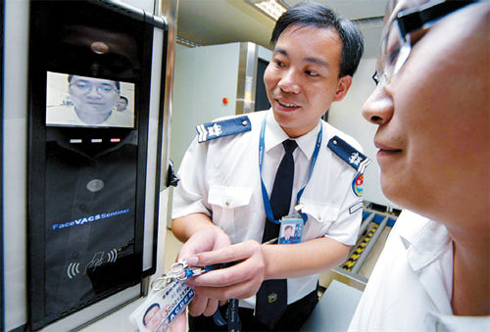
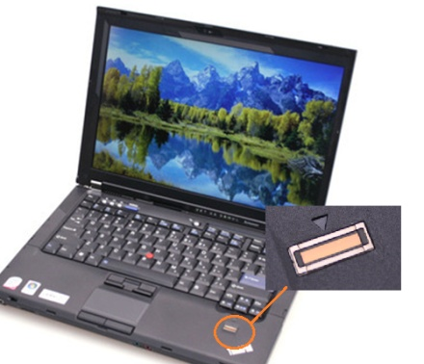
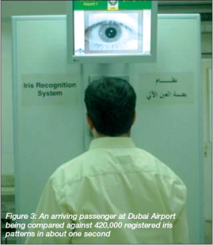
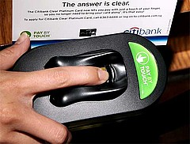
Biometrics in daily life
Biometrics
Images are downloaded from the internet

Slide 3
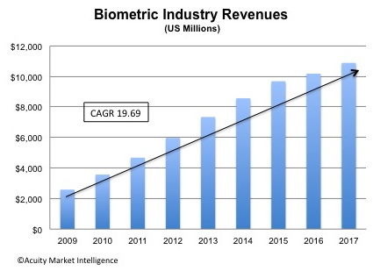
Biometrics in daily life
Advantages:
  Provides uniqueness
  Can not be lost
  Can not be forgotten
  Much harder to fool…
CAGR: Compound Annual Growth Rate
http://www.acuity-mi.com/FOB_Report.php

Slide 4
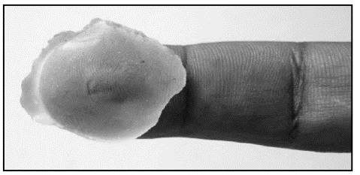
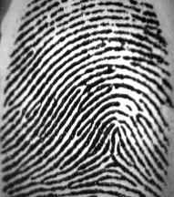
Threats to biometric templates
A fingerprint database
Tom loses his fingerprint forever!
ID | DOB | … | Fingerprint
Tom | 11-Jan-1981 | …
Applications associated with Tom’s fingerprint
Stolen
…
…
…
…
A fake finger
The images of this figure are from
Maltoni et al., Handbook of fingerprint Recognition, 2009
Once a biometric template is stolen:
  Cannot be updated and reissued
  Can be utilized to gain false identity
  May leak some private information of the user

Slide 5
Existing techniques
Template encryption
Cancelable biometric generation
Biometric key generation
Biometric data hiding

Slide 6
Template encryption
Key
Key
Encryption
Decryption
Original Template
Encrypted
Template
Original Template
Enrollment
Authentication
Decryption is required before template matching
The decrypted template is vulnerable

Slide 7
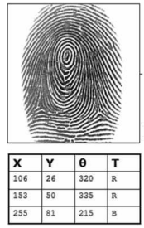
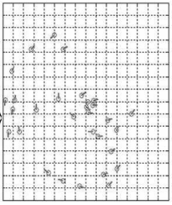
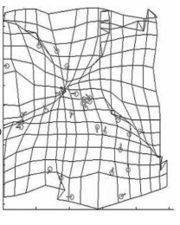
Cancelable biometric generation
Non-invertible transform: Ratha et al., PAMI, 2007
Key
Many to one mapping function
Original minutiae template
Cancelable minutiae template
The images of this figure are from Ratha et al., PAMI, 2007
Matching can be performed in the transformed domain. But the non-invertible transform will usually lead to a accuracy reduction

Slide 8




Cancelable biometric generation
Biohasing: Teoh et al., Pattern Recogn., 2004
$$F={\left\{\begin{matrix}f_{1} \\ f_{2} \\ ... \\ f_{n}\end{matrix}\right\}}^{T}$$
$$R=\left\{\begin{matrix}r_{11} r_{12} ...r_{1m} \\ r_{21} r_{22} ...r_{2m} \\ ... \\ r_{n1} r_{n2} ...r_{nm}\end{matrix}\right\}$$
$$H=FR$$
Extracted
features
Orthogonal pseudo-random matrix generated from the token
Binarization
Biohash: 0111…
The images of this figure are from
Teoh et al., Pattern Recogn., 2004
Very high accuracy under the assumption that the token is never stolen or shared. Once the token is stolen or shared, there will be a significant reduction in the accuracy.

Slide 9


Biometric key generation
Fuzzy commitment: Tuyls et al., AVBPA, 2005
T
10111…
$$D=C XOR T$$
$$C′=T′ XOR D$$
T'
10111…
Key
Codeword C
01011…
Error correction
Codeword C
01011…
Key
Enrollment
Authentication
Require the template to be aligned and ordered. Can not be applied for point set based features such as minutiae points

Slide 10
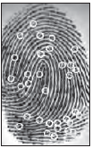
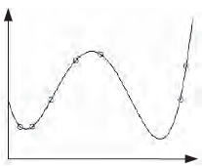
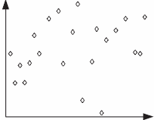


Biometric key generation
Fuzzy fault: Nandakumar et al. TIFS, 2007
Polynomial
transformation
$$T=\left\{t1,t2,\text{…}\right\}$$
Key
$$H=\left\{\left(t1,p(t1\right),\left(t2,p(t2\right)), \text{…}\right\}$$
Chaff points addition
The images of this figure are from
Nandakumar et al. TIFS, 2007
Enrollment
Vault

Slide 11
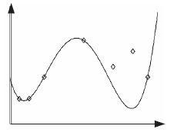

Biometric key generation
Fuzzy fault: Nandakumar et al. TIFS, 2007
Vault
Filtering
$$T′=\left\{t1,t2,\text{…}\right\}$$
Polynomial
reconstruction
Polynomial
p
Key
The images of this figure are from
Nandakumar et al. TIFS, 2007
Authentication
Able to handle point set based features. However, it requires a specific matcher, which may lead to a degradation in accuracy.

Slide 12
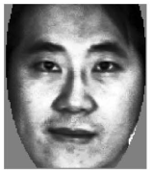
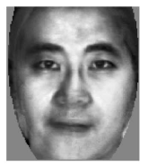
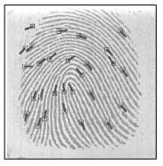
Biometric data hiding
Jain and Uludag, PAMI, 2003
Fingerprint with hidden data
Data embedding
Data extraction
Face matching
Yes/No
Fingerprint matching
Yes/No
Enrollment
Authentication
The images of this figure are from
Jain and Uludag, PAMI, 2003
The eign-face coefficients are hidden in a grayscale fingerprint so as to enhance the authenticity of the fingerprint
The fingerprint matching accuracy is slightly reduce due to the data hiding

Slide 13
Biometric data hiding
Data hiding technique are also applied to
  Statistic signature (grayscale image) Maiorara et al., BSYM, 2007.
  Color face image (color image) Vatsa et al., IMAGE VISION COMPUT., 2009.
  Electronic ink (sample sequence) Cao and Kot., TIFS, 2010
  Palmprint Competitive Code, Kong et al., Pattern Recogn., 2008.
  DNA, Shimanovsky, et al., IH, 2002

Slide 14
Full fingerprint reconstruction and its privacy concerns
The minutiae template is commonly stored in a database for fingerprint recognition.
A fingerprint can be reconstructed from the minutiae.
  Manufacturing a fake finger
  Submitting to the communication channel
It is necessary to examine to what extreme a reconstructed fingerprint can be similar to the original fingerprint.
  Prompt the research of countermeasures against the attacks due to reconstructed fingerprint
  Useful when the original fingerprint is not available or of low quality. E.g., the template interoperability problem, the latent fingerprint restoration problem.

Slide 15
Full fingerprint reconstruction and its privacy concerns
The existing works:
  Hill, Master’s thesis, 2001 heuristically draws a partial skeleton from the minutiae points
  Ross et al., PAMI, 2007. reconstruct a fingerprint from minutiae points by using stream lines.
  Cappelli et al., PAMI, 2007. iteratively grow the ridges from an initial image which records the minutiae local pattern.
  Feng et al., PAMI, 2010. adopt the AM-FM fingerprint model for the fingerprint reconstruction.
Our proposed scheme:
  Fewer artifacts and fewer spurious minutiae
  Good match against the original fingerprint and different impressions of the original fingerprint
  Application for fingerprint ridge frequency protection

Slide 16
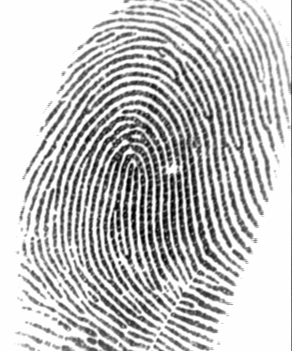
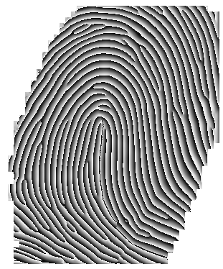
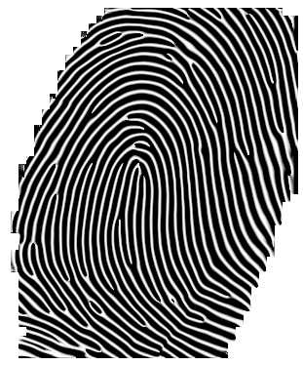
The AM-FM fingerprint model
Larkin and Fletcher, Optics Express, 2007
Original fingerprint I
Hologram phase ψ
Cos(ψ)
β = O_{u} +π/2

Slide 17



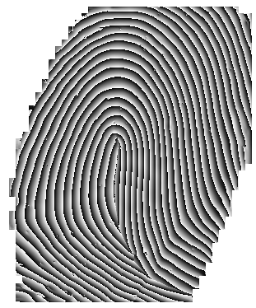

The AM-FM fingerprint model
Spiral phase: ψ_{s} calculated
from the spirals
ψ
Continuous phase: ψ_{c} = ψ− ψ_{s}
O_{u}

Slide 18
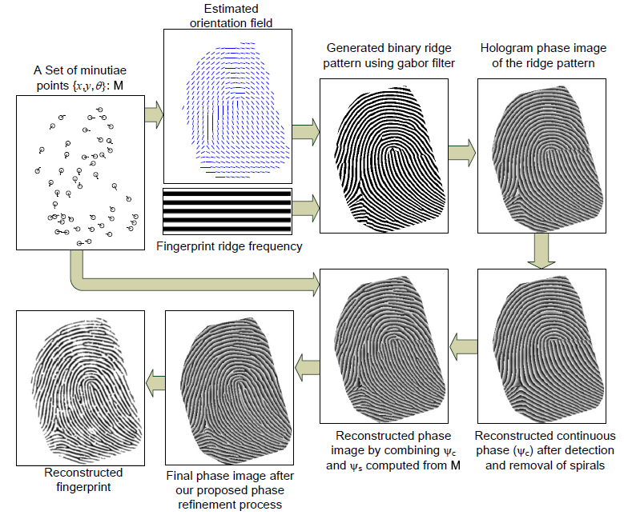
The proposed method
The proposed fingerprint reconstruction scheme

Slide 19
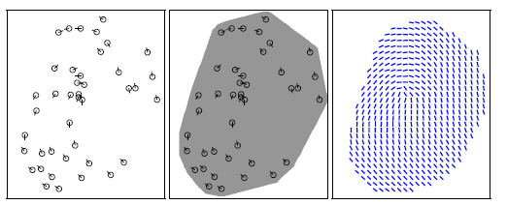
1. Orientation estimation
Existing fingerprint orientation models for global fingerprint representation, e.g., Zhou et al., TIP, 2004., Yang et al., PAMI, 2011.
Some specifically designed algorithms, e.g., Ross et al., PAMI, 2007., Feng et al., PAMI, 2011
A set of minutiae points
Region of interest
Estimated orientation
The orientation estimation scheme proposed by Feng et al. PAMI, 2010.

Slide 20

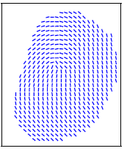

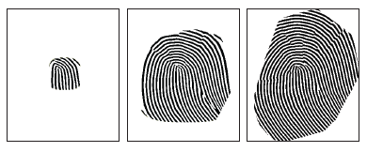
2. Binary ridge pattern generation
An initial image
The orientation
A predefined frequency
Gabor Filtering, Cappelli et al., ICPR, 2000

Slide 21
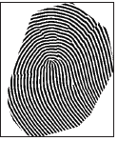
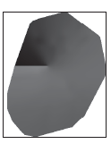
3. Continuous phase reconstruction
I(x,y)−a(x,y)
Enhanced ridge
pattern
Spirals detection and removal
β = O_{u} +π/2
The phase image ψ
The reconstructed
continuous phase: ψ_{c}
Unwrapped orientation

Slide 22
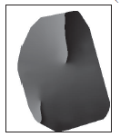
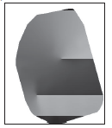
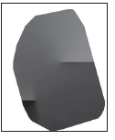
The proposed orientation unwrapping algorithm
Estimated orientation
Horizontally unwrapped orientation
Unwrapped orientation
1
2
Discontinuity Segments
Processing row by row from left to right
Processing from top to bottom
1
2

Slide 23
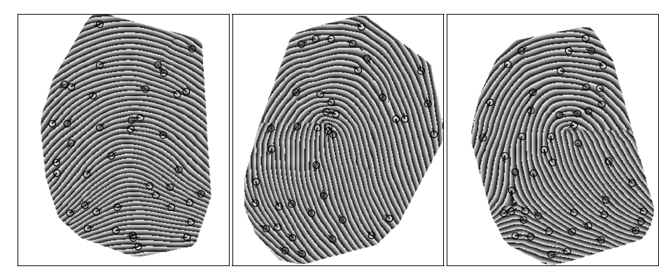
4. Continuous phase and spiral phase combination
ψ_{f} = ψ_{c} + ψ_{s}
Computed from the minutiae points
Examples of reconstructed phase images

Slide 24
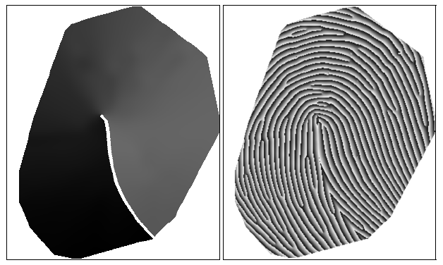
An example in the case that we adopt the branch cut based orientation unwrapping for continuous phase reconstruction

Slide 25
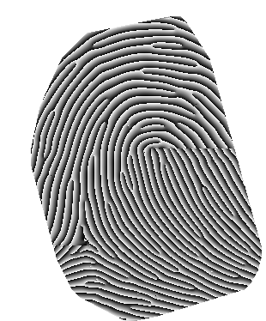

5. Reconstructed phase image refinement
For the reconstructed phase image with two Discontinuity Segments
ψ_{f}
A different form of the reconstructed phase image
The refined phase image
O′_{u}

Slide 26
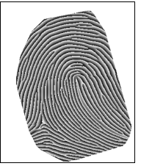
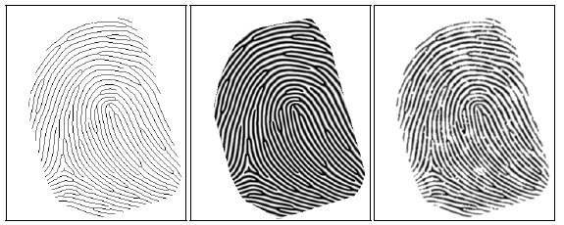
6. Real-look alike fingerprint creation
Refined phase image
Thinned version
Ideal fingerprint
Real-look alike fingerprint

Slide 27
Experimental results
Evaluation databases: FVC2002 DB1_A and FVC2002 DB2_A. Each database contains 800 grayscale fingerprint images from 100 fingers with 8 impressions per finger.
Algorithms for minutiae extraction and matching: The VeriFinger 6.3
Fingerprint images are reconstructed from all 800 minutiae templates (of each database) using our proposed technique and the-state-of-the-art method proposed by Feng et al..
We create our reconstructed fingerprint without the step of real-look alike fingerprint creation for a fairly comparison with Feng’s work.

Slide 28
Experimental results
Two types of matches:
  The type-A match: the reconstructed fingerprint is matched against the original fingerprint. In total 800 type-A matches for each database.
  The type-B match: the reconstructed fingerprint is matched against the different impressions of the original fingerprint. In total 800x7=5600 type-B matches for each database.

Slide 29
Comparison results on FVC2002 DB1_A
Type-A match
Type-B match

Slide 30
Comparison results on FVC2002 DB2_A
Type-A match
Type-B match

Slide 31
A visual comparison
A reconstructed fingerprint from the proposed method
The corresponding reconstructed fingerprint from Feng et al.’s method

Slide 32
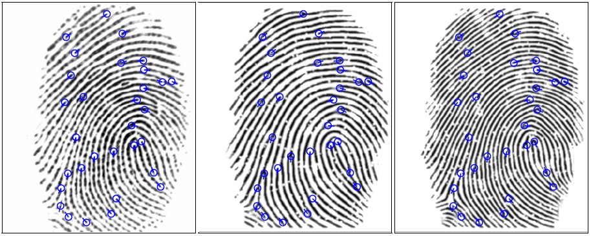
Generation of fingerprints with different frequencies
The original fingerprint
A generated fingerprint with f=0.11
A generated fingerprint with f=0.15
A generated fingerprint is reconstructed from both the minutiae and the original orientation

Slide 33
The performance evaluation
The first impressions of the 100 fingers in FVC2002 DB1_A are considered to be stored in the database
The other seven impressions of each finger are considered to be the full fingerprints (testing fingerprints) during verification.
For each testing fingerprint, we produce two generated fingerprints with f=0.11 and f=0.15.
In total two sets of generated fingerprints with 700 images per set
Each generated fingerprint is matched against the original fingerprint, producing 700 genuine matching scores for each set of generated fingerprints

Slide 34
The performance evaluation
FVC2002 DB1_A
FVC2002 DB2_A

Slide 35
Remarks
Losing one’s minutiae template means a high chance of losing his fingerprint
  Over 99% of Successful Type-A Match Rate at FAR of 0.01%
  Over 85% of Successful Type-B Match Rate at FAR of 0.01%
The fingerprint reconstruction technique can be adopted for protecting the privacy of the fingerprint
  The ridge frequency of the fingerprint is protected by using the generated fingerprints
  By using our generated fingerprints, the verification accuracy is slightly reduced (within 3% at FAR of 0.01%)

Slide 36
Feature Level Based Fingerprint Combination for Privacy Protection
The weaknesses of most of the existing fingerprint privacy protection techniques
  Require the user to carry a token or memorize a key: not convenient, vulnerable when both the token (or key) and the protected fingerprint are stolen
  Noticeable in their protected template: hacker maybe interested to crack such protected template
We propose a novel system that is able to protect the privacy of the fingerprint
  No key is required
  Imperceptible in the protected fingerprint template

Slide 37
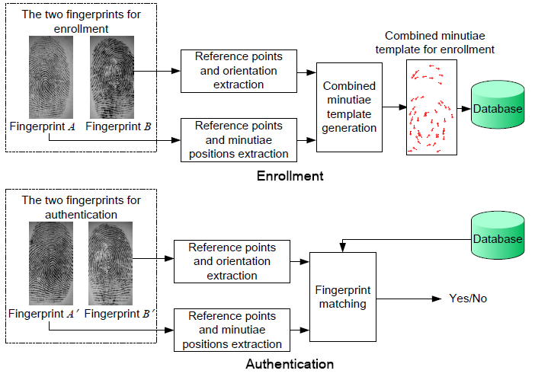
The proposed method
The proposed fingerprint privacy protection system

Slide 38
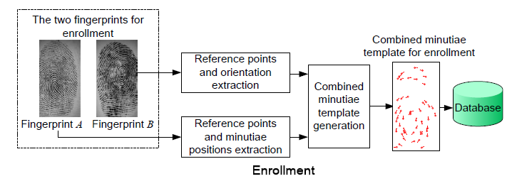
Enrollment
Minutiae position extraction
Orientation extraction
Reference points detection
Combined minutiae template generation

Slide 39
Reference points detection
Motivated by the method proposed by Nilsson et al., Pattern Recognition Letters, 2003
A fingerprint
Doubled orientation:2θ
R=z*T_{c}
z=cos(2θ)+jsin(2θ)
The reference point: (i) with the local maximum response, and (ii) the local maximum response is over a fixed threshold.

Slide 40
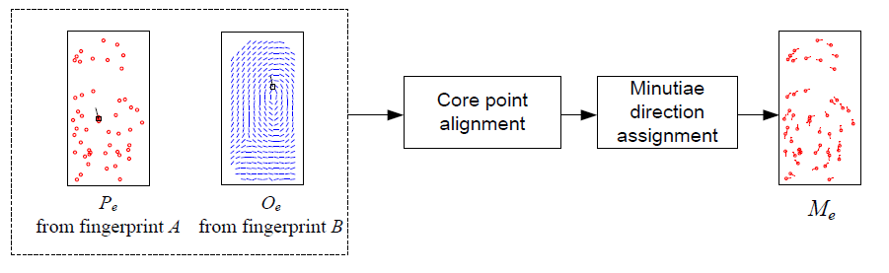
Combined minutiae template generation
The primary core: the reference point with the maximum response

Slide 41



Core point alignment
$P_{e}$ is translated and rotated such that the two primary cores are aligned
$$P_{e}$$
$$O_{e}$$

Slide 42


Minutiae direction assignment
Coding strategy 1: The angle of the combined minutiae only depends on the orientation of fingerprint B
For an aligned minutiae position $\left(x,y\right)$, its angle is assigned as
$$anglec \left(x,y\right)={Orientation}_{b}\left(x,y\right)+kπ$$
where $k \text{is} \text{randomly} \text{chosen} \text{from} \{0,1\}$.
The angle assigned to each minutiae point
In the fingerprint matching, we will do a modulo $π$ for the directions to remove the randomness.

Slide 43

Minutiae direction assignment
Coding strategy 2: The angle the combined minutiae depends on both the angle of the minutiae of fingerprint A and the orientation of fingerprint B
For an aligned minutiae position $\left(x,y\right)$, its angle is assigned as
$${angle}_{c} \left(x,y\right)= {Orientation}_{b}\left(x,y\right)+kπ$$
where $k=\left\{\begin{aligned}1 if mod\left(anglea\left(x,y\right), π\right)−Orientationb\left(x,y\right)>0 \\ 0 otherwise \end{aligned}\right.$
From
fingerprint A
From
fingerprint B
The original angle
The assigned angle

Slide 44


Minutiae direction assignment
Coding strategy 3: The angle of the combined minutiae depends on both the neighboring minutiae in fingerprint B and the orientation of fingerprint B
For an aligned minutiae position $\left(x,y\right)$, its angle is assigned as
$${angle}_{c} \left(x,y\right)={Orientation}_{b}\left(x,y\right)+kπ$$
where$k=\left\{\begin{aligned}1 if mod\left(aveb\left(x,y\right), π\right)−{Orientation}_{b}\left(x,y\right)>0 \\ 0 otherwise \end{aligned}\right.$
$$aveb\left(x,y\right)=\sum_{i=1}^{N}{angleb(i)/N }$$
Minutiae point from fingerprint B
The assigned angle

Slide 45

Authentication
Minutiae position extraction
Orientation extraction
Reference points detection
Fingerprint matching

Slide 46

Fingerprint matching

Slide 47
Experimental results
Database: FVC2002 DB2_A.
The VeriFinger 6.3 is used for the minutiae positions extraction and the minutiae matching
We use the first two impressions in the database, which contain 200 fingerprints from 100 fingers
Two different fingers form a finger pair

Slide 48
Part 1: Evaluating the performance of the proposed system
The 100 fingers are randomly paired to produce a group of 50 non-overlapped finger pairs.
The random pairing process is repeated 10 times to have 10 groups of 50 non-overlapped finger pairs.
For each group:
The first impressions of each finger pair are used to produce two combined minutiae templates. 100 templates in total. The corresponding second impressions are matched against the template using our proposed fingerprint matching algorithm.

Slide 49
Part 1: Evaluating the performance of the proposed system

Slide 50
Part 2: Evaluating the possibility to attack other systems by using the combined minutiae templates
In case the combined minutiae templates are stolen, the attacker can use the combined minutiae templates to attack other systems which store the original minutiae template. How is the successful attack rate?
The combined minutiae templates generated in Part 1 are matched against the corresponding fingerprint A (providing the minutiae position). In total 100*10=1000 matches.
The combined minutiae templates generated in Part 1 are matched against the corresponding fingerprint B (providing the orientation). In total 100*10=1000 matches

Slide 51
Part 2: Evaluating the possibility to attack other systems by using the combined minutiae template
Attack the system that stores the corresponding fingerprint A providing the minutiae position
Attack the system that stores the corresponding fingerprint B providing the orientation

Slide 52
Part 3: Evaluating the cancelablity of the system
For a set of J > 2 fingers, our system is able to create more different templates (J ×(J -1)) than a traditional fingerprint recognition
Considering a database that stores all the possible combined minutiae templates generated from a set of fingers. How is the performance of our system on such a database?
We randomly separate the 100 fingers in FVC2002 DB2_A into to 10 groups with 10 fingers per group (J =10). Each group produces 90 combined minutiae templates to be stored in a database

Slide 53
Part 3: Evaluating the diversity of combined minutiae template

Slide 54
Remarks
No key or token is required
A combined minutiae template containing only a partial minutiae
feature of each of the two fingerprints
The combined minutiae template looks like real minutiae
High accuracy
It is difficult to attack other systems by using the combined minutiae templates

Slide 55
Privacy protection of fingerprint database
A novel fingerprint authentication system is proposed to enhance the privacy of the fingerprint database
  Only the thinned fingerprint is stored
  The user identity is hidden into his thinned fingerprint
A novel data hiding scheme is proposed for a thinned fingerprint.
  Does not produce any boundary pixel in the thinned fingerprint during data embedding
  Reduces the detectability of data hiding technique used in our system

Slide 56


Why using a thinned fingerprint?
Thinned fingerprint VS. Grayscale fingerprint
  A Thinned fingerprint is much smaller in file size and keeps all the key features
  It is much faster to extract the fingerprint minutiae features or ridge features from the thinned fingerprint
Thinned fingerprint VS. Minutiae features
  Minutiae features won’t be sufficient to reconstruct the ridge valley of the original fingerprint
  Thinned fingerprints offer flexibility in choosing fingerprint matching algorithms

Slide 57

The proposed fingerprint authentication system
Additional biometric data

Slide 58

The proposed fingerprint authentication system

Slide 59
The proposed data hiding scheme for thinned fingerprint
Existing works for binary image data hiding are not appropriate for the thinned fingerprint
In the data embedding of our proposed method
  No modification of minutiae points
  No creation of boundary pixels
Cause abnormality
Yang and Kot, TMM, 2007. Yang and Kot, TMM, 2008.

Slide 60

The basic idea
Block partition
(3×3)
Block identification
Embeddability determination
Pixel exchange

Slide 61
The basic idea
Notation of a 3×3 block and its neighboring pixels

Slide 62
Block Partition
Non-overlapping
Overlapping

Slide 63
Block identification
16 different types of blocks are identified as candidate blocks for data embedding, for example
A candidate blocks can be identified by computing its pattern identification ζ with
The block is a candidate block if ζ equals to 1, 3, 5 or 7.
Two types of candidate blocks

Slide 64
Embeddability determination
For a candidate block, P_{s} is the swappable pixel with the center pixel P₀ where
P₈
P₀
P₈
P₀
P₈ is the swappable pixel with P₀ (ζ = 3)

Slide 65
Embeddability determination
For a candidate block, N_{k}, N_{k+1}and N_{k+2} are its key neighbors where
N₁₆
N₁₆
N₁₅
P₈
P₀
N₁₅
P₈
P₀
N₁₄
N₁₄
s = 8, k = 14. N₁₄, N₁₅ and N₁₆ are the key neighbors

Slide 66
Pixel exchange for embedding
N₁₆
N₁₆
Embed a bit “1”
N₁₅
P₈
P₀
N₁₅
P₈
P₀
N₁₄
N₁₄

Slide 67
Data embedding
Method A
Non-overlapping block partition
Chose an embeddable block
Exchange P_{s} with P₀
if needed
Yes
Method B
Overlapping block partition
Chose an candidate block
Mark the key neighbors as “fixed pixel”
P_{s} and P₀ are “fixed pixel”?
No
No
The block
embeddable?
Yes
Exchange P_{s} with P₀
if needed

Slide 68
Data extraction
Method A
Non-overlapping block partition
Chose an embeddable block
Extracted bit = P₀
Yes
Method B
Overlapping block partition
Chose an candidate block
Mark the key neighbors as “fixed pixel”
P_{s} and P₀ are “fixed pixel”?
No
No
The block
embeddable?
Yes
Extracted bit = P₀

Slide 69
Experimental results − visual quality
Hiding
600 bits
Our approach
Yang and Kot, 2007
Yang and Kot, 2008

Slide 70
Experimental results − capacity
Original thinned fingerprint | Capacity (bits)
 | Our approach |  | Yang and Kot 2007 (4×4 IB) | Yang and Kot 2008 (DPC)
 | Non- overlapping | Overlapping
tented arch | 506 | 1132 | 914 | 1252
arch | 474 | 1086 | 862 | 1131
right loop | 694 | 1535 | 1064 | 1255
left loop | 642 | 1495 | 1094 | 1384
whorl | 593 | 1391 | 846 | 1017

Slide 71
Remarks
A system for fingerprint database privacy protection
  The hacker would not be able to obtain the identity of the stolen templates
A scheme for data hiding in the thinned fingerprint
  Visually imperceptible
  The performance of the fingerprint identification is not compromised
  Sufficient capacity

Slide 72
Summary
The privacy of the fingerprint database can be protected by imperceptibly hiding the user identity into his thinned fingerprint
A reconstructed fingerprint could be very similar to the original fingerprint in terms of minutiae features
Fingerprint reconstruction techniques are useful for the fingerprint privacy protection
Storing the combined minutiae template is another way to protect the privacy of the fingerprint

Slide 73
Thank you!
Acknowledgement: LI Sheng, YANG Huijuan

