Slide 1
2IS55 Software Evolution
Architecture Evolution
Alexander Serebrenik

Slide 2
Assignment 2: Reminder
Deadline: Today, 23:59
Individual
PDF
How to submit: Peach
http://peach.win.tue.nl/
Assignment 3
Is already open
Deadline: March 8, 23:59
Groups: 1-2 students

Slide 3
Sources
Architecture reconstruction slides
Rainer Koschke (in German) http://www.informatik.uni-bremen.de/st/lehredetails.php?id=3&lehre_id=309

Slide 4
Where are we now?
Last week: requirements
This week: architecture
[IEEE Std. 1471-2000] Software architecture is the fundamental organization of a system embodied in
its components,
their relationships to each other and to the environment,
and the principles guiding its design and evolution.

Slide 5
Components? Relations?
M: module: static structure
decomposition
use
generalization
layers
CC: component & connectors: runtime structure
pipe and filter
shared data
publish and subscribe
client server
peer-to-peer
communicating processes
A: allocation: embedding in organizational development context
deployment
implementation
work assignment
Many views:
Kruchten’s 4+1
Siemens
Zachman
Perry and Wolf
Clements et al.
…
Notes:
Clements, Paul ; Bachmann, Felix ; Bass, Len ; Garlan, David ; Ivers, James ; Little, Reed ; Nord, Robert ; Stafford, Judith: Documenting Software Architecture. Boston : Addison-Wesley, 2002

Slide 6
Architecture
As intended
As described
Architecture Description Languages
Should express different views
As implemented
Code, deployment
From code to architecture: reverse engineering
Should extract different views
evolution
evolution
Notes:
We start with the “as implemented” architecture so you can start with your assignment!

Slide 7
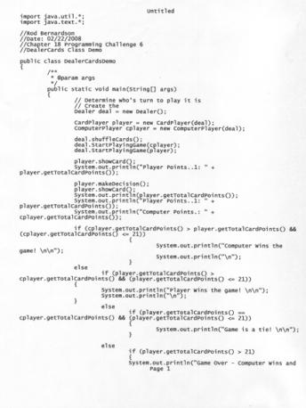
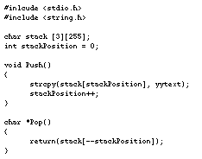
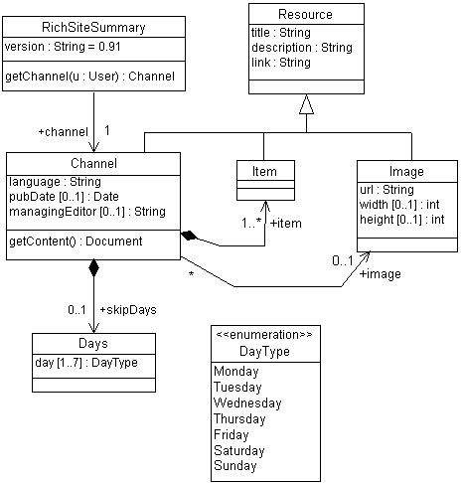
Reverse Engineering
[Chikofsky und Cross II 1990] Reverse Engineering is the process of analyzing a subject system to
identify the system’s components and their interrelationships and
create representations of the system in another form or a higher level of abstraction.
Reverse engineering: different meanings
Notes:
Chikofsky, Elliot J. ; Cross II., James H.: Reverse Engineering and Design Recovery: A Taxonomy. In: IEEE Software 7 (1990), Januar, Nr. 1, S. 13–17

Slide 8
Our Reverse Engineering
[Koschke 2008] Architecture reconstruction is the process of analyzing a subject system to reconstruct architectural views.
Different views require different architecture reconstruction techniques!
No silver bullets!
Notes:
Chikofsky, Elliot J. ; Cross II., James H.: Reverse Engineering and Design Recovery: A Taxonomy. In: IEEE Software 7 (1990), Januar, Nr. 1, S. 13–17

Slide 9
How can we chose the right AR approach?
Goals: What problem does the AR try to solve?
Ex.: Changes affect too many modules
Goal: Assess and improve current modularisation
Questions: What do we need to know to achieve the goal?
What are the dependencies between the modules?
How can one improve the modularisation?
Views: Which views are need to answer the questions?
Module-Use Views: as-is + improved
Metrics: How can we quantify the answers?
Number of dependencies between the modules, …

Slide 10
Architecture Reconstruction ⇒ UML
UML
De facto standard architecture description language
Various diagrams corresponding to different views
Structure:
Class diagrams, package diagrams
Behaviour:
Sequence diagrams, state machines, activity diagrams
AR is implemented in many commercial, open-source and academic tools
Assignment 3!
@TU/e: CPP2XMI
Today

Slide 11
AR: Class diagrams
Basic idea
import java.util.*;
class User {
int userCode;
String fullName;
static int nextCodeAv = 0;
…
public User(String name) {
fullname = Name;
userCode = User.nextCodeAv++;
}
public int getCode() {
return userCode;
}
}
User
userCode: int
fullName: String
nextCodeAv: int
User(String name)
getCode(): int
Notes:
Static attributes are underlined

Slide 12
What about the relationships?
Tonella, Potrich 2005
Notes:
Generalization and realization relationships are examples of abstraction mechanisms
commonly used in Object Oriented programming that can be shown
in a class diagram. Aggregation, association and dependency relationships are
displayed in a class diagram to indicate that a class has access to resources
(attributes or operations) from another class.
A generalization relationship connects two classes when one inherits features
(attributes and methods) from the other. The subclass can add further
features and can redefine inherited methods (overriding). A realization relationship
connects a class to an interface if the class implements all methods
declared in the interface. Users of this class are ensured that the operations
in the realized interface are actually available.
Generalization and realization relationships satisfy the substitutability
principle: in every place in the program where a location of the superclass/
interface type is declared and used, an instance of any sublass/class
realizing the interface can actually occur.
Relationships of access kind hold between pairs of classes each time one
class possesses a way to reference the other. Conceptually, access relationships
can be categorized by relative strength. A quite strong relationship is the
aggregation. A class is related to another class by an aggregation relationship
if the latter is a part-of the former. This means that the existence of an
object of the first class requires that one or more objects of the other class
do also exist, in that they are an integral part of the first object. Participants
in aggregation relationships may have their own independent life, but it is
not possible to conceive the whole (first class) without adding also the parts
(second class). An even stronger relationships is the composition. It is a form
of aggregation in which the parts and the whole have the same lifetime, in
that the parts, possibly created later, can not survive after the death of the
whole.
A weaker relationship among classes than the aggregation is the association.
Two classes are connected by a (bidirectional) association if there is the
possibility to navigate from an object instantiating the first class to an object
instantiating the second class (and vice versa). Unidirectional associations exist
when only one-way navigation is possible. Navigation from an object to
another one requires that a stable reference exists in the first object toward
the other one. In this way, the second object can be accessed at any time from
the first one.
An even weaker relationship among classes is the dependency. A dependency
holds between two classes if any change in one class (the target of the dependency) might affect the dependent class. The typical case is a class
that uses resources from another class (e.g., invoking one of its methods). Of
course, aggregation and association are subsumed by dependency.

Slide 13
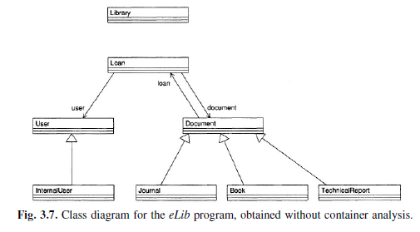
Library example
Tonella, Potrich 2005
Looks strange…
No relations between the library, its documents and its users?

Slide 14
What is going on?
class Library {
Map documents = new HashMap();
Map users = new HashMap();
Collection loans = new LinkedList();
public boolean addUser(User user) {
if (!users.containsValue(user)) {
users.put(
new Integer(
user.getCode()),
user);
return true;
}
return false;
}
}
Relation between Library and Map/Collection
Not drawn: library classes
Containers are weakly typed
Collect objects of the type that is not yet declared
Relation between Library and User is missed

Slide 15
What do we need?
Flow of information about objects
creation by allocation statements,
assignment to variables,
storage in class fields,
usage in method invocations
Data-flow analysis
We need a data structure to propagate the information
It should represent relations between objects
Both backward and forward propagation
of
Notes:
In – ingoing information for an object (variable, field, method parameter)
Out – idem outgoing
Gen – information being added
Kill – information being removed

Slide 16
Basic idea: Object Flow Graph
Vertices: variables,
x = y
x = y.m(a₁, …, a_{k})
Method m(f₁, …, f_{k})
x = new c(a₁, …, a_{k})
cs – constructor of c
fields, method parameters
y
x
y
m.this
a₁
f₁
…
a_{k}
f_{k}
m.return
x
a₁
f₁
…
a_{k}
f_{k}
cs.this
x

Slide 17
Example: Object Flow Graph
public boolean borrowDocument(User user, Document doc) {
if (user == null || doc == null) return false;
if (user.numberOfLoans() < MAX_NUMBER_OF_LOANS &&
doc.isAvailable() && doc.authorizedLoan(user)) {
Loan loan = new Loan(user, doc);
addLoan(loan);
return true;
}
return false;
}
Control-flow is ignored
Fields, parameters and methods are encoded with fully qualified names

Slide 18
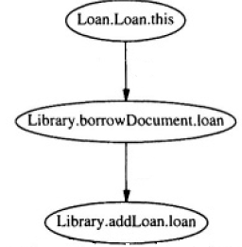
Example: Object Flow Graph
public boolean borrowDocument(User user, Document doc) {
if (user == null || doc == null) return false;
if (user.numberOfLoans() < MAX_NUMBER_OF_LOANS &&
doc.isAvailable() && doc.authorizedLoan(user)) {
Loan loan = new Loan(user, doc);
addLoan(loan);
return true;
}
return false;
}
Control-flow is ignored
Fields, parameters and methods are encoded with fully qualified names

Slide 19
Question
Does the path in the OFG always correspond to a possible execution?
if (user != null)
Loan loan = new Loan(user, doc);
if (user == null)
addLoan(loan);
This approach is conservative (safe):
no path in the Object Flow Graph ⇒ no execution can produce the flow
path in the Object Flow Graph ⇒ ???
Notes:
The solution produced by the algorithm in Fig. 2.3 has the property of being
valid for all program executions that give rise to the data flows represented
in the OFG. Since the OFG has been defined in order to take into account
all statically possible data flows, the resulting solution is conservative (safe),
in that no data flow can ever occur at run time which is not represented by
a path in the OFG. However, in general it is impossible to decide statically if
a path is feasible or not (i.e., if it can actually be executed for some input).
Thus, the solution produced by the algorithm might be over-conservative, in
that it may permit flow propagation along infeasible paths. Consequently, if
a flow information is present at a node, there may be an execution of the
program that actually produces it, while if it is absent, it is ensured that no
execution can ever produce it.

Slide 20
How can we use our graphs?
Problem: declared type ≠ actual type
Subclasses and implemented interfaces
Inheritance from a library superclass/interface is not visible in a class diagram!
In general: undecidable, we try our best
For any “x = new c” node record c:
Propagate this information through the graph:
From creation to use (forward)

Slide 21
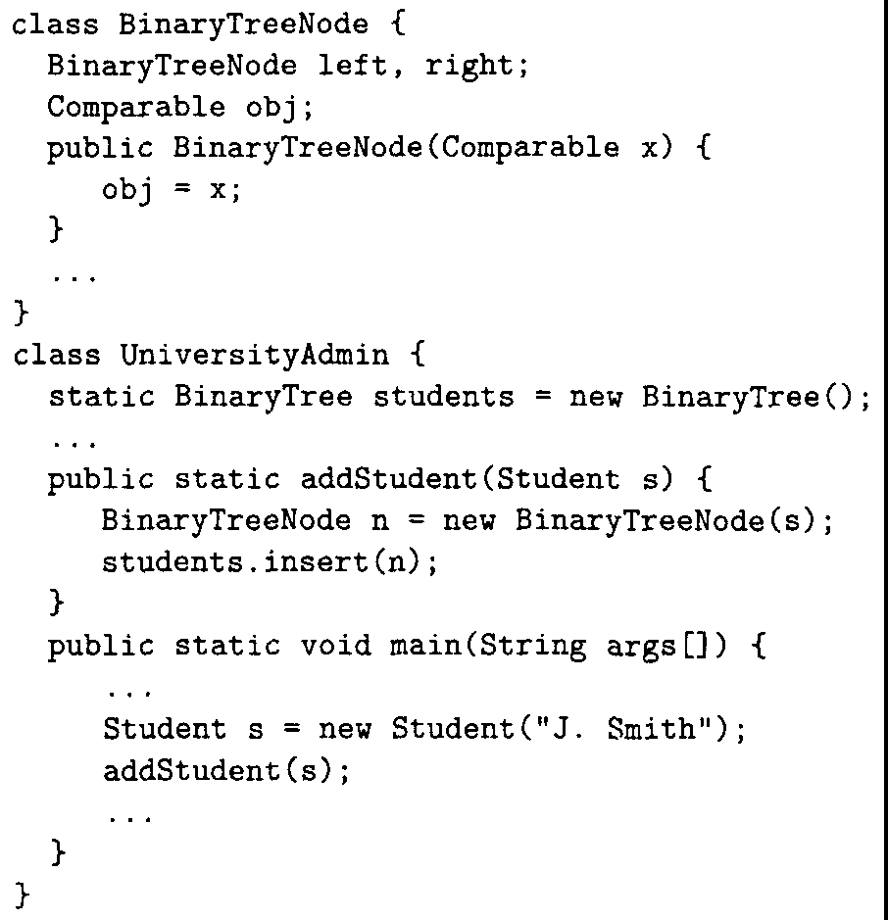
Example
gen(Student.Student.this) = {Student}
4
out(Student.Student.this) = {Student}
1
2
out(UA.main.s) = {Student}
out(UA.addStudent.s) = {Student}
3
3
out(BTN.BTN.x) = {Student}
4
1
out(BTN.obj) = {Student}
2
Notes:
3 – argument matching (s as x)

Slide 22
What about containers?
Containers: Map, List, Collection, Vector…
Weakly typed: Collect objects of the type that is not yet declared.
Operations: insert and extract
Information flow
insert
extract
The same approach works!
element
collection
collection
element

Slide 23
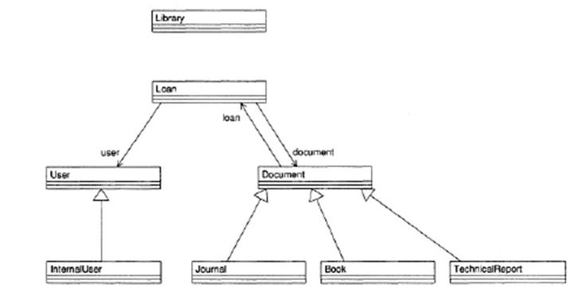
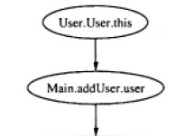
Back to the original problem: Missing link
class Library {
Map documents = new HashMap();
Map users = new HashMap();
Collection loans = new LinkedList();
public boolean addUser(User user) {
if (!users.containsValue(user)) {
users.put(
new Integer(
user.getCode()),
user);
return true;
}
return false;
}
}
gen(User.User.this) = {User}
class Main {
static Library lib = new Library();
…
public static void addUser(String cmd) {
…
User user = new User(args[0], args[1])
lib.addUser(user);
…
}
}
1
1
2
2
out(Library.users) = {User}

Slide 24
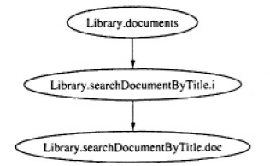
Is this all?
Associations can be introduced by extraction:
public List searchDocumentByTitle(String title) {
List docsFound = newLinkedList();
Iterator i = documents.values().iterator();
while (i.hasNext()) {
Document doc = (Document)i.next();
if (doc.getTitle().indexOf(title) != -1)
docsFound.add(doc);
}
return docsFound;
}
out(Library.documents) = {Document}
gen(Library.sDBT.i) = {Document}
Data-flow analysis progresses backwards!
Notes:
Insertion in docsFound.add(doc)

Slide 25
Concluding the example…
Tonella, Potrich 2005
Red associations were omitted by the “basic” AR technique.

Slide 26
Summary so far: AR – Class diagrams
Implemented in many tools
How precise? Depends on the tool…
Basic technique is very simple but imprecise
Improving precision necessitates data-flow analysis

Slide 27
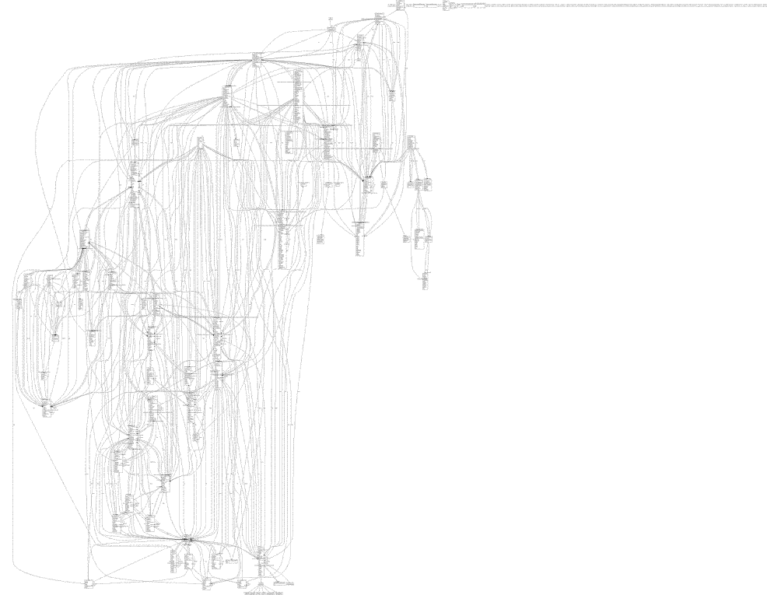
Is this the Holy Grail?..
unused
classes
We need something better...

Slide 28
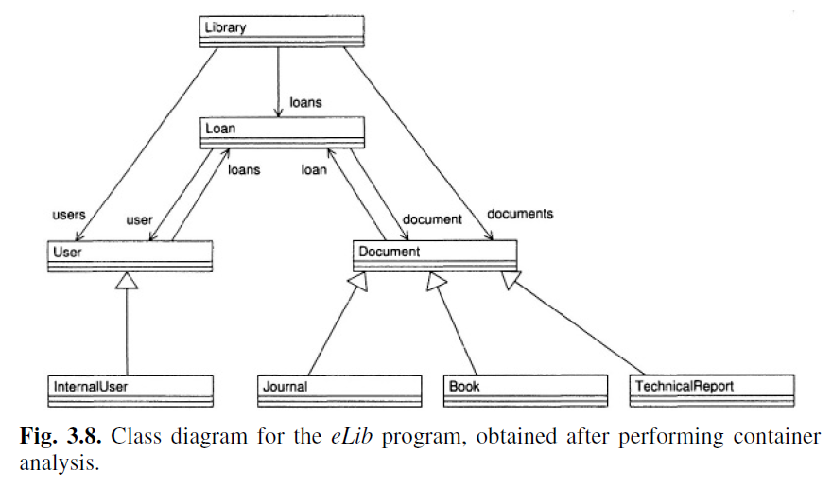
Packages
Higher level of abstraction
OO-languages usually contain explicit mechanism:
packages (Java), namespaces (C++), modules (Modula)
Easily derived from the class diagram

Slide 29
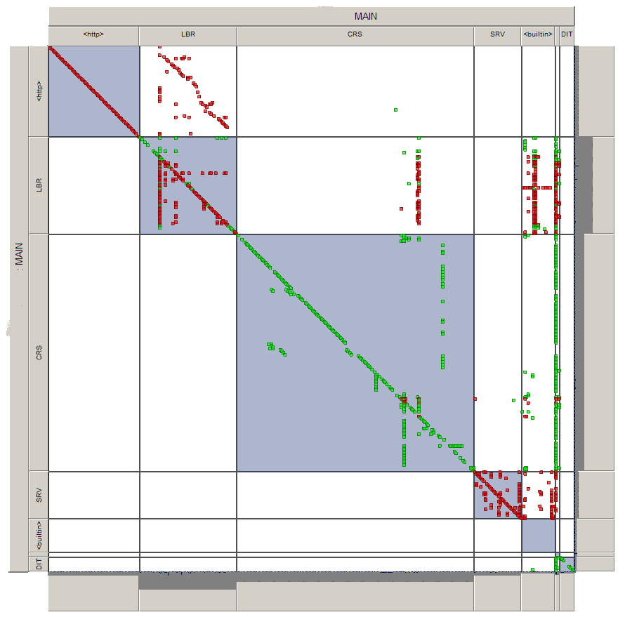
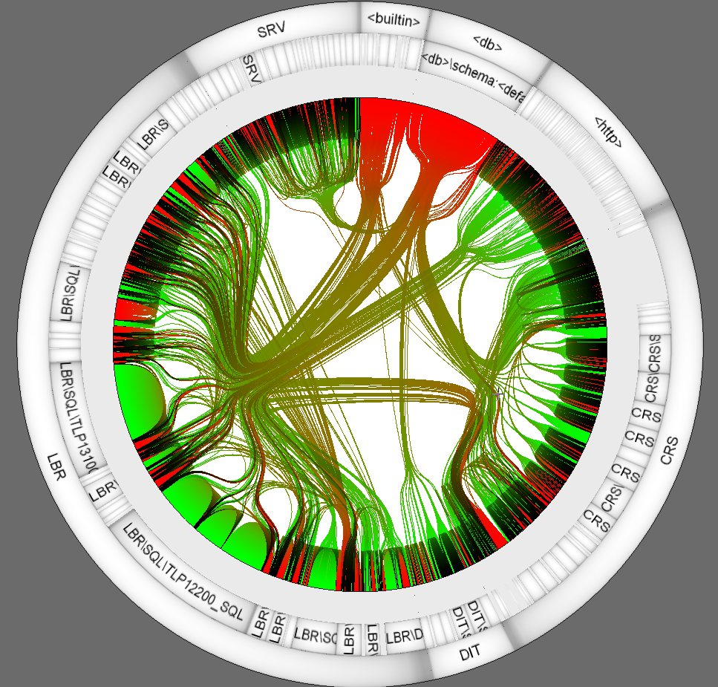
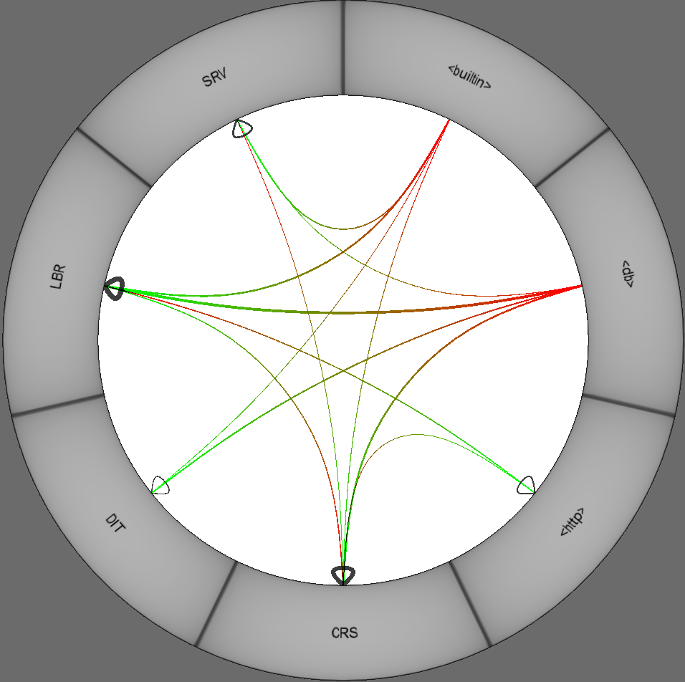
Better visualizations

Slide 30
What if the packages are unknown?
When can it happen?
Suitability for evolution
Packaging is being assessed for appropriateness
Implementation of evolution
Legacy language with no “packaging”
Inappropriate packaging
What can we do?
Let the user do it her/himself!
Do it automatically:
Join “similar” classes together: clustering
Packages can be composed into larger packages:
Hierarchical clustering

Slide 31
What is a good modularization?
Many intra-package dependencies: high cohesion
Few inter-package dependencies: low coupling
Joint measure
or
Notes:
mu_i - #dependencies in package P_i and N_i - #elements (classes)
epsilon_ij - #dependencies between Pi and Pj
k – number of packages
Ai and Eij range between 0 and 1

Slide 32
Modularity Quality
What does MQ = -1 mean?
No cohesion, maximal coupling
MQ = 1?
No coupling, maximal cohesion

Slide 33
Hierarchical Clustering
Init: every element is a cluster on its own
While (#clusters > 1) do
Calculate similarity between all pairs of clusters
Select two most similar clusters
Single linkage: max pairwise similarity
Reduces coupling
Complete linkage: min pairwise similarity
Increases cohesion
Usually more important
Merge these clusters

Slide 34
Hierarchical clustering in the library system
Tonella, Potrich 2005

Slide 35
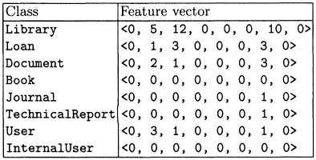
Hierarchical clustering: Classes
Class description: feature vectors
Dimension: feature
Methods called, types used, words in the description
Coordinate: number of references to this feature
NB: Should be “discriminating enough”
Variables and fields of the user-defined classes
Tonella, Potrich 2005
Notes:
Book and InternalUser use only objects coming from the standard classes, that is why they score 0 0 0 . This is also the reason why these classes are kind of apart at the previous slide.

Slide 36
When are two vectors similar?
Distance between and :
What happens if the vectors are almost empty?
Distance is small
Clustering is imprecise
d(red,green) = d(green,purple)
green and purple are more similar
or
1
1
2
3

Slide 37
Better alternative: Similarity measures
Cosine measure:
sim(red,green) = 0
sim(green,purple) = 1
Many more can be found in the literature
1
1
2
3

Slide 38
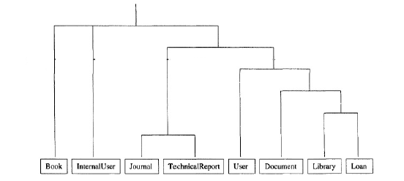
From clusters to packages
Where can we put the cutline(s)?
Evaluate the MQ!
Packages are created by cut points
Subpackages are created by more cut points

Slide 39
Algorithm: what have we done?
We can stop earlier, when the MQ no longer improves
Some cluster partition
Init: every element is a cluster on its own
While (#clusters > 1) do
Calculate similarity between all pairs of clusters
Select two most similar clusters
Single linkage: max pairwise similarity
Reduces coupling
Complete linkage: min pairwise similarity
Increases cohesion
Usually more important
Merge these clusters
Minor change in cluster partition

Slide 40
This is a combinatorial optimization problem!
Hill Climbing:
Start with a random cluster partitioning
As long as the optimization function increases
Select a best “neighbour” partition
Neighbour: small change
Best: with the highest opt. func. value
A: there may be more than one such partition
Problems: local maxima, plateau, ridges
There are better search techniques
Search-Based Software Engineering

Slide 41
What have we seen today?
Reverse engineering/architecture reconstruction
Different views – different approaches
Goal – Question – Views – Metrics
Class diagrams
Basic approach: simple, imprecise
Better precision requires data-flow analysis
Package diagrams
“Fixed” or “user-defined” packages
Automated techniques:
Clustering
Search-based, e.g. Hill climbing

Slide 42
Assignment 3
Adempiere vs. Compiere
Main tasks:
What views of software architecture will you consider?
What tools have you chosen?
Apply the tools
Compare C2.5.3 with C3.2.0 and A3.5.4a
Compare the evolution processes
Discuss threats to validity
Compiere 2.5.3 b
Compiere 3.2.0
ADempiere 3.5.4a

