Slide 1
2IMA00 - Seminar Algorithms
Parameterized complexity
Mark de Berg & Bart M. P. Jansen

Slide 2
Today
Introduction round
Remarks about the course
  Structure
  Planning
  Literature
  Context within the research group
Introduction to FPT (Bart)
Introduction to implementation challenge (Bart)
Publication culture in theoretical computer science (Mark)
Instruction for literature study assignment

Slide 3
Structure of the course
Student lectures on parameterized algorithms (50% of the grade)
  Each student presents an algorithmic topic in a 45-minute lecture
Literature study (does not affect the grade)
  Each student chooses a unique application area and searches for papers about parameterized algorithms in that area
  Details on the website
Implementation challenge (50% of the grade)
  We split in 2 groups and implement algorithms for Feedback Vertex Set based on the theory of parameterized complexity

Slide 4
Planning (tentative)
Week | Tuesday |  | Thursday
1 | 19-Apr | Kick-off | 21-Apr | No meeting
2 | 26-Apr | Literature study | 28-Apr | Intro to Feedback Vertex Set algorithms
3 | 03-May | Student lecture 1 | 05-May | No meeting (public holiday)
4 | 10-May | Student lecture 2 | 12-May | Brainstorm session
5 | 17-May | Student lecture 3 | 19-May | Student lecture 4
6 | 24-May | Student lecture 5 | 26-May | Brainstorm session
7 | 31-May | No meeting | 02-Jun | No meeting
8 | 07-Jun | Student lecture 6 | 09-Jun | Student lecture 7
9 | 14-Jun | Student lecture 8 | 16-Jun | Student lecture 9
10 | 21-Jun | No meeting (exam week) | 23-Jun | No meeting (exam week)
11 | 28-Jun | No meeting (exam week) | 30-Jun | No meeting (exam week)

Slide 5
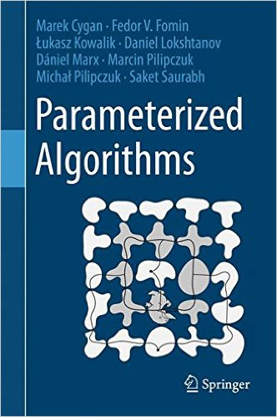
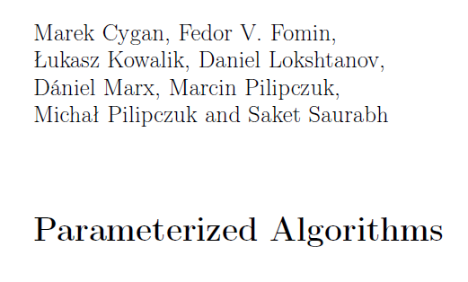
Literature
http://link.springer.com/book/10.1007%2F978-3-319-21275-3

Slide 6
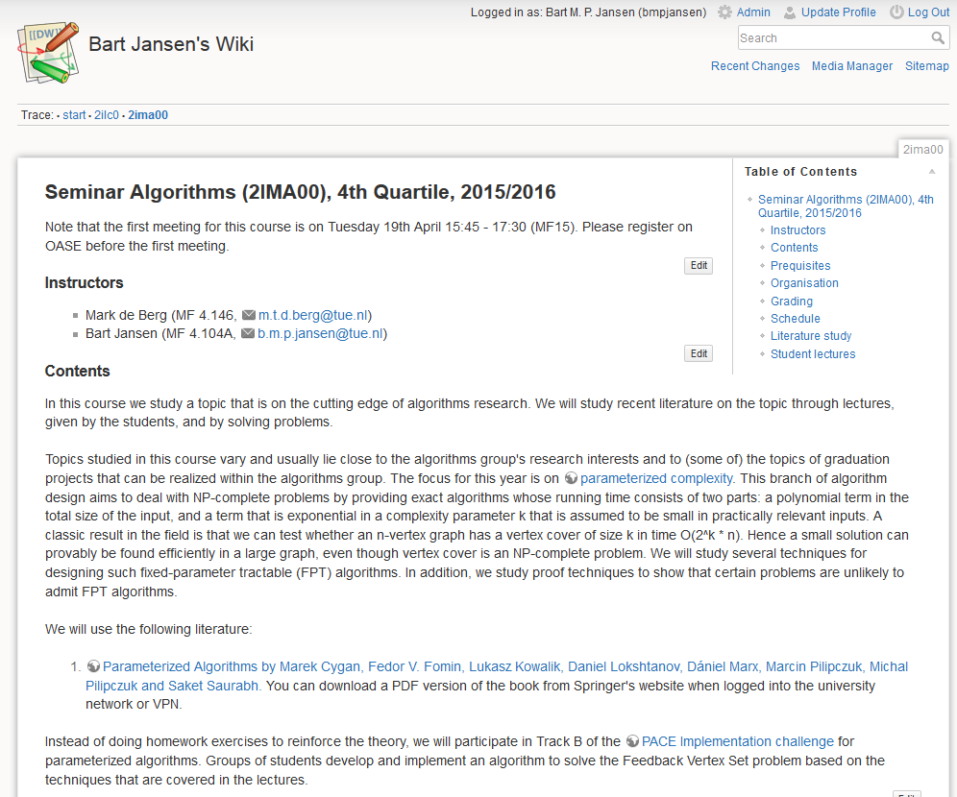
Course website
http://www.win.tue.nl/~bjansen/wiki/doku.php?id=2ima00

Slide 7
Context
There are many different directions of algorithms research within the algorithms group
  Advanced algorithms
  Geometric algorithms
  Algorithms for massive data
  Algorithms for geographic data
  …
This course focuses on parameterized algorithms, because none of the other courses cover it
After this seminar, you can search for a master thesis topic in any algorithmic direction of your choice

Slide 8
Introduction to parameterized algorithms

Slide 9
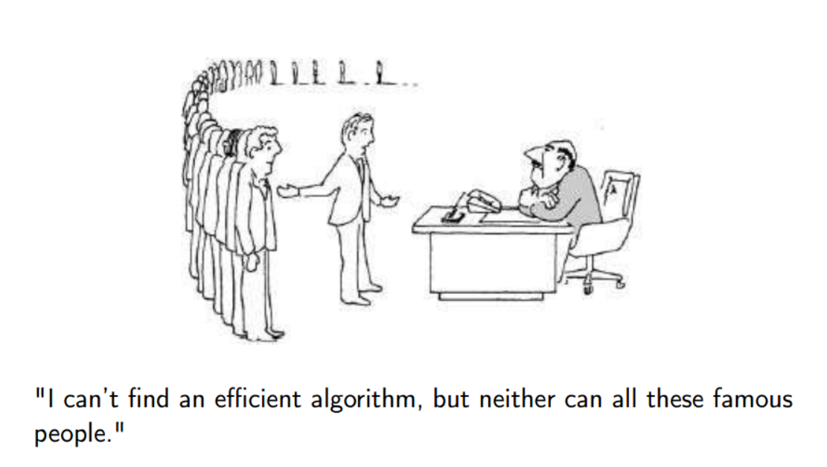
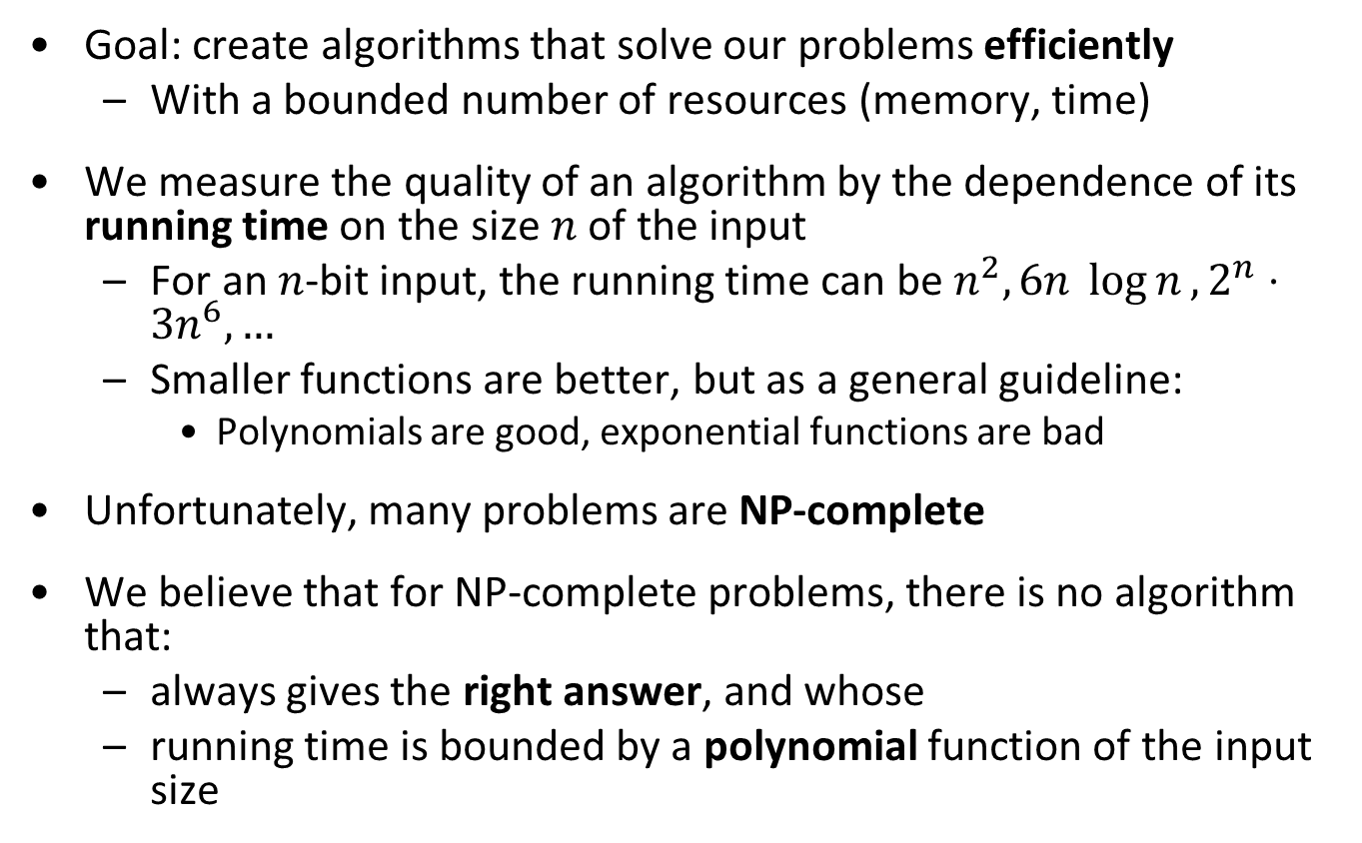
Primer on algorithm design
Goal: create algorithms that solve our problems efficiently
  With a bounded number of resources (memory, time)
We measure the quality of an algorithm by the dependence of its running time on the size $n$ of the input
  For an $n$-bit input, the running time can be $n^{2}, 6n \log{n}, 2^{n}⋅3n^{6},…$
  Smaller functions are better, but as a general guideline:
    Polynomials are good, exponential functions are bad
Unfortunately, many problems are NP-complete
We believe that for NP-complete problems, there is no algorithm that:
  always gives the right answer, and whose
  running time is bounded by a polynomial function of the input size

Slide 10
Dealing with NP-complete problems
Approximation
Sacrifice quality of the solution: quickly find a solution that is provably not very bad
Local search
Quickly find a solution for which you cannot give any quality guarantee (but which might often be good)
Branch & bound
Sacrifice running time guarantees: create an algorithm for which you do not know how long it will take (but which might do well on the inputs you use)
Parameterized algorithms
Sacrifice the running time: allow the running time to have an exponential factor, but ensure that the exponential dependence is not on the entire input size but just on some parameter that is hopefully small
Kernelization
Quickly shrink the input by preprocessing so that afterward running an exponential-time algorithm on the shrunk instance is fast enough

Slide 11
History of parameterized complexity
Fine-grained complexity
PCP Theorem
Downey & Fellows book
NP-completeness
Kernelization lower bounds
1940 1950 1960 1970 1980 1990 2000 2010 2016
2IMA00
Matching algorithm
Parameterized(in)tractability
Graph Minors Theorem
Simplex algorithm
Planar Dominating Set kernel

Slide 12
Google Scholar Papers on FPT and Kernelization

Slide 13
This lecture
Fixed-parameter tractability
Kernelization algorithms
Vertex Cover
Dynamic programming
Set Cover
Vertex Cover
Bounded-depth search trees

Slide 14
Fixed-parameter tractability

Slide 15
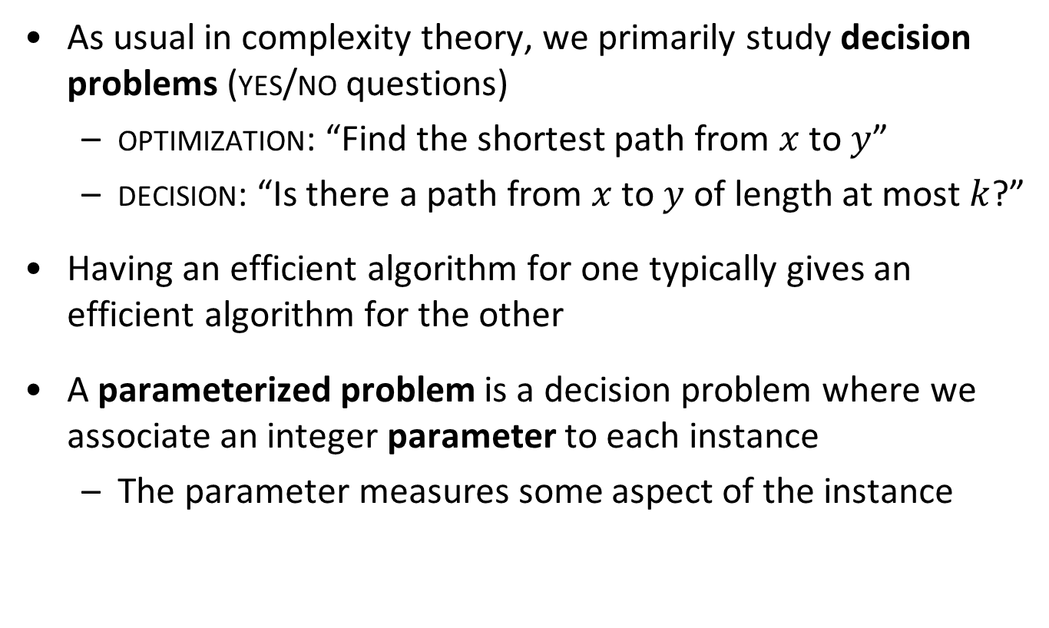
Parameterized problems
As usual in complexity theory, we primarily study decision problems (yes/no questions)
  optimization: “Find the shortest path from $x$ to $y$”
  decision: “Is there a path from $x$ to $y$ of length at most $k$?”
Having an efficient algorithm for one typically gives an efficient algorithm for the other
A parameterized problem is a decision problem where we associate an integer parameter to each instance
  The parameter measures some aspect of the instance

Slide 16
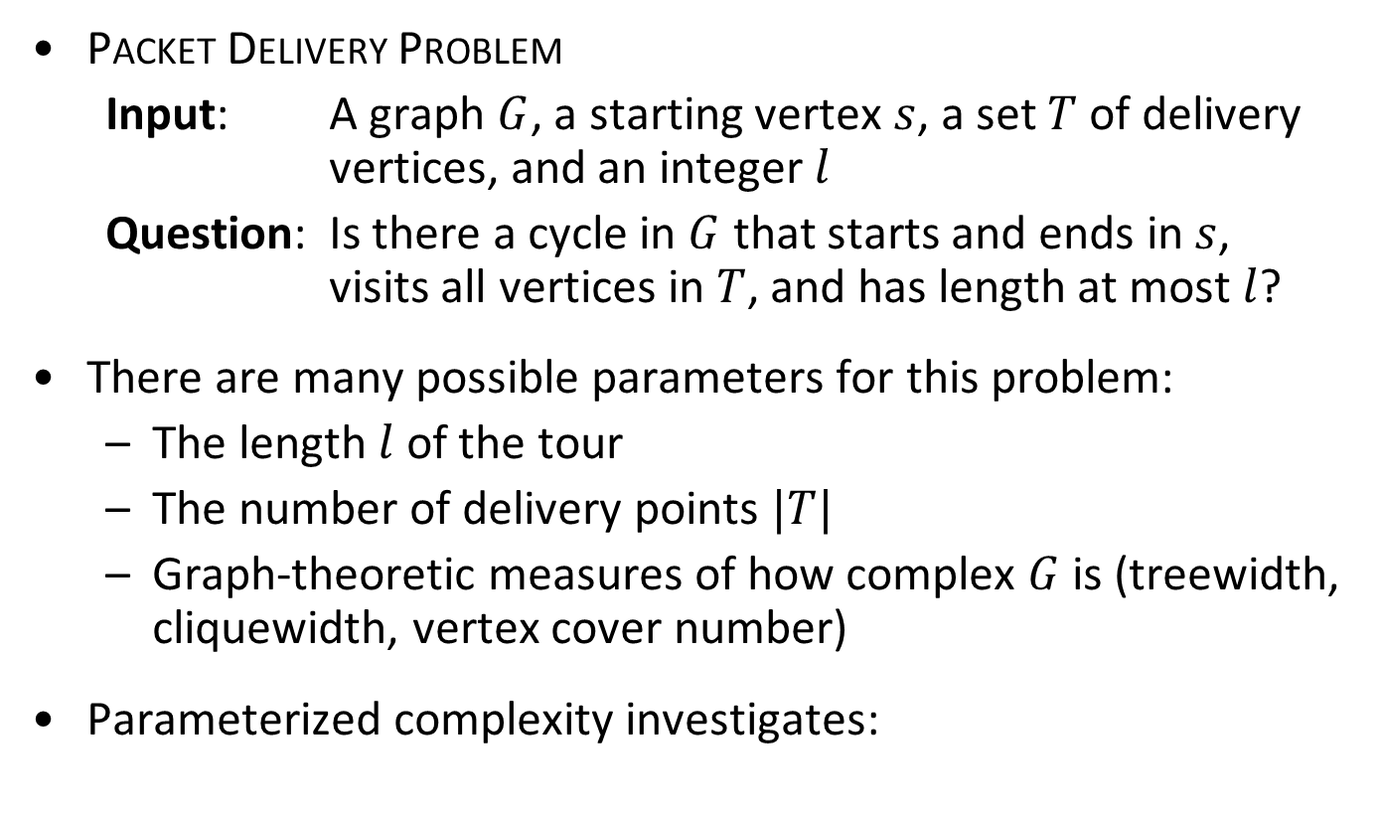
Problem parameterizations
Packet Delivery Problem
  Input: A graph $G$, a starting vertex $s$, a set $T$ of delivery vertices, and an integer $l$
  Question: Is there a cycle in $G$ that starts and ends in $s$, visits all vertices in $T$, and has length at most $l$?
There are many possible parameters for this problem:
  The length $l$ of the tour
  The number of delivery points $|T|$
  Graph-theoretic measures of how complex $G$ is (treewidth, cliquewidth, vertex cover number)
Parameterized complexity investigates:
  Can the problem be solved efficiently,
  if the parameter is small?

Slide 17
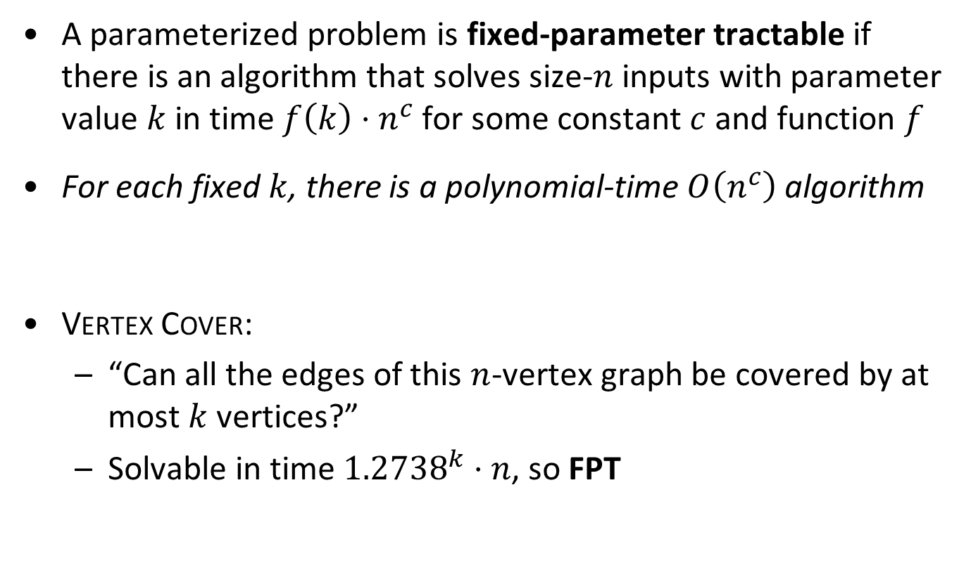
Fixed-parameter tractability – informally
A parameterized problem is fixed-parameter tractable if there is an algorithm that solves size-$n$ inputs with parameter value $k$ in time $f\left(k\right)⋅n^{c}$ for some constant $c$ and function $f$
For each fixed $k$, there is a polynomial-time $O\left(n^{c}\right)$ algorithm
Vertex Cover:
  “Can all the edges of this $n$-vertex graph be covered by at most $k$ vertices?”
  Solvable in time ${1.2738}^{k}⋅n$, so FPT

Slide 18
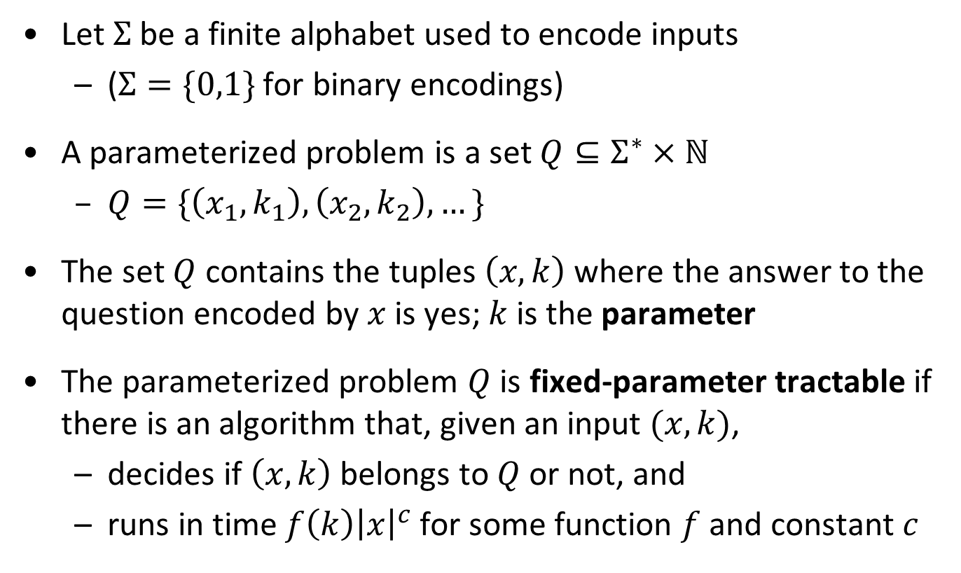
Fixed-parameter tractability – formally
Let $Σ$ be a finite alphabet used to encode inputs
  ($Σ=\{0,1\}$ for binary encodings)
A parameterized problem is a set $Q⊆Σ^{∗}×ℕ$
  $Q=\{\left(x_{1},k_{1}\right), \left(x_{2},k_{2}\right), …\}$
The set $Q$ contains the tuples $\left(x,k\right)$ where the answer to the question encoded by $x$ is yes; $k$ is the parameter
The parameterized problem $Q$ is fixed-parameter tractable if there is an algorithm that, given an input $(x,k)$,
  decides if $\left(x,k\right)$ belongs to $Q$ or not, and
  runs in time $f\left(k\right){\left|x\right|}^{c}$ for some function $f$ and constant $c$

Slide 19
kernelization

Slide 20
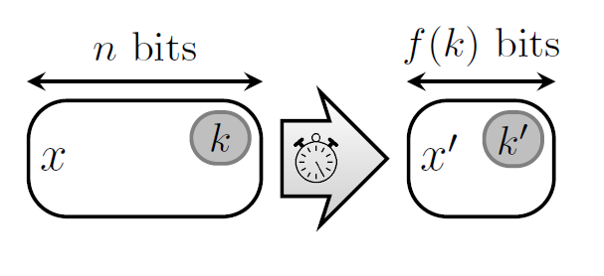
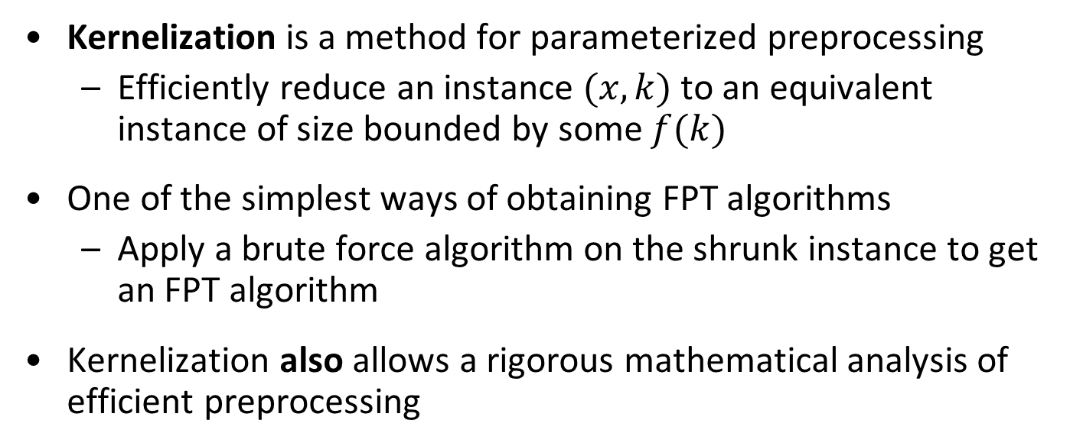
Data reduction with a guarantee
Kernelization is a method for parameterized preprocessing
  Efficiently reduce an instance $(x,k)$ to an equivalent instance of size bounded by some $f(k)$
One of the simplest ways of obtaining FPT algorithms
  Apply a brute force algorithm on the shrunk instance to get an FPT algorithm
Kernelization also allows a rigorous mathematical analysis of efficient preprocessing
Notes:
Let’s look at an example before giving the formal definition

Slide 21
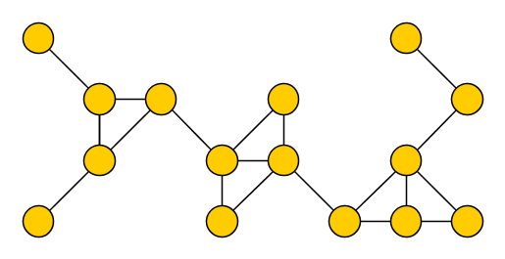
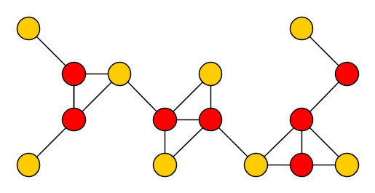

The Vertex Cover problem
Input: An undirected graph $G$ and an integer $k$
Parameter: $k$
Question: Is there a set $S$ of at most $k$ vertices in $G$, such that each edge of $G$ has an endpoint in $S$?
Such a set S is a vertex cover of $G$

Slide 22
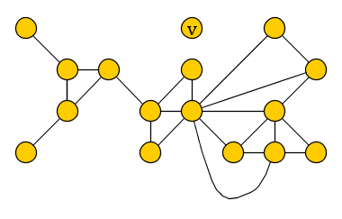
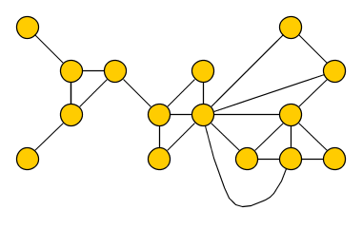

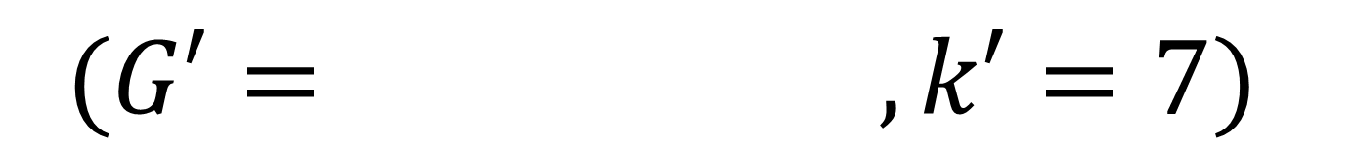
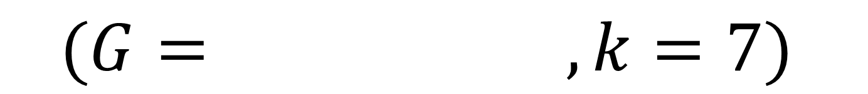
Reduction rules for Vertex Cover – (R1)
(R1) If there is an isolated vertex $v$, delete $v$ from $G$
  Reduce to the instance $\left(G−v,k\right)$
$$(G= , k=7)$$
$$(G′= , k′=7)$$

Slide 23
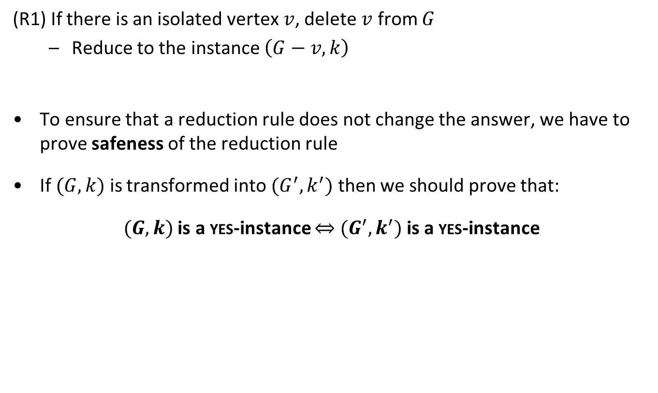
Reduction rules for Vertex Cover – (R1)
(R1) If there is an isolated vertex $v$, delete $v$ from $G$
  Reduce to the instance $\left(G−v,k\right)$
To ensure that a reduction rule does not change the answer, we have to prove safeness of the reduction rule
If $(G,k)$ is transformed into $(G^{′},k^{′})$ then we should prove that:
$(G,k)$ is a yes-instance $⇔$ $(G^{′},k^{′})$ is a yes-instance

Slide 24
Reduction rules for Vertex Cover – (R1)
(R1) If there is an isolated vertex $v$, delete $v$ from $G$
  Reduce to the instance $\left(G−v,k\right)$
$$(G= , k=7)$$
$$(G′= , k′=7)$$

Slide 25
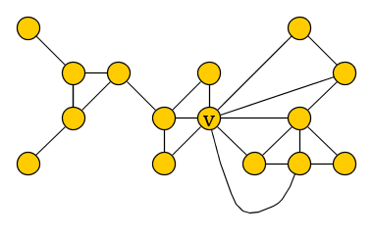
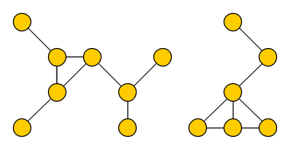
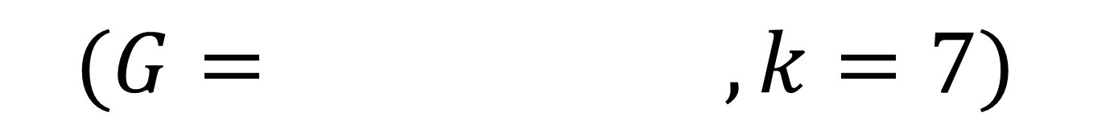

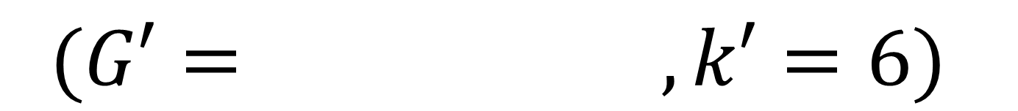
Reduction rules for Vertex Cover – (R2)
(R2) If there is a vertex $v$ of degree more than $k$, then delete $v$ (and its incident edges) from $G$ and decrease the parameter by 1
  Reduce to the instance $\left(G−v,k−1\right)$
$$(G= , k=7)$$
$$(G′= , k′=6)$$

Slide 26

Reduction rules for Vertex Cover – (R3)
(R3) If the previous rules are not applicable and $G$ has more than $k^{2}+k$ vertices or more than $k^{2}$ edges, then conclude that we are dealing with a no-instance

Slide 27
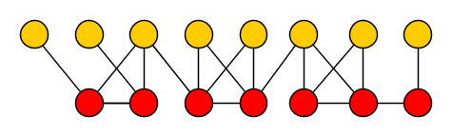
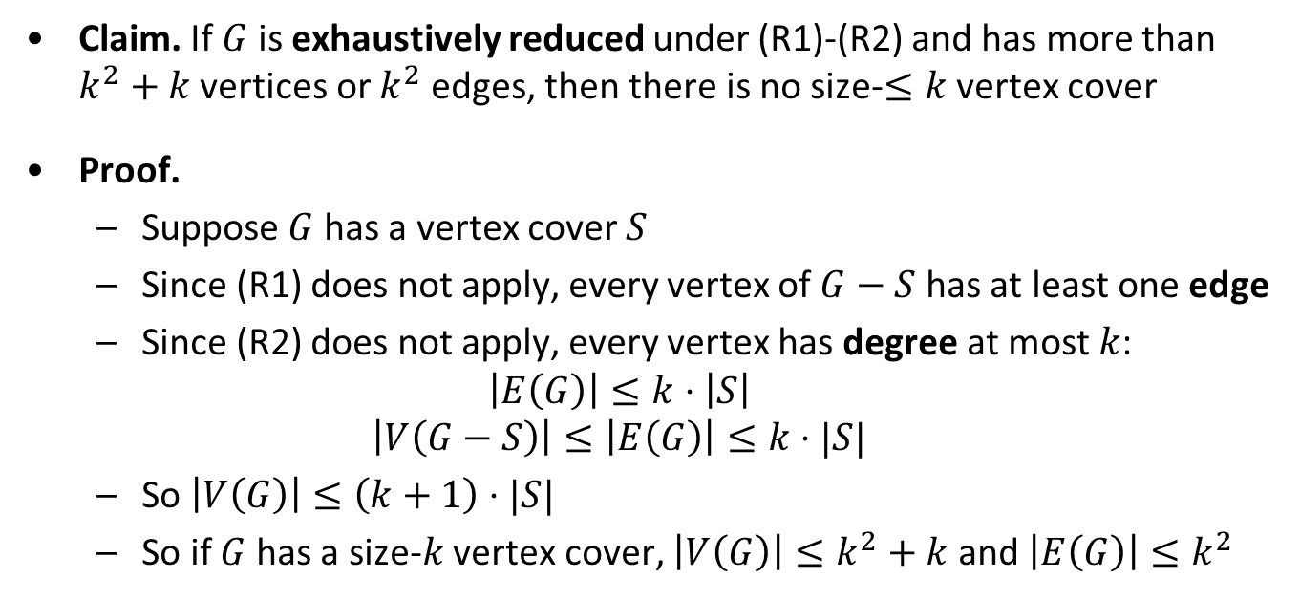

Correctness of the cutoff rule
Claim. If $G$ is exhaustively reduced under (R1)-(R2) and has more than $k^{2}+k$ vertices or $k^{2}$ edges, then there is no size-$≤k$ vertex cover
Proof.
  Suppose $G$ has a vertex cover $S$
  Since (R1) does not apply, every vertex of $G−S$ has at least one edge
  Since (R2) does not apply, every vertex has degree at most $k$:
  $$\left|E\left(G\right)\right|≤k⋅\left|S\right|$$
  $$\left|V\left(G−S\right)\right|≤\left|E\left(G\right)\right|≤k⋅|S|$$
  So $\left|V\left(G\right)\right|≤\left(k+1\right)⋅|S|$
  So if $G$ has a size-$k$ vertex cover, $\left|V\left(G\right)\right|≤k^{2}+k$ and $\left|E\left(G\right)\right|≤k^{2}$
S
$$≤k$$

Slide 28
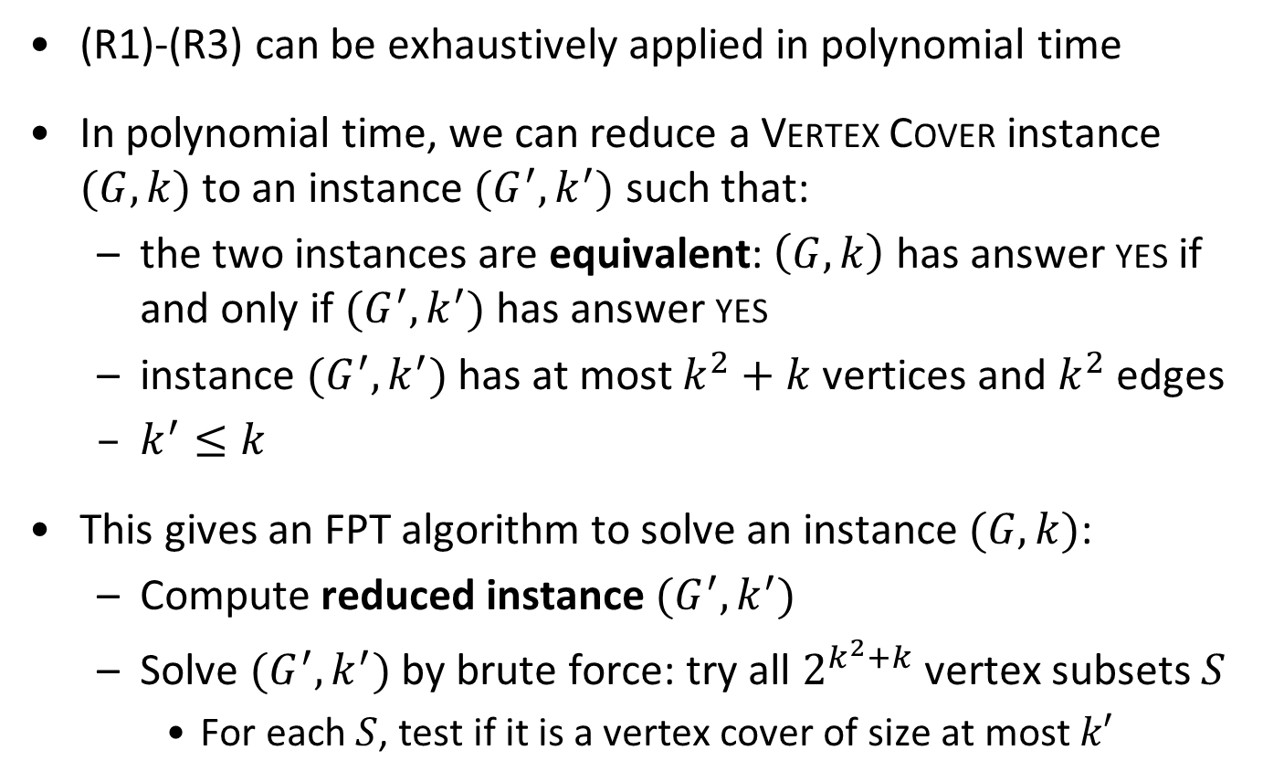
Preprocessing for Vertex Cover
(R1)-(R3) can be exhaustively applied in polynomial time
In polynomial time, we can reduce a Vertex Cover instance $(G,k)$ to an instance $(G^{′},k^{′})$ such that:
  the two instances are equivalent: $\left(G,k\right)$ has answer yes if and only if $(G^{′},k^{′})$ has answer yes
  instance $(G^{′},k^{′})$ has at most $k^{2}+k$ vertices and $k^{2}$ edges
  $k^{′}≤k$
This gives an FPT algorithm to solve an instance $(G,k)$:
  Compute reduced instance $(G^{′},k^{′})$
  Solve $(G^{′},k^{′})$ by brute force: try all $2^{k^{2}+k}$ vertex subsets $S$
    For each $S$, test if it is a vertex cover of size at most $k′$
Theorem. $k$-Vertex Cover is fixed-parameter tractable

Slide 29
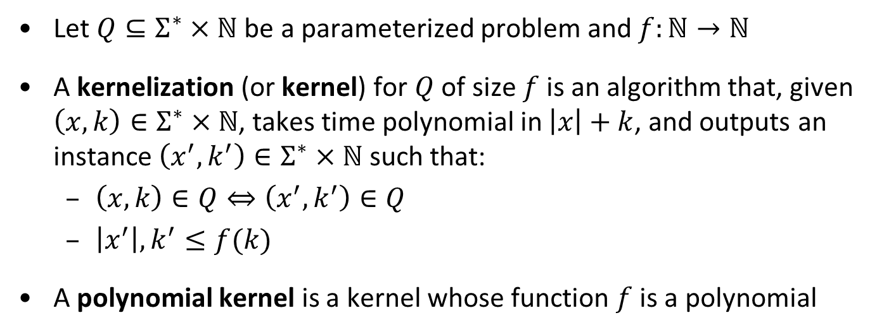
Kernelization – formally
Let $Q⊆Σ^{∗}×ℕ$ be a parameterized problem and $f:ℕ→ℕ$
A kernelization (or kernel) for $Q$ of size $f$ is an algorithm that, given $\left(x,k\right)∈Σ^{∗}×ℕ$, takes time polynomial in $\left|x\right|+k$, and outputs an instance $\left(x^{′},k^{′}\right)∈Σ^{∗}×ℕ$ such that:
  $\left(x,k\right)∈Q⇔\left(x^{′},k^{′}\right)∈Q$
  $\left|x^{′}\right|,k^{′}≤f(k)$
A polynomial kernel is a kernel whose function $f$ is a polynomial
  Theorem. A parameterized problem is fixed-parameter tractable if and only if it is decidable and has a kernel (of arbitrary size)

Slide 30
Bounded-depth search trees

Slide 31
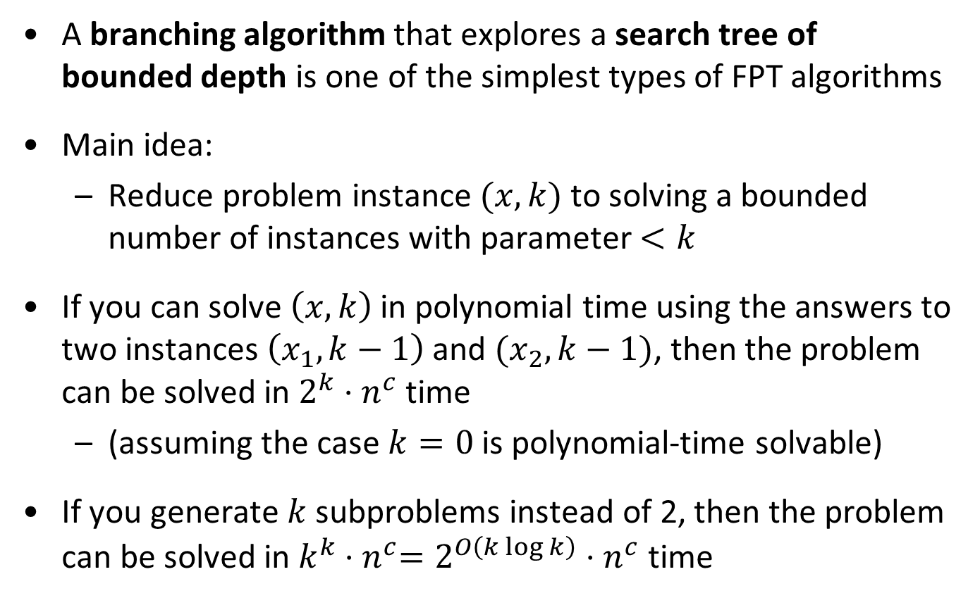
Background
A branching algorithm that explores a search tree of bounded depth is one of the simplest types of FPT algorithms
Main idea:
  Reduce problem instance $(x,k)$ to solving a bounded number of instances with parameter $<k$
If you can solve $\left(x,k\right)$ in polynomial time using the answers to two instances $\left(x_{1},k−1\right)$ and $(x_{2},k−1)$, then the problem can be solved in $2^{k}⋅n^{c}$ time
  (assuming the case $k=0$ is polynomial-time solvable)
If you generate $k$ subproblems instead of 2, then the problem can be solved in $k^{k}{⋅n}^{c}=2^{O\left(k\log{k}\right)}⋅n^{c}$ time

Slide 32





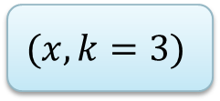









A search tree
$$(x,k=3)$$
$$(x_{1},2)$$
$$(x_{2},2)$$
$$(x_{3},1)$$
$$(x_{4},1)$$
$$(x_{5},1)$$
$$(x_{6},1)$$
$$(x_{7},0)$$
$$(x_{8},0)$$
$$(x_{9},0)$$
$$(x_{10},0)$$
$$(x_{11},0)$$
$$(x_{12},0)$$
$$(x_{13},0)$$
$$(x_{14},0)$$

Slide 33
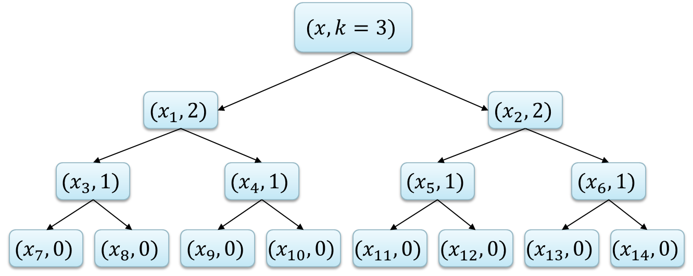
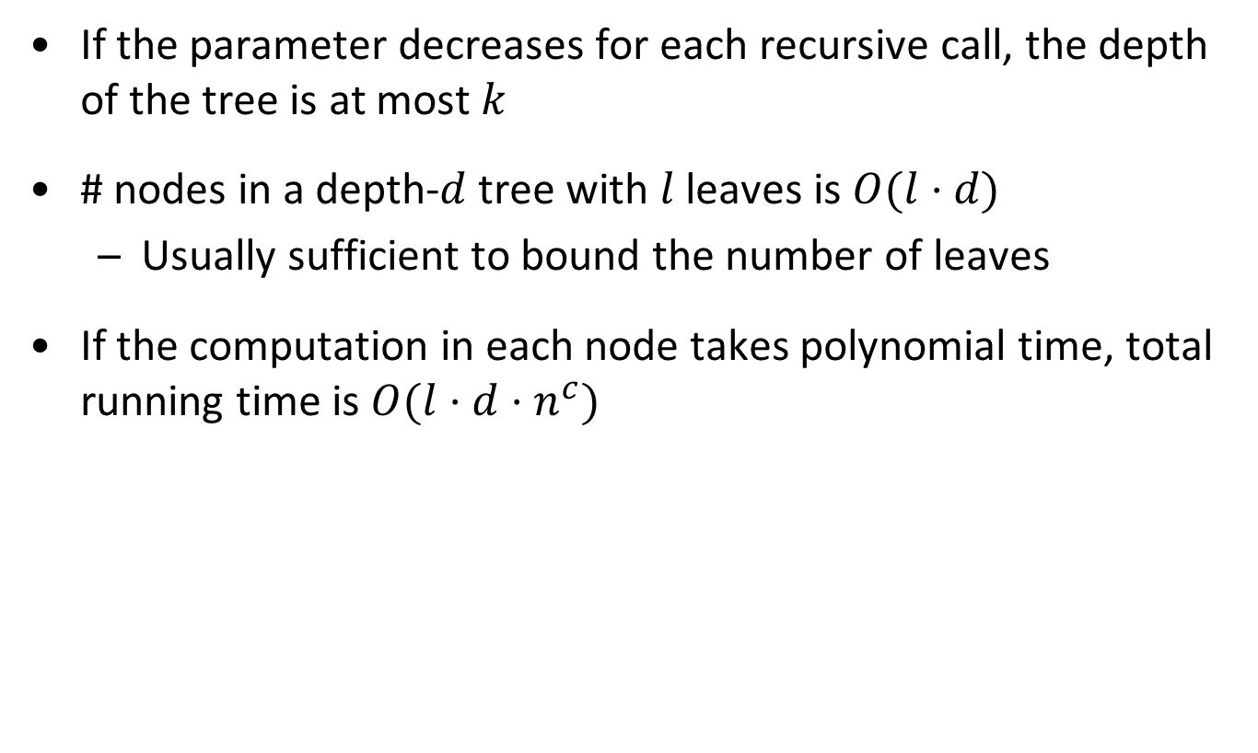
Analysis of bounded-depth search trees
If the parameter decreases for each recursive call, the depth of the tree is at most $k$
# nodes in a depth-$d$ tree with $l$ leaves is $O(l⋅d)$
  Usually sufficient to bound the number of leaves
If the computation in each node takes polynomial time, total running time is $O(l⋅d⋅n^{c})$

Slide 34
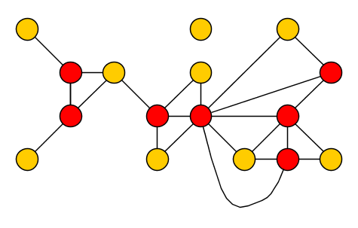
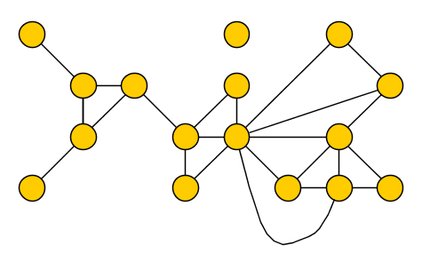

Vertex Cover revisited
Input: A graph $G$ and an integer $k$
Parameter: $k$
Question: Is there a set $S$ of at most $k$ vertices in $G$, such that each edge has an endpoint in $S$?

Slide 35
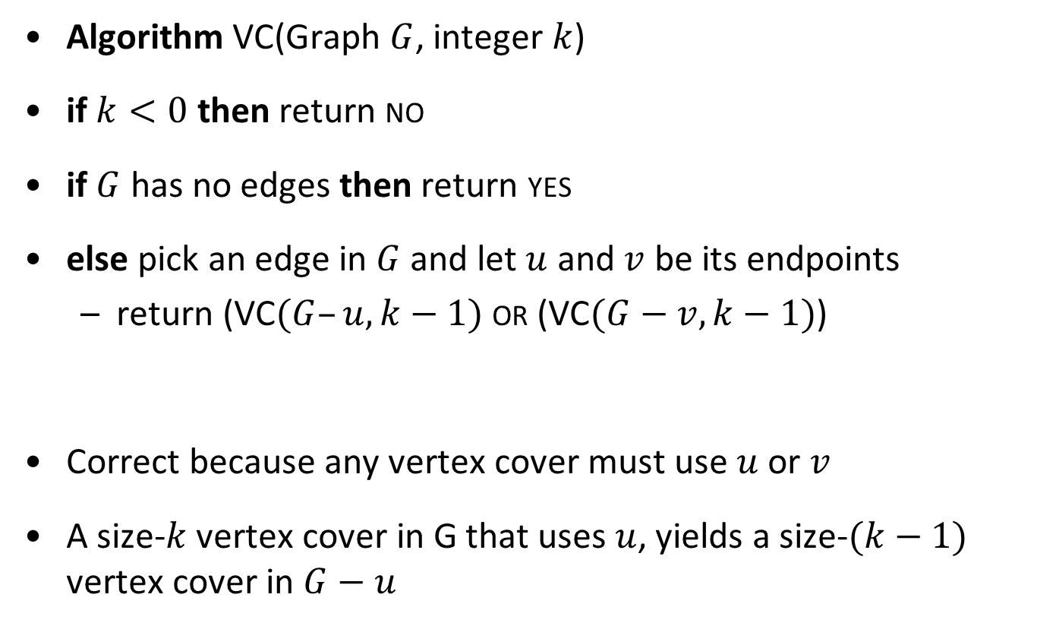
Algorithm for Vertex Cover
Algorithm VC(Graph $G$, integer $k$)
if $k<0$ then return no
if $G$ has no edges then return yes
else pick an edge in $G$ and let $u$ and $v$ be its endpoints
  return (VC$(G–u, k−1)$ or (VC$(G−v, k−1)$)
Correct because any vertex cover must use $u$ or $v$
A size-$k$ vertex cover in G that uses $u$, yields a size-$(k−1)$ vertex cover in $G−u$

Slide 36
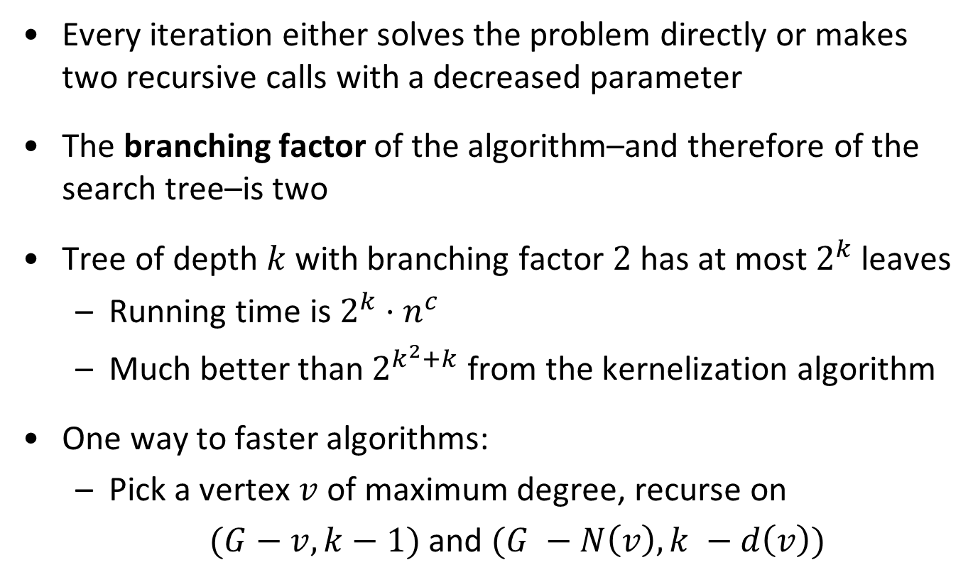
Running time for Vertex Cover
Every iteration either solves the problem directly or makes two recursive calls with a decreased parameter
The branching factor of the algorithm–and therefore of the search tree–is two
Tree of depth $k$ with branching factor $2$ has at most $2^{k}$ leaves
  Running time is $2^{k}⋅n^{c}$
  Much better than $2^{k^{2}+k}$ from the kernelization algorithm
One way to faster algorithms:
  Pick a vertex $v$ of maximum degree, recurse on
  $(G−v, k−1)$ and $(G −N\left(v\right), k −d\left(v\right))$

Slide 37
Dynamic programming

Slide 38
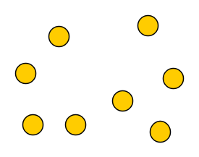
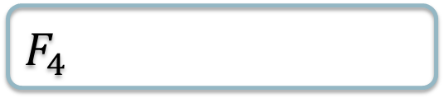
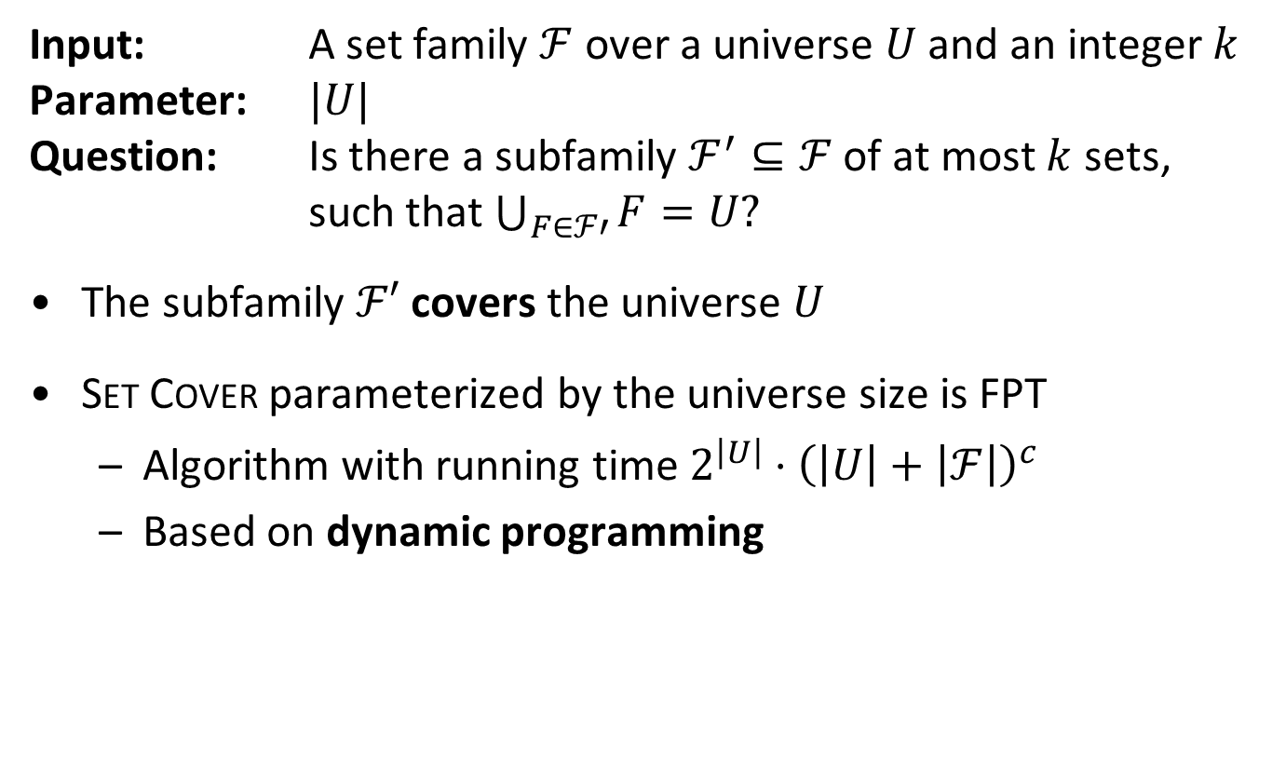

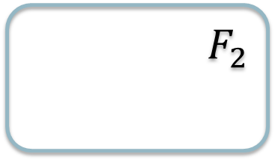

The Set Cover problem
Input: A set family $ℱ$ over a universe $U$ and an integer $k$
Parameter: $|U|$
Question: Is there a subfamily $ℱ^{′}⊆ℱ$ of at most $k$ sets,
such that $\bigcup_{F∈ℱ′}{F}=U?$
The subfamily $ℱ′$ covers the universe $U$
Set Cover parameterized by the universe size is FPT
  Algorithm with running time $2^{\left|U\right|}⋅{\left(\left|U\right|+\left|ℱ\right|\right)}^{c}$
  Based on dynamic programming
$$F_{2}$$
$$F_{3}$$
$$F_{1}$$
$$F_{4}$$

Slide 39
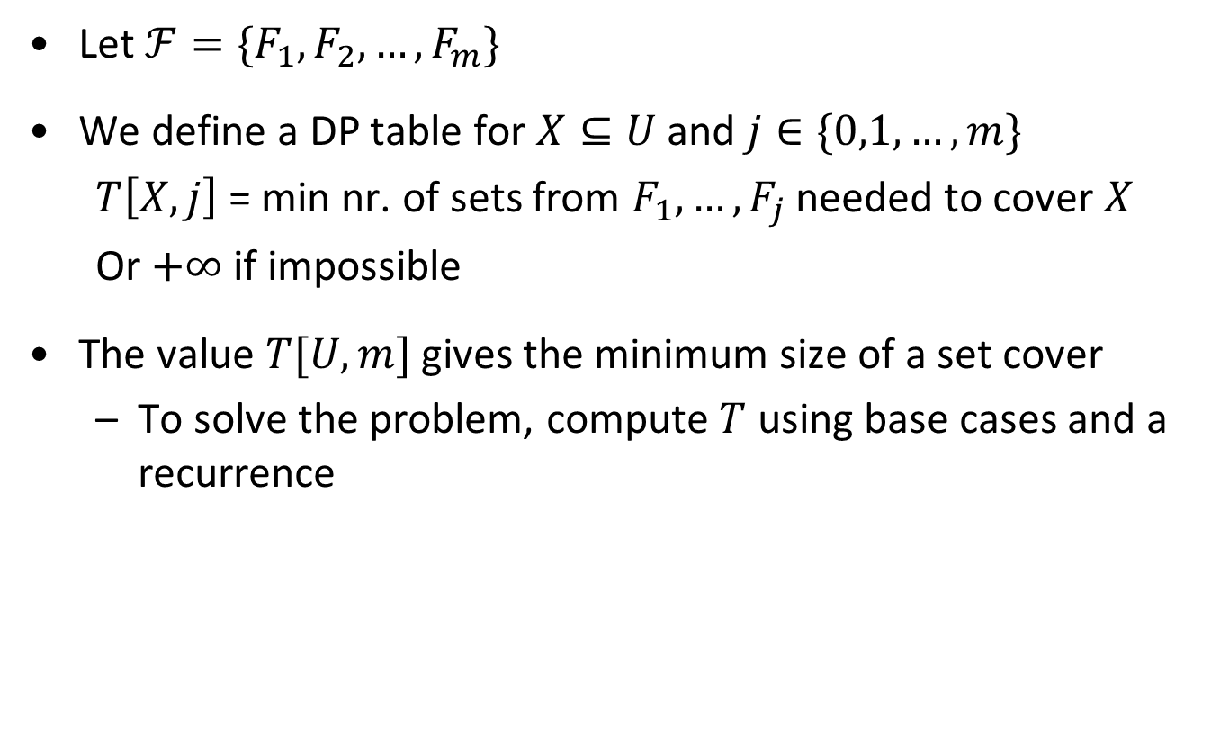
Dynamic programming for Set Cover
Let $ℱ=\{F_{1},F_{2},…,F_{m}\}$
We define a DP table for $X⊆U$ and $j∈\{0,1,…, m\}$
  $T\left[X,j\right]$ = min nr. of sets from $F_{1},…, F_{j}$ needed to cover $X$
  Or $+∞$ if impossible
The value $T[U,m]$ gives the minimum size of a set cover
  To solve the problem, compute $T$ using base cases and a recurrence

Slide 40
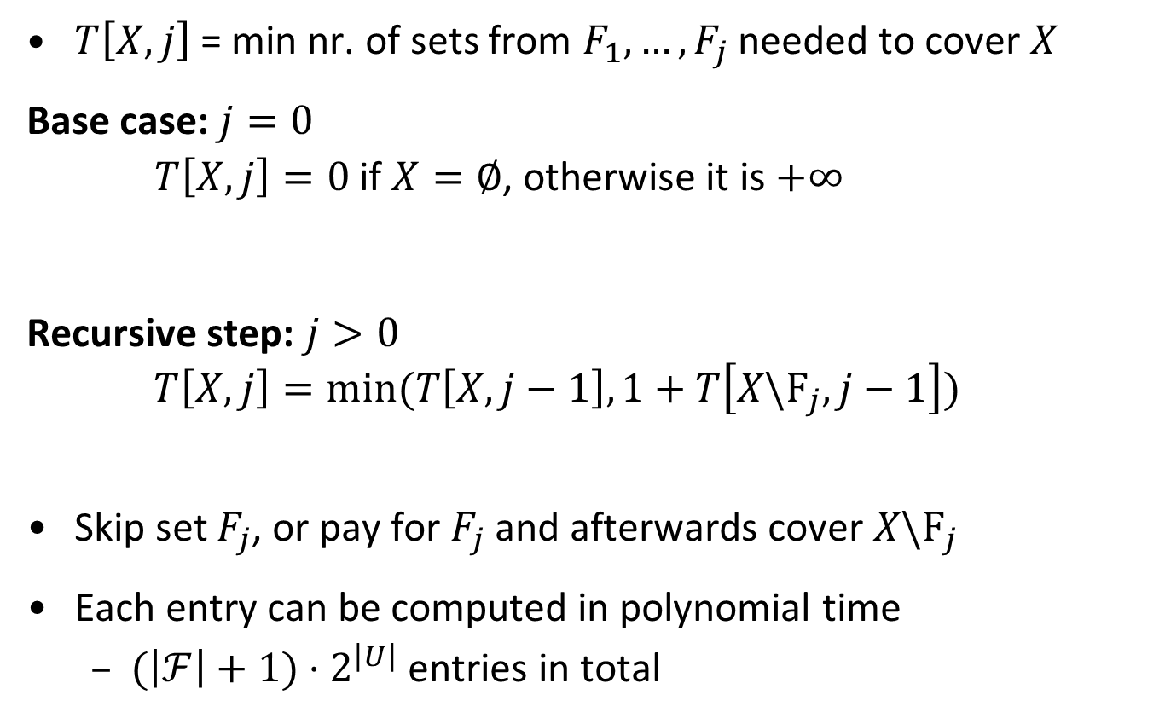
Filling the dynamic programming table
$T\left[X,j\right]$ = min nr. of sets from $F_{1},…, F_{j}$ needed to cover $X$
Base case: $j=0$
  $T\left[X,j\right]=0$ if $X=∅$, otherwise it is $+∞$
Recursive step: $j>0$
  $$T\left[X,j\right]=min⁡(T\left[X,j−1\right],1+T\left[X\backslash F_{j},j−1\right])$$
Skip set $F_{j}$, or pay for $F_{j}$ and afterwards cover $X\backslash F_{j}$
Each entry can be computed in polynomial time
  $(\left|ℱ\right|+1)⋅2^{\left|U\right|}$ entries in total

Slide 41
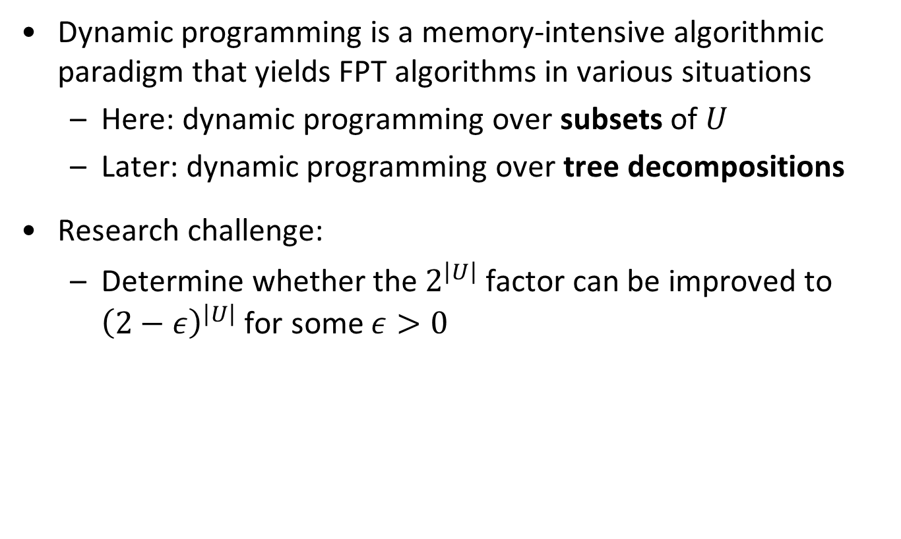
More on dynamic programming
Dynamic programming is a memory-intensive algorithmic paradigm that yields FPT algorithms in various situations
  Here: dynamic programming over subsets of $U$
  Later: dynamic programming over tree decompositions
Research challenge:
  Determine whether the $2^{\left|U\right|}$ factor can be improved to ${\left(2−ε\right)}^{\left|U\right|}$ for some $ε>0$

Slide 42
Summary
Parameterized algorithmics is a young, vibrant research area that investigates how to cope with NP-completeness
We saw three ways of building FPT algorithms:
  Kernelization
  Bounded-depth search trees
  Dynamic programming over subsets

Slide 43
Parameterized algorithms implementation challenge
Instead of having homework exercises, we participate in the first parameterized algorithms implementation challenge
  https://pacechallenge.wordpress.com/ (track B)
Split into 2 groups of 4/5 students
Make an algorithm that solves as many of the benchmark instances as possible, in at most 30 minutes per instance
  Single-threaded
  Allowed to use third-party subroutines for non-parameterized parts of the computation after asking permission
  Based on the theory of parameterized algorithms

Slide 44
Ingredients of good implementations
Kernelization
FPT algorithm
  Randomized
  Iterative compression
  Treewidth
Instance generator

Slide 45
Brainstorm sessions
We discuss progress, difficulties and new ideas during

