Slide 1

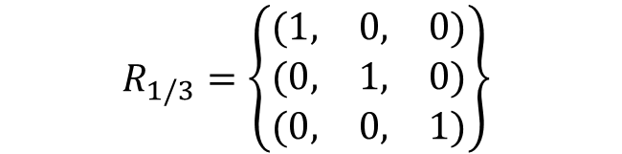
Algebraic Sparsification for
Decision and Maximization
Constraint Satisfaction Problems
$$R_{1/3}=\left\{\begin{matrix}(1, & 0, & 0) \\ (0, & 1, & 0) \\ (0, & 0, & 1)\end{matrix}\right\}$$
Bart M. P. Jansen
Based on joint works with:
Hubie Chen, Astrid Pieterse, Michał Włodarczyk
Frontiers of Parameterized Complexity Seminar
February 25th 2021
Notes:
Note: Algebra used here is not universal algebra of analyzing polymorphisms; we analyze one constraint at a time.
Idea: Add paper on List H-Coloring?

Slide 2
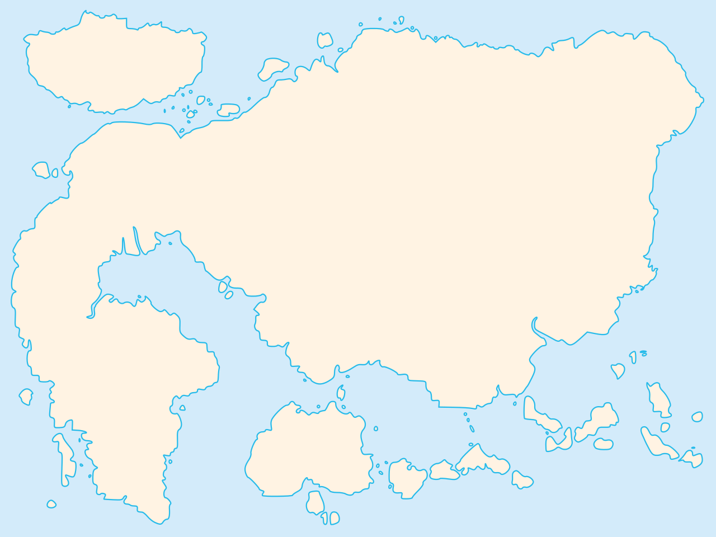
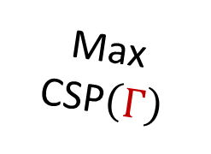
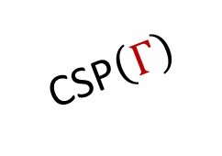

Talk landscape
Mal’tsev embeddings
Nontrivial
sparsification
Polynomials
CSP$\left(Γ\right)$
Symmetric CSP
Balanced
relations
NAE-SAT
1-in-$d$ SAT
Max
CSP$\left(Γ\right)$
Characteristic polynomial
Compression
Kernelization
Notes:
To give us the impression of taking a tour while being stuck in lockdown: mountaineering theme. For those of you who have seen an earlier version of the talk: the Max CSP continent is new, where we recently understood optimal compression completely.

Slide 3
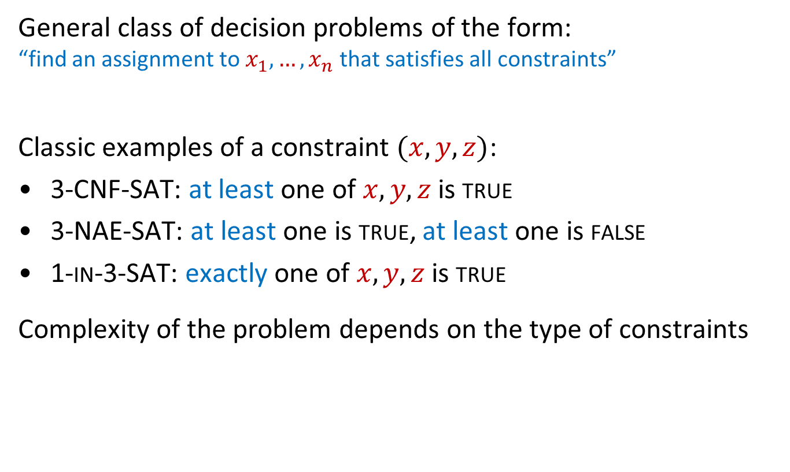
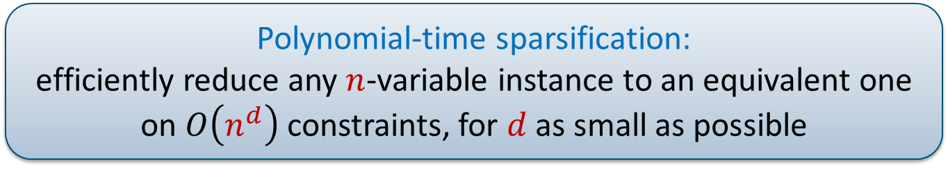
CSPs and sparsification
General class of decision problems of the form:
“find an assignment to $x_{1},…, x_{n}$ that satisfies all constraints”
Classic examples of a constraint $(x,y,z)$:
3-CNF-SAT: at least one of $x,y,z$ is true
3-NAE-SAT: at least one is true, at least one is false
1-in-3-SAT: exactly one of $x,y,z$ is true
Complexity of the problem depends on the type of constraints
Polynomial-time sparsification:
efficiently reduce any $n$-variable instance to an equivalent one on $O\left(n^{d}\right)$ constraints, for $d$ as small as possible
Notes:
We will start very concrete and make it more general as we go along. We focus on algorithmic results rather than hardness proofs, since that is where the main new ideas come in.

Slide 4

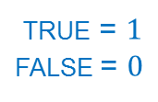
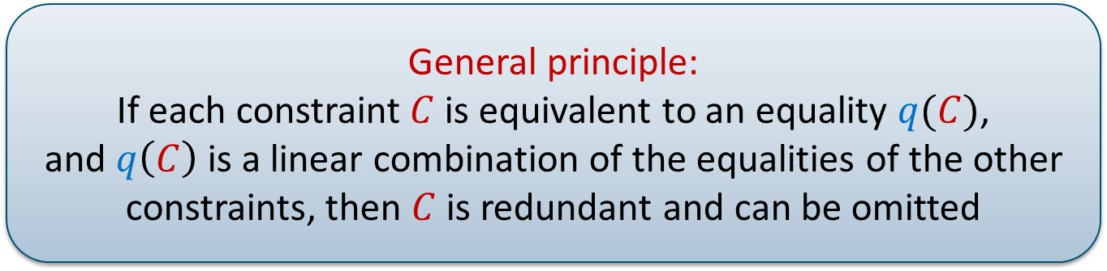

Warm-up: 1-in-3 SAT
Constraints are redundant when they are implied by others
Consider the following instance on variables $\{a,b,c,d,e\}$:
$\left(a,¬b,¬c\right)$ $⇔$ $a+b+c=1$
$\left(b,¬c,¬d\right)$ $b+c+\left(1−d\right)=1$
$\left(c,¬d,¬e\right)$ $c+\left(1−d\right)+e=1$
$(a,¬c,¬e)$ $a+c+e=1$
When the first three constraints are satisfied,
their equalities hold, so the fourth holds as well
Removing 4th constraint preserves the set of sat. assignments
$$+ \\ − \\ +$$
true = $1$
false = $0$
  General principle:
  If each constraint $C$ is equivalent to an equality $q(C)$,
  and $q\left(C\right)$ is a linear combination of the equalities of the other constraints, then $C$ is redundant and can be omitted
Notes:
Instance is satisfied by setting b,d,e to TRUE and rest to FALSE. We will look at this more formally as we continue.

Slide 5
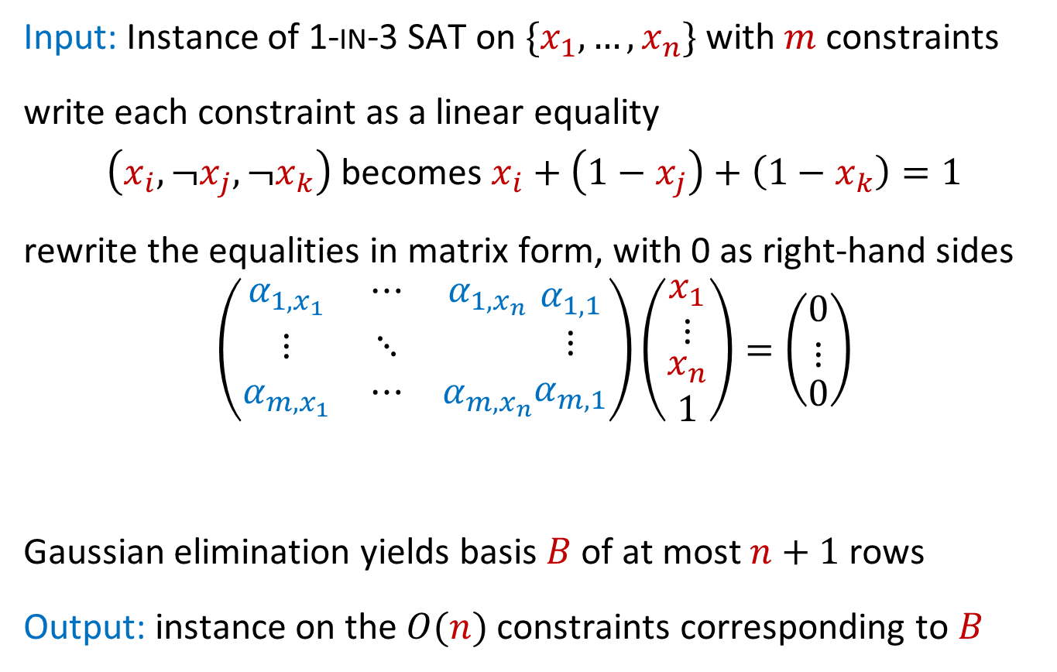
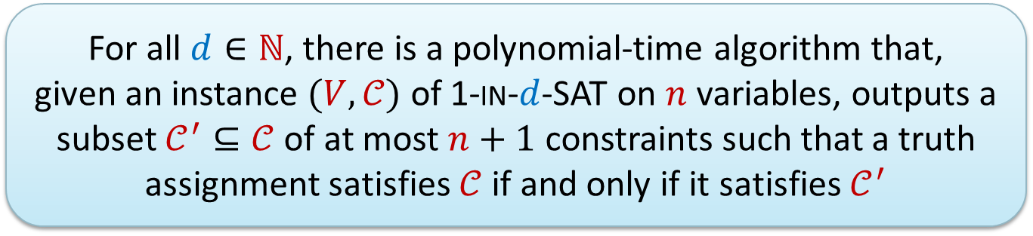

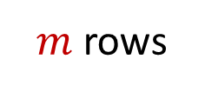
Systematic sparsification for 1-in-3 SAT
Input: Instance of 1-in-3 SAT on $\{x_{1},…, x_{n}\}$ with $m$ constraints
write each constraint as a linear equality
$\left(x_{i},¬x_{j}, ¬x_{k}\right)$ becomes $x_{i}+\left(1−x_{j}\right)+\left(1−x_{k}\right)=1$
rewrite the equalities in matrix form, with 0 as right-hand sides
$$\left(\begin{matrix}α_{1,x_{1}} & ⋯ & α_{1,x_{n}} \\ ⋮ & ⋱ & \\ α_{m,x_{1}} & ⋯ & α_{m,x_{n}}\end{matrix}\begin{matrix}α_{1,1} \\ ⋮ \\ α_{m,1}\end{matrix}\right)\left(\begin{matrix}\begin{matrix}x_{1} \\ ⋮\end{matrix} \\ \begin{matrix}x_{n} \\ 1\end{matrix}\end{matrix}\right)=\left(\begin{matrix}\begin{matrix}0 \\ ⋮\end{matrix} \\ 0\end{matrix}\right)$$
Gaussian elimination yields basis $B$ of at most $n+1$ rows
Output: instance on the $O(n)$ constraints corresponding to $B$
For all $d∈ℕ$, there is a polynomial-time algorithm that,
given an instance $(V,𝒞)$ of 1-in-$d$-SAT on $n$ variables, outputs a subset $𝒞^{′}⊆𝒞$ of at most $n+1$ constraints such that a truth assignment satisfies $𝒞$ if and only if it satisfies $𝒞^{′}$
$m$ rows
$n+1$ columns
Notes:
Output is a subset of the original constraints. Any satisfying assignment for the input, works for the output. If an assignment works for the output: then it satisfies all the constraints corresponding to B, so it satisfies all linear equalities of B. Since all rows of the matrix can be written as linear combinations of rows in B, and the right-hand sides are all 0, this implies it satisfies all equalities that we forgot about, and hence satisfies all original constraints as well.

Slide 6

Number of constraints versus encoding size
For 1-in-$d$-SAT we sparsified to $n+1$ constraints
You can encode a constraint on $d$ variables in $O(d\log{n})$ bits
For $d∈O(1)$, instance can be encoded in $O(n\log{n})$ bits
We focus on CSPs with constant-arity in this talk
Encoding size $≈$ number of constraints, up to $O(\log{n)}$ factor

Slide 7
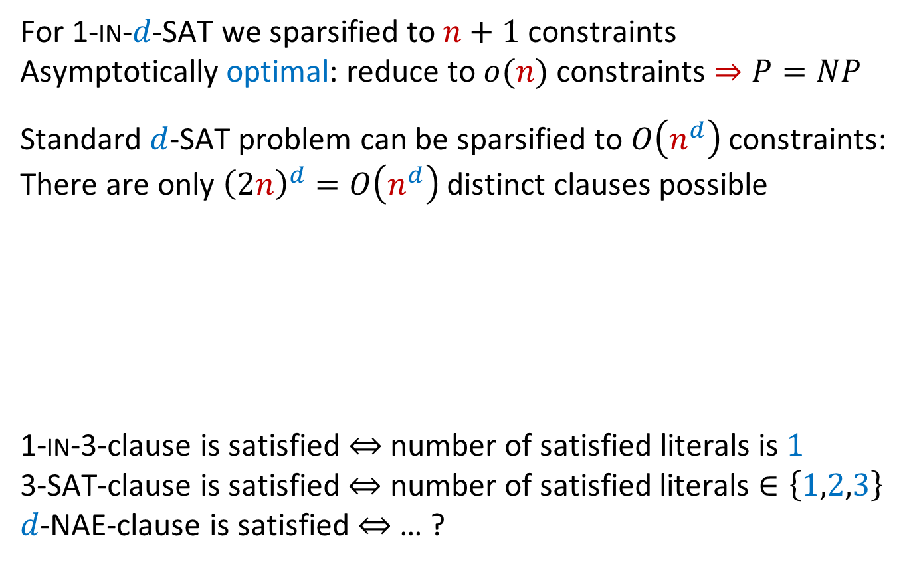
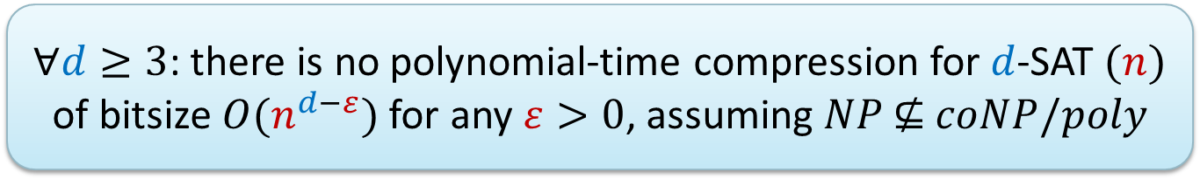
Towards optimal sparsification
For 1-in-$d$-SAT we sparsified to $n+1$ constraints
Asymptotically optimal: reduce to $o(n)$ constraints $⇒P=NP$
Standard $d$-SAT problem can be sparsified to $O\left(n^{d}\right)$ constraints:
There are only ${\left(2n\right)}^{d}=O\left(n^{d}\right)$ distinct clauses possible
1-in-3-clause is satisfied $⇔$ number of satisfied literals is $1$
3-SAT-clause is satisfied $⇔$ number of satisfied literals $∈\left\{1,2,3\right\}$
$d$-NAE-clause is satisfied $⇔$ … ?
$∀d≥3$: there is no polynomial-time compression for $d$-SAT $(n)$ of bitsize $O(n^{d−ε})$ for any $ε>0$, assuming $NP \text{⊈} coNP/poly$
[Dell&v.Melkebeek@JACM’14]
Notes:
We now know what optimal sparsification for 1-in-d SAT looks like. It is known what optimal sparsification for d-CNF-SAT looks like. Let’s try to understand more cases. Next up: d-NAE-SAT.

Slide 8
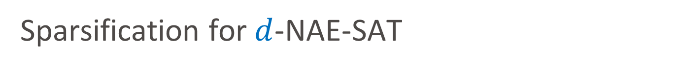
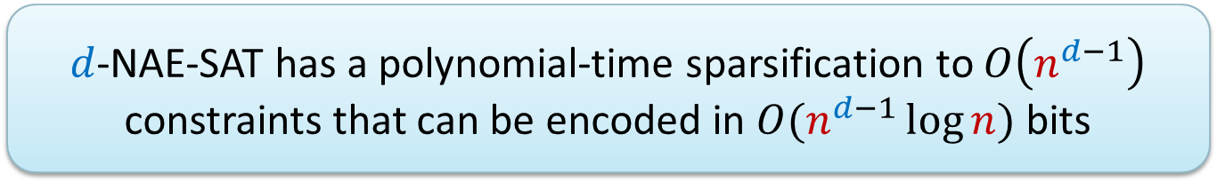
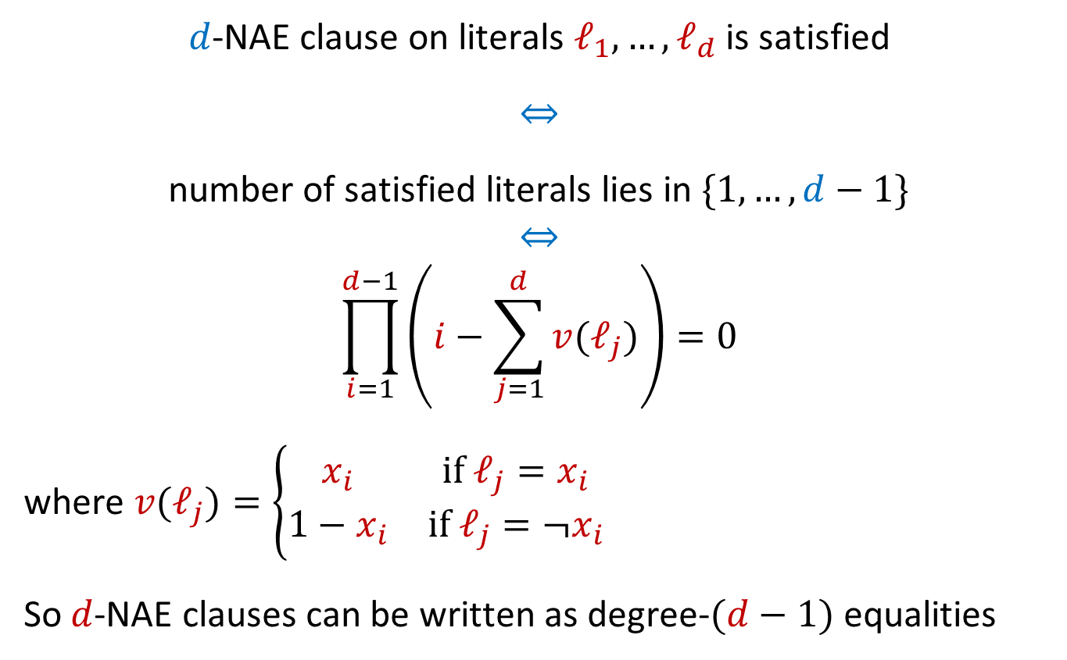
Sparsification for $d$-NAE-SAT
$d$-NAE-SAT has a polynomial-time sparsification to $O\left(n^{d−1}\right)$ constraints that can be encoded in $O(n^{d−1}\log{n})$ bits
$d$-NAE clause on literals $ℓ_{1},…, ℓ_{d}$ is satisfied
$⇔$
number of satisfied literals lies in $\{1,…, d−1\}$
$⇔$
$$\prod_{i=1}^{d−1}{\left(i−\sum_{j=1}^{d}{v(ℓ_{j})}\right)=0}$$
where $v(ℓ_{j})=\left\{\begin{matrix}x_{i} & \text{if} ℓ_{j}=x_{i} \\ 1−x_{i} & \text{if} ℓ_{j}=¬x_{i}\end{matrix}\right.$
So $d$-NAE clauses can be written as degree-$(d−1)$ equalities

Slide 9

Talk landscape
Climbing towards generality
Mal’tsev embeddings
Nontrivial
sparsification
Polynomials
CSP$\left(Γ\right)$
Balanced
relations
Symmetric CSP
NAE-SAT
1-in-$d$ SAT
Max
CSP$\left(Γ\right)$
Characteristic polynomial
Compression
Kernelization

Slide 10


Constraint languages
A constraint language $Γ$ is a (finite) set of (Boolean) relations $R_{i}$
Clause $(x,y,z)$ is 1-in-3 satisfied $⇔$ $\left(x,y,z\right)∈R_{0}$
Clause $(¬x,¬y,z)$ is 1-in-3 satisfied $⇔$ $\left(x,y,z\right)∈R_{2}$
Any 1-in-3 clause can be written as $\left(x,y,z\right)∈R_{i}$
1-in-3-SAT is equivalent to CSP with constraints from $Γ=\{R_{0},R_{1},R_{2},R_{3}\}$
$$\begin{matrix}R_{0}=\left\{\begin{matrix}(1, & 0, & 0) \\ (0, & 1, & 0) \\ (0, & 0, & 1)\end{matrix}\right\} & R_{1}=\left\{\begin{matrix}(0, & 0, & 0) \\ (1, & 1, & 0) \\ (1, & 0, & 1)\end{matrix}\right\} \\ R_{2}=\left\{\begin{matrix}(0, & 1, & 0) \\ (1, & 0, & 0) \\ (1, & 1, & 1)\end{matrix}\right\} & R_{3}=\left\{\begin{matrix}(0, & 1, & 1) \\ (1, & 0, & 1) \\ (1, & 1, & 0)\end{matrix}\right\}\end{matrix}$$
Notes:
Using the CSP framework, we can classify the sparsification complexity for many different constraint types at once

Slide 11
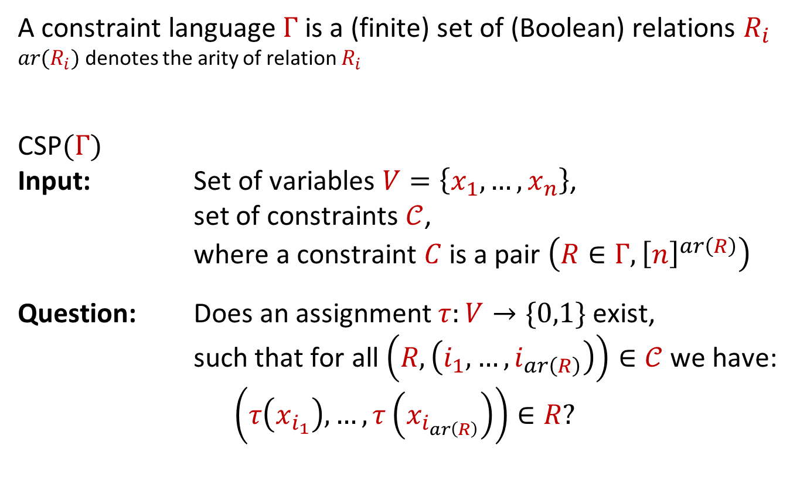
The CSP corresponding to a constraint language
A constraint language $Γ$ is a (finite) set of (Boolean) relations $R_{i}$
$ar(R_{i})$ denotes the arity of relation $R_{i}$
CSP$(Γ)$
Input: Set of variables $V=\left\{x_{1},…, x_{n}\right\}$,
set of constraints $𝒞$,
where a constraint $C$ is a pair $\left(R∈Γ,{\left[n\right]}^{ar\left(R\right)}\right)$
Question: Does an assignment $τ:V→\{0,1\}$ exist,
such that for all $\left(R,\left(i_{1},…, i_{ar\left(R\right)}\right)\right)∈𝒞$ we have:
$$\left(τ\left(x_{i_{1}}\right),…,τ\left(x_{i_{ar\left(R\right)}}\right)\right)∈R?$$
Notes:
To formally specify which types of constraints can be used in a Boolean CSP, the notion of constraint language is used.

Slide 12



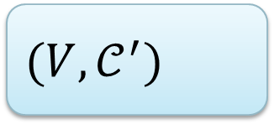


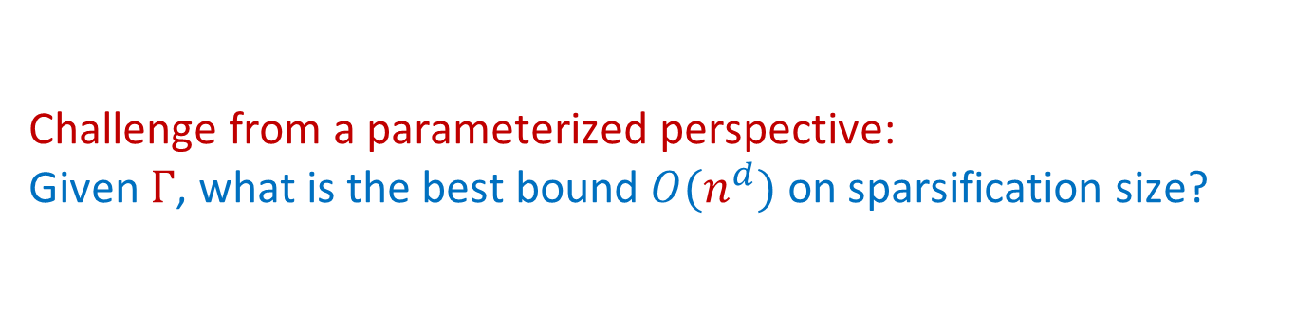
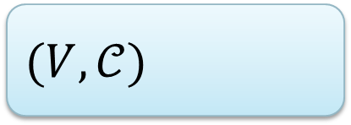

Characterizing CSP complexity based on $Γ$
Schaefer’s dichotomy theorem
For each finite Boolean constraint language $Γ,$
CSP$\left(Γ\right)$ is either P-time solvable or NP-complete
Elegant characterization in terms of closure properties of $Γ$
Challenge from a parameterized perspective:
Given $Γ$, what is the best bound $O(n^{d})$ on sparsification size?
$O(n^{d})$ constraints
$$(V,𝒞)$$
polynomial time
$$(V,𝒞^{′})$$
$$n$$
$$n$$

Slide 13

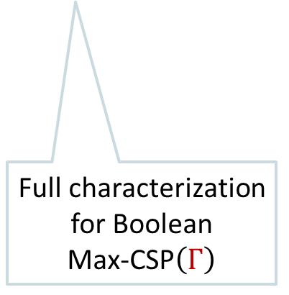
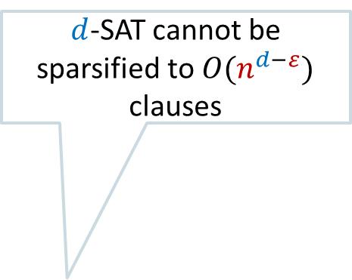
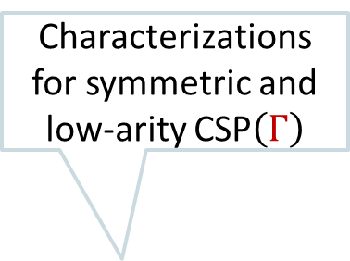
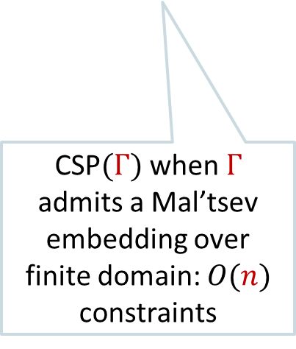
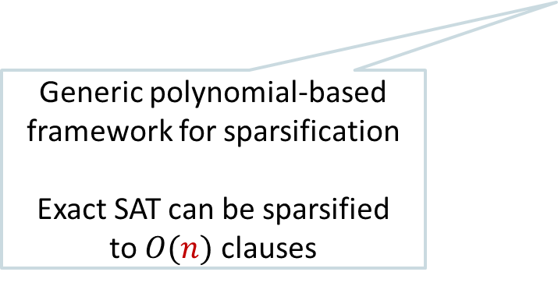

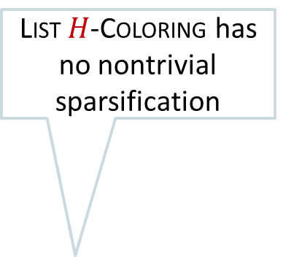
Timeline of polynomial-time sparsification
[Dell & van Melkebeek, STOC]
[Chen, J, Okrasa,
Pieterse & Rzazewski, ISAAC]
$d$-SAT cannot be sparsified to $O(n^{d−ε})$ clauses
List $H$-Coloring has no nontrivial sparsification
[Chen, J & Pieterse, IPEC]
Characterizations for symmetric and low-arity CSP$\left(Γ\right)$
[J & Pieterse, IPEC]
$d$-NAE-SAT can be sparsified to $O\left(n^{d−1}\right)$ clauses
2010 2011 2012 2013 2014 2015 2016 2017 2018 2019 2020 2021
Generic polynomial-based framework for sparsification
Exact SAT can be sparsified
to $O(n)$ clauses
Frontiers in PC
CSP$(Γ)$ when $Γ$ admits a Mal’tsev embedding over finite domain: $O(n)$ constraints
Full characterization for Boolean
Max-CSP$\left(Γ\right)$
[J & Pieterse, MFCS]
[J & Włodarczyk, ESA]
[Lagerkvist & Wahlströhm, CP]
Notes:
Victor Lagerkvist & Magnus Wahlstrom. Karolina Okrasa and Pawel Rzazewski. Next up: introducing the framework based on capturing constraints by low-degree polynomials and how they led to results on this timeline.

Slide 14
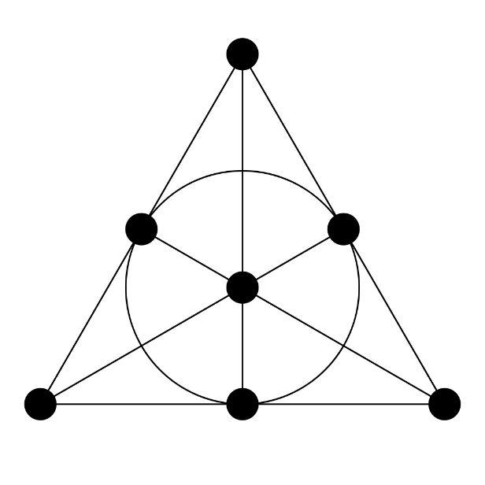










The polynomial framework for sparsification
Relation $R⊆{\left\{0,1\right\}}^{k}$ is captured by degree-$d$ polynomials,
if there are degree-$d$ polynomials $p_{i}$ over $ℤ/m_{i}ℤ$ for $i∈[N]$ s.t.
$$\left(x_{1},…, x_{k}\right)∈R⇔∀i∈[N]:p_{i}\left(x_{1},…, x_{k}\right)≡_{m_{i}}0$$
[Boolean assignment satisfies $R$ iff it is a root of all $N$ polynomials]
$$a$$ | $$b$$ | $$c$$ | $$m$$ | $$u$$ | $$v$$ | $$w$$
$$b$$
$$R_{\text{fano}}=\left\{\begin{matrix}\left(1, 1, 0, 0, 1, 0, 0\right) \\ \left(1, 0, 1, 0, 0, 1, 0\right) \\ (1, 0, 0, 1, 0, 0, 1) \\ (0, 1, 1, 0, 0, 0, 1) \\ (0, 1, 0, 1, 0, 1, 0) \\ (0, 0, 1, 1, 1, 0, 0) \\ (0, 0, 0, 0, 1, 1, 1)\end{matrix}\right\}$$
$$u$$
$$w$$
$$m$$
$$a$$
$$v$$
$$c$$
Notes:
Note that the moduli are allowed to be composites; you can still find small spanning sets for matrices over such rings. For polynomials over Z: you can replace many polynomials by a single polynomial by inflating the coefficients and using the fact that the range is bounded in terms of coefficients and arity.

Slide 15
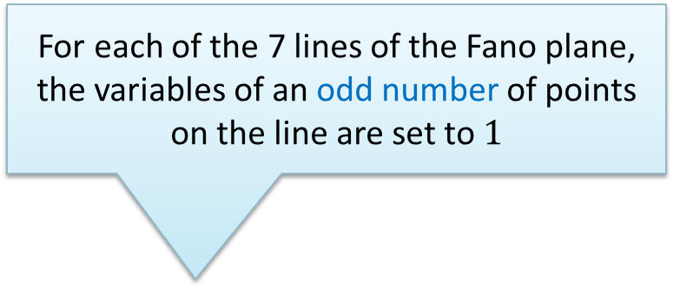

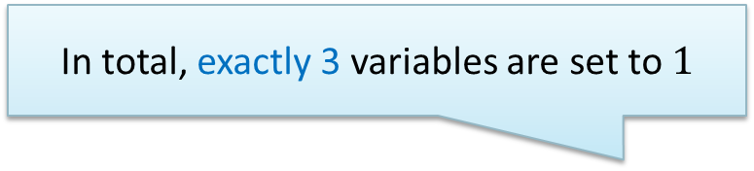
The polynomial framework for sparsification
Relation $R⊆{\left\{0,1\right\}}^{k}$ is captured by degree-$d$ polynomials,
if there are degree-$d$ polynomials $p_{i}$ over $ℤ/m_{i}ℤ$ for $i∈[N]$ s.t.
$$\left(x_{1},…, x_{k}\right)∈R⇔∀i∈[N]:p_{i}\left(x_{1},…, x_{k}\right)≡_{m_{i}}0$$
[Boolean assignment satisfies $R$ iff it is a root of all $N$ polynomials]
For each of the 7 lines of the Fano plane,
the variables of an odd number of points on the line are set to $1$
$$∀\left(a,b,c,m,u,v,w\right)∈{\left\{0,1\right\}}^{7}:$$
$$\left(a,b,c,m,u,v,w\right)∈R_{\text{fano}}$$
$$⇔$$
$a+b+u≡_{2}1,$ and
$a+m+w≡_{2}1,$ and
$$…$$
$u+v+w≡_{2}1,$ and
$$a+b+c+m+u+v+w≡_{11}3$$
$$b$$
$$u$$
$$w$$
$$m$$
In total, exactly 3 variables are set to $1$
$$a$$
$$v$$
$$c$$
Notes:
For polynomials over Z: you can replace many polynomials by a single polynomial by inflating the coefficients and using the fact that the range is bounded in terms of coefficients and arity. To see that this captures this relation. Suppose you have 3 variables $x_{i}x_{j}x_{ℓ}$ set to $1$, that do not form a line. There is a unique line through any two points, so consider the line L through $x_{i}x_{j}$. Since the triple is not on a line, $x_{ℓ}$ is not on L so the values of L sum to 2, which violates the constraint for line $L$. Relation $R_{\text{fano}}$ cannot be captured
using only polynomials modulo $2$

Slide 16
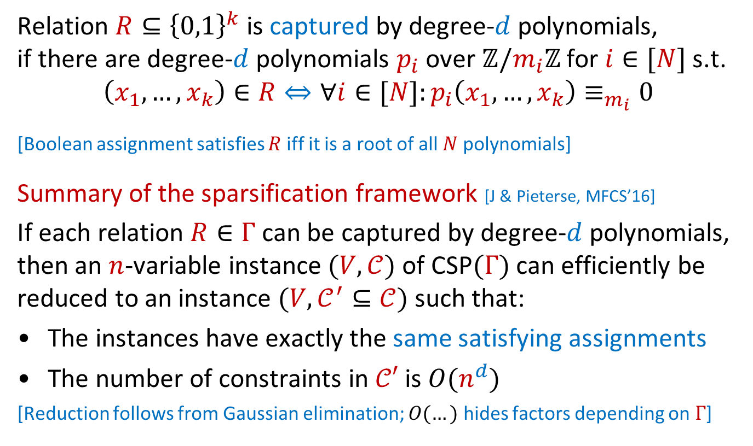
The polynomial framework for sparsification
Relation $R⊆{\left\{0,1\right\}}^{k}$ is captured by degree-$d$ polynomials,
if there are degree-$d$ polynomials $p_{i}$ over $ℤ/m_{i}ℤ$ for $i∈[N]$ s.t.
$$\left(x_{1},…, x_{k}\right)∈R⇔∀i∈[N]:p_{i}\left(x_{1},…, x_{k}\right)≡_{m_{i}}0$$
[Boolean assignment satisfies $R$ iff it is a root of all $N$ polynomials]
Summary of the sparsification framework [J & Pieterse, MFCS’16]
If each relation $R∈Γ$ can be captured by degree-$d$ polynomials, then an $n$-variable instance $(V,𝒞)$ of CSP$(Γ)$ can efficiently be reduced to an instance $(V,𝒞^{′}⊆𝒞)$ such that:
The instances have exactly the same satisfying assignments
The number of constraints in $𝒞′$ is $O(n^{d})$
[Reduction follows from Gaussian elimination; $O(…)$ hides factors depending on $Γ$]
Notes:
For polynomials over Z: you can replace many polynomials by a single polynomial by inflating the coefficients and using the fact that the range is bounded in terms of coefficients and arity.

Slide 17
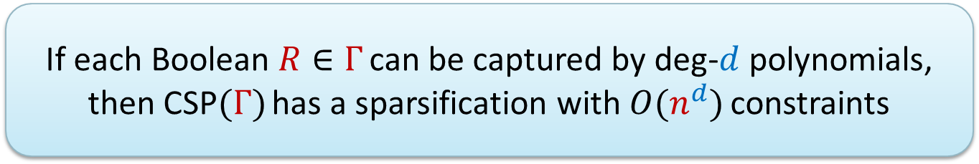
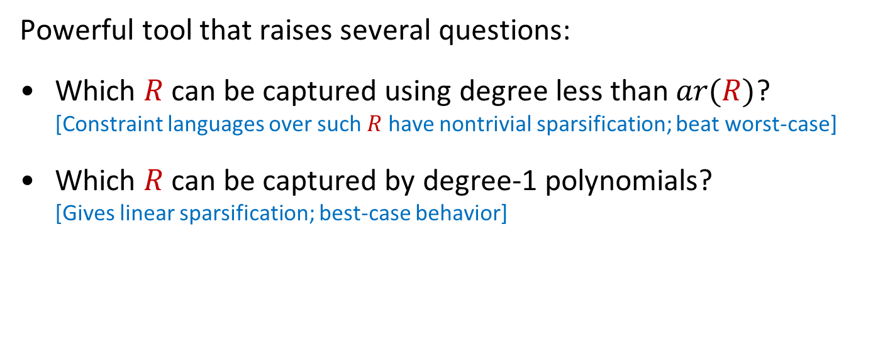
Questions about polynomial representations
  If each Boolean $R∈Γ$ can be captured by deg-$d$ polynomials, then CSP$(Γ)$ has a sparsification with $O(n^{d})$ constraints
Powerful tool that raises several questions:
Which $R$ can be captured using degree less than $ar(R)$?
[Constraint languages over such $R$ have nontrivial sparsification; beat worst-case]
Which $R$ can be captured by degree-1 polynomials?
[Gives linear sparsification; best-case behavior]

Slide 18
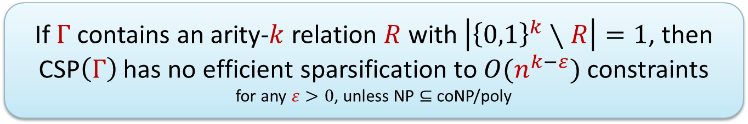

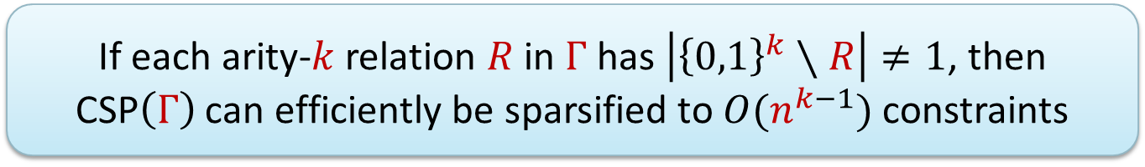
When is nontrivial sparsification possible?
Let $Γ$ be an intractable finite Boolean constraint language,
let $k$ be the maximum arity of a relation in $Γ$
For fixed $Γ$, there are $O(n^{k})$ possible constraints on $n$ variables
When can we get a sparsification with $O(n^{k−ε})$ constraints?
  If each arity-$k$ relation $R$ in $Γ$ has $\left|{\left\{0,1\right\}}^{k}∖R\right|≠1$, then
  CSP$\left(Γ\right)$ can efficiently be sparsified to $O(n^{k−1})$ constraints
[If $\left|{\left\{0,1\right\}}^{k}∖R\right|≠1$, then $R$ can be captured by a degree-($k−1$) polynomial]
  If $Γ$ contains an arity-$k$ relation $R$ with $\left|{\left\{0,1\right\}}^{k}∖R\right|=1$, then CSP$\left(Γ\right)$ has no efficient sparsification to $O(n^{k−ε})$ constraints
  for any $ε>0$, unless NP $⊆$ coNP/poly
[Chen, J & Pieterse, IPEC’18]

Slide 19
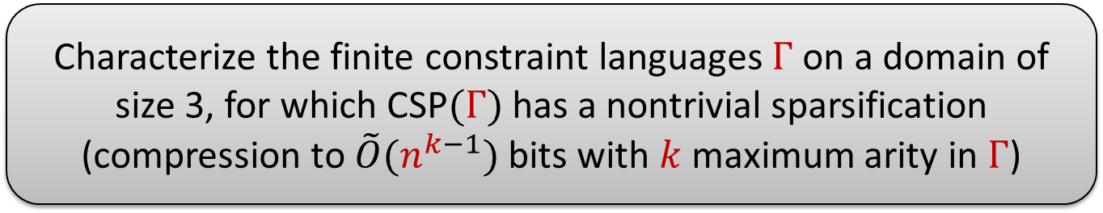

Open: Nontrivial sparsification for larger domains
Result shows which Boolean $Γ$ allow nontrivial sparsification
For constraint languages over larger domains, little is known
Open problem:
  Characterize the finite constraint languages $Γ$ on a domain of size 3, for which CSP$(Γ)$ has a nontrivial sparsification
  (compression to $\tilde{O}(n^{k−1})$ bits with $k$ maximum arity in $Γ$)

Slide 20
Talk landscape
Climbing towards generality
Mal’tsev embeddings
Nontrivial
sparsification
Polynomials
CSP$\left(Γ\right)$
Balanced
relations
Symmetric CSP
NAE-SAT
1-in-$d$ SAT
Max
CSP$\left(Γ\right)$
Characteristic polynomial
Compression
Kernelization
Notes:
We answered: when is nontrivial sparsification possible.
Next up: when is linear sparsification possible?

Slide 21
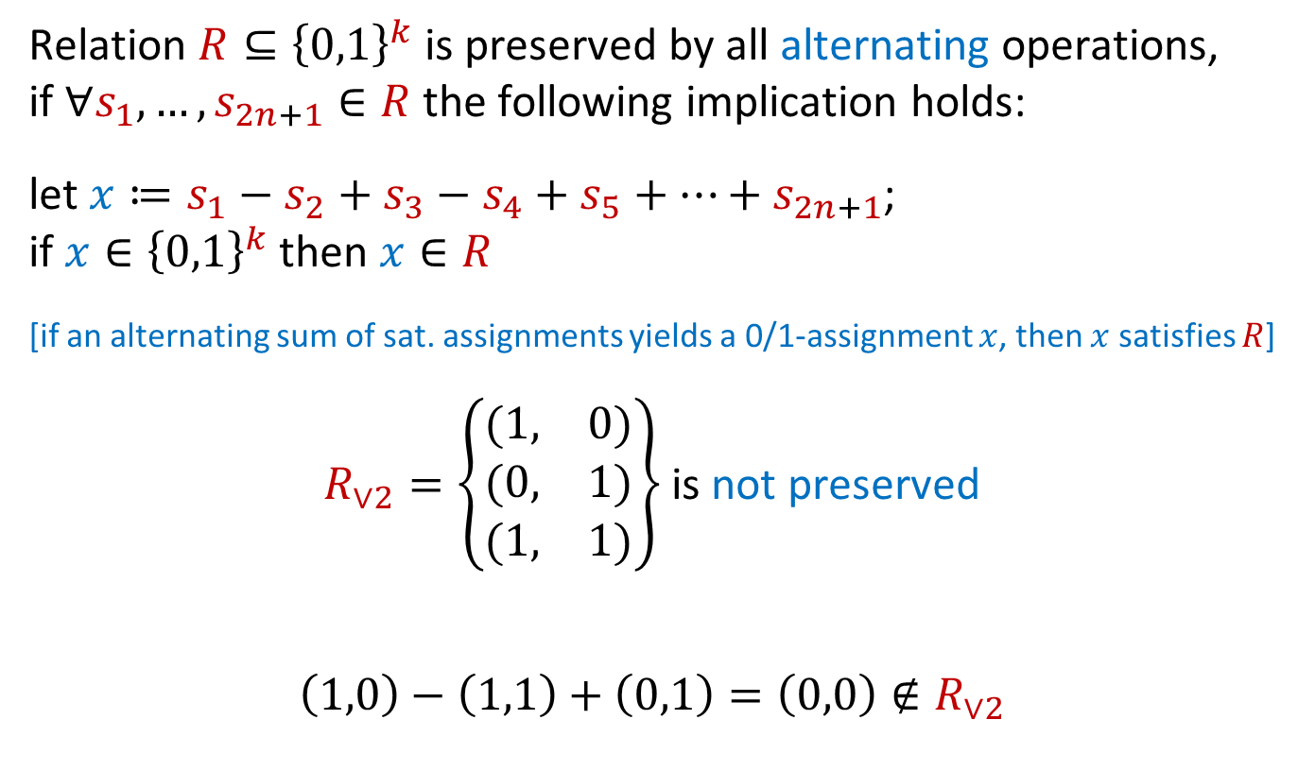
Capturing by linear polynomials
Relation $R⊆{\left\{0,1\right\}}^{k}$ is preserved by all alternating operations,
if $∀s_{1},…, s_{2n+1}∈R$ the following implication holds:
let $x≔s_{1}−s_{2}+s_{3}−s_{4}+s_{5}+…+s_{2n+1}$;
if $x∈{\left\{0,1\right\}}^{k}$ then $x∈R$
[if an alternating sum of sat. assignments yields a 0/1-assignment $x$, then $x$ satisfies $R$]
$R_{∨2}=\left\{\begin{matrix}(1, & 0) \\ (0, & 1) \\ (1, & 1)\end{matrix}\right\}$ is not preserved
$$\left(1,0\right)−\left(1,1\right)+\left(0,1\right)=\left(0,0\right)∉R_{∨2}$$
Notes:
(This in-lines some definitions from the algebraic analysis of CSPs.)
The assignments in the sum do not all have to be different; we are really asking about an integer linear combination whose coefficients sum to 1.

Slide 22
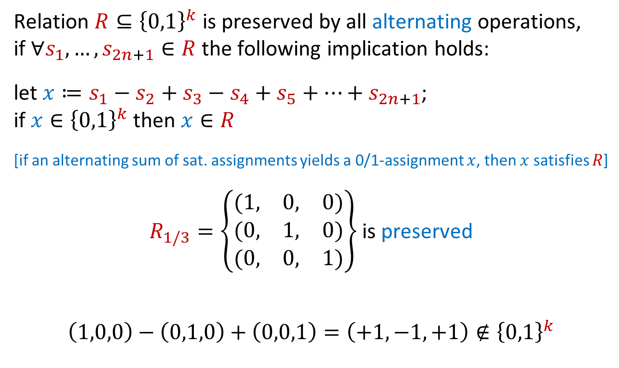
Capturing by linear polynomials
Relation $R⊆{\left\{0,1\right\}}^{k}$ is preserved by all alternating operations,
if $∀s_{1},…, s_{2n+1}∈R$ the following implication holds:
let $x≔s_{1}−s_{2}+s_{3}−s_{4}+s_{5}+…+s_{2n+1}$;
if $x∈{\left\{0,1\right\}}^{k}$ then $x∈R$
[if an alternating sum of sat. assignments yields a 0/1-assignment $x$, then $x$ satisfies $R$]
$R_{1/3}=\left\{\begin{matrix}(1, & 0, & 0) \\ (0, & 1, & 0) \\ (0, & 0, & 1)\end{matrix}\right\}$ is preserved
$$\left(1,0,0\right)−\left(0,1,0\right)+\left(0,0,1\right)=\left(+1,−1,+1\right)∉{\left\{0,1\right\}}^{k}$$

Slide 23
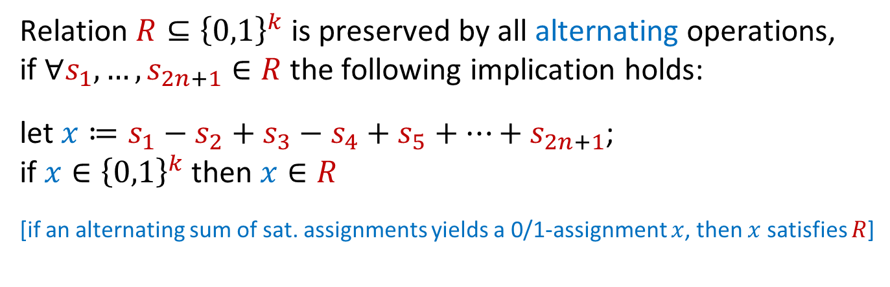


Capturing by linear polynomials
Relation $R⊆{\left\{0,1\right\}}^{k}$ is preserved by all alternating operations,
if $∀s_{1},…, s_{2n+1}∈R$ the following implication holds:
let $x≔s_{1}−s_{2}+s_{3}−s_{4}+s_{5}+…+s_{2n+1}$;
if $x∈{\left\{0,1\right\}}^{k}$ then $x∈R$
[if an alternating sum of sat. assignments yields a 0/1-assignment $x$, then $x$ satisfies $R$]
[Chen, J & Pieterse, IPEC’18]
  Boolean relation $R$ can be captured by linear polynomials
  $$⇔$$
  $R$ is preserved by all alternating operations
Relation preserved by all alternating operations is called balanced
Constraint language $Γ$consisting of balanced relations is called balanced
Notes:
Proof uses linear algebra over rings and Smith decomposition.

Slide 24

Balanced relations have linear representations
Consequences:
$Γ$ is balanced $⇒$ CSP$\left(Γ\right)$ can be sparsified to $O(n)$ constraints
$Γ$ is not balanced $⇒$ witnessed by an alternating operation
Witnesses can turn into lower-bound proofs for sparsification!
  Boolean relation $R$ can be captured by linear polynomials
  $$⇔$$
  $R$ is preserved by all alternating operations
Relation preserved by all alternating operations is called balanced
Constraint language $Γ$consisting of balanced relations is called balanced
Notes:
Using this machinery, we can therefore prove 2 characterizations of optimal sparsification size.

Slide 25

Open: Beyond linear combinations
  General principle:
  If each constraint $C$ is equivalent to an equality $q(C)$,
  and $q\left(C\right)$ is a linear combination of the equalities of the other constraints, then $C$ is redundant and can be omitted
The polynomial-based framework detects that a constraint is redundant by expressing it as a linear combination of others
Open research direction:
  Explore whether non-linear proof systems such as
  sum of squares can efficiently detect redundancy of constraint types not covered by our framework

Slide 26
Talk landscape
Climbing towards generality
Mal’tsev embeddings
Nontrivial
sparsification
Polynomials
CSP$\left(Γ\right)$
Balanced
relations
Symmetric CSP
NAE-SAT
1-in-$d$ SAT
Max
CSP$\left(Γ\right)$
Characteristic polynomial
Compression
Kernelization
Notes:
I’ll say a little bit about the island of Malt’sev embeddings that we are passing by.

Slide 27


Sparsification for symmetric CSPs
A Boolean relation $R⊆{\left\{0,1\right\}}^{k}$ is symmetric if $x∈R$ depends
only on the number of $1$’s in $x$,
and not on the position of the $1$’s in $x$
[Symmetric $R$ is characterized by the weights of the satisfying assignments]
We say $Γ$ is symmetric if each $R∈Γ$ is symmetric
Let $Γ$ be a finite symmetric intractable Boolean constraint language
  assuming NP ⊈ coNP/poly:
  CSP$(Γ)$ can efficiently be sparsified to $O(n)$ constraints
  $⇔$
  $Γ$ is balanced
[Chen, J & Pieterse, IPEC’18]
Notes:
If $Γ$ is balanced, then in polynomial time you find a subset of $O(n)$ constraints that preserves the solution space. If $Γ$ is not balanced, the problem has no generalized kernel of size $O(n^{2−ε})$.

Slide 28



Open: Linear sparsification for non-symmetric $Γ$
Balance characterizes which symmetric $Γ$ allow $O(n)$ sparsification
For non-symmetric $Γ$, the property of being balanced is:
sufficient to ensure $O(n)$ sparsification
not known to be necessary
Open problem:
  Characterize for which (non-symmetric) Boolean $Γ$ the problem CSP($Γ$) admits a sparsification to $O(n)$ constraints

Slide 29
Talk landscape
Mal’tsev embeddings
Nontrivial
sparsification
Polynomials
CSP$\left(Γ\right)$
Balanced
relations
Symmetric CSP
NAE-SAT
1-in-$d$ SAT
Max
CSP$\left(Γ\right)$
Characteristic polynomial
Compression
Kernelization

Slide 30

Characterizing optimal sparsification sizes
Based on largest or that $R∈Γ$ can express in a technical sense:
using constants, negations, and repetitions of variables,
but without introducing fresh variables
$R_{3NAE}=\left\{\begin{matrix}(0, & 0, & 1) \\ (0, & 1, & 0) \\ (0, & 1, & 1) \\ (1, & 0, & 0) \\ (1, & 0, & 1) \\ (1, & 1, & 0)\end{matrix}\right\}$ cone-defines $R_{∨2}=\left\{\begin{matrix}(1, & 0) \\ (0, & 1) \\ (1, & 1)\end{matrix}\right\}$
$$\left(x,y,0\right)∈R_{3NAE}⇔\left(x,y\right)∈R_{∨2}$$

Slide 31


Characterization for low-arity CSPs
Let $Γ$ be a finite Boolean intractable constraint language,
in which each relation has arity at most three
Characterizes optimal sparsification size based on easy condition
The polynomial-based framework gives optimal sparsifications for all constraint languages whose relations have arity $≤3$
[Chen, J & Pieterse, IPEC’18]
  Let $k≥1$ be the arity of the largest or that $Γ$ can cone-define.
  Then CSP$\left(Γ\right)$ has a sparsification with $O\left(n^{k}\right)$ constraints,
  but no sparsification with $O(n^{k−ε})$ constraints.
(for any $ε>0$, assuming NP ⊈ coNP/poly)
Notes:
This characterization does not extend to arbitrarily-large $k$. It fails for k in the range of 20, but may be true for k=4 and k=5. Characterization shows that sparsifiability is determined by the “worst” individual constraint in \Gamma, and does not depend on interactions between various relations in \Gamma (as long as the combination leads to an NP-hard problem.)

Slide 32


Talk landscape
Mal’tsev embeddings
Nontrivial
sparsification
Polynomials
CSP$\left(Γ\right)$
Balanced
relations
Symmetric CSP
NAE-SAT
1-in-$d$ SAT
Max
CSP$\left(Γ\right)$
Characteristic polynomial
Compression
Kernelization

Slide 33

Max CSPs
CSP$(Γ)$: can all constraints be satisfied simultaneously?
Max-CSP$(Γ)$: maximize number of satisfied constraints
For fixed $Γ$, decision may be easy while maximization is hard:
2-SAT is polynomial-time solvable, Max 2-SAT is NP-complete
Can we apply sparsification for Max-CSP$(Γ)$?
For Max-CSP, it matters how often the same constraint occurs
Each constraint has an integer weight of absolute value $≤n^{O\left(1\right)}$
Decision problem Max-CSP$(Γ)$:
$∃$assignment for which satisfied constraints have weight $≥t$?
Notes:
We look at the decision version of Max-CSP, asking if there is an assignment such that the satisfied constraints have total weight at least k. Each weight can be encoded in $O(\log{n)}$ bits. We assume that a constraint can only be applied once to a certain tuple of variables, as otherwise you can gadgeteer constraints of large weight.

Slide 34


Sparsification via redundancy fails
The principle we used for sparsification of CSP$(Γ)$ was:
This completely breaks for Max-CSP:
If $q\left(C\right)$ is a linear combination of constraints which are
not all satisfied, we have no guarantee whether $q\left(C\right)$ holds
  General principle:
  If each constraint $C$ is equivalent to an equality $q(C)$,
  and $q\left(C\right)$ is a linear combination of the equalities of the other constraints, then $C$ is redundant and can be omitted

Slide 35

Characteristic polynomials
For a Boolean relation $R⊆\{0,1\}^{k}$, its characteristic polynomial is the unique $k$-variate multilinear polynomial $p_{R}$ over $ℝ$ such that
$$p_{R}\left(x_{1},…, x_{k}\right)=\left\{\begin{aligned}0, \text{if} \left(x_{1},…, x_{k}\right)∉R \\ &1, \text{if} \left(x_{1},…, x_{k}\right)∈R\end{aligned}\right.$$
for all $x_{1},…, x_{k}∈\{0,1\}$.
Example 1.
For $R_{1\text{/}3}=\left\{\begin{matrix}(1, & 0, & 0) \\ (0, & 1, & 0) \\ (0, & 0, & 1)\end{matrix}\right\}$ the polynomial $p_{R_{1/3}}\left(x_{1},x_{2},x_{3}\right)$ is:
$$x_{1}+x_{2}+x_{3}−2x_{1}x_{2}−2x_{1}x_{3}−2x_{2}x_{3}+3x_{1}x_{2}x_{3}$$
Notes:
Has been applied in many contexts, for example in Nisan and Szegedy ‘94 in the paper introducing the sensitivity conjecture. Note that this differs from the polynomial expression $p\left(x,y,z\right)=x+y+z=1$ we used to capture the 1-in-3 constraint: this has degree 3, that one had degree 1! It is unique as a ‘formal polynomial’, so as a vector of coefficients for multilinear monomials. For input of weight 0: trivially get 0. For input of weight 1: we get +1 for the single variable. For input of weight 2: we get +1 +1 -2, so 0. For input of weight 3: we get +1 +1 +1 -2 -2 -2 +3 = 0, as we add 6 and subtract 6.

Slide 36

Characteristic polynomials
For a Boolean relation $R⊆\{0,1\}^{k}$, its characteristic polynomial is the unique $k$-variate multilinear polynomial $p_{R}$ over $ℝ$ such that
$$p_{R}\left(x_{1},…, x_{k}\right)=\left\{\begin{aligned}0, \text{if} \left(x_{1},…, x_{k}\right)∉R \\ &1, \text{if} \left(x_{1},…, x_{k}\right)∈R\end{aligned}\right.$$
for all $x_{1},…, x_{k}∈\{0,1\}$.
Example 2.
For $R_{3NAE}$, not-all-equal, the polynomial $p_{R_{3NAE}}\left(x_{1},x_{2},x_{3}\right)$ is:
$$x_{1}+x_{2}+x_{3}−x_{1}x_{2}−x_{1}x_{3}−x_{2}x_{3}$$

Slide 37

Characteristic polynomials
For a Boolean relation $R⊆\{0,1\}^{k}$, its characteristic polynomial is the unique $k$-variate multilinear polynomial $p_{R}$ over $ℝ$ such that
$$p_{R}\left(x_{1},…, x_{k}\right)=\left\{\begin{aligned}0, \text{if} \left(x_{1},…, x_{k}\right)∉R \\ &1, \text{if} \left(x_{1},…, x_{k}\right)∈R\end{aligned}\right.$$
for all $x_{1},…, x_{k}∈\{0,1\}$.
Note:
Demands the same value (1) for all satisfying assignments,
but also the same value (0) for all unsatisfying assignments
Not allowed to use any other ring than $ℝ$

Slide 38
Talk landscape
Mal’tsev embeddings
Nontrivial
sparsification
Polynomials
CSP$\left(Γ\right)$
Balanced
relations
Symmetric CSP
NAE-SAT
1-in-$d$ SAT
Max
CSP$\left(Γ\right)$
Characteristic polynomial
Compression
Kernelization

Slide 39

Compression via characteristic polynomials
If $\left(R,\left(i_{1},…, i_{ar\left(R\right)}\right),w\right)$ is a constraint of weight $w$,
it contributes ${w⋅p}_{R}(x_{i_{1}}, …, x_{i_{ar\left(R\right)}})$ to the satisfied weight,
since $p_{R}$ is 0/1-valued
For an instance of Max-CSP$(Γ)$ with weighted constraints $𝒞$,
total weight of constraints satisfied by $x_{1},…, x_{n}∈\{0,1\}$ equals:
$$\sum_{\left(R,\left(i_{1},…, i_{ar\left(R\right)}\right),w\right)∈𝒞}{{w⋅p}_{R}(x_{i_{1}}, …, x_{i_{ar\left(R\right)}})}$$
Optimizing the weight of satisfied constraints is equivalent to finding a $0/1$-assignment that maximizes the sum
Notes:
So the instance is equivalent to: find a Boolean assignment to $x_{1},…, x_{n}$ maximizing this sum.

Slide 40


Compression via characteristic polynomials
If $\left(R,\left(i_{1},…, i_{ar\left(R\right)}\right),w\right)$ is a constraint of weight $w$,
it contributes ${w⋅p}_{R}(x_{i_{1}}, …, x_{i_{ar\left(R\right)}})$ to the satisfied weight,
since $p_{R}$ is 0/1-valued
For an instance of Max-CSP$(Γ)$ with weighted constraints $𝒞$,
total weight of constraints satisfied by $x_{1},…, x_{n}∈\{0,1\}$ equals:
$$\sum_{\left(R,\left(i_{1},…, i_{ar\left(R\right)}\right),w\right)∈𝒞}{{w⋅p}_{R}(x_{i_{1}}, …, x_{i_{ar\left(R\right)}})}$$
If $\max_{R∈Γ}\deg\left(p_{R}\right)=d$, the sum has $O(n^{d})$ distinct monomials
We assumed $|w|∈n^{O\left(1\right)}$ for all $O(n^{\max{ar\left(R∈Γ\right)}})$ constraints
After collecting terms, each coefficient has bitsize $O(\log{n)}$
  Monomial-based compression:
  If $\max_{R∈Γ}\deg\left(p_{R}\right)=d$, then an instance of Max-CSP$(Γ)$ can be compressed to $O(n^{d}\log{n})$ bits by storing the $O(n^{d})$ coefficients of the weighted sum of applications of characteristic polynomials
Notes:
So the instance is equivalent to: find a Boolean assignment to $x_{1},…, x_{n}$ maximizing this sum.

Slide 41



Characteristic polynomials compress optimally
For a constraint language $Γ$, define $\deg\left(Γ\right)≔\max_{R∈Γ} deg⁡(p_{R})$
We have just seen:
This is optimal for all NP-hard Boolean Max-CSPs
[J & Włodarczyk, 2020]
  An instance of Max-CSP$\left(Γ\right)$ can be compressed in polynomial time to an equivalent instance, of a different problem,
  of bitsize $O(n^{deg\left(Γ\right)}\log{n})$
[J & Włodarczyk, 2020]
  If Max-CSP$\left(Γ\right)$ is NP-hard, then it does not admit a
  polynomial-time compression of bitsize $O(n^{deg\left(Γ\right)−ε})$
  for any $ε>0$, unless $NP⊆coNP/poly$
Notes:
When negative weights are allowed, of large magnitude, the polynomial-time cases are those when $deg\left(Γ\right)≤ 1$.

Slide 42


Complexity of CSP: Decision vs. maximization
By computing $\deg\left(Γ\right)$ for various classic problems,
we find the following optimal compression sizes
up to $n^{o\left(1\right)}$ factors, assuming $NP \text{⊈} coNP/poly$
The stronger restrictions on polynomials used for Max-CSP$\left(Γ\right)$ often make it much harder to compress than CSP$\left(Γ\right)$
$$Γ$$ | Optimal compression size for CSP$(Γ)$ | Optimal compression size for Max-CSP$(Γ)$
$d$-NAE-SAT for odd $d≥3$ | $$O(n^{d−1}\log{n})$$ | $$O(n^{d−1}\log{n})$$
$d$-NAE-SAT for even $d≥3$ | $$O(n^{d−1}\log{n})$$ | $$O(n^{d}\log{n})$$
1-in-$d$ SAT | $$O(n\log{n})$$ | $$O(n^{d}\log{n})$$
$d$-XOR-SAT | $$O(1)$$ | $$O(n^{d}\log{n})$$
Notes:
Compare: Capturing polynomials allow a different modulus for each unsatisfying assignment, and allow different nonzeros outcomes for unsat assignments; characteristic polynomials are always over R and require exact 0/1 outputs. Strange behavior of the degrees for NAE-sat comes from certain cancellation properties of sums of binomial coefficients.

Slide 43


Lower bound for Max 1-in-3-SAT
To illustrate the lower bound, we will prove:
To simplify the presentation:
We allow the constant $⊥$ in an instance
This can be avoided with some more work
Proof strategy:
Linear-parameter transformation from 3-CNF-SAT $(n)$,
for which this lower bound is known [Dell & van Melkebeek, STOC ‘10]
  Max-1-in-3 SAT does not admit a polynomial-time compression of bitsize $O(n^{3−ε})$ for any $ε>0$, unless $NP⊆coNP/poly$

Slide 44


The main ingredient
Claim. There is a collection $𝒞(x_{1},x_{2},x_{3})$ of weighted 1-in-3 constraints on variables $x_{1},x_{2},x_{3}∈\{0,1\}$ and the constant $⊥$ such that:
if $x_{1}∨x_{2}∨x_{3}=1$, then the satisfied weight in $𝒞$ is 1
If $x_{1}∨x_{2}∨x_{3}=0$, then the satisfied weight in $𝒞$ is 0
Constraint | Weight | For $(0,0,0)$ | For $(1,0,0)$ | For $(1,1,0)$ | For $(1,1,1)$
1-in-3 $(x_{1},x_{2},x_{3})$ | $$+1/3$$ | $$0$$ | $$+1/3$$ | $$0$$ | $$0$$
1-in-3 $(x_{1},x_{2},⊥)$ | $$+1/6$$ | $$0$$ | $$+1/6$$ | $$0$$ | $$0$$
1-in-3$(x_{1},x_{3},⊥)$ | $$+1/6$$ | $$0$$ | $$+1/6$$ | $$+1/6$$ | $$0$$
1-in-3 $(x_{2},x_{3},⊥)$ | $$+1/6$$ | $$0$$ | $$0$$ | $$+1/6$$ | $$0$$
1-in-3 $(x_{1},⊥,⊥)$ | $$+1/3$$ | $$0$$ | $$+1/3$$ | $$+1/3$$ | $$+1/3$$
1-in-3$(x_{2},⊥,⊥)$ | $$+1/3$$ | $$0$$ | $$0$$ | $$+1/3$$ | $$+1/3$$
1-in-3 $(x_{3},⊥,⊥)$ | $$+1/3$$ | $$0$$ | $$0$$ | $$0$$ | $$+1/3$$
 |  | $$0$$ | $$1$$ | $$1$$ | $$1$$
Notes:
Collection of 7 different 1-in-3 constraints. For the general lower bound, you can derive an expression of $d$-ary AND from a degree-$d$ characteristic polynomial.

Slide 45


Using the main ingredient
Claim. There is a collection $𝒞(x_{1},x_{2},x_{3})$ of weighted 1-in-3 constraints on variables $x_{1},x_{2},x_{3}∈\{0,1\}$ and the constant $⊥$ such that:
if $x_{1}∨x_{2}∨x_{3}=1$, then the satisfied weight in $𝒞$ is 1
If $x_{1}∨x_{2}∨x_{3}=0$, then the satisfied weight in $𝒞$ is 0
  Max-1-in-3 SAT does not admit a polynomial-time compression of bitsize $O(n^{3−ε})$ for any $ε>0$, unless $NP⊆coNP/poly$
To reduce a 3-CNF-SAT instance $F$ to a Max-1-in-3 SAT instance:
for each 3-CNF-SAT clause $(ℓ_{1},ℓ_{2},ℓ_{3})$,
insert the weighted 1-in-3 constraints $𝒞(ℓ_{1},ℓ_{2},ℓ_{3})$
The number of variables $n$ does not change
All $m$ clauses of F are simultaneously satisfiable
$$⇔$$
some assignment satisfies constraints with total weight $m$
Notes:
For the general lower bound, you can derive an expression of $d$-ary AND from a degree-$d$ characteristic polynomial.

Slide 46


The general lower bound
Claim. For any Boolean relation $R$ with $\deg\left(p_{R}\right)=d$, there is a collection $𝒞(x_{1},…, x_{d})$ of weighted $R$-constraints on variables $x_{1},…,x_{d}∈\{0,1\}$ and the constants $⊤,⊥$ such that:
if $\bigvee_{i=1}^{d}{x_{i}}=1$, then the satisfied weight in $𝒞$ is 1
if $\bigvee_{i=1}^{d}{x_{i}}=0$, then the satisfied weight in $𝒞$ is 0
The collection $𝒞$ is constructed by analyzing terms of $p_{R}$
Using $𝒞$ the $d$-CNF-SAT problem reduces to Max-CSP$(\{R\})$
Constants $⊤, ⊥$ can be gadgeteered using known ideas
[Khanna, Sudan, Trevisan & Williamson @ SICOMP’00]
Negated literals from CNF-SAT can also be gadgeteered into CSP
  If Max-CSP$\left(Γ\right)$ is NP-hard, then it does not admit a
  polynomial-time compression of bitsize $O(n^{deg\left(Γ\right)−ε})$
  for any $ε>0$, unless $NP⊆coNP/poly$

Slide 47
Talk landscape
Mal’tsev embeddings
Nontrivial
sparsification
Polynomials
CSP$\left(Γ\right)$
Balanced
relations
Symmetric CSP
NAE-SAT
1-in-$d$ SAT
Max
CSP$\left(Γ\right)$
Characteristic polynomial
Compression
Kernelization

Slide 48



Compression vs. sparsification
  An instance of Max-CSP$\left(Γ\right)$ can be compressed in polynomial time to an equivalent instance, of a different problem,
  of bitsize $O(n^{deg\left(Γ\right)}\log{n})$
How about compressing to an instance of the same problem?
Unknown how to sparsify to subset of $O(n^{deg\left(Γ\right)})$ constraints that yields the same set of optimal assignments
Using techniques from the lower bound, we can self-reduce
  Max-CSP$\left(Γ\right)$ with weights $\left|w\right|∈n^{O\left(1\right)}$can be reduced in polynomial time to Max-CSP$\left(Γ\right)$ on $O(n)$ variables with $O(n^{deg\left(Γ\right)})$ constraints and weights $\left|w\right|∈n^{O\left(1\right)}$

Slide 49
Talk landscape
Mal’tsev embeddings
Nontrivial
sparsification
Polynomials
CSP$\left(Γ\right)$
Balanced
relations
Symmetric CSP
NAE-SAT
1-in-$d$ SAT
Max
CSP$\left(Γ\right)$
Characteristic polynomial
Compression
Kernelization

Slide 50




Conclusion
Postdoc position
available!
Algebraic sparsification of CSPs yields several optimal results
For Boolean CSPs, explicit characterizations are known of:
Which CSP$\left(Γ\right)$ admit nontrivial sparsification
Which symmetric CSP$(Γ)$ admit a linear sparsification
Optimal compression size for all Max-CSP$(Γ)$ problems
Open problems:
Full characterization of (Boolean) CSPs with linear sparsification
Sparsification complexity for non-Boolean CSPs
Characterization of compression for non-Boolean Max-CSP

