Slide 1
Constrained Bipartite Vertex Cover: The Easy Kernel is Essentially Tight
Bart M. P. Jansen
June 4th, WORKER 2015, Nordfjordeid, Norway

Slide 2
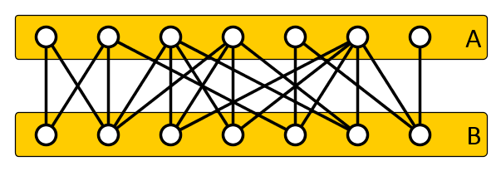
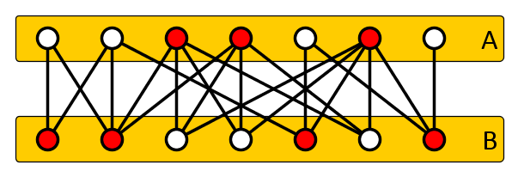
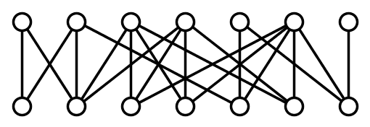
The Constrained Bipartite Vertex Cover problem
Input: Bipartite graph $G=(A∪B, E)$ and $k_{A}, k_{B}∈ℕ$ Question: Does $G$ have a vertex cover $S$ such that
$$\left|S∩A\right|≤k_{A}, \left|S∩B\right|≤k_{B}?$$
NP-complete, applications in reconfigurable VLSI
Differs from Constrained Minimum Bipartite Vertex Cover:
Is there a minimum vertex cover $S$ in $G$ for which $\left|S∩A\right|≤k_{A}$ and $\left|S∩B\right|≤k_{B}$?
$$k_{A}=3$$
$$k_{B}^{}=4$$

Slide 3
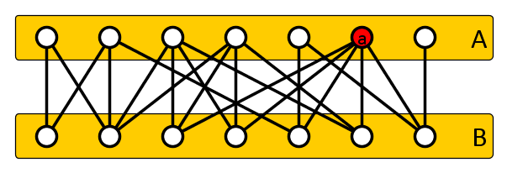
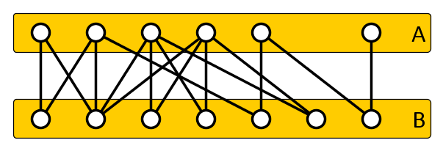
The easy kernel
If there is a vertex $a∈A$ with $\deg\left(a\right)>k_{B}$:
If $a$ is not in the cover, then all $a$’s neighbors must be
We cannot afford that, since there are more than $k_{B}$
Any solution contains $a$: delete $a$ and decrease $k_{A}$ by 1
Similarly, if there is a vertex $b∈B$ with $\deg\left(b\right)>k_{A}$:
Delete $b$, decrease $k_{B}$ by one
$$k_{A}=3$$
$$k_{B}^{}=4$$
$$k_{A}=2$$
$$k_{B}^{}=4$$

Slide 4
Analysis of the easy kernel
If $(G=\left(A,B,E\right), k_{A}, k_{B})$ is exhaustively reduced:
The $k_{A}$ vertices from $A$ cover at most $k_{B}$ edges each
The $k_{B}$ vertices from $B$ cover at most $k_{A}$ edges each
A yes-instance has at most $2\left(k_{A}⋅k_{B}\right)$ edges
Therefore at most $4(k_{A}⋅k_{B})$ vertices
This easy kernel was first given by Evans (1981)
Also helps to get fast FPT algorithms
$O({1.4}_{}^{k_{A}+k_{B}}+\left(k_{A}+k_{B}\right)⋅n))$ by Fernau and Niedermeier
Implemented and re-engineered by Bai and Fernau
Can the kernel size be improved?

Slide 5
Our results (I)
Both the number of vertices and edges of the easy kernel is essentially tight
If $NP$ is not in $coNP/poly$, there is no polynomial-time algorithm that reduces
an instance $(G=\left(A,B,E\right), k_{A}, k_{B})$ of Con. B. V. Cover to
an instance $(G^{′}=\left(A^{′},B^{′},E^{′}\right),k_{A}^{′},k_{B}^{′})$ such that
the instances are equivalent,
$k_{A}^{′}≤{\left(k_{A}\right)}^{O\left(1\right)}$,
$k_{B}^{′}≤{\left(k_{B}\right)}^{O\left(1\right)}$, and
$\left|V\left(G^{′}\right)\right|∈O({\left(k_{A}⋅k_{B}\right)}^{1−ε})$ for some $ε>0$

Slide 6
Our results (II)
Both the number of vertices and edges of the easy kernel is essentially tight
If $NP$ is not in $coNP/poly$, there is no polynomial-time algorithm that reduces
an instance $(G=\left(A,B,E\right), k_{A}, k_{B})$ of Con. B. V. Cover to
an instance $(G^{′}=\left(A^{′},B^{′},E^{′}\right),k_{A}^{′},k_{B}^{′})$ such that
the instances are equivalent, and
$\left|E\left(G^{′}\right)\right|∈O({\left(k_{A}⋅k_{B}\right)}^{1−ε})$ for some $ε>0$
Follows from a more general result:
There is no poly-time algorithm compressing $n$-vertex instances of Con. B. V. Cover to instances of size $O\left(n^{2−ε}\right)$ of an arbitrary problem, unless $NP⊆coNP/poly$

Slide 7
Vertex lower bound

Slide 8
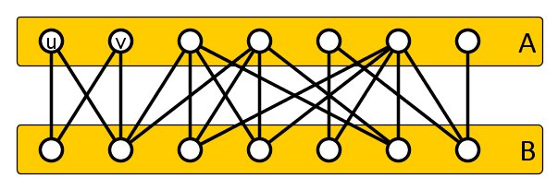
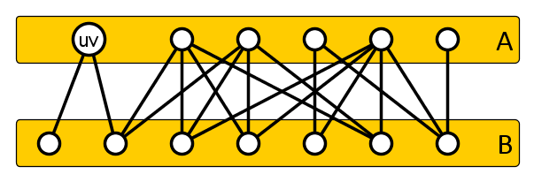
False twins simulate weights
Suppose vertices $u$ and $v$ have the same (open) neighborhood
A minimal vertex cover contains both $u$ and $v$, or neither
So we can merge $u$ and $v$ into one vertex of weight two
The construction uses vertices of polynomial weight
These can be replaced by repeated copies in the end

Slide 9
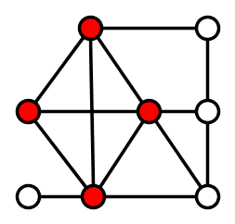
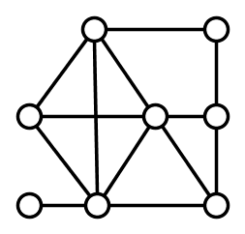
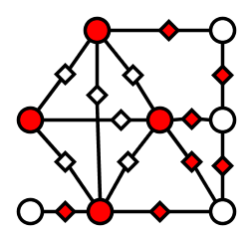
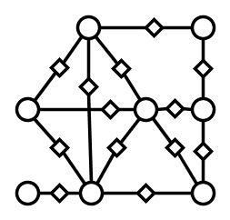
NP-Completeness proof
Reduction from a Clique instance $(G,k)$ [Kuo and Fuchs’87]
Build $G^{′}$ by subdividing each edge by a new vertex
Let $A′$ be the original vertices of $G$ and $B’$ the subdividers
Put ${k′}_{A}≔k$ and ${k′}_{B}≔\left|E\left(G\right)\right|−\left({k \atop 2}\right)$
$$k=4$$
$${k′}_{A}=4$$
$$k_{B}^{′}=7$$

Slide 10
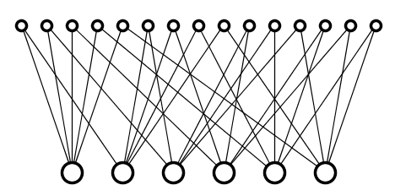
A canonical instance
Define the following bipartite graph $𝒢_{n}$
$A ≔\{a_{i}∣i∈\left[n\right]\}$, $B≔\left\{b_{\left\{i,j\right\}}\right|\left\{i,j\right\}∈\left({n \atop 2}\right)\}$
For each $\left\{i,j\right\}∈\left({n \atop 2}\right)$ make $b_{\left\{i,j\right\}}$ adjacent to $a_{i}$ and $a_{j}$
The graph $𝒢_{n}$ is canonical in the following way:
For each $n$-vertex Clique instance $(G,k)$, the graph $G’$ produced by the NP-completeness reduction is an induced subgraph of $𝒢_{n}$
$$𝒢_{6}$$

Slide 11
Key construction (I)
There is an algorithm with the following specifications
Input: A list of $t$ graphs $G_{1}, …, G_{t}$ with exactly $n$ vertices each, where $n$ is even and $t$ is a power of two
Output: A bipartite graph $G^{′}=\left(A^{′}∪B^{′}, E^{′}\right)$ along with integers $k_{A}^{′}, k_{B}^{′}$ such that:
$∃i∈\left[t\right]$ such that $G_{i}$ contains a clique of size $n/2$ $⇔$ $∃$vertex cover $S$ of $G’$ with $\left|S∩A^{′}\right|≤k_{A}^{′},\left|S∩B^{′}\right|≤k_{B}^{′}$
$k_{A}^{′}∈O(n^{2}\log{t)}$
$k_{B}^{′}∈O(n⋅t)$
The running time is polynomial in $t$ and $n$

Slide 12
Key construction (II)
Input: A list of $t$ graphs $G_{1}, …, G_{t}$ with exactly $n$ vertices each, where $n$ is even and $t$ is a power of two.
Output:
Adjacencies $B_{i}⇔A_{\left\{0,1\right\},[\log{t]}}$ follow binary expansion of $i$
Adjacencies $B_{i}⇔A_{c}$ follow edges in input $G_{i}$
$a_{\left\{p,q\right\}}$ adjacent to $B_{i}$ if $\left\{p,q\right\}∉E\left(G_{i}\right)$
$∀i∈[t]$: $G^{′}\left[{(A}_{c}∪B_{c}\right)−N_{G^{′}}(B_{i})]$ is the graph that the NP-completeness proof produces for $G_{i}$
Set $k_{A}≔\left({n \atop 2}\right)−\left({n/2 \atop 2}\right)+\left({n \atop 2}\right)\log{t}$, set $k_{B}≔\frac{n}{2}+\left(t−1\right)n$
$k_{A}$ is linear in $\log{t}$ instead of $t$
Weight $\left({n \atop 2}\right)$ per block, $2log{t}$ blocks
$$𝒢_{n}$$
Weight $n$ per block, $t$ blocks

Slide 13
Key construction (III)
Set $k_{A}≔\left({n \atop 2}\right)−\left({n/2 \atop 2}\right)+\left({n \atop 2}\right)\log{t}$, set $k_{B}≔\frac{n}{2}+\left(t−1\right)n$
Weight $\left({n \atop 2}\right)$ per block, $2log{t}$ blocks
Weight $n$ per block, $t$ blocks
If graph $G_{i}$ has a clique of size $n/2$:
Form cover $S$ by corresponding solution in $𝒢_{n}$ together with $B_{j}$ for $j≠i$ and sets $A_{\left\{0,1\right\},j}$ based on $j$-th bit of nr. $i$

Slide 14
Key construction (IV)
Set $k_{A}≔\left({n \atop 2}\right)−\left({n/2 \atop 2}\right)+\left({n \atop 2}\right)\log{t}$, set $k_{B}≔\frac{n}{2}+\left(t−1\right)n$
Weight $\left({n \atop 2}\right)$ per block, $2log{t}$ blocks
Weight $n$ per block, $t$ blocks
If graph $G′$ has a constrained vertex cover $S$:
$S$ contains exactly one vertex for each bit position, thereby encoding an integer $i$ through selected bits
$S$ contains $B_{j}$ for all $j≠i$, but does not contain $B_{i}$
$S$ avoids $\left({n/2 \atop 2}\right)$ vertices from $A_{c}$, which represent edges of $G_{i}$
The represented edges span $\frac{n}{2}$ vertices in $S∩B_{c}$, a clique in $G_{i}$
Summary. We embed $t$ instances of Clique into one instance of Constrained Bipartite Vertex Cover with $k_{A}∈O(n^{2}\log{t)}$ and $k_{B}∈O(t⋅n)$ that is yes if and only if a Clique-input is yes

Slide 15
Complementary witness lemma
Transforms efficient instance compression into efficient proof procedures for non-membership (Dell & van Melkebeek)
Needed to leverage the construction into a lowerbound
Lemma (simplified version). Let $L, L’⊆Σ^{∗}$ be languages
If there is a constant $c$ and a polynomial-time algorithm as follows:
Input: list of $t≔n^{c}$ strings $x_{1},…, x_{t}$, each of length at most $n$,
Output: string $x^{∗}$ such that
$x^{∗}∈L^{′}⇔∃i∈\left[t\right]:x_{i}∈L$, and
$\left|x^{∗}\right|∈O\left(t log t\right)=O(n^{c}\log{n})$,
then $L∈coNP/poly$
If L is NP-hard, then $NP⊆coNP/poly$
By the pigeon-hole principle, there is an input from which only $O(\log{n)}$ bits remain

Slide 16
Simplified vertex lower bound
If $NP$ is not in $coNP/poly$, there is no polynomial-time algorithm that reduces
an instance $(G=\left(A,B,E\right), k_{A}, k_{B})$ of Con. B. V. Cover to
an instance $(G^{′}=\left(A^{′},B^{′},E^{′}\right),k_{A}^{′},k_{B}^{′})$ such that
the instances are equivalent,
$k_{A}^{′}≤k_{A}$,
$k_{B}^{′}≤k_{B}$, and
$\left|V\left(G^{′}\right)\right|∈O({\left(k_{A}⋅k_{B}\right)}^{0.9})$
Proof. Assume such a kernelization algorithm $𝒦$ exists
Using $𝒦$, the key construction, and the easy kernel, we build a compression algorithm for Clique instances
$NP∈coNP/poly$ by complementary witness lemma

Slide 17
Compression algorithm for Clique instances
$$G_{1}$$
$$G_{2}$$
$$G_{n^{100}}$$
$$k_{A}^{}∈O(n^{2}\log{t)}$$
In:
$$…$$
OR
$$k_{B}^{}∈O\left(n⋅t\right)=O(n^{100+1})$$
Sufficient to compress Clique inputs having exactly $n$ vertices that ask for a clique of size $\frac{n}{2}$ (simple padding arguments)
Reduce |V| to $O\left({\left(k_{A}⋅k_{B}\right)}^{0.9}\right)≤$
$$O{\left({(n}^{103}\log{n^{100}}\right)}^{0.9})$$
$$𝒦$$
$$A’$$
Out:
$$\deg\left(b∈B^{∗}\right)≤k_{A}^{′}∈O(n^{2}\log{n)}$$
Evans
$$\left|B′\right|≤|V|∈O(n^{93})$$
$$\left|E^{∗}\right|≤\left|B^{∗}\right|⋅\deg\left(b∈B^{∗}\right) \\ \left|E^{∗}\right|≤\left|B^{′}\right|⋅k_{A} \\ \left|E^{∗}\right|∈O(n^{93}⋅n^{2}\log{n)}∈O\left(n^{96}\right)$$
$$k_{A}^{′}≤k_{A}∈O(n^{2}\log{n) }$$

Slide 18
General vertex lower bound
The given proof contains all the ideas of the general proof
We can rule out kernelization algorithms that reduce to $O\left({\left(k_{A}⋅k_{B}\right)}^{1 −ε}\right)$ vertices and have $k_{A}^{′}≤k_{A}$ and $k_{B}^{′}≤k_{B}$
Works for all $ε>0$ by choosing $c$ large enough
Can even rule out $k_{A}^{′}∈{\left(k_{A}\right)}^{O\left(1\right)}$ and $k_{B}^{′}∈{\left(k_{B}\right)}^{O\left(1\right)}$
Relies on $NP$ not in $coNP/poly$

Slide 19
Edge lower bound

Slide 20
Brief outline of the edge lowerbound
Bound on the number of edges uses traditional methods
By giving a degree-2 or-cross-composition for the parameterization by the number of vertices, we rule out compressions of size $O(n^{2 −ε})$
Construction based on a $2×\sqrt{t}$ “table structure” as first used by Dell & Marx
Suppose that a kernel with $O\left({\left(k_{A}⋅k_{B}\right)}^{1−ε}\right)$ edges exists
If $k_{A}≥\left|A\right|$ or $k_{B}≥|B|$, the answer is yes
Otherwise, $O\left({\left(k_{A}⋅k_{B}\right)}^{1−ε}\right)⊆O\left({\left(n^{2}\right)}^{1−ε}\right)=O\left(n^{2−2ε}\right)$
Hence kernel leads to subquadratic compression

Slide 21
Conclusion
The easy kernel for Constrained Bipartite Vertex Cover is essentially tight
Both in terms of number of vertices and number of edges
Our problem is harder than Constrained Minimum Bipartite Vertex Cover
That has a kernel with $2\left(k_{A}+k_{B}\right)$ vertices (Chen and Kanj, 2001)
Compare to the classic Vertex Cover case:
The easy kernel (Buss’ rule) gives tight bounds on the number of edges
The number of vertices in the easy kernel can be improved to $2k$
Open problems:
Does Feedback Vertex Set admit a kernel with $O(k^{2−ε})$ vertices?
Does Feedback Vertex Set admit a kernel with 𝑂(𝑘^(2−𝜖)) vertices?
Are there kernels for Constrained Bipartite Vertex Cover with $O{\left({(k}_{A}⋅k_{B}\right)}^{1−ε})$ vertices that transfer budget from one side to the other?
Are there kernels for Constrained Bipartite Vertex Cover with 𝑂(〖(𝑘〗_𝐴⋅𝑘_𝐵 )^(1−𝜖)) vertices that transfer budget from one side to the other?
THANK YOU!

