Slide 1
Constrained Bipartite Vertex Cover: The Easy Kernel is Essentially Tight
Bart M. P. Jansen
February 18th, STACS 2016, Orléans, France

Slide 2
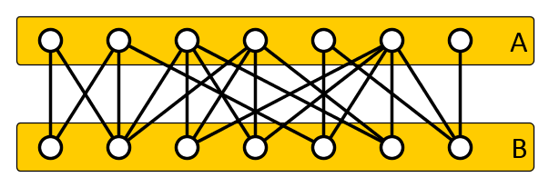
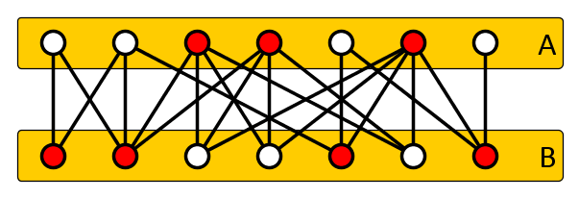
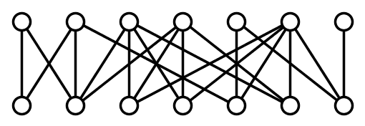
The Constrained Bipartite Vertex Cover problem
Input: Bipartite graph $G=(A∪B, E)$ and $k_{A}, k_{B}∈ℕ$ Question: Does $G$ have a vertex cover $S$ such that
$$\left|S∩A\right|≤k_{A}, \left|S∩B\right|≤k_{B}?$$
NP-complete, applications in reconfigurable VLSI
Differs from Constrained Minimum Bipartite Vertex Cover:
Is there a minimum vertex cover $S$ in $G$ for which $\left|S∩A\right|≤k_{A}$ and $\left|S∩B\right|≤k_{B}$?
$$k_{A}=3$$
$$k_{B}^{}=4$$

Slide 3
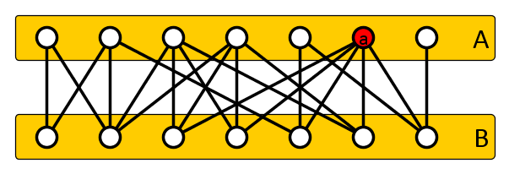
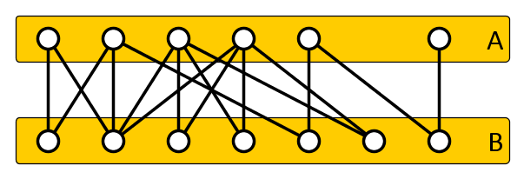
The easy kernel
If there is a vertex $a∈A$ with $\deg\left(a\right)>k_{B}$:
If $a$ is not in the cover, then all $a$’s neighbors must be
We cannot afford that, since there are more than $k_{B}$
Any solution contains $a$: delete $a$ and decrease $k_{A}$ by 1
Similarly, if there is a vertex $b∈B$ with $\deg\left(b\right)>k_{A}$:
Delete $b$, decrease $k_{B}$ by one
$$k_{A}=3$$
$$k_{B}^{}=4$$
$$k_{A}=2$$
$$k_{B}^{}=4$$

Slide 4
Analysis of the easy kernel
If $(G=\left(A,B,E\right), k_{A}, k_{B})$ is exhaustively reduced:
The $k_{A}$ vertices from $A$ cover at most $k_{B}$ edges each
The $k_{B}$ vertices from $B$ cover at most $k_{A}$ edges each
A yes-instance has at most $2\left(k_{A}⋅k_{B}\right)$ edges
Therefore at most $4(k_{A}⋅k_{B})$ vertices
This easy kernel was first given by Evans (1981)
Also helps to get fast FPT algorithms
$O({1.4}_{}^{k_{A}+k_{B}}+\left(k_{A}+k_{B}\right)⋅n))$ by Fernau and Niedermeier
Implemented and re-engineered by Bai and Fernau
Can the kernel size be improved?

Slide 5
Our results (I)
Both the number of vertices and edges of the easy kernel is essentially tight in terms of the product $k_{A}⋅k_{B}$
If $NP$ is not in $coNP/poly$, there is no polynomial-time algorithm that reduces
an instance $(G=\left(A,B,E\right), k_{A}, k_{B})$ of Con. Bip. VC to
an instance $(G^{′}=\left(A^{′},B^{′},E^{′}\right),k_{A}^{′},k_{B}^{′})$ such that
the instances are equivalent,
$k_{A}^{′}≤{\left(k_{A}\right)}^{O\left(1\right)}$,
$k_{B}^{′}≤{\left(k_{B}\right)}^{O\left(1\right)}$, and
$\left|V\left(G^{′}\right)\right|∈O({\left(k_{A}⋅k_{B}\right)}^{1−ε})$ for some $ε>0$

Slide 6
Our results (II)
Both the number of vertices and edges of the easy kernel is essentially tight in terms of the product $k_{A}⋅k_{B}$
If $NP$ is not in $coNP/poly$, there is no polynomial-time algorithm that reduces
an instance $(G=\left(A,B,E\right), k_{A}, k_{B})$ of Con. Bip. VC to
an instance $x$ of an arbitrary problem $L$ such that
the instances are equivalent,
$\left|x\right|∈O(n^{2−ε})$ for some $ε>0$, where $n≔|V\left(G\right)|$
Implies that the number of edges in an instance of Con. Bip. VC cannot be reduced to $O\left({\left(k_{A}⋅k_{B}\right)}^{1−ε}\right)$, unless $NP⊆coNP/poly$

Slide 7
Proof: Vertex lower bound

Slide 8
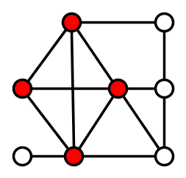
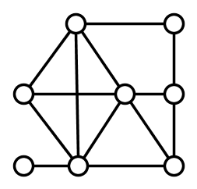
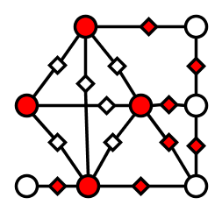
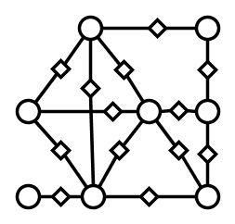
NP-Completeness proof
Reduction from a Clique instance $(G,k)$ [Kuo and Fuchs’87]
Build $G^{′}$ by subdividing each edge by a new vertex
Let $A′$ be the original vertices of $G$ and $B’$ the subdividers
Put ${k′}_{A}≔k$ and ${k′}_{B}≔\left|E\left(G\right)\right|−\left({k \atop 2}\right)$
$$k=4$$
$${k′}_{A}=4$$
$$k_{B}^{′}=7$$

Slide 9
Key construction
There is an algorithm with the following specifications
Input: A list of $t$ graphs $G_{1}, …, G_{t}$ with exactly $n$ vertices each, where $n$ is even and $t$ is a power of two
Output: A bipartite graph $G^{′}=\left(A^{′}∪B^{′}, E^{′}\right)$ along with integers $k_{A}^{′}, k_{B}^{′}$ such that:
$∃i∈\left[t\right]$ such that $G_{i}$ contains a clique of size $n/2$ $⇔$ $∃$vertex cover $S$ of $G’$ with $\left|S∩A^{′}\right|≤k_{A}^{′},\left|S∩B^{′}\right|≤k_{B}^{′}$
$k_{A}^{′}∈O(n^{2}\log{t)}$
$k_{B}^{′}∈O(n⋅t)$
The running time is polynomial in $t$ and $n$

Slide 10
Sketch of key construction
Input: A list of $t$ graphs $G_{1}, …, G_{t}$ with exactly $n$ vertices each, where $n$ is even and $t$ is a power of two.
Output:
Blocks in $A$ represent 0/1 bit values for $log⁡t$ bit positions
Blocks in $B$ represent input graphs
Connect $B_{i}$ to bit values based on binary expansion of $i$
Connect $B_{i}$ to subdividers for edges that do not exist in $G_{i}$
Weight $\left({n \atop 2}\right)$ per block, $2log{t}$ blocks
Weight $n$ per block, $t$ blocks

Slide 11
Sketch of key construction
Input: A list of $t$ graphs $G_{1}, …, G_{t}$ with exactly $n$ vertices each, where $n$ is even and $t$ is a power of two.
Output:
Bit selectors force one block $B_{i}$ to be chosen
In the canonical part, this disables the subdividers for non-existing edges in $G_{i}$
This makes the left part act as the result of the NP-completeness reduction for Clique-instance $G_{i}$
Weight $\left({n \atop 2}\right)$ per block, $2log{t}$ blocks
Weight $n$ per block, $t$ blocks
Summary. We embed $t$ instances of Clique into one instance of Constrained Bipartite Vertex Cover with $k_{A}∈O(n^{2}\log{t)}$ and $k_{B}∈O(t⋅n)$ that is yes if and only if a Clique-input is yes

Slide 12
Complementary witness lemma
Lemma saying: [Dell & van Melkebeek, 2010]
Sufficiently good compression for hard problems implies an unlikely complexity-theoretic collapse
Lemma (simplified version). Let $L’⊆Σ^{∗}$ be a language.
If there is a polynomial-time algorithm as follows:
Input: list of $t=n^{100}$ graphs $G_{1},…, G_{t}$ with $n$ vertices each,
Output: string $x^{∗}$ such that
$x^{∗}∈L^{′}$ if and only if some $G_{i}$ has a clique of size $n/2$, and
$\left|x^{∗}\right|∈O\left(n^{100}\right)$,
then $NP⊆coNP/poly$.
By the pigeon-hole principle, there is an input from which only $O(1)$ bits remain

Slide 13
Simplified vertex lower bound
If $NP$ is not in $coNP/poly$, there is no polynomial-time algorithm that reduces
an instance $(G=\left(A,B,E\right), k_{A}, k_{B})$ of Con. Bip. VC to
an instance $(G^{′}=\left(A^{′},B^{′},E^{′}\right),k_{A}^{′},k_{B}^{′})$ such that
the instances are equivalent,
$k_{A}^{′}≤k_{A}$,
$k_{B}^{′}≤k_{B}$, and
$\left|V\left(G^{′}\right)\right|∈O({\left(k_{A}⋅k_{B}\right)}^{0.9})$
Proof. Assume such a kernelization algorithm $𝒦$ exists
Using $𝒦$, the key construction, and the easy kernel, we build a compression algorithm for Clique instances
$NP∈coNP/poly$ by complementary witness lemma

Slide 14
Compression algorithm for Clique instances
$$G_{1}$$
$$G_{2}$$
$$G_{t=n^{100}}$$
$$k_{A}^{}∈O(n^{2}\log{t)}$$
In:
$$…$$
OR
$$k_{B}^{}∈O\left(n⋅t\right)=O(n^{100+1})$$
Reduce |V| to $O\left({\left(k_{A}⋅k_{B}\right)}^{0.9}\right)≤$
$$O{\left({(n}^{103}\log{n^{100}}\right)}^{0.9})$$
$$𝒦$$
$$A’$$
Out:
$$\deg\left(b∈B^{∗}\right)≤k_{A}^{′}∈O(n^{2}\log{n)}$$
Evans
$$\left|B′\right|≤|V′|∈O(n^{93})$$
$$\left|E^{∗}\right|≤\left|B^{∗}\right|⋅\deg\left(b∈B^{∗}\right) \\ \left|E^{∗}\right|≤\left|B^{′}\right|⋅k_{A} \\ \left|E^{∗}\right|∈O(n^{93}⋅n^{2}\log{n)}∈O\left(n^{96}\right)$$
$$k_{A}^{′}≤k_{A}∈O(n^{2}\log{n) }$$

Slide 15
Discussion
The given proof contains all the ideas of the general proof
More careful math makes it work for all $ε>0$
We rely crucially on the fact that the budgets do not increase
The lower bound construction produces a lopsided graph
One side is much larger than the other
Result II (sparsification bound) uses a balanced construction
Both sides of the bipartite graph have the same size

Slide 16
Conclusion
The easy kernel for Con. Bip. VC is essentially tight in terms of $k_{A}⋅k_{B}$
Both the number of vertices and edges
Compare to the classic Vertex Cover case:
The easy kernel (Buss’ rule) gives tight bounds on the number of edges
The number of vertices in the easy kernel can be improved to $2k$
Open problems:
Does Constrained Bipartite Vertex Cover have a kernel with $O(k_{A}+k_{B})$ vertices?
Does Constrained Bipartite Vertex Cover have a kernel with 𝑂(𝑘_𝐴+𝑘_𝐵) vertices?
Does Feedback Vertex Set admit a kernel with $O(k^{2−ε})$ vertices?
Does Feedback Vertex Set admit a kernel with 𝑂(𝑘^(2−𝜖)) vertices?
THANK YOU!

