Slide 1
Turing Kernelization for Finding Long Paths and Cycles in Restricted Graph Classes
Bart M. P. Jansen
September 8th, ESA 2014, Wrocław

Slide 2
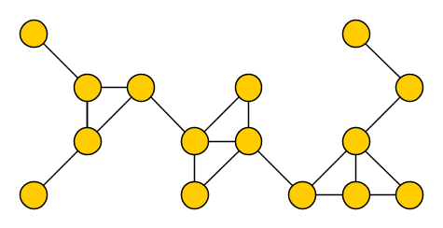
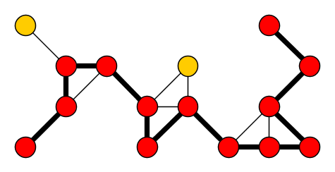
Finding long paths and cycles
$k$-Path ($k$-Cycle) Input: An undirected graph $G$ and an integer $k$ Parameter: $k$ Question: Is there a simple path (cycle) of length at least $k$?
Such a path (cycle) is called a $k$-path ($k$-cycle)
Generalizes Hamiltonian Path (Cycle), so NP-complete
Even on planar graphs of degree at most three
$k$-Path and $k$-Cycle are fixed-parameter tractable
Solvable in $f\left(k\right)⋅n^{O(1)}$ time

Slide 3
Running times for $k$-Path
Year | Authors | Deterministic $f(k)$ | Randomized $f(k)$
1985 | Monien | $k!$
1993 | Bodlaender | $k!{⋅2}^{k}$
1995 | Alon et al. |  | ${5.44}^{k}$
1995 | Alon et al. | $c^{k}$ ($c>8000)$
2006 | Kneis et al. | ${16}^{k}$
2007 | Chen et al. | ${12.6}^{k}$
2007 | Chen et al. |  | $4^{k}$
2008 | Koutis |  | ${2.83}^{k}$
2009 | Williams |  | $2^{k}$
2010 | Björklund et al. |  | ${1.66}^{k}$
2013 | Fomin et et al. | ${2.851}^{k}$

Slide 4
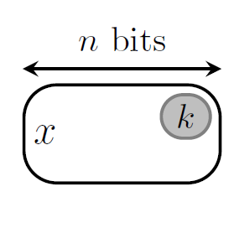
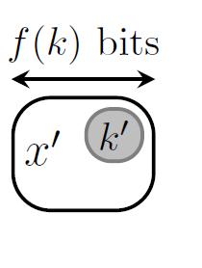
Preprocessing for path and cycle problems
Kernelization models provably effective preprocessing
It is a technique to obtain FPT algorithms
While $k$-Path was known to be FPT since 1985, for a long time we did not know whether it has a polynomial kernel
In 2008, Bodlaender et al. proved that $k$-Path and $k$-Cycle do not admit polynomial kernels unless $NP⊆coNP/poly$
Not even on planar graphs of degree at most three

Slide 5
Relaxed notions of preprocessing
For other parameterized problems that do not admit polynomial kernels, researchers found provably effective preprocessing schemes in a slightly different model
A reduction to a list of $poly(k)$-size instances
Are there provably effective preprocessing schemes for $k$-Path and $k$-Cycle in such relaxed models?
?

Slide 6
Turing kernelization
Let $Q⊆Σ^{∗}×ℕ$ be a parameterized problem and let $f:ℕ→ℕ$
A Turing kernelization for $Q$ of size $f$ is an algorithm that
decides whether a given instance $\left(x,k\right)∈Σ^{∗}×ℕ$ is in $Q$
in time polynomial in $\left|x\right|+k$
when given access to an oracle that
for any instance $\left(x^{′},k^{′}\right)$ with $\left|x^{′}\right|,k^{′}≤f\left(k\right)$,
decides whether $\left(x^{′},k^{′}\right)∈Q$ in a single step

Slide 7
Our results
Theorem. The $k$-Path and $k$-Cycle problems admit polynomial-size Turing kernels when the input graph is
planar, or
claw-free, or
$K_{3,t}$-minor-free for some constant $t$, or
of constant degree
The degree of the polynomial depends on the graph class
For planar $k$-cycle, kernel of $4k^{2.59}$ vertices
The difficult part of finding long paths and cycles in these graph classes can be confined to small subtasks

Slide 8
Adaptivity
The kernel crucially exploits the possibility of an adaptive interaction with the oracle
The next queries depend on previous answers
Compare to the non-adaptive list of small output instances
Rare phenomenon; only other adaptive Turing kernelization is due to Thomassé et al. [WG 2014]

Slide 9
Turing kernel for planar $k$-Cycle

Slide 10
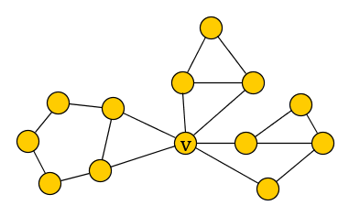
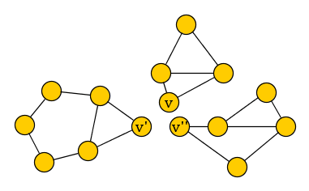
Splitting rule for $k$-Cycle
If there is a connected component of $G$ that is not biconnected, then split it into its biconnected components

Slide 11
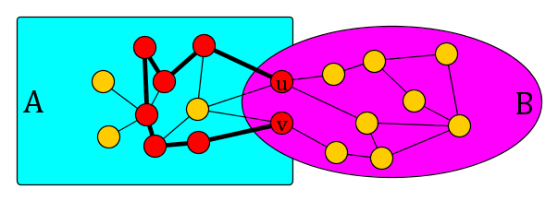
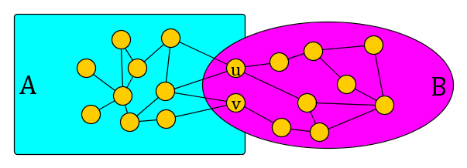
Long cycles through $2$-separators
Claim.
Let $A,B⊆V(G)$ such that $A∪B=V(G)$, $A∩B=\{u,v\}$, and there are no edges between $A∖B$ and $B∖A$
Let $S⊆V(G)$ be the vertices on a longest $uv$ path in $G[A]$
If $G$ has a cycle of length $≥k$, then:
The graph $G[A]$ has a cycle of length $≥k$, or
The graph $G[S∪B]$ has a cycle of length $≥k$

Slide 12
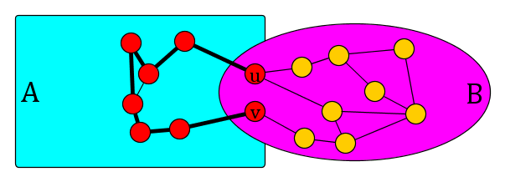
Turing reduction rule for $k$-Longest Cycle
This info can be obtained from the decision oracle for $k$-Cycle by self-reduction on the $poly(k)$-size subgraph $G[A]$
If there is a 2-separation $A,B⊆V(G)$ such that $A∩B=\left\{u,v\right\}$ is a minimal separator, and $\left|A\right|≤poly(k)$:
If $G[A]$ has a cycle of length at least $k$, output yes
If $G[A]$ does not have a cycle of length at least $k$:
Query oracle for the vertices $S$ of a longest $uv$ path in $G\left[A\right]$
If $\left|S\right|≥k$, then conclude that the answer is yes
Else, remove the vertices of $A∖S$ from the graph
Query the oracle for the instance $(G\left[A\right],k)$ with $poly\left(k\right)$ vertices

Slide 13
Decompose-Query-Reduce
Rule reduces the graph after querying the oracle
If every connected component has size $poly(k)$, we are done
Query the oracle for each component, terminate
Otherwise, we decompose the input graph into small pieces that interact through vertex sets of size at most two
Use the decomposition to find a 2-separation on which we can apply the reduction rule
Decomposition step relies on lower bounds on circumference

Slide 14
Circumference of triconnected graphs
Let $G$ be a triconnected graph on $n$ vertices and let $ℓ$ be its circumference
If $G$ is planar, then: [Chen & Yu 2002]
$$ℓ≥n^{\log_{3}{2}}≈n^{0.63}$$
If $G$ is $K_{3,t}$-minor-free, then: [Chen et al. 2012]
$$ℓ≥{\left(\frac{1}{2}\right)}^{t\left(t−1\right)}⋅n^{\log_{1729} 2}$$
If $G$ is claw-free, then: [Bilinski et al. 2011]
$$ℓ≥{\left(\frac{n}{12}\right)}^{0.753}+2$$
If $G$ has maximum degree at most $Δ≥4$, then: [Chen et al. 2006]
$$ℓ≥\frac{n^{\log_{r}2}}{2}+3$$
$$r≔max⁡(64, 4Δ+1)$$
Triconnected graphs from the considered classes have a cycle (and therefore path) of length $n^{ε}$ for some $ε>0$

Slide 15
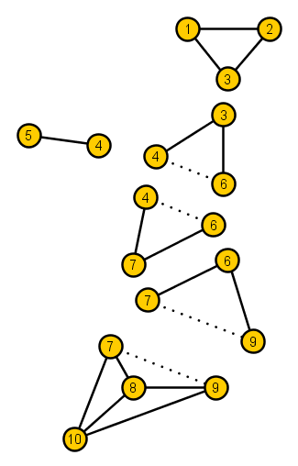
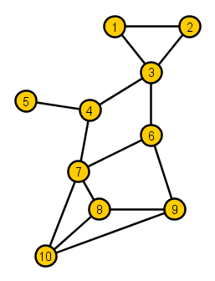
Decomposition into triconnected components
Every graph can be decomposed into triconnected components [Tutte 1966]

Slide 16
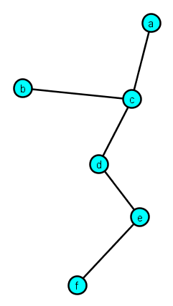
Decomposition into triconnected components
Every triconnected component is a triconnected topological minor of $G$
Arranged in a tree structure
Intersections of adjacent components are minimal separators of $G$
Observation. If a planar graph $G$ has a triconnected component with $≥k^{\frac{1}{0.63}}$ vertices, then $G$ has a cycle of length at least $k$

Slide 17
Reducing using the decomposition
If there is a connected component that is not biconnected:
Split it into biconnected components, restart
If there is a connected component $G’$ with $>k^{α}$ vertices:
Decompose $G′$ into triconnected components
If some triconnected component $G’’$ has $≥k^{\frac{1}{ε}}$ vertices:
$G$ has a cycle of length $≥k$: output yes
If all triconnected components have $≤k^{\frac{1}{ε}}$ vertices:
We find a 2-separation to apply the reduction rule on
Start by rooting the decomposition tree

Slide 18
Finding a 2-separation to reduce (I)
Select a lowest node $x$ whose subtree represents $>k^{α}$ vertices of $G$
If $deg\left(v\right)≤k^{\frac{2}{ε}}$:
Some child subtree represents has more than $k$ and less than $k^{α}$ vertices of $G$
Apply the reduction rule to the corresponding 2-separation

Slide 19
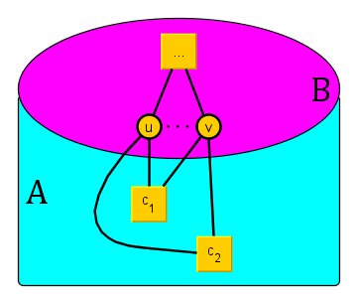
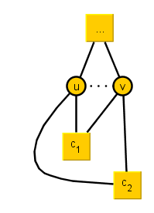
Finding a 2-separation to reduce (II)
If $deg\left(v\right)>k^{\frac{2}{ε}}$:
Two children $c_{1},c_{2}$ of $v$ attach to the same minimal separator $\{u,v\}$
Let $A$ be the vertices represented in $T_{c_{1}}∪T_{c_{2}}$
Let $B$ contain the remaining vertices (and $\{u,v\}$)
Apply the reduction rule to $(A,B)$

Slide 20
Summary of the kernelization
After decomposing the input graph, if there is a connected component with more than $k^{α}$ vertices we either find a $k$-cycle or reduce to a smaller graph
Each step decreases the number of vertices or increases the number of biconnected components
After a polynomial number of rounds, all connected components have $poly(k)$ vertices
We query the oracle for each of them and decide
$k$-Cycle has a polynomial Turing kernel on planar graphs

Slide 21
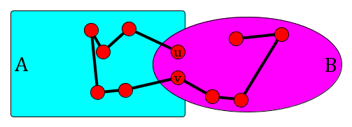
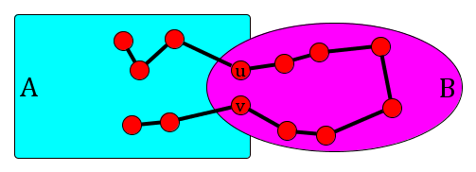
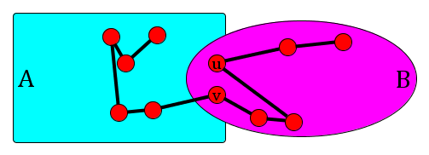
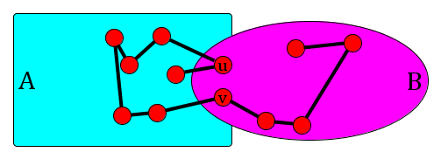
Extensions
By using lower bounds on the circumference of other graph classes, same reduction rules work for Claw-free $k$-Cycle etc.
Crucial part is that triconnected components of claw-free graphs are claw-free, etc.
For $k$-Path, the reduction rule needs to be updated
There are 6 structurally different ways in which a longest path can cross a 2-separation
Reduction rule preserves a maximum-length copy of each

Slide 22
Lower bounds for Turing kernels

Slide 23
Colored $k$-path
Input: An integer $k$ and a graph G where each vertex is assigned a color $c\left(v\right)∈[k]$ Parameter: $k$ Question: Is there a simple path containing exactly one vertex of each color?
Hermelin et al. [IPEC 2014] introduced a complexity class $WK[1]$ and conjectured that no $WK[1]$-hard problem has a polynomial Turing kernel
$FPT⊆WK\left[1\right]⊆W\left[1\right]⊆…⊆XP$
They proved that Colored $k$-Path is $WK[1]$ hard

Slide 24
Colored paths are harder to find
We prove that the $WK[1]$-hardness of the colored version is unrelated to the uncolored version
Colored $k$-Path on subcubic graphs is WK[1]-hard
$k$-Path on subcubic graphs has a polynomial Turing kernel
Open problem. Does $k$-Path have a polynomial Turing kernel in general graphs?

Slide 25
Conclusion
The $k$-Path and $k$-Cycle problems have polynomial Turing kernels in several restricted graph families
In Turing kernelization, reduce using the solutions to small instances of NP-hard subproblems, supplied by the oracle
Open problems:
What about $k$-Path in general graphs? Or even chordal graphs?
What about 𝑘-Path in general graphs? Or even chordal graphs?
Is there a non-adaptive Turing kernel?
Does Exact $k$-Cycle in planar graphs have a polynomial Turing kernel?
Does Exact 𝑘-Cycle in planar graphs have a polynomial Turing kernel?
THANK YOU!

