Slide 1

A treasure from the lost continent of polynomial time
Kernelization for Feedback Vertex Set
Bart M. P. Jansen
December 6th 2016, TU/e Algorithms Seminar, Netherlands

Slide 2

The lost continent of polynomial time

Slide 3
The lost continent of polynomial time
1970’s: Discovery of NP-completeness
  Many problems (probably) cannot be solved in poly-time
1980’s: Work on theory of approximation algorithms
  Output a solution that is provably not very bad
1990’s: Early results on parameterized complexity
2000’s: Discovery of the lost continent of polynomial time [Fellows‘06]
  Polynomial-time algorithms that attack NP-hard problems
  Work to optimal solutions, but fall short of finding them
  The lost continent of polynomial time contains:
  provably effective and efficient preprocessing algorithms
  that reduce the sizes of NP-hard inputs
  (without changing the answer)

Slide 4

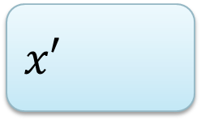
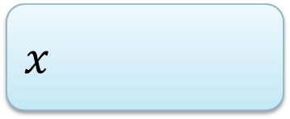
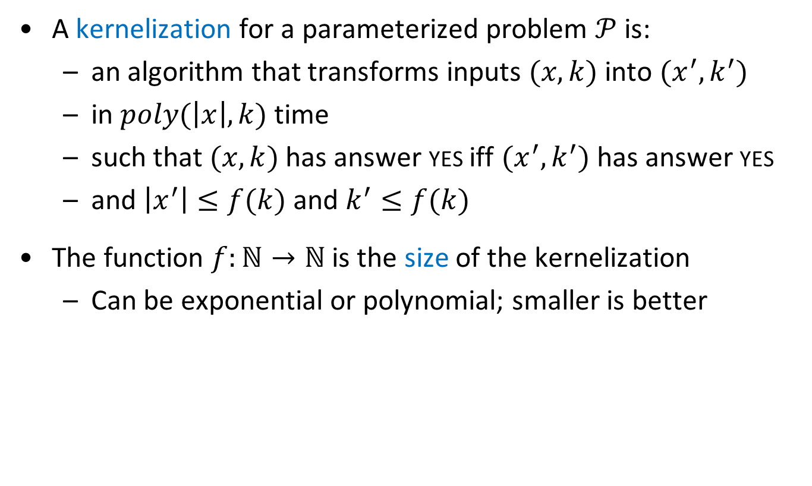
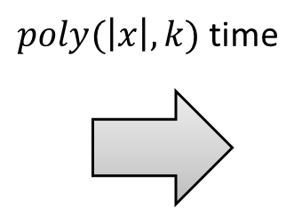




Kernelization: data reduction with a guarantee
A kernelization for a parameterized problem $𝒫$ is:
  an algorithm that transforms inputs $(x,k)$ into $(x^{′},k^{′})$
  in $poly(\left|x\right|,k)$ time
  such that $(x,k)$ has answer yes iff $(x^{′},k^{′})$ has answer yes
  and $\left|x^{′}\right|≤f(k)$ and $k^{′}≤f(k)$
The function $f:ℕ→ℕ$ is the size of the kernelization
  Can be exponential or polynomial; smaller is better
  A kernelization guarantees that instances that are large with respect to their complexity parameter can be shrunk
$n$ bits
$f(k)$ bits
$$x$$
$poly(\left|x\right|,k)$ time
$$x′$$
$$k$$
$$k′$$

Slide 5

Gems in kernelization
Graph Coloring
Edge Clique Cover
Feedback Vertex Set

Slide 6
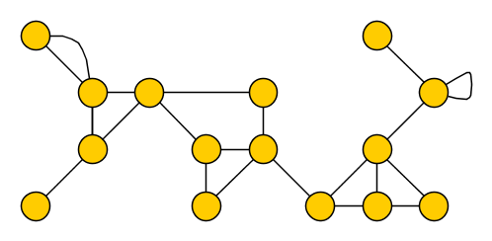
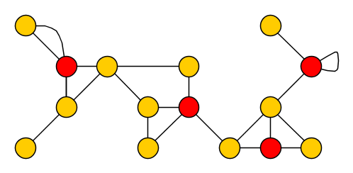
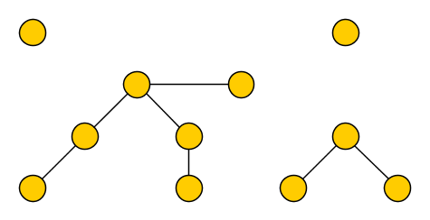

Feedback Vertex Set
Input: An undirected (multi)graph $G$ and an integer $k$
Parameter: $k$
Question: Is there a set $S$ of at most $k$ vertices in $G$, such that each cycle contains a vertex of $S$?
We allow multiple edges and self-loops
Such a set $S$ is a feedback vertex set of $G$
  Removing $S$ from $G$ results in an acyclic graph, a forest

Slide 7
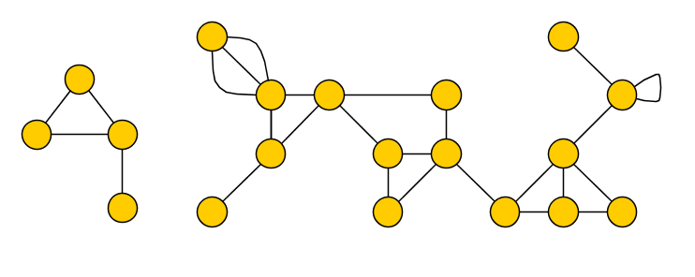
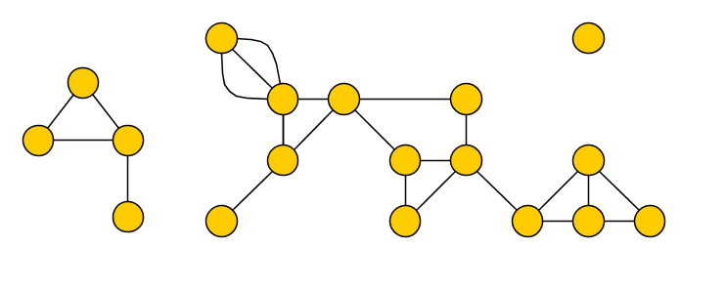
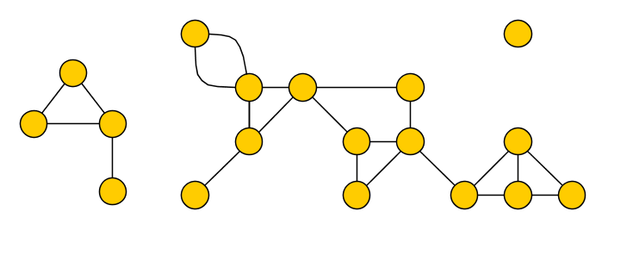
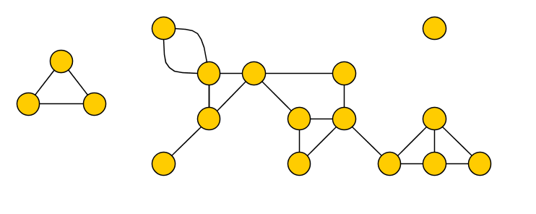
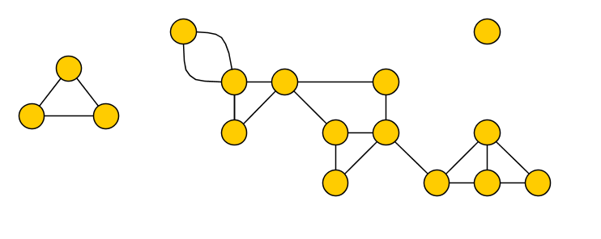
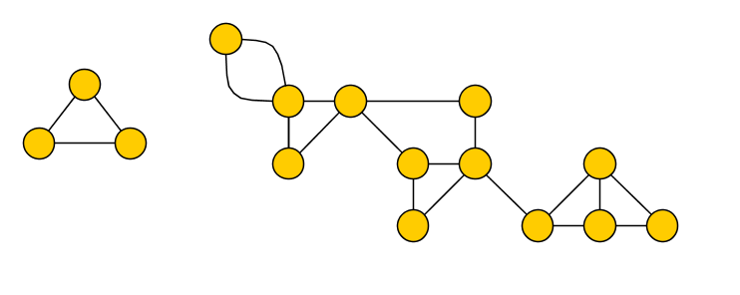
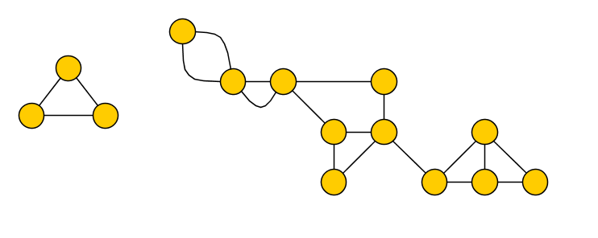
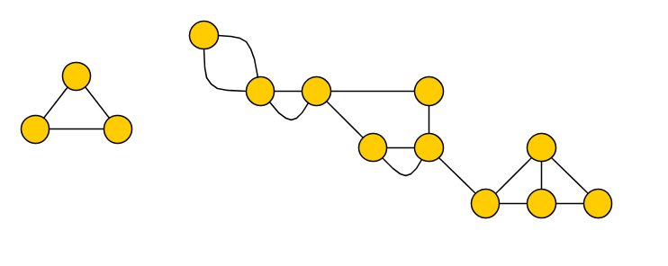
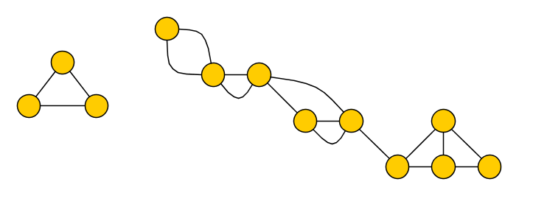
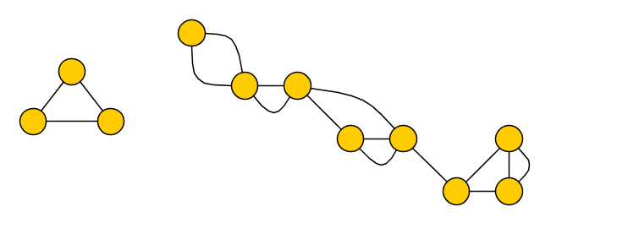
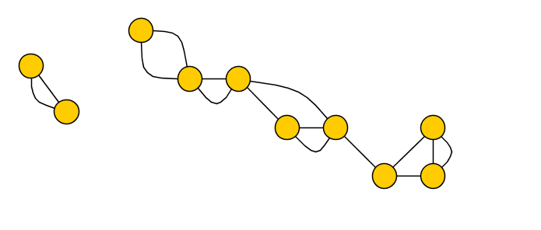
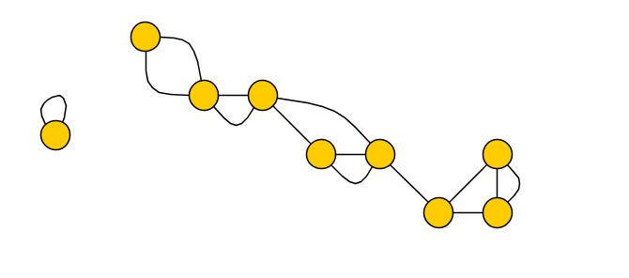
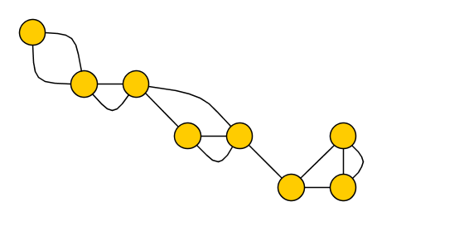
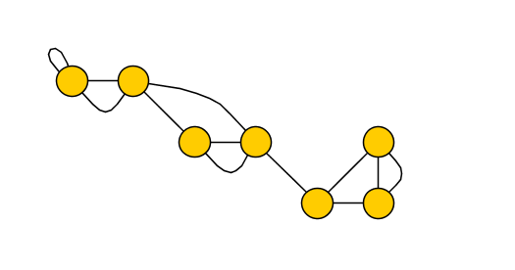
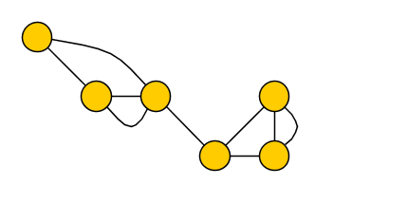
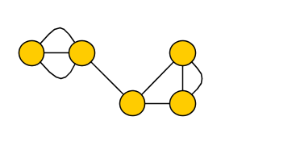
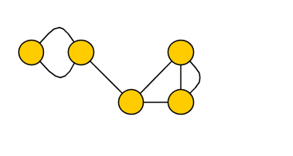
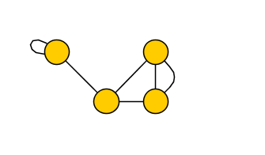
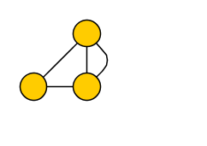
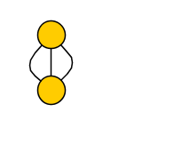
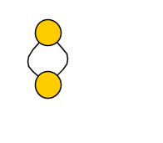
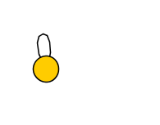
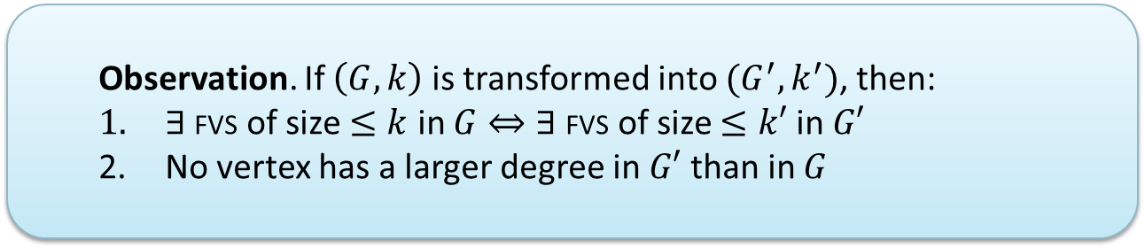
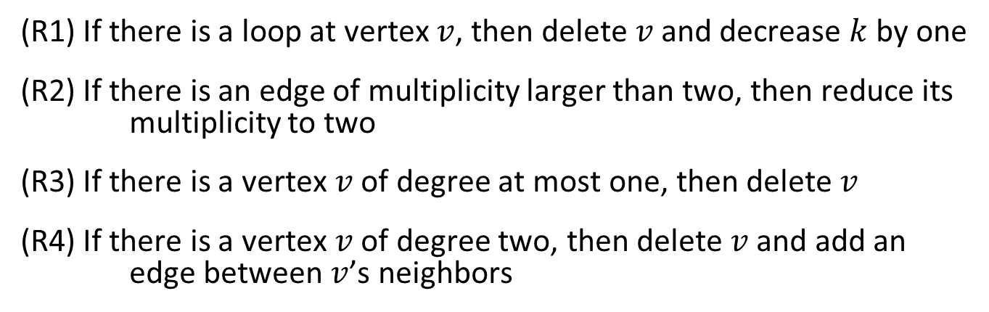
Simple reduction rules
(R1) If there is a loop at vertex $v$, then delete $v$ and decrease $k$ by one
(R2) If there is an edge of multiplicity larger than two, then reduce its multiplicity to two
(R3) If there is a vertex $v$ of degree at most one, then delete $v$
(R4) If there is a vertex $v$ of degree two, then delete $v$ and add an edge between $v$’s neighbors
  If (R1-R4) cannot be applied anymore, then there are no loops and each vertex has degree at least three
  Observation. If $\left(G,k\right)$ is transformed into $(G^{′},k^{′})$, then:
  $∃$ fvs of size $≤k$ in $G⇔$ $∃$fvs of size $≤k′$ in $G′$
  No vertex has a larger degree in $G′$ than in $G$

Slide 8
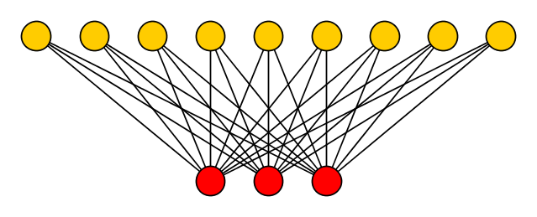



Are we done already?
Given rules are not enough to reduce input to size $poly(k)$
Template for large irreducible instances:
$$⋯$$
$$⋯$$
Graph is large but feedback vertex set is small
High-degree vertices in FVS are the (only) problem

Slide 9
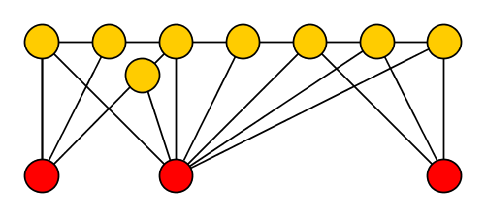
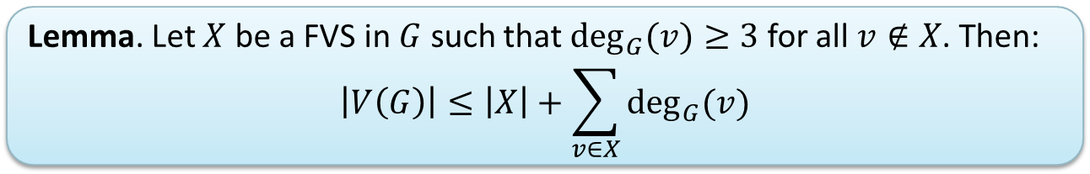
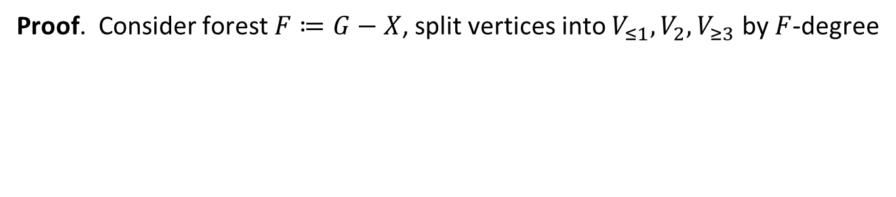
The degree-sum of feedback vertex sets
Lemma. Let $X$ be a FVS in $G$ such that $\deg_{G}{(v)}≥3$ for all $v∉X$. Then:
$$\left|V\left(G\right)\right|≤\left|X\right|+\sum_{v∈X}{\deg_{G}⁡(v)}$$
Proof. Consider forest $F≔G−X$, split vertices into $V_{≤1}, V_{2},V_{≥3}$ by $F$-degree
Notes:
Q: State the lemma when G – X has degree >= 3?

Slide 10
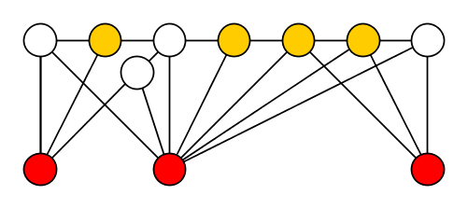

The degree-sum of feedback vertex sets
Lemma. Let $X$ be a FVS in $G$ such that $\deg_{G}{(v)}≥3$ for all $v∉X$. Then:
$$\left|V\left(G\right)\right|≤\left|X\right|+\sum_{v∈X}{\deg_{G}⁡⁡(v)}$$
Proof. Consider forest $F≔G−X$, split vertices into $V_{≤1}, V_{2},V_{≥3}$ by $F$-degree
Each ${v∈V}_{2}$ has at least one edge to $X$, since $\deg_{G}\left(v\right)≥3$
$$\sum_{v∈X}{\deg\left(v\right)≥\left|V_{2}\right|+2\left|V_{≥1}\right|≥\left|V_{2}\right|+\left|V_{≥1}\right|+\left|V_{≥3}\right|=|V\left(F\right)|}$$

Slide 11
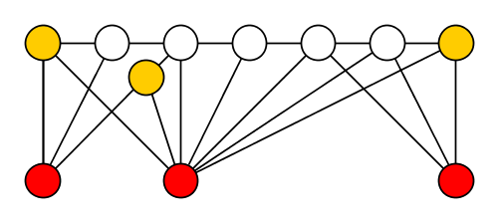


The degree-sum of feedback vertex sets
Lemma. Let $X$ be a FVS in $G$ such that $\deg_{G}{(v)}≥3$ for all $v∉X$. Then:
$$\left|V\left(G\right)\right|≤\left|X\right|+\sum_{v∈X}{\deg_{G}⁡⁡(v)}$$
Proof. Consider forest $F≔G−X$, split vertices into $V_{≤1}, V_{2},V_{≥3}$ by $F$-degree
Each ${v∈V}_{≤1}$ has at least two edges to $X$, since $\deg_{G}\left(v\right)≥3$
$$\sum_{v∈X}{\deg\left(v\right)≥\left|V_{2}\right|+2\left|V_{≥1}\right|≥\left|V_{2}\right|+\left|V_{≥1}\right|+\left|V_{≥3}\right|=|V\left(F\right)|}$$
$$\sum_{v∈X}{\deg\left(v\right)≥\left|V_{2}\right|+2\left|V_{≥1}\right|≥\left|V_{2}\right|+\left|V_{≥1}\right|+\left|V_{≥3}\right|=|V\left(F\right)|}$$

Slide 12
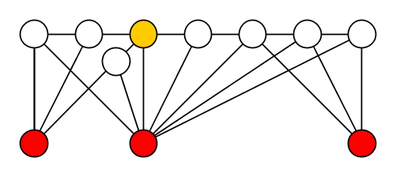


The degree-sum of feedback vertex sets
Lemma. Let $X$ be a FVS in $G$ such that $\deg_{G}{(v)}≥3$ for all $v∉X$. Then:
$$\left|V\left(G\right)\right|≤\left|X\right|+\sum_{v∈X}{\deg_{G}⁡⁡(v)}$$
Proof. Consider forest $F≔G−X$, split vertices into $V_{≤1}, V_{2},V_{≥3}$ by $F$-degree
Each ${v∈V}_{≥3}$ forces another leaf in the forest, so $\left|V_{≥1}\right|≥|V_{≥3}|$
$$\sum_{v∈X}{\deg\left(v\right)≥\left|V_{2}\right|+2\left|V_{≥1}\right|≥\left|V_{2}\right|+\left|V_{≥1}\right|+\left|V_{≥3}\right|=|V\left(F\right)|}$$
$$\sum_{v∈X}{\deg\left(v\right)≥\left|V_{2}\right|+2\left|V_{≥1}\right|≥\left|V_{2}\right|+\left|V_{≥1}\right|+\left|V_{≥3}\right|=|V\left(F\right)|}$$

Slide 13

The degree-sum of feedback vertex sets
Lemma. Let $X$ be a FVS in $G$ such that $\deg_{G}{(v)}≥3$ for all $v∉X$. Then:
$$\left|V\left(G\right)\right|≤\left|X\right|+\sum_{v∈X}{\deg_{G}⁡⁡(v)}$$
Proof. Consider forest $F≔G−X$, split vertices into $V_{≤1}, V_{2},V_{≥3}$ by $F$-degree
Since $\left|V\left(G\right)\right|=\left|X\right|+\left|V\left(F\right)\right|$, this completes the proof
$$\sum_{v∈X}{\deg\left(v\right)≥\left|V_{2}\right|+2\left|V_{≥1}\right|≥\left|V_{2}\right|+\left|V_{≥1}\right|+\left|V_{≥3}\right|=|V\left(F\right)|}$$

Slide 14
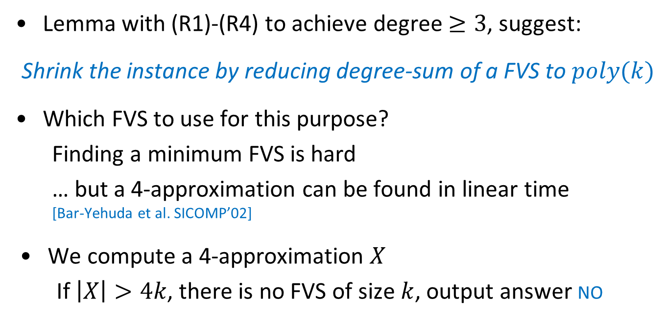
The degree-sum of feedback vertex sets
Lemma. Let $X$ be a FVS in $G$ such that $\deg_{G}{(v)}≥3$ for all $v∉X$. Then:
$$\left|V\left(G\right)\right|≤\left|X\right|+\sum_{v∈X}{\deg_{G}⁡⁡(v)}$$
Lemma with (R1)-(R4) to achieve degree $≥3$, suggest:
Shrink the instance by reducing degree-sum of a FVS to $poly(k)$
Which FVS to use for this purpose?
  Finding a minimum FVS is hard
  … but a 4-approximation can be found in linear time
  [Bar-Yehuda et al. SICOMP’02]
We compute a 4-approximation $X$
  If $\left|X\right|>4k$, there is no FVS of size $k$, output answer no

Slide 15
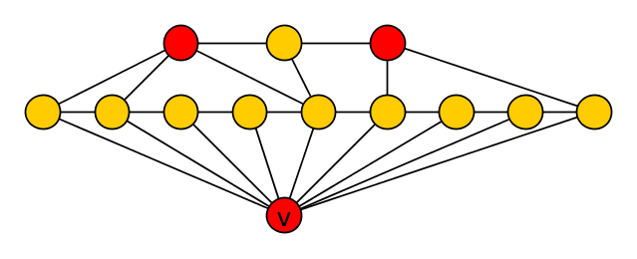
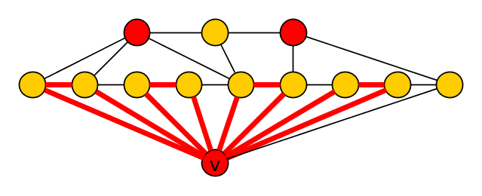



Reducing the degree-sum of $X$
We work with an approximate solution $X$ of size $≤4k$
  Reduce degree-sum to $f(k)$ by reducing $\deg\left(v\right)∀v∈X$
Inspiration of how to reduce degree comes from an example:
Each FVS of size $≤3$ contains vertex $v$,
since $4$ vertex-disjoint cycles pass through $v$

Slide 16

Reducing the degree-sum of $X$
We work with an approximate solution $X$ of size $≤4k$
  Reduce degree-sum to $f(k)$ by reducing $\deg\left(v\right)∀v∈X$
Inspiration of how to reduce degree comes from an example:
Every minimum FVS contains vertex $v$
Answer is preserved when removing $v$ and decreasing $k$ by one

Slide 17
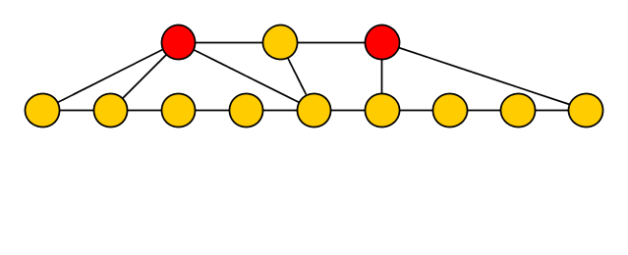
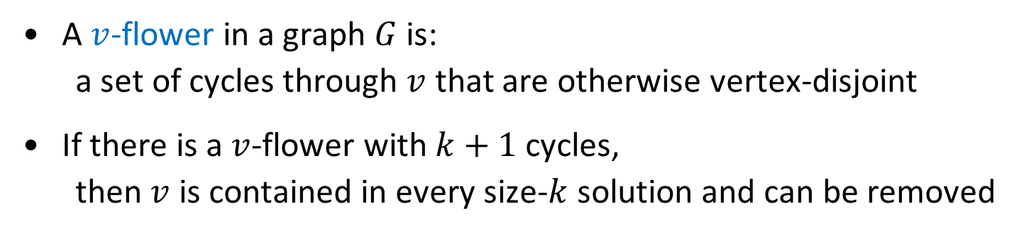

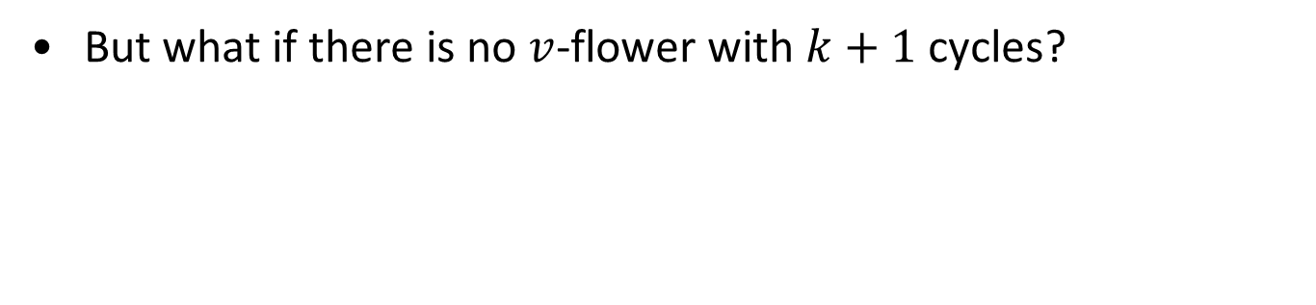
Flowers
A $v$-flower in a graph $G$ is:
  a set of cycles through $v$ that are otherwise vertex-disjoint
If there is a $v$-flower with $k+1$ cycles,
  then $v$ is contained in every size-$k$ solution and can be removed
But what if there is no $v$-flower with $k+1$ cycles?
  Win/win: there is a $v$-flower with $k+1$ cycles,
  or a FVS without $v$ of size $O(k)$
  (and both can be found efficiently)
Every minimum FVS contains vertex $v$
Answer is preserved when removing $v$ and decreasing $k$ by one

Slide 18
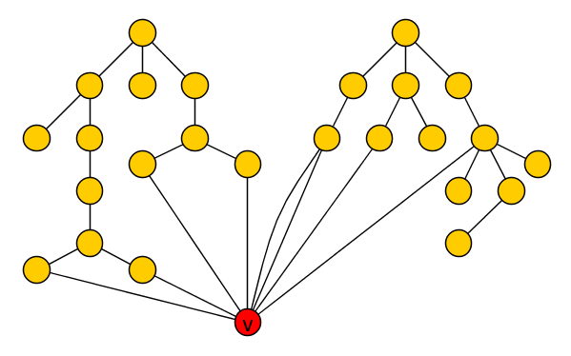
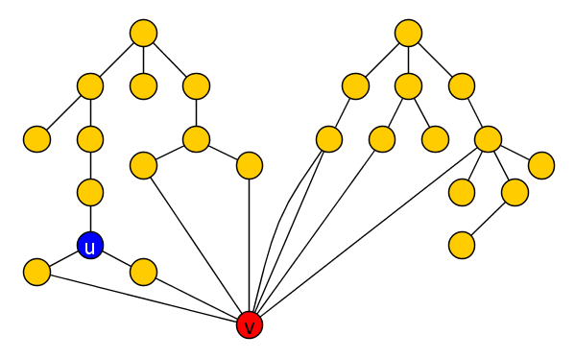
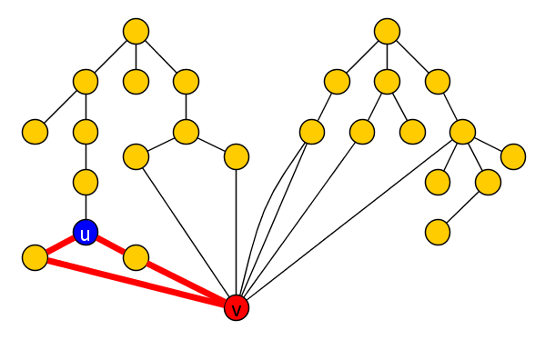










$v$-flowers and solutions without $v$
Lemma. If $H$ is a graph without loops such that $H−\{v\}$ is acyclic, then the size of a smallest FVS $Y$ without $v$ equals the size of the largest $v$-flower.
Both structures can be found in linear time.
Constructive proof:
Pick a root for each tree in the forest $F≔H−\{v\}$
Initialize $Y≔∅$
While $H−Y$ has a cycle:
Pick lowest $u$ whose subtree $T_{u}−Y$ has $≥2$ edges to $v$
Add $u$ to $Y$
Add cycle through $T_{u}$ to flower
$$T_{u}$$
All cycles visiting $T_{u}$ contain vertex $u$
All cycles visiting $T_{u}$ are broken due to $u∈Y$
Notes:
We first do v-flowers vs solutions without v in a graph such that G-v is acyclic, and then lift it to work in general.

Slide 19









Exploiting $v$-flowers and solutions without $v$
Lemma. If $H$ is a graph without loops such that $H−\{v\}$ is acyclic, then the size of a smallest FVS $Y$without $v$ equals the size of the largest $v$-flower.
Both structures can be found in linear time.
Given FVS $X$ of size $≤4k$ in original input $G$ and $v∈X$: reduce $deg⁡(v)$
  Apply Lemma to $H≔G −(X∖\{v\})$, since $H−\left\{v\right\}=G−X=$ acyclic
If $v$-flower in $H$ has $>k$ cycles: delete $v$, decrease $k$ by 1
If $v$-flower in $H$has $≤k$ cycles: then $\left|Y\right|≤k$
  $Y_{v}≔Y∪(X∖\{v\})$ is a FVS without 𝑣 of size at most 5𝑘
$$X$$

Slide 20






Reducing degree using a solution without $v$
Lemma. Given a feedback vertex set $Y_{v}⊆V\left(G\right)∖\{v\}$, the degree of $v$ can be reduced to $\left|Y_{v}\right|⋅(k+4)$ efficiently, without changing the answer.
Consider forest
$$F≔G−(Y_{v}∪\{v\})$$
  Using (R2), each vertex of $Y_{v}$ has at most two edges to $v$
  Each tree of $F$ has at most one edge to $v$
Reduce $deg⁡(v)$ by reducing connections to trees

Slide 21







Reducing degree using a solution without $v$
Lemma. Given a feedback vertex set $Y_{v}⊆V\left(G\right)∖\{v\}$, the degree of $v$ can be reduced to $\left|Y_{v}\right|⋅(k+4)$ efficiently, without changing the answer.
Consider forest
$$F≔G−(Y_{v}∪\{v\})$$
  Using (R2), each vertex of $Y_{v}$ has at most two edges to $v$
  Each tree of $F$ has at most one edge to $v$
  After reduction:
$$\deg\left(v\right)≤2\left|Y_{v}\right|+|Y_{v}|(k+2)$$
$$Y_{v}$$
  For each $u∈Y_{v}$, mark up to $k+2$ trees of $F$ that contain both a neighbor of $v$ and a neighbor of $u$
  Remove edges from $v$ to all unmarked trees

Slide 22





Reducing degree using a solution without $v$
Claim. If graph $G’$ is obtained from $G$ by removing an edge
from $v$ to an unmarked tree $T$, then any FVS $X′$ for $G’$ of size $≤k$ is a FVS for $G$.
Lemma. Given a feedback vertex set $Y_{v}⊆V\left(G\right)∖\{v\}$, the degree of $v$ can be reduced to $\left|Y_{v}\right|⋅(k+4)$ efficiently, without changing the answer.
If $v∈X$, then $G^{′}−X=G−X$
If $v∉X′$, then $X′$ contains all of $T$’s neighbors except $v$
So $T$ is a tree in $G−X′$ connecting to the remainder using $1$ edge
$$T$$
For all $u∈N_{G}\left(T\right)∖\{v\}$, there are $k+2$ marked trees adjacent to $u$ and $v$
  At least two such trees $T_{1},T_{2}$ are disjoint from $X′$
  If $\left\{u,v\right\}∩X^{′}=∅$, then $T_{1}∪T_{2}∪\{u,v\}$ has a cycle in $G^{′}−X$
So $X′$ contains $v$, or $X′$ contains all of $N_{G}\left(T\right)∖\{v\}$

Slide 23

Complete kernelization for Feedback Vertex Set
Compute approximate feedback set $X$ (or output no)
$∀v∈X$ find $v$-flower and FVS $Y$ without $v$ in $G−(X∖\{v\})$
  If flower has more than $k$ cycles, delete $v$ and decrease $k$
  Else $Y_{v}≔Y∪(X∖\left\{v\right\})$ is a FVS in $G$ without $v$
  $\left|Y_{v}\right|≤5k$, use marking to reduce degree of $v$ to $O\left(k^{2}\right)$
Apply (R1)-(R4) to ensure minimum degree $≥3$ for $G−X$
Output has a feedback vertex set of degree-sum $O\left(k^{3}\right)$:
  size at most $4k$
  each vertex has degree $O\left(k^{2}\right)$
Resulting graph has $O(k^{3})$ vertices by degree lemma

Slide 24


Theorem. The Feedback Vertex Set problem has a kernel with $O\left(k^{3}\right)$ vertices.
There is an efficient algorithm that, given a graph $G$,
computes a graph $G’$ and a vertex set $Z$ such that:
If $X’$ is a minimum FVS in $G’$, then $Z∪X’$ is a minimum FVS in $G$
The graph $G’$ has $O(MinFVS{\left(G\right)}^{3})$ vertices

Slide 25

Conclusion
A new kernel for Feedback Vertex Set with $O\left(k^{3}\right)$ vertices results by combining elementary but nontrivial graph-theoretic insights
  Can be improved to $O(k^{2})$ vertices and edges [Thomassé, TALG’14]
  Improvement uses the 2-expansion lemma (matching theory)
  Kernel can be computed in $O(n⋅k^{O\left(1\right)})$ time [Huib Donkers]
Bitsize $O\left(k^{2}\right)$ for the kernel is optimal [Dell & van Melkebeek, JACM’14]
  No kernel of size $O(k^{2−ε})$ exists unless NP $⊆$ coNP/poly
Open whether there is a kernel with $O(k)$ vertices
Understanding fvs was the first step in my recent paper with Marcin Pilipczuk on Chordal Vertex Deletion [SODA’17]
THANK YOU!

