Slide 1
Fine-Grained Complexity Analysis of Improving Traveling Salesman Tours
Mark T. de Berg Kevin A. Buchin Bart M. P. Jansen Gerhard J. Woeginger
October 31st 2017, Asperen, The Netherlands Networks training week

Slide 2
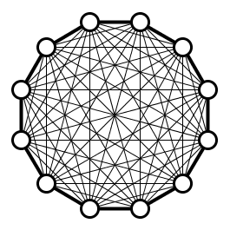
The Traveling Salesman Problem
Find a tour among $n$ cities visiting each city exactly once while minimizing the total travel distance
Classic problem with an extensive history
The lens of fine-grained analysis uncovers new insights!
We focus on the symmetric problem on graphs
$$d\left(u,v\right)=d(v,u)$$
fine-grained

Slide 3
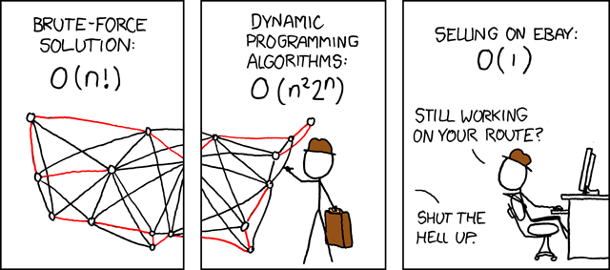
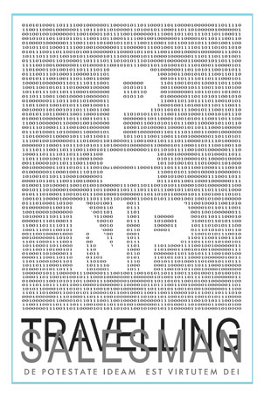
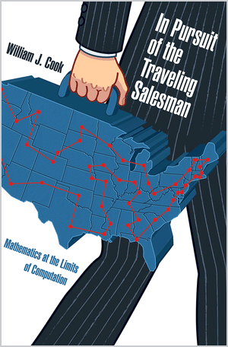
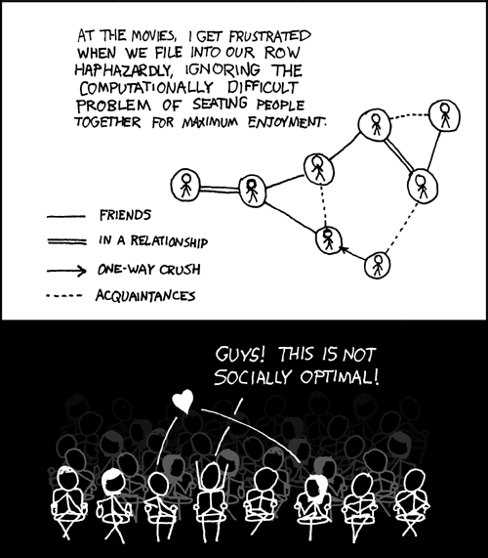
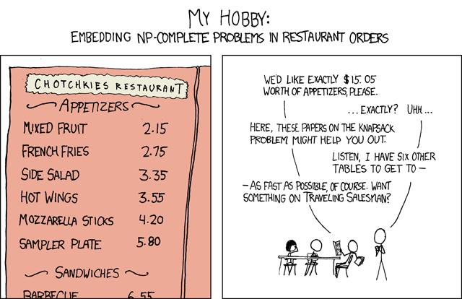
Background of TSP
© xkcd.com

Slide 4
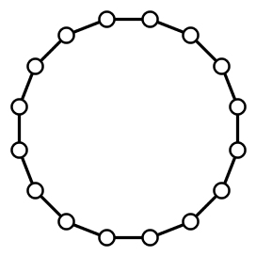
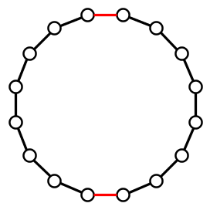
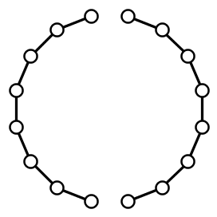
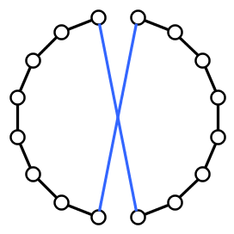
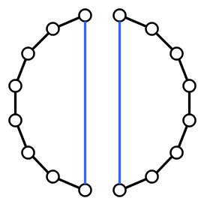
Local search heuristics for TSP
A popular way to deal with TSP in practice is using local search
Explore the local neighborhood of the current tour $T$
The $2$-opt neighborhood is often used
Consists of tours obtained from $T$ by replacing 2 edges
Notes:
As mentioned by Claire Mathieu on Friday.

Slide 5
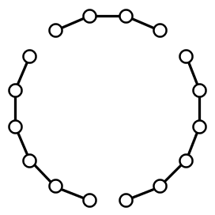
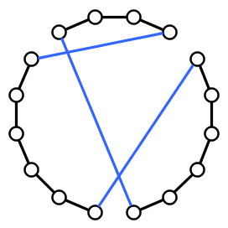
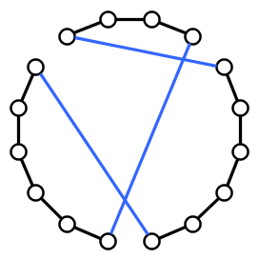
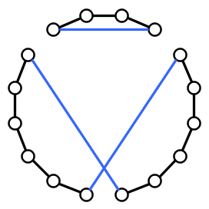
General $k$-opt neighborhood
The $k$-opt neighborhood of tour $T$ contains:
Tours obtained from $T$ by replacing at most $k$ edges
Removing $k$ edges splits a tour into $k$ paths
For $k≥3$, there are multiple ways to reconnect the tour

Slide 6
Analysis of local search for TSP
Many aspects to analyze:
How many iterations until convergence?
How far are local optima from global optima?
How much time is needed for a single iteration?

Slide 7
Two computational problems about $k$-opt
$k$-opt detection Input: A tour $T$ in a weighted complete graph $G$ Question: Is there a $k$-opt move that decreases the cost?
$k$-opt optimization Input: A tour $T$ in a weighted complete graph $G$ Task: Find the best tour in the $k$-opt neighborhood of $T$

Slide 8
Complexity of $k$-opt detection / optimization
For fixed $k$ there is an $O(n^{k})$ algorithm for $k$-opt optimization
Try all $\left({n \atop k}\right)$ possibilities for $k$ edges $X$that leave the tour
Try all $f(k)$ different ways to reconnect into a tour
Motivating question:
What is the exact complexity of detecting whether a given tour can be improved by a $k$-opt move, for small $k$?

Slide 9
Our results for $k$-opt
$2$-opt detection requires $Ω\left(n^{2}\right)$ time
$3$-opt detection is unlikely to have a truly subcubic algorithm
Could $Θ(n^{k})$ be the right complexity for all $k$?
Theorem. $3$-opt detection solvable in $O(n^{3−ε})$ time for some $ε>0$
$$⇔$$
All pairs shortest paths solvable in $O(n^{3−δ})$ time for some $δ>0$
Notes:
2-opt: easy adversarial argument; must read the entire input.

Slide 10
Exhaustive search can be avoided for $k≥4$
For all $k≥4$ we can do better than ${Θ(n}^{k})$
Best $k$-opt move can be found in time $O(n^{1+\left\lfloor \frac{2k}{3}\right\rfloor })$
Based on an analysis of the structure of $k$-opt moves
Theorem. 4-opt optimization can be solved in $Θ\left(n^{3}\right)$ time

Slide 11
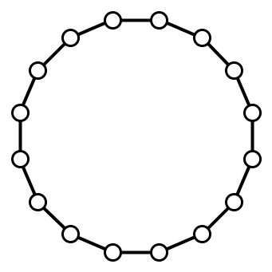
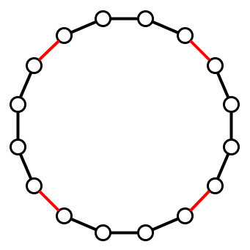
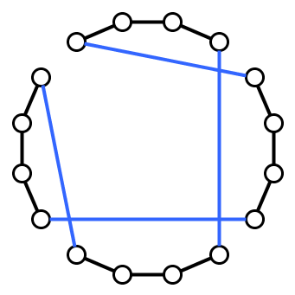
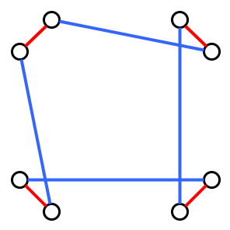
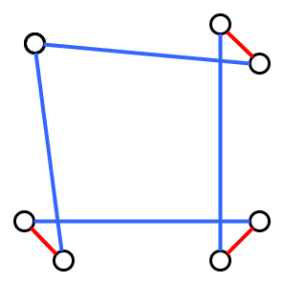
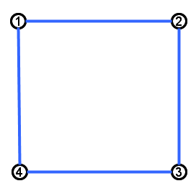
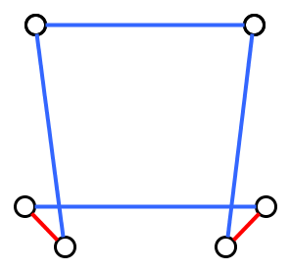
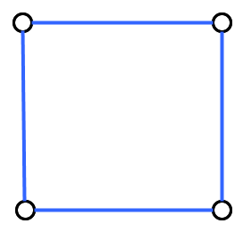
The signature of a $k$-opt move
Consider a $k$-opt move that removes edges $X$ and inserts $Y$
The signature of the $k$-opt move is defined as follows:
Take the symmetric difference 𝑋Δ𝑌, contract all edges of 𝑋
For each endpoint of each replacement edge $y$, store if it attaches to 1st or 2nd endpoint of $x$ in this orientation
2nd
2nd
1st
1st
Starting point
1st
2nd
2nd
1st
Notes:
Fix starting point and orientation so that we can talk about the 1st, 2nd, 3rd and 4th deleted edges.

Slide 12
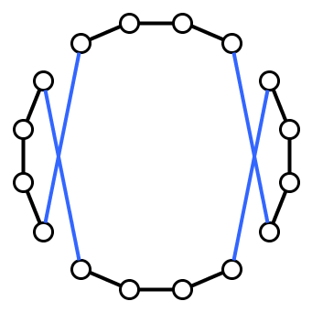
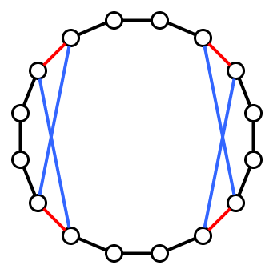
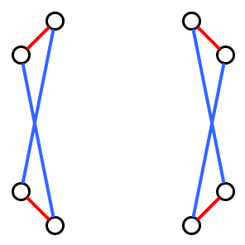
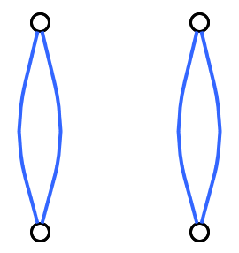
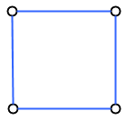
Signatures of $4$-opt moves

Slide 13
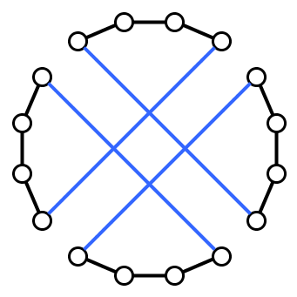
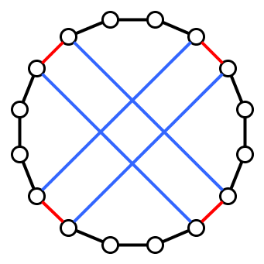
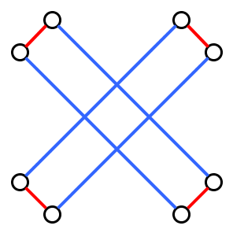
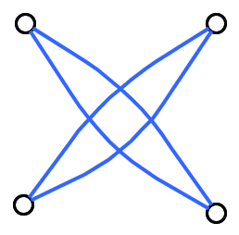
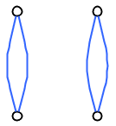
Signatures of $4$-opt moves

Slide 14
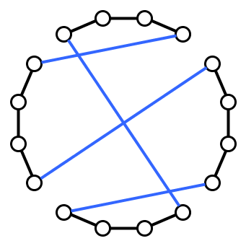
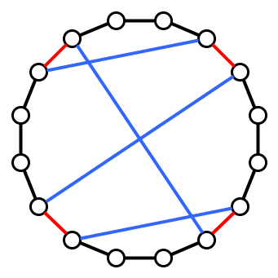
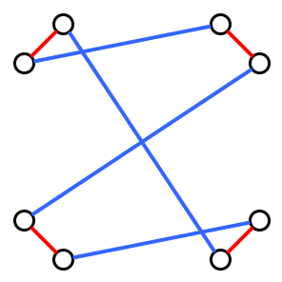
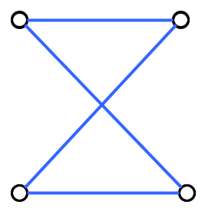
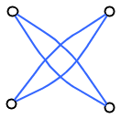
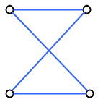
Signatures of $4$-opt moves
Main insight:
For each type of signature, best move with that signature can be found in time $O\left(n^{2+1}\right)$ by exploiting signature of the move

Slide 15
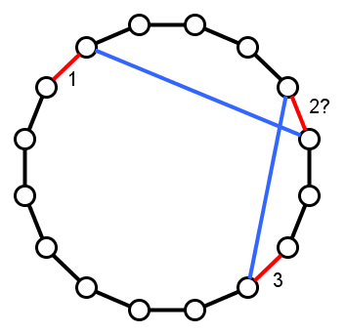
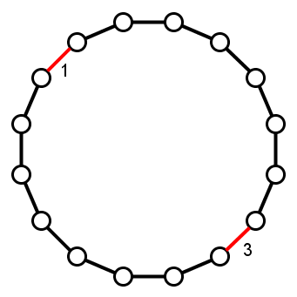
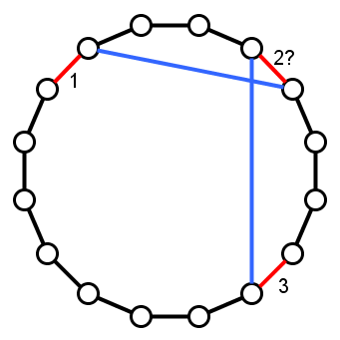
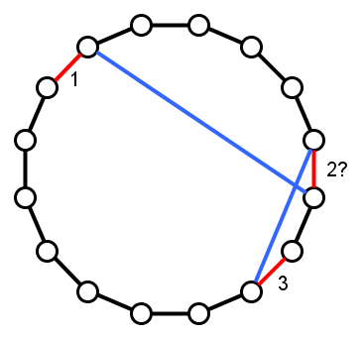
$O(n^{3})$ algorithm for simple $4$-opt signature
2
2
Find best $4$-opt for this signature:
Try all realizations for leaving edges $1\&3$
For each of the $Θ\left(n^{2}\right)$ options:
Find best realization for $2$ and $4$
Yields 2 independent $O(n)$-time problems
1
1
1
2
2
1

Slide 16
Conclusion
Subcubic equivalence $3$-opt detection $⇔$ All Pairs Shortest P.
For $k≥4$, we can improve upon exhaustive search for $k$-opt
Recent improvement: 5-opt in $O\left(n^{3.4}\right)$ time [Cygan et al.]
Open problems:
Is $k$-opt detection fixed-parameter tractable:
Is 𝑘-opt detection fixed-parameter tractable:
in planar graphs?
for finding tours among points in the plane?
THANK YOU!
Notes:
Applications of random-restart hill-climbing for TSP?

