Slide 1
On Structural Parameterizations of Hitting Set:
Hitting Paths in Graphs Using 2-SAT
Bart M. P. Jansen
June 19th, WG 2015, Munich, Germany

Slide 2
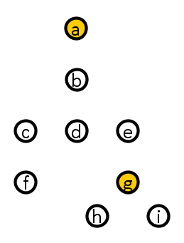
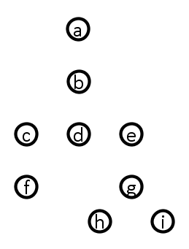


The Hitting Set Problem
Input: A family $ℱ=\{S_{1},…,S_{m}\}$ of subsets of a finite universe $U$, and an integer $t$
Question: $∃X⊆U$ of size $≤t$ that intersects all sets in $ℱ?$
A solution set $X$ is called a hitting set
Hard problem:
  NP-complete
  No constant-factor approximation unless $P=NP$
  $W[2]$-complete parameterized by $t$
    Probably no algorithm with runtime $f\left(t\right){⋅\left(\left|ℱ\right|+\left|U\right|\right)}^{O\left(1\right)}$
$$\left\{a,b,c,e\right\}$$
$$\left\{b,c,d,g,h\right\}$$
$$\left\{d,f,g,i\right\}$$
$$\left\{a,b,e\right\}$$

Slide 3
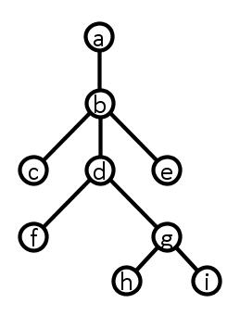

Tree hypergraphs
A set family $ℱ$ over universe $U$ is a tree hypergraph if:
  there is a tree $T$ on vertex set $U$ such that
  for each $S∈ℱ$ the elements of $S$ induce a subtree of $T$
A tree representation can be computed from $ℱ$ in poly time
$$\left\{a,b,c,e\right\}$$
$$\left\{b,c,d,g,h\right\}$$
$$\left\{d,f,g,i\right\}$$
$$\left\{a,b,e\right\}$$

Slide 4
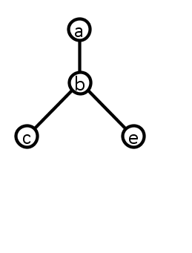
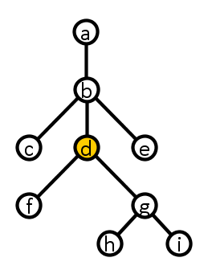

Hitting Set is easy on tree hypergraphs
Root the tree and select a deepest node $d$ such that its subtree $T_{d}$ contains at least one set $S∈ℱ$ entirely
There is a minimum hitting set that contains $d$
  Recurse on $\left(ℱ∖\{S∈ℱ ∣ d∈S\right\},U∖\{d\})$

Slide 5
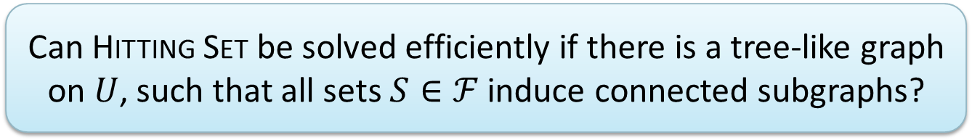
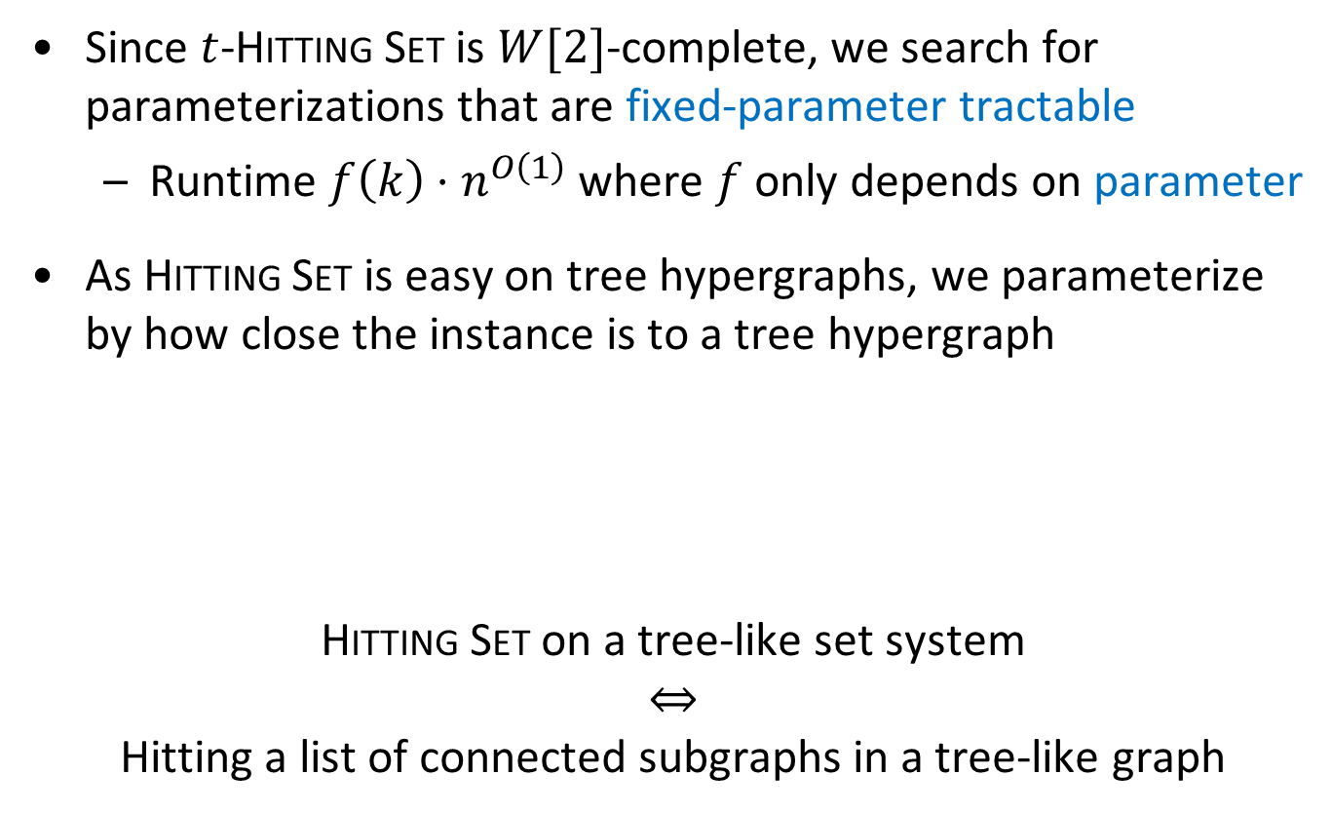
Structural parameterizations of Hitting Set
Since $t$-Hitting Set is $W[2]$-complete, we search for parameterizations that are fixed-parameter tractable
  Runtime $f\left(k\right)⋅n^{O\left(1\right)}$ where $f$ only depends on parameter
As Hitting Set is easy on tree hypergraphs, we parameterize by how close the instance is to a tree hypergraph
Hitting Set on a tree-like set system
$$⇔$$
Hitting a list of connected subgraphs in a tree-like graph
Can Hitting Set be solved efficiently if there is a tree-like graph on $U$, such that all sets $S∈ℱ$ induce connected subgraphs?

Slide 6
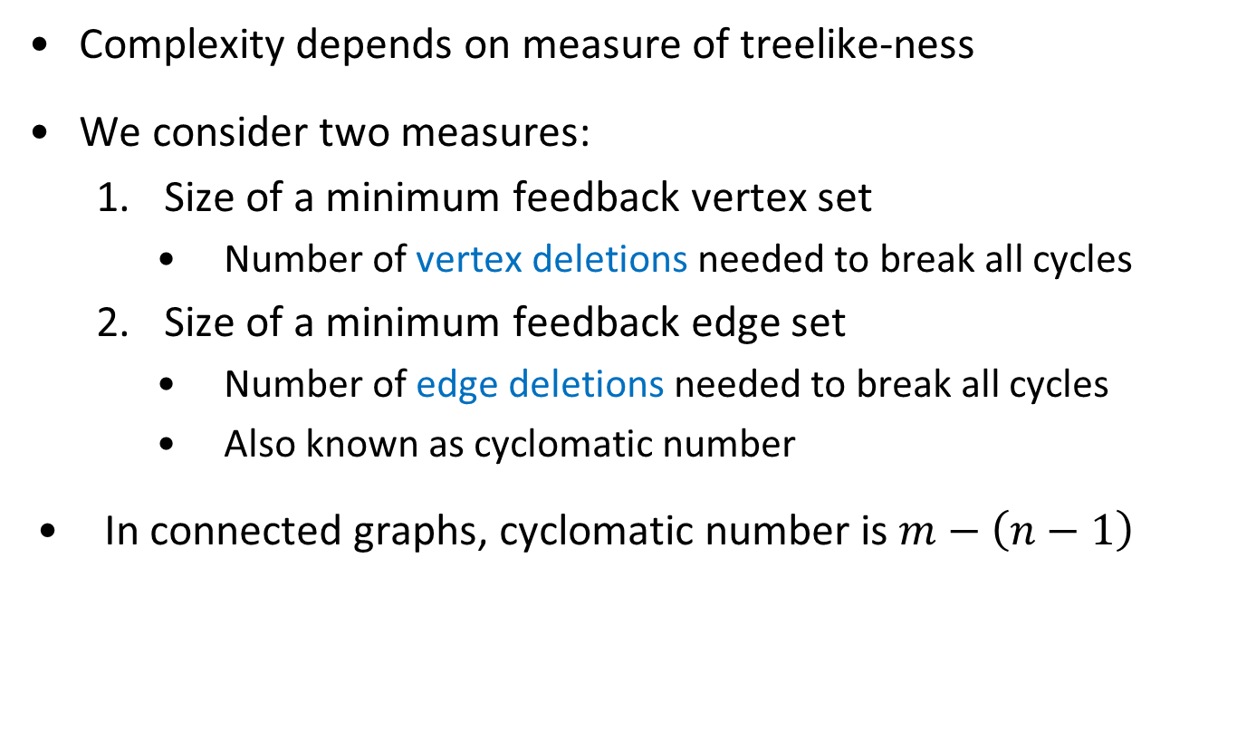
Measures for treelike-ness
Complexity depends on measure of treelike-ness
We consider two measures:
  Size of a minimum feedback vertex set
    Number of vertex deletions needed to break all cycles
  Size of a minimum feedback edge set
    Number of edge deletions needed to break all cycles
    Also known as cyclomatic number
In connected graphs, cyclomatic number is $m−\left(n−1\right)$

Slide 7
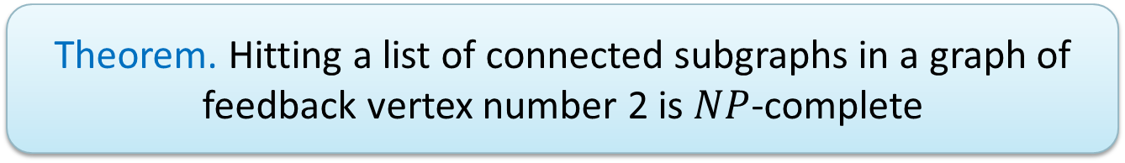

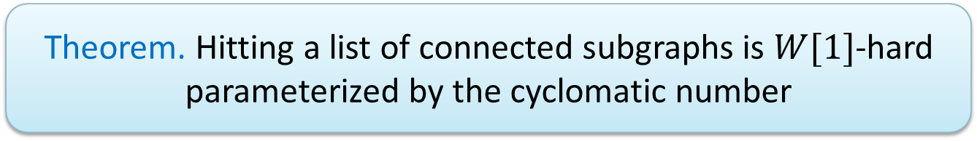
Negative results
Without further restrictions, not much can be done
Parameterization by feedback vertex number not FPT
  (Unless $P=NP$)
Parameterization by cyclomatic number not FPT
  (Unless $FPT=W[1]$)
  Not even when all subgraphs are 3-leaf trees
Theorem. Hitting a list of connected subgraphs in a graph of
feedback vertex number 2 is $NP$-complete
Theorem. Hitting a list of connected subgraphs is $W[1]$-hard parameterized by the cyclomatic number

Slide 8
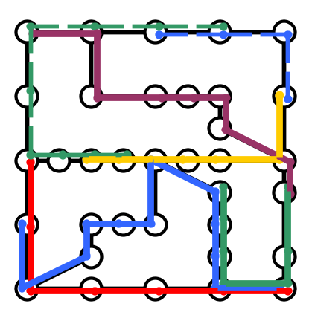
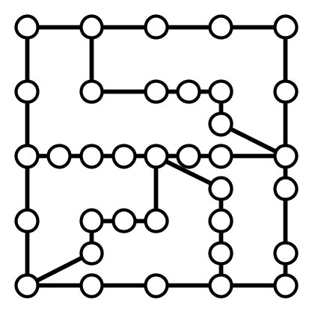

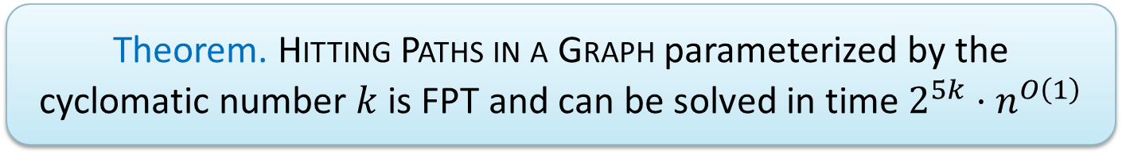
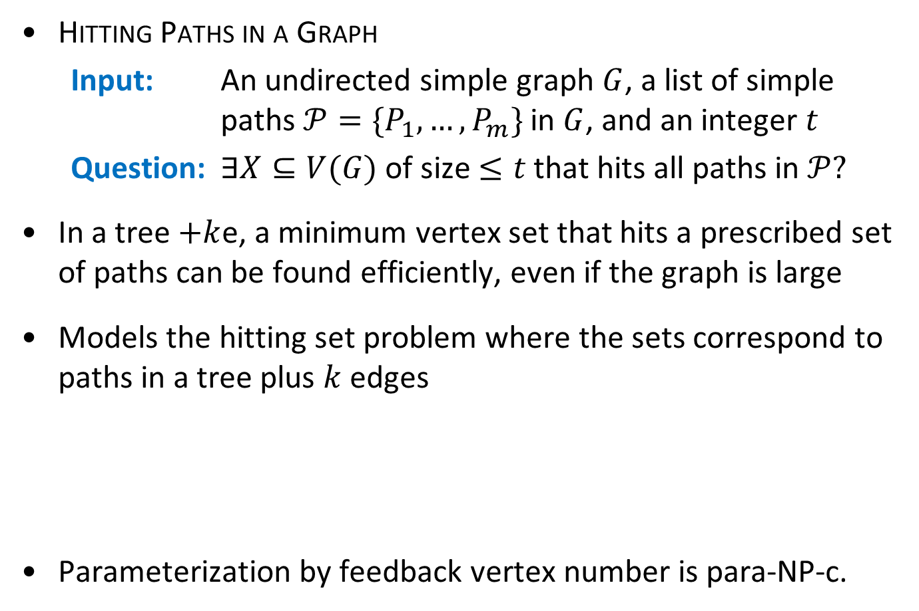
Positive results
Hitting Paths in a Graph
  Input: An undirected simple graph $G$, a list of simple paths $𝒫=\{P_{1},…, P_{m}\}$ in $G$, and an integer $t$
  Question: $∃X⊆V(G)$ of size $≤t$ that hits all paths in $𝒫?$
In a tree $+k$e, a minimum vertex set that hits a prescribed set of paths can be found efficiently, even if the graph is large
Models the hitting set problem where the sets correspond to paths in a tree plus $k$ edges
Parameterization by feedback vertex number is para-NP-c.
Theorem. Hitting Paths in a Graph parameterized by the cyclomatic number $k$ is FPT and can be solved in time $2^{5k}⋅n^{O\left(1\right)}$

Slide 9
Hitting paths in graphs

Slide 10
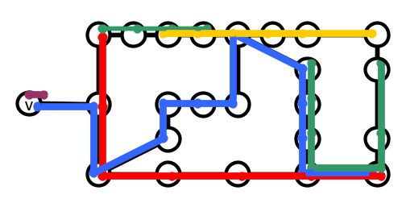
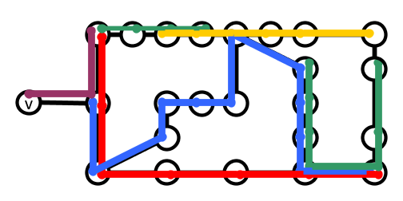
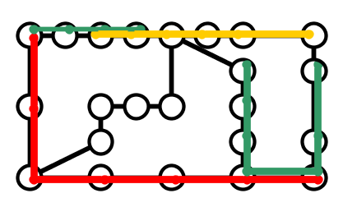
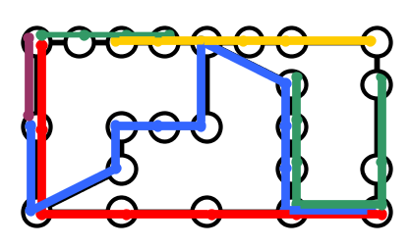

Removing degree-1 vertices from the graph
If $\deg\left(v\right)=1$ and $\{v\}$ is singleton target path:
  Remove $v$ and all target paths through $v$, decrease $t$ by $1$
If $\deg\left(v\right)=1$ and $\{v\}$ is not a singleton target path:
  Remove $v$ from $G$ and from all target paths
Cyclomatic number is not affected

Slide 11
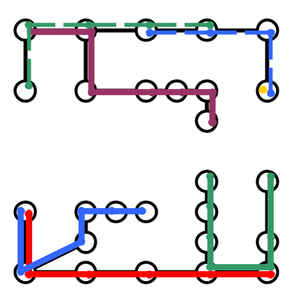
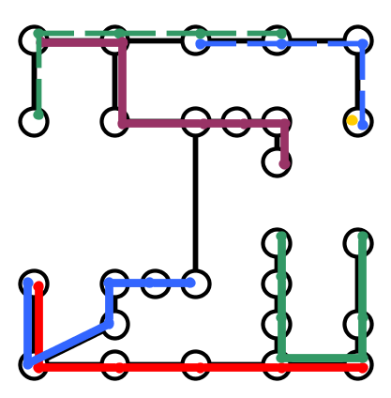
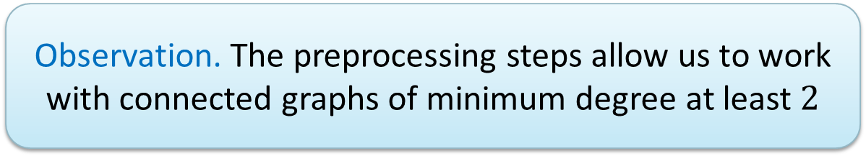
Connecting the graph
If the graph is not connected:
  Add an edge between two connected components
Cyclomatic number and hitting sets are not affected
Observation. The preprocessing steps allow us to work with connected graphs of minimum degree at least $2$

Slide 12

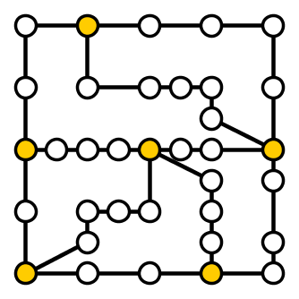
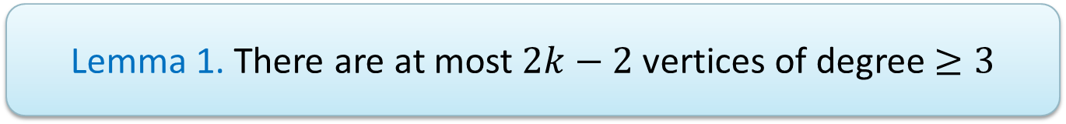

Properties of the cyclomatic number (I)
Consider a connected graph $G$ of cyclomatic number $k$ and minimum degree at least two
Lemma 1. There are at most $2k−2$ vertices of degree $≥3$

Slide 13
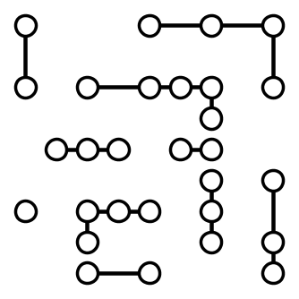
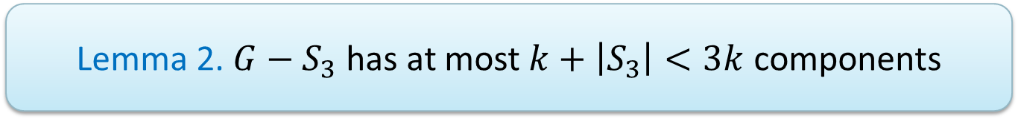

Properties of the cyclomatic number (II)
Consider a connected graph $G$ of cyclomatic number $k$ and minimum degree at least two
Let $S_{3}⊆V(G)$ be the vertices of degree $≥3$
Lemma 2. $G−S_{3}$ has at most $k+\left|S_{3}\right|<3k$ components

Slide 14
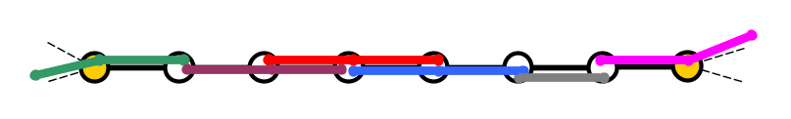
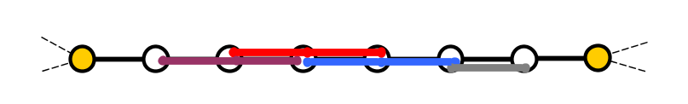



Hitting sets on subpaths
Consider a component $C$ of $G−S_{3}$ in a preprocessed graph
For each such component we define opt$(C)$:
  Min. hitting set size for target paths contained fully in $C$
  Can be found efficiently by a greedy approach

Slide 15


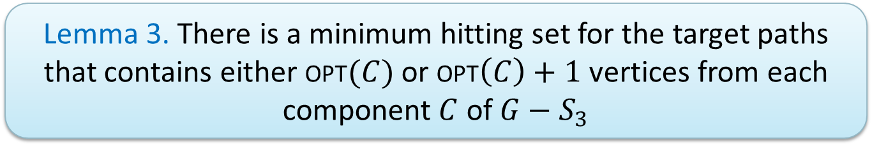
Budgets on degree-$2$ paths
Lemma 3. There is a minimum hitting set for the target paths that contains either opt$(C)$ or opt$\left(C\right)+1$ vertices from each component $C$ of $G−S_{3}$
If a hitting set $X$ contains at least opt$\left(C\right)+2$ vertices from $C$:
  Replace solution within $C$ by opt$(C)$, add the neighbors $N$ of the endpoints of $C$ to the solution
  $\left|N\right|≤2$ since $C$ is a component of degree-$2$ vertices
  The replacement hits all paths using a vertex of $C$

Slide 16
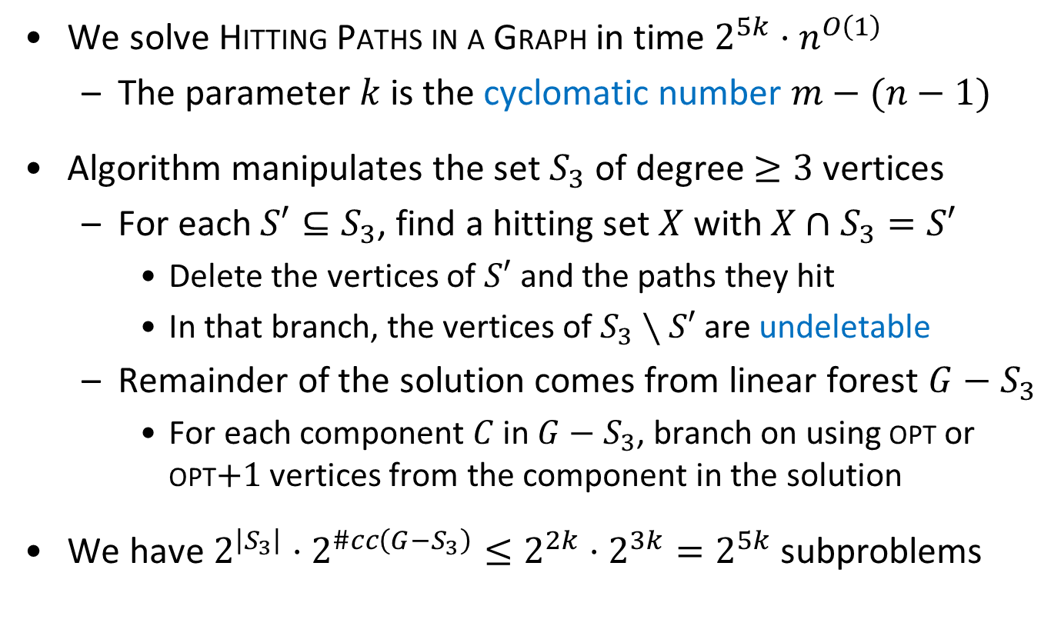
Algorithm outline
We solve Hitting Paths in a Graph in time $2^{5k}⋅n^{O\left(1\right)}$
  The parameter $k$ is the cyclomatic number $m−(n−1)$
Algorithm manipulates the set $S_{3}$ of degree $≥3$ vertices
  For each $S′⊆S_{3}$, find a hitting set $X$ with $X∩S_{3}=S′$
    Delete the vertices of $S′$ and the paths they hit
    In that branch, the vertices of $S_{3}∖S′$ are undeletable
  Remainder of the solution comes from linear forest $G−S_{3}$
    For each component $C$ in $G−S_{3}$, branch on using opt or opt$+1$ vertices from the component in the solution
We have $2^{\left|S_{3}\right|}⋅2^{\#cc\left(G−S_{3}\right)}≤2^{2k}⋅2^{3k}=2^{5k}$ subproblems

Slide 17


Simplifying a subproblem
Subproblem gives $S^{′}⊆S_{3}$ and $a_{C}∈\left\{0,1\right\}$ for $C∈G−S_{3}$
  Find minimum hitting set $X$ with $X∩S_{3}=S′$, such that
  for each component $C$ of $G−S_{3}$: $\left|X∩C\right|=$ opt$\left(C\right)+a_{C}$

Slide 18
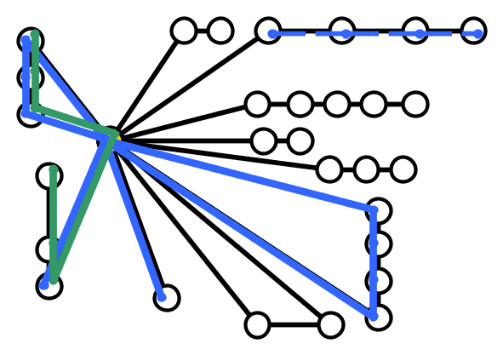
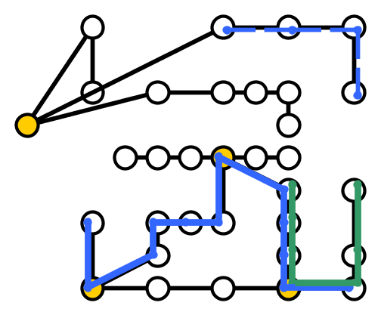
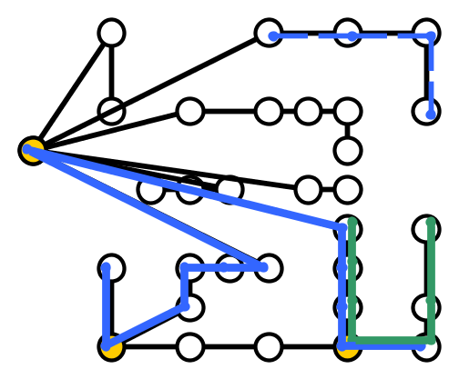
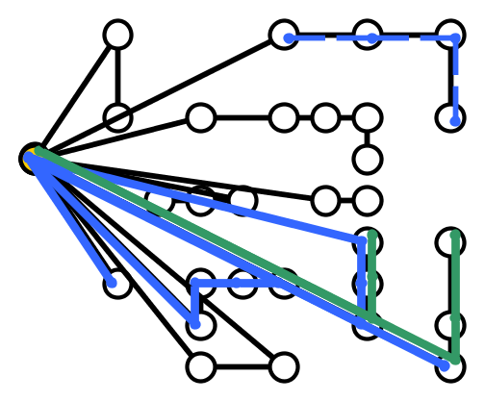
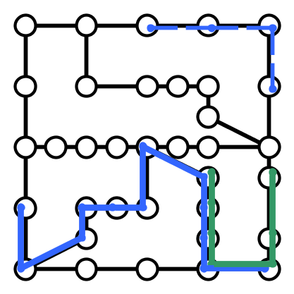
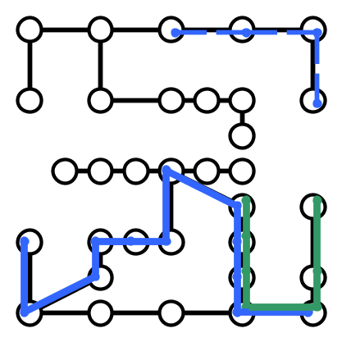
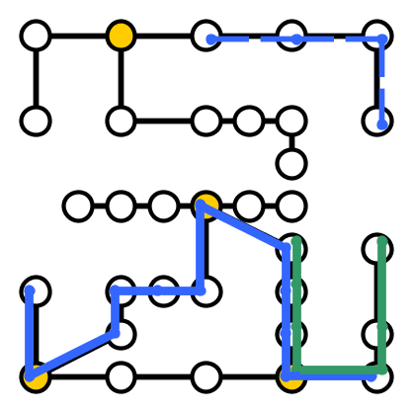

Simplifying a subproblem
Remove all paths hit by $S′$ and remove the vertices of $S′$
The remaining vertices of degree $≥3$ are undeletable
  Merge them into a single undeletable vertex

Slide 19
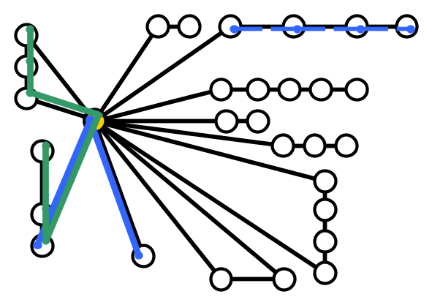
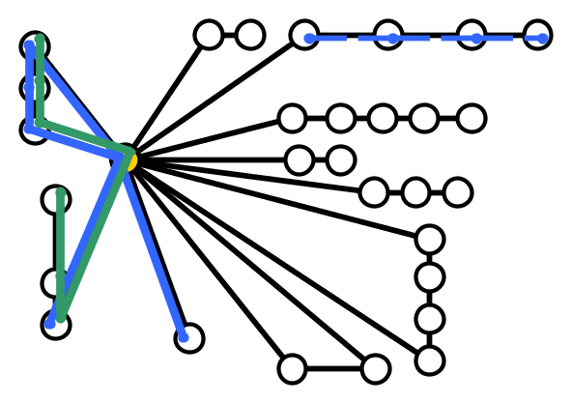

Simplifying a subproblem
Target paths may become cyclic due to merging
  If target path $P$ fully contains a component $C∈G−S_{3}$ with positive budget: remove $P$ since it will be hit on $C$
  If $P$ fully contains $C$ of budget zero: remove $C$ from $P$

Slide 20



Hitting paths in a flower with budgets
  Input: A flower graph $G$ with a core $z$, a list of simple paths $𝒫=\{P_{1},…, P_{m}\}$ in $G$, and for each petal $C$ of $G−\{z\}$ a budget $b_{C}$
  Question: $∃X⊆V\left(G\right)∖\{z\}$ that hits all target paths and contains exactly $b_{C}$ vertices from each petal $C?$

Slide 21


Canonical solutions within petals
A priori, it is not clear how to spend the budget on a petal
  A vertex further left will hit more paths that enter the petal from the left, and vice versa
If we fix the leftmost vertex from that goes in the hitting set, there is a greedy optimal extension for the given budget
  Repeatedly find the earliest ending path that is not hit yet, pick its rightmost vertex
  We call this the canonical solution for that leftmost index
$b_{C}=$opt$\left(C\right)=2$

Slide 22





Requirements imposed on canonical solutions
Using canonical solutions, the problem turns into:
  For each petal $C$, choose an index $x_{C}$ such that the corresponding canonical solutions hit all target paths
We can encode the requirement that a path must be hit by constraining the indices that may be chosen
Leftmost vertex on $C_{1}$ is far enough left to hit $P$ on $C_{1},$ or leftmost vertex on $C_{2}$ is far enough right that canonical solution hits $P$ on $C_{2}$
Petal $C_{1}$
$${(x}_{C_{1}}≤4∨x_{C_{2}}≥3)$$
Petal $C_{2}$

Slide 23


Reduction to multi-valued 2-SAT
We obtain constraints on the indices of canonical solutions
  Each constraint is a disjunction of two literals
  A literal is “at least”: $x_{i}≥α$ or “at most”: $x_{i}≤β$
We are asking if there is a satisfying assignment to a
2-CNF-SAT formula in multi-valued logic such as:
$$\left(x_{1}≥4∨x_{6}≤8\right)∧\left(x_{2}≤3∨x_{3}≤5\right)∧(x_{4}≥6∨x_{4}≤1)$$
Chosen canonical solutions hit all paths $⇔$ formula is satisfied
The problem can be solved in polynomial time on flowers!
Theorem (Manyà 2001). 2-SAT with truth value set $\{1,…,N\}$ and literals $x_{i}≤α$ and $x_{i}≥β$ can be solved in polynomial time

Slide 24


Algorithm summary
The algorithm branches into $2^{5k}$ directions
  Each branch is simplified into a budgeted flower problem
The subproblem Hitting paths in a flower with budgets is in P
  Reduces to multi-valued 2-SAT, which reduces to 2-SAT
Theorem. Hitting Paths in a Graph parameterized by the cyclomatic number $k$ is FPT and can be solved in time $2^{5k}⋅n^{O\left(1\right)}$

Slide 25


Conclusion
We analyzed hitting set problems in graphs, motivated by structural parameterizations of hitting set
How to compute, given a set system $ℱ$, a tree-like graph in which there is a simple path representing every set?
Parameter | Hitting 3-leaf trees | Hitting paths
Cyclomatic number | $W[1]$-hard | $O^{∗}(2^{5k})$ algorithm No $k^{O\left(1\right)}$ kernel ($NP⊆coNP/poly$) No $O^{∗}\left(2^{o\left(k\right)}\right)$ under ETH
Feedback vertex number | Para-NP-complete | Para-NP-complete
THANK YOU!

