Slide 1

Kernelization and Beyond
Bart M. P. Jansen Eindhoven University of Technology
with input from:
Faisal Abu-Khzam, Stéphane Bessy, Marin Bougeret, Yixin Cao, Robert Ganian, Petr Golovach, Danny Hermelin, Stefan Kratsch, Daniel Lokshtanov, André Nichterlein, Marcin Pilipczuk, Michal Pilipczuk, Ashutosh Rai, Ignasi Sau, Saket Saurabh, Ondrej Suchy, Dimitrios Thilikos, Erik Jan van Leeuwen, Magnus Wahlström, Michal Wlodarczyk, Meirav Zehavi
FPT Fest 2023 in the honour of Mike Fellows
June 13th 2023
Notes:
Figure: the lost continent of polynomial time.
Keyboard shortcuts: g for slide overview, ctrl-s to go to specific slide.

Slide 2
Goal for this session
To have an interactive session about:
the current state of the field of kernelization,
the status and relevance of its open problems,
and its directions for the future
To discuss the status of open problems, I asked colleagues the following questions:
What is your favorite open problem in kernelization?
Is the problem still relevant?
Which direction do you think the answer lies?
What is the simplest version you do not know how to crack?
What was the original motivation?
How much time have you invested in the problem?

Slide 3
Reasons to study kernelization
Kernelization is a method to obtain FPT algorithms
Data reduction is important in practice; kernels allow us to deeply study it in theory
  A kernel can be used to preprocess regardless of the follow-up strategy
  Exact exponential-time algorithm, FPT, local search, approximation, heuristic
  Research into kernelization can lead to useful reduction rules
The field of kernelization offers many accessible and interesting problems
Kernelization is a mathematically deep and elegant direction of inquiry, combining the practicality of polynomial time with the intrigue of NP-hard problems
It can serve as a great outlet for graph-theoretical min/max theorems and extremal combinatorics
Kernelization is a mature research area with a wide variety of upper- and lower bound tools, making it possible to get definitive answers to many questions
Any others?

Slide 4
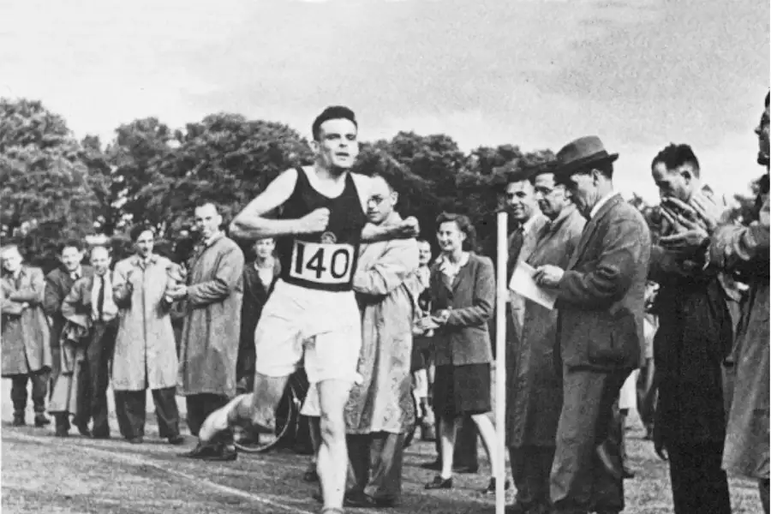
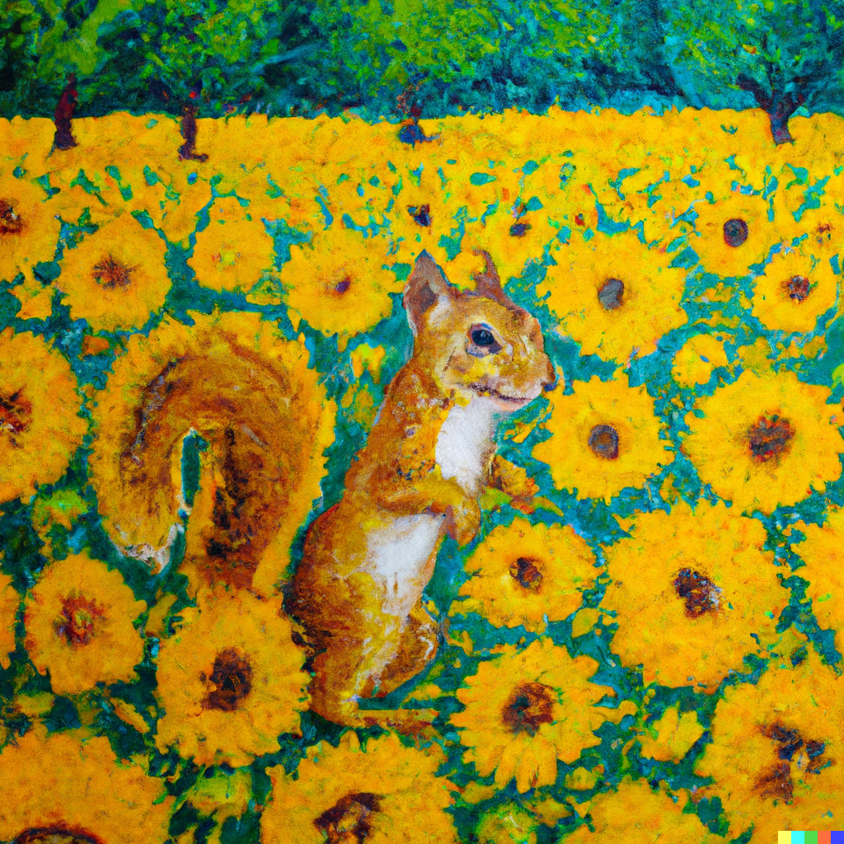
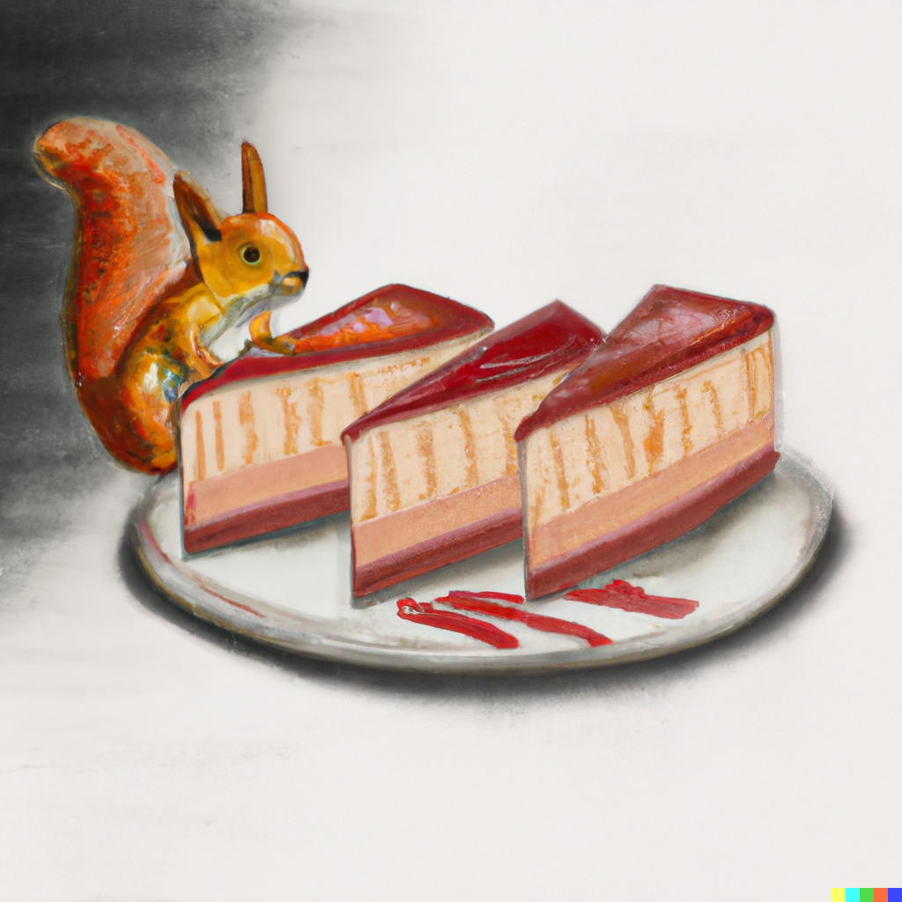
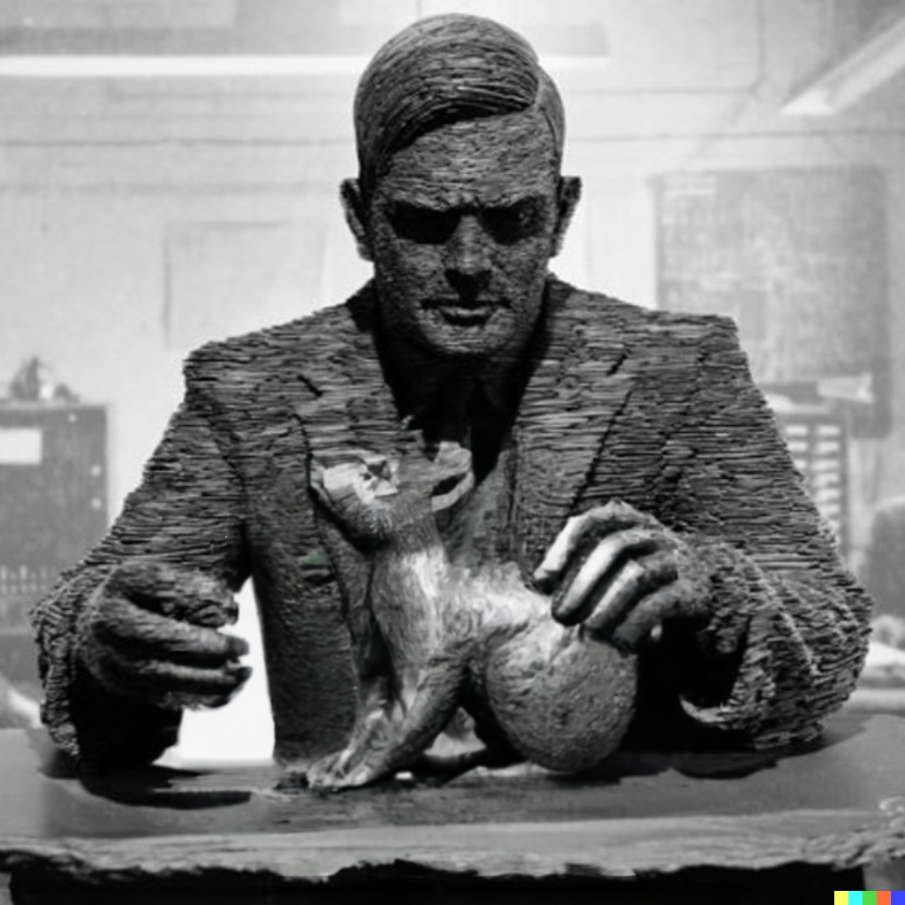
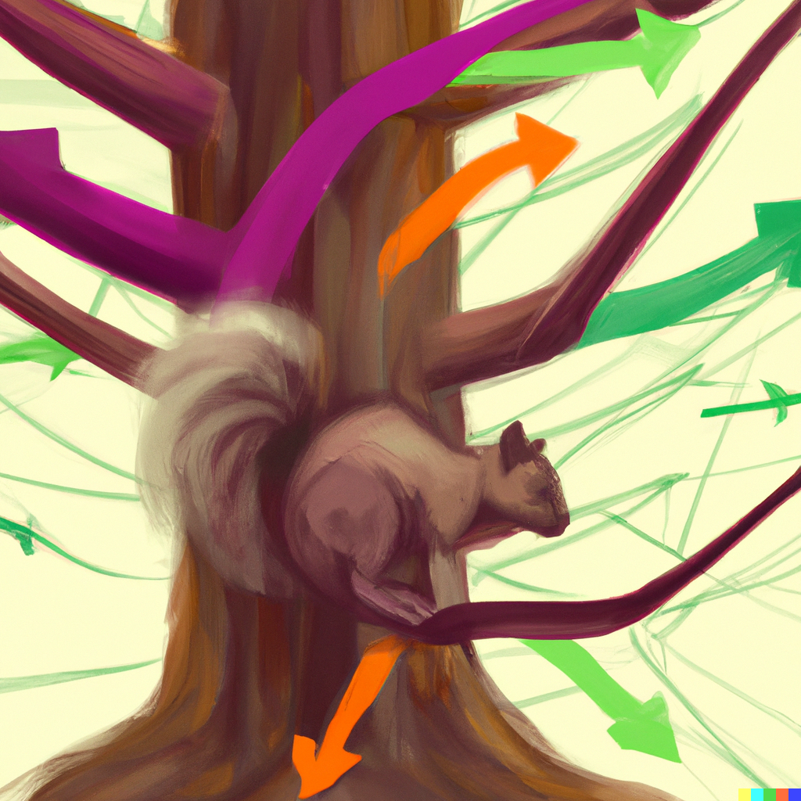
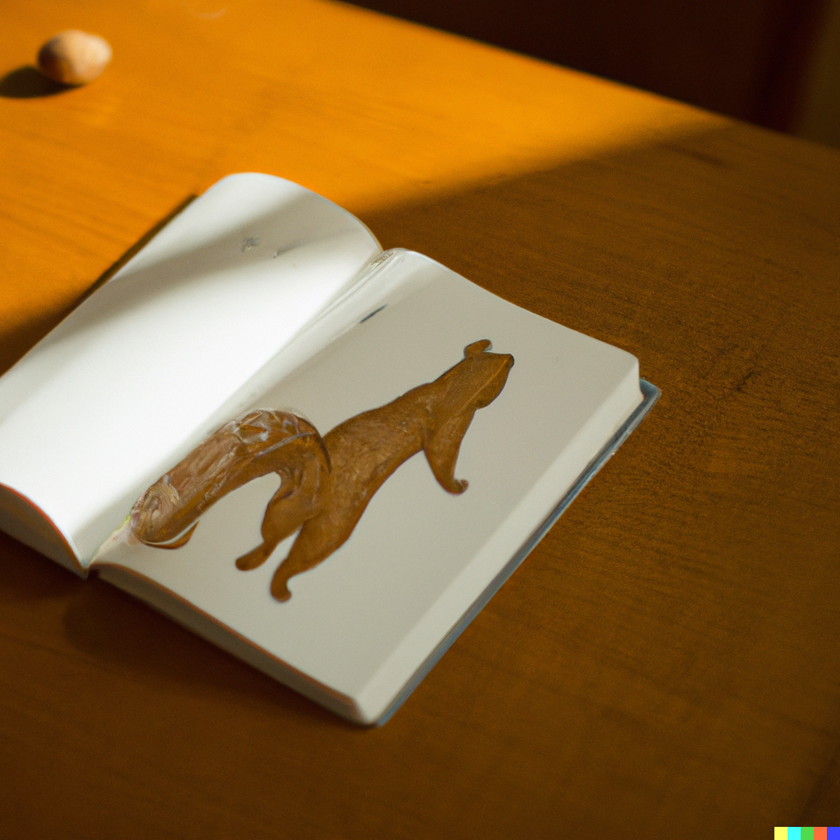

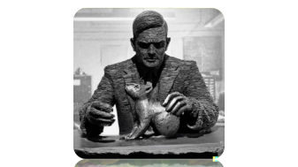
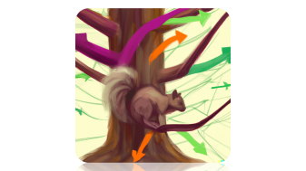
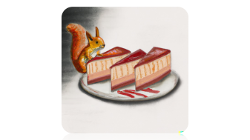

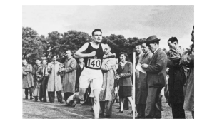



1. Directed Feedback Vertex Set
2. Vertex Planarization
3. Claw-free Edge Deletion
4. Interval Completion
5. Turing kernel for
$k$-Path
6. Turing kernel lower bounds
7. Vertex Multiway Cut
Notes:
Interaction warm-up round.

Slide 5
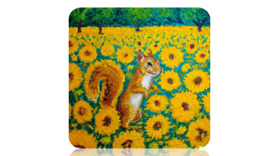
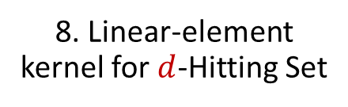
1. Directed Feedback Vertex Set
2. Vertex Planarization
3. Claw-free Edge Deletion
4. Interval Completion
5. Turing kernel for
$k$-Path
6. Turing kernel lower bounds
7. Vertex Multiway Cut
8. Linear-element kernel for $d$-Hitting Set
Go into presentation mode and click a picture, or scroll to the end of the slideset

Slide 6
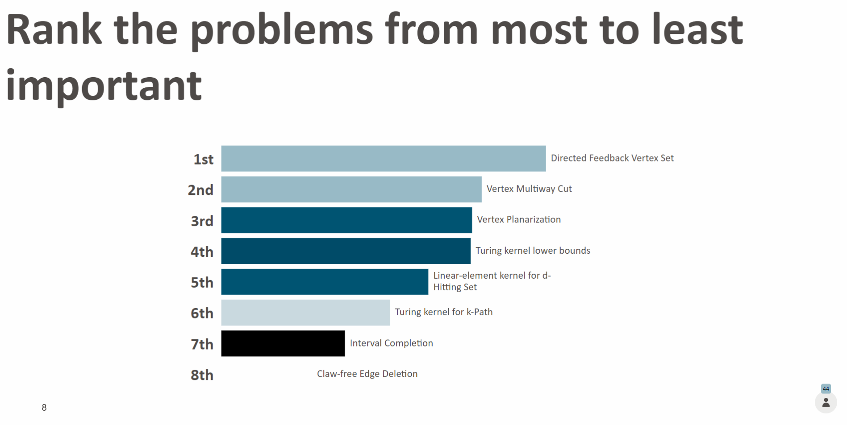

Slide 7

beyond kernelization

Slide 8

Kernelization as a model for effective preprocessing
Definition of kernelization yields an improvement in running time,
compared to solving the input instance by brute force
What if a nontrivial (parameterized) algorithm is used afterwards?
Yes
No
$n$ bits
$f(k)$ bits
$$x$$
$n^{O\left(1\right)}$ time
$$x′$$
$g(k)$ time
$$k$$
$$k′$$

Slide 9
Kernelization as a model for effective preprocessing
Definition of kernelization yields an improvement in running time,
compared to solving the input instance by brute force
Kernelization guarantees that the size of the preprocessed instance is bounded.
For exponential speed-ups, it is important to reduce the search space instead.
$n$ bits
$f(k)$ bits
$$k$$
$$k′$$
depth $k′$
depth $k$
Notes:
How ‘search space’ should be interpreted depends on the type of follow-up algorithm. Some options: size of the search tree for recursive algorithms; number of partial solutions considered in dynamic programming algorithms.
In a certain sense (which can be made surprisingly concrete!) kernelization asks about proving upper-bounds on sizes of obstruction sets, rather than reducing search space.

Slide 10
Kernelization as a model for effective preprocessing
Definition of kernelization yields an improvement in running time,
compared to solving the input instance by brute force
How can we rigorously reason about preprocessing aimed at reducing search space?
Preprocessing to decrease the parameter in polynomial time?
Such a preprocessing guarantee for an NP-hard problem in XP would imply $P=NP$
Kernelization guarantees that the size of the preprocessed instance is bounded.
For exponential speed-ups, it is important to reduce the search space instead.
Notes:
How ‘search space’ should be interpreted depends on the type of follow-up algorithm. Some options: size of the search tree for recursive algorithms; number of partial solutions considered in dynamic programming algorithms.
In a certain sense (which can be made surprisingly concrete!) kernelization asks about proving upper-bounds on sizes of obstruction sets, rather than reducing search space.

Slide 11
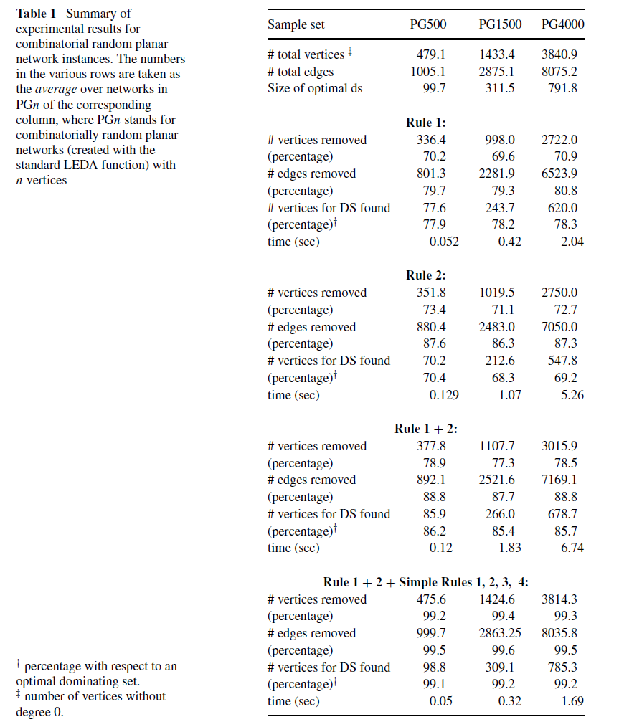
Rigorous analysis of search space reduction
Goal for search space reduction depends on the nature of the follow-up algorithm
Dynamic-programming algorithms over graph decompositions
Search space reduction = finding a better decomposition to work with
Branching algorithms based on parameterizations by solution size
Identify some elements of an optimal solution to decrease the parameter!

Slide 12
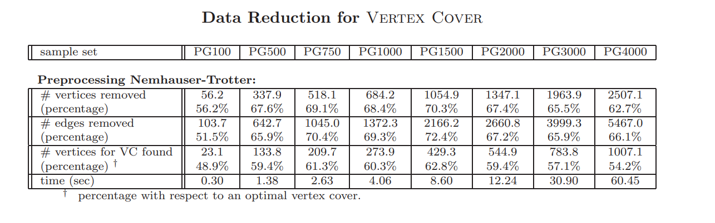
Rigorous analysis of search space reduction
Goal for search space reduction depends on the nature of the follow-up algorithm
Dynamic-programming algorithms over graph decompositions
Search space reduction = finding a better decomposition to work with
Branching algorithms based on parameterizations by solution size
Identify some elements of an optimal solution to decrease the parameter!
[Alber 2002]

Slide 13
Rigorous analysis of search space reduction
Goal for search space reduction depends on the nature of the follow-up algorithm
Dynamic-programming algorithms over graph decompositions
Search space reduction = finding a better decomposition to work with
Branching algorithms based on parameterizations by solution size
Identify some elements of an optimal solution to decrease the parameter!
How can a rigorous theory of search space reduction be formulated?
Questions posed by the formalism of kernelization
do not always lead to the identification of practical preprocessing algorithms
Notes:
Nice tree decomposition, not many join bags, refer back to work on $ℋ$-elimination distance and $ℋ$-treewidth.
Does the model of kernelization ask the right questions for obtaining practical algorithms? (Exponents in recent kernel sizes are comparable to the exponents of PTAS’es that Mike once complained about).
Think back to the quote of Roger Bacon: half of science is asking the right questions. Has the formalism of kernelization been asking the right questions to identify practical preprocessing algorithms?

Slide 14

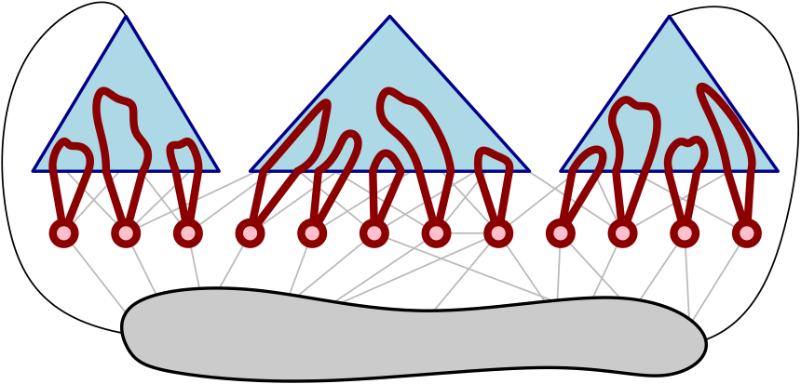
Formalisms for rigorous search-space space reduction
Targeted at parameterizations by solution size
Two recent case studies: efficiently find part of the optimum if:
Give efficient algorithms that, under as mild conditions as possible,
guarantee to find at least one element of an optimal solution
Guarantees to decrease the parameter for vertex-deletion problems and many others
1. there is an essential vertex that
belongs to all reasonable solutions
2. there is a vertex set with a simple certificate for membership in OPT
[Bumpus, Kroon, J. ESA ‘22]
[Donkers, J. WG ‘21]
Notes:
This could be a track for PACE!

Slide 15
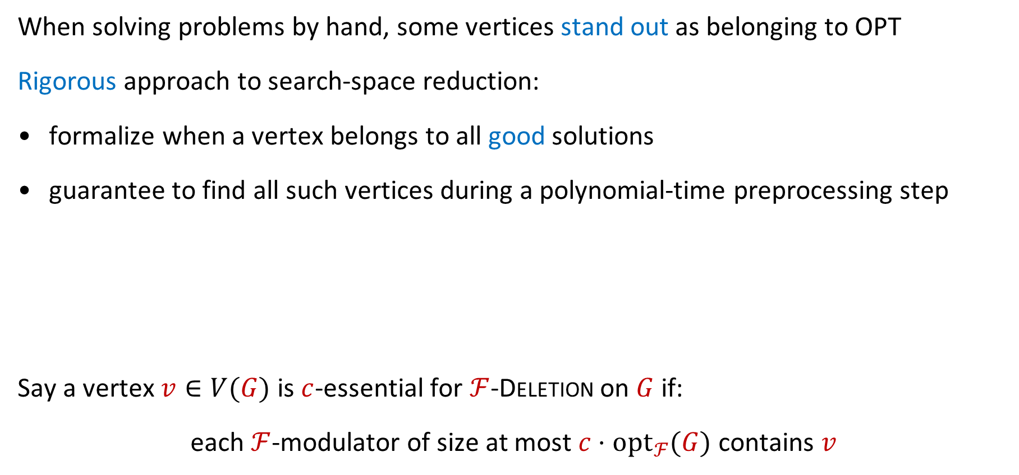

Essential vertices for deletion problems
When solving problems by hand, some vertices stand out as belonging to OPT
Rigorous approach to search-space reduction:
formalize when a vertex belongs to all good solutions
guarantee to find all such vertices during a polynomial-time preprocessing step
Say a vertex $v∈V(G)$ is $c$-essential for $ℱ$-Deletion on $G$ if:
each $ℱ$-modulator of size at most $c⋅opt_{ℱ}(G)$ contains $v$
Can we efficiently detect the $c$-essential vertices in a solution?
(Or a superset of them contained in an optimal solution)
Can we efficiently detect those vertices which are part of all $c$-approximate solutions?
[Bumpus, Kroon, J. ESA ‘22]
Notes:
Example for vertex cover and lots of other problems (even inapproximable ones!) is essentially: yes. “Yes we can!”

Slide 16
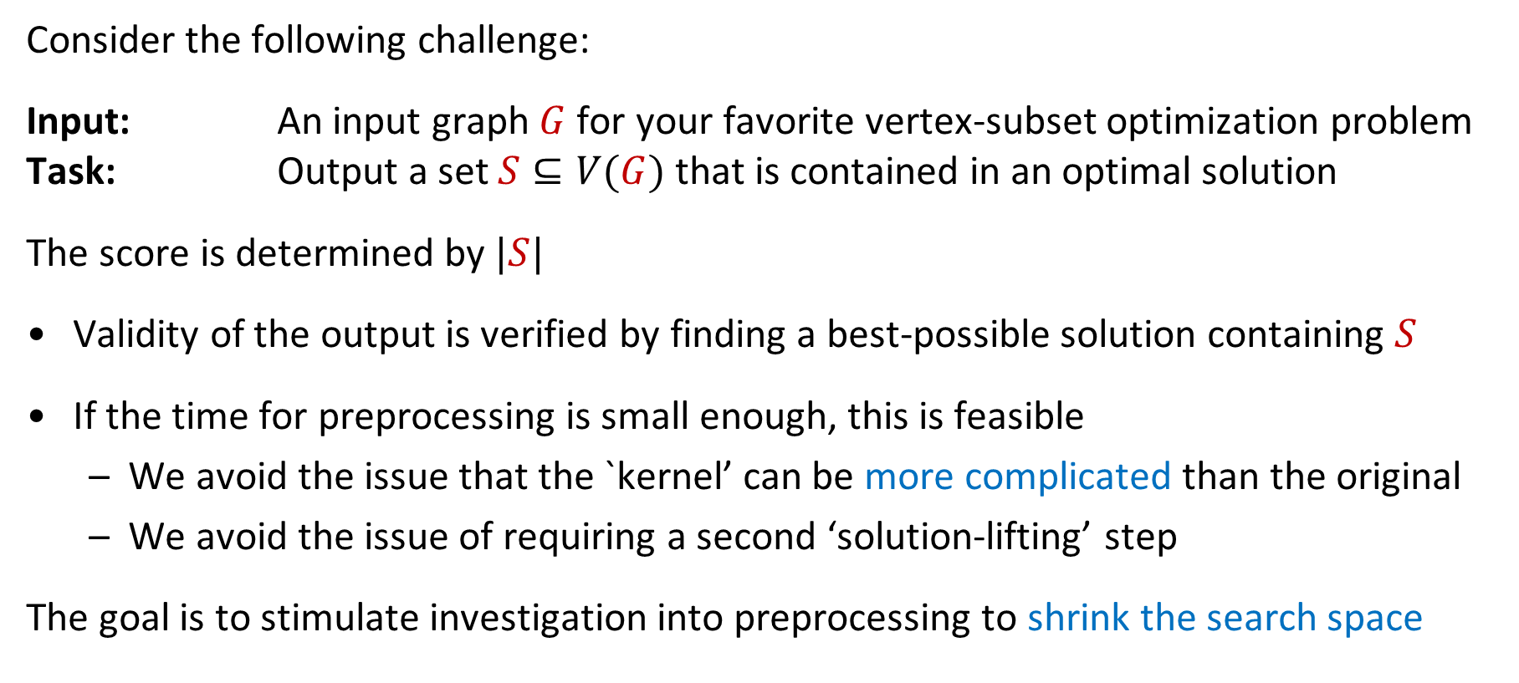
A new type of preprocessing track for PACE?
Consider the following challenge:
Input: An input graph $G$ for your favorite vertex-subset optimization problem
Task: Output a set $S⊆V(G)$ that is contained in an optimal solution
The score is determined by $|S|$
Validity of the output is verified by finding a best-possible solution containing $S$
If the time for preprocessing is small enough, this is feasible
  We avoid the issue that the `kernel’ can be more complicated than the original
  We avoid the issue of requiring a second ‘solution-lifting’ step
The goal is to stimulate investigation into preprocessing to shrink the search space
What do you think?

Slide 17
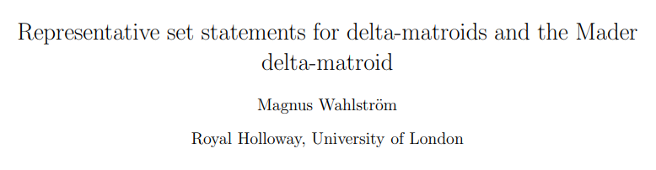
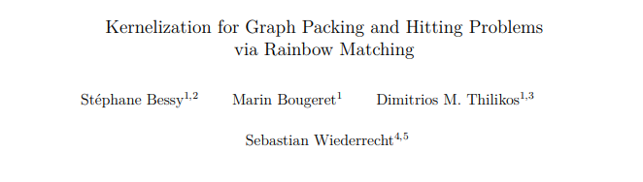



Conclusion
Kernelization is definitely not dead
But the list of accessible, well-motivated open problems is getting smaller
I advocate shifting focus to problems whose answers can have more impact
Which theoretical questions should we ask to find practical preprocessing algorithms?

Slide 18


Slide 19
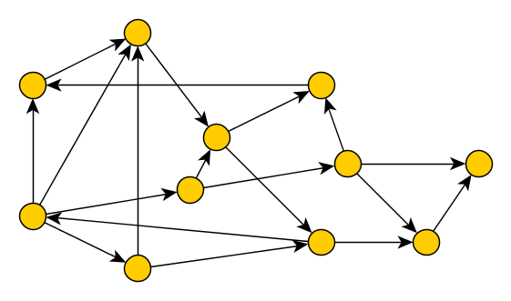



Directed Feedback Vertex Set – Background
Input: A directed graph $G$ and an integer $k$
Parameter: $k$
Question: Is there a set $X$ of at most $k$ vertices in $G$, such that $G−X$ is acyclic?
Equivalent to the arc-deletion version under parameter-preserving reductions
Notes:
If it gets resolved, it might open the door to the study of Min UNSAT questions for CSPs with (infinite) domain $ℚ$ with binary constraints of the form ‘point $x$ lies before point $y$’ etc.

Slide 20
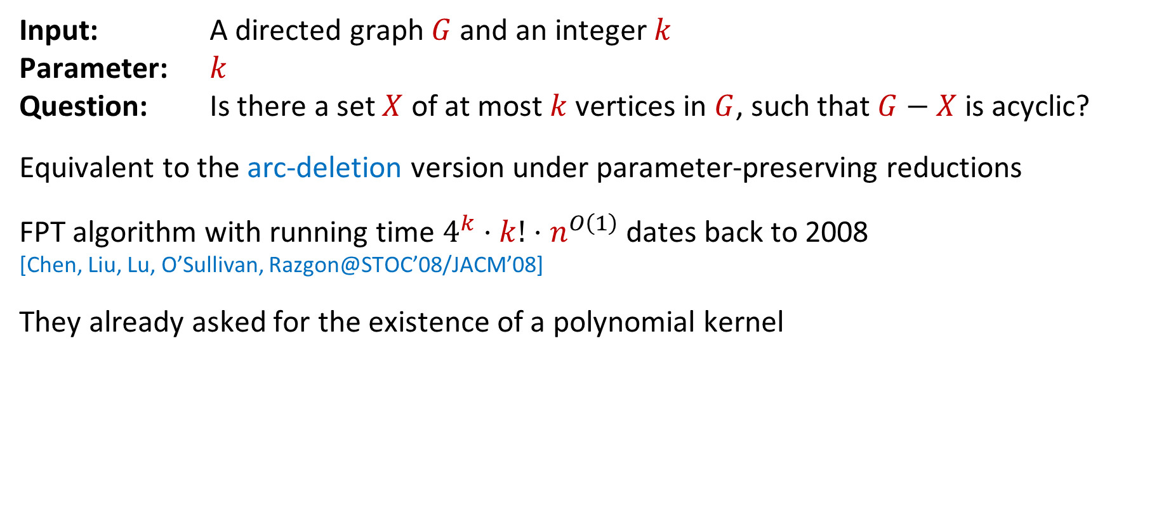
Directed Feedback Vertex Set – Background
Input: A directed graph $G$ and an integer $k$
Parameter: $k$
Question: Is there a set $X$ of at most $k$ vertices in $G$, such that $G−X$ is acyclic?
Equivalent to the arc-deletion version under parameter-preserving reductions
FPT algorithm with running time $4^{k}⋅k!⋅n^{O\left(1\right)}$ dates back to 2008
[Chen, Liu, Lu, O’Sullivan, Razgon@STOC’08/JACM’08]
They already asked for the existence of a polynomial kernel
Notes:
If it gets resolved, it might open the door to the study of Min UNSAT questions for CSPs with (infinite) domain $ℚ$ with binary constraints of the form ‘point $x$ lies before point $y$’ etc.

Slide 21
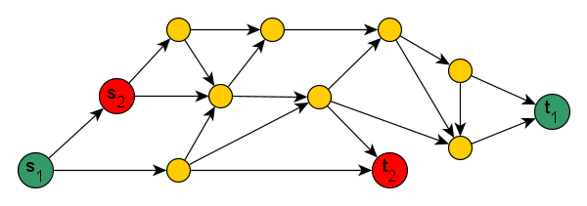

Directed Feedback Vertex Set – Open and closed cases
Easiest cases which are open:
Eulerian digraphs
Planar digraphs of maximum degree 4
The problem is polynomial for planar graphs of maximum degree 3 [Cao’23]
Skew multicut in DAGs for two terminal pairs
Hardest cases which are closed:
Digraphs of bounded independence number (also for Feedback Arc Set)
[Bang-Jensen, Maddaloni & Saurabh@Algorithmica’16] [Lochet, Lokshtanov, Misra, Saurabh, Sharma, Zehavi@ITCS’20]
Wannabe-bounded-treewidth graphs (modulator to DAG of constant treewidth)
[Lokshtanov, M. S. Ramanujan, Saurabh, Sharma, Zehavi@WADS’19]
Notes:
If it gets resolved, it might open the door to the study of Min UNSAT questions for CSPs with (infinite) domain $ℚ$ with binary constraints of the form ‘point $x$ lies before point $y$’ etc.

Slide 22
Directed Feedback Vertex Set – Relevance and motivation
The problem has several applications, for example in deadlock resolution
But most researchers are interested in it for theoretical reasons:
It is fundamental, elementary to state, and a gap in our knowledge
A kernel may lead to the discovery of new tools for graph separation problems
Notes:
Some researchers indicated spending “far too much” time on it.

Slide 23
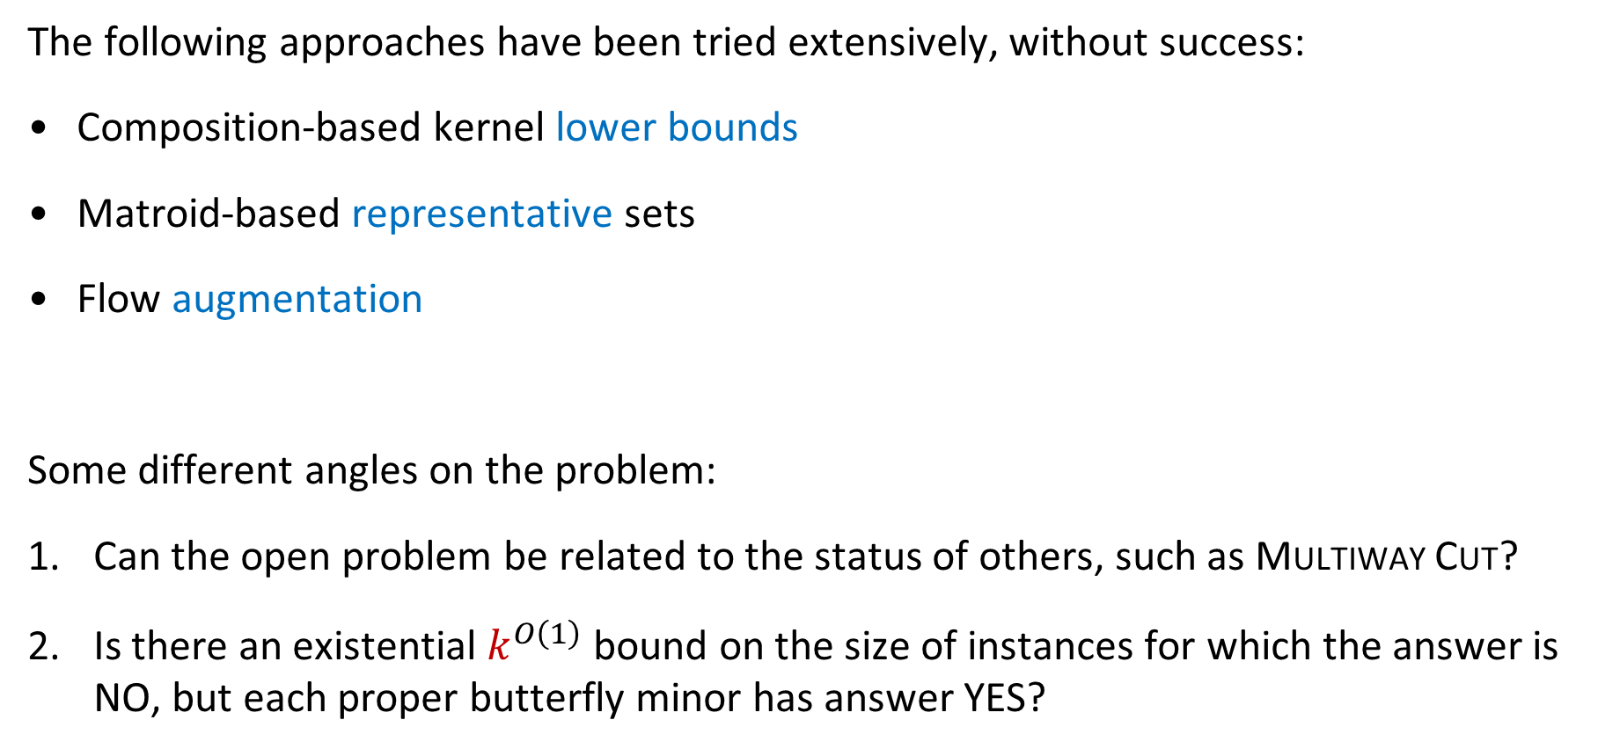
Directed Feedback Vertex Set – Status
The following approaches have been tried extensively, without success:
Composition-based kernel lower bounds
Matroid-based representative sets
Flow augmentation
Some different angles on the problem:
Can the open problem be related to the status of others, such as Multiway Cut?
Is there an existential $k^{O\left(1\right)}$ bound on the size of instances for which the answer is NO, but each proper butterfly minor has answer YES?
All researchers who responded, lean towards a positive outcome

Slide 24


Slide 25
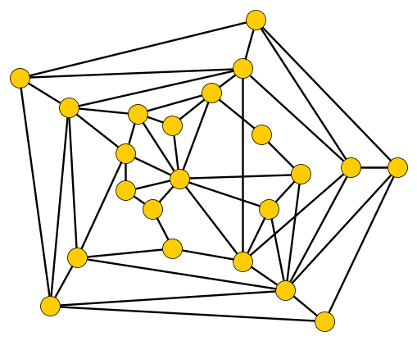
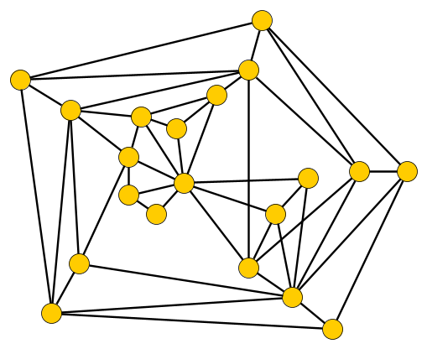
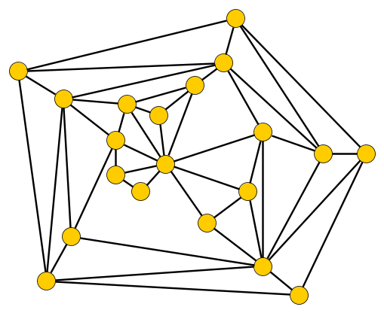

Vertex Planarization – Background
Input: An undirected graph $G$ and an integer $k$
Parameter: $k$
Question: Is there a set $X$ of at most $k$ vertices such that $G−X$ is planar?

Slide 26
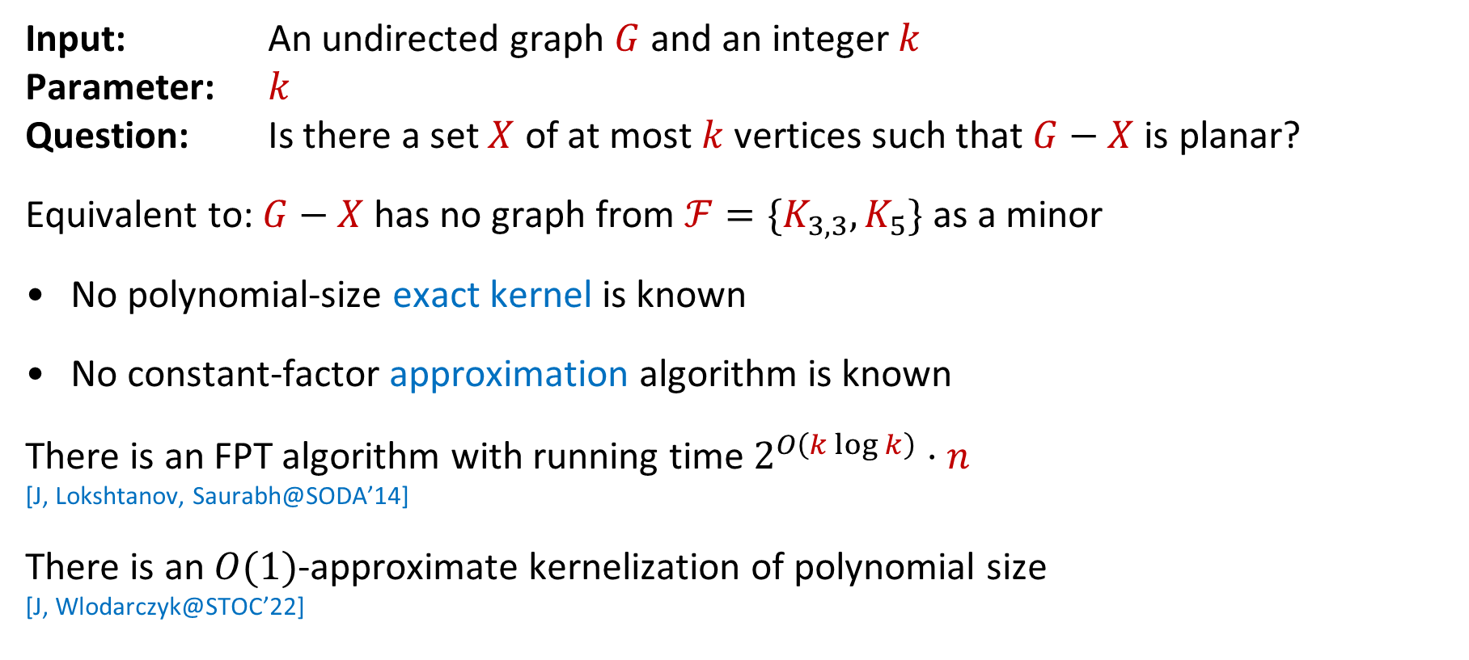
Vertex Planarization – Background
Input: An undirected graph $G$ and an integer $k$
Parameter: $k$
Question: Is there a set $X$ of at most $k$ vertices such that $G−X$ is planar?
Equivalent to: $G−X$ has no graph from $ℱ=\{K_{3,3},K_{5}\}$ as a minor
No polynomial-size exact kernel is known
No constant-factor approximation algorithm is known
There is an FPT algorithm with running time $2^{O\left(k\log{k}\right)}⋅n$
[J, Lokshtanov, Saurabh@SODA’14]
There is an $O(1)$-approximate kernelization of polynomial size
[J, Wlodarczyk@STOC’22]

Slide 27
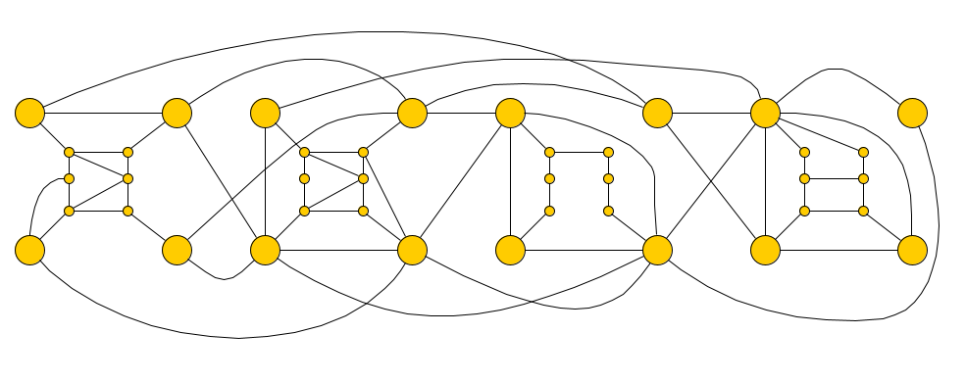
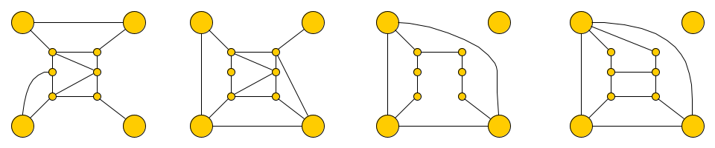


Vertex Planarization – Open and closed cases
Easiest cases which are open:
Planarization by edge deletion
The input graph $G$ is obtained from $k$ disjoint plane graphs $G_{1},…, G_{k}$, each with $k$ terminal vertices on their outer face, by adding edges between terminals
$$k=4$$

Slide 28
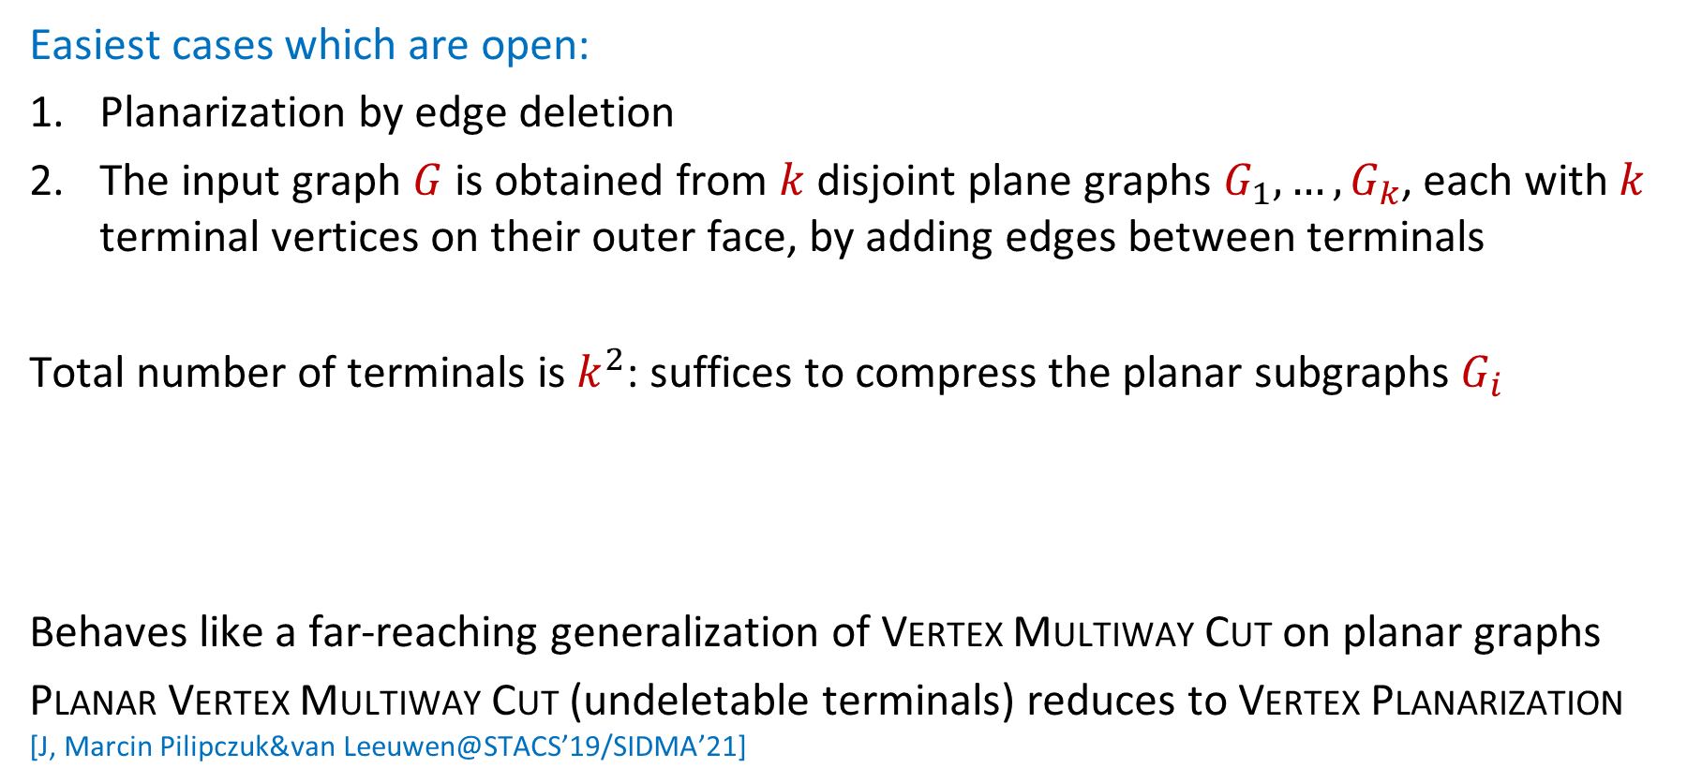
Vertex Planarization – Open and closed cases
Easiest cases which are open:
Planarization by edge deletion
The input graph $G$ is obtained from $k$ disjoint plane graphs $G_{1},…, G_{k}$, each with $k$ terminal vertices on their outer face, by adding edges between terminals
Total number of terminals is $k^{2}$: suffices to compress the planar subgraphs $G_{i}$
Behaves like a far-reaching generalization of Vertex Multiway Cut on planar graphs
Planar Vertex Multiway Cut (undeletable terminals) reduces to Vertex Planarization
[J, Marcin Pilipczuk&van Leeuwen@STACS’19/SIDMA’21]
Difficulty: Preserve the cost of destroying partial Kuratowski minors involving the terminals of $G_{i}$
Notes:
Terminals are not allowed to be deleted. There IS a kernel for Planar Vertex Multiway Cut, but it is quite complicated and it seems daunting to build something on top.

Slide 29
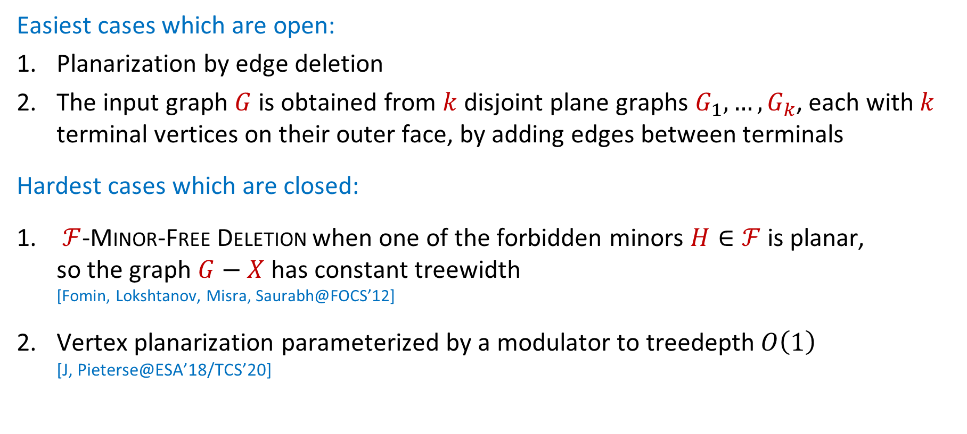
Vertex Planarization – Open and closed cases
Easiest cases which are open:
Planarization by edge deletion
The input graph $G$ is obtained from $k$ disjoint plane graphs $G_{1},…, G_{k}$, each with $k$ terminal vertices on their outer face, by adding edges between terminals
Hardest cases which are closed:
$ℱ$-Minor-Free Deletion when one of the forbidden minors $H∈ℱ$ is planar,
so the graph $G−X$ has constant treewidth
[Fomin, Lokshtanov, Misra, Saurabh@FOCS’12]
Vertex planarization parameterized by a modulator to treedepth $O\left(1\right)$
[J, Pieterse@ESA’18/TCS’20]

Slide 30

Vertex Planarization – Relevance and motivation
Planarization has applications in visualization and graph drawing
Theoretical reasons to study the problem:
It is a mystery from the perspective of polynomial kernels and $O(1)$-approximation
Resolving it may enable progress for other/all $ℱ$-minor-free deletion problems,
such as deleting to a graph embeddable on the torus

Slide 31

Vertex Planarization – Status
Lossy kernel suggests difficulty is compressing planar subgraphs with $O(k)$ terminals
A positive result has to generalize the kernel for Planar Vertex Multiway Cut
Such a kernel exists, but it is quite technical and daunting to generalize
Builds on the $O(k^{142})$ kernel for Planar Steiner Tree parameterized by solution size
[Pilipczuk, Pilipczuk, Sankowski, van Leeuwen@FOCS’14/TALG’18]
Daniel Lokshtanov: It absolutely has a polynomial kernel, no doubt about it

Slide 32


Slide 33
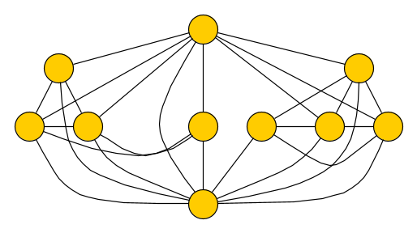
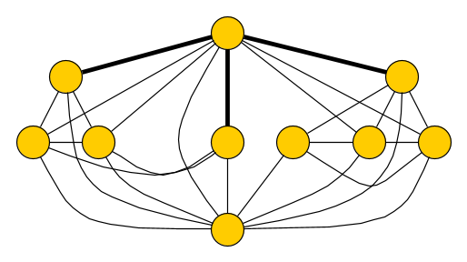
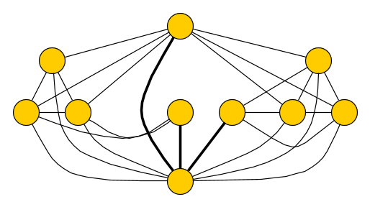
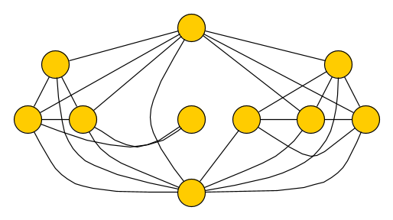

Claw-free Edge Deletion – Background
Input: An undirected graph $G$ and an integer $k$
Parameter: $k$
Question: Is there a set $Y$ of at most $k$ edges such that $G∖Y$ is claw-free,
that is, $G∖Y$does not contain an induced $K_{1,3}$ subgraph?
Deleting an edge to resolve an existing claw, may create a new claw elsewhere
Problem is FPT in time $3^{k}⋅n^{O\left(1\right)}$ by bounded-depth branching
Fits in the broader theme of $H$-free edge modification (addition, removal)
For some $H$, known not to have polynomial kernels unless $NP⊆coNP/poly$
[Kratsch&Wahlström@IPEC’09/Disc. Opt.’13] [Marx&Sandeep@ESA’20/JCSS’22]

Slide 34
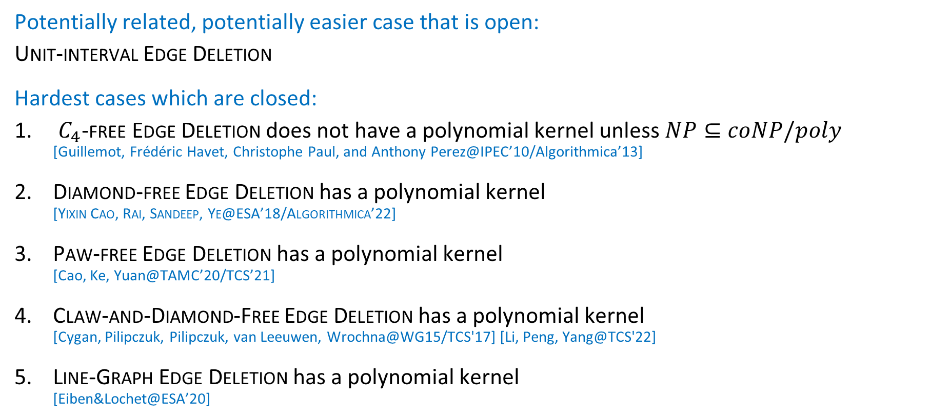
Claw-free Edge Deletion – Open and closed cases
Potentially related, potentially easier case that is open:
Unit-interval Edge Deletion
Hardest cases which are closed:
$C_{4}$-free Edge Deletion does not have a polynomial kernel unless $NP⊆coNP/poly$
[Guillemot, Frédéric Havet, Christophe Paul, and Anthony Perez@IPEC’10/Algorithmica’13]
Diamond-free Edge Deletion has a polynomial kernel
[Yixin Cao, Rai, Sandeep, Ye@ESA’18/Algorithmica’22]
Paw-free Edge Deletion has a polynomial kernel
[Cao, Ke, Yuan@TAMC’20/TCS’21]
Claw-and-Diamond-Free Edge Deletion has a polynomial kernel
[Cygan, Pilipczuk, Pilipczuk, van Leeuwen, Wrochna@WG15/TCS'17] [Li, Peng, Yang@TCS'22]
Line-Graph Edge Deletion has a polynomial kernel
[Eiben&Lochet@ESA’20]

Slide 35
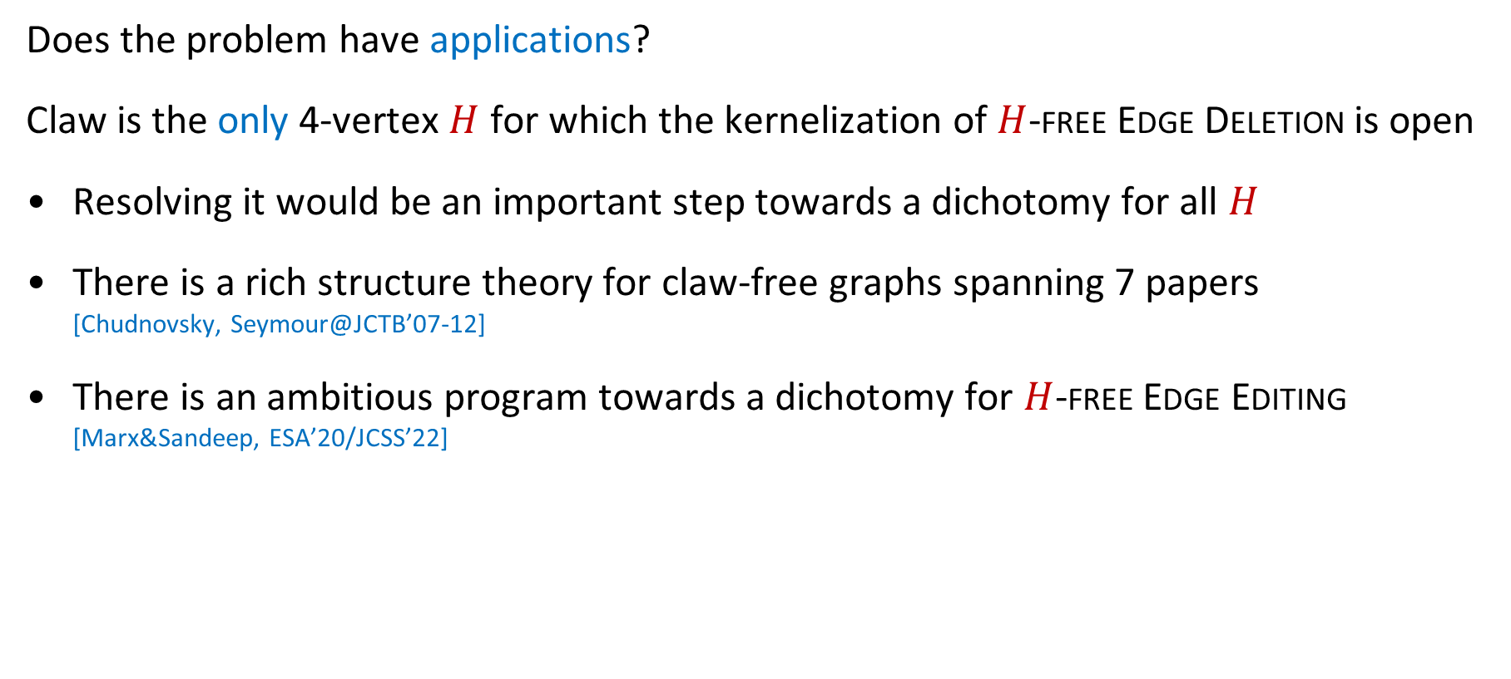
Claw-free Edge Deletion – Relevance and motivation
Does the problem have applications?
Claw is the only 4-vertex $H$ for which the kernelization of $H$-free Edge Deletion is open
Resolving it would be an important step towards a dichotomy for all $H$
There is a rich structure theory for claw-free graphs spanning 7 papers
[Chudnovsky, Seymour@JCTB’07-12]
There is an ambitious program towards a dichotomy for $H$-free Edge Editing
[Marx&Sandeep, ESA’20/JCSS’22]

Slide 36
Claw-free Edge Deletion – Status
While this problem is open since 2013, there has been steady progress over the years
It might be that the answer is positive, but that the technical structural decomposition of Chudnowsky and Seymour is needed to prove it
Yixin Cao: I hope the answer is YES, and the only YES among the remaining unknowns

Slide 38
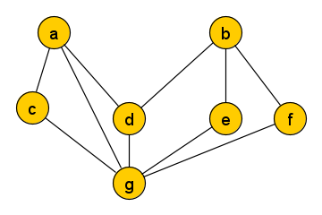
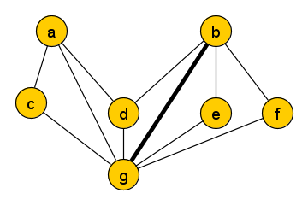
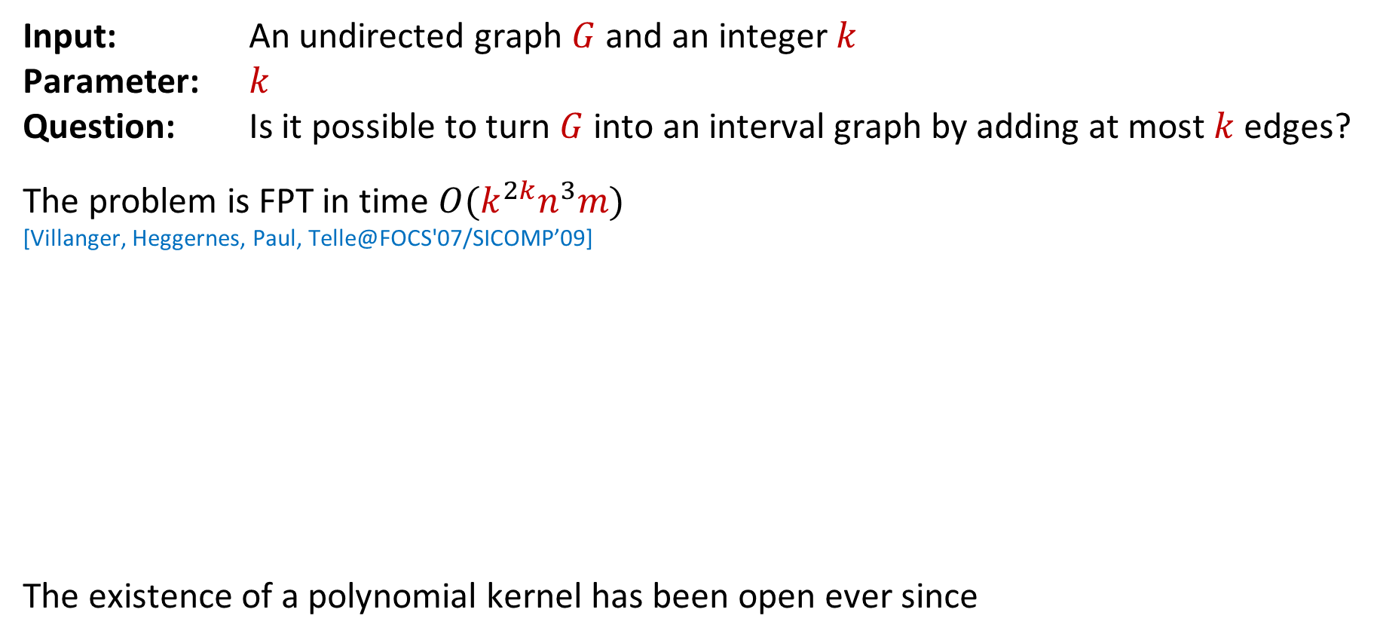
Interval Completion – Background
Input: An undirected graph $G$ and an integer $k$
Parameter: $k$
Question: Is it possible to turn $G$ into an interval graph by adding at most $k$ edges?
The problem is FPT in time $O(k^{2k}n^{3}m)$
[Villanger, Heggernes, Paul, Telle@FOCS'07/SICOMP’09]
The existence of a polynomial kernel has been open ever since
a
b
c
d
e
f
g

Slide 39
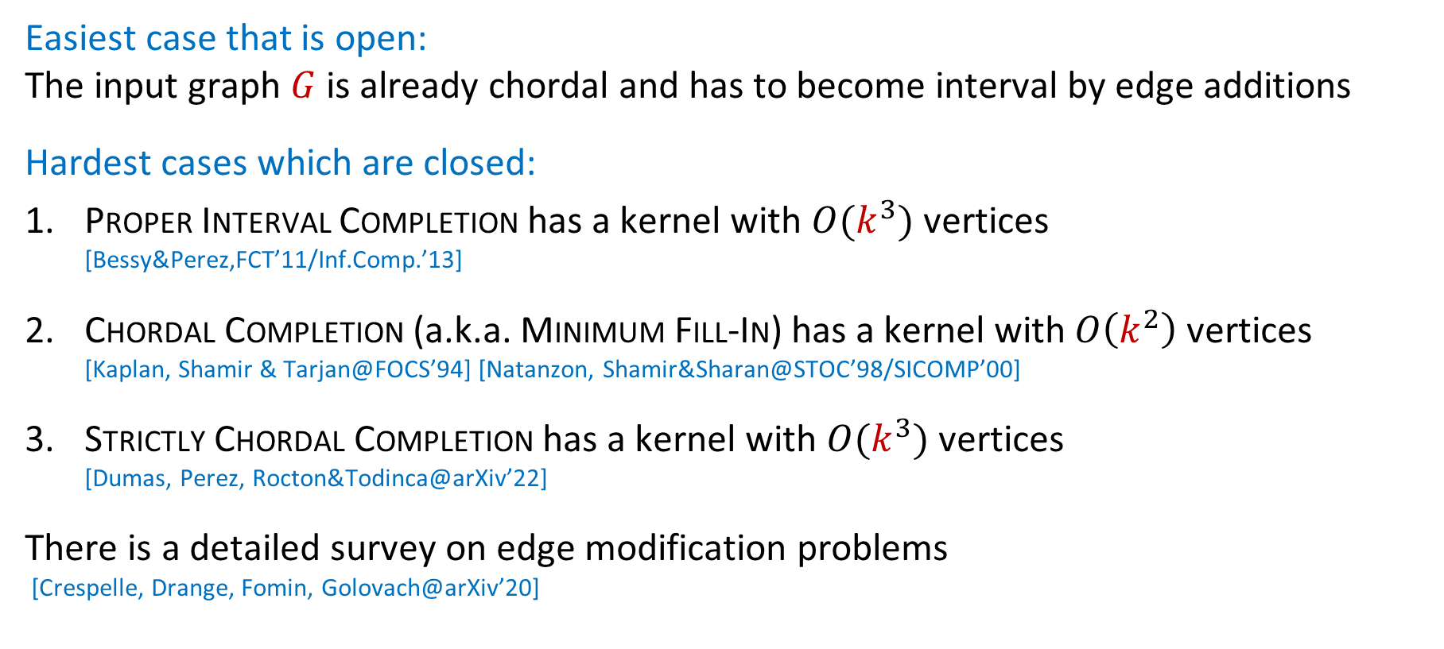
Interval Completion – Open and closed cases
Easiest case that is open:
The input graph $G$ is already chordal and has to become interval by edge additions
Hardest cases which are closed:
Proper Interval Completion has a kernel with $O(k^{3})$ vertices
[Bessy&Perez,FCT’11/Inf.Comp.’13]
Chordal Completion (a.k.a. Minimum Fill-In) has a kernel with $O\left(k^{2}\right)$ vertices
[Kaplan, Shamir & Tarjan@FOCS’94] [Natanzon, Shamir&Sharan@STOC’98/SICOMP’00]
Strictly Chordal Completion has a kernel with $O(k^{3})$ vertices
[Dumas, Perez, Rocton&Todinca@arXiv’22]
There is a detailed survey on edge modification problems
[Crespelle, Drange, Fomin, Golovach@arXiv’20]
Notes:
Strictly chordal = chordal and dart,gem-free, which are the graphs you get from a block graph (each biconnected component is a clique) by adding true-twin copies of vertices.

Slide 40
Interval Completion – Relevance, motivation, status
The problem has applications in profile minimization for sparse matrix storage
Chordal Completion is about optimizing Gaussian elimination on sparse matrices
Interval graphs form a natural and well-studied graph class
The completion problem is an elegant unresolved edge modification problem
Relatively few respondents indicated interest in this problem
Notes:
Is there anything else to motivate this problem?

Slide 42
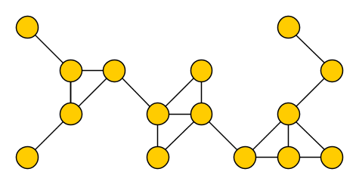








Turing kernel for $k$-Path – Background
Input: An undirected graph $G$ and an integer $k$
Parameter: $k$
Question: Does $G$ contain a simple path on $k$ vertices?
Famously FPT by color-coding, current-best algorithm runs in time ${1.66}^{k}⋅k^{O\left(1\right)}⋅m$
[Alon, Yuster&Zwick@STOC’94/JACM’95] [Björklund, Husfeldt, Kaski, Koivisto@JCSS’17]
$k$-Path inspired the composition & distillation framework for kernel lower bounds
No polynomial kernel unless $NP⊆coNP/poly$, not even on planar cubic graphs
[Bodlaender, Downey, Fellows&Hermelin@ICALP’08/JCSS’09
Can you solve $k$-Path in polynomial time,
using an oracle that solves instances of size $k^{O\left(1\right)}$in constant time?
Notes:
Mention technique: by extremal results, we can decompose into a tree decomposition of constant adhesion and bags of size $poly(k)$.

Slide 43



Turing kernel for $k$-Path – Open and closed cases
Hardest cases which are closed:
Polynomial Turing kernel when $G$ is planar or has bounded degree
[J@ESA’14/JCSS’17]
... or when $G$is $H$-topological-minor-free for some fixed $H$
[J, Marcin Pilipczuk, Wrochna@IPEC’17/Algorithmica’19]
Easiest cases which are open:
The input graph is chordal
The input graph has bounded expansion or bounded twinwidth
Exact $k$-Cycle on planar graphs
Planar $≥k$-Cycle is known to admit a polynomial Turing kernel

Slide 44

Turing kernel for $k$-Path – Relevance and motivation
One of the original motivations for the problem:
Can you bypass the impossibility result by relaxing the model of kernelization?
The Turing kernel for the planar case already answers this question affirmatively
... since the lower bound even applies to planar graphs
It is not clear that a polynomial Turing kernel would lead to faster solutions
The existing FPT algorithm is linear in the size of the graph: ${1.66}^{k}⋅k^{O\left(1\right)}⋅m$
A Turing kernel that makes $Ω(m)$ queries for $k$-path on graphs of size $O(k)$,
will not lead to a better worst-case running time
An adaptive Turing kernel would also not allow you to do the work in parallel

Slide 45

Turing kernel for $k$-Path – Relevance and motivation
One of the original motivations for the problem:
Can you bypass the impossibility result by relaxing the model of kernelization?
The Turing kernel for the planar case already answers this question affirmatively
... since the lower bound even applies to planar graphs
It is not clear that a polynomial Turing kernel would lead to faster solutions
Yet, the problem forms an ``obvious hole’’ in our knowledge
If it gets resolved, it may help to decide other, more complex problems of this type
A negative answer would close the Turing-kernelization trichotomy for
$H$-Subgraph Testing for each hereditary family $ℱ$ of pattern graphs $H∈ℱ$
[J&Marx, SODA’15]

Slide 46
Turing kernel for $k$-Path – Status
The problem on general graphs is not known to be WK[1] or MK[2] hard
My guess: there is a polynomial Turing kernel
The known Turing kernels for restricted graph classes all exploit technical lower bounds on the circumference of triconnected graphs, as a black box
Perhaps it helps to open up the black box and use its results adaptively while communicating with the oracle
But I am not convinced the required effort is well-spent
Stefan Kratsch: We probably lack the tools for a negative answer

Slide 47


Slide 48

Turing kernel lower bounds – Background
For traditional kernels, there is a lower-bound framework assuming $NP⊈coNP/poly$
[Bodlaender, Downey, Fellows&Hermelin@ICALP’08/JCSS’09] [Fortnow&Santhanam@STOC’08/JCSS’11]
We have no tools to exclude polynomial-size Turing kernels under established conjectures in classic complexity
There is a hardness framework via MK[2] and WK[1], based on unproven conjectures
[Hermelin, Kratsch, Soltys, Wahlström, Wu@IPEC’13/Algorithmica’15]
The following problem is WK[1]-complete:
Connected Vertex Cover $(k)$
Input: An undirected graph $G$ and integer $k$
Parameter: $k$
Question: Does $G$ have a vertex cover $S$ with $\left|S\right|≤k$ and $G[S]$ connected?

Slide 49

Turing kernel lower bounds – Background
For traditional kernels, there is a lower-bound framework assuming $NP⊈coNP/poly$
[Bodlaender, Downey, Fellows&Hermelin@ICALP’08/JCSS’09] [Fortnow&Santhanam@STOC’08/JCSS’11]
We have no tools to exclude polynomial-size Turing kernels under established conjectures in classic complexity
There is a hardness framework via MK[2] and WK[1], based on unproven conjectures
[Hermelin, Kratsch, Soltys, Wahlström, Wu@IPEC’13/Algorithmica’15]
The following problem is MK[2]-complete:
CNF-SAT $(n)$
Input: A CNF formula $φ$ on $n$ variables, with clauses of arbitrary size
Parameter: $n$
Question: Is $φ$ satisfiable?
Notes:
The edge clique cover result only works because it is still NP-hard when the parameter is log k.

Slide 50

Turing kernel lower bounds – Background
For traditional kernels, there is a lower-bound framework assuming $NP⊈coNP/poly$
[Bodlaender, Downey, Fellows&Hermelin@ICALP’08/JCSS’09] [Fortnow&Santhanam@STOC’08/JCSS’11]
We have no tools to exclude polynomial-size Turing kernels under established conjectures in classic complexity
There is a hardness framework via MK[2] and WK[1], based on unproven conjectures
[Hermelin, Kratsch, Soltys, Wahlström, Wu@IPEC’13/Algorithmica’15]
$$MK\left[1\right]⊆WK\left[1\right]⊆MK\left[2\right]⊆WK\left[2\right]⊆…⊆FPT$$
MK[1] contains problems that have a polynomial-size compression into NP
It is conjectured that WK[1]- or MK[2]-hard problems do not have poly Turing kernels
Notes:
The edge clique cover result only works because it is still NP-hard when the parameter is log k.

Slide 51
Turing kernel lower bounds – Open and closed cases
Hardest cases which are closed:
Edge Clique Cover does not have a polynomial-size Turing kernel unless every problem in NP has a quasi-polynomial-sized circuit family
[Ludo@TCS’22]
Turing kernelization is unconditionally more powerful than standard kernelization
[Witteveen, Bottesch&Torenvliet@SOFSEM’19]
Many problems are known to be MK[2] or WK[1]-hard under PPTs
Easiest (to state) case that is open:
Does CNF-SAT parameterized by #variables have a polynomial Turing kernel?
Notes:
The edge clique cover result only works because it is still NP-hard when the parameter is log k.

Slide 52

Turing kernel lower bounds – Relevance
From a complexity-theoretic point of view, the problem is still very relevant
Given the success of kernelization and its lower bound theory,
it is an intriguing and challenging open direction
It seems to lie firmly beyond the reach of existing tools in complexity theory
The story is different from the viewpoint of an algorithm designer working on FPT
If you believe that MK[2] and WK[1]-hard problems have no poly Turing kernels,
then most questions are settled
Turing kernelization only gives an advantage in very few cases
The $k$-Path problem is a notorious exception; unknown to be WK[1]-hard

Slide 53

Turing kernel lower bounds – Status
The problem has had a lot of attention from complexity experts
[Drucker@FOCS’12/SICOMP’15]
It is not amenable to information-theoretic proofs like for OR-distillation
During the process, the algorithm can communicate the entire input to the oracle
... but the oracle only sees small chunks of it at a time
Existing proof techniques work against Turing kernels that communicate $k^{O\left(1\right)}$ bits
The authors of the WK[..]-framework are not 100% convinced their conjectures hold
Danny Hermelin: If I had to pick a favorite problem, it would be complexity theoretic results to exclude polynomial Turing kernels. At the time I thought about this a lot.
Notes:
Do YOU think WK[1]- or MK[2]-hardness rules out polynomial Turing kernelization?

Slide 54


Slide 55


Vertex Multiway Cut – Background
Input: Undirected graph $G$, terminals $T⊆V(G)$, integer $k$
Parameter: $k$
Question: Is there a set $X⊆V\left(G\right)∖T$ of size at most $k$, such that
each connected component of $G∖X$ has at most one terminal?

Slide 56


Vertex Multiway Cut – Background
Input: Undirected graph $G$, terminals $T⊆V(G)$, integer $k$
Parameter: $k$
Question: Is there a set $X⊆V\left(G\right)∖T$ of size at most $k$, such that
each connected component of $G∖X$ has at most one terminal?
Fixed-parameter tractable using important separators
[Marx@IPEC’04/TCS’06]
Question about a polynomial kernel dates back as far as WORKER 2010

Slide 57

Vertex Multiway Cut – Open and closed cases
Hardest cases which are closed:
There is a kernel with $O\left(k^{1486}\right)$ vertices when the input is planar
[J, Marcin Pilipczuk & van Leeuwen@STACS’19/SIDMA’21]
There is a polynomial kernel when you are allowed to delete terminals
[Kratch&Wahlström@FOCS’12/JACM’20]
There is a polynomial kernel when the number of terminals is $O(1)$
[Kratch&Wahlström@FOCS’12/JACM’20]
There is a quasi-polynomial kernel for the edge-deletion variant
[Wahlström@ICALP’20/TALG’22]
Easiest case that is open:
The terminals have bounded degree, or even all vertices (for edge deletion)

Slide 58
Vertex Multiway Cut – Relevance and motivation
The Encyclopedia of Algorithms says:
Multiway Cut is used in computer vision
It has applications in parallel and distributed computing, as well as in chip design
I am not convinced this is still the case, but:
The deletable-terminal case led to matroid-based representative sets
They found lots of applications elsewhere
There are also connections to mimicking networks (for cuts, matchings, multiway cuts, etc.) which are of independent interest
The matroid-based kernel for the deletable-terminal case is not practical
... but LP-based preprocessing for Multiway Cut is surprisingly effective
[Pilipczuk&Ziobro@arXiv’18]

Slide 59
Vertex Multiway Cut – Status
It is still an active research direction with occasional progress
Unclear in which direction the answer will go; I hope it will be positive
Magnus Wahlström: Even though this problem has seen a lot of research time, it does not seem like a complete brick wall (unlike DFVS)
Notes:
Poll for the outcome?

Slide 60


Slide 61


Slide 62















Linear-element kernel for $d$-Hitting Set – Background
Input: Set $U$, integer $k$, and a collection $ℱ=F_{1},…, F_{m}⊆U$ of size-$d$ subsets
Parameter: $k$
Question: $∃S⊆U$ with $\left|S\right|≤k$ and $S∩F_{i}≠∅$ for all $i∈[m]$?
Does the problem admit a kernel with $O(k)$ universe elements?
$$x$$
$$y$$
$$g$$
$$i$$
$$U$$
$$f$$
$$e$$
$$h$$
$$c$$
$$z$$
$$j$$
$$b$$
$$a$$
$$d$$

Slide 63

Linear-element kernel for $d$-Hitting Set – Background
Input: Set $U$, integer $k$, and a collection $ℱ=F_{1},…, F_{m}⊆U$ of size-$d$ subsets
Parameter: $k$
Question: $∃S⊆U$ with $\left|S\right|≤k$ and $S∩F_{i}≠∅$ for all $i∈[m]$?
The sunflower lemma gives a kernel with $O(k^{d})$ sets and elements, bitsize $O\left(k^{d}\log{k}\right)$
[Erdős&Rado@’60] [Flum&Grohe@’06]
The sunflower-based kernel can be computed in linear time or logarithmic space
[Bevern@COCOON’12/Algorithmica’13] [Kratsch&Fafianie@MFCS’15]
There is an improved kernel with $O\left(k^{d−1}\right)$ elements and $O(k^{d})$ sets
[Abu-Khzam@WADS’07/JCSS’10]
There is no kernel with bitsize $O(k^{d−ε})$ for any $ε>0$ unless $NP⊆coNP/poly$
[Dell&van Melkebeek@STOC’10/JACM’14]
Notes:
... so the worst-case number of sets in the kernel cannot be improved.

Slide 64


Linear-element kernel for $d$-Hitting Set – Open and closed cases
Many problems on graphs are implicit $d$-Hitting Set problems
Easiest cases which are open:
Triangle-Free Vertex Deletion
Feedback Vertex Set on Tournaments (there is a kernel with $O(k^{1+\frac{O\left(1\right)}{\sqrt{\log{k}}}})$ vertices)
[Bessy, Bougeret, Thilikos, Wiederrecht@SODA’23]
Hardest cases which are closed:
Cluster Vertex Deletion has a kernel with $O(k)$ vertices
[Bessy, Bougeret, Thilikos, Wiederrecht@arXiv’23]
The $H$-free Vertex Deletion problem on planar or bounded-expansion input graphs
[Bodlaender, Fomin, Lokshtanov, Penninkx, Saurabh, Thilikos@FOCS’09/JACM’16] [Ahn, Kim&Kwon@arXiV’22]

Slide 65

Linear-element kernel for $d$-Hitting Set – Relevance & motivation
Many interesting problems are special cases of $d$-Hitting Set
Results for the general version can find many applications
From the perspective of reducing bitsize, the existing kernels are already optimal
If a kernel with $O(k)$ elements is found, it will not improve the encoding size
It is not clear it will improve the running time of follow-up FPT algorithms
Perhaps such a kernel could lead to faster exact exponential-time algorithms

Slide 66

Linear-element kernel for $d$-Hitting Set – Status
Even very special cases for $d=3$, encoded implicitly on graphs, are elusive
Triangle-free Vertex Deletion and Feedback Vertex Set in Tournaments have been studied intensively
The faith of $d$-Hitting Set seems linked to $d$-Set Packing, although not formally proven
Meirav Zehavi: If I have to guess, I'd guess that the answer is negative

