Slide 1
Characterizing the Easy-to-Find Subgraphs from the Viewpoint of Polynomial-Time Algorithms, Kernels, and Turing Kernels
Bart M. P. Jansen
Dániel Marx
January 16th, Computer Science Seminar, Edinburgh

Slide 2
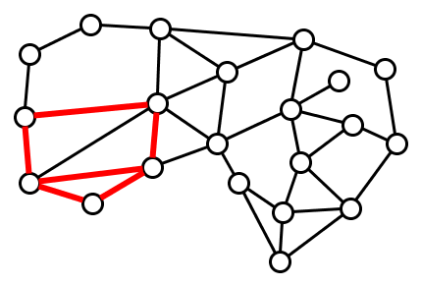
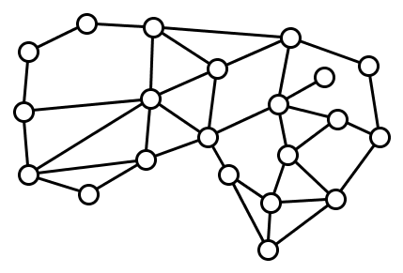
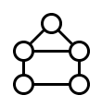

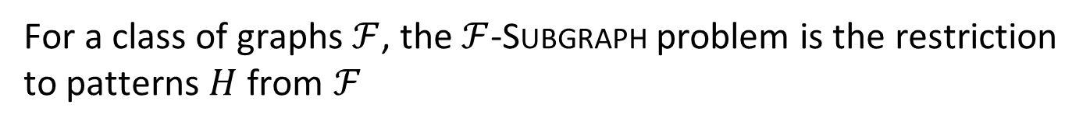
The Subgraph problem
Input: Host graph $G$, pattern graph $H$
Question: Does $G$ contain a subgraph isomorphic to $H$?
Does contain ?
For a class of graphs $ℱ$, the $ℱ$-Subgraph problem is the restriction to patterns $H$ from $ℱ$

Slide 3
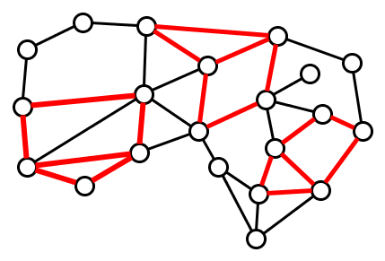
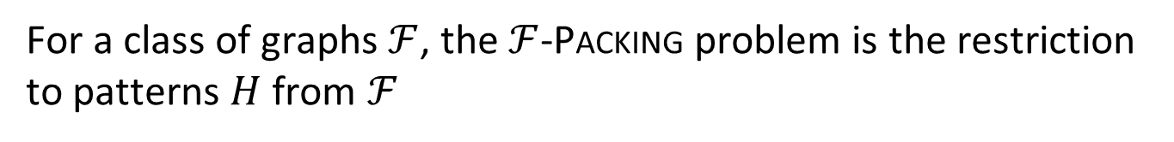


The Packing problem
Input: Host graph $G$, pattern graph $H$, integer $t$
Question: Does $G$ contain $t$ vertex-disjoint subgraphs, each isomorphic to $H$?
Does contain $3$ ?
For a class of graphs $ℱ$, the $ℱ$-Packing problem is the restriction to patterns $H$ from $ℱ$

Slide 4
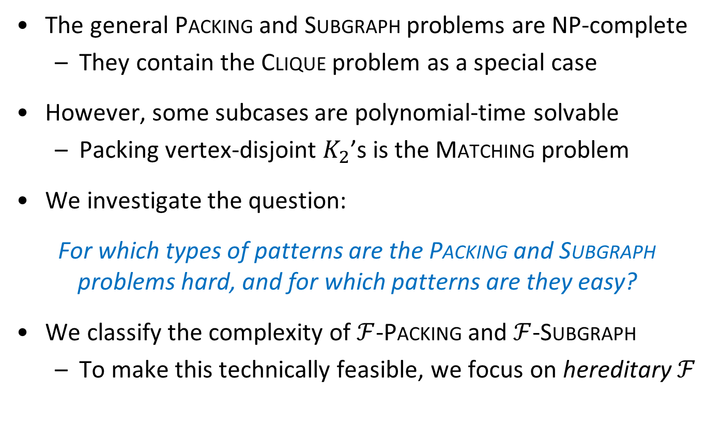
Complexity depends on the type of pattern
The general Packing and Subgraph problems are NP-complete
  They contain the Clique problem as a special case
However, some subcases are polynomial-time solvable
  Packing vertex-disjoint $K_{2}$’s is the Matching problem
We investigate the question:
For which types of patterns are the Packing and Subgraph problems hard, and for which patterns are they easy?
We classify the complexity of $ℱ$-Packing and $ℱ$-Subgraph
  To make this technically feasible, we focus on hereditary $ℱ$

Slide 5
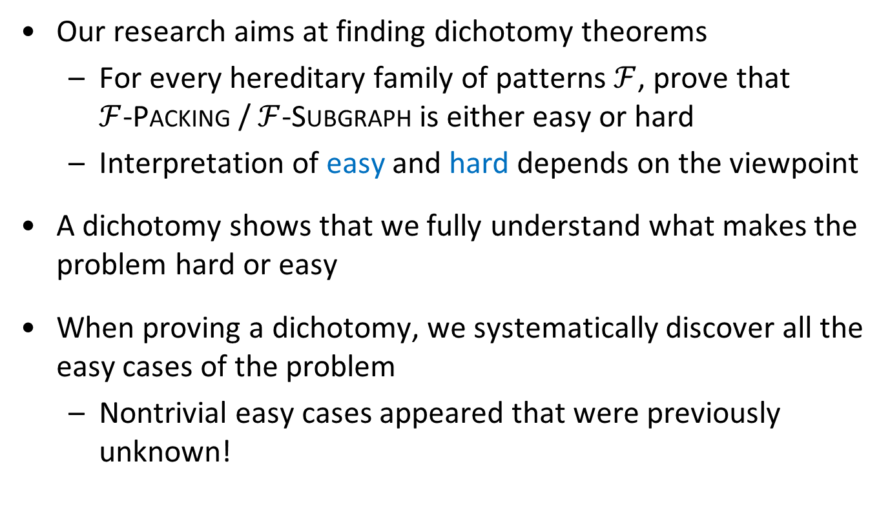
Characterizing the complexity of a pattern
Our research aims at finding dichotomy theorems
  For every hereditary family of patterns $ℱ$, prove that
  $ℱ$-Packing / $ℱ$-Subgraph is either easy or hard
  Interpretation of easy and hard depends on the viewpoint
A dichotomy shows that we fully understand what makes the problem hard or easy
When proving a dichotomy, we systematically discover all the easy cases of the problem
  Nontrivial easy cases appeared that were previously unknown!

Slide 6
Ingredients of our dichotomy theorems
Algorithms for the easy cases of the problem
Hardness proofs for a small number of representative hard cases
Ramsey-theoretic argument: every family of patterns that does not satisfy the characterizing property, contains a hard subfamily
A combinatorial characterization of the families $ℱ$ for which the problem is easy
A combinatorial characterization of the families ℱ for which the problem is easy

Slide 7
Polynomial-time solvability
Viewpoint I

Slide 8

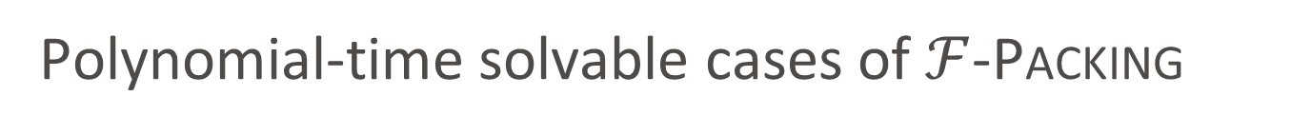
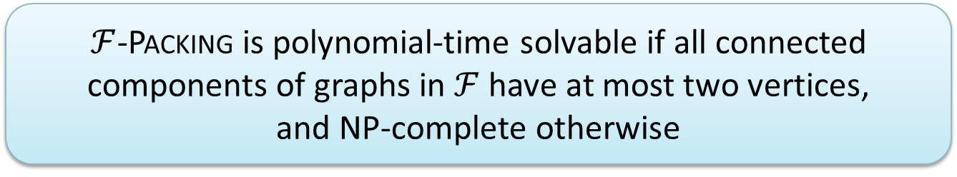
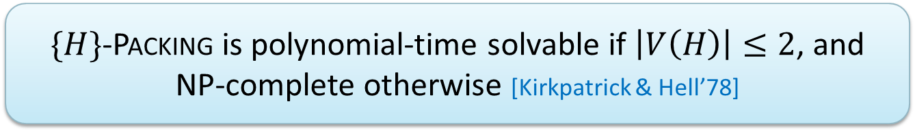
Polynomial-time solvable cases of $ℱ$-Packing
Complexity of packing connected graphs $H$ is well-understood
This easily extends to $ℱ$-Packing for hereditary families $ℱ$ of (possibly disconnected) pattern graphs
$\{H\}$-Packing is polynomial-time solvable if $\left|V\left(H\right)\right|≤2$, and NP-complete otherwise [Kirkpatrick & Hell’78]
$ℱ$-Packing is polynomial-time solvable if all connected components of graphs in $ℱ$ have at most two vertices,
and NP-complete otherwise

Slide 9
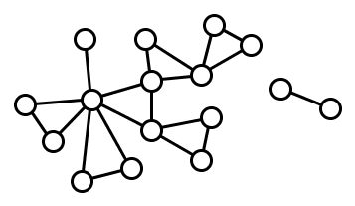
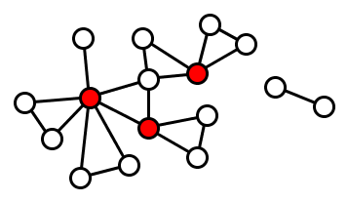
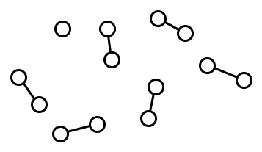

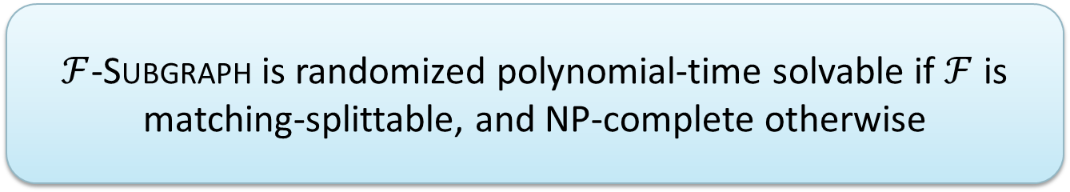
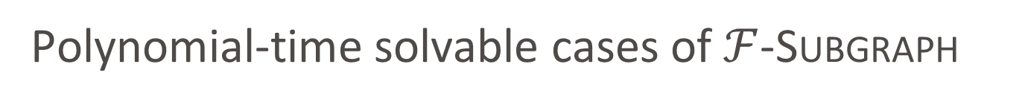
Polynomial-time solvable cases of $ℱ$-Subgraph
A graph $H$ is $c$-matching-splittable if
  there is a set $S$ of at most $c$ vertices, such that
  every component of $H−S$ has at most two vertices
A graph family $ℱ$ is matching-splittable if there is a constant $c$ such that every graph $H∈ℱ$ is $c$-matching-splittable
$ℱ$-Subgraph is randomized polynomial-time solvable if $ℱ$ is matching-splittable, and NP-complete otherwise

Slide 10
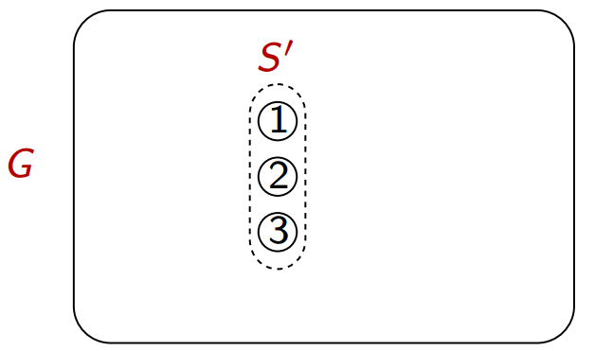
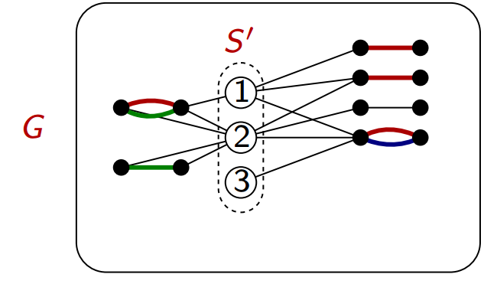
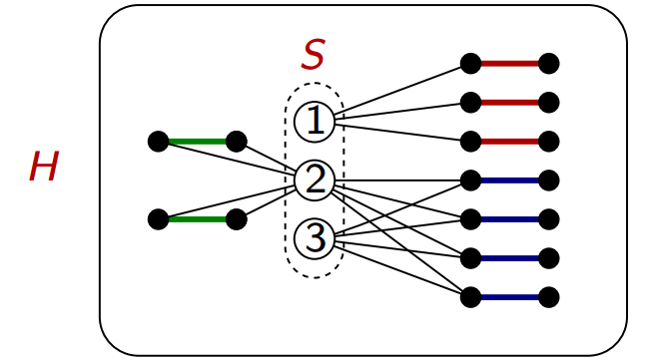
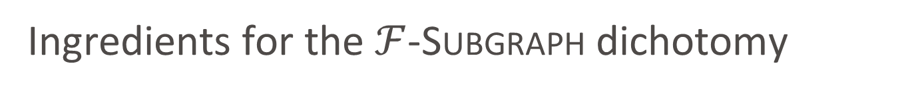
Ingredients for the $ℱ$-Subgraph dichotomy
Randomized polynomial-time algorithm to test for the existence of a perfect matching of exactly a given weight [Mulmuley, Vazirani, Vazirani’87]
NP-completeness proofs for Triangle Packing, $P_{3}$-Packing, Clique, and Biclique
NP-completeness proofs for Triangle Packing, 𝑃_3-Packing, Clique, and Biclique
Hereditary families $ℱ$ that are not matching-splittable contain all cliques, bicliques, unions of triangles, or unions of $P_{3}$’s
Hereditary families ℱ that are not matching-splittable contain all cliques, bicliques, unions of triangles, or unions of 𝑃_3’s
Matching-splittable graph families characterize the easy cases

Slide 11
kernelization
Viewpoint II

Slide 12
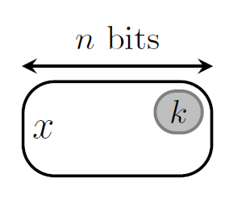

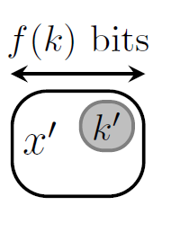
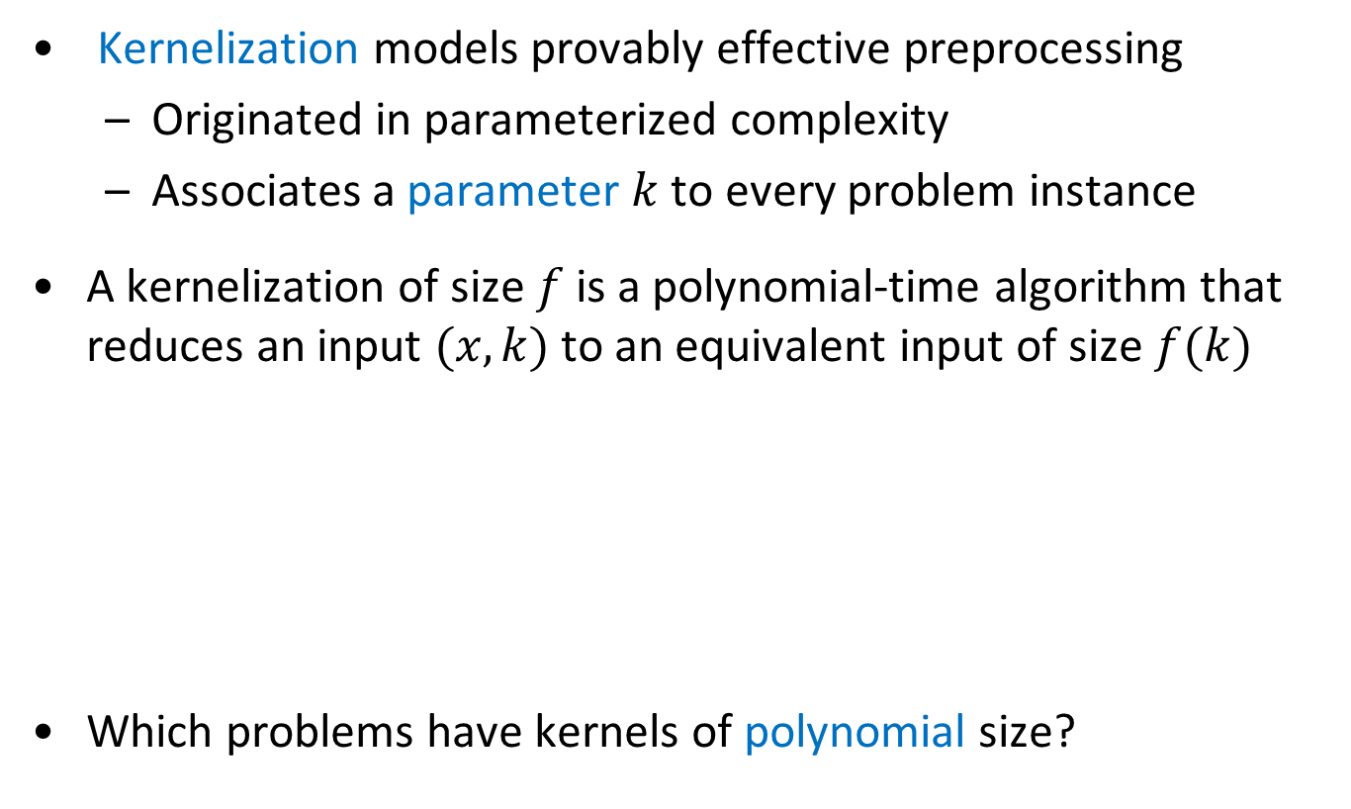
Kernelization
Kernelization models provably effective preprocessing
  Originated in parameterized complexity
  Associates a parameter $k$ to every problem instance
A kernelization of size $f$ is a polynomial-time algorithm that reduces an input $(x,k)$ to an equivalent input of size $f(k)$
Which problems have kernels of polynomial size?

Slide 13
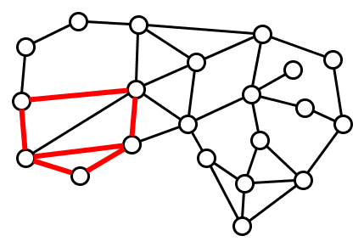
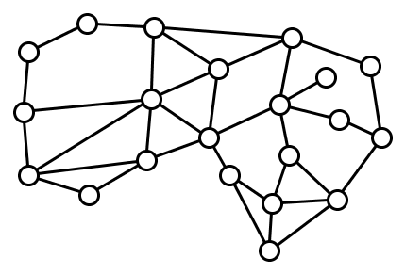
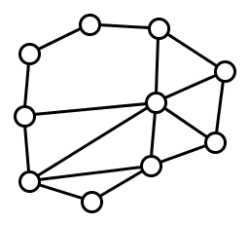

Kernelization for Subgraph and Packing
We choose $k$ to be the size of the solution
  For Subgraph, $k≔|V\left(H\right)|$
  For Packing, $k≔t⋅|V\left(H\right)|$
For which $ℱ$ can an instance of $ℱ$-Subgraph/$ℱ$-Packing be reduced to an equivalent one of size $poly(k)$?
“Easy $ℱ$”:
  has a kernel whose size is a polynomial of degree depending on $ℱ$, but not on $H$
“Hard $ℱ$”:
  no polynomial kernel whose degree is independent of $H$ (under some complexity-theoretic assumption)
Does contain ?

Slide 14
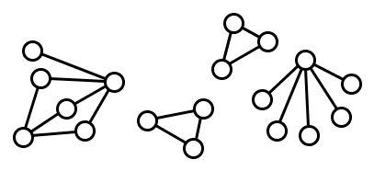
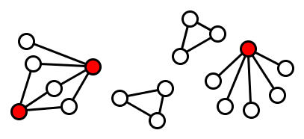


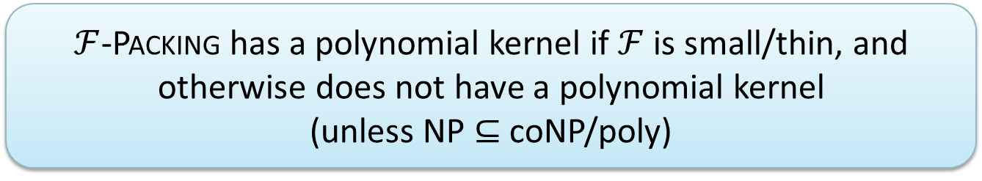
Kernelizable cases of $ℱ$-Packing
A graph $H$ is $a$-small/$b$-thin if every connected component
  has at most $a$ vertices, or
  is a bipartite graph whose smallest side has size at most $b$
A graph family $ℱ$ is small/thin if there are constants $a,b$ such that every graph $H∈ℱ$ is $a$-small/$b$-thin
3-small/2-thin
$ℱ$-Packing has a polynomial kernel if $ℱ$ is small/thin, and otherwise does not have a polynomial kernel
(unless NP $⊆$ coNP/poly)

Slide 15
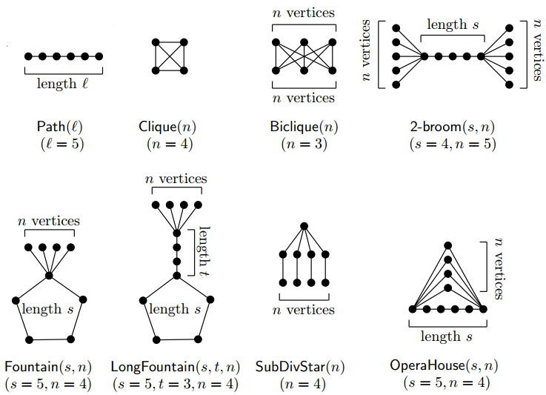
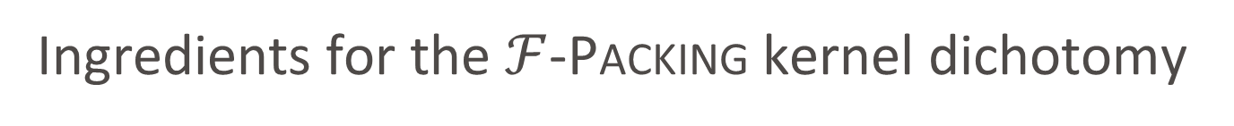
Ingredients for the $ℱ$-Packing kernel dichotomy
Sunflower lemma [Erdös & Rado‘60] for small components, novel marking procedure for thin bipartite components
Kernelization lower bounds by cross-composition and polynomial-parameter transformations from Uniform Exact Small Universe Set Cover
Hereditary $ℱ$ that are not small/thin contain one of 8 hard families, using [Atminas, Lozin, Razgon’12]: large path implies large induced path, clique, or induced biclique
Hereditary ℱ that are not small/thin contain one of 8 hard families, using [Atminas, Lozin, Razgon’12]: large path implies large induced path, clique, or induced biclique
Small/thin graph families characterize the easy cases

Slide 16
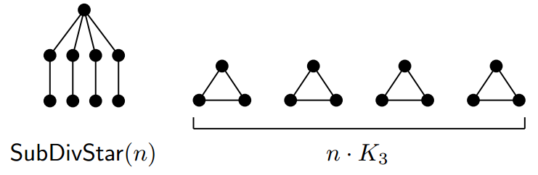
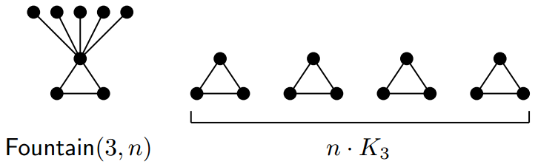
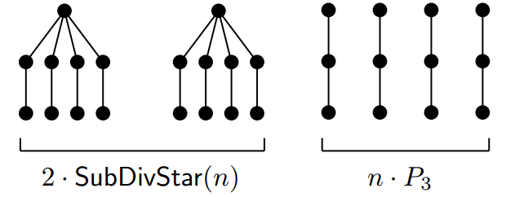
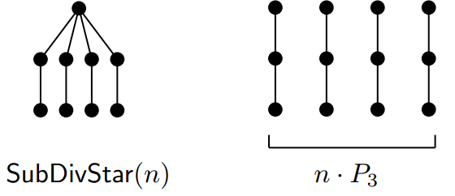


Kernelizable cases of $ℱ$-Subgraph?
We do not have a dichotomy for kernelization for $ℱ$-Subgraph
  If such a theorem exists, it must be a lot more fragile than for case of Packing
Consider the following concrete examples:
No polynomial kernel
Polynomial kernel

Slide 17
Turing kernelization
Viewpoint III

Slide 18
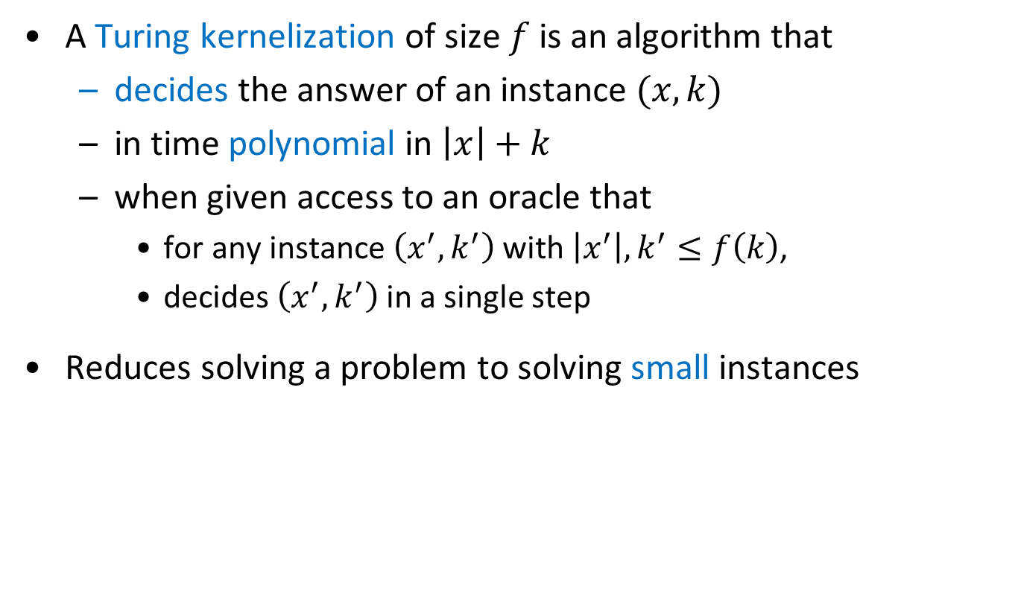
Turing kernelization
A Turing kernelization of size $f$ is an algorithm that
  decides the answer of an instance $(x,k)$
  in time polynomial in $\left|x\right|+k$
  when given access to an oracle that
    for any instance $\left(x^{′},k^{′}\right)$ with $\left|x^{′}\right|,k^{′}≤f\left(k\right)$,
    decides $\left(x^{′},k^{′}\right)$ in a single step
Reduces solving a problem to solving small instances

Slide 19
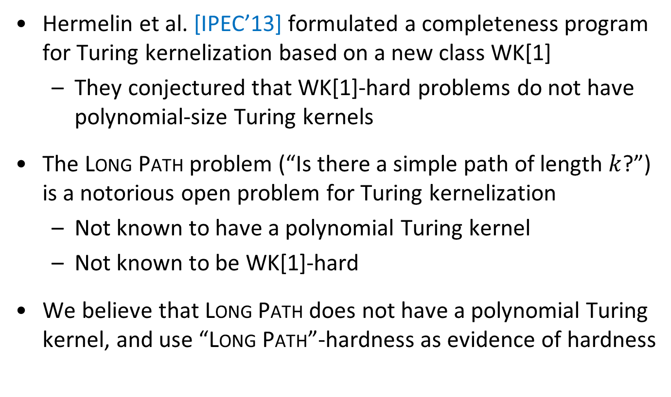
Long Path-hardness
Hermelin et al. [IPEC’13] formulated a completeness program for Turing kernelization based on a new class WK[1]
  They conjectured that WK[1]-hard problems do not have polynomial-size Turing kernels
The Long Path problem (“Is there a simple path of length $k$?”) is a notorious open problem for Turing kernelization
  Not known to have a polynomial Turing kernel
  Not known to be WK[1]-hard
We believe that Long Path does not have a polynomial Turing kernel, and use “Long Path”-hardness as evidence of hardness

Slide 20
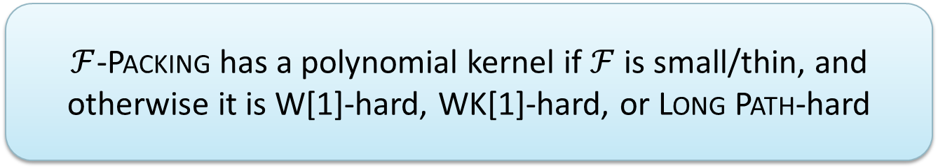
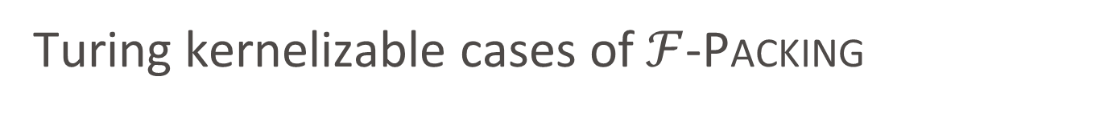
Turing kernelizable cases of $ℱ$-Packing
For the Packing problem, Turing kernelization is not more powerful than normal kernelization
  A normal kernel also qualifies as Turing kernel
For the Subgraph problem, Turing kernelization is more powerful
$ℱ$-Packing has a polynomial kernel if $ℱ$ is small/thin, and otherwise it is W[1]-hard, WK[1]-hard, or Long Path-hard

Slide 21
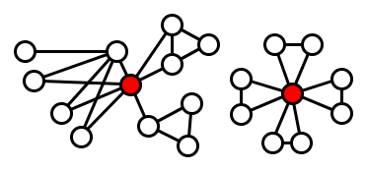
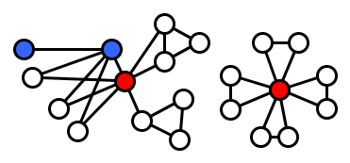
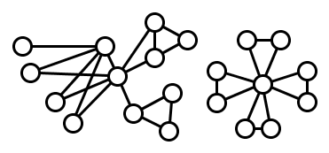




Turing kernelizable cases of $ℱ$-Subgraph
A graph $H$ is $(a,b,c,d)$-splittable if there is a set $S$ of at most $c$ vertices such that every component $C$ of $H−S$:
  has at most $a$ vertices, or
  is a $b$-thin bipartite graph in which the closed neighborhoods of at most $d$ vertices are not universal to $N_{H}\left(C\right)∩S$
A graph family $ℱ$ is splittable if there are constants $a,b,c,d$ such that every graph $H∈ℱ$ is $(a,b,c,d)$-splittable
$(3,1,2,2)$-splittable
$ℱ$-Subgraph has a polynomial Turing kernel if $ℱ$ is splittable, and otherwise it is W[1]-hard, WK[1]-hard, or Long Path-hard

Slide 22

Conclusion
We proved dichotomy theorems for $ℱ$-Packing and $ℱ$-Subgraph
  Three viewpoints: polynomial-time solvable, kernelizable, Turing kernelizable
Our work shows that proving dichotomy theorems is feasible, and aiming for them is a realistic goal
  See also Dániel Marx’s MFCS talk: “Every graph is easy or hard”
Proving dichotomy theorems led us to the fact that thin bipartite graphs are easy to find and pack
Thank you!

