Slide 1
Kernelization for a Hierarchy of Structural Parameters
Bart M. P. Jansen
Third Workshop on Kernelization
2-4 September 2011, Vienna
Notes:
TODO: Add slide explaining k-Path with structural parameters. Copy result for coloring and for k-Path.

Slide 2


Outline
Motivation
Hierarchy of structural parameters
Case studies
Vertex Cover / Independent Set
Graph Coloring
Long Path & Cycle Problems
Importance of treewidth to kernelization
Conclusion and open problems

Slide 3
Motivations for structural parameters
They can be smaller than the natural parameter
Stronger preprocessing (Vertex Cover, Two-Layer Planarization)
The natural parameter might not admit polynomial kernels
Because it is NP-complete for fixed k (Graph Coloring)
Because it is compositional (Long Path)
Alternative direction to kernels for restricted graph classes
Change the parameter instead of the class of inputs
Connections to practice
Guide the search for reduction rules which exploit different properties of an instance
Help explain why known heuristics work (Treewidth)
Fundamentals
Gives a complete picture of the power of preprocessing

Slide 4
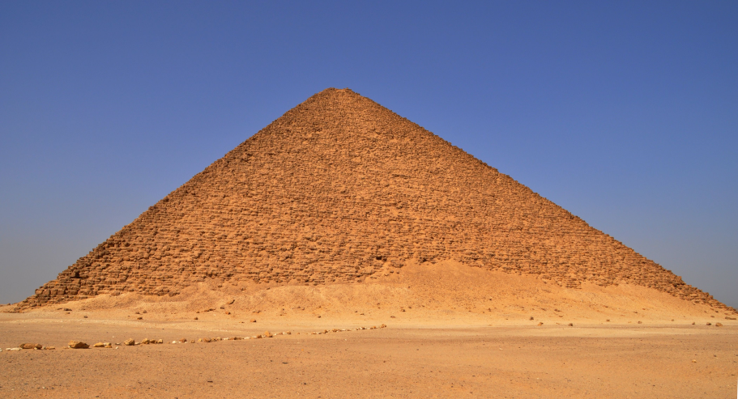
a hierarchy of parameters

Slide 5
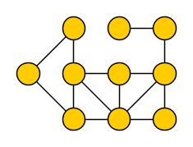
Some well-known parameters
Vertex Cover number
  Size of the smallest set intersecting each edge

Slide 6
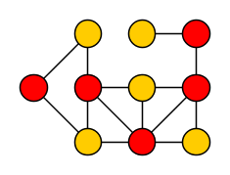
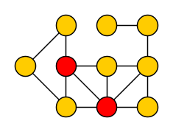
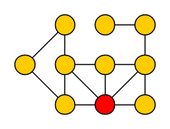
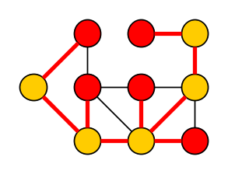
Some well-known parameters
Vertex Cover number
  Size of the smallest set intersecting each edge
≥
Feedback Vertex number
  Size of the smallest set intersecting each cycle
≥
Odd Cycle Transversal number
  Size of the smallest set intersecting all odd cycles
Max Leaf Spanning tree nr
  Maximum # leaves in a spanning tree

Slide 7
Structural graph parameters
Let F be a class of graphs
Parameterize by this deletion distance for various F [Cai’03]
If F‘ ⊆ F then d(G, F) ≤ d(G, F’)
If graphs in F have treewidth at most c:
  tw(G) ≤ d(G, F) + c
For a graph G, the deletion distance d(G, F) to F is
the minimum size of a vertex set X such that G – X ∈ F

Slide 8
Some well-known parameters
Vertex Cover number
  Deletion distance to an independent set
≥
Feedback Vertex number
  Deletion distance to a forest
≥
Odd Cycle Transversal number
  Deletion distance to a bipartite graph
Max Leaf Spanning tree nr
  …

Slide 9
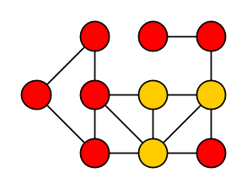
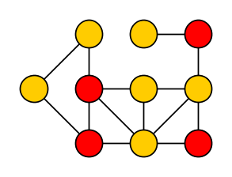
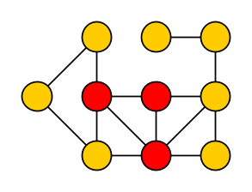
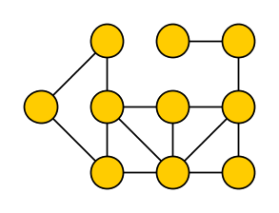
Some lesser-known parameters
Clique Deletion number
  Deletion distance to a single clique
≥
Cluster Deletion number
  Deletion distance to a disjoint union of cliques
Linear Forest number
  Deletion distance to a disjoint union of paths
Outerplanar Deletion number
  Distance to planar with all vertices on the outer face

Slide 10
Vertex Cover
Distance to Clique
Max Leaf #
Distance to Co-cluster
Distance to Cluster
Distance to linear forest
Does problem X have a polynomial kernel when parameterized by the size of a given deletion set to a linear forest?
Distance to split graph components
Distance to Cograph
Distance to Interval
Feedback Vertex Set
Distance to Chordal
Distance to Outerplanar
Pathwidth
Assume the deletion set is given to
distinguish between the complexity of
finding the deletion set ⇔ using the deletion set
Odd Cycle Transversal
Treewidth
Distance to Perfect
Chromatic Number
Requirement that a deletion set is given can often be dropped, using an approximation algorithm
Notes:
DeLaVina and Waller

Slide 11

vertex cover / independent set
vertex cover

Slide 12
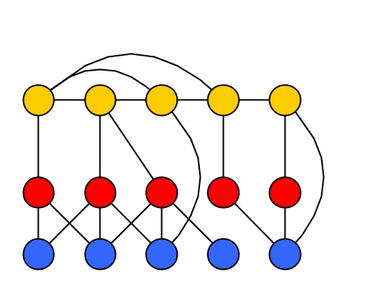
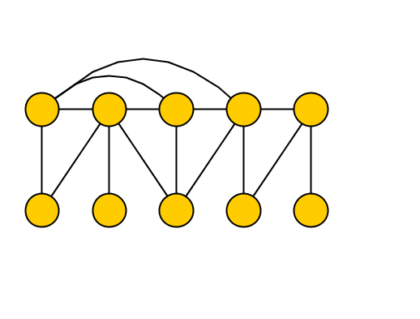
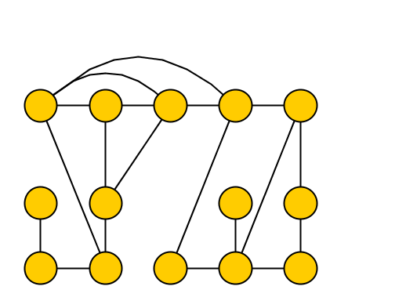
Vertex Cover parameterized by distance to F
Input: Graph G, integer l, set X⊆V s.t. G – X ∈ F
Parameter: k := |X|
Question: Does G have a vertex cover of size ≤l?
Equivalent to: α(G) ≥ |V| - l?
(parameter does not change)
Deletion to independent set
Deletion to forest
Deletion to bipartite
X
Feedback Vertex Set
Odd Cycle Transversal
Vertex cover
Notes:
Mention that this parameter applies to ANY input, is not restricted to some graph class!

Slide 13
Vertex Cover / Independent Set
Vertex Cover
Distance to Clique
Max Leaf #
Distance to Co-cluster
Distance to Cluster
Distance to linear forest
Distance to split graph components
Distance to Cograph
Distance to Interval
Feedback Vertex Set
Distance to Chordal
Distance to Outerplanar
Pathwidth
Odd Cycle Transversal
Treewidth
Distance to Perfect
Chromatic Number

Slide 14
Vertex Cover / Independent Set
Vertex Cover
Distance to Clique
Max Leaf #
Distance to Co-cluster
Distance to Cluster
Distance to linear forest
Distance to split graph components
Distance to Cograph
Distance to Interval
Feedback Vertex Set
NP-complete for fixed k
Planar Vertex Cover is NP-complete
Planar graphs are 4-colorable
Distance to Chordal
Distance to Outerplanar
Pathwidth
Odd Cycle Transversal
Treewidth
Distance to Perfect
Chromatic Number

Slide 15
Vertex Cover / Independent Set
Vertex Cover
Distance to Clique
Max Leaf #
Distance to Co-cluster
Distance to Cluster
Distance to linear forest
Distance to split graph components
Distance to Cograph
Distance to Interval
Feedback Vertex Set
Fixed-Parameter Tractable
Guess how solution intersects deletion set
Compute optimal solution in remainder
Perfect graph, so polynomial time by Grötschel, Lovász & Schrijver 1988
Distance to Chordal
Distance to Outerplanar
Pathwidth
Odd Cycle Transversal
Treewidth
Distance to Perfect
Chromatic Number

Slide 16
Vertex Cover / Independent Set
Vertex Cover
Distance to Clique
Max Leaf #
Distance to Co-cluster
Distance to Cluster
Distance to linear forest
Distance to split graph components
Distance to Cograph
Distance to Interval
Feedback Vertex Set
Distance to Chordal
Distance to Outerplanar
Pathwidth
Odd Cycle Transversal
Treewidth
Distance to Perfect
Chromatic Number

Slide 17
Vertex Cover / Independent Set
Vertex Cover
Distance to Clique
Max Leaf #
Distance to Co-cluster
Distance to Cluster
Distance to linear forest
Distance to split graph components
Distance to Cograph
Distance to Interval
Feedback Vertex Set
Fixed-Parameter Tractable by Dynamic Programming
Distance to Chordal
Distance to Outerplanar
Pathwidth
Odd Cycle Transversal
Treewidth
Distance to Perfect
Chromatic Number

Slide 18
Vertex Cover / Independent Set
Vertex Cover
Distance to Clique
Max Leaf #
Distance to Co-cluster
Distance to Cluster
Distance to linear forest
Distance to split graph components
Distance to Cograph
Distance to Interval
Feedback Vertex Set
Distance to Chordal
Distance to Outerplanar
Pathwidth
Odd Cycle Transversal
Treewidth
Distance to Perfect
Chromatic Number

Slide 19
Vertex Cover / Independent Set
Vertex Cover
Distance to Clique
Max Leaf #
Polynomial kernel
O(k²) vertices [BussG’93]
Linear-vertex kernels
  Nemhauser-Trotter theorem [NT’75]
  Crown reductions [ChorFJ’04, Abu-KhzamFLS’07]
Distance to Co-cluster
Distance to Cluster
Distance to linear forest
Distance to split graph components
Distance to Cograph
Distance to Interval
Feedback Vertex Set
Distance to Chordal
Distance to Outerplanar
Pathwidth
Odd Cycle Transversal
Treewidth
Distance to Perfect
Chromatic Number

Slide 20
Vertex Cover / Independent Set
Vertex Cover
Distance to Clique
Max Leaf #
Distance to Co-cluster
Distance to Cluster
Distance to linear forest
Distance to split graph components
Distance to Cograph
Distance to Interval
Feedback Vertex Set
Distance to Chordal
Distance to Outerplanar
Pathwidth
Odd Cycle Transversal
Treewidth
Distance to Perfect
Chromatic Number

Slide 21
Vertex Cover / Independent Set
Vertex Cover
Distance to Clique
Max Leaf #
Distance to Co-cluster
Distance to Cluster
Distance to linear forest
Linear-vertex kernel
Using extremal structure arguments [FellowsLMMRS’09]
Distance to split graph components
Distance to Cograph
Distance to Interval
Feedback Vertex Set
Distance to Chordal
Distance to Outerplanar
Pathwidth
Odd Cycle Transversal
Treewidth
Distance to Perfect
Chromatic Number

Slide 22
Vertex Cover / Independent Set
Vertex Cover
Distance to Clique
Max Leaf #
Distance to Co-cluster
Distance to Cluster
Distance to linear forest
Distance to split graph components
Distance to Cograph
Distance to Interval
Feedback Vertex Set
Distance to Chordal
Distance to Outerplanar
Pathwidth
Odd Cycle Transversal
Treewidth
Distance to Perfect
Chromatic Number

Slide 23
Vertex Cover / Independent Set
Vertex Cover
Distance to Clique
Max Leaf #
Distance to Co-cluster
Distance to Cluster
Distance to linear forest
Cubic-vertex kernel
Through combinatorial arguments [JansenB@STACS’11]
Distance to split graph components
Distance to Cograph
Distance to Interval
Feedback Vertex Set
Distance to Chordal
Distance to Outerplanar
Pathwidth
Odd Cycle Transversal
Treewidth
Distance to Perfect
Chromatic Number

Slide 24
Vertex Cover / Independent Set
Vertex Cover
Distance to Clique
Max Leaf #
Distance to Co-cluster
Distance to Cluster
Distance to linear forest
Distance to split graph components
Distance to Cograph
Distance to Interval
Feedback Vertex Set
Distance to Chordal
Distance to Outerplanar
Pathwidth
Odd Cycle Transversal
Treewidth
Distance to Perfect
Chromatic Number

Slide 25
Vertex Cover / Independent Set
Vertex Cover
Distance to Clique
Max Leaf #
Distance to Co-cluster
Distance to Cluster
Distance to linear forest
Distance to split graph components
Randomized polynomial kernel
Using Matroid compression technique of Kratsch & Wahlström
Unpublished result [JansenKW]
Distance to Cograph
Distance to Interval
Feedback Vertex Set
Distance to Chordal
Distance to Outerplanar
Pathwidth
Odd Cycle Transversal
Treewidth
Distance to Perfect
Chromatic Number

Slide 26
Vertex Cover / Independent Set
Vertex Cover
Distance to Clique
Max Leaf #
Distance to Co-cluster
Distance to Cluster
Distance to linear forest
Distance to split graph components
Distance to Cograph
Distance to Interval
Feedback Vertex Set
Distance to Chordal
Distance to Outerplanar
Pathwidth
Odd Cycle Transversal
Treewidth
Distance to Perfect
Chromatic Number

Slide 27
Vertex Cover / Independent Set
Vertex Cover
Distance to Clique
Max Leaf #
Distance to Co-cluster
Distance to Cluster
Distance to linear forest
No polynomial kernel unless NP⊆coNP/poly
Using cross-composition [BodlaenderJK@STACS’11]
Distance to split graph components
Distance to Cograph
Distance to Interval
Feedback Vertex Set
Distance to Chordal
Distance to Outerplanar
Pathwidth
Odd Cycle Transversal
Treewidth
Distance to Perfect
Chromatic Number

Slide 28
Vertex Cover / Independent Set
Vertex Cover
Distance to Clique
Max Leaf #
Distance to Co-cluster
Distance to Cluster
Distance to linear forest
Distance to split graph components
Distance to Cograph
Distance to Interval
Feedback Vertex Set
Distance to Chordal
Distance to Outerplanar
Pathwidth
Odd Cycle Transversal
Treewidth
Distance to Perfect
Chromatic Number

Slide 29
Vertex Cover / Independent Set
Vertex Cover
Distance to Clique
Max Leaf #
Distance to Co-cluster
Distance to Cluster
Distance to linear forest
Distance to split graph components
No polynomial kernel unless NP⊆coNP/poly
Using OR-composition for the refinement version [BodlaenderDFH’09]
Distance to Cograph
Distance to Interval
Feedback Vertex Set
Distance to Chordal
Distance to Outerplanar
Pathwidth
Odd Cycle Transversal
Treewidth
Distance to Perfect
Chromatic Number

Slide 30
Vertex Cover / Independent Set
Vertex Cover
Distance to Clique
Max Leaf #
Distance to Co-cluster
Distance to Cluster
Distance to linear forest
Distance to split graph components
Distance to Cograph
Distance to Interval
Feedback Vertex Set
Distance to Chordal
Distance to Outerplanar
Pathwidth
Odd Cycle Transversal
Treewidth
Distance to Perfect
Chromatic Number

Slide 31
Vertex Cover / Independent Set
Vertex Cover
Distance to Clique
Max Leaf #
Distance to Co-cluster
Distance to Cluster
Distance to linear forest
No polynomial kernel unless NP⊆coNP/poly
Unpublished, using Cross-Composition [JansenK]
Distance to split graph components
Distance to Cograph
Distance to Interval
Feedback Vertex Set
Distance to Chordal
Distance to Outerplanar
Pathwidth
Odd Cycle Transversal
Treewidth
Distance to Perfect
Chromatic Number

Slide 32
Vertex Cover / Independent Set
Vertex Cover
Distance to Clique
Max Leaf #
Distance to Co-cluster
Distance to Cluster
Distance to linear forest
Distance to split graph components
Distance to Cograph
Distance to Interval
Feedback Vertex Set
Distance to Chordal
Distance to Outerplanar
Pathwidth
Odd Cycle Transversal
Treewidth
Distance to Perfect
Chromatic Number

Slide 33
Polynomial kernels
Vertex Cover
Distance to Clique
Max Leaf #
Distance to Co-cluster
Distance to Cluster
Distance to linear forest
Distance to split graph components
Distance to Cograph
Distance to Interval
Feedback Vertex Set
Distance to Chordal
Distance to Outerplanar
Pathwidth
FPT, no poly
kernel unless
NP⊆coNP/poly
Odd Cycle Transversal
Treewidth
Distance to Perfect
NP-complete for k=4
Chromatic Number
Complexity overview for Vertex Cover parameterized by…

Slide 34
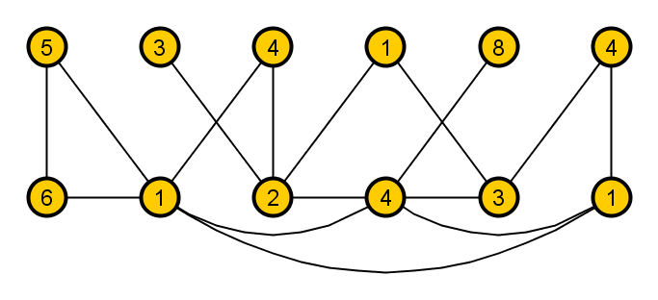
Weighted Independent Set param. by Vertex Cover number
Input: Graph G on n vertices, integer l, a vertex cover X, and a weight function w: V→{1,2,…,n}
Parameter: k := |X|
Question: Does G have an independent set of weight ≥ l?
We will prove a kernel lower-bound for this problem using cross-composition [JansenB@STACS’11]
X

Slide 35
Cross-composition of Ã into B
poly(t · n) time
“Similar” instances of classical problem Ã
x₁
x₂
x₃
x₄
x₅
x₆
x…
x_{t}
n
1 instance of param. problem B
(x*,k*) ∈ B ⇔ ∃_{i}: x_{i} ∈ Ã
k*
x*
poly(n+log t)
If an NP-hard problem Ã cross-composes into the parameterized problem B, then B does not admit a polynomial kernel unless NP⊆coNP/poly [BodlaenderJK’11@STACS,BodlaenderDFH’09,FortnowS’11]

Slide 36
Lower-bound using cross-composition
We give an algorithm to compose a sequence of instances of unweighted independent set (G₁, l₁), (G₂, l₂), … , (G_{t}, l_{t})
  where |V(G_{i})| = n, |E(G_{i})| = m, and l_{i} = l for all i,
into a single instance of weighted independent set parameterized by vertex cover
This choice of “similar” instances is justified by a polynomial equivalence relationship in the cross-composition framework
First: a transformation for independent set instances

Slide 37
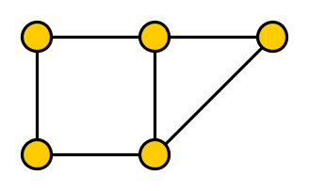
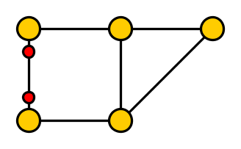
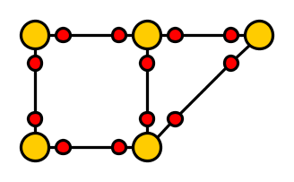
Transformations for Independent Set
Let G be a graph, and {u,v} ∈ E
By subdividing {u,v} with two new vertices, the independence number increases by one
  Reverse of the “folding” rule [ChenKJ’01]
If G’ is obtained by subdividing all m edges of G:
  α(G’) = α(G) + m

Slide 38
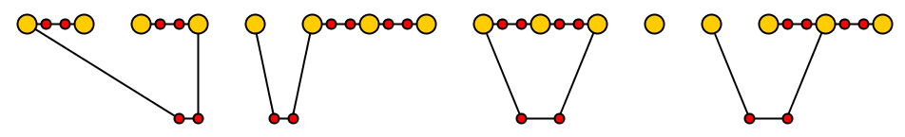
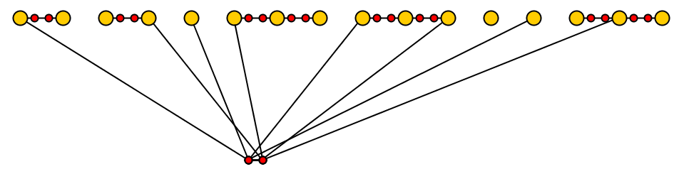
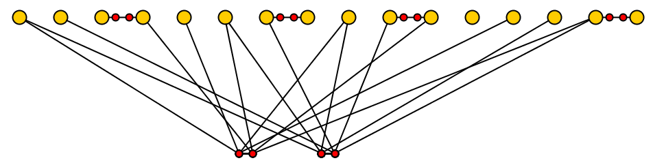
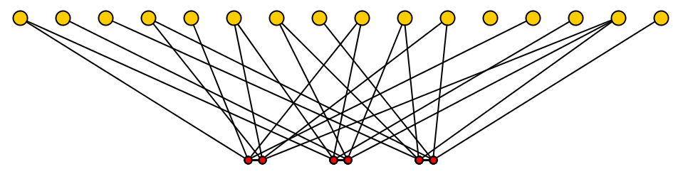
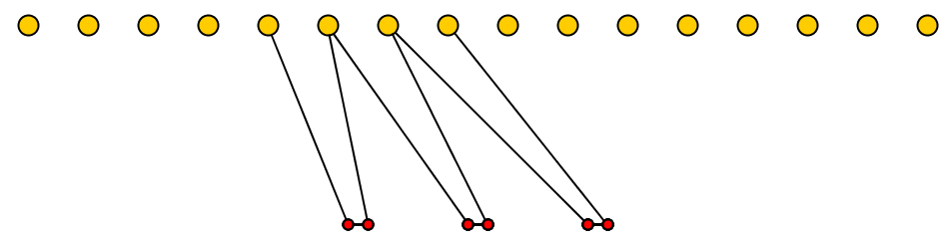
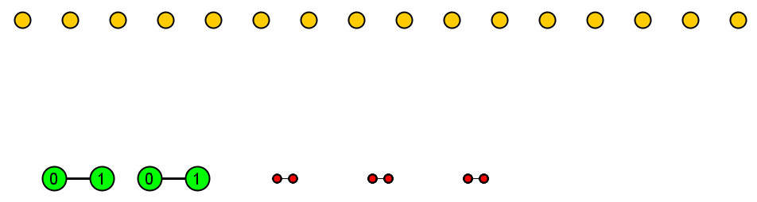
Construction of composite instance
G₁
G’₁
00
G₂
G’₂
01
G₃
G’₃
10
G₄
G’₄
11
X
First bit
Second bit
Example for l =3
N:=t·n is the total # vertices in the input
Bit position vertices have weight N each
Other vertices have weight 1
Set l* := N·log t + l + m
Claim: Construction is
polynomial-time
Claim: Parameter k’ := |X| is
2(m + log t) ➔ poly(n + log t)

Slide 39
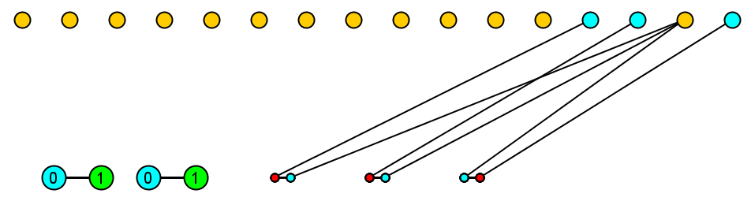
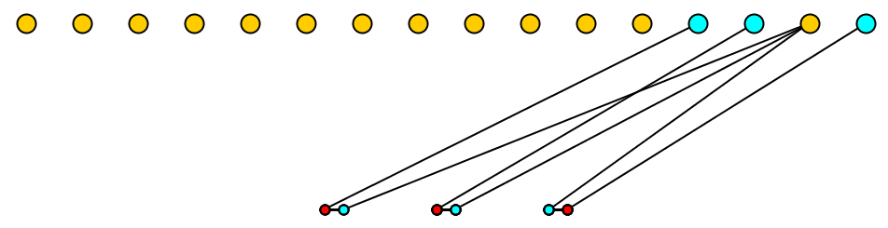
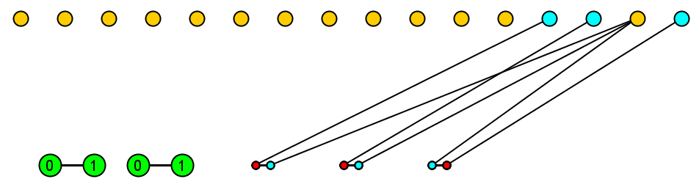
∃_{i}: α(G_{i}) ≥ l implies α_{w}(G*) ≥ l*
G₁
G’₁
00
G₂
G’₂
01
G₃
G’₃
10
G₄
G’₄
11
First bit
Second bit
Total weight l + m + N log t = l*

Slide 40
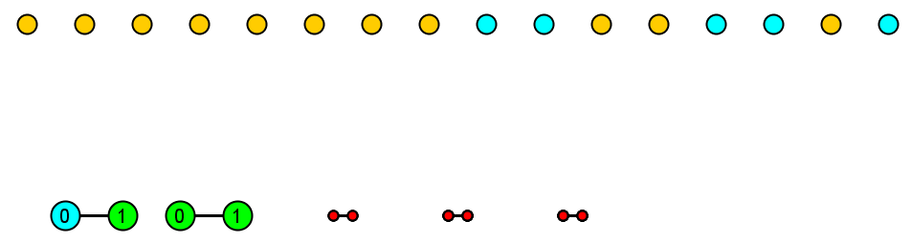
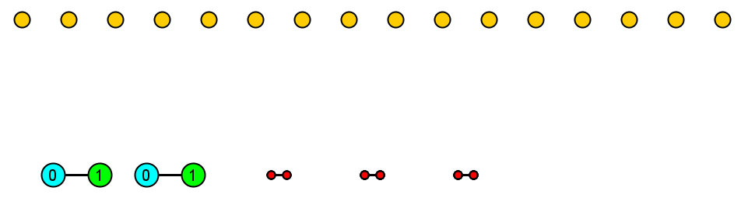
∃_{i}: α(G_{i}) ≥ l follows from α_{w}(G*) ≥ l*
G’₁
00
G’₂
01
G’₃
10
G’₄
11
First bit
Second bit
When a bit position is avoided:
  Replace input vertices (≤N) by a position vertex (weight N)
  So assume all bit positions are used
Independent set uses input vertices of 1 instance (complement of bitstring)
  Total weight l + m in remainder
  α(G’_{i}) ≥ l + m, so α(G_{i}) ≥ l

Slide 41
Results
From the cross-composition we get:
Weighted Independent Set parameterized by the size of a vertex cover
does not have a polynomial kernel unless NP⊆coNP/poly
By Vertex Cover ⬄ Independent Set equivalence
  (parameter does not change)
Weighted Vertex Cover parameterized by the size of a vertex cover
does not have a polynomial kernel unless NP⊆coNP/poly
Contrast: Weighted Vertex Cover parameterized by weight of a vertex cover, does admit a polynomial kernel [ChlebíkC’08]

Slide 42
The difficulty of vertex weights
Parameterized by vertex cover number:
  unweighted versions admit polynomial kernels
  weighted versions do not unless NP⊆coNP/poly, but are FPT
Vertex Cover / Independent Set
Feedback Vertex Set
Odd Cycle Transversal
Treewidth
Chordal Deletion
[JansenB@STACS’11]
[JansenK@IPEC’11]
[BodlaenderJK@ICALP’11]
[Thomasse@ACM Tr.’10,BodlaenderJK@STACS11]
Unpublished

Slide 43

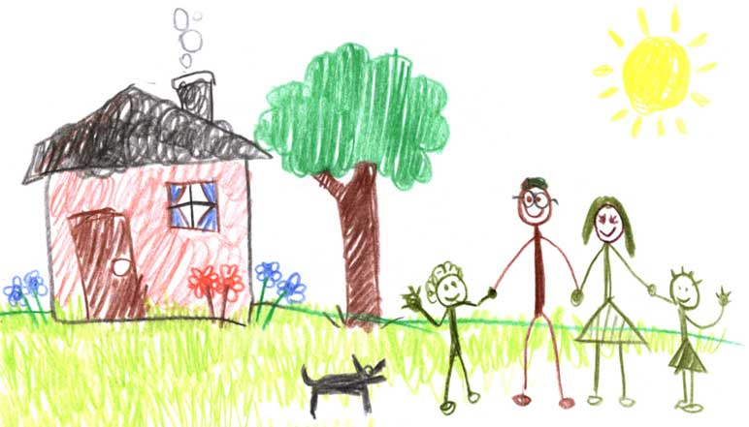
graph coloring
graph coloring

Slide 44
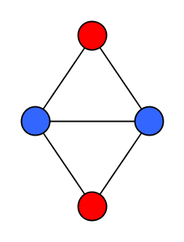
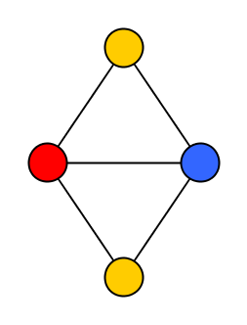
Vertex Coloring of Graphs
Given an undirected graph G and integer q, can we assign each vertex a color from {1, 2, …, q} such that adjacent vertices have different colors?
  If q is part of the input: Chromatic Number
  If q is constant: q-Coloring
3-Coloring is NP-complete
Chromatic Number parameterized by Vertex Cover does not admit a polynomial kernel unless NP⊆coNP/poly [BodlaenderJK@STACS’11]

Slide 45
q-Coloring
Vertex Cover
Distance to Clique
Max Leaf #
Distance to Co-cluster
Distance to Cluster
Distance to linear forest
Distance to split graph components
Distance to Cograph
Distance to Interval
Feedback Vertex Set
Distance to Chordal
Distance to Outerplanar
Pathwidth
Odd Cycle Transversal
Treewidth
Distance to Perfect
Chromatic Number

Slide 46
q-Coloring
Vertex Cover
Distance to Clique
Max Leaf #
Distance to Co-cluster
Distance to Cluster
Distance to linear forest
Distance to split graph components
Distance to Cograph
Distance to Interval
Feedback Vertex Set
NP-complete for k=2 [Cai’03]
No kernel unless P=NP
Distance to Chordal
Distance to Outerplanar
Pathwidth
Odd Cycle Transversal
Treewidth
Distance to Perfect
Chromatic Number

Slide 47
q-Coloring
Vertex Cover
Distance to Clique
Max Leaf #
Distance to Co-cluster
Distance to Cluster
Distance to linear forest
Distance to split graph components
Distance to Cograph
Distance to Interval
Feedback Vertex Set
Distance to Chordal
Distance to Outerplanar
Pathwidth
Odd Cycle Transversal
Treewidth
Distance to Perfect
Chromatic Number

Slide 48
q-Coloring
Vertex Cover
Distance to Clique
Max Leaf #
Distance to Co-cluster
Distance to Cluster
Distance to linear forest
Distance to split graph components
Distance to Cograph
Distance to Interval
Feedback Vertex Set
Fixed-Parameter Tractable by dynamic programming
Distance to Chordal
Distance to Outerplanar
Pathwidth
Odd Cycle Transversal
Treewidth
Distance to Perfect
Chromatic Number

Slide 49
q-Coloring
Vertex Cover
Distance to Clique
Max Leaf #
Distance to Co-cluster
Distance to Cluster
Distance to linear forest
Distance to split graph components
Distance to Cograph
Distance to Interval
Feedback Vertex Set
Distance to Chordal
Distance to Outerplanar
Pathwidth
Odd Cycle Transversal
Treewidth
Distance to Perfect
Chromatic Number

Slide 50
q-Coloring
Vertex Cover
Distance to Clique
Max Leaf #
Distance to Co-cluster
Distance to Cluster
Distance to linear forest
Distance to split graph components
Distance to Cograph
Distance to Interval
Feedback Vertex Set
Fixed-Parameter Tractable since yes-instances have treewidth ≤k+q
Distance to Chordal
Distance to Outerplanar
Pathwidth
Odd Cycle Transversal
Treewidth
Distance to Perfect
Chromatic Number

Slide 51
q-Coloring
Vertex Cover
Distance to Clique
Max Leaf #
Distance to Co-cluster
Distance to Cluster
Distance to linear forest
Distance to split graph components
Distance to Cograph
Distance to Interval
Feedback Vertex Set
Distance to Chordal
Distance to Outerplanar
Pathwidth
Odd Cycle Transversal
Treewidth
Distance to Perfect
Chromatic Number

Slide 52
q-Coloring
Vertex Cover
Distance to Clique
Max Leaf #
Distance to Co-cluster
Distance to Cluster
Distance to linear forest
Linear-vertex kernel since vertices of degree < q are irrelevant
(using Kleitman-West Theorem)
Distance to split graph components
Distance to Cograph
Distance to Interval
Feedback Vertex Set
Distance to Chordal
Distance to Outerplanar
Pathwidth
Odd Cycle Transversal
Treewidth
Distance to Perfect
Chromatic Number

Slide 53
q-Coloring
Vertex Cover
Distance to Clique
Max Leaf #
Distance to Co-cluster
Distance to Cluster
Distance to linear forest
Distance to split graph components
Distance to Cograph
Distance to Interval
Feedback Vertex Set
Distance to Chordal
Distance to Outerplanar
Pathwidth
Odd Cycle Transversal
Treewidth
Distance to Perfect
Chromatic Number

Slide 54
q-Coloring
Vertex Cover
Distance to Clique
Max Leaf #
Distance to Co-cluster
Distance to Cluster
Distance to linear forest
O(k^{q})-vertex kernel (shown next) [JansenK@FCT’11]
Distance to split graph components
Distance to Cograph
Distance to Interval
Feedback Vertex Set
Distance to Chordal
Distance to Outerplanar
Pathwidth
Odd Cycle Transversal
Treewidth
Distance to Perfect
Chromatic Number

Slide 55
q-Coloring
Vertex Cover
Distance to Clique
Max Leaf #
Distance to Co-cluster
Distance to Cluster
Distance to linear forest
Distance to split graph components
Distance to Cograph
Distance to Interval
Feedback Vertex Set
Distance to Chordal
Distance to Outerplanar
Pathwidth
Odd Cycle Transversal
Treewidth
Distance to Perfect
Chromatic Number

Slide 56
q-Coloring
Vertex Cover
Distance to Clique
Max Leaf #
Distance to Co-cluster
Distance to Cluster
Distance to linear forest
Distance to split graph components
Distance to Cograph
Distance to Interval
Feedback Vertex Set
Polynomial kernels [JansenK@FCT’11]
Polynomial kernels [JansenK@FCT’11]
Distance to Chordal
Distance to Outerplanar
Pathwidth
Odd Cycle Transversal
Treewidth
Distance to Perfect
Chromatic Number

Slide 57
q-Coloring
Vertex Cover
Distance to Clique
Max Leaf #
Distance to Co-cluster
Distance to Cluster
Distance to linear forest
Distance to split graph components
Distance to Cograph
Distance to Interval
Feedback Vertex Set
Distance to Chordal
Distance to Outerplanar
Pathwidth
Odd Cycle Transversal
Treewidth
Distance to Perfect
Chromatic Number

Slide 58
q-Coloring
Vertex Cover
Distance to Clique
Max Leaf #
Distance to Co-cluster
Distance to Cluster
Distance to linear forest
No polynomial kernel unless NP⊆coNP/poly [JansenK@FCT’11]
Distance to split graph components
Distance to Cograph
Distance to Interval
Feedback Vertex Set
Distance to Chordal
Distance to Outerplanar
Pathwidth
Odd Cycle Transversal
Treewidth
Distance to Perfect
Chromatic Number

Slide 59
q-Coloring
Vertex Cover
Distance to Clique
Max Leaf #
Distance to Co-cluster
Distance to Cluster
Distance to linear forest
Distance to split graph components
Distance to Cograph
Distance to Interval
Feedback Vertex Set
Distance to Chordal
Distance to Outerplanar
Pathwidth
Odd Cycle Transversal
Treewidth
Distance to Perfect
Chromatic Number

Slide 60
Polynomial kernels
Vertex Cover
Distance to Clique
Max Leaf #
Distance to Co-cluster
Distance to Cluster
FPT, no poly
kernel unless
NP⊆coNP/poly
Distance to linear forest
Distance to split graph components
Distance to Cograph
Distance to Interval
Feedback Vertex Set
Distance to Chordal
Distance to Outerplanar
Pathwidth
Odd Cycle Transversal
Treewidth
Distance to Perfect
NP-complete for k=2
Chromatic Number
Complexity overview for q-Coloring parameterized by…

Slide 61
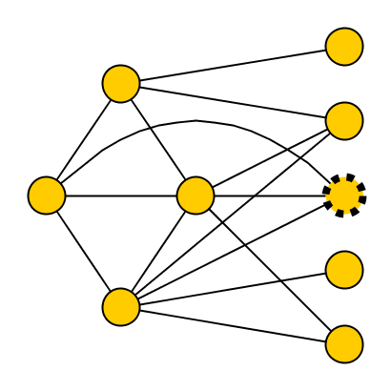
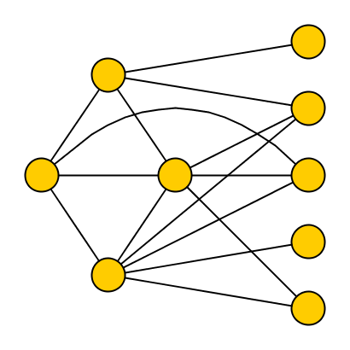
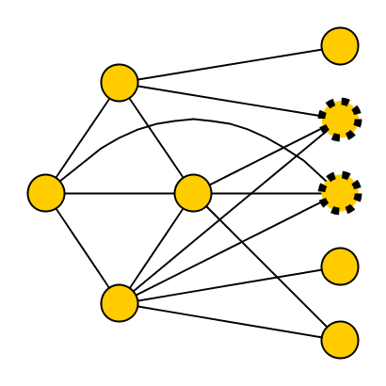
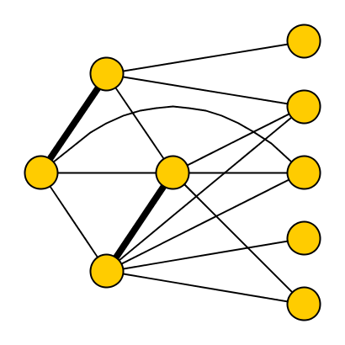
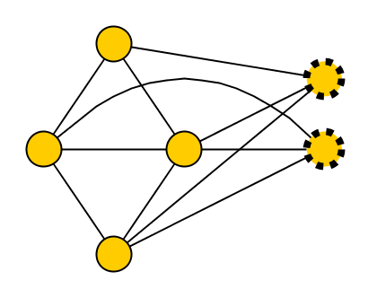
Preprocessing algorithm parameterized by Vertex Cover Nr
Input: instance G of q-Coloring
Compute a 2-approximate vertex cover X of G
For each set S of q vertices in X, mark a vertex v_{S} which is adjacent to all vertices of S (if one exists)
Delete all vertices which are not in X, and not marked
Output the resulting graph G’ on n’ vertices
  n’ ≤ |X| + |X|^{q}
  ≤ 2k + (2k)^{q}
X
q=3
Claim: Algorithm runs in
polynomial time
Claim: n’ is O(k^{q}),
with k = vc(G)

Slide 62
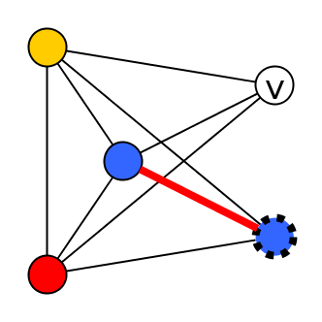
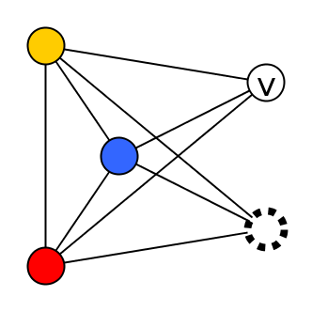
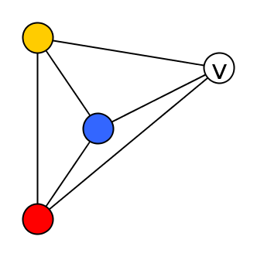
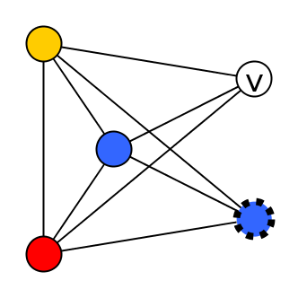
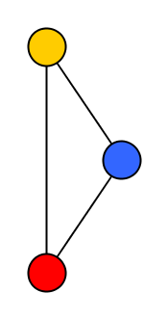
Correctness: χ(G)≤q ⬄ χ(G’)≤q
(➔) Trivial since G’ is a subgraph of G
(⬅) Take a q-coloring of G’
  For each deleted vertex v:
    If there is a color in {1, …, q} which does not appear on a neighbor of v, give v that color
  Proof by contradiction: we cannot fail
    when failing: q neighbors of v each have a different color
    let S⊆X be a set of these neighbors
    look at v_{S} we marked for set S
    all colors occur on S → v_{S} has neighbor with same color
X

Slide 63
Result
The reduction procedure gives the following:
Also applies to q-List Coloring
q-Coloring parameterized by vertex cover number has a kernel with O(k^{q}) vertices

Slide 64
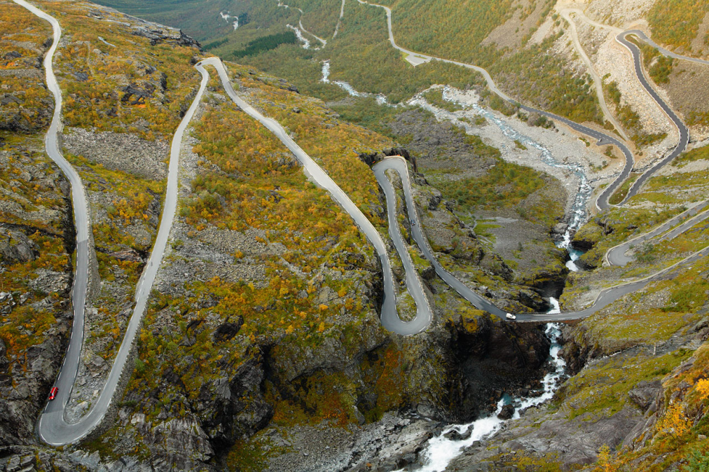
long path & cycle problems

Slide 65
Long Path & Cycle problems
Question: does a graph G have a simple path (cycle) on at least l vertices?
Natural parameterization k-Path was one of the main motivations for development of the lower-bound framework
… not even on planar, connected graphs [ChenFM’09]
k-Path does not admit a polynomial kernel unless NP⊆coNP/poly [BodlaenderDFH’09]

Slide 66
Long Path
Vertex Cover
Distance to Clique
Max Leaf #
Distance to Co-cluster
Distance to Cluster
Distance to linear forest
Distance to Cograph
Distance to Interval
Feedback Vertex Set
Distance to Outerplanar
Pathwidth
Distance to Chordal
Odd Cycle Transversal
Treewidth
Distance to Perfect
Chromatic Number

Slide 67
Long Path
Vertex Cover
Distance to Clique
Max Leaf #
Distance to Co-cluster
Distance to Cluster
Distance to linear forest
Distance to Cograph
Distance to Interval
Feedback Vertex Set
Cubic-vertex kernel
Through combinatorial arguments [BodlaenderJ’11]
NP-complete for k=0
Distance to Outerplanar
Pathwidth
Distance to Chordal
Odd Cycle Transversal
Treewidth
Distance to Perfect
Chromatic Number

Slide 68
Long Path
Vertex Cover
Distance to Clique
Max Leaf #
Distance to Co-cluster
Distance to Cluster
Distance to linear forest
Distance to Cograph
Distance to Interval
Feedback Vertex Set
Distance to Outerplanar
Pathwidth
Distance to Chordal
Odd Cycle Transversal
Treewidth
Distance to Perfect
Chromatic Number

Slide 69
Long Path
Vertex Cover
Distance to Clique
Max Leaf #
Distance to Co-cluster
Distance to Cluster
Distance to linear forest
Distance to Cograph
Distance to Interval
Feedback Vertex Set
Fixed-Parameter Tractable by Dynamic Programming
Distance to Outerplanar
Pathwidth
Distance to Chordal
Odd Cycle Transversal
Treewidth
Distance to Perfect
Chromatic Number

Slide 70
Long Path
Vertex Cover
Distance to Clique
Max Leaf #
Distance to Co-cluster
Distance to Cluster
Distance to linear forest
Distance to Cograph
Distance to Interval
Feedback Vertex Set
Distance to Outerplanar
Pathwidth
Distance to Chordal
Odd Cycle Transversal
Treewidth
Distance to Perfect
Chromatic Number

Slide 71
Long Path
Vertex Cover
Distance to Clique
Max Leaf #
Quadratic-vertex kernel using matching technique
[BodlaenderJK@IPEC’11]
Distance to Co-cluster
Distance to Cluster
Distance to linear forest
Distance to Cograph
Distance to Interval
Feedback Vertex Set
Distance to Outerplanar
Pathwidth
Distance to Chordal
Odd Cycle Transversal
Treewidth
Distance to Perfect
Chromatic Number

Slide 72
Long Path
Vertex Cover
Distance to Clique
Max Leaf #
Distance to Co-cluster
Distance to Cluster
Distance to linear forest
Distance to Cograph
Distance to Interval
Feedback Vertex Set
Distance to Outerplanar
Pathwidth
Distance to Chordal
Odd Cycle Transversal
Treewidth
Distance to Perfect
Chromatic Number

Slide 73
Long Path
Vertex Cover
Distance to Clique
Max Leaf #
Distance to Co-cluster
Distance to Cluster
Distance to linear forest
Polynomial kernel using a weighted problem with a Karp reduction
[BodlaenderJK@IPEC’11]
Distance to Cograph
Distance to Interval
Feedback Vertex Set
Distance to Outerplanar
Pathwidth
Distance to Chordal
Odd Cycle Transversal
Treewidth
Distance to Perfect
Chromatic Number

Slide 74
Long Path
Vertex Cover
Distance to Clique
Max Leaf #
Distance to Co-cluster
Distance to Cluster
Distance to linear forest
Distance to Cograph
Distance to Interval
Feedback Vertex Set
Distance to Outerplanar
Pathwidth
Distance to Chordal
Odd Cycle Transversal
Treewidth
Distance to Perfect
Chromatic Number

Slide 75
Long Path
Vertex Cover
Distance to Clique
Max Leaf #
Distance to Co-cluster
Distance to Cluster
Distance to linear forest
Distance to Cograph
Distance to Interval
Feedback Vertex Set
Polynomial kernel using a weighted problem with a Karp reduction
[BodlaenderJK’11@IPEC]
Distance to Outerplanar
Pathwidth
Distance to Chordal
Odd Cycle Transversal
Treewidth
Distance to Perfect
Chromatic Number

Slide 76
Long Path
Vertex Cover
Distance to Clique
Max Leaf #
Distance to Co-cluster
Distance to Cluster
Distance to linear forest
Distance to Cograph
Distance to Interval
Feedback Vertex Set
Distance to Outerplanar
Pathwidth
Distance to Chordal
Odd Cycle Transversal
Treewidth
Distance to Perfect
Chromatic Number

Slide 77
Long Path
Vertex Cover
Distance to Clique
Max Leaf #
Distance to Co-cluster
Distance to Cluster
Distance to linear forest
No polynomial kernel unless NP⊆coNP/poly
Simple (cross)-composition
Distance to Cograph
Distance to Interval
Feedback Vertex Set
Distance to Outerplanar
Pathwidth
Distance to Chordal
Odd Cycle Transversal
Treewidth
Distance to Perfect
Chromatic Number

Slide 78
Long Path
Vertex Cover
Distance to Clique
Max Leaf #
Distance to Co-cluster
Distance to Cluster
Distance to linear forest
No polynomial kernel unless NP⊆coNP/poly
By cross-composing Hamiltonian s-t Path on bipartite graphs [BodlaenderJK’11@IPEC]
Distance to Cograph
Distance to Interval
Feedback Vertex Set
Distance to Outerplanar
Pathwidth
Distance to Chordal
Odd Cycle Transversal
Treewidth
Distance to Perfect
Chromatic Number

Slide 79
Polynomial kernels
Vertex Cover
Distance to Clique
Max Leaf #
Distance to Co-cluster
Distance to Cluster
FPT
poly kernel?
Distance to linear forest
Distance to Cograph
Distance to Interval
Feedback Vertex Set
FPT?
poly kernel?
Distance to Outerplanar
Pathwidth
Distance to Chordal
Odd Cycle Transversal
FPT, no poly
kernel unless
NP⊆coNP/poly
Treewidth
Distance to Perfect
NP-complete for k=0
Chromatic Number
Complexity overview for Long Path parameterized by…

Slide 80

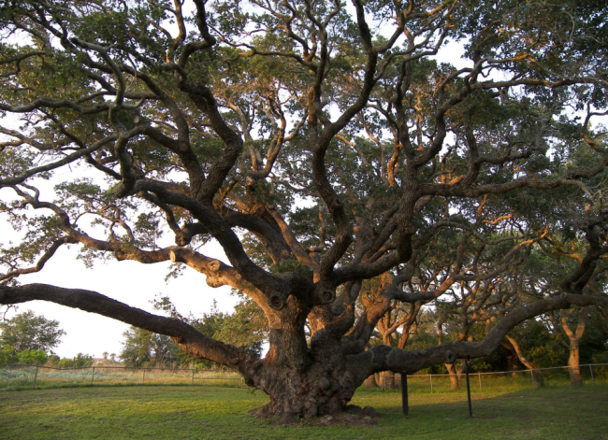
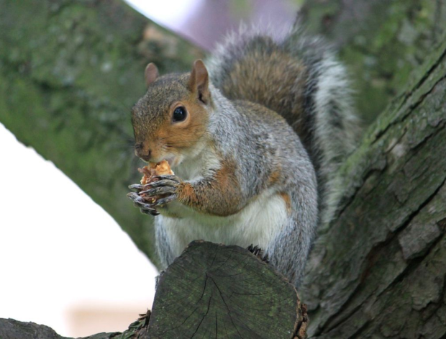
importance of treewidth

Slide 81
Treewidth
Deletion distance to constant treewidth
As a problem
As a problem
  f(k)O(n) by Bodlaender’s algorithm
  Vertex Cover (r=0)
  Feedback Vertex Set (r=1)
Parameter for algorithms
Parameter for algorithms
  All MSOL problems FPT by treewidth (Courcelle’s Theorem)
  All MSOL problems in FPT
  Some hard layout problems FPT parameterized by Vertex Cover [FellowsLMRS’08]
Parameter for kernels
Parameter for kernels
  No polynomial kernels known
  OR / AND composition & Improvement versions
  Polynomial kernels for some problems
  Strongly related to protrusions on H-minor-free graphs

Slide 82
… parameterized by deletion distance to constant treewidth
[on general graphs]
 | tw 0 | tw 1 | tw 2
Vertex Cover | ☺ | ☺ | ☹

Slide 83
… parameterized by deletion distance to constant treewidth
[on general graphs]
 | tw 0 | tw 1 | tw 2
Vertex Cover | ☺ | ☺ | ☹
Feedback Vertex Set | ☺ | ☺ | ☹
Odd Cycle Transversal | ☺ | ☺ | ☹

Slide 84
… parameterized by deletion distance to constant treewidth
[on general graphs]
 | tw 0 | tw 1 | tw 2
Vertex Cover | ☺ | ☺ | ☹
Feedback Vertex Set | ☺ | ☺ | ☹
Odd Cycle Transversal | ☺ | ☺ | ☹
Treewidth | ☺ | ☺ | ?

Slide 85
… parameterized by deletion distance to constant treewidth
[on general graphs]
 | tw 0 | tw 1 | tw 2
Vertex Cover | ☺ | ☺ | ☹
Feedback Vertex Set | ☺ | ☺ | ☹
Odd Cycle Transversal | ☺ | ☺ | ☹
Treewidth | ☺ | ☺ | ?
Longest Path | ☺ | ? | ☹

Slide 86
… parameterized by deletion distance to constant treewidth
[on general graphs]
 | tw 0 | tw 1 | tw 2
Vertex Cover | ☺ | ☺ | ☹
Feedback Vertex Set | ☺ | ☺ | ☹
Odd Cycle Transversal | ☺ | ☺ | ☹
Treewidth | ☺ | ☺ | ?
Longest Path | ☺ | ? | ☹
q-Coloring | ☺ | ☹ | ☹

Slide 87
… parameterized by deletion distance to constant treewidth
[on general graphs]
 | tw 0 | tw 1 | tw 2
Vertex Cover | ☺ | ☺ | ☹
Feedback Vertex Set | ☺ | ☺ | ☹
Odd Cycle Transversal | ☺ | ☺ | ☹
Treewidth | ☺ | ☺ | ?
Longest Path | ☺ | ? | ☹
q-Coloring | ☺ | ☹ | ☹
Clique | ☹ | ☹ | ☹
Chromatic Number | ☹ | ☹ | ☹
Dominating Set | ☹ | ☹ | ☹
We cross a threshold going from 1 to 2 – why ?

Slide 88
… parameterized by deletion distance to constant treewidth
[on H-minor-free graphs]
Meta-theorems for kernelization on
  planar, bounded-genus [BodlaenderFLPST’09]
  and H-minor-free graphs [FominLST’10]
Work by replacing protrusions in the graph
  Pieces of constant treewidth, with a constant-size boundary
Existence of large protrusions is governed by deletion distance to constant treewidth
  Theorem. For any fixed graph H, if G is H-minor-free and has deletion distance k to constant treewidth, then G has a protrusion of size Ω(n/k) [FominLRS’11]

Slide 89
conclusion

Slide 90
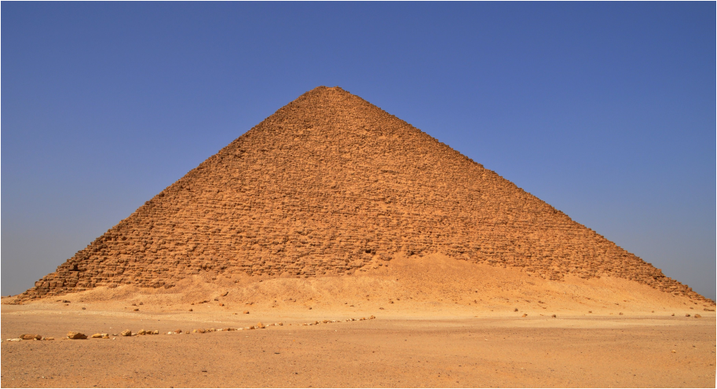

Polynomial kernels
Vertex Cover
Distance to Clique
Max Leaf #
Polynomial kernels
Distance to Co-cluster
Distance to Cluster
Distance to linear forest
Vertex Cover
Distance to Clique
Max Leaf #
Distance to Cograph
Distance to split graph components
Distance to Interval
Feedback Vertex Set
FPT, no poly
kernel unless
NP⊆coNP/poly
Polynomial kernels
Distance to Co-cluster
Distance to Cluster
Distance to linear forest
Vertex Cover
Distance to split graph components
Distance to Clique
Max Leaf #
Distance to Chordal
Distance to Cograph
Distance to Outerplanar
Distance to Interval
Feedback Vertex Set
Pathwidth
Distance to Co-cluster
Distance to Cluster
FPT
poly kernel?
Distance to linear forest
FPT, no poly
kernel unless
NP⊆coNP/poly
Odd Cycle Transversal
Distance to Chordal
Distance to Outerplanar
Pathwidth
Treewidth
Distance to Cograph
Distance to Interval
Feedback Vertex Set
Distance to Perfect
Odd Cycle Transversal
FPT?
poly kernel?
NP-complete for k=4
Chromatic Number
Treewidth
Distance to Outerplanar
Pathwidth
Distance to Perfect
NP-complete for k=2
Distance to Chordal
Odd Cycle Transversal
Chromatic Number
FPT, no poly
kernel unless
NP⊆coNP/poly
Treewidth
Distance to Perfect
NP-complete for k=0
Chromatic Number

Slide 91
Recent results
Fellows, Lokshtanov, Misra, Mnich, Rosamond & Saurabh [CIE’07]
  The Complexity Ecology of Parameters: An Illustration Using Bounded Max Leaf Number
Dom, Lokshtanov & Saurabh [ICALP’09]
  Incompressibility through Colors and ID’s
Johannes Uhlmann & Mathias Weller [TAMC’10]
  Two-Layer Planarization Parameterized by Feedback Edge Set
Bodlaender, Jansen & Kratsch [STACS’11]
  Cross-Composition: A New Technique for Kernelization Lower Bounds
Jansen & Bodlaender [STACS’11]
  Vertex Cover Kernelization Revisited: Upper and Lower Bounds for a Refined Parameter
Bodlaender, Jansen & Kratsch [ICALP‘11]
  Preprocessing for Treewidth: A Combinatorial Analysis through Kernelization
Betzler, Bredereck, Niedermeier & Uhlmann [SOFSEM’11]
  On Making a Distinguished Vertex Minimum Degree by Vertex Deletion
Jansen & Kratsch [FCT’11]
  Data Reduction for Graph Coloring Problems
Cygan, Lokshtanov, Pilipczuk, Pilipczuk & Saurabh [IPEC’11]
  On cutwidth parameterized by vertex cover
  On the hardness of losing width
Jansen & Kratsch [IPEC’11]
  On Polynomial Kernels for Structural Parameterizations of Odd Cycle Transversal
Bodlaender, Jansen & Kratsch [IPEC’11]
  Kernel Bounds for Path and Cycle Problems

Slide 92
Open problems
Poly kernels parameterized by Vertex Cover for:
Bandwidth
Cliquewidth
Branchwidth
Poly kernels for Long Path parameterized by:
distance to a path
distance to a forest (feedback vertex number)
distance to a cograph
Poly kernel for Treewidth parameterized by:
distance to constant treewidth r
Is Longest Path in FPT parameterized by:
distance to an Interval graph?
distance to an outerplanar graph

Slide 93
THANK YOU!
Polynomial kernels
Vertex Cover
Distance to Clique
Max Leaf #
Polynomial kernels
Distance to Co-cluster
Distance to Cluster
Distance to linear forest
Vertex Cover
Distance to Clique
Max Leaf #
Distance to Cograph
Distance to split graph components
Distance to Interval
Feedback Vertex Set
FPT, no poly
kernel unless
NP⊆coNP/poly
Polynomial kernels
Distance to Co-cluster
Distance to Cluster
Distance to linear forest
Vertex Cover
Distance to split graph components
Distance to Clique
Max Leaf #
Distance to Chordal
Distance to Cograph
Distance to Outerplanar
Distance to Interval
Feedback Vertex Set
Pathwidth
Distance to Co-cluster
Distance to Cluster
FPT
poly kernel?
Distance to linear forest
FPT, no poly
kernel unless
NP⊆coNP/poly
Odd Cycle Transversal
Distance to Chordal
Distance to Outerplanar
Pathwidth
Treewidth
Distance to Cograph
Distance to Interval
Feedback Vertex Set
Distance to Perfect
Odd Cycle Transversal
FPT?
poly kernel?
NP-complete for k=4
Chromatic Number
Treewidth
Distance to Outerplanar
Pathwidth
Distance to Perfect
NP-complete for k=2
Distance to Chordal
Odd Cycle Transversal
Chromatic Number
FPT, no poly
kernel unless
NP⊆coNP/poly
Treewidth
Distance to Perfect
NP-complete for k=0
Chromatic Number

