Slide 1
A Near-Optimal Planarization Algorithm
Insert «Academic unit» on every page: 1 Go to the menu «Insert» 2 Choose: Date and time 3 Write the name of your faculty or department in the field «Footer»
4 Choose «Apply to all"
Bart M. P. Jansen Daniel Lokshtanov University of Bergen, Norway
Saket Saurabh Institute of Mathematical Sciences, India
February 13th 2014, Dagstuhl Seminar 14071 Graph Modification Problems

Slide 2
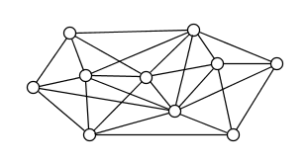
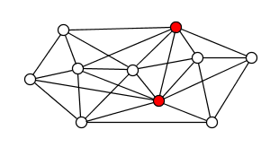
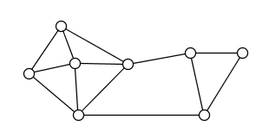
Problem setting
Generalization of the Planarity Testing problem
k-Vertex Planarization
In: An undirected graph G, integer k
Q: Can k vertices be deleted from G to get a planar graph?
Vertex set S such that G – S is planar, is an apex set
Planarization is NP-complete [Lewis & Yanakkakis]
Applications:
Visualization
Approximation schemes for graph problems on nearly-planar graphs

Slide 3
Previous planarization algorithms
Robertson & Seymour (1980’s)
For every fixed k, there is an O(n³)-time algorithm
Marx & Schlotter (2007, 2012)
Constructive $2^{k^{O(k^{3})}}∙n^{2}$-time algorithm
Constructive 2^(𝑘^(𝑂(𝑘^3)) )∙𝑛^2-time algorithm
Kawarabayashi (2009)
Constructive $2^{k^{Ω(k^{3})}}∙n$-time algorithm
Constructive 2^(𝑘^(Ω(𝑘^3)) )∙𝑛-time algorithm
Non-constructive (Graph-minors theorem)
Involves astronomical constants
Based on iterative compression, treewidth reduction & dynamic programming
Techniques from graph minors project instead of iterative compression
Chekuri & Sidiropoulos (2013)
Polynomial-time poly(opt, log n) approximation on bounded-degree graphs

Slide 4
Our contribution
Algorithm with runtime $2^{O(k\log{k})}∙n$
Using new treewidth-DP with runtime $2^{O(w\log{w})}∙n$
Based on elementary techniques:
Breadth-first search
Planarity testing
Decomposition into 3-connected components
Tree decompositions of k-outerplanar graphs
Our algorithm is near-optimal
Linear dependence on n cannot be improved
Assuming the Exponential-Time Hypothesis, the problem cannot be solved in $2^{o(k)}n^{O(1)}$ time

Slide 5
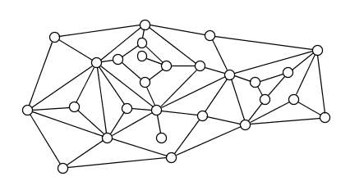
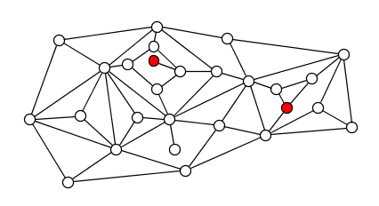
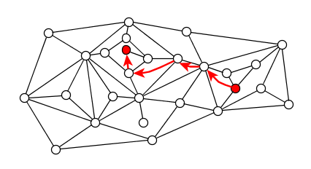
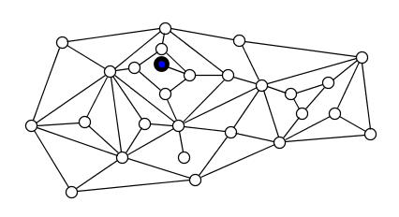
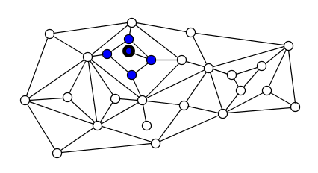
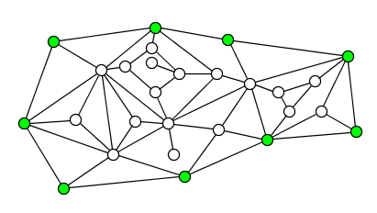
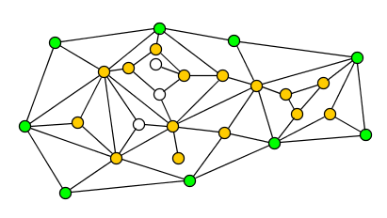
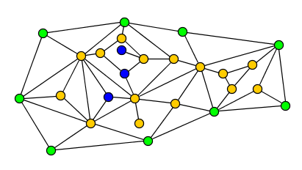
Preliminaries
Radial distance between u and v in a plane graph:
Length of a shortest u-v path when hopping between vertices incident on a common face in a single step
Radial c-ball around v:
Vertices at radial distance ≤ c from v
Induces a subgraph of treewidth O(c)
Outerplanarity layers of a plane graph G:
Partition V(G) by iteratively removing vertices on the outer face

Slide 6
Algorithm outline
I. Find approximate apex set
Apex set of size O(k)
II. Reduce treewidth to O(k)
Irrelevant vertices inside planar grids
III. Dynamic programming
On tree decomposition of width O(k)

Slide 7
I. Finding approximate apex sets

Slide 8
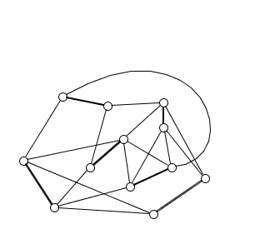
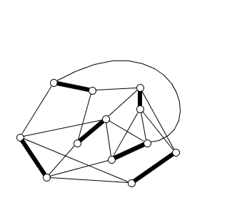
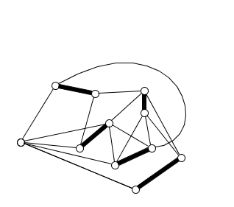
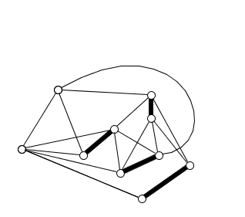
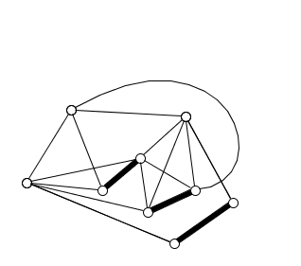
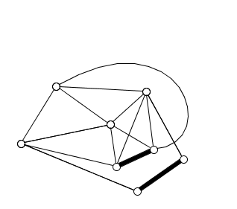
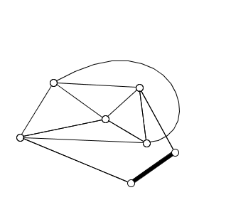
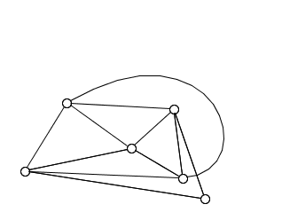
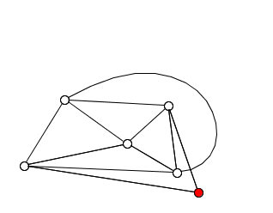
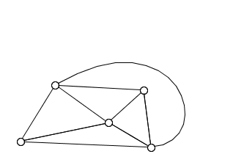
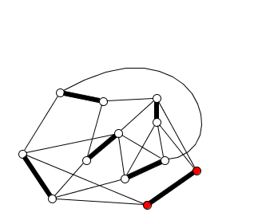
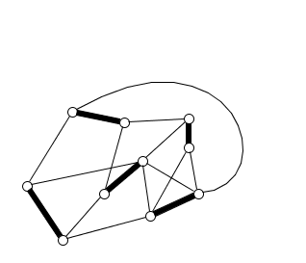
I. Finding an approximate apex set
Marx & Schlotter used iterative compression in Ω(n²) time
Our linear-time strategy:
Preprocessing step to reduce number of false twins
Greedily find a maximal matching M
If there is a k-apex set, |M| ≥ Ω$\left(\frac{n}{{k∙2}^{k}}\right)$
Contract edges in M, recurse on G/M to get apex set S_{M}
Let S₁ ⊆ V(G) contain S_{M} and its matching partners
(G – S₁)/M is planar
Output S₁ ∪ (approximate apex set in G-S₁)
Reduces to approximation on matching-contractible graphs

Slide 9
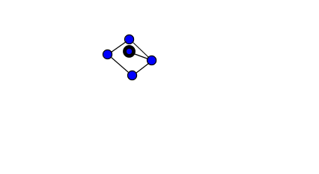
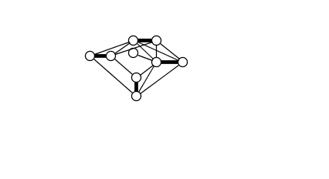
Matching-contractible graphs
A matching-contractible graph H with embedded H/M is locally planar if:
for each vertex v of H/M, the subgraph of H/M induced by the 3-ball around v remains planar when decontracting M
We prove:
If a matching-contractible graph is locally planar, it is planar
Allows us to reduce the planarization task on H to (decontracted) bounded-radius subgraphs of H/M
These have bounded treewidth and can be analyzed by our DP
Yields FPT-approximation in matching-contractible graphs
With the previous step: approximate apex set in linear time
Theorem. If a matching-contractible graph is locally planar, then it is (globally) planar

Slide 10
II. Reducing treewidth

Slide 11
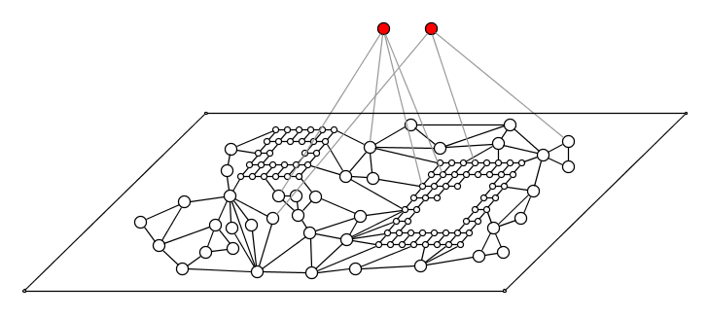
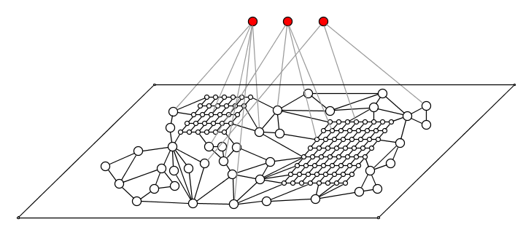
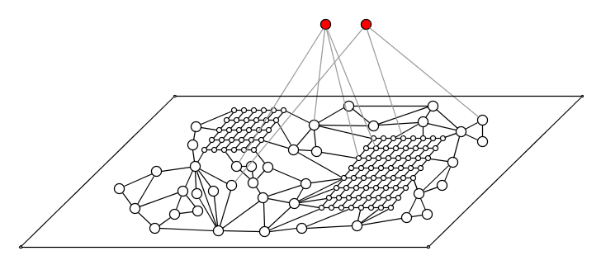
II. Reducing treewidth
Given an apex set S of size O(k), reduce the treewidth without changing the answer
Sufficient to reduce treewidth of planar graph G-S
Previous algorithms use two steps:
Delete apices in S that have to be part of every solution
Delete vertices in planar subgraphs surrounded by θ(k) concentric cycles

Slide 12
Irrelevant vertex rule
A sequence of vertex-disjoint cycles C₁, … , C_{k} is nested if:
V(C_{i}) separates V(C_{i+1}) from V(C_{i-1}) for i ∈ [2 .. k-1]
The interior of C_{i} is the subgraph of G induced by:
V(C_{i}) together with the comp. of G-V(C_{i}) containing C_{i+1}
Irrelevant vertex rule: If
C₁, … , C_{2k+2} are nested cycles in G, and
V(C_{2k+2}) separates v from V(C_{2k+1}), and
the interior of C₁ is planar,
then G is k-apex iff G-v is k-apex
C₁
v
C_{2k+2}

Slide 13
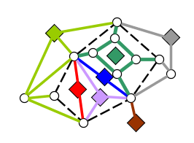
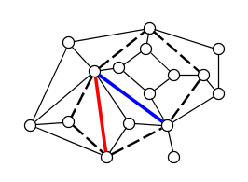
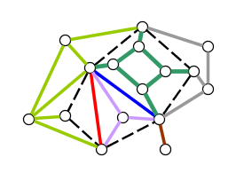
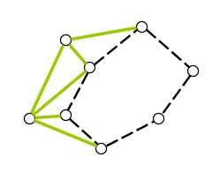
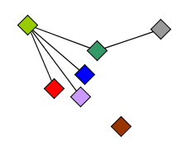
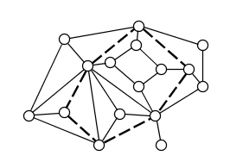
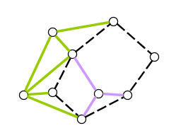
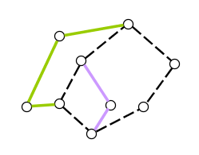
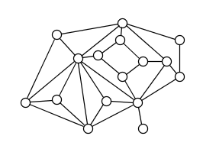
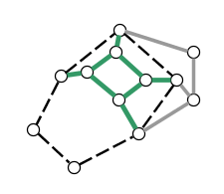
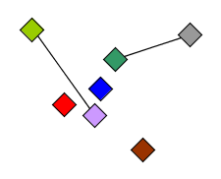
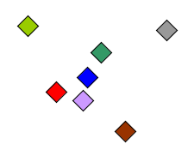
A characterization of planarity
Theorem [Folklore]. If C is a cycle in G, then G is planar iff
The overlap graph wrt. C is bipartite
For each C-bridge H, the graph C ∪ H is planar
If C is a cycle in G then a C-bridge is a subgraph H of G that is:
a chord of C, or
a connected component of G-V(C) with its edges to C
Vertices H ∩ C are attachment points of H onto C
Two C-bridges H, H’ overlap if they cannot be drawn on the same side of C
3 attachment points in common or attachment points interleave
The overlap graph of G with respect to C has:
One vertex per C-bridge
Edge between overlapping bridges

Slide 14
Correctness of irrelevant vertex rule
Irrelevant vertex rule: If
C₁, … , C_{2k+2} are nested cycles in G, and
V(C_{2k+2}) separates v from V(C_{2k+1}), and
the interior of C₁ is planar,
then G is k-apex ⬄ G-v is k-apex
Proof. Forward is trivial
Suppose (G-v) – S is planar; we prove G – S is planar
k-apex set S avoids at least two successive cycles C_{i}, C_{i+1}
Apply planarity characterization to cycle C_{i} in G – S
For each C_{i} bridge H in G – S, graph C_{i} ∪ H is planar?
C_{i}-bridges without v also exist in planar (G-v) – S
C_{i}-bridge with v is a subgraph of interior of C₁, so planar
The overlap graph wrt. C_{i} is bipartite?
Analyze how C_{i}-bridges change when adding v to (G-v) – S
C₁
v
C_{2k+2}
C_{i}

Slide 15
Changes to the overlap graph
How could C_{i}-bridges when adding v to (G-v)–S?
If v has no neighbors in G-S:
Vertex v is not adjacent to C_{i} since C_{i+1} separates them
New C_{i}-bridge without edges in overlap graph
If v has neighbors in G-S:
C_{i}-bridges of neighbors are merged by v
At most one C_{i}-bridge with a neighbor of v has attachment points on C_{i}
All N(v)-C_{i} paths intersect C_{i+1} and are therefore contained in same C_{i}-bridge
All but one of the bridges being merged are isolated vertices in overlap graph
Graph remains bipartite
By planarity characterization, G-S is planar □
C₁
v
C_{2k+2}
C_{i}

Slide 16
Linear-time treewidth reduction to O(k)
How to decrease width to O(k)?
Irrelevant-vertex argument applies to vertices surrounded by θ(k) concentric cycles
Need θ(k) to ensure that after k deletions, some isolating cycle remains
Treewidth remains Ω$(k\sqrt{k})$
Solution: Introduce annotated version of the problem where some vertices are forbidden to be deleted by a solution
2 surrounding undeletable cycles make a vertex irrelevant
Annotation ensures the cycles survive when deleting a solution

Slide 17
Guessing undeletable regions
To apply the irrelevant vertex rule, we need to find cycles whose interior is planar
Holds for cycles in the planar part whose interior has no neighbors of the approximate solution
If the neighbors of the approximate solution are spread all over the planar graph, we cannot reduce
Theorem: If there is a k-apex set disjoint from the approximate solution, then its neighborhood into a 3-connected component of the planar part can be covered by O(k) balls of constant radius 3
The neighborhood of the approximation does not spread out!

Slide 18
Exploiting small covering of the neighborhood
Branch to guess how a solution intersects the approximate apex set
Reduce to the Disjoint Planarization problem
Cover the neighborhood of the remaining apices by O(k) 3-balls
Avoid these balls in a Baker layering scheme
Find k+1 disjoint groups of layers s.t. deleting a group reduces TW to O(k)
Branch into k+1 ways of making the vertices of a group undeletable
Apply irrelevant vertex rule to undeletable parts to make it “thin” (BFS)

Slide 19
IIi. Dynamic programming

Slide 20
III. Dynamic programming
Previous algorithms for Vertex Planarization on graphs of bounded treewidth were doubly-exponential in treewidth w
States for a bag X based on partial models of Kuratowski minors after deleting some S ⊆ X
Requires Ω$\left(2^{2^{w}}\right)$ states per bag
We give an algorithm with running time $2^{O(w\log{w)}}∙n$
States are based on possible embeddings of the graph
Similar approach as Kawarabayashi, Mohar & Reed for computing genus of bounded-treewidth graphs
Unlikely that $2^{o(w\log{w})}∙n$ is possible [Marcin Pilipczuk]

Slide 21
Conclusion
Near-optimal algorithm for k-Vertex Planarization using elementary techniques
FPT-approximation in matching-contractible graphs
Treewidth reduction to O(k) using undeletable vertices
Dynamic program in $2^{O(w\log{w})}∙n$ time
Open problems
$2^{O(k)}∙n$ algorithm? (avoid treewidth?)
2^(𝑂(𝑘))∙𝑛 algorithm? (avoid treewidth?)
Polynomial-size problem kernel?
Poly(opt) approximation in general graphs?
Linear-time algorithm for vertex-deletion to get a toroidal graph? H-minor-free graph?
Planarization by edge deletion and contraction?

Slide 22
Thank you!

