Slide 1
On Sparsification for Computing Treewidth
Insert «Academic unit» on every page: 1 Go to the menu «Insert» 2 Choose: Date and time 3 Write the name of your faculty or department in the field «Footer»
4 Choose «Apply to all"
Bart M. P. Jansen
September 4th 2013, IPEC 2013, Sophia Antipolis

Slide 2
Outline
Treewidth
Sparsification
Results
Sparsification lower bound for Treewidth
Quadratic-vertex kernel upper bound for Treewidth [vc]
Conclusion

Slide 3
Treewidth
Measure of how “tree-like” a graph is
Decompose a graph into a tree decomposition of small width to reveal its internal structure
Dynamic programming solves many optimization problems when a tree decomposition is known
First step: find good tree decomposition
Treewidth Input: A graph G, an integer k Question: Is the treewidth of G at most k?
NP-complete [Arnborg et al.’87]

Slide 4
Sparsification
The task of making a problem instance less dense, without changing its answer
Density
.. of a CNF formula: ratio of clauses to variables
.. of a graph: ratio of edges to vertices
Work on sparsification
Eppstein et al. @ J.ACM’97: Sparsification to speed up dynamic graph algorithms
Impagliazzo et al. @ JCSS’01: Subexponential-time Sparsification Lemma for Satisfiability
Dell & van Melkebeek @ STOC’10: No nontrivial polynomial-time sparsification for d-cnf-sat

Slide 5
Sparsification for Computing Treewidth
Given a graph G, we want to make it easier to find a good tree decomposition of G
Main idea:
quickly compute G’ which is “simpler” than G,
such that minimum-width decomposition of G’ easily leads to minimum-width decomposition of G
Possible ways to make G’ provably simpler than G:
Upper bound on the density of G’
Upper bound on the vertex count of G’, in terms of structural measures of G
Notes:
Say that simpler can mean less edges.

Slide 6
Parameterized Complexity and Kernelization
A parameterized problem is a subset Q ⊆ Σ* × ℕ
For an instance (x,k) ∈ Σ* × ℕ, we call k the parameter
Let Q, Q’ be parameterized problems and $f:\text{ℕ}→\text{ℕ}$
A generalized kernelization of Q into Q’ with size $f$ is
an algorithm that takes (x,k) as input,
runs in poly(|x| + k) time,
outputs (x’,k’) such that:
(x,k) ∈ Q iff (x’,k’) ∈ Q’
|x’|, k’ ≤ $f$(k)
It is a kernelization (or kernel) if Q = Q’
Poly-time mapping from Q to Q’
preserves the answer
$f$(k)-size output bound

Slide 7
Sparsification Analysis using Kernelization
Based on the parameterization by vertex count:
n-Treewidth Input: n ∈ ℕ, an n-vertex graph G, an integer k Parameter: n Question: Is the treewidth of G at most k?
An instance (G,k,n) can be encoded in O(n²) bits
Most relaxed form of polynomial-time sparsification:
generalized kernel for n-Treewidth of size O(n^{2-ε}) for ε > 0
Theorem. n-Treewidth does not have a generalized kernel of bitsize O(n^{2-ε}), for any ε > 0, unless NP ⊆ coNP/poly

Slide 8
Proof Technique
Corollary [Bodlaender et al.’12].
If there is a polynomial-time algorithm that:
composes the or of t² similar size-s instances of an NP-hard problem,
into an instance (G*,n*,k*) of n-Treewidth with n* ∈ O(t · s^{O(1)}),
then n-Treewidth does not have a generalized kernel of bitsize O(n^{2-ε}), for any ε > 0, unless NP ⊆ coNP/poly
Proof using cross-composition of bounded cost
Introduced in the journal version of the paper on cross-composition [Bodlaender, J, Kratsch ’12]
Easier front-end to the complementary witness lemma of Dell & van Melkebeek [STOC’10]
x_{1,1}
x_{1,2}
x…
x_{1,t}
NP-hard inputs
x_{2,1}
x_{2,2}
x…
x_{2,t}
x…
x …
x…
x …
x_{t,1}
x_{t,2}
x…
x_{t,t}
poly(s · t)-time
n-Treewidth
instance
(G*,k*,n*)
n* ∈ O(t · s^{O(1)})

Slide 9
Proof Strategy
Convenient source problem
Cobipartite Graph Elimination
“Given a restricted type of cobipartite graph, does it have treewidth at most k?”
Based on Arnborg et al.’s NP-completeness proof for Treewidth
Embed t² instances into a t × 2 table (Dell & Marx [SODA’12])
Turn rows into cliques to get a cobipartite graph
Gadgets enforce an or-gate through the cobipartite graph
10 pages of proof to make it work
A1 | A2 | A3 | A4
B1 | B2 | B3 | B4

Slide 10
Consequences of the Lower Bound
Corollary 1. For every ε > 0 and every parameter Π that does not exceed the vertex count, Treewidth [Π] does not have a kernel of bitsize O(k^{2-ε}), unless NP ⊆ coNP/poly
Applies to parameterizations by Vertex Cover, Feedback Vertex Set, Vertex-Deletion Distance to …
The constructed graph is cobipartite
For cobipartite graphs, treewidth equals pathwidth
Corollary 2. n-Pathwidth does not have a generalized kernel of bitsize O(n^{2-ε}), for any ε > 0, unless NP ⊆ coNP/poly

Slide 11
Treewidth Parameterized by Vertex Cover
Treewidth [vc] Input: A graph G, vertex cover X of G, and an integer k Parameter: |X| Question: Is the treewidth of G at most k?
Lower bound implies:
No kernel with bitsize O(|X|^{2-ε}) unless NP ⊆ coNP/poly
Previous-best was a kernel with O(|X|³) vertices
Bodlaender, J, Kratsch [ICALP’11]
We improve this to |X|² vertices

Slide 12
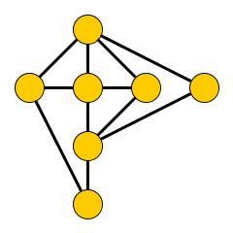
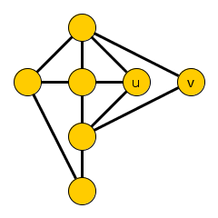
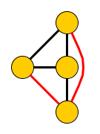
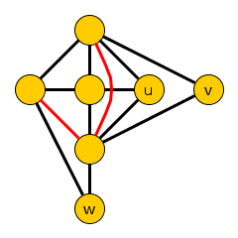
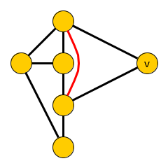
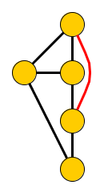
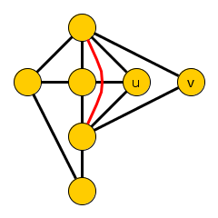
Treewidth-Invariant Sets
Kernel is based on treewidth-invariant sets
Vertex set whose elimination has a predictable effect on treewidth
Consider a graph G with an independent set T
Let Ĝ_{T} be the result of eliminating T from G, one vertex at a time (order does not matter)
If Ĝ_{T} is a minor of G – {z} for every z ∈ T, then T is a treewidth-invariant set in G
Let Δ(T) := max_{v∈T} deg(v)
Ĝ_{{u,v}}
Ĝ_{{u,v,w}}
Lemma. If T is a treewidth-invariant set in G, then tw(G) = max{tw(Ĝ_{T}), Δ(T)}

Slide 13
Reduction Based on Treewidth-Invariant Sets
Consider an instance (G,k) of Treewidth with a treewidth-invariant set T:
If Δ(T) ≥ k + 1: output no
Else reduce to Ĝ_{T}
Invariance lemma shows that tw(G) ≤ k iff tw(Ĝ_{T}) ≤ k, reduction is safe
Remaining issue: how to find treewidth-invariant sets?
Seems hard in general
NP-complete to test if a given set is treewidth-invariant!
q-Expansion
Lemma

Slide 14
q-Expansion Lemma
Let H be a bipartite graph with partite sets A and B, and q ∈ ℕ
A subset A’ ⊆ A is saturated by q-stars into B’ if we can assign to each v ∈ A’ a set of q private neighbors from B’
N_{H}(T)
A
A’
T
B
B’
q-Expansion Lemma [Fomin et al.@STACS’11]
Let m be the size of a maximum matching H. If |B| > m · q, then there is a nonempty set T ⊆ B such that N_{H}(T) is saturated by q-stars into T. It can be found in polynomial time.

Slide 15
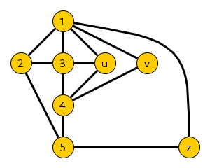
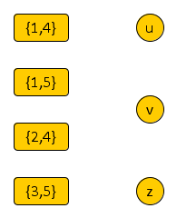
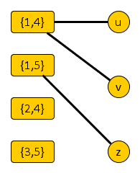
Finding Treewidth-Invariant Sets
Given a graph G with vertex cover X, form a bipartite non-edge connection graph H_{G,X}
One side corresponds to non-edges in G[X]
One side consists of the independent set $\overline{X}$
H_{G,X} has an edge between non-edge {p,q} and v ∈ $\overline{X}$, if v is adjacent to both p and q in G
Contracting v into p or q creates the edge {p,q}
G
H_{G,X}
Lemma. If H_{G,X} contains a set T ⊆ $\overline{X}$ such that N_{H}(T) can be saturated by 2-stars into T, then T is a treewidth-invariant set
X

Slide 16
Kernel Size Bound
Maximum matching in H_{G,X} has size at most $\left({|X| \atop 2}\right)$
Non-edge side has at most this many vertices
q-Expansion Lemma [Fomin et al.@STACS’11]
Let m be the size of a maximum matching H. If |B| > m · q, then there is a nonempty set T ⊆ B such that N_{H}(T) is saturated by q-stars into T. It can be found in polynomial time.
If |$\overline{X}$| > 2 $\left({|X| \atop 2}\right)$, find a 2-expansion in poly-time and reduce
Reduced instances have ≤ |X| + 2$\left({|X| \atop 2}\right)$ = |X|² vertices
Encoding into O(|X|³) bits
Theorem. Treewidth [vc] has a kernel with |X|² vertices that can be encoded in O(|X|³) bits

Slide 17
Conclusion
Main contributions
1. No nontrivial polynomial-time sparsification for Treewidth and Pathwidth, unless NP ⊆ coNP/poly
2. Treewidth [vc] has a kernel with |X|² vertices
Open problems
1. Are there graphs whose edge-count is superquadratic in their vertex cover number, which do not have treewidth-invariant sets?
2. Which problems admit nontrivial polynomial-time sparsification?
3. Does Treewidth [vc] have a kernel of bitsize O(|X|²)?
4. Does Pathwidth [vc] have a kernel with O(|X|²) vertices?

Slide 18
Thank you!

Slide 19
Invariance Property
Let Δ(T) := max_{v∈T} deg(v)
Lemma. If T is a treewidth-invariant set in G,
then tw(G) = max{tw(Ĝ_{T}), Δ(T)}
Proof.
(≥) G contains Ĝ_{T} and a (Δ(T)+1)-clique as a minor
(≤) Consider a tree decomposition T of Ĝ_{T}
For every v ∈ T, N_{G}(v) exists in Ĝ_{T} and forms a clique there
So T has a bag containing N_{G}(v)
Append a new bag with N_{G}(v) U {v}, of size ≤ Δ(T) + 1
Update independently for each v ∈ T

