Slide 1
Vertex Deletion Parameterized by Elimination Distance and Even Less
Bart M. P. Jansen Jari J. H. de Kroon Michał Włodarczyk
Networks Training Week April 2021 April 22
Notes:
Headsup: full paper in STOC is 76 pages, cannot describe all results.

Slide 2
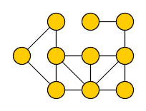
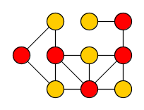
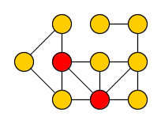
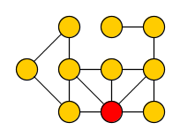
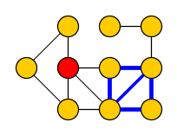
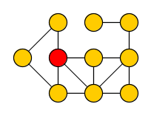
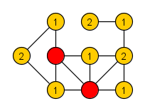
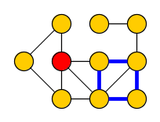
Vertex-deletion problems
Vertex Deletion to Graph Class $ℋ$ Input: Undirected graph $G$ Output: Minimum vertex set $S$ such that $G−S$ belongs to graph class $ℋ$
Many classic NP-hard graph problems can be phrased in this way:
Vertex Cover
Delete vertices to get edgeless graph
Feedback Vertex Set
Delete vertices to get acyclic graph
Odd Cycle Transversal
Delete vertices to get bipartite graph
Chordal Vertex Deletion
Delete vertices to get graph without chordless cycles
Notes:
The first two are among Karp’s 21. Applications in data cleaning, but also in deadlock prevention, process monitoring, quantum computing, and as bootstrapping mechanism for solving other problems.

Slide 3
Fixed-parameter tractable algorithms for vertex deletion
Fixed-parameter tractability is a framework to deal with NP-hard problems:
Choose a complexity parameter $k$ independent of the number of vertices $n$
Find an optimal solution in time $f\left(k\right)⋅n^{O(1)}$ for some function $f$ ?
Vertex Cover
Delete vertices to get edgeless graph
Feedback Vertex Set
Delete vertices to get acyclic graph
Odd Cycle Transversal
Delete vertices to get bipartite graph
Chordal Vertex Deletion
Delete vertices to get graph without chordless cycles
Notes:
Using approximation algorithms, as described by Laura Sanita on Monday, is one way of coping with NP-hardness. Main point of our paper: new FPT algorithms for solving vertex-deletion problems with parameterizations that dominate the ones previously used.

Slide 4
Vertex-deletion problems parameterized by solution size
Natural choice: use the size opt of the optimal solution as the complexity parameter
Develop algorithms which can efficiently find a small solution in a large graph
When opt $≈n$, these FPT algorithms are not much better than brute-force $2^{n}$
Vertex Cover
${1.27}^{\text{opt}}⋅n^{O\left(1\right)}$
Feedback Vertex Set
${2.7}^{\text{opt}}⋅n^{O(1)}$
Can we develop algorithms which are provably optimal and efficient on classes of inputs whose optimal solutions are large?
Odd Cycle Transversal
${2.31}^{\text{opt}}⋅n^{O(1)}$
Chordal Vertex Deletion
$2^{O\left(\text{opt}\log{\text{opt}}\right)}n^{O(1)}$
Notes:
Can we develop algorithms which are provably optimal and efficient in graphs whose solutions are large?

Slide 5
Vertex-deletion problems parameterized by graph complexity
Alternative: use a complexity measure of the graph as the parameter
Develop algorithms for graphs which are large but simply structured
Popular width measures of graphs include treedepth (td) and treewidth (tw)
Vertex Cover
$2^{\text{tw}}⋅n^{O(1)}$
Feedback Vertex Set
$3^{\text{tw}}⋅n^{O(1)}$
Odd Cycle Transversal
$3^{\text{tw}}⋅n^{O(1)}$
Chordal Vertex Deletion
$f(\text{tw})⋅n^{O(1)}$
Notes:
Simply structure: think treelike. Same running time bounds can be obtained for treedepth, sometimes in polynomial space.
For all of them: can replace TW by TD. For VC and OCT, this gives poly-space algorithms.

Slide 6
New problem parameterizations
We use parameterizations that combine the best of both worlds:
never larger than the solution size opt,
never larger than the treedepth (this talk) or treewidth (in the paper),
and develop FPT algorithms for Vertex Deletion to $ℋ$using these parameterizations
Driven by a suitable decomposition of the input graph associated to the parameter
Our algorithms simultaneously exploit:
the target class $ℋ$ in regions of the graph where the solution is small,
tree-likeness in regions of the graph where the solution is large
Notes:
Yields algorithms that are guaranteed to efficiently yield optimal solutions in classes of inputs that cannot be handled by either of the previous approaches alone.

Slide 7
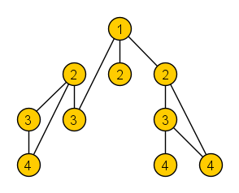
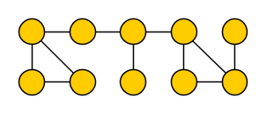
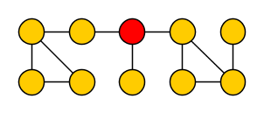
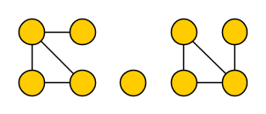
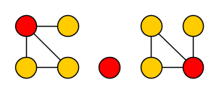
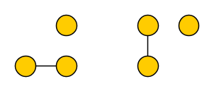
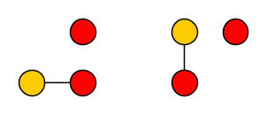
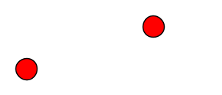
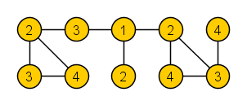
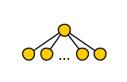
Treedepth
The treedepth $td(G)$ of graph $G$ is:
the minimum number of rounds to reduce $G$ to an empty graph without vertices,
when deleting one vertex from each connected component per round
Yields elimination forest in which all edges of $G$ connect ancestors to descendants
Note:
$td(G)$ is the minimum depth of an elimination forest
Intuitively, $td(G)$ captures how star-like the graph is: $td\left( \right)=2$
Notes:
Well-known to those of you who participated in the PACE challenge last year! Treedepth can be large even though solution to vertex-deletion can be small: an n*n grid has treedepth >= n but since it is bipartite, the empty set is a solution to odd cycle transversal on the grid.

Slide 8
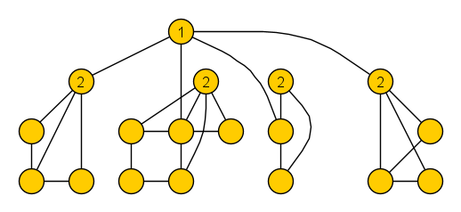
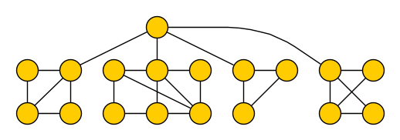
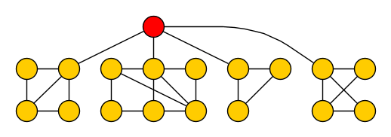
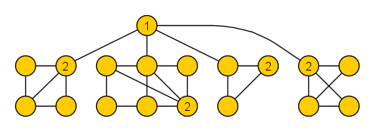
Elimination distance to $ℋ$
For a graph class $ℋ$, the elimination distance $ed_{ℋ}(G)$ of graph $G$ to $ℋ$ is:
the minimum number of rounds to reduce $G$ to a graph in class $ℋ$,
when deleting one vertex from each connected component per round
Yields $ℋ$-elimination forest whose leaves are connected subgraphs belonging to $ℋ$
Note:
$ed_{ℋ}(G)$ is the minimum depth of an $ℋ$-elimination forest
$ed_{ℋ}(G)$ is never larger than treedepth or vertex-deletion distance to $ℋ$
$ℋ$= bipartite
we refer to these as base components
Notes:
Treedepth is also known as vertex ranking number or vertex elimination number. Depth of elimination tree corresponds to number of rounds.

Slide 9
Results
We obtained three types of results for various graph classes $ℋ$:
1. Decomposition algorithms
2. Algorithms solving Vertex Deletion to $ℋ$
2. Algorithms solving Vertex Deletion to ℋ
3. Hardness proofs
Given a graph $G$ with $ed_{ℋ}\left(G\right)=k$, output an $ℋ$-elimination forest of depth $k^{O\left(1\right)}$ in time $f(k)⋅n^{O\left(1\right)}$(✓) or even $2^{k^{O\left(1\right)}}⋅n^{O\left(1\right)}$ (★)
Given a graph 𝐺 with 𝑒𝑑_ℋ (𝐺)=𝑘, output an ℋ-elimination forest of depth 𝑘^𝑂(1) in time 𝑓(𝑘)⋅𝑛^𝑂(1) (✓) or even 2^(𝑘^𝑂(1) )⋅𝑛^𝑂(1) (★)
Given an $ℋ$-elimination forest of depth $k$ of a graph $G$, output a minimum set $S$ such that $G−S∈ℋ$ in time $2^{k^{O\left(1\right)}}⋅n^{O\left(1\right)}$
Given an ℋ-elimination forest of depth 𝑘 of a graph 𝐺, output a minimum set 𝑆 such that 𝐺−𝑆∈ℋ in time 2^(𝑘^𝑂(1) )⋅𝑛^𝑂(1)
For some graph classes for which we did not find algorithms as above, no such algorithms exist unless $FPT=W[1]$
For some graph classes for which we did not find algorithms as above, no such algorithms exist unless 𝐹𝑃𝑇=𝑊[1]
Target class $ℋ$ | 1 | 2 | 3
Bipartite graphs | ★ | ✓
Planar graphs | ✓ | ✓
Interval graphs | ★
Chordal graphs | ★ | ✓
O(1) forbidden con. induced subgraphs | ★ | ✓
O(1) forbidden connected minors | ✓ | ✓
O(1) forbidden con. topological minors | ✓
Perfect graphs |  |  | X
Notes:
When combining 1&2: solve vertex-deletion optimally in FPT-time parameterized by elimination distance. For some $ℋ$ we can even do it in polynomial space, such as for bipartite graphs.
In the paper, we present similar results for the parameterization that extends treewidth.

Slide 10
1. Outline of decomposition algorithms
To build a good $ℋ$-elimination forest we have to identify the base components, and arrange the internal vertices of the decomposition tree in a suitable way
In an elimination forest of small depth, base components have small neighborhoods
$ℋ$= bipartite
Observation. Each base component $C$ is a connected subgraph belonging to $ℋ$, whose neighbors in $G$ are ancestors of the leaf representing $C$

Slide 11
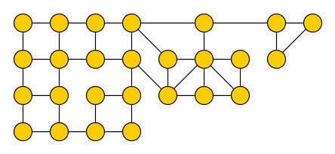
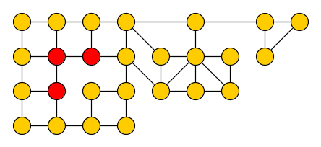
1. Finding $ℋ$-subgraphs with small neighborhoods
Leads to the following algorithmic problem for fixed graph classes $ℋ$:
$(ℋ,k)$-separation Input: Graph $G$, integer $k$, connected vertex set $Z$ Output: A connected vertex set $C⊇Z$ with $G\left[C\right]∈ℋ$ and $\left|N_{G}\left(C\right)\right|≤k$, if such a set exists
$ℋ$= bipartite
$k=2$
$$Z$$
Notes:
High-level approach: by repeatedly calling the algorithm we can find ‘maximal’ sets of potential base components. Based on these we partition the vertex set of the graph into connected sets, and establish a relation between the $ℋ$-elimination distance of $G$ and the treedepth of the graph you get when contracting each set into a single vertex.

Slide 12
1. Finding $ℋ$-subgraphs with small neighborhoods
Leads to the following algorithmic problem for fixed graph classes $ℋ$:
$(ℋ,k)$-separation Input: Graph $G$, integer $k$, connected vertex set $Z$ Output: A connected vertex set $C⊇Z$ with $G\left[C\right]∈ℋ$ and $\left|N_{G}\left(C\right)\right|≤k$, if such a set exists
We develop FPT-approximation algorithms for extensions of this problem, based on:
important separators, the Erdős–Pósa property, bounded-depth branching algorithms, min-cut max-flow
Lemma. If $(ℋ,k)$-separation can be solved in time $f(n,k)$, then there is an algorithm that given a graph $G$ with $ed_{ℋ}\left(G\right)=k$, outputs an $ℋ$-elimination forest of depth $O(k^{3}\log{k})$ in time $f\left(n,k\right)⋅n^{O\left(1\right)}$.
Notes:
High-level approach: by repeatedly calling the algorithm we can find ‘maximal’ sets of potential base components. Based on these we partition the vertex set of the graph into connected sets, and establish a relation between the $ℋ$-elimination distance of $G$ and the treedepth of the graph you get when contracting each set into a single vertex.

Slide 13
2. Outline of solving Vertex Deletion using a decomposition
An $ℋ$-elimination forest provides a decomposition of the graph by small separators
We can use dynamic programming over this decomposition, but need a way to solve the subproblems corresponding to base components (leaves) of the decomposition
$ℋ$= bipartite
Observation. If $ℋ$ is characterized by a set of connected forbidden substructures, then any optimal solution deletes $≤ed_{ℋ}\left(G\right)$ vertices from a base component.
Notes:
In many cases, this allows us to employ algorithms for the solution-size parameterization to compute the information for the leaves of the decomposition. The remaining process of computing a solution is similar as for treewidth.

Slide 14
2. Outline of solving Vertex Deletion using a decomposition
An $ℋ$-elimination forest provides a decomposition of the graph by small separators
Allows FPT algorithms for the parameterization by opt to be used to bootstrap the DP
$ℋ$= bipartite
Observation. If $ℋ$ is characterized by a set of connected forbidden substructures, then any optimal solution deletes $≤ed_{ℋ}\left(G\right)$ vertices from a base component.
Notes:
In many cases, this allows us to employ algorithms for the solution-size parameterization to compute the information for the leaves of the decomposition. The remaining process of computing a solution is similar as for treewidth.

Slide 15
Conclusion
We provided three types of results for new parameterizations of Vertex deletion:
Results carry over to $ℋ$-treewidth with changes in the polynomial factors
Open problems:
Can a $c$-approximation to $ed_{ℋ}$ be computed in time $2^{k^{O\left(1\right)}}⋅n^{O\left(1\right)}$ ?
Can variants of these hybrid parameterizations be effective for directed graphs?
1. Decomposition algorithms
3. Hardness proofs
2. Algorithms solving Vertex Deletion to $ℋ$

