Slide 1
Vertex Deletion Parameterized by Elimination Distance and Even Less
Bart M. P. Jansen Jari J. H. de Kroon Michał Włodarczyk
Warwick Online Seminar December 6th 2021
Notes:
Headsup: full paper in STOC is 76 pages, cannot describe all results.

Slide 2
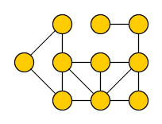
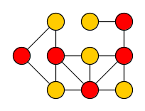
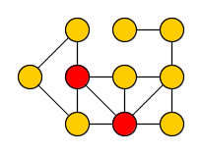
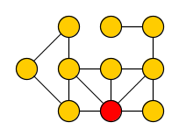
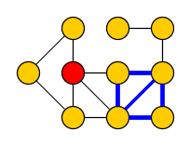
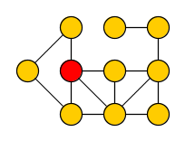
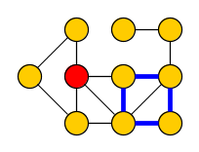
Vertex-deletion problems
Vertex Deletion to Graph Class $ℋ$ Input: Undirected graph $G$ Output: Minimum vertex set $S$ such that $G−S$ belongs to graph class $ℋ$
Many classic NP-hard graph problems can be phrased in this way:
Vertex Cover
Delete vertices to get edgeless graph
Feedback Vertex Set
Delete vertices to get acyclic graph
1
2
1
Odd Cycle Transversal
Delete vertices to get bipartite graph
Chordal Vertex Deletion
Delete vertices to get graph without chordless cycles
2
2
1
2
1
1
Notes:
The first two are among Karp’s 21. Applications in data cleaning, but also in deadlock prevention, process monitoring, quantum computing, and as bootstrapping mechanism for solving other problems.

Slide 3
Fixed-parameter tractable algorithms for vertex deletion
Fixed-parameter tractability is a framework to deal with NP-hard problems:
Choose a complexity parameter $k$ independent of the number of vertices $n$
Find an optimal solution in time $f\left(k\right)⋅n^{O(1)}$ for some function $f$ ?
Vertex Cover
Delete vertices to get edgeless graph
Feedback Vertex Set
Delete vertices to get acyclic graph
Odd Cycle Transversal
Delete vertices to get bipartite graph
Chordal Vertex Deletion
Delete vertices to get graph without chordless cycles
Notes:
Using approximation algorithms is one way of coping with NP-hardness. Main point of our paper: new FPT algorithms for solving vertex-deletion problems with parameterizations that dominate the ones previously used.

Slide 4
Vertex-deletion problems parameterized by solution size
Natural choice: use the size opt of the optimal solution as the complexity parameter
Develop algorithms which can efficiently find a small solution in a large graph
When opt $≈n$, these FPT algorithms are not much better than brute-force $2^{n}$
Vertex Cover
${1.27}^{\text{opt}}⋅n^{O\left(1\right)}$
Feedback Vertex Set
${2.7}^{\text{opt}}⋅n^{O(1)}$
Can we develop algorithms which are provably optimal and efficient on classes of inputs whose optimal solutions are large?
[Chen, Kanj, Xia’10]
[Li, Nederlof ’19]
Odd Cycle Transversal
${2.31}^{\text{opt}}⋅n^{O(1)}$
Chordal Vertex Deletion
$2^{O\left(\text{opt}\log{\text{opt}}\right)}n^{O(1)}$
[LNRRS’14]
[Cao, Marx’16]
Notes:
Can we develop algorithms which are provably optimal and efficient in graphs whose solutions are large?

Slide 5
Vertex-deletion problems parameterized by graph complexity
Alternative: use a complexity measure of the graph as the parameter
Develop algorithms for graphs which are large but simply structured
Popular width measures of graphs include treedepth (td) and treewidth (tw)
Vertex Cover
$2^{\text{tw}}⋅n^{O(1)}$
Feedback Vertex Set
$3^{\text{tw}}⋅n^{O(1)}$
[CNPPRW’11]
Odd Cycle Transversal
$3^{\text{tw}}⋅n^{O(1)}$
Chordal Vertex Deletion
$f(\text{tw})⋅n^{O(1)}$
Notes:
Simply structure: think treelike. Same running time bounds can be obtained for treedepth, sometimes in polynomial space.
For all of them: can replace TW by TD. For VC and OCT, this gives poly-space algorithms.

Slide 6
Hybrid problem parameterizations
We use parameterizations that combine the best of both worlds:
never larger than the solution size opt,
never larger than the treedepth (this talk) or treewidth (in the paper),
and can be arbitrarily much smaller.
We develop FPT algorithms for Vertex Deletion to $ℋ$using these parameterizations
Driven by a suitable decomposition of the input graph associated to the parameter
Our algorithms simultaneously exploit:
the target class $ℋ$ in regions of the graph where the solution is small,
tree-likeness in regions of the graph where the solution is large
Notes:
Yields algorithms that are guaranteed to efficiently yield optimal solutions in classes of inputs that cannot be handled by either of the previous approaches alone.

Slide 7
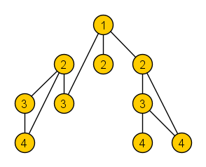
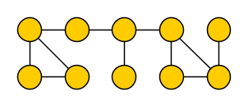
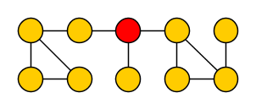
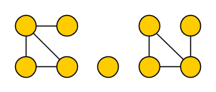
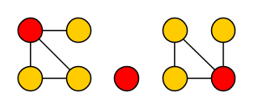
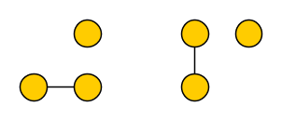
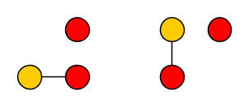
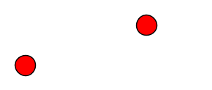
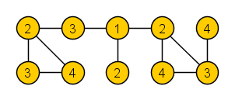
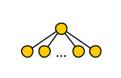
Treedepth
The treedepth $td(G)$ of graph $G$ is:
the minimum number of rounds to reduce $G$ to an empty graph without vertices,
when deleting one vertex from each connected component per round
Yields elimination forest in which all edges of $G$ connect ancestors to descendants
Note:
$td(G)$ is the minimum depth of an elimination forest
Intuitively, $td(G)$ captures how star-like the graph is: $td\left( \right)=2$
Notes:
Well-known to those of you who participated in the PACE challenge last year! Treedepth can be large even though solution to vertex-deletion can be small: an n*n grid has treedepth >= n but since it is bipartite, the empty set is a solution to odd cycle transversal on the grid.

Slide 8
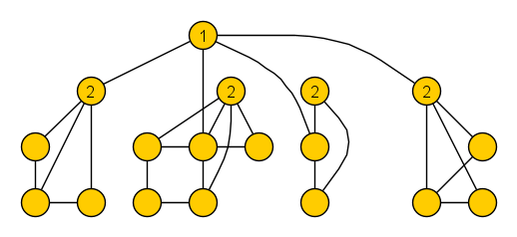
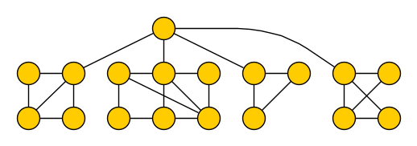
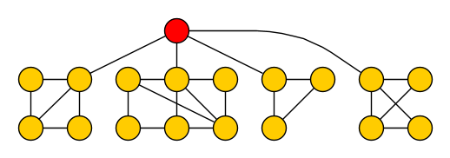
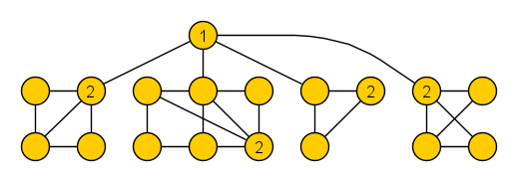
Elimination distance to $ℋ$
For a graph class $ℋ$, the elimination distance $ed_{ℋ}(G)$ of graph $G$ to $ℋ$ is:
the minimum number of rounds to reduce $G$ to a graph in class $ℋ$,
when deleting one vertex from each connected component per round
Yields $ℋ$-elimination forest whose leaves are connected subgraphs belonging to $ℋ$
Note:
$ed_{ℋ}(G)$ is the minimum depth of an $ℋ$-elimination forest
$ed_{ℋ}(G)$ is never larger than treedepth or vertex-deletion distance to $ℋ$
$ℋ$= bipartite
we refer to these as base components
Notes:
Treedepth is also known as vertex ranking number or vertex elimination number. Depth of elimination tree corresponds to number of rounds.

Slide 9
Prior work on computing treedepth and elimination distance
Treedepth can be computed exactly in time $2^{O\left(n\right)}$ and $2^{O(OPT^{2})}⋅n$ [Reidl, Rossmanith, Sánchez Villaamil, Sikdar ’14]
Elimination forest of depth $OPT^{2}\log{OPT}$ can be computed in polynomial time [Czerwinski, Nadara, Pilipczuk ’19]
$ℋ$-elimination distance was introduced by Bulian & Dawar [IPEC ’14, Algorithmica ‘16]
$ℱ$-minor-free graphs [Bulian & Dawar]
ℱ-minor-free graphs [Bulian & Dawar]
Bounded-degree graphs (approximation) [Bulian & Dawar]
Bounded-degree graphs (planar inputs) [Lindermayr, Siebertz, Vigny, MFCS‘20]
Cluster graphs [Agrawal & Ramanujan, IPEC‘20]
Bipartite graphs [J. & de Kroon, WG ’21]
All classes defined by a finite set of forbidden induced subgraphs [Agrawal, Kanesh, Panolan, Ramanujan, Saurabh, STACS’21]
Rankwidth $≤c$ [Eiben, Ganian, Hamm, Kwon, MFCS‘19]
Rankwidth ≤𝑐 [Eiben, Ganian, Hamm, Kwon, MFCS‘19]
Notes:
In all cases: huge parameter dependence.
Measuring what matters: A hybrid approach to dynamic programming with treewidth. Eiben Ganian Hamm Kwon.’21

Slide 10
Results
We obtained three types of results for various hereditary graph classes $ℋ$:
1. Decomposition algorithms
2. Algorithms solving Vertex Deletion to $ℋ$
2. Algorithms solving Vertex Deletion to ℋ
3. Hardness proofs
Given a graph $G$ with $ed_{ℋ}\left(G\right)=k$, output an $ℋ$-elimination forest of depth $k^{O\left(1\right)}$ in time $f(k)⋅n^{O\left(1\right)}$(✓) or even $2^{k^{O\left(1\right)}}⋅n^{O\left(1\right)}$ (★)
Given a graph 𝐺 with 𝑒𝑑_ℋ (𝐺)=𝑘, output an ℋ-elimination forest of depth 𝑘^𝑂(1) in time 𝑓(𝑘)⋅𝑛^𝑂(1) (✓) or even 2^(𝑘^𝑂(1) )⋅𝑛^𝑂(1) (★)
Given an $ℋ$-elimination forest of depth $k$ of a graph $G$, output a minimum set $S$ such that $G−S∈ℋ$ in time $2^{k^{O\left(1\right)}}⋅n^{O\left(1\right)}$
Given an ℋ-elimination forest of depth 𝑘 of a graph 𝐺, output a minimum set 𝑆 such that 𝐺−𝑆∈ℋ in time 2^(𝑘^𝑂(1) )⋅𝑛^𝑂(1)
For some graph classes for which we did not find algorithms as above, no such algorithms exist unless $FPT=W[1]$
For some graph classes for which we did not find algorithms as above, no such algorithms exist unless 𝐹𝑃𝑇=𝑊[1]
Target class $ℋ$ | 1 | 2 | 3
Bipartite graphs | ★ | ✓
Planar graphs | ✓ | ✓
Interval graphs | ★
Chordal graphs | ★ | ✓
O(1) forbidden con. induced subgraphs | ★ | ✓
O(1) forbidden connected minors | ✓ | ✓
O(1) forbidden con. topological minors | ✓
Perfect graphs |  |  | X
Notes:
When combining 1&2: solve vertex-deletion optimally in FPT-time parameterized by elimination distance. For some $ℋ$ we can even do it in polynomial space, such as for bipartite graphs.
In the paper, we present similar results for the parameterization that extends treewidth.

Slide 11
Conceptual message of our results
Old mindset of the complexity of exactly solving vertex-deletion problems:
can only be done efficiently when the solution is small, or the graph is treelike
High-level message of our results:
Vertex-deletion instances with large optimal solutions and large treewidth can be solved efficiently, if the elimination distance to the target class is small
Notes:
Wide applicability came as a surprise: initially thought this was a ‘fluke’, only for OCT based on polynomial-time compression problem. Remainder of the talk: some technical details of 1) decomposition algorithms and 2) solving vertex-deletion problems.

Slide 12
1. approximating $ℋ$-elimination distance
Notes:
Our algorithms for solving vertex-deletion problems consist of two parts: 1) algorithms to approximate $ℋ$-elimination distance and build an $ℋ$-elimination forest; 2) algorithms that use an elimination forest to compute a minimum vertex-deletion set to $ℋ$.

Slide 13
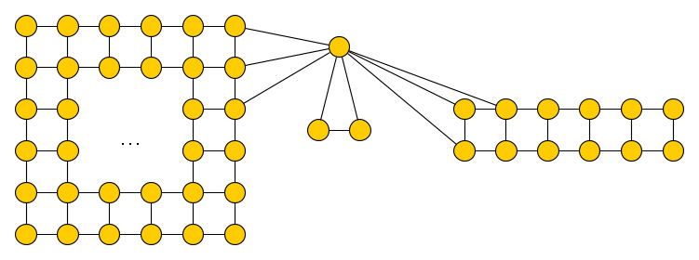
High-level idea to approximate $ℋ$-elimination distance
Exploit existing algorithms to compute or approximate treedepth
Applying them directly is not useful:
$td(G)$ can be arbitrarily large compared to $ed_{ℋ}(G)$
$ℋ$= bipartite
$k=1$

Slide 14
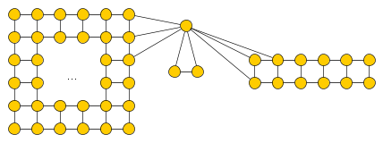
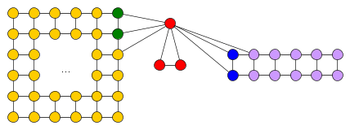
High-level idea to approximate $ℋ$-elimination distance
Exploit existing algorithms to compute or approximate treedepth
1. Treedepth of $G′$ is bounded in terms of $ed_{ℋ}\left(G\right)$
Base components of large treedepth should be contracted to small vertex sets
2. Given elimination forest of $G′$ depth $k$, can find $ℋ$-elimination forest of $G$ of depth $poly\left(k\right)$
Each contracted set $S$ should be $C∪N_{G}(C)$, where $G\left[C\right]∈ℋ$ and $\left|N_{G}\left(C\right)\right|≤{ed_{ℋ}(G)}^{O\left(1\right)}$
Idea: Contract $G$ into a graph $G′$ such that $td\left(G′\right)≈ed_{ℋ}(G)$
Notes:
Then you can mimic an elimination process on $G′$ to the empty graph, by an elimination process in $G$ that ends with a graph from $ℋ$. For each vertex of $G′$ that you eliminate: eliminate the corresponding boundary, leave the H-subgraph alive.

Slide 15
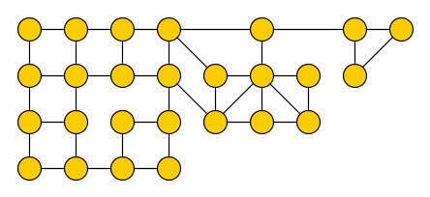
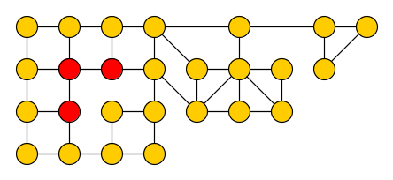
Finding $ℋ$-subgraphs with small neighborhoods
Leads to the following algorithmic problem for fixed graph classes $ℋ$:
$ℋ$-separation Input: Graph $G$, integer $k$, connected vertex set $Z$ Output: A connected vertex set $C⊇Z$ with $G\left[C\right]∈ℋ$ and $\left|N_{G}\left(C\right)\right|≤k$, if such a set exists
$ℋ$= bipartite
$k=2$
$$Z$$
$$C$$
Notes:
Related to secluded subgraph problems studied earlier in the literature, but with additional requirement of containing a set Z.
High-level approach: by repeatedly calling the algorithm we can find ‘maximal’ sets of potential base components. Based on these we partition the vertex set of the graph into connected sets, and establish a relation between the $ℋ$-elimination distance of $G$ and the treedepth of the graph you get when contracting each set into a single vertex.

Slide 16
Finding $ℋ$-subgraphs with small neighborhoods
Leads to the following algorithmic problem for fixed graph classes $ℋ$:
$ℋ$-separation Input: Graph $G$, integer $k$, connected vertex set $Z$ Output: A connected vertex set $C⊇Z$ with $G\left[C\right]∈ℋ$ and $\left|N_{G}\left(C\right)\right|≤k$, if such a set exists
We develop FPT-approximation algorithms for extensions of this problem, based on:
important separators, the Erdős–Pósa property, bounded-depth branching algorithms, min-cut max-flow
Lemma. If $ℋ$-separation can be solved in time $f(n,k)$, then there is an algorithm that, given a graph $G$ with $ed_{ℋ}\left(G\right)=k$, outputs an $ℋ$-elimination forest of depth $O(k^{3}\log{k})$ in time $f\left(n,k\right)⋅n^{O\left(1\right)}$.
Notes:
High-level approach: by repeatedly calling the algorithm we can find ‘maximal’ sets of potential base components. Based on these we partition the vertex set of the graph into connected sets, and establish a relation between the $ℋ$-elimination distance of $G$ and the treedepth of the graph you get when contracting each set into a single vertex.

Slide 17
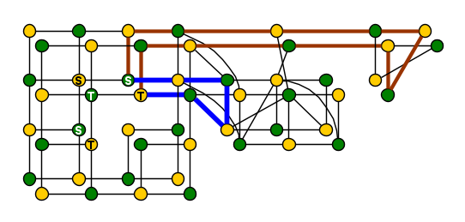
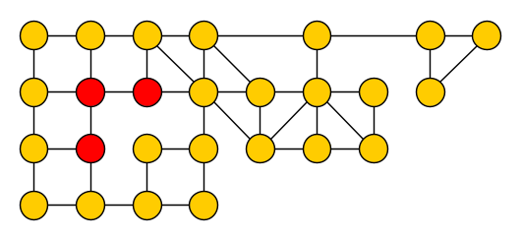
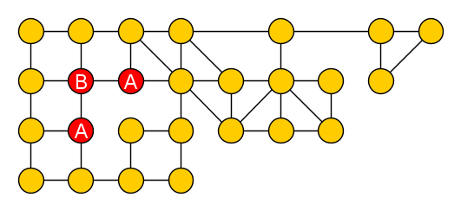
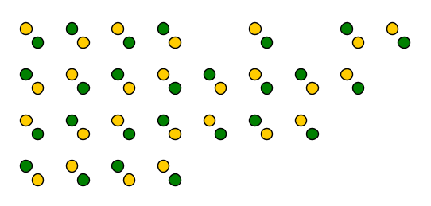
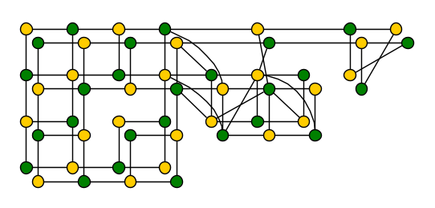
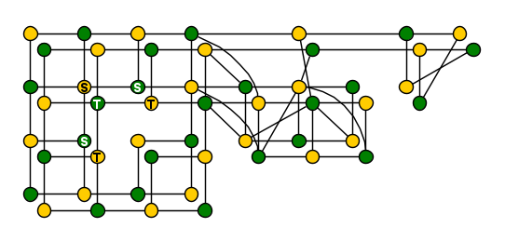
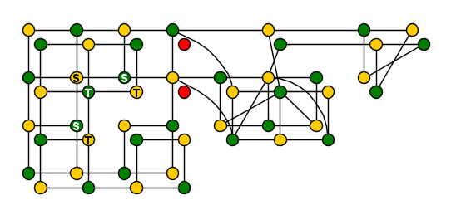
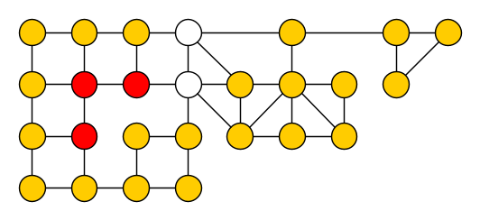
Approximating $bipartite$-separation
Approximate $bipartite$-separation Input: Graph $G$, integer $k$, connected vertex set $Z$ Output: Connected set $C⊇Z$ such that $G\left[C\right]$ is bipartite and $\left|N_{G}\left(C\right)\right|≤2k$, if such a set with a neighborhood of size $k$ exists
Given a graph $G$ with elimination distance $k$ to a bipartite graph, a $bipartite$-elimination forest of depth $O(k^{3}\log{k})$ can be computed in polynomial time.
Polynomial-time algorithm:
Fix 2-coloring of $G[Z]$ with color classes $A,B$
Create parity graph $G′$ on $\left\{v^{′},v^{′′} ∣ v∈V\left(G\right)\right\},$ edges $u^{′}v^{′′} and u^{′′}v^{′}$ for all $uv∈E\left(G\right)$
Define two sets: $S=\left\{v^{′} ∣ v∈Z∩A\right\}∪\{v^{′′}∣v∈Z∩B\}$ $T=\left\{v^{′′} ∣ v∈Z∩A\right\}∪\{v^{′}∣v∈Z∩B\}$
Find $(S,T)$ separator $X′⊆V\left(G^{′}\right)∖(S∪T)$
If $X^{′}>2k$: fail (neighborhood $≤k$ is impossible)
Let $X=\{v∈V\left(G\right)∣v^{′}∈X^{′}∨v^{′′}∈X^{′}\}$
Output component $C$ of $G−X$ containing $Z$
$$X$$
$$X$$
$$Z$$
$$C$$
Notes:
If you take a closed walk in a bipartite subgraph: the parity of the vertex from which you start is equal to that from which you return. To return to a vertex of opposite parity, you have to traverse an odd cycle. This means that a path that switches parity contains an odd cycle. It turns out that breaking paths which allows you to switch parity, is sufficient to break all reachable odd cycles.

Slide 18
2. solving vertex-deletion problems using a decomposition
Notes:
Now: seen general approach to compute H-elimination distance from H-separations, and concrete example for bipartite graphs. Next: see some generic ideas for solving vertex-deletion problems, as well as some concrete ideas for bipartite graphs.

Slide 19
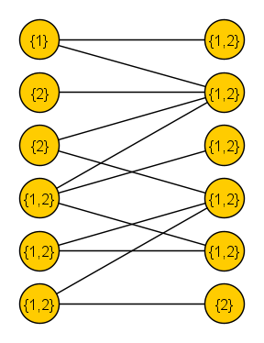
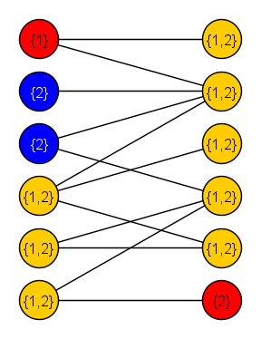
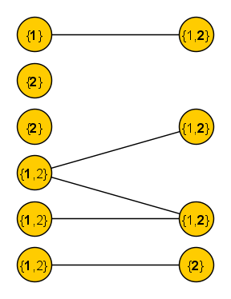
A polynomial-time subroutine for Odd Cycle Transversal
Based on the insight from the iterative-compression algorithm by Reed, Smith & Vetta:
$$X=\left\{v∈V_{1}:1∉L(v)\right\}∪\{v∈V_{2}:2∉L(v)\}$$
$$Y=\left\{v∈V_{1}:2∉L(v) \right\}∪\{v∈V_{2}:1∉L\left(v\right)\}$$
$S$ is a solution $⇔$ no path from $X∖S$ to $Y∖S$ in $G−S$
Compute minimum $(X,Y)$-separator $S$ via maximum flow
Given a bipartite graph $G=(V_{1}∪V_{2},E)$ with a list $L\left(v\right)⊆\{1,2\}$ for all $v∈V(G)$, in polynomial time we can compute a minimum $S⊆V(G)$ such that $G−S$ has a proper 2-coloring that assigns each vertex $v$ a color from its list
Notes:
There cannot be a path from vertex on the left that is not allowed color 1, to a vertex on the right that is not allowed to have color 1: both would be forced to be colored 2, but there is an odd-length path between them in $G−S$. Similarly, there cannot be a path from a vertex that cannot have color 1 on the left, to a vertex that cannot have color 2 on the left: they would be forced to opposite colors, but there is an even-length path between them.

Slide 20
Odd Cycle Transversal parameterized by elimination distance
Solve a more general problem: each vertex $v∈V(G)$ has a list $L\left(v\right)⊆\{1,2\}$, find minimum vertex set $S$ such that $G−S$ has a 2-coloring respecting the lists
Recursive algorithm, given $bipartite$-elimination forest of depth $k$:
If $G$ is disconnected, solve separately on each connected component
If $G$ is bipartite ($k=0$), solve in polynomial time via subroutine
Else, let $v$ be the vertex eliminated from the connected graph in the first of the $k$ rounds Recurse on three subproblems, output smallest solution found:
Recurse on $G−v$, add $v$ to the solution that is found
If $1∈L(v)$: recurse on $G−v$ with color 1 removed from the lists of $v$’s neighbors
If $2∈L(v)$: recurse on $G−v$ with color 2 removed from the lists of $v$’s neighbors
In each recursive call, $G−v$ has $bipartite$-elimination distance at most $k−1$
Given a graph $G$ of elimination distance $k$ to a bipartite graph, a minimum odd cycle transversal can be computed in time $n^{O\left(1\right)}+2^{O\left(k^{3}\log{k}\right)}⋅(n+m)$ and polynomial space.
Given a graph $G$ with a $bipartite$-elimination forest of depth $k$, a minimum odd cycle transversal can be computed in time $3^{k}⋅k^{2}⋅(n+m)$ and polynomial space.
Notes:
nO(1) + 2O(k3 log k) ·(n + m)

Slide 21
Outline of solving Vertex Deletion using a decomposition
An $ℋ$-elimination forest provides a decomposition of the graph by small separators
We can use dynamic programming over this decomposition, but need a way to solve the subproblems corresponding to base components (leaves) of the decomposition
$ℋ$= bipartite
Observation. If $ℋ$ is characterized by a set of connected forbidden substructures, then any optimal solution deletes $≤ed_{ℋ}\left(G\right)$ vertices from a base component.
Notes:
Now: brief discussion of generic approach. In many cases, this allows us to employ algorithms for the solution-size parameterization to compute the information for the leaves of the decomposition. The remaining process of computing a solution is similar as for treewidth.

Slide 22
Outline of solving Vertex Deletion using a decomposition
An $ℋ$-elimination forest provides a decomposition of the graph by small separators
Allows FPT algorithms for the parameterization by opt to be used to bootstrap the DP
$ℋ$= bipartite
Observation. If $ℋ$ is characterized by a set of connected forbidden substructures, then any optimal solution deletes $≤ed_{ℋ}\left(G\right)$ vertices from a base component.
Notes:
In many cases, this allows us to employ algorithms for the solution-size parameterization to compute the information for the leaves of the decomposition. The remaining process of computing a solution is similar as for treewidth.

Slide 23
Conclusion
We provided three types of results for new parameterizations of Vertex deletion:
Results carry over to $ℋ$-treewidth with changes in the polynomial factors [Eiben, Ganian, Hamm, Kwon @ MFCS’19]
Open problems:
Can a $c$-approximation to $ed_{ℋ}$ be computed in time $2^{k^{O\left(1\right)}}⋅n^{O\left(1\right)}$ ?
Can variants of these hybrid parameterizations be effective for directed graphs?
1. Decomposition algorithms
3. Hardness proofs
2. Algorithms solving Vertex Deletion to $ℋ$

