Slide 1
Organization
2IN60: Real-time Architectures (for automotive systems)

Slide 2
Description of the course
General introduction to real-time systems in the automotive domain, with several examples illustrating problems we will be solving
Pick one leading example: part of the pre-crash system comprised of two ECU’s:
Sense a sensor, communicate the sensed data, actuate an actuator
Work towards the solutions bottom-up:
Identify problems and see how to address these
Notes:
We will pick one leading example representing part of the pre-crash system … . In the end you will design and implement a distributed controller, with one ECU sensing a sensor and communicating the sensed data to the other, which then actuates an actuator.

Slide 3
Goals for the course
After this course you should be able to:
Explain and apply the fundamental concepts and terminology of real-time systems in the automotive domain
Explain and address the fundamental problems of real-time systems
Analyze real-time systems designs
Design a real-time system
Implement simple programs on an embedded platform

Slide 4
Outline of the course
Week 1: Introduction
Week 2: Microcontrollers & Multitasking
Week 3: Preemption and atomicity
Week 4: Real-time Operating Systems: μC/OS-II
Week 5: Synchronization
Week 6: Real-time analysis
Week 7: Networked systems
Week 8:

Slide 5
Organization
Lectures
Weekly, 8 weeks
Exercises
Weekly, 8 weeks
30% of the grade
Exam
At the end of the course
70% of the grade
Website
Lecture slides, exercises, introduction to programming C, …
http://www.win.tue.nl/~mholende/automotive
Book (recommended)
A. Burns, A. Wellings, “Real-Time Systems and Programming Languages”, 4th Edition, 2009
J. Labrosse, “MicroC/OS-II: The Real-Time Kernel”, 2nd Edition, 2002
Notes:
Lecture slides and exercises will be posted on the website weekly before Thursday.

Slide 6
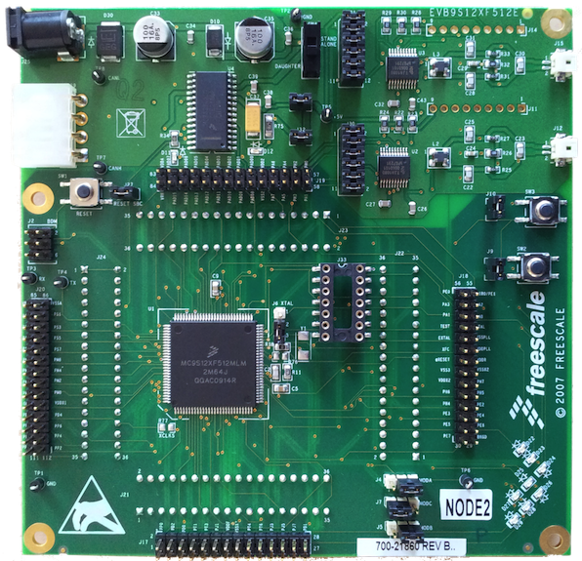
Exercises
Assignments posted on the website
Accessible only from the TU/e network
Programming the Freescale EVB9S12XF512E board
Follow a programming course online (optional)
Work in groups of two (1 board per 2 groups)
Hand in a weekly report
Answer all questions written in bold
Email to m.holenderski@tue.nl
Before 23:59 on the following Monday
Hard deadline!
One report per group
Single file, preferably PDF
File name: exercises<#>_group<group#>
E.g. exercises1_group3.pdf
Include group and student numbers inside the report
Notes:
Hard deadline! Forgot to attach assignment, deadline is missed!
For both exercises and exam it is important to be concise. You can invalidate a good answer by adding something which is wrong. There is no additional points for writing a story. Writing a story you only risk making mistakes, for which points will be deducted.

