Slide 1
Legal Informatics, Privacy and Cyber Crime
Part One: Web Application Security
Sandro Etalle
2020/29021

Slide 2
A suggested book
It is not obligatory to use it, it is suggested.

Slide 3
About this part of the course
Topic: Web Security
Underlying material: Slides only

Slide 4
Disclaimer
Any actions and or activities related to the material contained in these slides is solely your responsibility. The misuse of the information presented here can result in criminal charges brought against the persons in question.
The author(s) and the TU/e do not promote, encourage and or endorse ANY illegal activities. The author(s) and the TU/e will not be held responsible in the event any criminal charges be brought against any individuals misusing such information to break the law.

Slide 5
You need to get your hands a bit dirty
Please install
Something to tamper with the http request, such as liveHTTPheaders or TamperData.
liveHTTPheaders and TamperData do not work with the last version of Firefox. As alternative you can use Chrome with TamperChrome (a bit more complicated to use, but the result is the same, there is also a video tutorial).
2018: What now works with my firefox is the add-on HTTP header live.
Install Firefox, look for a plug-in for “headers” and install it.

Slide 6
The trouble with webapplications
Until a few years ago attacks Used to be on the Operating Systems
Now it is easier to attack the (web) applications
Either for a direct attack (steal information)
Or an indirect attack (attack a user using the webapplication)
Recent trend: attacking the OS/Silicon, again (e.g. Triton)
Let’s take a look at OWASP

Slide 7
What do you see here?

Slide 8
What happens when you go to nu.nl?
Your browser (Internet Explorer, Firefox, Safari, Opera) will
Display content coming from nu.nl
Display content coming from external sites (tens of sometimes hundreds of them)
So the browser will also transmit some information to these external sites
Display aggregate content from a number of advertisers
Carry out some operations
Some of them determined by NU.nl
Some of them determined by some external sites
Input to these operations is partly determined by them
DEFINITION: BROWSER

Slide 9
Simple Exercise
Easy
Start using TamperChrome (or if you have an old version of Firefox TamperData) and take a look at all the http request that are originated by your browser when you go to www.nu.nl
login Facebook
For the advanced user: install a proxy
Start burpproxy
under Kali: applications > web application analysis > burpsuite
make sure your browser is connected to the right proxy
typically: localhost:8081 (see the options in burpsuite)

Slide 10
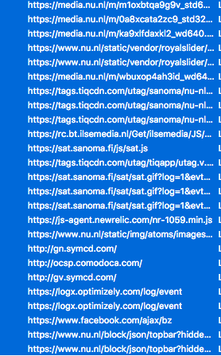
Result
This is a small fraction of the requests that are generate when you go to nu.nl
Notice that they are mostly external sites
….
(this is using tamperdata and clicking on submit every time, tamperchrome and livehttpheaders have a different interface)

Slide 11
This is what it is
Each box is a software component and it has vulnerabilities
And third party content is particularly untrusted
database
3rd party
nu.nl
webapplication
3rd party
3rd party
webserver
internet
Somewhere else
Browser
home
…

Slide 12
Let’s play a bit

Slide 13
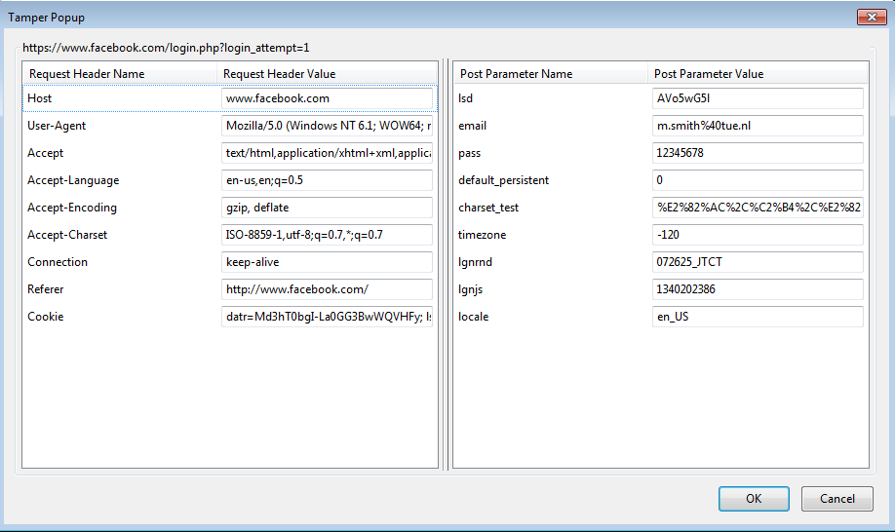
TamperData allows you to (and alter) an HTTP request …
TBD: show the request to third party
Obligatory exercise: activate “tamper data” and log in a site you know.
In most cases the password is sent in clear (can be intercepted – unless https is uses)
notice that you are able to modify the parameters
HTTP Request

Slide 14
An HTTP request contains parameters
The usual ones
Host
Referer. “The HTTP referer (originally a misspelling of referrer^{[1]}) is an HTTP header field that identifies the address of the webpage (i.e. the URI or IRI) that linked to the resource being requested. By checking the referrer, the new webpage can see where the request originated
Cookies
The unusual ones
username,
password
Important to understand: there exist two kind of parameters: GET and POST parameters.

Slide 15
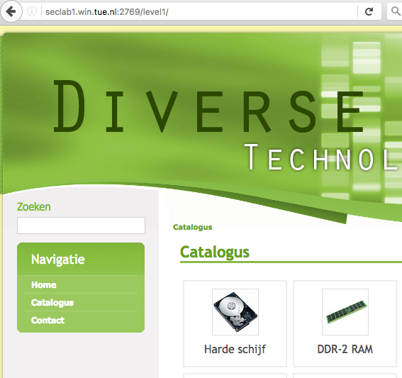
Get parameter by example
This is a page taken from the level 1 challenge on SQL injections
Type “ouch” in the “search” (Zoeken) field, press enter and you see….

Slide 16
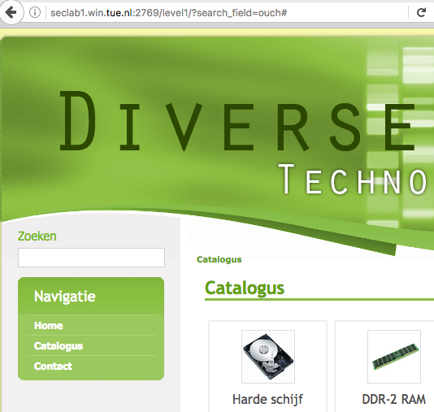
Get parameter by example (2)
That the parameter of the search is passed in the URL
This is thus a GET method parameter
Notice that you see something “different” in the URL also when you click on one of the buttons.

Slide 17
POST method by example (1)
The old Facebook example,
When you try to login you don’t see your login name and password in the url of facebook,

Slide 18
POST method by example (1)
The parameters are now “hidden” in the request: they are thus POST parameters.
You need to use temperdata to see them
What are the consequences of this difference security-wise?

Slide 19
Some differences
(from w3schools.com)
 | GET | POST
BACK button/Reload | Harmless | Data will be re-submitted (the browser should alert the user that the data are about to be re-submitted)
Bookmarked | Can be bookmarked | Cannot be bookmarked
Cached | Can be cached | Not cached
Encoding type | application/x-www-form-urlencoded | application/x-www-form-urlencoded or multipart/form-data. Use multipart encoding for binary data
History | Parameters remain in browser history | Parameters are not saved in browser history
Restrictions on data length | Yes, when sending data, the GET method adds the data to the URL; and the length of a URL is limited (maximum URL length is 2048 characters) | No restrictions
Restrictions on data type | Only ASCII characters allowed | No restrictions. Binary data is also allowed
Security | GET is less secure compared to POST because data sent is part of the URL Never use GET when sending passwords or other sensitive information! | POST is a little safer than GET because the parameters are not stored in browser history or in web server logs
Visibility | Data is visible to everyone in the URL | Data is not displayed in the URL
GET parameter: visible in the URL
You can bookmark it
Less secure: (e.g. when you only need to craft a link your victim has to click on)
POST parameter: not visible in the URL
But sometimes the webapplication accepts transforming a post into a get parameter

Slide 20
… and an HTTP Response
The response contains interesting information:
the status of the request.
parameters that may be reused

Slide 21
Nb: some parameter are encoded
This is to make the request more digestible by the webserver, webapplication etc.
Very often requests are encoded,
Very often the webapplication accepts several different encodings
Hexadecimal encoding: 0x41 = A, etc
URL encodings
%3d =
%25 %
%20 space
%0a new line
%00 null byte

Slide 22
One of the underlying problems: HTTP “weak” Sessions (1)
HTTP is connectionless
In particular it is sessionless, and does not have a “state”
Small exception: HTTP keep-alive, or HTTP connection reuse in which you reuse the same TCP connection (Connection: Keep-Alive), this is however often unlinked to the application logic, so as far as we are concerned there is no connection state.
So, think about a web shop, in which you change “state” by putting things in the car etc.
The webapplication has no memory of what you have done so far.
Question: How can a server (dealing with 100s of connection at the same time)
“know” which requests comes from you and which ones come from someone else?
Know the status of request, and what you have done earlier? Think about cheking out at a webshop.

Slide 23
HTTP “weak” Sessions (2)
All the information needed to process your request
Proof of who you are,
Information about what you have done so far (elements you have in the basket)
IS STORED IN YOUR BROWSER
database
nu.nl
webapplication
webserver
internet
Browser
home
…
PAGE 22

Slide 24
So, why don’t we use SSL and thereby “solve” all our problems?
SSL DOES NOT HELP against the attacks we just mentioned!
Actually, we should talk about TLS “Tansport Layer Security”
Where does SSL help?

Slide 25
Where SSL acts
SSL takes care of securing the communication (TCP/IP).
E.g. eavesdropping if you are at an internet café
Or at home using Wifi & WEP
Or WPA
The security problems we mentioned before have nothing to do with the application vulnerabilities.
Also: there are other ways of intercepting traffic.
database
nu.nl
webapplication
webserver
internet
SSL
Browser
home
…

Slide 26
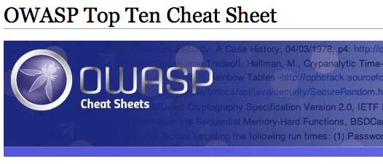
Owasp.org
If you have to develop any webapplication, you should look here for information how to avoid security problems
Look at the cheat sheets.
Interesting for us is the OWASP top 10
There is a tentative 2017 version

Slide 27
OWASP Top 10 (2017) edition
Injection
Broken Authentication
Sensitive Data Exposure [NEW]
XML External Entities (XXE) [NEW!]
Broken Access Control
Security Misconfiguration [Down from #5, still high enough]
Cross-Site Scripting (XSS) [Down from #3]
Insecure Deserialization [NEW!]
Using Components with Known Vulnerabilities
Insufficient Logging & Monitoring [NEW and interesting]

Slide 28
The old OWASP
A1: Injection
A10: Unvalidated Redirects and Forwards
A5: Security Misconfiguration
A3: Cross-Site Scripting (XSS)
A2: Broken Authentication and Session Management
A4: Insecure Direct Object References
A7: Missing Function Level Access Control
A6: Sensitive Data Exposure
A8: Cross Site Request Forgery (CSRF)
A9: Using Known Vulnerable Components
credit to owasp.org
Notes:
A9 is the only new item in the top 10 for 2013.

Slide 29
Cookies

Slide 30
Cookies in a nutshell (1)
The HTTP answer (from the webapplication to the browser), may contain cookies that set a value in the browser
Eg. The response coming from amazon.com may contain
Set-Cookie: SessId=191041-1042
Set-Cookie: UID=1042
Set-Cookie: DiscountAgreed=25
The next time we visit amazon.com the browser will include in the header the following information
Cookie: SessId=191041-1042
Cookie: UID=1042
Cookie: DiscountAgreed=25
Nb: you can change this with temperdata

Slide 31
How cookies work
Each cookie has a domain and a path
It will be submitted to each request in which
The domain is a subdomain of the cookie domain
The path is a subdirectory of the cookie path
Domain and path can be determined by the server in the so-called cookie policy
Set-Cookie: LSID=DQAAAK…; Domain=docs.foo.com; Path=/accounts
Provided that foo.com is the actual domain (or a subdomain) of the http request, otherwise the cookie will not be accepted for security reasons.
Some cookies have an expiration moment
Some last only for the duration of the session
Some have an expiration date (e.g. June 15, 2025)

Slide 32
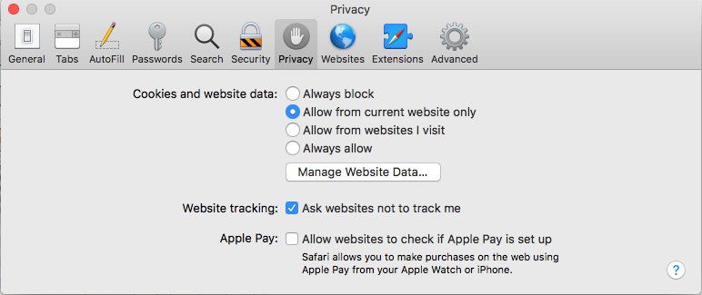
Third-party cookie and privacy
What happens when you change these settings?
Think about it a second.

Slide 33
Cookies and tracking
We have seen that an HTTP request to nu.nl actually generates requests to other sites as well: google.com, amazon.com, advertiser.nl.
These sites (let’s call them collateral sites) will not be able to see the cookies set by nu.nl, but they will receive the cookies they have set in our browsers, even in previous sessions
So what happens when we block “third party” cookies?
That these collateral sites will not be able to set new cookies in the browser, but they are still able to read their own (older) cookies. So tracking can take place anyhow.

Slide 34
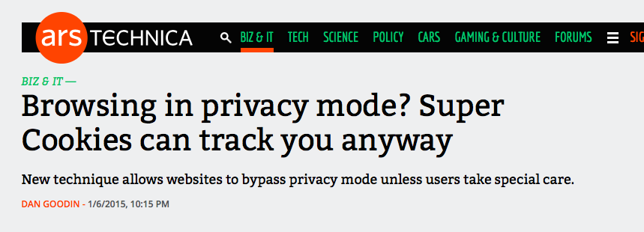
Supercookies & IP addresses
Supercookies are like cookies, but associated to a first-level domain: They are maintained by your internet provider
They are used also when the browser is in ”private mode”
Are not eliminated when you clean the cookies from your browser
Allow sites to track you even better.
Tracking is also done via IP addresses:
I was looking at AIRBNB houses in Italy, and my son (upstairs) got some ads on the very same topic.

Slide 35
A very effective tracking method

Slide 36
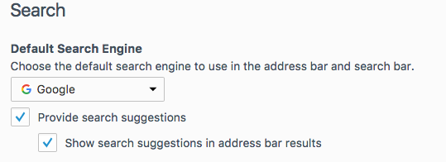
A very effective tracking method
Search suggestions
Don’t lie: it is probably “on” in your browser
Exercise: turn on tamper data, and then type www.yourfavoritesite.com
What do you see?
Each time you type a letter a new query goes to google, including all google’s cookies.
Google knows exactly what you type in the browser, all the time
And if you ever logged in google on that browser, google knows it’s you

Slide 37
Back to attacks (whether targeted or not)

Slide 38
Browser Exploitation Framework
Take a look at beefproject.com
Very nice video at
https://www.youtube.com/watch?time_continue=132&v=xdbvU_U42kY
Features
Fingerprinting: Browser, OS, location fingerprinting
They adapt the response to the request (e.g. when they see a Firefox browser they put an exploit for Firefox in the response)
They can be used for targeted attacks (e.g. introduce the exploit only if browser originates from a given IP range)

Slide 39
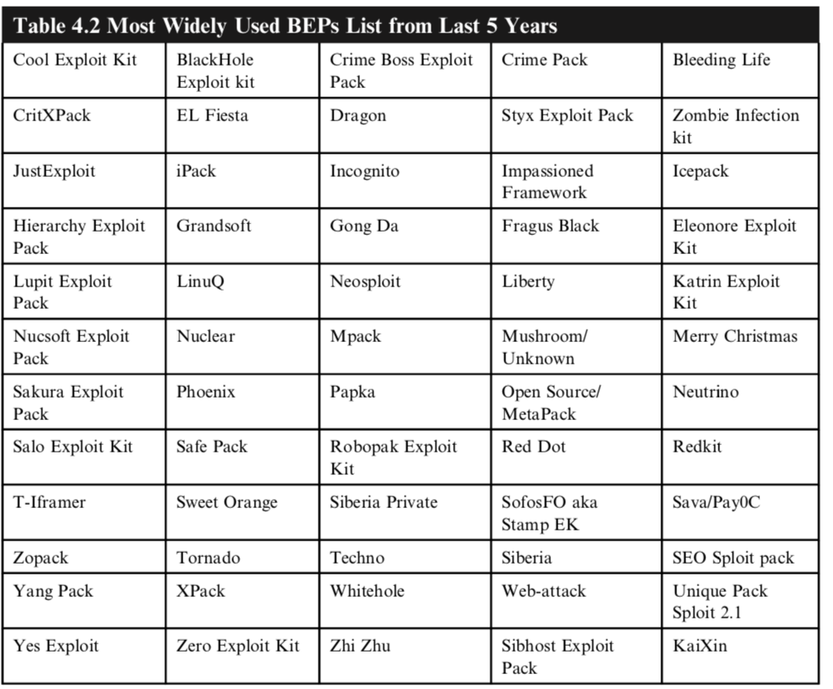
Some BEPs
Easy to find….

Slide 40
Watering Hole Attacks
Gather Intelligence on the target
Discover suitable sites
Infect steppingstone site
Possibly via 3rd party sites
When target visits the site it is infected
Usually with a dropper
Dropper on target contacts CC (command and control site) to download full malware
Malware carries out the exploitation
Data exfiltration
Key logging
Etc etc etc

Slide 41
Phishing
Email with malicious link/instructions
Can be very targeted spear-phishing
Like it appears coming from your boss
Sharing a document you should review
In simple cases it redirects to a genuine-looking site where you need to fill some credentials

Slide 42
Phishing II

Slide 43
Direct Attacks (will be handled next)
Anything that has a service that is reachable from the outside can be compromised directly.
Typical example, a webservice
XSS
SQL injections
Attacking PHP
Internet
Switch/Firewall/Router/Modem
Office or home computer
SCADA or a TV
Web Server
• • • • • • • •
NAS?

Slide 44
Distributed Denial Of Service
There is a whole market for DDoS attacks, you can just buy one. We’ll see some examples

Slide 45
QUESTIONS

Slide 46
HTTP Weak Sessions (3)
The webapplication stores something in the browser, (during the previous response), that will be sent back to the server in the moment a new request is done
Cookies
Post parameters, like in
Hidden forms (the values are passed as POST parameters)
Disabled forms (the ones you see in gray, and you cannot modify by hand)
ASP.NET uses a hidden form field called “ViewState”
Get parameter
Needless to say, this is an important source of vulnerabilities
Because CLIENTS (Browsers) CANNOT BE TRUSTED
It is very easy to manipulate answers, we shall see this in a minute

Slide 47
Example: Hidden form fields
More often than you think, forms contain hidden fields that web applications use to store some value that the user is not supposed to manipulate.
Example from the book:
<form action=”order.asp” method=”post”>
<p>Product: Sony VAIO A217S</p>
<p>Quantity: <input size=”2” name=”quantity”>
<input name=”price” type=”hidden” value=”1224.95”>
<input type=”submit” value=”Buy!”></p>
</form>
In this case the webapp programmer found it easier to store the agreed price in a hidden form on the client side, rather than storing it on the server and linking it to the appropriate session.
With an intercepting proxy (burp proxy, for instance), you can modify the price on the fly.

Slide 48
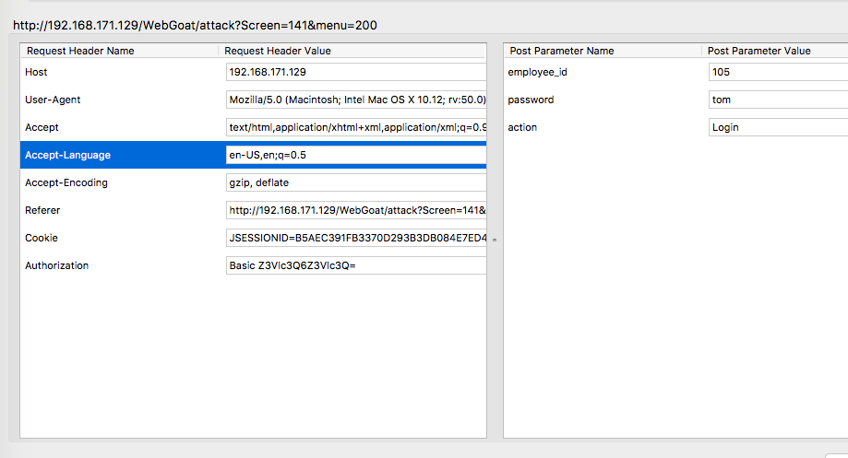
A seemingly more elaborate example
Impersonification
By changing the (post) parameter employee_id you might be able to impersonate another employee.
Particularly if the webapplication does not check for integrity

