Slide 1
Legal Informatics, Privacy and Cyber Crime
Part Two: Attack Theory
Sandro Etalle
2020-2021

Slide 2
Topic: how cybercriminals usually structure their attacks
Underlying material: slides and the book (chapter 2)

Slide 3
Basic Definitions
Zero day
why are they considered weapons?
Why are they expensive?
Targeted attack
Broad (non-targeted) attack
Advanced Persistent Threat (APT)

Slide 4
The steps in a targeted attack
https://www.lockheedmartin.com/en-us/capabilities/cyber/cyber-kill-chain.html
Lockheed Martin cyber kill chain
Reconnaissance
Weaponization preparation of the attack, gathering of tools
Delivery e.g. via phishing of watering hole
Exploitation the first infection
Installation of the full malware
Command and Control connects home to update itself and receive commands. Possible lateral movement. Some data exfiltration starts taking place.
Action on Objectives could be data exfiltration, or something else

Slide 5
OSINT (Open Source Intelligence Gathering).
Many free and paid tools for it. For instance:
Maltego,
creep.py,
The Harverster, ..); if there is time we (you) can install them to see how easy it is to trace someone and let him “go” where you want him to be

Slide 6
Other Interesting tools to experiment with
Interesting experiment to do: install FOCA
https://www.elevenpaths.com/labstools/foca/index.html, and play with it
“FOCA (Fingerprinting Organizations with Collected Archives) is a tool used mainly to find metadata and hidden information in the documents its scans. These documents may be on web pages, and can be downloaded and analyzed with FOCA.
It is capable of analyzing a wide variety of documents, with the most common being Microsoft Office, Open Office, or PDF files, although it also analyzes Adobe InDesign or SVG files, for instance.
These documents are searched for using three possible search engines: Google, Bing, and DuckDuckGo. The sum of the results from the three engines amounts to a lot of documents. It is also possible to add local files to extract the EXIF information from graphic files, and a complete analysis of the information discovered through the URL is conducted even before downloading the file.”

Slide 7
Why Targeted Attacks are relatively easy to carry out
You can probably drive a car, but you cannot build one, right?
Carrying out a cyberattacks is like driving a car
Until a few years ago, you needed to craft your own attack (equivalent to building your own car if you wanted to drive around)
Today, you can buy the car, and drive it. (Actually, you can put together the car you want, it is a bit like the IKEA market for cyberattacks: you need to do some work to put it together, but anyone can do that).
Let’s see how

Slide 8
Generic Home/Office/OT Network
(things are mixed up for the sake of the explanation)
Internet
Switch/Firewall/Router/Modem
Office or home computer
SCADA or a TV
Web Server
• • • • • • • •
• • • • • • • •
Smart Devices or PLCs
This network cannot exist in practice, it just serves for illustration purposes

Slide 9
Step 1a, get a host for your command and control
Just rent it on the black market. Our you can set up your own, but then you are more traceable
Internet
Switch/Firewall/Router/Modem
Office or home computer
SCADA or a TV
Web Server
• • • • • • • •
• • • • • • • •
Smart Devices or PLCs
This network cannot exist in practice, it just serves for illustration purposes

Slide 10
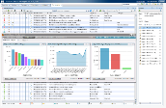
Step 1b, put the right (C&C) software on it
You have to buy this on the black market. It is plenty of them on the internet. You haven’t written a line of code yet.
Internet
Switch/Firewall/Router/Modem
Office or home computer
SCADA or a TV
Web Server
• • • • • • • •
• • • • • • • •
Smart Devices or PLCs
This network cannot exist in practice, it just serves for illustration purposes

Slide 11
Step 2, gather intelligence about the target
Facebook, google … use one of many specialized tools or … ask the underground market.
Which sites does he look at (important for watering hole)
Which systems does he use? (important to select the exploits)
What are his role and colleagues inside the organization? (for Spear Phishing)
Internet
?
Switch/Firewall/Router/Modem
Office or home computer
SCADA or a TV
Web Server
• • • • • • • •
• • • • • • • •
Smart Devices or PLCs
This network cannot exist in practice, it just serves for illustration purposes

Slide 12
Step 3: Choose the right exploit, to get “the foot in the door”
Internet
For instance, you know that the target uses Adobe Acrobat and you may choose an exploit that uses a vulnerability of Adobe
?
Switch/Firewall/Router/Modem
Office or home computer
SCADA or a TV
Web Server
• • • • • • • •
• • • • • • • •
Smart Devices or PLCs
This network cannot exist in practice, it just serves for illustration purposes

Slide 13
Step 4: Choose the right malware
The Exploit is a small chunk of code that allows to get ”in” the target
The Malware is a much more complex framework that allows to “do” things after you have compromised the computer. Choose one depending on needs: keylogging, RAT? Spyware? Data exfiltration? Lateral Movement? Do you need privilege escalation?
Internet
Switch/Firewall/Router/Modem
Office or home computer
SCADA or a TV
Web Server
• • • • • • • •
• • • • • • • •
Smart Devices or PLCs
This network cannot exist in practice, it just serves for illustration purposes

Slide 14
Example: ProRAT toolkit

Slide 15
Step 4: Attack the target
Usually using Watering holes or Spear Phishing. Direct attacks are less popular
1. Website infected with
2. C&C contains
3. User visits infected site
Internet
3
Switch/Firewall/Router/Modem
Office or home computer
SCADA or a TV
Web Server
• • • • • • • •
• • • • • • • •
Smart Devices or PLCs
This network cannot exist in practice, it just serves for illustration purposes

Slide 16
Step 4: Attack the target
Usually using Watering holes or Spear Phishing
Direct attacks are less popular
Internet
Switch/Firewall/Router/Modem
Office or home computer
SCADA or a TV
Web Server
• • • • • • • •
• • • • • • • •
Smart Devices or PLCs
This network cannot exist in practice, it just serves for illustration purposes

Slide 17
Step 4: Use it!
Now you usually have control on the end-system.
It can also wait for more commands from you to diversify the attack
Internet
Switch/Firewall/Router/Modem
Discuss: droppers, and Payload,
Office or home computer
SCADA or a TV
Web Server
• • • • • • • •
• • • • • • • •
Smart Devices or PLCs
This network cannot exist in practice, it just serves for illustration purposes

Slide 18
Step 4: perhaps you can steal the VPN credentials
And then connect directly to the VPN port of the switch, rather than via the CC.
QUESTIONS: WHAT ARE THE ADVANTAGES AND THE DISADVANTAGES OF THIS APPROACH?
Internet
Switch/Firewall/Router/Modem
Office or home computer
SCADA or a TV
Web Server
• • • • • • • •
• • • • • • • •
Smart Devices or PLCs
This network cannot exist in practice, it just serves for illustration purposes

Slide 19
Example of Lateral Movement (1)
Once inside, lateral movement is relatively easy, because “inside” there is usually very little authentication, and it is easy to steel credentials (e.g. via keylogging)
QUESTION: why can’t you attack the TV directly?
Internet
Switch/Firewall/Router/Modem
Office or home computer
SCADA or a TV
Web Server
• • • • • • • •
• • • • • • • •
Smart Devices or PLCs
This network cannot exist in practice, it just serves for illustration purposes

Slide 20
Example of Lateral Movement (2)
And then the TV/SCADA may be controlled by you either
Via the previously compromised system
Via the CC (the TV/SCADA can connect to the CC)
Via … (there always other ways)
QUESTION: why can’t you attack the TV directly?
Internet
Switch/Firewall/Router/Modem
Office or home computer
SCADA or a TV
Web Server
• • • • • • • •
• • • • • • • •
Smart Devices or PLCs
This network cannot exist in practice, it just serves for illustration purposes

Slide 21
Lateral Movement can get physical
Then you can also damage physical systems, e.g. the air conditioning (see StuxNet, Ukraine attacks, Triton/Triconex)
Internet
Switch/Firewall/Router/Modem
Office or home computer
SCADA or a TV
Web Server
• • • • • • • •
• • • • • • • •
Smart Devices or PLCs
This network cannot exist in practice, it just serves for illustration purposes

Slide 22
The Schema of Drive-by Download

Slide 23
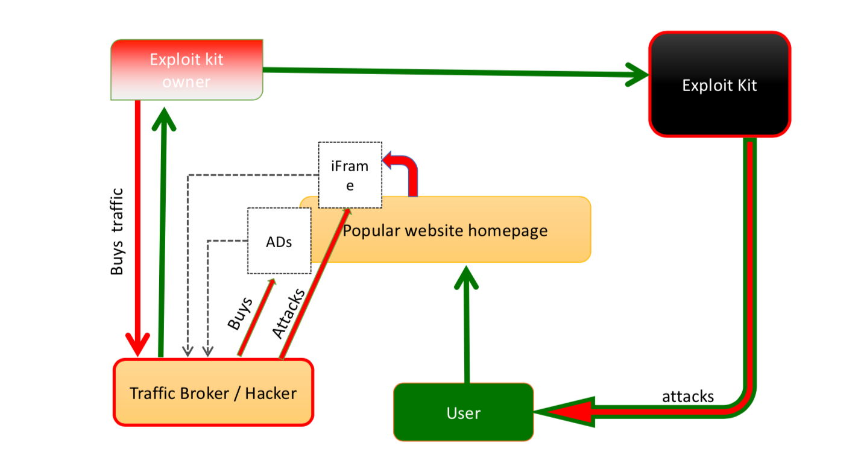
The Schema of Browser Redirect and Malware Delivery

Slide 24
Other attack techniques
Watering hole
USB attack: not very common, but it was the method Stuxnet used to penetrate the system
Direct attack: anything hosting a service can be attacked if the software implementing the service has vulnerabilities
A webserver. Examples: SQL injection, Cross-Site Scripting (XSS), …
A router at home. Usually has some “ports” open for e.g. maintenance
CCTVs, Televisions, Fridges, Printers … they all have a webserver, (discussion on isolation of networks, and firewalls)
“One notorious targeted attack was launched against Bit9 [13,14]. Attackers exploited the Internet facing web server of Bit9 and conducted a successful SQL injection that provided access to the critical systems of Bit9. SQL injection is an attack technique in which unauthorized SQL statements are injected as input values to dif- ferent parameters in the web applications to manipulate the backend database.”

Slide 25
Example of a Direct Attack 1: the webserver (or the NAS you have at home that is reachable from outside)
Because the switch forwards some ports to the webserver, you can reach it. If you have an exploit for the webserver, you can install your RAT on it, or use it as a stepping stone
Same reasoning applies to everything you have that is reachable from the outside (do you have a NAS? Also some thermostats…)
Internet
Switch/Firewall/Router/Modem
Office or home computer
SCADA or a TV
Web Server
• • • • • • • •
• • • • • • • •
Smart Devices or PLCs
This network cannot exist in practice, it just serves for illustration purposes

Slide 26
Example of a Direct Attack 2: the router
The router is usually reachable.
Disadvantage: may not be able to carry a full RAT, and you are not yet where the important information is.
But it is a very good stepping stone. E.g. to attacks systems that are never monitored: the TV, the printer….
Internet
Switch/Firewall/Router/Modem
Office or home computer
SCADA or a TV
Web Server
• • • • • • • •
• • • • • • • •
Smart Devices or PLCs
This network cannot exist in practice, it just serves for illustration purposes

Slide 27
ABOUT VULNERABILITIES

Slide 28
Consideration on the target Can I be a target?
Sometime in 2009, a few Romanians compromised the sandwich chain Subway. Over the next 2 years, they managed to steal somewhere between $3 million and $10 million. As reported by Wired¹:
The hackers allegedly scanned the internet to identify vulnerable POS systems with certain remote desktop software applications installed on them, and then used the applications to log into the targeted POS system, either by guessing the passwords or using password-cracking software.
This is opportunistic targeting
Anyone can be a victim. So the motto “there is nothing interesting here” does not apply
(quote from the book)

Slide 29
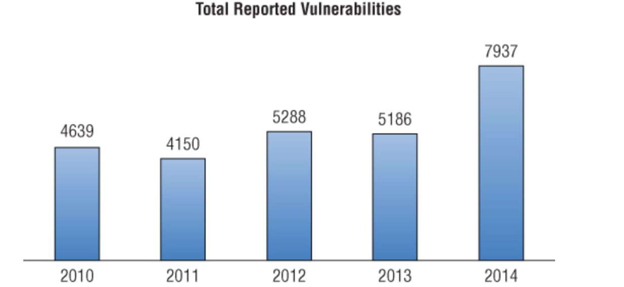
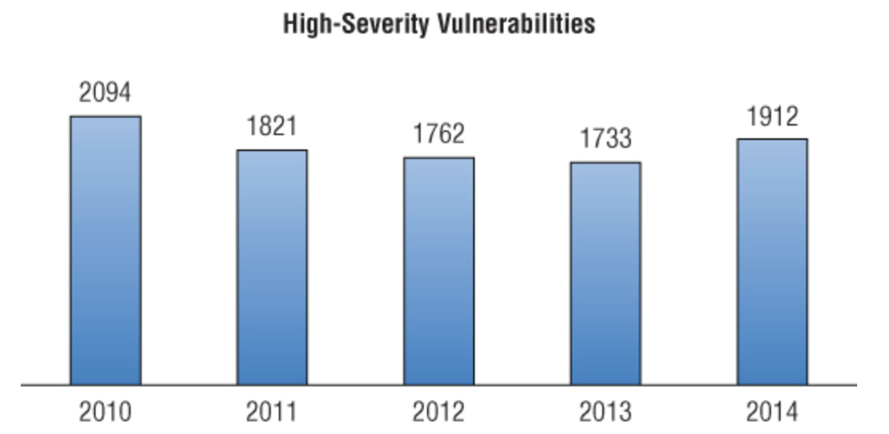
Considerations on Vulnerabilities
We expect you to know the definition of vulnerability
Here are some stats about them:
One thing you will learn: “high severity” means really nothing…

Slide 30
From Vulnerability to Zero Day Exploits
Today, the majority of nation states are developing cyber war capabilities. Zero-day exploits in critical software … are now considered to be attack weapons
Discussion: what are zero-day exploits and why are they considered weapons?

Slide 31
Lifetime of zero-days
According to the 2012 Symantec study “Before We Knew It: An Empirical Study of Zero-Day Attacks in the Real World,” a previously unknown exploit (a Zero-Day) is used for between 19 days and 30 months, with an average of 10 months and a median of 8.
Immunity Security published a report stating that the average was over 1 year. Either way, that means the Attacker can expect well over one-half year of initiative per exploit. That is quite an advantage.

Slide 32
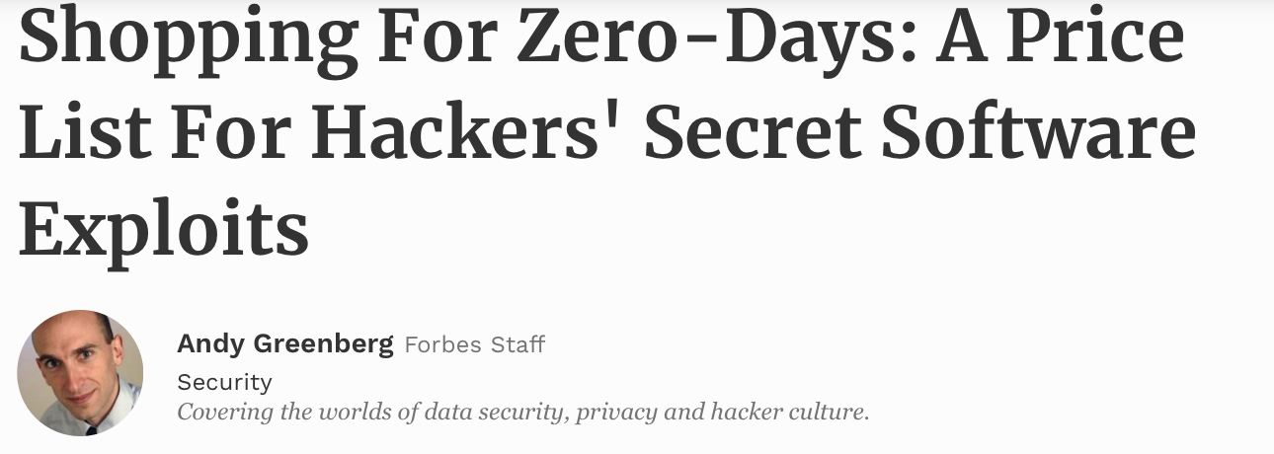
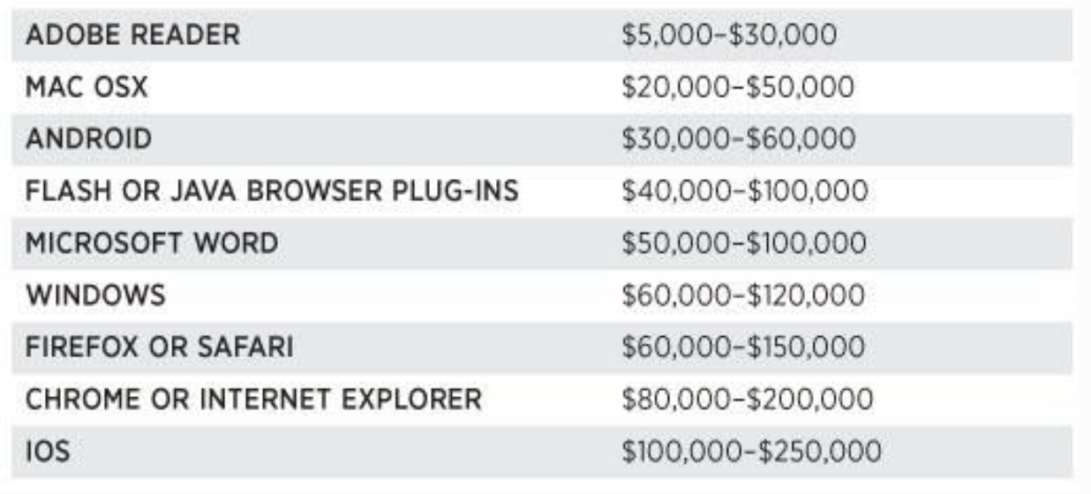
A very very very old price list (2012)

Slide 33
More recent information
From https://www.csoonline.com/article/3077447/security/cost-of-a-windows-zero-day-exploit-this-one-goes-for-90000.html

Slide 34
Targeted vs Non-Targeted
Considerations:
There exists several definitions of targeted cyber attacks. In general, targeted attacks should not be confused with broad-based attacks that are random in nature and focus on infecting and compromising large groups of users.
However: The boundary between targeted attack and broad-based attacks is getting weaker. There are campaigns (e.g. Havex, Epic Turla), that have the features of targeted attacks (customization, stealth, etc), but they actually target a number of companies (in the case of Havex, Energy companies)

Slide 35
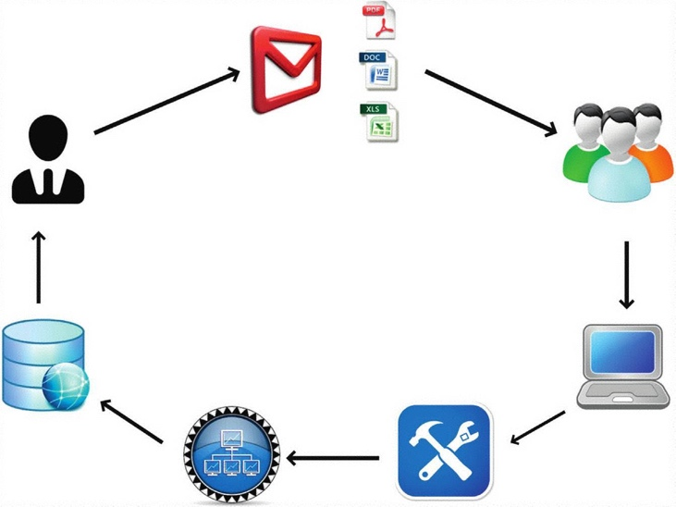
Example: Spear Phishing with Malicious attachment
A spear phishing attack was used against the RSA Corporation which is named as “RSA Secure ID Breach.” The overall damage of this attack is not determined, but it is assumed that attackers stole Secure ID product information and number of token seeds used by several companies (organizations) such as Bank of America, Lockheed, JPMorgan Chase, Wells Fargo, and Citigroup. In RSA Attack, the attacker targeted two different batches of employees over a period of 2 days with a well-crafted phishing e-mail. The e-mail carried an XLS file containing exploit code of a then unknown vulnerability. Figure 3.2 shows how the phishing e-mail targeting RSA looked like. There could be other variants, but this one was widely distributed.

Slide 36
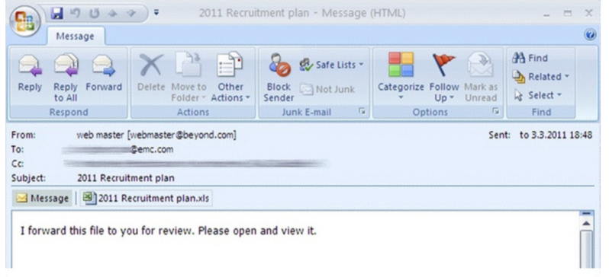
The RSA hack (part 2)
The attachment carried an exploit code of a zero-day for Adobe Flash Player vulnerability which was later identified as CVE-2011-0609. Once the exploit was successfully executed, the malware took control of internal servers. The attacker then used a RAT named as Poison Ivy [3] to take persistent control over the target servers. The stolen information was compressed and exfiltrated from the infected system using the FTP.
Questions: explain CVE-2011-0609, RAT, FTP, and how the could possibly have taken control of the internal servers.

Slide 37
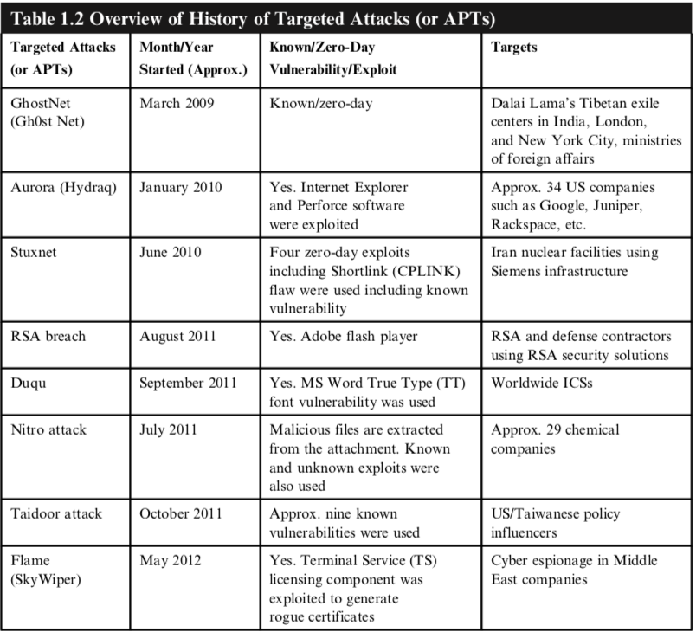
Some early targeted attacks
From the book
“Targeted attacks”

Slide 38
Table 3.1 (from the book “Targeted attacks”): has nice examples of emails used for targeting companies

Slide 39
From Symantec 2018 & 2019 Internet Security Threat Report

Slide 40
Targeted Attacks: stats and purposes
Overall targeted attack activity is
up by 10 % in 2017
and down a bit in 2018.
Motivation
primarily (>90 percent) by intelligence gathering (both 2017 and 2018)
However, a not-so-insignificant 8% (2018) of attack groups engage in some form of disruptive activity. (with an increase over 2017)
Source: Symantec 2018 & 2019 Internet Security Threat Report

Slide 41
Targeted attacks: techniques
The “Living off the Land” trend continues with attack groups opting for tried-and-trusted means to infiltrate target organizations. (2017 and 2018)
Spear phishing is the number one infection vector in both 2017 and 2018.
In 2018: Mail attachments as a primary infection vector (48% using MS Office, up from 5% the year before)
The use of zero days continues to fall out of favor. In fact, in 2017 only 27% of the 140 targeted attack groups that Symantec tracks have been known to use zero-day vulnerabilities at any point in the past. In 2018 only 23%
Source: Symantec 2018 & 2019 Internet Security Threat Report

Slide 42
About Living off the Land
From https://www.darkreading.com/analytics/stealing-data-by-living-off-the-land/d/d-id/1322063 (2015)
Hackers latest tactic involves a malware-free attack using a company's own system credentials and admin tools to gain access. “cyber criminals are using the target company’s own system credentials and legitimate software administration tools to move freely throughout their network, infecting and collecting valuable data. Burdette, who is part of the CTU operations team, says this has been the method to gain access to networks in nearly all of the intrusions responded to by the Incident Response Team over the past year.”
Basically: attackers now minimize the use of vulnerabilities.

Slide 43
QUESTIONS?

