Slide 1
Legal Informatics, Privacy and Cyber Crime
Part 5: Defensive Policies – what works and what doesn’t
Etalle
2018-2019

Slide 2

CCD Course
Sandro’s #7: Defensive Policies
What works and what doesn’t
Sandro Etalle
Mathematics and Computer Science

Slide 3
Study Material
Encryption in ICS networks: a blessing or a curse? https://research.tue.nl/en/publications/encryption-in-ics-networks-a-blessing-or-a-curse
So Long, And No Thanks for the Externalities: The Rational Rejection of Security Advice by Users, by Cormac Herley. https://www.microsoft.com/en-us/research/wp-content/uploads/2016/02/SoLongAndNoThanks.pdf
Where Do All The Attacks Go? By Dinei Florencio and Cormac Herley. Not the mathematics, only the principles. Available at: http://www.econinfosec.org/archive/weis2011/papers/Where%20Do%20All%20the%20Attacks%20Go.pdf]

Slide 4
Example of security policies
Password policies
PWDs must be long
PWDs must have particular composition (e.g. digits, special characters)
Dictionary membership (in any language) should not be allowed
Don’t write down passwords
Don’t share passwords with anyone
Change passwords regularly
Don’t re-use passwords across sites.
Communication should be encrypted

Slide 5
Network Encryption
Encryption is certainly useful (and needed) for external connections.
But for internal ones?
Let us take a look…

Slide 6
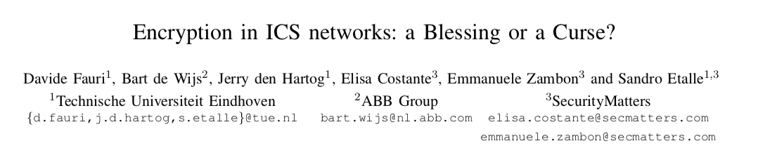
Let us take a look at some of our work
Our thesis:
Encryption in the internal network does not yield extra SCADA security
Encryption can negatively affect security
Encryption can complicate troubleshooting

Slide 7
We focus on encryption in the internal network of an ICS system

Slide 8
Encryption does not yield extra SCADA security -1
Example: Stuxnet
Infection was through a USB stick, without network communication
Spreading used infected files, network shares, zero-days in print spooler and SMB protocols
Exploitation of WinCC software was local, upload of malicious code was through legitimate commands, MITM of process data happened entirely within the PLC
Example: BlackEnergy (Ukraine blackout)
Infection was through phishing emails, on corporate (not SCADA) network
Recon and pivoting to SCADA network was possible by using locally harvested credentials to VPN in other stations, and then through local exploits
Attack execution was through a RAT with valid credentials, launching legitimate commands and directly interacting with the HMI
…

Slide 9
Encryption does not yield extra SCADA security -2
Encryption does not stop any of the known SCADA attacks (2)
Because they went through the endpoint, not the cable
Chances are that future attacks will be on the endpoint too
The endpoint is much more vulnerable than the cable. o encryption will not help either

Slide 10
Encryption does not yield extra SCADA security - Summary
In a nutshell: if an attacker has access to the cable, then
A) chances are that he has easier access to the endpoint
B) you have a bigger problem than the attacker
An on-the-cable attack is in general more difficult to execute and much easier to detect than an endpoint-based attack
Excluded from this reasoning: various situations including long-haul connection and places where confidentiality is crucial, see conclusions

Slide 11
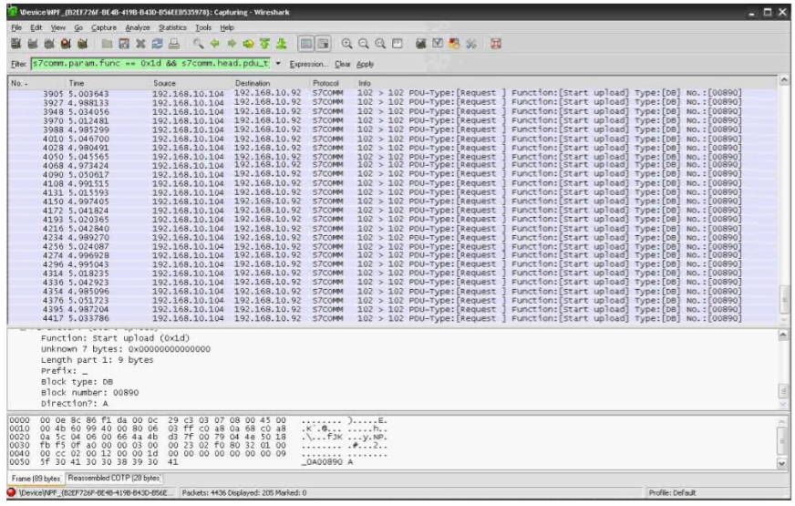
Encryption can negatively affect security
In most observed SCADA incidents, a proper network monitoring solution could have detected the attack as an anomaly
Monitoring flow information at network and transport layers (not obfuscated by encryption) might help in attack detection
Encryption obscures application layer data, which is needed for attack identification

Slide 12
Encryption can complicate troubleshooting
With slow networks or non-healthy devices, you need to diagnose the issue: first response is to tap into the LAN and monitor the traffic. Encryption limits or slows this process.
With encryption also come the costs of managing, distributing, revoking keys and certificates.
Key management is even more important with emergency operations:
Replacing components is “consistently, the biggest barrier to apply security technologies” (cit. Schneider Electric).
Granting 3rd party access
One final issue is how encryption is implemented by the vendor: see “Problems with ICS Proprietary Encryption (or Encraption)” by V.Dashchenko

Slide 13
What is certainly needed
Of course, desirable properties are:
User/device authentication, and message authenticity
Integrity of the communication
(but you don’t need full encryption for this)
End-to-end encryption is certainly good for
Protecting long-haul communications along untrusted networks (ex. internet) or in adversarial environments
Guaranteeing confidentiality when it is crucial (ex. privacy of smart meters), and sniffing could be an issue
Many other things …

Slide 14
Economics of Security Policies

Slide 15
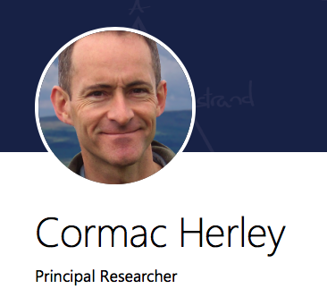
Meet Cormac Herley,
Microsoft Research
“Some of my recent work explains…
why Nigerian scammers say they’re from Nigeria,
why those scary numbers you hear about billions lost to cybercrime are junk, and
why you’re right to suspect that most security advice is a waste of time.”
We focus on the third paper.
But: they are all worth reading.
TBD: possible read on the unfalsifiability of security claims

Slide 16
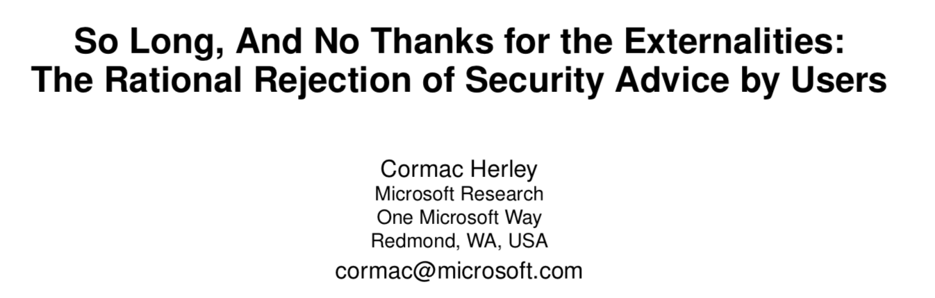
Why we are all wrong
https://www.microsoft.com/en-us/research/wp-content/uploads/2016/02/SoLongAndNoThanks.pdf

Slide 17
Summary of the paper
It is often suggested that users are hopelessly lazy and unmotivated on security questions. They chose weak passwords, ignore security warnings, and are oblivious to certificates errors.
We argue that users’ rejection of the security advice they receive is entirely rational from an economic perspective.
For example,
much of the advice concerning passwords is outdated and does little to address actual treats,
100% of certificate error warnings appear to be false positives.
Further, if users spent even a minute a day reading URLs to avoid phishing, the cost (in terms of user time) would be two orders of magnitude greater than all phishing losses.

Slide 18
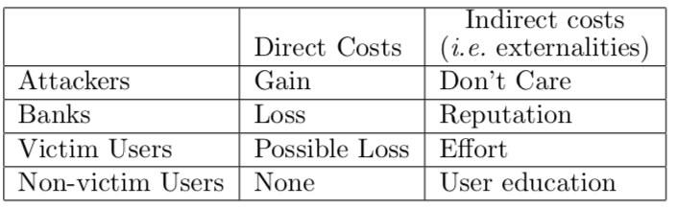
About the costs and the benefits of an attack
Direct costs: zero-sum
Indirect costs: everything that does not contribute to the zero-sum (it is obviously a negative sum game). E.g. time wasted to fix the problem.
In computer crime, the direct costs/benefits are usually very small wrt the indirect costs.
Indirect costs are hard to measure: “According to the Paypal CISO [10]: “Phishing was not just impacting consumers, in terms of general loss, it was impacting their view of the safety of the Internet and it was indirectly damaging our brand.”
and benefits

Slide 19
Example of an indirect cost calculation for an attack
Example: a campaign of 350 million spam messages (see citation #32 in the paper)
Direct benefit: $2731 worth of sales made
Direct costs: $2731 (it is a zero-sum game!)
Indirect costs: $28188 assuming
1% of the spam made it into inboxes,
each message in an inbox absorbed 2 seconds of the recipient’s time
= 1944 hours of user time wasted,
twice the US minimum wage of $7.25 per hour as hourly cost

Slide 20
About the costs and the benefits of an advice
An advice has Costs and Benefits (let’s say per year)
Costs include #of_additional_hours * #of_total_users * hourly_cost_per_user
      #of_total_users = 180 millions, hourly cost >= 14.5$ per hour
Indirect benefits are +- #of_saved_hours * #of_affected_users * hourly_cost_per_user
Direct benefits are less that the gain of the attacker (by definition)
For an advice to make economical sense we would have that
Advice_cost < Indirect benefits + Direct benefits
and benefits

Slide 21
Example of the costs of an advice
An advice that
costs 1 hour per year,
saves 24 hours of work to 10.000 attacked people
(notice that 10.000 attacked people and 2 days of saved work is a lot, so the estimate is conservative)
Costs > 1h * 180m * 14.5$ = 2.6b$
Indirect benefits = 24h *10k * 14.5$ = 3.5m$
Whatever advice that is, it is irrational, because the direct benefits will never be in the billion range.
and benefits

Slide 22
Applying the reasoning to passwords
Common rules on password
Length
Composition (e.g. digits, special characters)
Dictionary membership (in any language)
Don’t write it down
Don’t share it with anyone
Change it often
Don’t re-use passwords across sites.

Slide 23
Important to the discussion: the attacks on PWDs
Accorting to: D. Florencio, C. Herley, and B. Coskun. Do Strong Web Passwords Accomplish Anything? Proc. Usenix Hot Topics in Security, 2007.
Attacks on passwords are
phishing,
keylogging,
brute-force attack on the user’s account,
bulk-guessing attack on all accounts at the server,
special-access attacks (guessing, shoulder surfing and console access).

Slide 24
Analysis of 1-3
Common rules on password
Length
Composition (e.g. digits, special characters)
Dictionary membership (in any language)
Don’t write it down
Don’t share it with anyone
Change it often
Don’t re-use passwords across sites.
Rules 1-3 cover password strength. Florencio et al. [27] suggest that strength rules for web passwords accomplish very little when a lockout rule can restrict access. In this case a simple 6-digit PIN can suffice.
Only when there is an off-line attack on the password does strength become very important.
Strength above this minimum accomplishes very little.
In any case almost useless against everything but attack #4 (bulk-guessing attack on all accounts at the server)

Slide 25
Analysis of 4, 5
Common rules on password
Length
Composition (e.g. digits, special characters)
Dictionary membership (in any language)
Don’t write it down
Don’t share it with anyone
Change it often
Don’t re-use passwords across sites.
#4 Many security experts question this advice ([3, 4] of the paper). It’s clear that writing passwords in plain view is bad practice, however, keeping them written in a safe place, such as a wallet, only increases the risk from someone who has access to the wallet. If the threat is an anonymous attacker rather than a knowledgeable opponent then following Rule 4 carries no benefit.
#5, I would say, it depends on the security policies of the person you share it with.

Slide 26
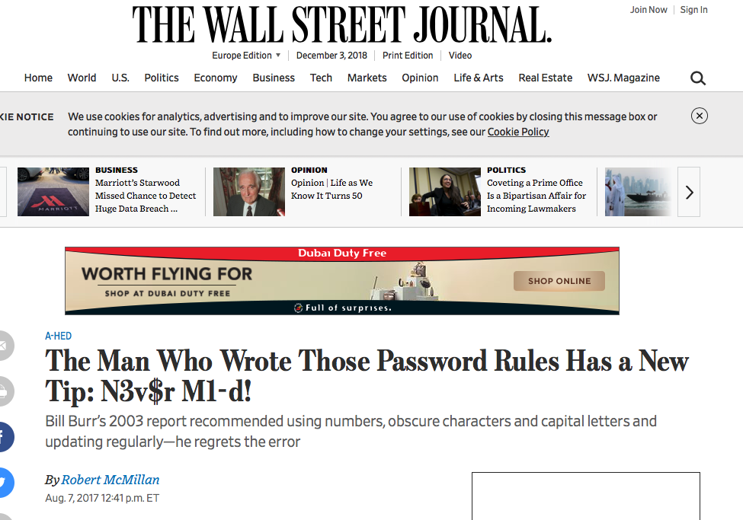
Analysis of 6 (1)
Common rules on password
Length
Composition (e.g. digits, special characters)
Dictionary membership (in any language)
Don’t write it down
Don’t share it with anyone
Change it often
Don’t re-use passwords across sites.
AARGH!!!! Imho the single worst security advice ever
And it is still implemented

Slide 27
Analysis of 6 (2)
Common rules on password
Length
Composition (e.g. digits, special characters)
Dictionary membership (in any language)
Don’t write it down
Don’t share it with anyone
Change it often
Don’t re-use passwords across sites.
The cost can be enormous, particularly when you have a complex structure (e.g. the TU/e), where changing one password suddenly locks you out from other services.
It all started in 2003, when Back in 2003, as a midlevel manager at the National Institute of Standards and Technology, Bill Burr was the author of “NIST Special Publication 800-63. Appendix A.” The 8-page primer advised people to protect their accounts by inventing awkward new words rife with obscure characters, capital letters and numbers—and to change them regularly.

Slide 28
Analysis of 7
Common rules on password
Length
Composition (e.g. digits, special characters)
Dictionary membership (in any language)
Don’t write it down
Don’t share it with anyone
Change it often
Don’t re-use passwords across sites.
“As estimated by Florencio and Herley a typical user has 25 accounts and 6.5 passwords, each used at 3.9 sites.”
Password costs are “increased by 6.9x” (this is not really true).
But benefits are marginal at best. Only against bulk or phishing attacks.

Slide 29
Against the attacks
Common rules on password
Length
Composition (e.g. digits, special characters)
Dictionary membership (in any language)
Don’t write it down
Don’t share it with anyone
Change it often
Don’t re-use passwords across sites.
phishing,
keylogging,
brute-force attack on the user’s account,
bulk-guessing attack on all accounts at the server,
special-access attacks (guessing, shoulder surfing and console access).
Rules 1-5 don’t work against a), b), are too strong for c).
Rule 6 has costs much higher than benefits
Rule 7 has marginal benefits at best

Slide 30
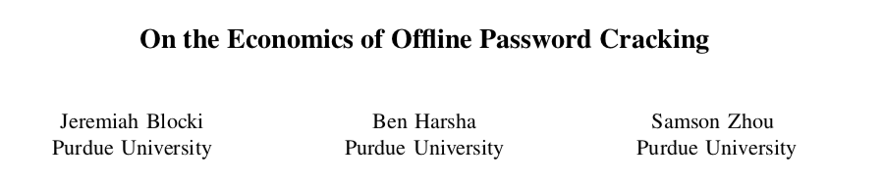
Something extra about Passwords
  “Passwords must be strong and complex”
    I would agree but he question is whether this is useful at all. Because:
      In an online attack, the attacker has usually no way to try all possibilities
      In an offline attack, even very strong password are cracked (and: there is a good business model for it)
    Recent large scale password breaches include LastPass, AshleyMadison, Dropbox and Yahoo! (see paper below)

Slide 31
Teaching Users to Recognize Phishings URL
The costs:
Early attempts: recognize mis-spellings, e.g. www.paypa1.com (easy)
Later: recognize misplacings, e.g. www.paypal.com.login.evil. com (more difficult)
Also: <a href="www.evil.com">www.PayPal.com</a> (recognizing this requires education)
Not to mention the fact that
some sites use (or refer to) sites that have a slightly different name (Bank of Ireland online banking is (was?) done at www.365online.com)
www.amazon.co.uk is legitimate, while www.bankofthewest.co.uk would not be….

Slide 32
Cost/Benefits of Phishing training
Direct phishing losses in the US in 2008 (old, sorry) $60m. (But according to the recent 2017 Internet Crime Report it should be to $29,703,421 https://pdf.ic3.gov/2017_IC3Report.pdf)
The article states that, doing some math it turns out that any advice for dealing with phishing that costs more than 2.6 minutes per year is not economically viable
Don’t quite agree on the calculation, because only direct costs are accounted for, and not the indirect ones.
But still, it shows that even the most “common” security advice is economically unsound.

Slide 33
And then there is the fact that we (human) are loss-averse
Loss aversion explains partly why we follow irrational advices.
“people's tendency to prefer avoiding losses to acquiring equivalent gains: it is better to not lose $5 than to find $5”
Daniel Kahneman

Slide 34
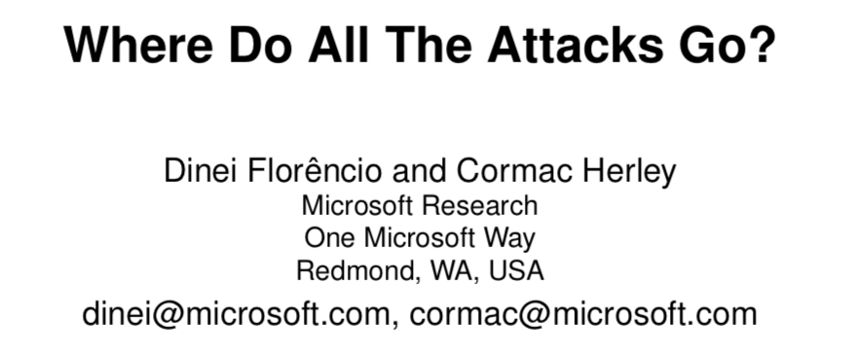
Where do all the attacks go?
Where Do All The Attacks Go? By Dinei Florencio and Cormac Herley. Not the mathematics, only the principles. Available at:
https://www.microsoft.com/en-us/research/publication/where-do-all-the-attacks-go-2/

Slide 35
Summary (quotes from the paper)
The fact that a majority of Internet users appear un-harmed each year is difficult to reconcile with a weakest-link analysis.
We seek to explain this enormous gap between potential and actual harm.
The answer, we find, lies in the fact that an Internet attacker, who attacks en masse, faces a sum-of-effort rather than a weakest-link defense. Large-scale attacks must be profitable in expectation, not merely in particular scenarios. For example, knowing the dog’s name may open an occasional bank account, but the cost of determining one million users’ dogs’ names is far greater than that information is worth.
The strategy that appears simple in isolation leads to bankruptcy in expectation.
Many attacks cannot be made profitable, even when many profitable targets exist.

Slide 36
Why aren’t we attacked every day?
Our passwords are stolen,
our computer are vulnerable,
our software is unpatched (we use the old version, see eg Adobe and IE),
the majority of computer users ignores security policies/warnings,
our antivirus … (which antivirus?)
There is no question that there is an enormous gap between the potential attacks and the actual attacks even if we restrict the potential attacks to those in which attackers make a profit

Slide 37
The System-Centric Threat Model Fails
Usually to assess risk we confront the capabilities of the attackers with the capabilities of the defender.
“weakest link” is an often-used word
But this system does not take into account a number of important factors:
There is no reference to the cost of defence to Alice, or of the attack to Charles.
It makes no reference to the fact that Charles is generally uncertain about the value of the asset and the extent of the defence
It makes no provision for the possibility that exogenous events save Alice, even when her own defence fails (e.g., her bank catches fraudulent transfers). It ignores the fact that Charles must compete against other attackers.
But in particular

Slide 38
The System-Centric Threat Model Fails (2)
It ignores scale: assuming that Internet users greatly outnumber attackers it is simply numerically impossible for every user to have an attacker who identifies and exploits her weakest-link.
And even if we did: This model, where weakest-links are ruthlessly exploited, is unable to explain the reality we observe: 20% use a significant date or pet’s name as password, yet 20% are not victimized. It is this inability to explain observations that we seek to address.
The big problem: it ignores the fact that there is a crowd of attackers and a crowd of potential victims

Slide 39
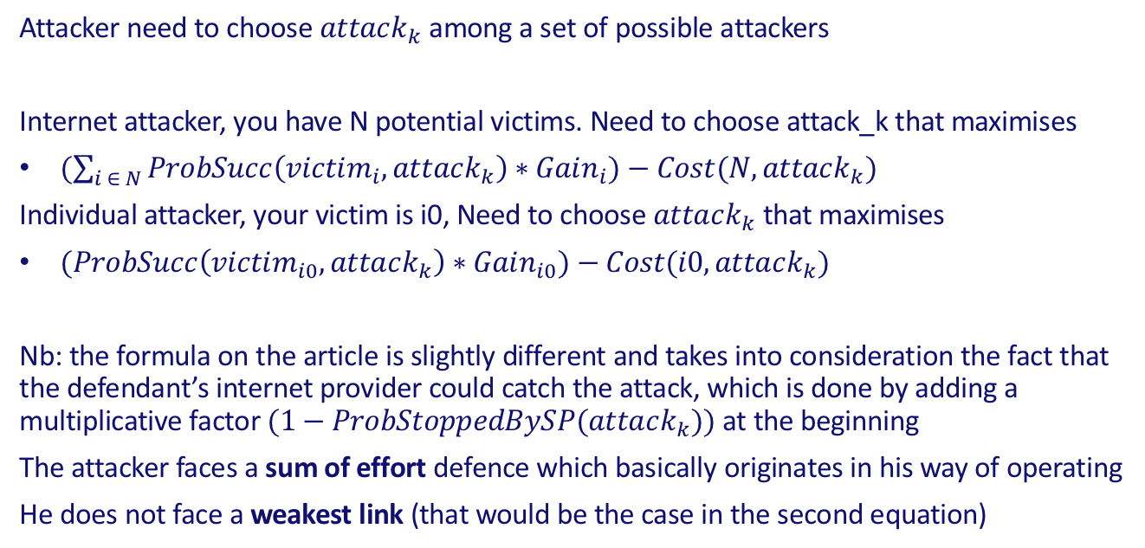
Gain in the internet attacker vs individual attacker
Attacker need to choose $attack_{k}$among a set of possible attackers
Internet attacker, you have N potential victims. Need to choose attack_k that maximises
$(\sum_{i ∈ N}{ProbSucc\left(victim_{i},attack_{k}\right)∗Gain_{i})−Cost(N,attack_{k}) }$
Individual attacker, your victim is i0, Need to choose $attack_{k}$ that maximises
$(ProbSucc\left(victim_{i0},attack_{k}\right)∗Gain_{i0})−Cost(i0,attack_{k})$
Nb: the formula on the article is slightly different and takes into consideration the fact that the defendant’s internet provider could catch the attack, which is done by adding a multiplicative factor $(1−ProbStoppedBySP(attack_{k}))$at the beginning
The attacker faces a sum of effort defence which basically originates in his way of operating
He does not face a weakest link (that would be the case in the second equation)

Slide 40
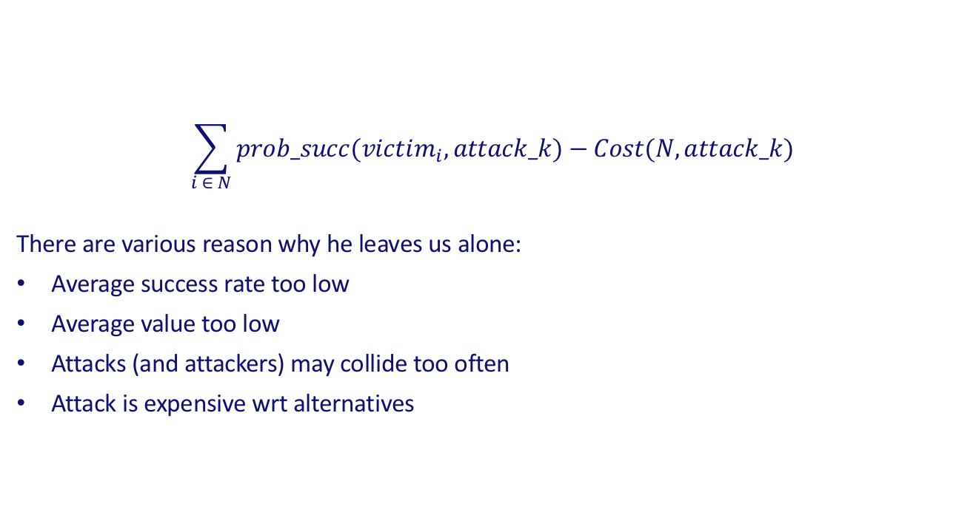
When you look at the (economical) Internet Attacker…
$$\sum_{i ∈ N}{prob_succ(victim_{i},attack_k)−Cost(N,attack_k) }$$
There are various reason why he leaves us alone:
Average success rate too low
Average value too low
Attacks (and attackers) may collide too often
Attack is expensive wrt alternatives

Slide 41
Types of attackers
Interesting types
Criminals (Cost < Benefit)
Hacktivists (Cost < fixed limit)
Nation states (no constraints)
Occasional (typically: insiders)

Slide 42
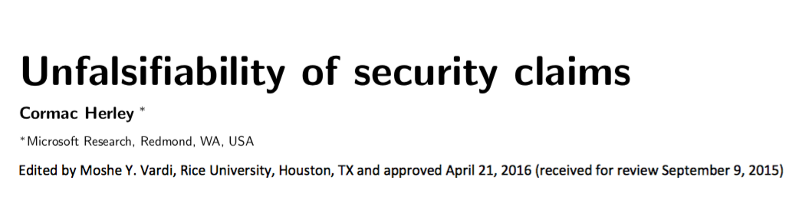
The Unfalsifiability of Security Claims
Which is the root reason of many of our policy errors

Slide 43
Abstract
There is an inherent asymmetry in computer security: things can be declared insecure by observation, but not the reverse. There is no observation that allows us to declare an arbitrary system or technique secure.
This implies that claims of necessary conditions for security are unfalsifiable.
This in turn implies an asymmetry in self-correction: while the claim that countermeasures are sufficient is always subject to correction, the claim that they are necessary is not.
Some examples
We need strong passwords, and to change them so often
Sandro’s note: this is true until we have good data on actual attacks, I would add, but again, data on actual attacks is something reasonably new even for experts

Slide 44
Policy-creep
The response to new information can only be to ratchet upward:
Newly observed or speculated attack capabilities can argue a countermeasure in, but no possible observation argues one out.
Further, when justifications are unfalsifiable, deciding the relative importance of defensive measures reduces to a subjective comparison of assumptions.
Summarizing, relying on such claims is the source of two problems:
once we go wrong we stay wrong and errors accumulate,
we have no systematic way to rank or prioritize measures.

Slide 45
QUESTIONS

Slide 46
OTHER SLIDES

Slide 47
Technical Countermeasures
For instance
Use of VM’s for surfing
IDS/IPS
Honeynet
New: deceiving technology
Fact is: every countermeasure has running costs

Slide 48
Network: Segmentation and Monitoring
Proper network segmentation should be a no-brainer
But with the IoT we are going the other way
Proper traffic monitoring
External traffic: mandatory for everyone
Internal traffic: should be done, but it is too hard in IT systems.
SIM/SIEM solutions

Slide 49
Wrong Myths (1)
Deployment of Secure Sockets Layer (SSL) prevents you from all types of attacks
Implementation of firewall as a network perimeter defense makes the environment bulletproof.
Deployment of an Intrusion Prevention System (IPS) or Intrusion Detection System (IDS) protects malicious code from entering my network.
Custom encryption provides similar strength as standardized cryptographic algorithms.

Slide 50
Wrong Myths (2)
Usage of Two-factor Authentication (TFA) protects from all types of fraudulent activities.
Deployment of security policies eradicates the risks
Anti-virus (AV) engines provide robust protection.
Malware is distributed primarily through shady and rogue web sites such as torrents and warez
Email filtering mechanisms only allow secure and verified attachments to be delivered with emails.
Malware infections are specific to certain operating systems.
Mobile devices are completely secure.
Virtualization technologies are untouched by malware.

Slide 51
Questions?

