Slide 1
Legal Informatics, Privacy and Cyber Crime
Part 6
Etalle
2021

Slide 2
CCD course
Lecture 4b: Attacks Evolution
New in 2020

Slide 3
Material
Underlying material: [OBLIGATORY READ!]
We usually refer to the last two Internet Security Threat Reports by Symantec, but for some reasons (I guess it has to do with the fact that Symantec has been acquired by Broadcom), there is no 2020 Internet Security Threat Report.
Therefore for in 2020 we refer to the 2020 Sonicwall Cyber Threat Report https://www.sonicwall.com/resources/2020-cyber-threat-report-pdf/ (also available in the slides directory – very “commercial” but still has good info)
Presentation Maastricht Ransomware Attack (done by Bart van den Heuvel, the CISO) https://connect.geant.org/wp-content/uploads/2020/10/Presentation-ransomware-attack-2019.pdf (also available in the slides directory)
Possible additional source [NON OBLIGATORY]: 2020 Checkpoint Cyber Security Report, which I somehow freely downloaded from https://www.ntsc.org/assets/pdfs/cyber-security-report-2020.pdf

Slide 4
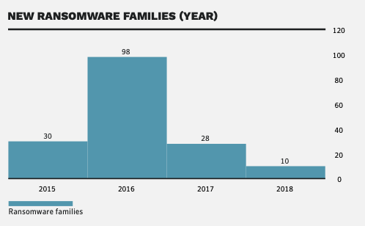
The big comeback: Ransomware Just one year ago (2019 Symantec Report): Ransomware seemed a thing of the past. This is what we quoted:
When viewed as a business, it’s clear that ransomware profitability in 2016 led to a crowded market with overpriced ransom demands.
In 2017, the ransomware “market” made a correction with fewer ransomware families and lower ransom demands—signaling that ransomware has become a commodity.
The average ransom demand dropped in 2017 to $522, less than half the average of the year prior.
The number of ransomware families dropped,
Many cyber criminals may have shifted their focus to coin mining

Slide 5
The new Entry: Targeted Ransomware
In 2019, we saw an escalation of sophisticated and targeted ransomware exploits.
Specific industries were heavily victimized, including state and local government and healthcare organizations. The new, stark reality is that attackers are spending more time to gather intelligence on their victims, achieving maximum disruption and scaled-up ransoms.
Attacks have become so damaging that the FBI has softened its previous stance on paying ransoms.
Attacks have ranged from hospitals, police stations and educational institutions to aluminium factories (Norsk Hydro, Norway) and power grids (City Power, Johannesburg).
(text from the 2020 Checkpoint Cyber Security Report)

Slide 6
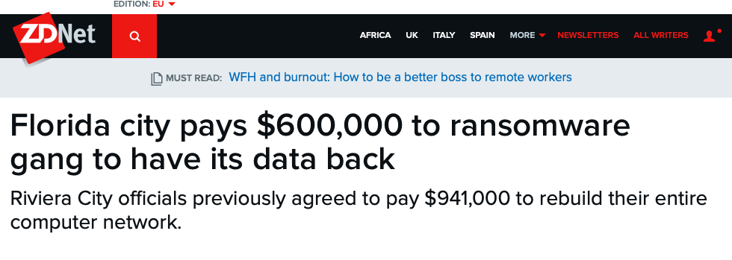
New kind of Ransomware: Example #1 (first examples back in 2019)
https://www.zdnet.com/article/florida-city-pays-600000-to-ransomware-gang-to-have-its-data-back/

Slide 7
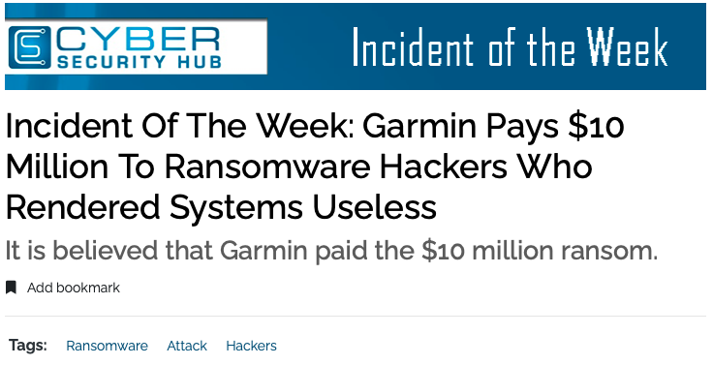
New kind of Ransomware Example 2: GARMIN
On July 23, 2020 Garmin users went to Twitter to express their concern over inaccessible website features. Four days later, Garmin released an official statement confirming that a cyber attack had taken place. Garmin assured its users that no PII (personal identifying information) was compromised.
https://www.cshub.com/attacks/articles/incident-of-the-week-garmin-pays-10-million-to-ransomware-hackers-who-rendered-systems-useless

Slide 8
Garmin Hack, part 2
Hackers deployed the ransomware tool WastedLocker, which encrypts key data on a company’s digital infrastructure.
In the case of Garmin, website functions, customer support, and user applications were all affected.
Unlike typical ransomware software, WastedLocker does not steal identifying information and hold it for ransom. Instead, it renders programs useless until decrypted. The hacking organization then demands a fee for the decryption key. In the case of Garmin, although not verified by the U.S. corporation, it is believed that Garmin paid the $10 million ransom.

Slide 9
Garmin Hack, attribution and politics
In the world of cyber crime, however, nothing is cut and dry.
Cyber security experts have linked this young ransomware tool with the Russian hacking group known as Evil Corp.
If this is the case, assuming the WastedLocker attack occurred under Evil Corp’s authority and not as a ransomware-for-hire event, Garmin had a difficult choice to make.
To return their systems to working order, they had to risk breaking U.S. sanctions against Evil Corp.

Slide 10
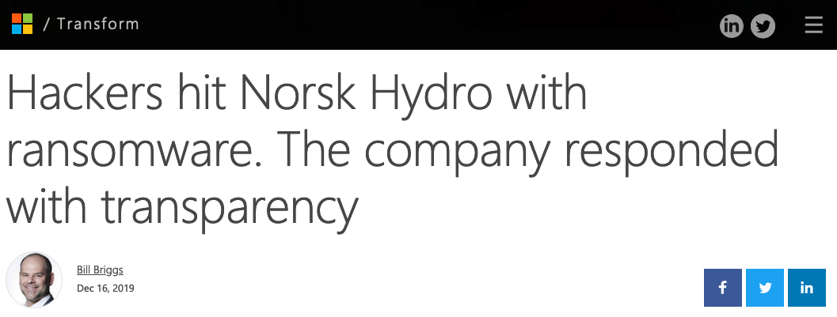
Another Targeted Ransomware
This time, the victim did NOT pay the ransom.
he breach last March would ultimately affect all 35,000 Norsk Hydro employees across 40 countries, locking the files on thousands of servers and PCs. The financial impact would eventually approach $71 million.
All of that damage had been set in motion three months earlier when one employee unknowingly opened an infected email from a trusted customer. That allowed hackers to invade the IT infrastructure and covertly plant their virus.
https://news.microsoft.com/transform/hackers-hit-norsk-hydro-ransomware-company-responded-transparency/

Slide 11
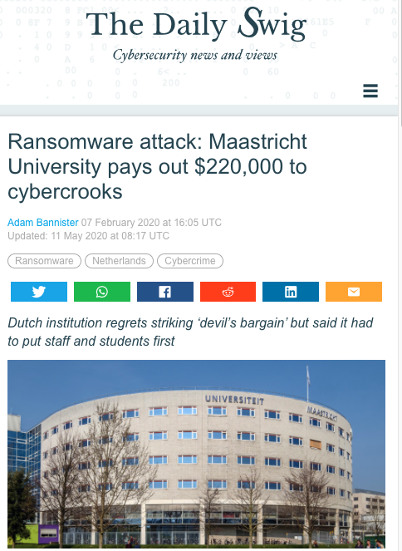
Maastricht Attack (December 19)
Affecting file, email, and backup servers, the cyber-attack prompted a network-wide shutdown and put valuable research and commercial operations data at risk
"Part of our technical infrastructure was affected during the attack. That infrastructure consists of 1,647 Linux and Windows servers and 7,307 workstations,"
"The attack ultimately focused on 267 servers of the Windows domain. The attacker focused on encrypting data files in the Windows domain. The backup of a limited number of systems was also affected."
https://portswigger.net/daily-swig/ransomware-attack-maastricht-university-pays-out-220-000-to-cybercrooks

Slide 12
This slide and the following ones are copied on 23/11/2020 from
https://connect.geant.org/wp-content/uploads/2020/10/Presentation-ransomware-attack-2019.pdf

Slide 13
https://connect.geant.org/wp-content/uploads/2020/10/Presentation-ransomware-attack-2019.pdf

Slide 14
https://connect.geant.org/wp-content/uploads/2020/10/Presentation-ransomware-attack-2019.pdf
GRACE-RAT is the Remote Access Tool, TA505 is the cybercriminal group

Slide 16
Questions to think about
Why did they pick Maastricht?
What is the business model of the attackers and how is it different from the ”regular” ransomware business model?
What is really new about this (and Garmin’s) attack?

Slide 17
Why did they pick Maastricht
We don’t know, but most likely (almost) at random

Slide 18
What is the business model of the attackers and how is it different from the ”regular” ransomware business model?
It is different because
Ransomware typically try to infect as many target as possible, and ask a relatively small ransom
Ransomware attacks typically hold data hostage, not the services
The
It required a lot of preparation on a single target

Slide 19
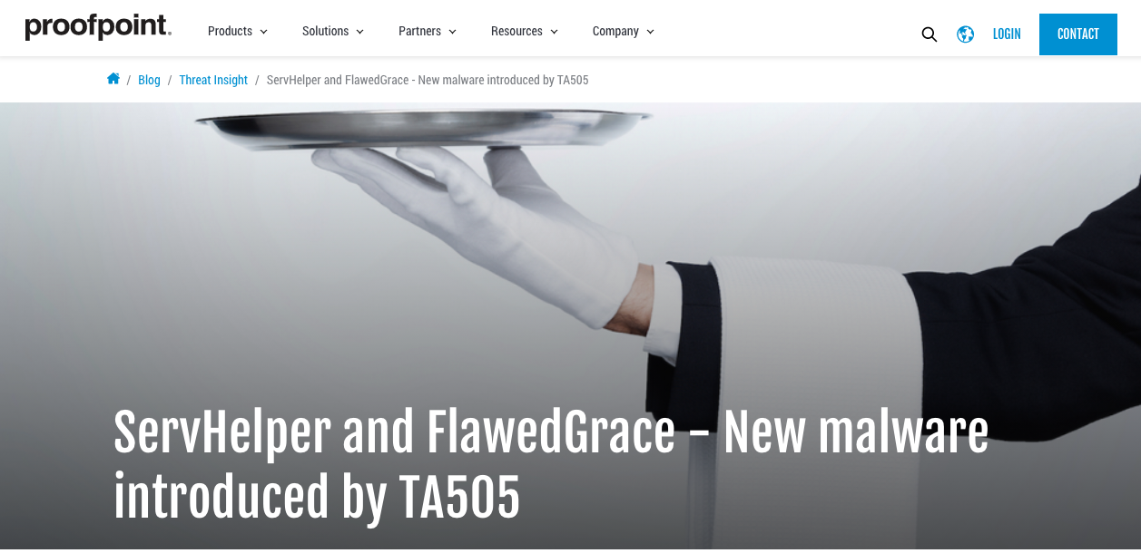
More About TA505
https://www.proofpoint.com/us/threat-insight/post/servhelper-and-flawedgrace-new-malware-introduced-ta505, January 9, 2019

Slide 20
In a Nutshell
Malware researchers
discovered two new malware families
distributed through phishing campaigns last year (2018)
carried out by the TA505 cybercriminal group
ServHelper backdoor with two variants and FlawedGrace remote access trojan (RAT).
The threat actor continues to target organizations in the financial and retail sectors, the researchers say, using Microsoft Word, Microsoft Publisher, and PDF files pull the malware on the victim computer host.

Slide 21
November 9: “Tunnel” Campaign
“On November 9, 2018, we observed a relatively small email campaign (thousands of messages) delivering a new malware family that we call “ServHelper” based on file names associated with infection. The campaign primarily targeted financial institutions and was attributed to the threat actor TA505. The messages (Figure 1) contained Microsoft Word or Publisher attachments with macros that, when enabled, downloaded and executed the malware. This campaign used the “tunnel” variant of ServHelper, described in the “Malware Analysis” section.”

Slide 22
November 15, 2018 “Downloader” Campaign
On November 15, 2018, we saw a similar, but larger campaign (tens of thousands of messages) from the same actor. In addition to financial institutions, this campaign also targeted the retail industry. The messages (Figure 2) contained Microsoft “.doc”, “.pub”, or “.wiz” attachments. The documents contained macros that, when enabled, downloaded and executed the ServHelper malware. This campaign used the “downloader” variant of ServHelper with the tunneling functionality removed.

Slide 23
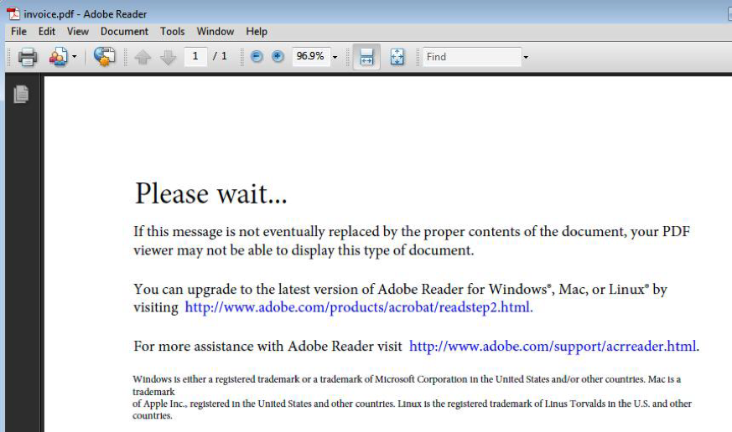
December 13 “FlawedGrace” Campaign
On December 13, 2018, we observed another large ServHelper “downloader” campaign targeting retail and financial services customers. The messages used a mixture of Microsoft Word attachments with embedded malicious macros, PDF attachments with URLs linking to a fake “Adobe PDF Plugin” webpage linking to the malware (Figure 3), and direct URLs in the email body linking to a ServHelper executable.

Slide 24
ServHelper Malware Analysis (small excerpt)
ServHelper is a new malware family -- best classified as a backdoor -- that we first observed in the wild in November 2018.
The malware is written in Delphi and at the time of this writing is being actively developed. New commands and functionality are being added to the malware in almost every new campaign …
The “tunnel” (larger) variant has more features and focuses on setting up reverse SSH tunnels to allow the threat actor to access the infected host via Remote Desktop Protocol (RDP).
Once ServHelper establishes remote desktop access, the malware contains functionality for the threat actor to “hijack” legitimate user accounts or their web browser profiles and use them as they see fit. The

Slide 25
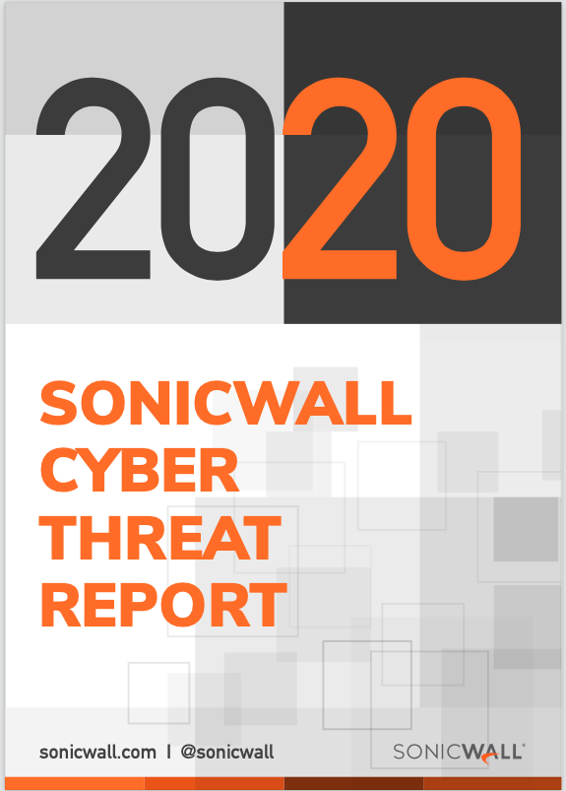
Our new source
Available at
https://www.sonicwall.com/resources/2020-cyber-threat-report-pdf/
And in the slides directory

Slide 26
Risks from New Kits and Macros
With the indictments of various cybercriminal gang members, some exploit kits (EK) have emerged to replace older variants. But even the new EKs still utilize fairly old Internet Explorer and Adobe Flash vulnerabilities. Like their predecessors, they also are mainly distributed via “drive-by-download” and malvertizing campaigns.
Newer and more sophisticated EKs, however, use fileless attacks instead of dropping traditional payloads to the disk. Magnitude EK, Underminer EK and Purplefox EK have been known to leverage fileless payloads, many of which are ransomware.
As another example, router-based exploit kits can alter a router’s DNS settings so that users are redirected to phishing and other malicious websites.
Each year, SonicWall sees an increase in the use of document files as an initial vector for malware infection.

Slide 27
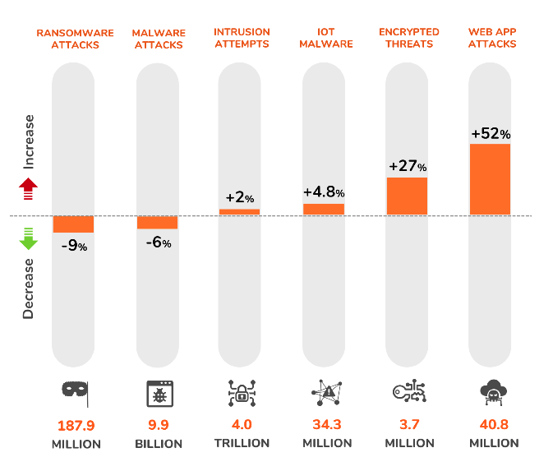
Trends
Still from the SonicWall report
My notes:
1) these figures are (clearly) about the number of attacks witnessed, not the global damage/business. The fact that ransomware “down” is does not mean that ransomware has become less a threat.
2) I disagree with the measures used. “Encrypted threats” is not about a specific threat type but about the use of encryption by threats
3) Not clear to me what it is meant by “intrusion attempts”. Other figures are interesting.

Slide 28
An interesting “information”
This is taken straight from the SonicWall report.
What do you think it is going on here?
Phishing is now less popular, because watering hole attacks have become more effective
Phishing is now less popular, because direct attacks (“intrusion attempts” and “web app” attacks in the previous slide) are more popular
Phishing has done less damage in 2019 than in 2018
None of the above

Slide 29
My explanation
Phishing is not “down”, but the volume of Phishing is.
This is probably because attacks are more targeted (e.g. ransomware).
So the number of phishing attempts is lower, but their quality is higher.
I am ready to bet that Phishing has done more total damage in 2019 than in 2018.
In this respect this is a very bad title.
The authors do explain a bit what is going on: “… cybercriminals are being more targeted with phishing than ever before … volume is only part of the story. Phishers are being measured, pragmatic and patient. “

Slide 30
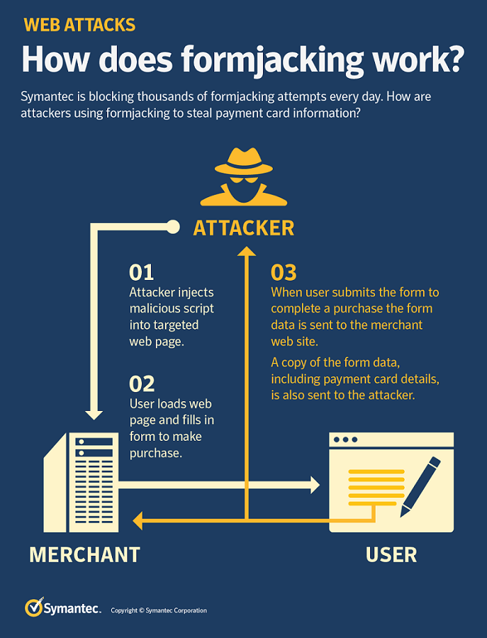
Formjacking: the new entry in 2019
use of malicious JavaScript code to steal payment card details and other information from payment forms on the checkout web pages of
one of the biggest cyber security trends of the year, with an average of 4,800 websites compromised with formjacking code every month in 2018.
The fact that the 2020 report by sonicwall shows an 52% increase in web application attacks probably indicates that this kind of attack is still very popular

Slide 31
Formjacking (2)
This increase in formjacking reflects the general growth in supply chain attacks … many cases targeting third-party services in order to get its code onto targeted websites.
In the high-profile breach of Ticketmaster, for example, Magecart compromised a third-party chatbot, which loaded malicious code into the web browsers of visitors to Ticketmaster’s website, with the aim of harvesting customers’ payment data.
The growth in formjacking in 2018 may be partially explained by the drop in the value of cryptocurrencies during the year: cyber criminals who may have used websites for cryptojacking may now be opting for formjacking.

Slide 32
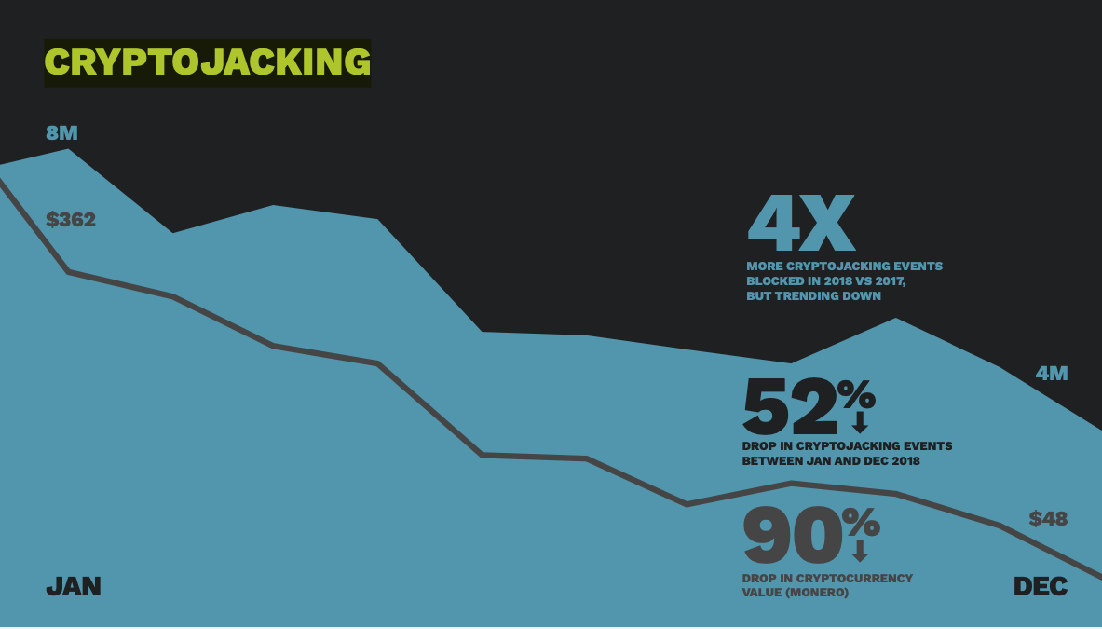
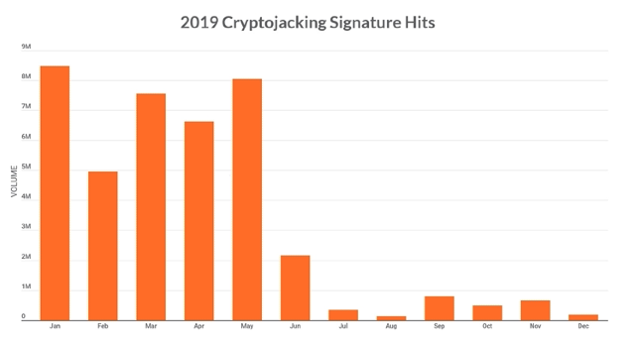
Coin-mining attacks
Beautiful example of a flourishing attacker business that has been completely wiped out.
2017: 8,500% increase wrt 2016.
2018: 400% increase wrt 2017 but declining towards the end of the year
2019: basically zeroed. The shuttering of the Coinhive mining operation in March 2019 dealt a devasting blow to the nefarious cryptojacking racket that abused the service.
Coinhive was not inherently malicious…
Why is that? Tip: attackers are lazy too….

Slide 33
Living off the land and supply chain attacks
2017
Despite the EternalBlue exploit wreaking havoc in 2017, the reality is that vulnerabilities are becoming increasingly difficult for attackers to identify and exploit. (see also living off the land)
In response to this, Symantec saw in 2017 seeing an increase in attackers injecting malware implants into the supply chain to infiltrate unsuspecting organizations, with a 200 percent increase in these attacks
2018
This trend of “living off the land” shows no sign of abating—in fact, there was a significant increase in certain activity in 2018.
PowerShell usage is now a staple of both cyber crime and targeted attacks—reflected by a massive 1,000 percent increase in malicious PowerShell scripts blocked in 2018 on the endpoint.
2019: too bad the 2020 report does not cover living off the land, but be sure it is still popular

Slide 34
Advantage of software supply chain attacks
Motivation for attackers:
01 Infiltration of well-protected organizations by leveraging a trusted channel
02 Fast distribution: number of infections can grow quickly as users update automatically
03 Targeting of specific regions or sectors
04 Infiltration of isolated targets, such as those in industrial environments
05 Difficult for victims to identify attacks as trusted processes are misused
06 May provide attacker with elevated privileges during installation

Slide 35
Drop in zero days can’t halt the rise in targeted attacks
This is a very interesting one:
The “Living off the Land” trend continues with attack groups opting for tried-and-trusted means to infiltrate target organizations.
#1 infection vector: spear phishing (71%)
The use of zero days keeps dropping. In fact, only 27 percent of the 140 targeted attack groups that Symantec tracks have been known to use zero-day vulnerabilities at any point in the past.

Slide 36
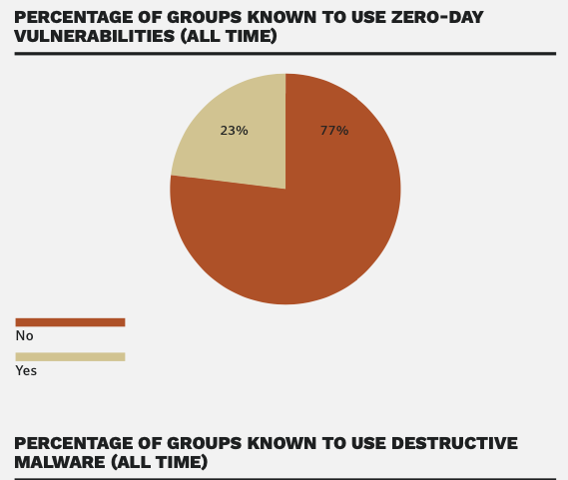
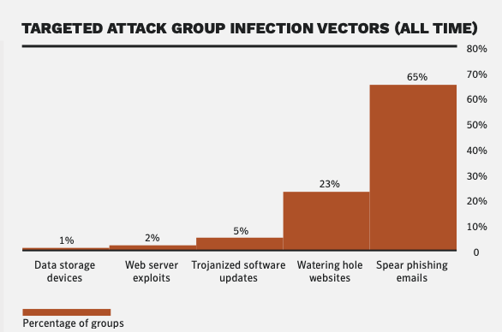
Targeted attacks and 0-day: infection vectors (2019 data0
3 new targeted attacks groups every year
90% intelligence, 10% disruptive
23% does not use 0-day vulnerabilities

Slide 37
Mobile malware continues to surge
The number of new mobile malware variants up 54%
an average of 24,000 malicious mobile applications blocked each day.
the problem is exacerbated by the continued use of older operating systems.
Mobile users also face privacy risks from grayware, apps that aren’t completely malicious but can be troublesome. Symantec found that 63 percent of grayware apps leak the device’s phone number. With grayware increasing by 20 percent in 2017, this isn’t a problem that’s going away.

Slide 38
IoT
2017:
Symantec already found a 600 percent increase in overall IoT attacks in 2017, which means that cyber criminals could exploit the connected nature of these devices to mine en masse.
2018:
After a massive increase in Internet of Things (IoT) attacks in 2017, attack numbers stabilized in 2018, when the number of attacks averaged 5,200 per month against Symantec’s IoT honeypot.
Routers and connected cameras were by far the main source of IoT attacks, accounting for over 90 percent of all attacks on the honeypot.
The notorious Mirai distributed denial of service (DDoS) worm remained an active threat and, with 16 percent of the attacks, was the third most common IoT threat in 2018.

Slide 39
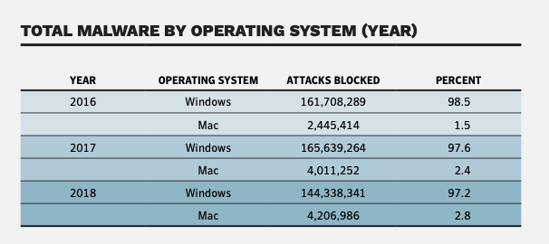
Windows vs Mac
Total Mac malware up, but relatively stable wrt 2017

Slide 40
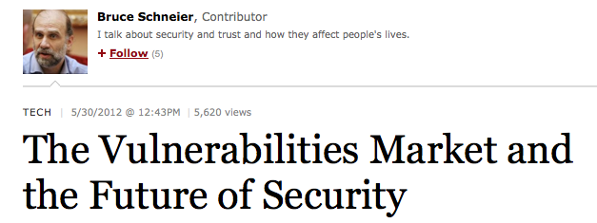
1000 shades of gray market 1 out of 2
Up until 2010, there was little market for vulnerabilities http://unsecurityresearch.com/index.php?option=com_content&view=article&id=52&Itemid=57
Now, it is a booming market: Vupen, Netragard, Endgame, Northrop Grumman…
Disclosure of vulnerabilities was the way to counter poorly-written software: Not ideal, but better than nothing
What is going to happen next? Hackers have no incentive to disclose. Government agencies have no incentive to disclose
How about programmers?

Slide 41
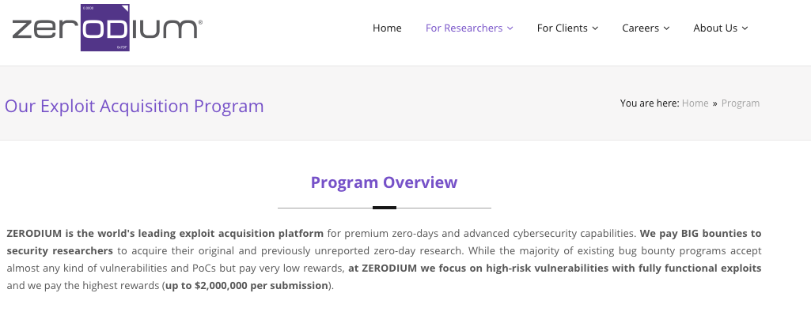
For instance…
“ZERODIUM is the world's leading exploit acquisition platform for premium zero-days and advanced cybersecurity capabilities. We pay BIG bounties to security researchers…”

Slide 42
Underground economy 1/3

Slide 45
OLD SLIDES: to be removed

Slide 46
Insider Danger (NOT PART OF THE COURSE – here possible future evolution)

Slide 47
Material for this section
UNINTENTIONAL INSIDER THREATS: SOCIAL ENGINEERING
Only the sections: 3, 5, 6.1, 6.2, 6.3

Slide 48
Definition of unintentional insider threat is
(1) a current or former employee, contractor, or business partner
(2) who has or had authorized access to an organization’s network, system, or data and who,
(3) through action or inaction without malicious intent,
(4) unwittingly causes harm or substantially increases the probability of future serious harm to the confidentiality, integrity, or availability of the organization’s resources or assets, including information, information systems, or financial systems.

Slide 49
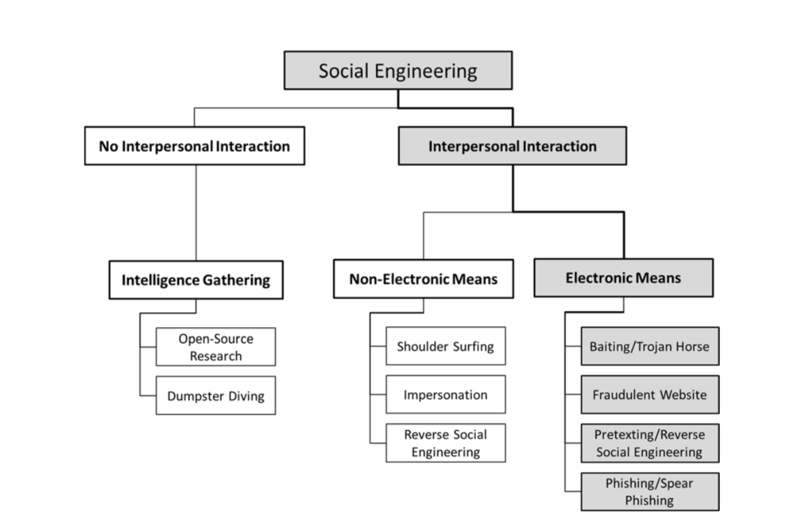
Taxonomy of Social Engineering

Slide 50
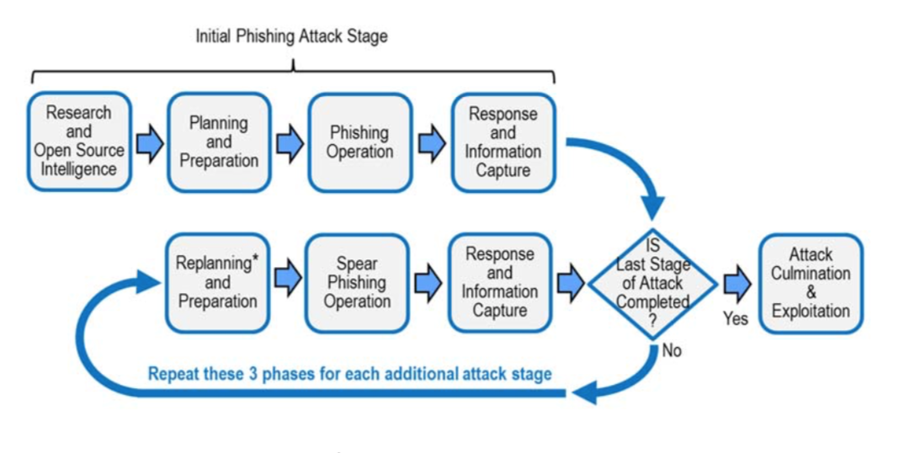
Procedures: one or more stages

Slide 51
Case 1 of 3 (from the book “Targeted Attacks”)
INDUSTRY: Information and telecommunication
STAGING: Single
INCIDENT: Attackers sent an innocent-looking email to news service staffers urging them to click on a link to an important article on another news organization’s blog that, unknown to the victims, would infect their computers with malware. The malware allowed the hackers to capture passwords to the news service’s Twitter account.
BREACH: Access to the news service’s Twitter account allowed the attacker to send an erroneous Tweet warning of two explosions in a government building.
OUTCOME: Within minutes, the bogus story had a brief but very real effect on the stock market, causing it to drop significantly. This stock market loss was made up after the story was confirmed to be false.
This was the second widespread social engineering attack on the news service, which had implemented extensive training after the first.

Slide 52
Case 2 of 3
INDUSTRY: Computer manufacturer
STAGING: Single
INCIDENT: Malware to attack computer manufacturers was spread through a website for software developers. The website advertised a Java plug-in that could be installed on desktops.
BREACH: A few employees of one reported company installed the so-called Java plug-in, which was in fact cleverly placed malware. The incident affected a small number of systems.
OUTCOME: The manufacturer worked with law enforcement to find the source of the malware. The manufacturer’s native antimalware software was able to catch the malware and isolate it.
.

Slide 53
Case of a two-staged attack
First stage: “general purpose” phishing aimed at people who have little security training.
Eg: (from https://www.csoonline.com/article/3230548/cyber-attacks-espionage/multi-stage-spear-phishing-bait-hook-and-catch.html )
Then reconnaissance (gathering of intelligence for the second stage)
Second stage: customized spear-phishing to the executives.

Slide 54
Case 3 of 3
INDUSTRY: Banking and finance, manufacturing
STAGING: Multiple
INCIDENT: The phisher impersonated the company's bank, requesting information to address security concerns. The insider clicked on a link in a phishing email and entered confidential information.
Stage 1 - phishing to multiple bank customers
Stage 2 - spear phishing to executives with likely wire-transfer authority
BREACH: The disclosure included credentials and passwords that enabled outsiders to transfer funds to accounts in several countries.
OUTCOME: The bank was able to reverse 70 percent of total money lost.
RESPONSE: The company recovered the remainder in a court settlement resulting from a lawsuit brought against the bank.

