Slide 1
Algorithmic Methods for Markov Chains
Dr. Ahmad Al Hanbali
Industrial Engineering Dep
University of Twente
a.alhanbali@utwente.nl

Slide 2
Content
Numerical solution for equilibrium equations of Markov chain:
Exact methods: Gaussian elimination, and GTH
Approximation (iterative) methods: Power method, Gauss-Seidel variant
Transient analysis of Markov process, uniformization, and occupancy time
M/M/1-type models: Quasi Birth Death processes and Matrix geometric solution
G/M/1 and M/G/1-type models: Free-skip processes in one direction
Finite Quasi Birth Death processes

Slide 3
Lecture 1
Algorithmic methods for finding the equilibrium distribution of finite Markov chains
Exact methods: Gaussian elimination, and GTH
Approximation (iterative) methods: Power method, Gauss-Seidel variant

Slide 4
Introduction
Let $\left\{X_{n}:n≥0\right\}$ denote a discrete time stochastic process with finite states space $\left\{0,1,…,N\right\}$
Markov property: $P\left(X_{n}=j|X_{n−1},…,X_{0}\right)=P\left(X_{n}=j|X_{n−1}\right)$
If the process $\left\{X_{n}:n≥0\right\}$ satisfies the Markov property, it is then called a discrete time Markov chain
A Markov chain is stationary if $P\left(X_{n}=j|X_{n−1}=i\right)$ is independent of $n$, i.e., $P\left(X_{n}=j|X_{n−1}=i\right)=p_{ij}$. In this case $p_{ij}$ is called the one-step transition probability from state i to j
The matrix $P=\left(p_{ij}\right)$, is transition probability matrix of $\left\{X_{n}:n≥0\right\}$, $Pe=e$, where $e$ is column vector of ones. The element $\left(i,j\right)$ of $P^{n}$, matrix $P$ to power n, represents the transition probability to go from i to j in $n$ steps

Slide 5
Introduction
A stationary Markov chain can be represented by a transition states diagram
In a transition states diagram, two states can communicate if there is a route that joins them
A Markov chain is irreducible if all its states can communicate between each other, i.e., $∃ n$ an integer $n≥1$ such that $p_{ij}^{\left(n\right)}$ >0)
1
0.5
1
2
1
2
0.3
0.3
0.5
0.7
0.7
3
0.5
3
0.5
1
Three states irreducible MC
Three states absorbing MC: state 3 is absorbing, {1,2} are transient
Notes:
A set of states is called transient if its elements can communicate but it can be left after a number of transition.

Slide 6
Introduction
Let $t$ denotes the set of transient states and $a$ the set of absorbing states. For absorbing Markov chains the transition probability matrix $P$can be written as, $I$ identity matrix,
$P=\left(\begin{matrix}P_{tt} & P_{ta} \\ 0 & I\end{matrix}\right),$
Let $m_{ij}$, $i,j∈t$, denote expected number of visits to $j$ before absorption given that the chain starts in $i$ at the time 0.
The matrix M$=\left(m_{ij}\right)$ gives
$M={\left(I−P_{tt}\right)}^{−1}=I+P_{tt}+{{(P}_{tt})}^{2}+…$
1
0.5
2
0.3
0.7
1
3
1
Notes:
Note by Theorem 3.2.1 of [Grinstead and Snell, Finite Markov Chains] any absorbing Markov chain the matrix M exists, i.e., I-P_tt is invertible.
Note (P_tt)^n->0 (eventually the chain will jumps to absorbing state), this gives that the largest absolute value of the eigenvalues of P_tt is strictly smaller than one.
It is also possible to compute the variance of and higher moment of the number of visits before absorption.
Similarly for continuous-time absorbing Markov chains with transient generator Q: -${\left[Q^{−1}\right]}_{ij}$is the expected time spent in state j until absorption given the chain starts in state i at time 0. Moreover, let T_{a} denote the time until absorption occurs, given initial distribution α, then $P(T_{a}<x)=1−αexp(Tx)e, E[Ta]=−αT−1e,$

Slide 7
Equilibrium distribution of MC
The equilibrium, steady state, probability is defined
$$p_{j}=\lim_{n→∞}{P\left(X_{n}=j|X_{0}=i\right)}, i,j=0,…,N$$
The equilibrium distribution $p=\left(p_{0},p_{1},…,p_{N}\right)$ of the (irreducible) MC is the unique solution to
$p=pP, pe=1,$ where $e$ is a column vector of ones
For small size Markov chains $p$ can be computed
$$p={e^{t}\left(I−P+ee^{t}\right)}^{−1},$$
where $e$ is a column vector of ones, $e^{t}$ is the transpose of $e$. Note $ee^{t}$ is a matrix of ones
Notes:
- $p=pP$ and e=Pe means that one is an eigenvalue of P and that p is the corresponding left eigenvector and e is corresponding right eigenvector.
- $I−P+ee^{t}$ is invertible if ($I−P+ee^{t}$)x=0 => x=0 and is unique.
Note p($I−P+ee^{t}$)x=0 => e^t x=0.
($I−P+ee^{t}$)x=0 => x=Px-ee^t x => x=Px (using e^t x=0) => x=ce (x is right eigenvector of P which is e up to constant).
e^t x=0 => e^t c e=0 => c=0 => x=0 (unique)
Following the same steps you can say that $I−P+ey$ is nonsingular for y nonnegative or nonpositive.
- Another way to find the equilibrium probabilities is to replace column i of I-P by ones and then invert this matrix and multiply it to the left by e_i (unit vector of ith element equal to one and the rest to zero). The matrix ${\left(I−P+ee^{t}\right)}^{−1}$ is sometimes called as the fundamental matrix because a lot measures are found as a function of this matrix, see Chap 4 the book of Grinstead and Snell on Finite Size Markov Chains.

Slide 8
Exact Methods
Gaussian elimination algorithm (linear algebra)
Grassmann, Taskar and Heyman (GTH) algorithm

Slide 9
Gaussian Elimination Algorithm (1)
Example on board of 3 states Markov chain
Equilibrium equation can be written
$\sum_{j=0}^{N}{p_{j}\left(p_{ji}−δ_{ji}\right)}=0, i=0,1,…,N$,
where $δ_{ij}$= 1 if $i$=$j$ and 0 otherwise
Gaussian elimination:
Step 1: First isolate $p_{0}$ in Eq. 0, and eliminate $p_{0}$ from all other equations. Then we isolate $p_{1}$ from first equation (modified second of the original system) in the new system and eliminate $p_{1}$ from the remaining equations, and so on, until we solve Eq. N-1 for $p_{N−1}$ which gives $p_{N−1}$ as function of $p_{N}$
Notes:
Why do we stop at Eq N-1. Because Eq N will be redundant because of the idea of the balance

Slide 10
Gaussian Elimination Algorithm (2)
Gaussian elimination:
Step2 (backward iterations): Call the unknowns $v_{N}$. Use Eq. N- 1 in the last iteration to express $v_{N−1}$ as function of $v_{N}=1$, and so on until you find $v_{0}$. Note, here the values of $v_{i}$ is equal to the probability $p_{i}$ up to scale parameter c ($v_{i}={cp}_{i}$)
Step 3 (normalization): the constant $c$ can be found using the normalization equation ($\sum_{i=0}^{N}{p_{i}=1}$). This gives,
$$p_{i}=\frac{v_{i}}{\sum_{j=0}^{N}{v_{j}}}$$
Question: shows that $v_{i}$, $i=0,…,N−1$, can be interpreted the mean number of visits to state i between two successive visits to state N multiplied by (1-$p_{NN}$).
Hint: given that the chain has just left state N at time 0, the mean number of visits to state i before returning to N can be found by assuming that N is an absorbing state.
Notes:
Consequence: $p_{i}$ can be seen as the result of the application of renewal reward Theorem

Slide 11
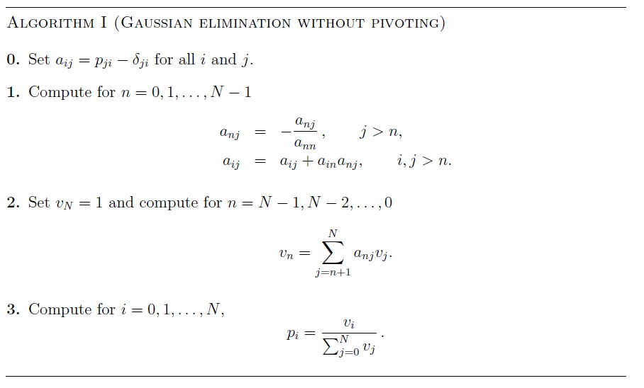
Gaussian elimination
Gaussian eliminations
Gaussian backward iterations
Normalization

Slide 12
Complexity of Gaussian Algorithm
The operations required to solve the equilibrium equation involve subtractions which may cause a loss of high order precision
For Gaussian elimination the complexity is O(N³)

Slide 13
GTH Algorithm (1)
GTH is based on Gaussian elimination algorithm and on state space reduction
Let $a_{ij}^{(1)}$ be equal to $a_{ij}$ after the first iteration in step 1 of the Gaussian algorithm. We find
$$a_{ij}^{(1)}=p_{ji}+\frac{p_{0i}p_{j0}}{1−p_{00}}−δ_{ji}=p_{ji}^{(1)}−δ_{ji}$$
$p_{ji}^{(1)}$ can be interpreted as the one
step transition probability from state
$j$ to $i$ in the chain restricted
to states $\left\{1,2,…,N\right\}$
Is this chain irreducible? Markovian?
j
$$p_{ji}$$
i
$$p_{j0}$$
0
$$p_{0i}$$
$$p_{00}$$
Notes:
Note the sum $p_{ji}^{(1)}$ for all i !=0 is equal to one.

Slide 14
GTH (2)
By induction one may prove that the value of $a_{ij}$ after the n-th iteration in step 1 of the Gaussian algorithm gives,
$a_{ij}^{(n)}=p_{ji}^{\left(n\right)}−δ_{ij},$
where $p_{ji}^{\left(n\right)}$ is the transition probability of the Markov chain restricted to the states $\left\{n,n+1,…,N\right\}$. Therefore, the sum of $p_{ji}^{n}$ over $i=n,n+1,…,N$ is one. This is called folding

Slide 15
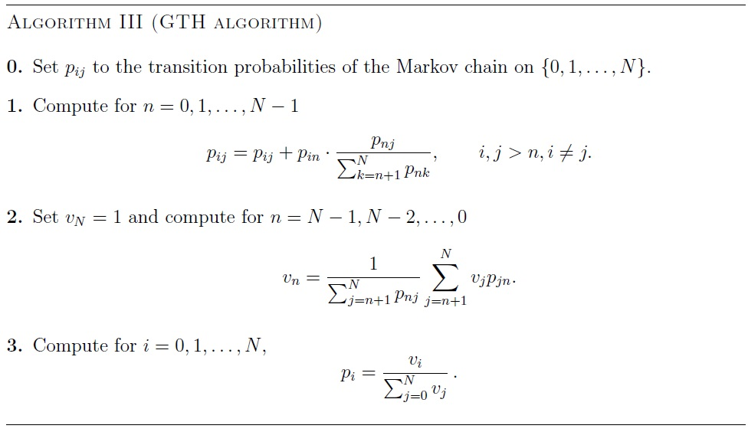
GTH (3)
Gaussian algorithm rewrites:
Folding
Forward Gaussian iterations
Unfolding
Backward iterations
Normalization
Normalization
This is a numerically stable algorithm.
Can we generalize the idea folding to more than one states, e.g., folding multiple states at once?
Notes:
Note in the successive iterations of step the state space of the Markov chain is reduced by one successively. This can be also generalized to successive reduction of multiple states at once, see, Kemeny and Snell Theorem 6.1.1 for more details

Slide 16
References (Direct Methods)
W.K. Grassmann, M.I. Taskar, D.P. Heymann, Regenerative analysis and steady state distributions for Markov chains, Operations Research, 33 (1985), pp. 1107-1116
W.J. Stewart, Introduction to the numerical solution of Markov chains, Princeton University Press, Princeton, 1994
J. Stoer, R. Bulirsch, Introduction to numerical analysis, Springer-Verlag, New York, 1980
J. Kemeny and J. Snell, Finite Markov Chains, Springer-Verlag, New York, 1976
http://www.win.tue.nl/~iadan/algoritme/

Slide 17
Iterative methods for solving the equilibrium equations
Problem: find p such that (matrix form of equilibrium equations)
$p = pP, pe = 1$,
where p equilibrium probability vector, P is transition matrix of an irreducible Markov chain, and e a column vector with ones
Let $p_{ij}^{\left(n\right)}$ denote the entries the matrix P^{n}, then $p_{ij}^{\left(n\right)}$ represents the probability of transition from state i to j in n steps
A matrix is aperiodic if the largest common divisor is one for all n such that $p_{ij}^{\left(n\right)}$ >0

Slide 18
Background (1)
The spectral radius of Q a nonnegative, irreducible and aperiodic N-by-N matrix is
$ρ\left(Q\right)$=max{ |λ|; λ is an eigenvalue of Q }. Let y* be the corresponding left eigenvector of $ρ\left(Q\right)$ referred to as spectral vector.
Under the previous assumptions $ρ\left(Q\right)$ is unique and positive, and y*>0
The sub-radius of Q defines
ρ₂(Q)=max{ |λ|; λ is eigenvalue of Q with |λ| < $ρ\left(Q\right)$}
Proposition: Let $v$be an N-row vector with $v≥0$ and $v≠0$. Then there exist a constant $a>0$ and an integer k, with $0≤k ≤N$, such that
$$vQ^{n}=aρ{\left(Q\right)}^{n}y^{∗}+O\left(n^{k}ρ_{2}{\left(Q\right)}^{n}\right), n→∞$$
What does this proposition mean for P, a transition matrix of an irreducible, aperiodic Markov chain?
Notes:
Aperiodic for nonnegative matrix means there is no state that can be only entered at certain periodic intervals (every n steps with n>1).
Applying this proposition to P (transition matrix of an irreducicble aperiodic Markov chain) means that: $ρ\left(P\right)=1,$y*=c.p (c positive constant), $P^{n}→e.p, n→∞.$ Note $e.p$ is matrix with all rows equal to p (equilibrium probability vector)

Slide 19
Iterative methods
Matrix power
Power method
Gauss-Seidel method
Iterative bounds

Slide 20
Matrix powers
Compute $P, P², P4, P8, … ,$until $P2n$ is almost constant matrix
If $P$ is irreducible aperiodic transition proba. matrix then $[P2n]ij$ converges to $pj$ and both $maxi([P2n]ij)$and $mini([P2n]ij)$converges to $pj$
$P2n$is dense matrix. Each iteration requires $O(N3)$
Remark: Any irreducible transition probability matrix can be made aperiodic by the following transformation: $Q=αI+\left(1−α\right)P$, $0<α<1$. Note if $p=pP$ then $pQ=p$
Notes:
Given that the rows of $P2n$ converges to p the are unnecessary computations done.

Slide 21
Power method
Choose an initial probability distribution$p^{(0)}$, and compute for $n=0,1, …$
$p^{(n+1)}=p^{(n)}.P$, (1)
until $|p^{(n+1)}−p^{(n)}|$ is small
$p^{(n+1)}$ is an approximation of $p$, equilibrium probability vector
Note: $p^{(n)}=p^{(0)}.Pn = a.p+O\left(nkρ_{2}{\left(Q\right)}^{n}\right), n→∞,$ then Power method converges geometrically with a rate determined by the sub-radius of $P$

Slide 22
Gauss-Seidel method
It is variant of the Power method. The Power method computes $p^{(n+1)}$ recursively from $p^{(n)}$. However, Gauss-Seidel method uses for the computation of $p_{i}^{(n+1)}$ the new values $p_{j}^{(n+1)}$ for $j≤i$ and $p_{j}^{(n)},j>i$
Let $PU$ the upper triangular matrix of P incl. main diagonal and $PL$the lower triangular matrix. The power method iteration, Equation (1), rewrites
$$p^{(n+1)}=p^{(n+1)}PU+p^{(n)}PL$$
$$p^{(n+1)}=p^{(n+1)}PL{\left(I−PU\right)}^{−1}$$
The convergence of Gauss-Seidel in much faster than Power method
Notes:
$PL{\left(I−PU\right)}^{−1}$ this matrix is not necessarily stochastic nor irreducible. $I−PU$ is non-singular because $PU$ is transition probability of a transient chain. In addition, it is easy to find $I−PU$ because since it upper triangular matrix.

Slide 23
Iterative bounds (1)
Let $vi$ denote expected number of visits to state $i$ between two consecutive visits to state $0$ multiplied by $1−p_{00}$. Then $v0=1$ and $vi$ reads $v_{i}=\frac{p_{i}}{p_{0}}, i=0,1,…,N$
This latter equality is due to renewal reward theorem with inter-renewal times as time between two consecutive visits to state 0
Plugging $vi$ into balance equations gives
$$v_{i}=p_{0i}+\sum_{j=1}^{N}{v_{j}p_{ji}}$$
Notes:
The mean number of visits to i btw 2 consecutive visits to i is equal to contributions of the first transition from 0 to i plus the contributions of the other states j (except 0) to i. Note state j will be visited multiple times before the chain return to i.

Slide 24
Iterative bounds (2)
Let $Q$ denote the N-by-N matrix where entries $qij = pji$ for $i,j=1, …, N$. The mean visits equation then rewrites (contractive equation $ρ\left(Q\right)<1$)
$$v^{(n+1)}=r+Qv^{\left(n\right)},$$
where $v^{\left(n\right)}N$-column vectors with elements $v_{i}^{\left(n\right)}$ and $ri = p0i , i= 1, …, N$
Once $v^{\left(n\right)}$ is determined then, $p_{i}=\frac{v_{i}}{\sum_{j=0}^{N}{v_{j}}}$

Slide 25
Iterative bounds (3)
Further, it is possible to construct an upper and lower bounds of $vi$ and shows that these bounds are contractive under the condition that Q is irreducible and aperiodic.
The upper bound of $vi$ is denoted by ${\overline{v}}_{i}^{\left(n\right)}$, and lower bound by ${\underline{v}}_{i}^{\left(n\right)}$
Let $α_{n}=\min_{i}{\frac{v_{i}^{\left(n+1\right)}−v_{i}^{\left(n\right)}}{v_{i}^{\left(n\right)}−v_{i}^{\left(n−1\right)}}}, β_{n}=\max_{i}{\frac{v_{i}^{\left(n+1\right)}−v_{i}^{\left(n\right)}}{v_{i}^{\left(n\right)}−v_{i}^{\left(n−1\right)}}}$

Slide 26
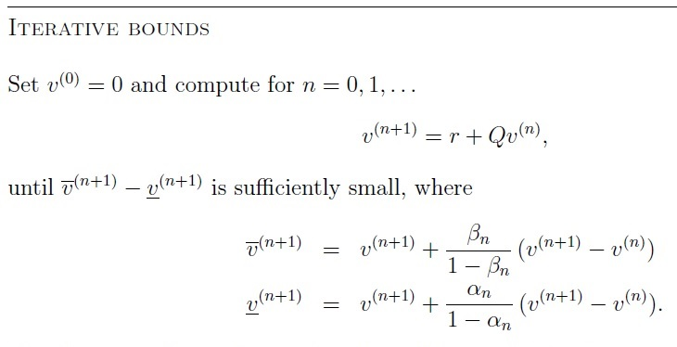
Iterative bounds (4)

Slide 27
References
A. Berman, R.J. Plemmons, Nonnegative matrices in the mathematical sciences, Academic Press, New York, 1979.
J.L. Doob, Stochastic processes, Wiley, New York, 1953.
M.C. Pease, Methods of matrix algebra, Academic Press, New York, 1965.
E. Seneta, Nonnegative matrices and Markov chains, 2nd edition, Springer-Verlag, Berlin, 1980.
P.J. Schweitzer, Iterative solution of the functional equations of undiscounted Markov renewal programming, J. Math. Anal. Appl., 34 (1971), pp. 495-501.
H.C. Tijms, Stochastic modelling and analysis: a computational approach, John Willey & Sons, Chichester, 1990.
R. Varga, Matrix iterative analysis, Prentice Hall, Englewood Clis, 1962.
J. van der Wal, P.J. Schweitzer, Iterative bounds on the equilibrium distribution of a finite Markov chain, Prob. Eng. Inf. Sci., 1 (1987), pp. 117-131.

