Slide 1
Lecture 3: Algorithmic Methods for M/M/1-type models
Dr. Ahmad Al Hanbali
Department of Industrial Engineering
University of Twente
a.alhanbali@utwente.nl

Slide 2
Lecture 3
This Lecture deals with continuous time Markov chains with infinite state space as opposed to finite space Markov chains in Lectures 1 and 2
Objective: To find equilibrium distribution of the Markov chain

Slide 3
Background (1): M/M/1 queue
Customers arrive according to Poisson process of rate $λ$, i.e., the inter-arrival times are iid exponential random variables (rv) with rate $λ$
Costumers service times are iid exponential rv with rate $μ$
inter-arrivals and service times are independent
Service discipline can be Fisrt-In-First-Out (FIFO), Last-In-First-Out (LIFO), or Processor Sharing (PS)
Under above assumptions, $\{N(t), t≥ 0\}$, the nbr of customers in M/M/1 queue at time $t$ is continuous-time infinite space Markov chain

Slide 4
Background (2): M/M/1 queue
λ
λ
λ
λ
λ
λ
0
1
i-1
i
i+1
µ
µ
µ
µ
µ
µ
Let $pi$ denote equilibrium probability of state $i$, then
$$−λp0 +μp1 = 0,$$
$$λp_{i−1} −\left(λ+μ\right)pi+μp_{i+1}= 0, i= 1,2, …$$
Solving equilibrium equations for $ρ=λ/μ<1$ (with $\sum_{i≥0}{pi}=1$) gives:
$pi=p_{i−1}ρ, p_{0}=1−ρ⇒$ $pi=\left(1−ρ\right)ρ^{i}, i≥ 0$,
This means N is geometrically distributed with parameter $ρ$

Slide 5
Background (3)
Stability condition, expected queue length is finite, load ρ:= λ/µ < 1. This can be interpreted as drift to right is smaller than drift to right
In stable case ρ is probability the M/M/1 system is non-empty, i.e. , $P(N=0)=1−ρ$
Q, the generator of M/M/1 queue, is a tridiagonal matrix, form has the form
$$Q=\left(\begin{aligned}−λ \\ μ \\ 0 \\ ⋮ \\ ⋮\end{aligned}\begin{aligned}λ \\ −λ−μ \\ μ \\ ⋱ \\ ⋱\end{aligned}\begin{aligned}0 \\ λ \\ −λ−μ \\ μ \\ ⋱\end{aligned}\begin{aligned}… \\ ⋱ \\ ⋱ \\ ⋱ \\ ⋱\end{aligned}\right)$$
Notes:
What happens if Q becomes $\left(\begin{aligned}B_{00} \\ B_{01} \\ 0 \\ ⋮ \\ ⋮\end{aligned}\begin{aligned}B_{01} \\ B_{11} \\ A_{2} \\ ⋱ \\ ⋱\end{aligned}\begin{aligned}0 \\ A_{0} \\ A_{1} \\ A_{2} \\ ⋱\end{aligned}\begin{aligned}… \\ ⋱ \\ A_{0} \\ A_{1} \\ ⋱\end{aligned}\begin{aligned}… \\ ⋱ \\ ⋱ \\ ⋱ \\ ⋱\end{aligned}\right)$

Slide 6
Quasi Birth Death Process
A 2-dimensional irreducible continuous time Markov process with states $(i,j)$, where $i=0,…,∞$ and $j=0,…,m−1$
Subset of state space with common $i$ entry is called level $i (i>0)$ and denoted $l(i)=\{(i,0),(i,1),…,(i,m−1)\}$. $l(0)=\{(0,0),(0,1),…,(i,n−1)\}$. This means state space is $∪_{i≥0}l(i)$
Transition rate from $(i,j)$to $(i′,j′)$is equal to zero for $|i−i′| ≥ 2$
For $n>0$, transition rate between states in $l(i)$ and between states in $l(i)$ and $l(i±1)$ is independent of n

Slide 7
Quasi Birth Death Process
Order the states lexicographically, i.e., $\left(0,0\right),…,\left(0,m−1\right),\left(1,0\right),…,\left(1,m−1\right),\left(2,0\right),…, \left(2,m−1\right),…$, the generator of the QBD has the following form:
$$Q=\left(\begin{aligned}B_{00} \\ B_{10} \\ 0 \\ ⋮ \\ ⋮\end{aligned}\begin{aligned}B_{01} \\ B_{11} \\ A_{2} \\ ⋱ \\ ⋱\end{aligned}\begin{aligned}0 \\ A_{0} \\ A_{1} \\ A_{2} \\ ⋱\end{aligned}\begin{aligned}0 \\ 0 \\ A_{0} \\ A_{1} \\ ⋱\end{aligned}\begin{aligned}… \\ ⋱ \\ ⋱ \\ ⋱ \\ ⋱\end{aligned}\right)$$
where $A0$ and $A2$ are nonnegative $m$-by-$m$ matrices; $A1$ and $B_{11}$ are $m$-by-$m$ matrix with strictly negative diagonal; $B_{00}$ is $n$-by-$n$ matrix with strictly negative diagonal; $B_{10}$ $n$-by-$m$ and $B_{01}$ $m$-by-$n$ nonnegative matrices. Note, $(B_{00}+B_{01})e=0$, $(B_{10}+B_{11}+A_{0})e=0,$and $(A_{2}+A1+ A0)e=0$

Slide 8
Stability
Theorem: The QBD is ergodic (i.e., mean recurrence time of the states is finite) iff
$πA0e<πA2e$, (mean drift condition)
where $e$ is the column vector of ones and $π$ is the equilibrium distribution of the irreducible Markov chain with generator $A=A0+A1+A2$,
$$πA=0, πe=1$$
Interpretation: $πA0e$ is mean drift from level $i$ to $i+1$. $πA2e$ is mean drift from level $i$ to $i−1$. Generator $A$ describes the behavior of QBD within level
Notes:
It is assumed here the A is a generator of an irreducible Markov chain. For less restrictive assumption on A see book of Latouche & Ramaswami Section 7.3

Slide 9
Equilibrium distribution of QBDs
Let $pn=(p(n,0),..,p(n,m−1))$ and $p=(p0,p1,…)$ then equilibrium equation $pQ=0$ reads
$p0B_{00}+p1B_{10}= 0$,
$$p0B_{01}+p1B_{11}+p1A_{2}= 0$$
$p_{n−1}A0+pnA1+p_{n+1}A2 = 0$, $n≥2$
Theorem: if the QBD is positive recurrent the equilibrium probability distribution then reads
$$p_{n}=p1R^{n−1}, n≥2,$$
where $R=A0N$, called rate matrix, and the matrix $N$ records the expected sojourn time in the states of $l(n)$, starting from $l(n)$, before the first visit to $l(n−1)$
Notes:
The rate matrix is a non-negative matrix of unit less numbers. Note that row i of A_0 is a row of zeros this gives the ith row of R is also zero. This may simplies the finding of R computed iteratively.

Slide 10
Proof
On board. Based on proof of Latouche & Ramaswami in the book “Introduction to Matrix Analytic Methods in Stochastic Modeling” Chap. 6 P. 129-133
......
A direct result of the previous theorem is that spectral radius of $R$ is < 1
It remains to find $p0$, $p1$, and $R$ ?

Slide 11
Equilibrium Distribution (cnt'd)
Lemma: The matrix $R$ is the minimal non-
negative solution of
$A0+ RA1+R2A2 = 0$
Lemma: The stationary probability vectors $p0$ and $p1$
are the unique solution of
$p0B_{00}+p_{1}B_{10}=0$
$$p0B_{01}+p_{1}{(B}_{11}+RA_{2})=0$$
$p_{0}e+ p1 {\left(I−R\right)}^{−1}e=1$ (Normalization condition)
Notes:
Note that B_00 is invertible because eventually the process will leave level 0. Therefore $p0=−p_{1}B_{10}B_{00}^{−1}$. Inserting in the second equation we get that:
$p_{1}\left(−B_{10}B_{00}^{−1}B_{01}+B_{11}+RA_{2}\right)=0.$ The normalization condition can be rewritten as $p_{1}(−B_{10}B_{00}^{−1}+ {\left(I−R\right)}^{−1})e=1$. Let matrix X be $\left(−B_{10}B_{00}^{−1}B_{01}+B_{11}+RA_{2}\right)$ but with column i $\left(−B_{10}B_{00}^{−1}+ {\left(I−R\right)}^{−1}\right)e.$ Then we get that $p_{1}=e_{i}X^{−1}$, $e_{i}$ a row vector with i-th entry 1 and rest zero.

Slide 12
Compute R
Rearrange the quadratic equation of the rate matrix:
$$R=−\left(A0+R2A2\right)A_{1}^{−1}$$
A₁ is invertible since it is a generator of a transient Markov chain states l(n), n>0
Fixed point equation solved by successive substitution
$R_{k+1}=−(A_{0}+R_{k}^{2}A_{2})A_{1}^{−1}$, with $R0=0$
It can be shown that $Rk→ R$for $k→∞$.
Notes:
Note that Latouche and Ramaswami in their book proposed to find the matrix G which satisfies: $A_{0}G^{2}+A_{1}G+A_{2}=0;$ Note that G is a nonnegative stochastic matrix (sum of its rows equal to one). Then R is simply found as $R=−A_{0}{\left(A_{1}+A_{0}G\right)}^{−1}.$ In their book, G is computed iteratively. (i,j) entry G records the probability starting in level n in state (n,i) to for the first time reach level (n-1) in state (n-1,j), n>=2.

Slide 13
Special cases
For $A_{2}=v.α$ is a product of two vectors where $v$ is column vector and $α$ is row vector with $\sum_{j=0}^{m}{α_{j}}=1$, the rate matrix reads, $e$ is a column vector of ones,
$R=−A_{0}{\left(A_{1}+A_{0}eα\right)}^{−1}$,
For $A_{0}=w. β$ is a product of two vectors where $w$ is column vector and $β$ is row vector with $\sum_{j=0}^{m}{β_{j}}=1$, the rate matrix reads
$$R=w.a⇒R^{i}={\left(η\right)}^{i−1}R$$
where $a$ is some row and $η=$ $a.w$ (a number). $η$ is spectral radius of $R$ and can be found as the root (0,1) of
$\det\left(A_{0}+xA_{1}+x^{2}A_{2}\right)=0$
Notes:
* Make a plot on the board: what it means v.\alpha? It means that given state i in a level n, with n>2, rate to jump to state j in level n-1 is nothing than v_i*\alpha_j. So, given that chain starts in level n in state i the probability to go first time reach j in level n-1 is equal \alpha_j. This means that G=e.\alpha. R follows right away from that.
* Starting with R=0 in the recursion $R_{k+1}=−(A_{0}+R_{k}^{2}A_{2})A_{1}^{−1}$, it is easily found that $R_{k}={wa}_{k}$.
* Why $η$ is unique? Since R is non-negative matrix this follows from Perron-Frobenius proposition

Slide 14
Spectral expansion method
The balance equation can be seen as a difference equation with a basis solution of form
$p_{n}=yx^{n},$ $y=\left(y\left(0\right),…,y\left(m\right)\right)≠0 and \left|x\right|<1$
Inserting this solution in the balance equation $p_{n−1}A0+pnA1+p_{n+1}A2 = 0$, $n≥2$ yields
$$y\left(A_{0}+xA_{1}+x^{2}A_{2}\right)=0⇒\det\left(A_{0}+xA_{1}+x^{2}A_{2}\right)=0$$
This latter equation has $m+1$ roots in the unit disk and
$$p_{n}=\sum_{j=0}^{m}{c_{j} y_{j}{\left(x_{j}\right)}^{i−1}, n=1,2,…}$$
The constants $c_{j},j=0,…,m,$ are found using the boundary equations and the normalization condition

Slide 15
Spectral expansion method
The roots $x_{0},…,x_{m+1}$ are eigenvalue of the rate matrix $R$ with corresponding left eigenvectors $y_{0},…,y_{m+1}$
If it appears some these roots are of a multiplicity higher than one a more complicated basis solution should be considered
No probabilistic interpretation is available for $x_{i}$’s and $y_{i}$’s
Numerically it has been found that Matrix geometric methods is more stable than the spectral expansion

Slide 16
M/M/1 Type models
Machine with set-up times
Unreliable machine
M/E_{r}/1 model
E_{r}/M/1 model

Slide 17
Machine with set-up times (1)
In addition to assumptions of M/M/1 system, further assume that the system is turned off when it is empty
System is turned on again when a new costumer arrives
The set-up time is exponentially distributed with mean $1/θ$

Slide 18
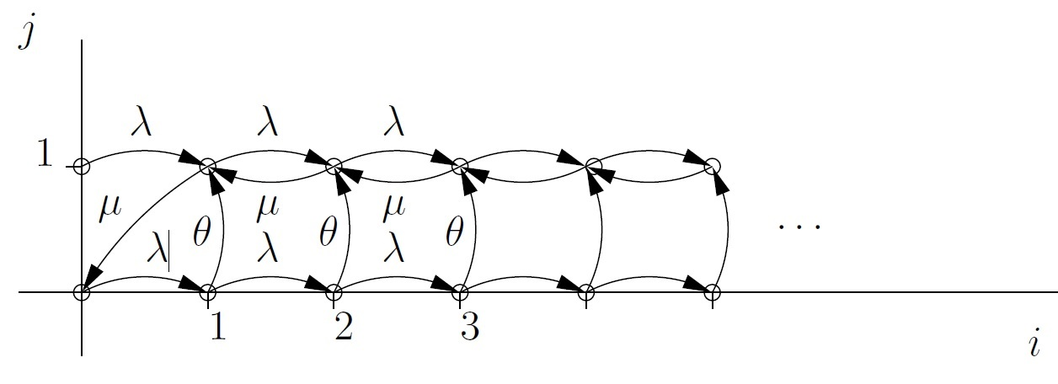
Machine with set-up time (2)
Number of customers in system is not a Markov process
Two-dimensional process of state $(i,j)$where $i$ is number of costumers and $j$is system state ($j =0$, sys. is off, $j =1$, sys. is on) is Markov process

Slide 19
Machine with set-up time (3)
Let $p(i,j)$ denote equilibrium prob. of state $(i,j), i ≥ 0, j=0,1$. Equilibrium equations read
$$p(0,0)λ = p(1,1)μ$$
$$p(i,0)(λ+θ) = p(i−1,0)λ, i≥1$$
$$p(i,1)(λ+μ) = p(i,0)θ+p(i+1,1)μ+p(i−1,1)λ, i≥1$$
Let $pi=(p(i,0),p(i,1))$, then Equilibrium eqs read
$$p0B1+ p1B2 = 0,$$
$$p_{i−1}A0+ p_{i}A1+p_{i+1}A2 = 0, i≥1$$

Slide 20
Machine with set-up time (4)
where
$$A_{0}=\left(\begin{matrix}λ & 0 \\ 0 & λ\end{matrix}\right), A_{2}=\left(\begin{matrix}0 & 0 \\ 0 & μ\end{matrix}\right), A_{1}=\left(\begin{matrix}−\left(λ+θ\right) & θ \\ 0 & −\left(λ+μ\right)\end{matrix}\right),$$
$$B_{1}=\left(\begin{matrix}−λ & 0 \\ 0 & −λ\end{matrix}\right), B_{2}=\left(\begin{matrix}0 & 0 \\ 0 & μ\end{matrix}\right)$$
We shall use the Matrix geometric to the find the equilibrium probability
Notes:
It can be easily checked that $(A_{0}$+$A_{1}$+$A_{2})e=0$.

Slide 21
Matrix Geometric Method (1)
Global balance equations are given by equating flow from level $i$ to $i+1$ with flow from $i+1$ to $i$ which gives,
$$\left(p\left(i,0\right)+p\left(i,1\right)\right)λ=p\left(i+1,1\right)μ, i≥1$$
In matrix notation this gives
$p_{i+1}A2=p_{i}A3,$ where $A_{3}=\left(\begin{matrix}λ & 0 \\ λ & 0\end{matrix}\right)$
This gives, $i≥1$,
$$p_{i−1}A0+p_{i}\left(A1+A3\right)=0⇒ p_{i}=−p_{i−1}A_{0}{\left(A_{1}+A_{3}\right)}^{−1}$$
$$⇒ R=−A_{0}{\left(A_{1}+A_{3}\right)}^{−1}=\left(\begin{matrix}λ /\left(λ+θ\right) & λ/μ \\ 0 & λ/μ\end{matrix}\right)$$
Notes:
Note that $A_{2}=v.α=\left(\begin{aligned}0 \\ μ\end{aligned}\right)\left(\begin{matrix}0 & 1\end{matrix}\right).$ This is one of special cases that we saw earlier we can conclude directly that: $R=−A_{0}{\left(A_{1}+A_{0}eα\right)}^{−1}$

Slide 22
Matrix Geometric method (2)
Stability condition: absolute values of eigenvalues of R should be strictly smaller than 1
$$λ<μ and θ>0$$
Normalization condition gives
$$p_{0}\left(I+R+R^{2}+⋯\right)e=1⇒p_{0}{\left(I−R\right)}^{−1}e=1$$
Note $\left(0,1\right)$ is a transient state thus $p\left(0,1\right)=0$. Normalization gives that $p\left(0,0\right)=\frac{θ}{θ+λ}\left(1−\frac{λ}{μ}\right)$
Mean number of costumers
$$E[L] = ∑i≥1 ip_{i}e= p0 R{\left(I−R\right)}^{−2}e$$
Notes:
Note that the drift condition for stability is not applicable here because $A=(A_{0}$+$A_{1}$+$A_{2})$ is not irreducible.

Slide 23
Unreliable machine (1)
Costumers arrive according to Poisson process of rate $λ$
Service times is exponentially distributed of rate $μ$
Up time of the machine is exp. distributed with rate $1/η$
Repair time is exp. dist. with rate $1/θ$
Stability condition: load is smaller than capacity of the machine: $λ/μ<P(machine is up)=θ/(θ+η)$

Slide 24
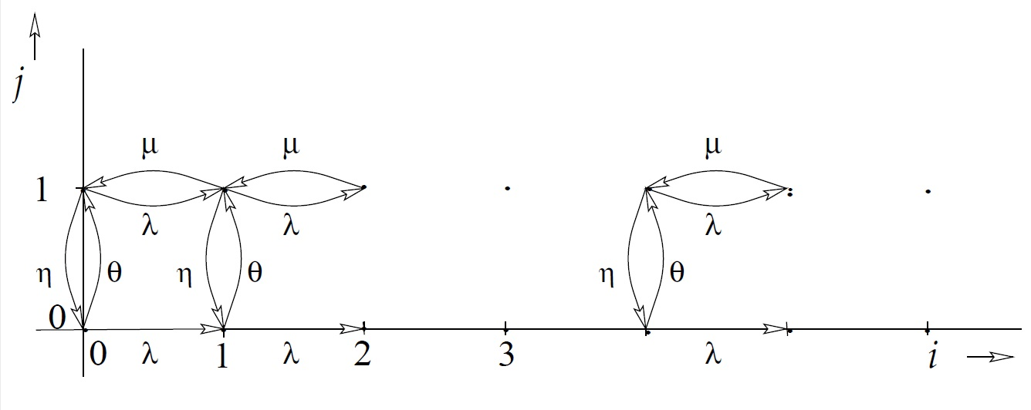
Unreliable machine (2)
Under the above assumption the two-dimensional process of state $(i,j)$, where $i$ nbr of costumers, $j$ the state of machine ($j=1$ machine up, $j=0$ machine down), Then

Slide 25
Unreliable machine (3)
Note $A_{2}=vα$, matrix geometric method gives
$pi = p0R^{i}, i≥1,$ $R=−A_{0}{\left(A_{1}+A_{0}eα\right)}^{−1}=\frac{λ}{μ}\left(\begin{matrix}\frac{η+μ}{λ+θ} & 1 \\ \frac{η}{λ+θ} & 1\end{matrix}\right)$
Note in this case we have that $p_{0}{\left(I−R\right)}^{−1}=\left(\begin{matrix}1−p_{u} & p_{u}\end{matrix}\right)$, where $p_{u}$ is probability that the machine is up $θ/(η+θ)$.
We find $p_{0}=\left(\begin{matrix}1−p_{u} & p_{u}\end{matrix}\right)\left(I−R\right)=\left(p_{u}−\frac{λ}{μ}\right)\left(\begin{matrix}\frac{η}{λ+θ} & 1\end{matrix}\right)$
Spectral expansion method gives
$$pi=c1y1x_{1}^{i}+c2y2x_{2}^{i}$$
where $x1$ and $x2$ are roots of (eigenvalues of $R$):
$$μ\left(λ+θ\right)x^{2}−λ\left(λ+μ+η+θ\right)x+λ^{2}=0$$
Notes:
$A_{2}=\left(\begin{aligned}0 \\ 0\end{aligned}\begin{aligned}0 \\ μ\end{aligned}\right)=\left(\begin{aligned}0 \\ μ\end{aligned}\right)\left(\begin{matrix}0 & 1\end{matrix}\right)=vα,$ with $v=\left(\begin{aligned}0 \\ μ\end{aligned}\right)$ and $α$=$\left(\begin{matrix}0 & 1\end{matrix}\right)$.

Slide 26
M/E_{r}/1 model (1)
Poisson arrivals with rate λ
Service times is Erlang distributed of r phases of mean r/μ, i.e., is sum r exponentially distributed rv each of rate μ
Stability is offered load is smaller than 1
ρ = λ.r/μ < 1
Two dimensional process of state (i,j) where i is nbr of costumers in the system (excluding the costumer in service) and j remaining phases of customer in service is Markov process

Slide 27
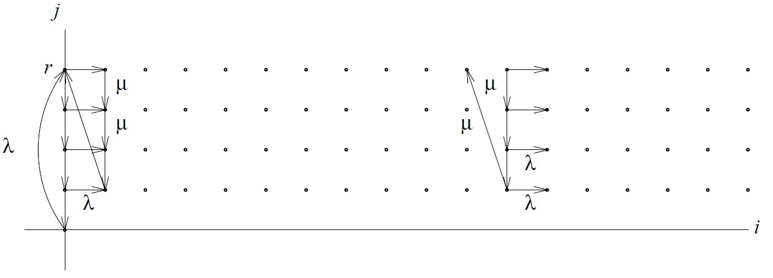
M/E_{r}/1 model (2)
State diagram:
$$A_{0}=λI, A_{2}=\left(\begin{matrix}\begin{matrix}0 & ⋯ \\ ⋮ & \end{matrix} & \begin{matrix}0 & μ \\ 0 & 0\end{matrix} \\ \begin{matrix}⋮ & \\ 0 & ⋯\end{matrix} & \begin{matrix} & ⋮ \\ ⋯ & 0\end{matrix}\end{matrix}\right),A_{1}=μ\left(\begin{matrix}\begin{matrix}−1 & 0 \\ 1 & −1\end{matrix} & \begin{matrix}… & 0 \\ ⋱ & 0\end{matrix} \\ \begin{matrix}⋮ & ⋱ \\ 0 & ⋯\end{matrix} & \begin{matrix}⋱ & 0 \\ 1 & −1\end{matrix}\end{matrix}\right)−λI$$
Notes:
Note that $A_{2}=\left(\begin{aligned}μ \\ 0 \\ ⋮\end{aligned}\right)\left(\begin{matrix}\begin{matrix}0 & … & 0\end{matrix} & 1\end{matrix}\right)=vα,$ with $v=\left(\begin{aligned}μ \\ 0 \\ ⋮\end{aligned}\right)$ and $α$=$\left(\begin{matrix}\begin{matrix}0 & … & 0\end{matrix} & 1\end{matrix}\right)$.
Note this is a very simple queue. First, all stable single server queues satisfying Little’s law have that p(0,0)=1-$λE\left[S\right]=1−\frac{λr}{μ}.$
Note $μ p\left(0,1\right)=λ p\left(0,0\right), \left(λ+μ\right)p\left(0,1\right)=μp\left(0,2\right),⋯, \left(λ+μ\right)p\left(0,r−1\right)=μp\left(0,r\right), \left(λ+μ\right)p\left(0,r\right)=λp\left(0,0\right)+μp\left(1,1\right), ….$ So basically all probability can be found.

Slide 28
M/E_{r}/1 model (2)
Matrix geometric method gives
$p_{i}=p0R^{i}, i≥1,$
$$R=−A_{0}{\left(A_{1}+A_{0}eα\right)}^{−1}=−λ{\left(A_{1}+λeα\right)}^{−1}$$
Sherman-Morrison formula gives that, $x=μ/(λ+μ)$,
$$R=\left(1−x\right)\left(\begin{matrix}\begin{matrix}1 & 0 \\ x & 1\end{matrix} & \begin{matrix}… & 0 \\ ⋱ & 0\end{matrix} \\ \begin{matrix}⋮ & ⋱ \\ x^{r−1} & ⋯\end{matrix} & \begin{matrix}⋱ & 0 \\ x & 1\end{matrix}\end{matrix}\right)+\frac{\left(1−x\right)}{x^{r}}\left(\begin{aligned}1−x \\ 1−x^{2} \\ ⋮ \\ 1−x^{r}\end{aligned}\right)\left(\begin{matrix}x^{r−1} & … & 1\end{matrix}\right)$$
Note for any M/PH/1 queue we have that $A_{2}$ is a rank one matrix (product of a column and row vector). So, $R$ can be found in closed form
Notes:
Sherman-Morrison for inverse of a sum of a nonsingular matrix and a rank one matrix
$${\left( A + u v^{T} \right)}^{−1} = A^{−1} −\frac{\left(A^{−1} u v^{T} A^{−1}\right)}{1 + v^{T} A^{−1}u}.$$
Similarly to finding R. The inverse of I-R can be found in closed form.

Slide 29
Phase-Type Distribution
Consider a continuous time absorbing Markov chain (AMC) with $\{1,…,m\}$transient states and one absorption state $m+1$, i.e., $q_{m+1m+1}=0$.
Let $T$ denote the transition rate matrix between transient states, and $α$ the initial state.
Let $T^{0}$ denote the transition rate vector of the transient states to absorption state. $Te+T^{0}=0⇒ −T^{−1}T^{0}=e$
Definition: A probability distribution $F(.)$on [0,∞) is a phase type distribution (PH-distribution) if and only if it is the distribution of the time to absorption of AMC. The pair $(α,T)$is called a representation $F(.)$
Notes:
Let T_{a} denote the time until absorption occurs, given initial distribution α, then $P(Ta<x)=1−αexp(Tx)e, E[Ta]=−αT−1e,$

Slide 30
Phase-Type Distribution
Examples of phase-type distribution are Erlang-n, Hyper-exponential, and Coxian distributions
Hyper-exponential distribution of n phases each of rate $μi$ with $α=\left(p1,…,pn\right)$
Coxian distribution of $n$ phases each of rate $μi$, where $pi+qi=1$, $i=1,..,n−1$, and $qn=1$, and $α$=(1,0,…,0)
p₁
p₂
p_{n}
1
2
n
μ₁
μ₂
μ_{n}
p₁μ₁
p₂μ₂
p_{n-1}μ_{n-1}
1
2
n
q₁μ₁
q₂μ₂
μ_{n}
Notes:
Let T_{a} denote the time until absorption occurs, given initial distribution α, then $P(Ta<x)=1−αexp(Tx)e, E[Ta]=−αT−1e,$

Slide 31
PH/PH/1 queue
Inter-arrival times distribution is phase-type with n phases denoted $\left(α,T\right)$and with mean $−αT^{−1}e$. Let $T^{0}=−Te$
Service time distribution is of Phase type with $ν$ phases denoted $(β,S$) and with mean $−βS^{−1}e$. Let $S^{0}=−Se$
Assume that customers are as FIFO
The queue is stable if $−αT^{−1}e>$ $−βS^{−1}e$
Let $N_{t},A_{t},{and S}_{t}$ denote number of jobs in the system, phase of inter-arrival, and phase of job in service at time t

Slide 32
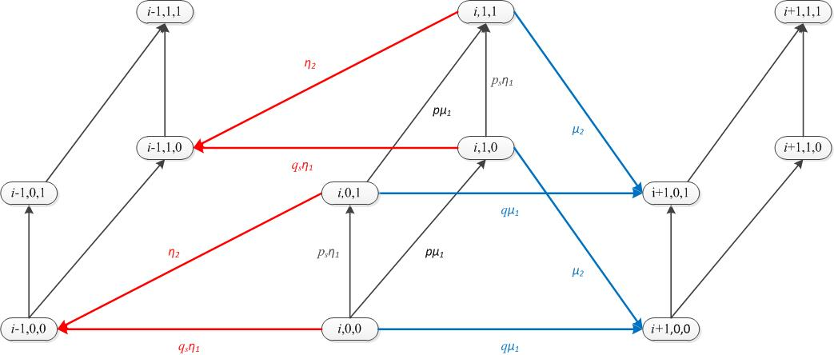
PH/PH/1 model
The process $\left(N_{t},A_{t},S_{t}\right)$ is continuous-time Quasi-Death-Process
For Cox2/Cox2/1 queue, transitions between level $i$ states, level $i$to $i+1$, and level $i$ to $i−1$ are as follows:
Notes:
In this figure we consider $T=\left(\begin{matrix}−μ_{1} & pμ_{1} \\ 0 & {−μ}_{2}\end{matrix}\right)$ and $S=\left(\begin{matrix}−η_{1} & p_{s}η_{1} \\ 0 & {−η}_{2}\end{matrix}\right).$Note p+q=1 and p_s+q_s=1

Slide 33
PH/PH/1 model
Note if Q is generator of joint process of two independent Markov chains of size $N1$and $N2$. Then, Q is sum of two kronecker products, i.e.,
$$Q=Q_{1}⊗I_{N1}+I_{N2}⊗Q_{2}$$
The generator of the PH/PH/1
$$Q=\left(\begin{aligned}B_{00} \\ B_{10} \\ 0 \\ ⋮ \\ ⋮\end{aligned}\begin{aligned}B_{01} \\ A_{1} \\ A_{2} \\ ⋱ \\ ⋱\end{aligned}\begin{aligned}0 \\ A_{0} \\ A_{1} \\ A_{2} \\ ⋱\end{aligned}\begin{aligned}0 \\ 0 \\ A_{0} \\ A_{1} \\ ⋱\end{aligned}\begin{aligned}… \\ ⋱ \\ ⋱ \\ ⋱ \\ ⋱\end{aligned}\right),$$
where $A_{1}=T⊗I_{ν}+I_{n}⊗S, A_{0}=T^{0}α⊗I_{ν}, A_{2}=I_{n}⊗S^{0}β,$
$B_{00}=T, B_{01}=T^{0}α⊗β$, and $B_{10}=I⊗S^{0}$.
Notes:
$A⊗$B: means every element of A is multiplied by matrix B as whole.

Slide 34
PH/PH/1 model
The rate matrix $R$ is the minimal solution of the quadratic equation $A_{0}+RA_{1}+{R^{2}A}_{2}=0,$
$$T^{0}α⊗I_{ν}+R(T⊗I_{ν}+I_{n}⊗S)+R^{2}I_{n}⊗S^{0}β=0,$$
Example: consider the Cox2/Cox2/1 queue with mean inter-arrival time 6/5, mean service time 5/6,
$α=\left(\begin{matrix}1 & 0\end{matrix}\right), T=\left(\begin{matrix}−1 & 0.4 \\ 0 & −2\end{matrix}\right)$ and$β=\left(\begin{matrix}1 & 0\end{matrix}\right), S=\left(\begin{matrix}−1.5 & 0.5 \\ 0 & −2\end{matrix}\right)$
The iterative scheme needs about 40 iteration for ${10}^{−5}$ precision
$$R=\text{0.3833 0.0639 0.0609 0.0140}$$
$\text{ 0.0975 0.2163 0.0214 0.0243}$
$$\text{ 1.2777 0.2129 0.2030 0.0467}$$
$$\text{ 0.3251 0.7208 0.0712 0.0810}$$
$p_{0}=\left(\begin{matrix}0.2374 & 0.0681\end{matrix}\right), E\left[N\right]=1.9582$.
Notes:
For kronecker product you can use the built-in function in Matlab kron(X,Y)

Slide 35
References
R. Nelson. Matrix geometric solutions in Markov models: a mathematical tutorial. IBM Technical Report 1991.
G. Latouche and V. Ramaswami (1999), Introduction to Matrix Analytic Methods in Stochastic Modeling. SIAM.
I. Mitrani and D. Mitra, A spectral expansion method for random walks on semi-infinite strips, in: R. Beauwens and P. de Groen (eds.), Iterative methods in linear algebra. North-Holland, Amsterdam (1992), 141–149.
M.F. Neuts (1981), Matrix-geometric solutions in stochastic models. The John Hopkins University Press, Baltimore.

